Slide 1
What do I know now?
Bonjour ! Ça va ?
jaune
Révision
Several SSC
Notes:
Artwork by Steve Clarke. Pronoun pictures from NCELP (www.ncelp.org). All additional pictures selected from Pixabay and are
available under a Creative Commons license, no attribution required.
The AUDIO version of the lesson material includes additional audio for the new language
presented (phonics, vocabulary) and audio for the instructions on the slide.
In addition, it includes VIDEO clips of the phonics and the phonics’ source words. Pupils can be
encouraged to look at the shape of the mouth/lips on slides where these appear, and try to copy
it/them.
Phonics: Revisit several SSC: [en/an] [ien] [ou] [on] [eu] [r] [ç/soft c] [(a)in] [u] [qu] [j/soft g] [ai] [tion] [oi]
Vocabulary: Revisit any Term 3 vocabulary
Revisit 1: mois [179] janvier [939] février [1139] mars [868] avril [1022] mai [943] juin [931] juillet [1326] aout [1445] septembre [944] octobre [826] novembre [982] décembre [891] quand [119] anniversaire [2043] en [7]
Revisit 2: combien [800] bouche [1838] main [418] œil [474] oreille [1884] pied [626] tête [343] yeux [474] des [2]
Londsale, D., & Le Bras, Y. (2009). A Frequency Dictionary of French: Core vocabulary for learners London: Routledge.
The frequency rankings for words that occur in this PowerPoint which have been previously introduced in these resources are given
in the SOW and in the resources that first introduced and formally re-visited those words.
For any other words that occur incidentally in this PowerPoint, frequency rankings will be provided in the notes field wherever
possible.
1

Slide 2
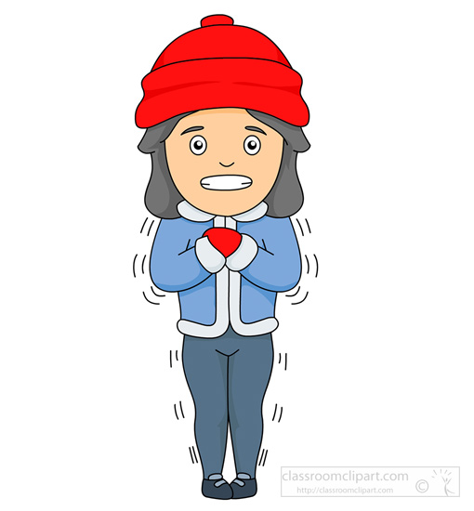
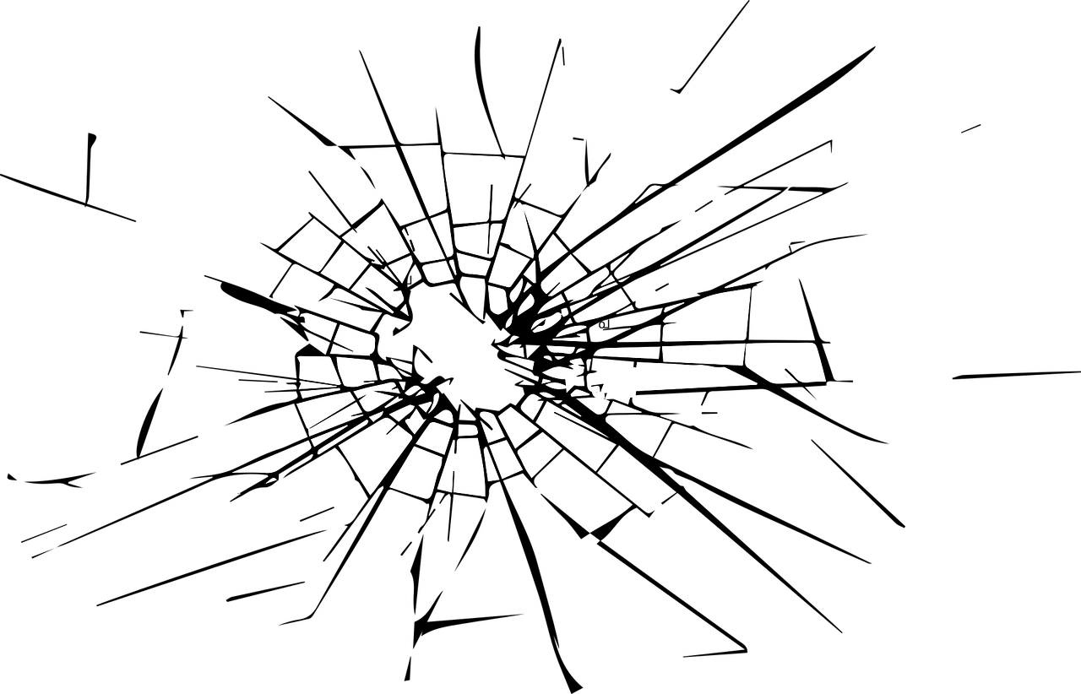
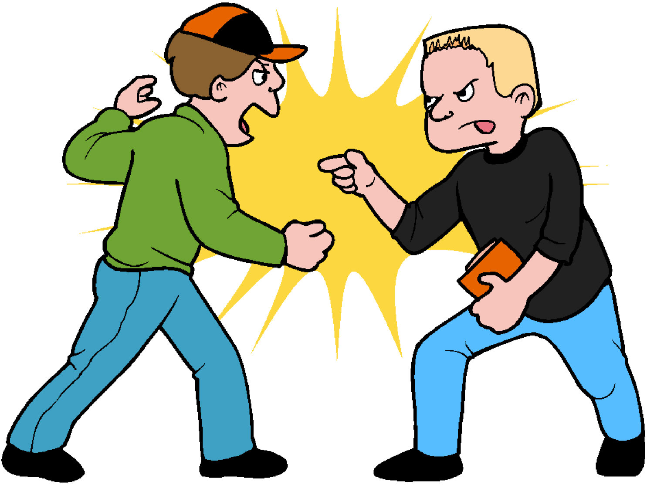
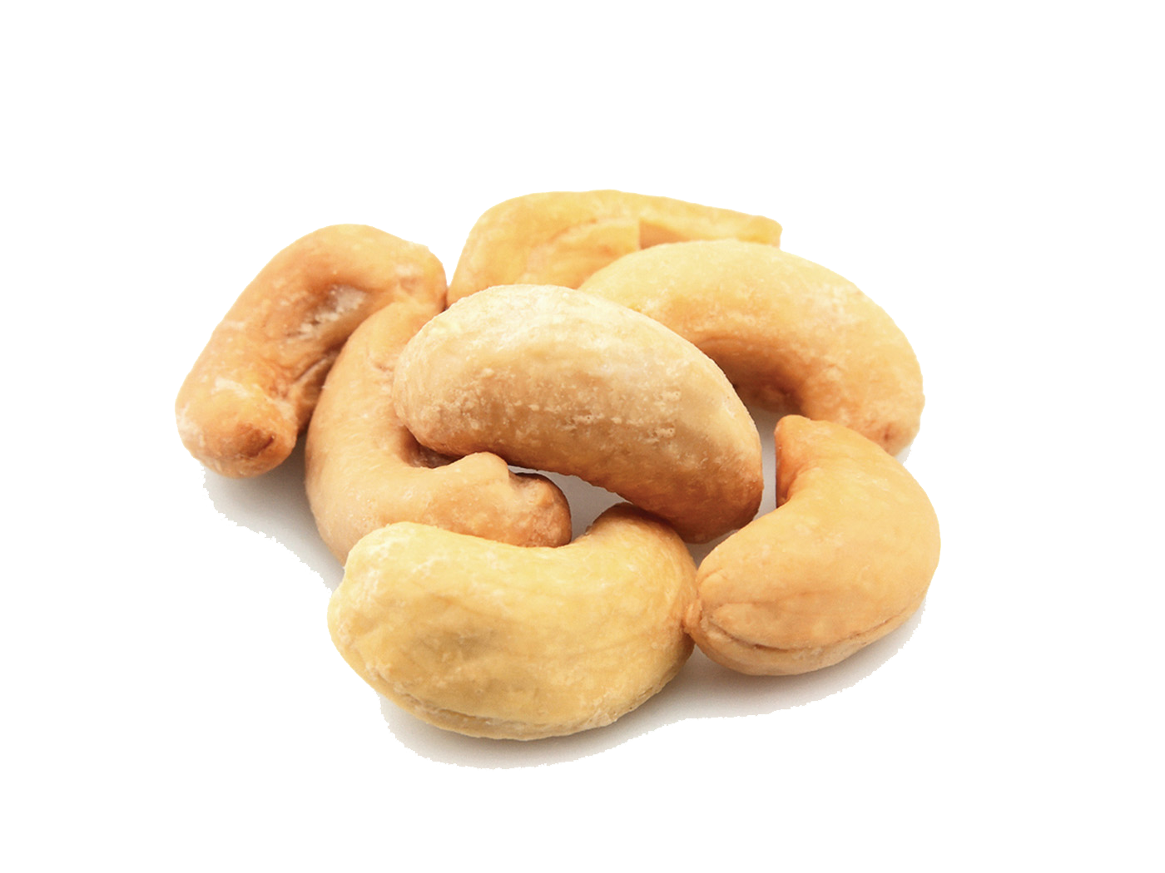
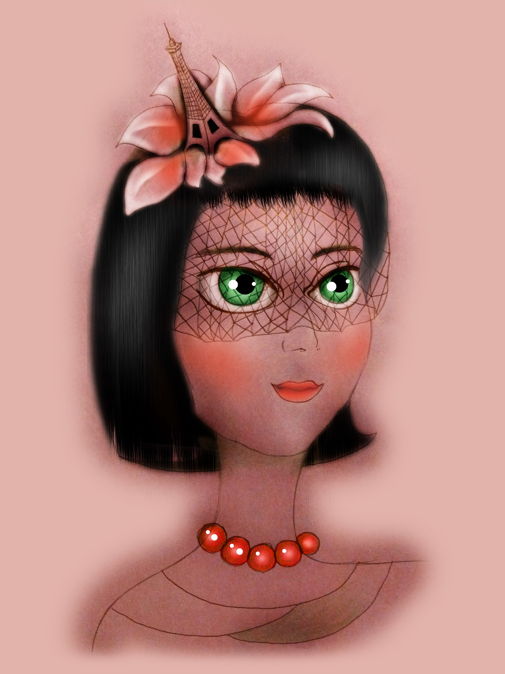
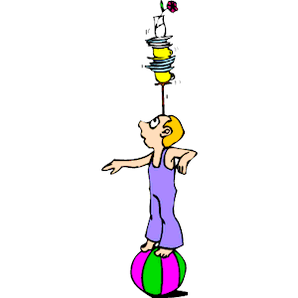
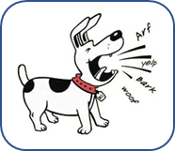
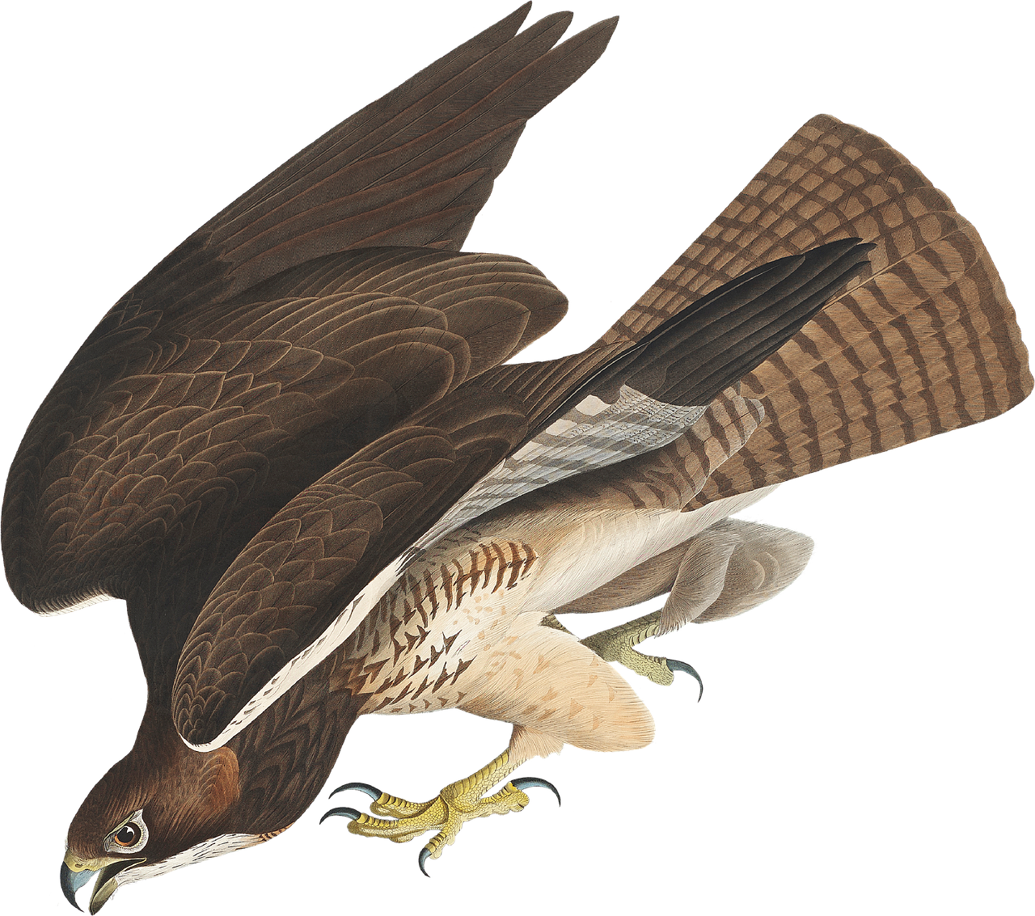
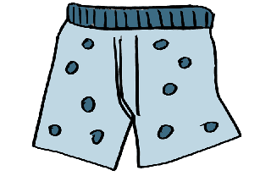
La phonétique
Écoute bien. Écris les SSC correspondants.
bolivien
[Bolivian]
option [option]
frisquet [chilly]
bagarre
[fight]
fêlure
[crack]
boliv_ _ _ |  | op_ _ _ _ | fris_ _ et | baga_ _ e |  | fêl_re
noix de caj_ _ |  | v_ _ lette |  | coup_ |  | lun_ _ re
cale_on | b_ _ cal | _apper |  | c_ _ tre | fauc_ _ | adi_ _ x
45
Noix de cajou
[cashew]
voilette [veil]
coupe
[trophy]
lunaire [lunar]
S
caleçon
[boxer shorts]
bancal
[wobbly]
japper [to bark]
cintre
[hanger]
faucon
[falcon]
adieux [goodbyes]
0
DÉBUT
Notes:
Timing: 5 minutes
Aim: to practise applying knowledge of a selection of 15 of this year’s SSC to unknown words.
Procedure: 1. Click on the picture to hear the word. Pupils transcribe the missing letter(s).
2. Click to correct.
3. Start the timer. Attempt to elicit choral pronunciation of all the words again, using the animated prompts, within the 45 seconds allowed.
Frequency of unknown words and cognates: acajou [>5000] acon [>5000] adieu [3968] bancal [>5000] bagarre [>5000] bolivien [>5000] caleçon [>5000] cintre [>5000] coupe [>5000] fêlure [>5000] frisquet [>5000] japper [>5000] lunaire [>5000] option [2156] voilette [>5000]
Londsale, D., & Le Bras, Y. (2009). A Frequency Dictionary of French: Core vocabulary for learners London: Routledge.

Slide 3
Vocabulaire
Prononce les mots. La connexion, c’est quoi ?
la langue | la chambre | comment ? | la description | la tête
prononcer
étudier
la porte
où ?
pratique
le pied
prononcer
le lit
quoi ?
utile
mal
mots
enseigner
le bureau
quand ?
propre
les yeux
vocabulaire
1. le pied
2. étudier
3. pratique
4. la porte
5. mal
7. utile
8. prononcer
9. quoi
6. où
10. le lit
11. quand
12. propre
15. le bureau
13. enseigner
14. les yeux
Notes:
Timing: 5 minutes
Aim: to practise pronunciation of previously taught words; to practise written comprehension of 20 previously taught words by finding the associations.
Procedure:
Tell pupils they need to pronounce all the words and also find a title word to associate them with.
Do the first one with pupils. Say: ‘Le pied, c’est quoi en anglais ?’ foot – bien. la connexion, c’est quoi ? la langue ? la chambre ? comment ? la description ? la tête ?
Pupils work in pairs to say all the words and decide which words belong in which category.
Elicit the answers and click on each word to move it to its correct category.
Note: if pupils get stuck, encourage them not to work sequentially 1-15, but to look at all the items and find connections.

Slide 4
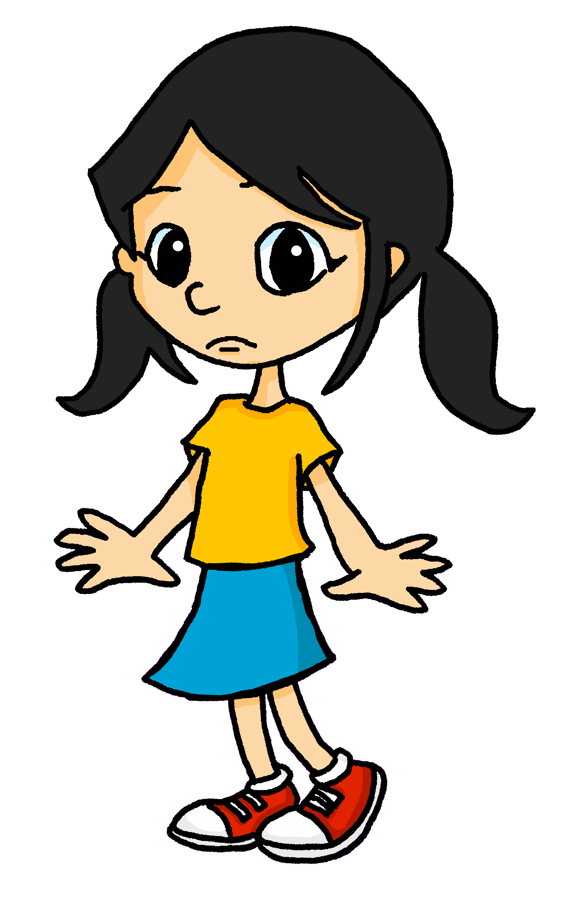
lire
Grammaire
Put a (X) next to the word(s) that complete(s) the sentence.
.
est
1. | Aujourd’hui, elle _________ à l’école. Today she is at school. | ☐ il y a ☐ a ☐ est
2. | Mais un ami _________ absent. But a friend is absent. | ☐ il y a ☐ a ☐ est
3. | Il __________ chaud et froid. He is hot and cold. | ☐ il y a ☐ a ☐ est
4. | Dans la classe _________ deux portes. In the class there are two doors. | ☐ il y a ☐ a ☐ est
5. | Elle ______ peur. She is scared. | ☐ il y a ☐ a ☐ est
6. | Sur la table__________ un livre. On the table there is a book. | ☐ il y a ☐ a ☐ est
est
a
il y a
a
il y a
Notes:
Timing: 5 minutes
Aim: to practise written understanding of il y a and est.
Procedure:
Ensure that the task is clear.
Pupils could write 1 – 6 and the correct English verb.
Transcript:
Aujourd’hui, elle est à l’école. Mais un ami est absent. Il a chaud et froid. Dans la classe il y a deux portes. Elle a peur. Sur la table il y a un livre.
4

Slide 5
Saying ‘it’ in French
Remember that to say ‘he’ and ‘she’ in French we say ‘il’ and ‘elle’:
Comment ? means how? but il/elle est comment ? (It is how?) means What is it like?
Pierre a un livre.
He has a book.
Il a un livre.
We also use ‘il’ and ‘elle’ to mean ‘it’:
We use ‘il’ for masculine nouns and ‘elle’ for feminine nouns:
Il est comment ?
Le livre est utile.
Il est utile.
It is useful.
Elle est comment ?
La chanson est typique.
Elle est typique.
It is typical.
Remember! Adjectives already ending in –e are spelt the same for masculine and feminine nouns.
Notes:
Timing: 2 minutes
Aim: to introduce the use of il / elle to mean ‘it’ with masculine / feminine nouns
Procedure:
Click through the animations to present the new knowledge orally and in writing.
Elicit the English meanings for the French examples.

Slide 6
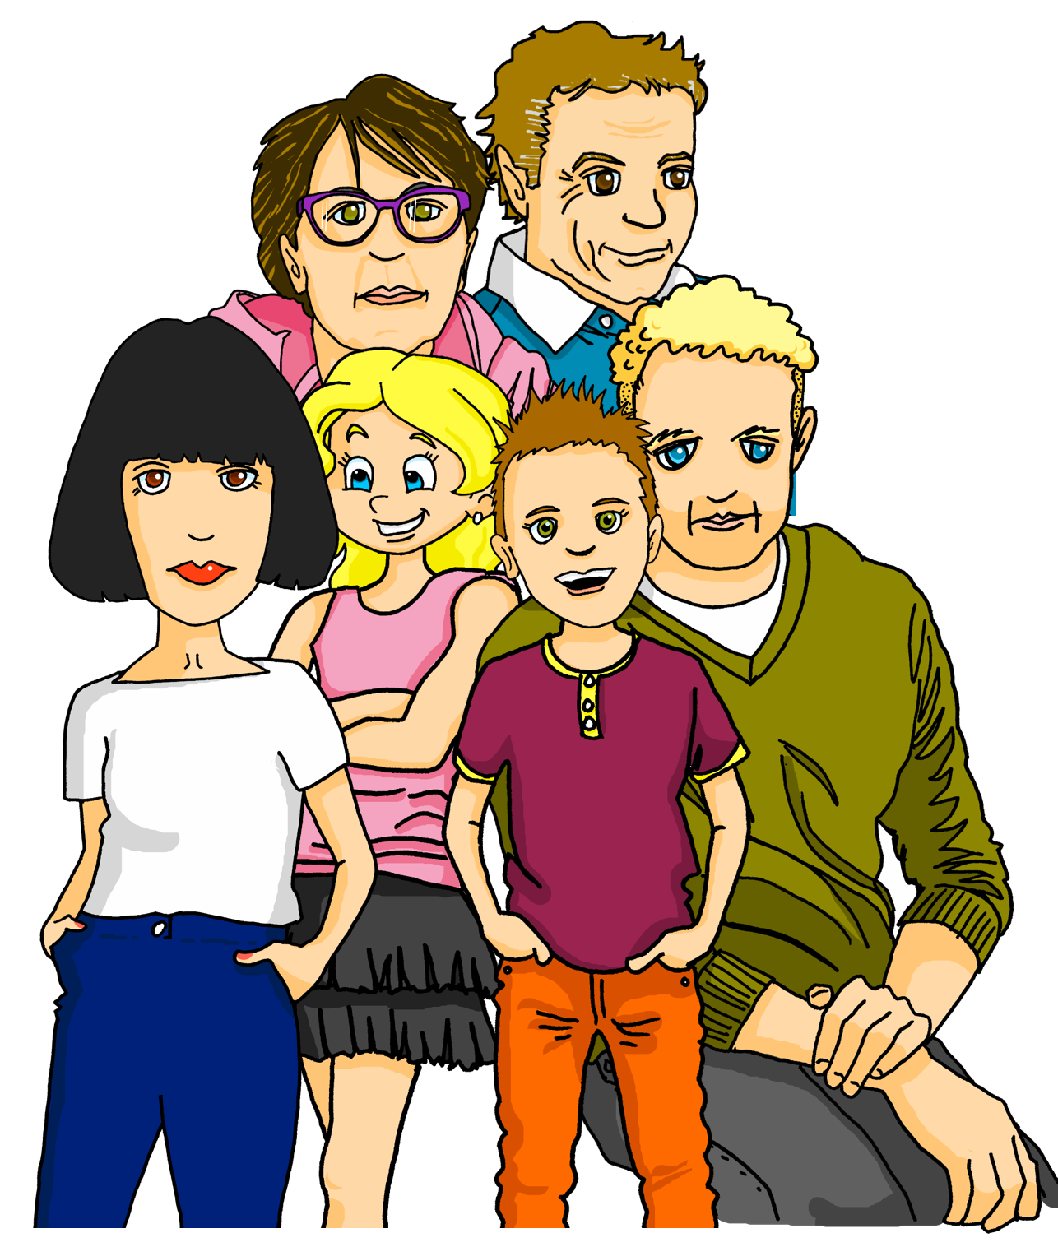
Jigsaw translation
Écris en français et en anglais.
.
français |  | anglais
Voici mon grand-père. Il est drôle. | [This is] mon grand-père. [He is funny]. Hervé, mon père, enseigne [music]. Adèle [prefers] le sport. [It is] pratique. Moi, [I like] la chanson ‘Brave’. [It is] unique. [My grandma] est française [but she speaks] anglais. [She has] un livre en anglais. [It is also very] utile pour moi. | This is my grandad. He is funny. Hervé, my dad, teaches music. Adèle prefers le sport. It is practical. Me, I like the song ‘Brave’. It is unique. My grandma is French but she speaks English. She has a book in English. It is also very useful for me.
Hervé, mon père, enseigne la musique. Adèle préfère le sport. Il est pratique.
Moi, j’aime la chanson ‘Brave’. Elle est unique.
Ma grand-mère est française mais elle parle anglais.
Elle a un livre en anglais. Il est aussi très utile pour moi.
Notes:
Timing: 12 minutes
Aim: to practise written production written production and comprehension of a range of taught vocabulary and structures, particularly
Procedure:
Teachers read the instruction and clarify the meaning.
Talk pupils through the first sentence and reveal the French and English translations.
Pupils works in pairs/small groups to complete the rest of the sentences.
Teacher circulates to support.
Click to reveal and correct responses.
NB: The full audio for the whole text is heard by clicking on the text, if required.

Slide 7
Au revoir !
jaune
Notes:
7

