Slide 1
What do I know now?
Bonjour ! Ça va ?
jaune
Follow ups 1-5
Notes:
Artwork by Steve Clarke. Pronoun pictures from NCELP (www.ncelp.org). All additional pictures selected from Pixabay and are available under a Creative Commons license, no attribution required.
Phonics: Revisit several SSC: [en/an] [ien] [ou] [on] [eu] [r] [ç/soft c] [(a)in] [u] [qu] [j/soft g] [ai] [tion] [oi]
Vocabulary: Revisit any Term 3 vocabulary
Revisit 1: mois [179] janvier [939] février [1139] mars [868] avril [1022] mai [943] juin [931] juillet [1326] aout [1445] septembre [944] octobre [826] novembre [982] décembre
[891] quand [119] anniversaire [2043] en [7]
Revisit 2: combien [800] bouche [1838] main [418] œil [474] oreille [1884] pied [626] tête [343] yeux [474] des [2]
Londsale, D., & Le Bras, Y. (2009). A Frequency Dictionary of French: Core vocabulary for learners London: Routledge.
The frequency rankings for words that occur in this PowerPoint which have been previously introduced in these resources are given in the SOW and in the resources that first introduced and formally re-visited those words.
For any other words that occur incidentally in this PowerPoint, frequency rankings will be provided in the notes field wherever possible.

Slide 2
Follow up 1:
Prononce les mots.
prononcer
[an/en]
[-ien]
[(a)in]
[noise/racket]
[wild dog]
boucan
historien
dingo
Notes:
Timing: 5 minutes (five slides)
Aim: to revisit read aloud 15 of this year’s SSC.
Procedure:
Click to bring up the first flashcard.
Elicit choral read aloud.
If desired, click on the word to listen to the pronunciation.
Continue with the remaining flashcards.
Go on to the next slide and repeat.
Frequency of unknown words and cognates:
affreux [4369] ampoule [>5000] blazon [>5000] boucan [>5000] coller [2973] dingo [>5000] envoi [2960] historien [3284] mesurer [1110] motion [855] polaire [>5000] vente [1096]
Londsale, D., & Le Bras, Y. (2009). A Frequency Dictionary of French: Core vocabulary for learners London: Routledge.

Slide 3
Follow up 1:
Prononce les mots.
prononcer
[-tion]
[on]
[oi]
[shield]
[delivery]
motion
blason
envoi
Notes:
[2/5]

Slide 4
Follow up 1:
Prononce les mots.
prononcer
[ai]
[é|er]
[eu]
[polar]
[to stick]
[awful]
polaire
coller
affreux
Notes:
[3/5]

Slide 5
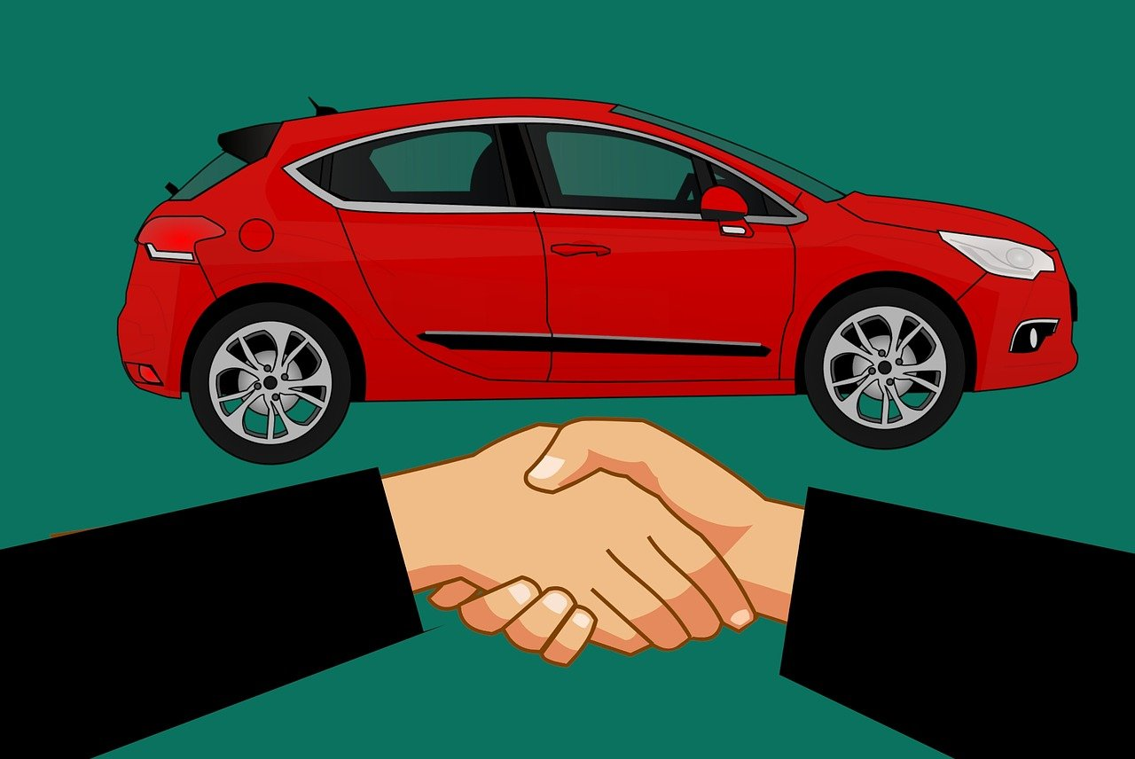
Follow up 1:
Prononce les mots.
prononcer
[u]
[SFC]
[SFe]
[to measure]
[sale]
mesurer
ampoules
vente
Notes:
[4/5]

Slide 6
Follow up 1:
Prononce les mots.
prononcer
[r]
[qu]
[j|g]
1 4
[spinning wheel]
rouet
quart
brossage
Notes:
[5/5]

Slide 7
Follow up 2a:
Écoute. La catégorie correcte, c’est quoi ?
1
tante | grand-mère | grand-père
famille
écouter
2
livre | magazine | phrase
lire
Catégorie
3
juin | mai | aout
mois
4
musée | pays | université
visite
5
main | oreille | œil
corps (body)
6
jeudi | dimanche | mardi
jour
7
apporter | rester | montrer
verbe
8
musique | français | sport
école
9
porte | chaise | bureau
chambre
jour
lire
famille
corps (body)
verbe
visite
école
chambre
mois
Notes:
Note: we usually do short exercises of 6 items only, but this is a revision week so we are revisiting a lot of words in a short exercise.
Timing: 5 minutes
Aim: to revisit aural recognition of previously taught words and their connection to other previously taught ‘category’ words.
Procedure:
Click to play the audio.
Pupils listen and write down the category word.
Elicit answers and click to provide feedback.
Continue to the next slide for a written extension to the activity.
Transcript:
1. tante | grand-mère | grand-père
2. livre | magazine | phrase
3. juin | mai | aout
4. musée | pays | université 5. main | oreille | œil
6. jeudi | dimanche | mardi
7. apporter | rester | montrer
8. musique | français | sport
9. porte | chaise | bureau

Slide 8
Follow up 2b:
Écris un ou deux mots pour chaque catégorie.
écrire
 | Catégorie
1. tante | grand-mère | grand-père | famille
2. livre | magazine | phrase | lire
3. juin | mai | aout | mois
4. musée | pays | université | visite
5. main | oreille | œil | corps (body)
6. jeudi | dimanche | mardi | jour
7. apporter | rester | montrer | verbe
8. musique | français | sport | école
9. porte | chaise | bureau | chambre
1
| père | mère
2
| mot | message | texte | liste
3
| janvier | février | mars| avril | juillet
4
| parc
5
| pied | tête| bouche | yeux
6
| lundi | mercredi | vendredi
7
| étudier | détester | adorer
8
|anglais
9
| lit | affiche
Notes:
Timing: 4 minutes
Aim: to practise written production of some of this year’s vocabulary.
Procedure:
1. Pupils try to write one or two words that could plausibly belong to the 9 categories.
2. Click to provide possible suggested answers. Note that some of the categories have many possible answers.
3. Option: click to play the optional answers, together with the original words.
1. tante | grand-mère | grand-père | père | mère
2. livre | magazine | phrase | mot | message | texte | liste
3. juin | mai | aout | janvier | février | mars| avril | juillet
4. musée | pays | université | parc
5. main | oreille | œil | pied | tête| bouche | yeux
6. jeudi | dimanche | mardi | lundi | mercredi | vendredi
7. apporter | rester | montrer | étudier | détester | adorer
8. musique | français | sport |anglais
9. porte | chaise | bureau | lit | affiche

Slide 9
Follow up 3:
Lis le texte. Écris en anglais.
lire
Bonjour !
Ça va ? Je suis Alex. J’ai neuf ans et je suis française. Aujourd’hui, c’est samedi et je suis dans ma chambre. J’écoute ma chanson préférée. Tu aimes la musique ?
1. What two details do we find out about Alex?
They are 9 years old, French, and a girl.
2. What does Alex say about today? (3 details)
Today is Saturday, she is in her room, listening to favourite song.
3. What does Alex say about learning English? ….(2 details)
J’adore les langues. Chanter en anglais, c’est facile, mais écrire, c’est différent. Par exemple, mercredi c’est ‘Wed-nes-day’ ! C’est difficile, non ? Ton mot préféré, c’est quoi ?
Singing in English is easy. Writing is different/hard.
4. What does Alex do with her friend Anne?
(2 details)
Je joue dehors avec mon amie Anne tous les jours. Elle est grande et active. Elle aime le sport mais je préfère dessiner. Tu aimes aussi dessiner ?
Écris-moi ! Alex
play outside, every day
5. What questions does Alex ask in the letter? (5 questions)
How are you? Do you like music? It’s difficult, no? What is your favourite word? Do you like drawing, too?
Notes:
Timing: 5 minutes
Aim: to practise written comprehension of a longer text made up of previously taught language from this year.
Procedure: 1. Read the text aloud with pupils. 2. Give pupils time to answer the question themselves. 3. Elicit and check answers.
Note: this task can be made less challenging if needed by giving pupils a smaller portion of the text and fewer questions to answer.

Slide 10
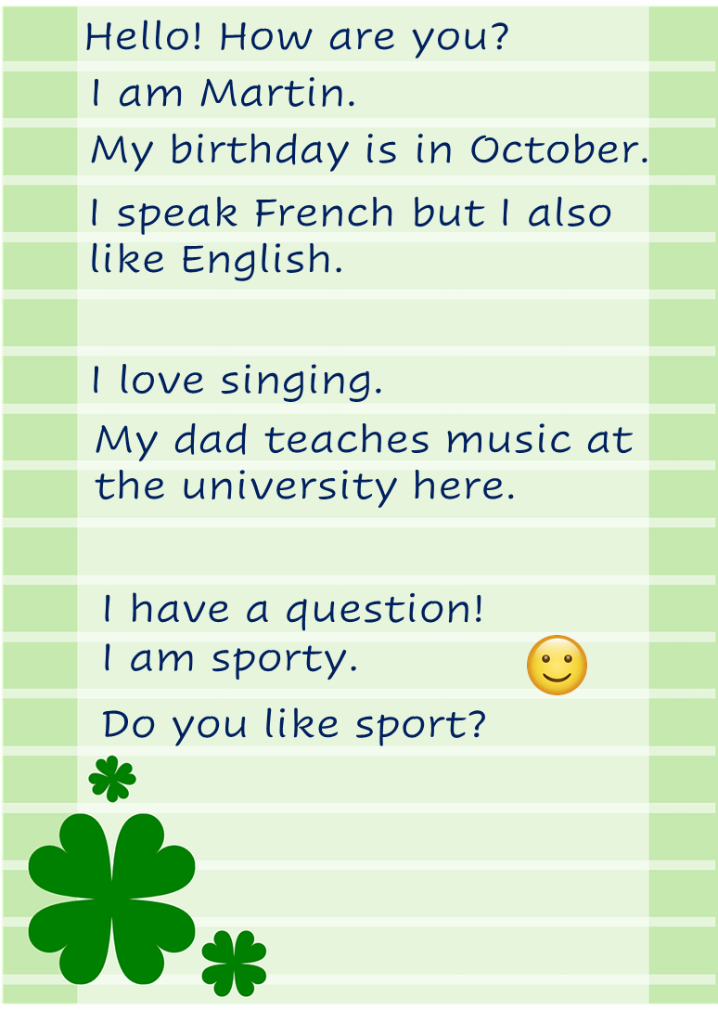
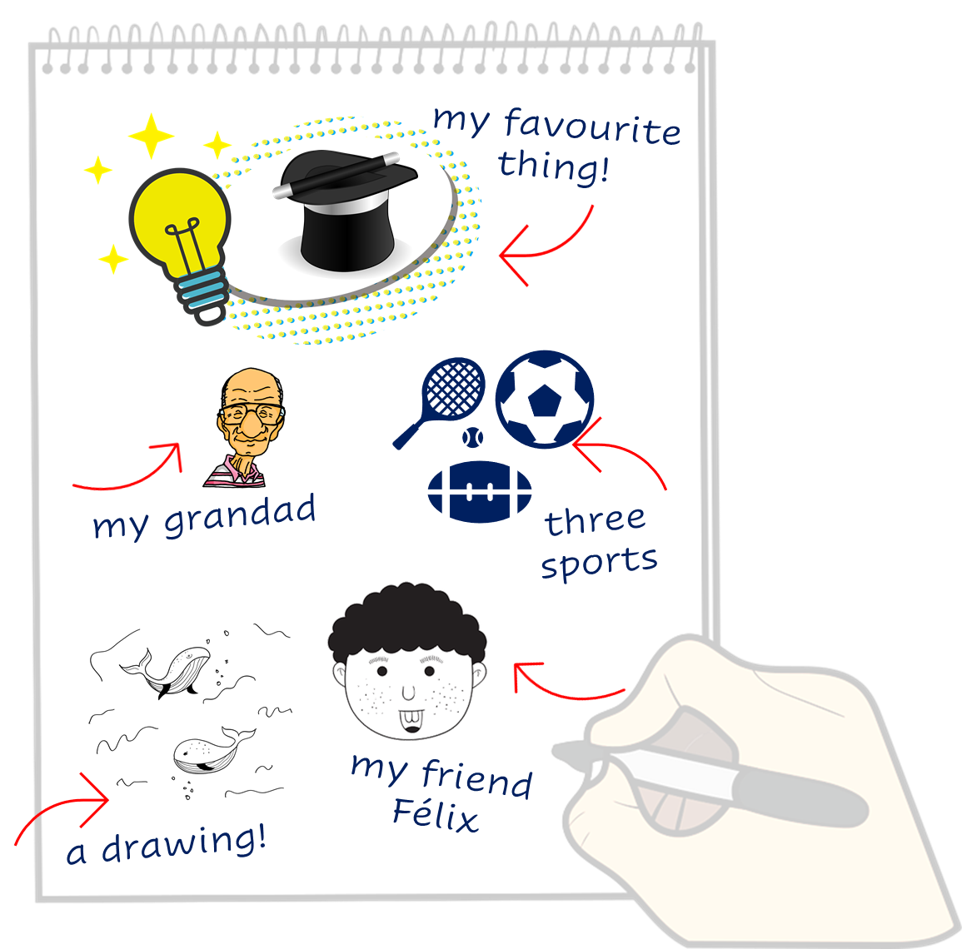
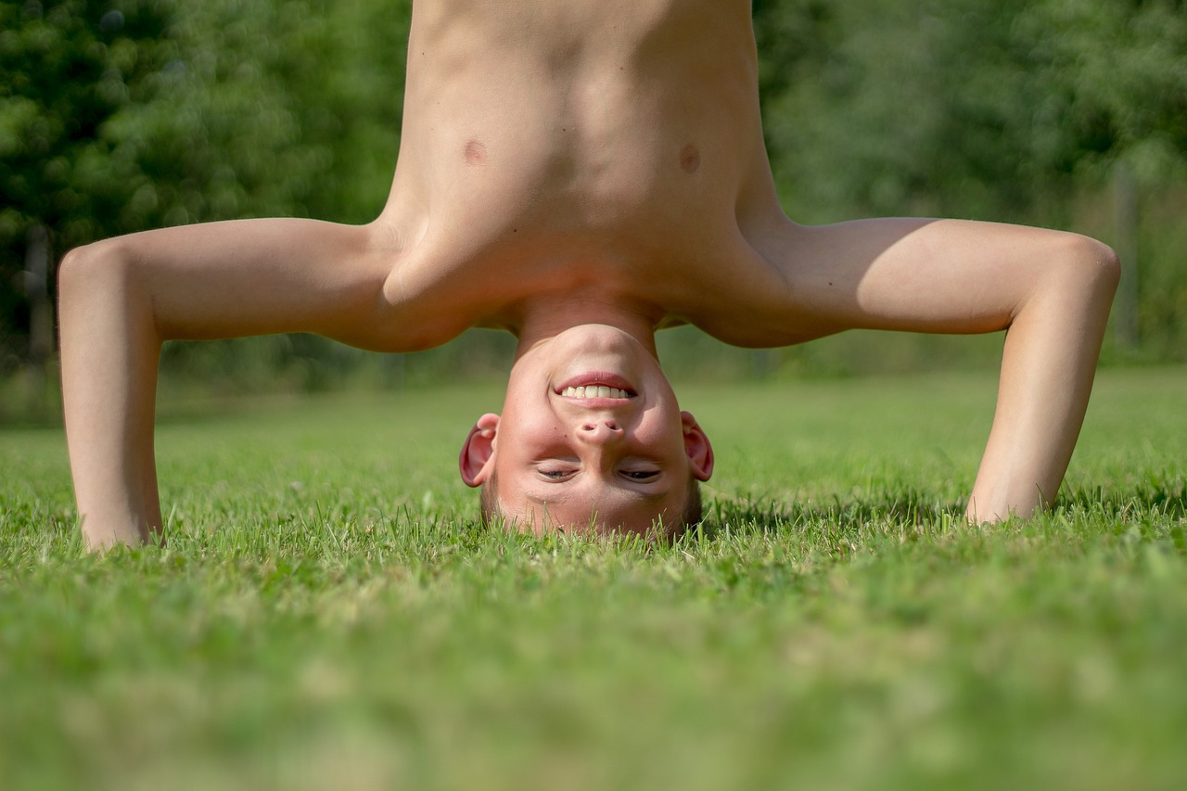
Follow up 4:
Lis le texte. Écris des mots en français.
Just have a go! Write any of these English words in French. You can add different words, too.
écrire
Notes:
Timing: 5 minutes
Aim: to practise written production of this year’s vocabulary.
Note: This is a more straightforward version of the activity, asking pupils for individual words. A more challenging version can be found on the following slide, where pupils are encouraged to write a mixture of sentences and words.
Procedure:
Pupils read the message from Martin in the green text box.
Pupils use Martin’s message and the words and pictures on the notebook to the right as inspiration. They use the lines on the left to write any words in French that they could use to reply to Martin. They could use any of the words on the notebook, and any other words they know.

Slide 11
Follow up 4:
Write a message to Martin in French. Write anything you like. You can write short sentences or words or a mixture, like Martin.
Écris en français.
écrire
Notes:
Timing: 8 minutes
Aim: to practise written production of this term’s vocabulary and to practise written production of short sentences.
Note: This is a more challenging version of the activity, where pupils are encouraged to write a mixture of sentences and words. A more straightforward version of the activity can be found on the previous slide, where pupils are asked to write individual words.
Procedure:
Pupils read the message from Martin in the green text box.
Pupils use Martin’s message and the words and pictures on the notebook to the right as inspiration. They use the lines on the left and the empty notepad to write any words or sentences in French that they could use to reply to Hanna.

Slide 12
vocabulaire
Follow up 5a: Écris en anglais : Can you get at least 15 points?
mots
 | combien ? | la main | des
 | l’oreille | les yeux | l’œil
 | quand ? | décembre | le mois
 | aout | l’anniversaire | en
 | la peur | apporter | chaud
 | de rien | beaucoup (de) | le matin
how many?
(the) hand
some
x3
(the) ear
(the) eyes
(the) eye
when?
December
(the) month
x2
August
(the) birthday
in
(the) fear
to bring, bringing
hot
x1
you’re welcome
a lot (of)
(the) morning
Notes:
Timing: 5 minutes
Aim: to practise written comprehension of vocabulary from week 1, last week and this week.
Procedure: 1. Give pupils a blank grid. They fill in the English meanings of any of the words they know, trying to reach 15 points in total. 2. Remind pupils that adjectives can refer to male or female persons and they should note this in their translations. E.g. pleased (f), short (m).
Note: The most recently learnt and practised words are pink, words from the previous week are green and those from week 1 are blue, thus more points are awarded for them, to recognise that memories fade and more effort (heavy lifting!) is needed to retrieve them.
12

Slide 13
vocabulaire
Follow up 5b: Écris en français : Can you get at least 15 points?
mots
 | some | (the) mouth | how many?
 | (the) eyes | (the) head | (the) foot
 | (the) month | (the) birthday | when?
 | February | November | July
 | cold | very | (the) thing
 | clean | a lot (of) | dirty
des
la bouche
combien ?
x3
les yeux
la tête
le pied
le mois
l’anniversaire
quand ?
x2
février
novembre
juillet
froid
très
la chose
x1
propre
beaucoup (de)
sale
Notes:
Timing: 5 minutes
Aim: to practise written comprehension of vocabulary from week 1, last week and this week.
Procedure: 1. Give pupils a blank grid. They fill in the French meanings of any of the words they know, trying to reach 15 points in total. 2. Remind pupils that adjectives can refer to male or female persons and they should note this in their translations. E.g. pleased (f), short (m).
Note: The most recently learnt and practised words are pink, words from the previous week are green and those from week 1 are blue, thus more points are awarded for them, to recognise that memories fade and more effort (heavy lifting!) is needed to retrieve them.
13

Slide 14
vocabulaire
Follow up 5a: Écris en anglais : Can you get at least 15 points?
mots
 | combien ? | la main | des
 | l’oreille | les yeux | l’œil
 | quand ? | décembre | le mois
 | aout | l’anniversaire | en
 | la peur | apporter | chaud
 | de rien | beaucoup (de) | le matin
x3
x2
x1
Notes:
HANDOUT
14

Slide 15
vocabulaire
Follow up 5b: Écris en français : Can you get at least 15 points?
mots
 | some | (the) mouth | how many?
 | (the) eyes | (the) head | (the) foot
 | (the) month | (the) birthday | when?
 | February | November | July
 | (the) cold | very | (the) thing
 | clean | a lot (of) | dirty
x3
x2
x1
Notes:
HANDOUT
15

