Slide 1
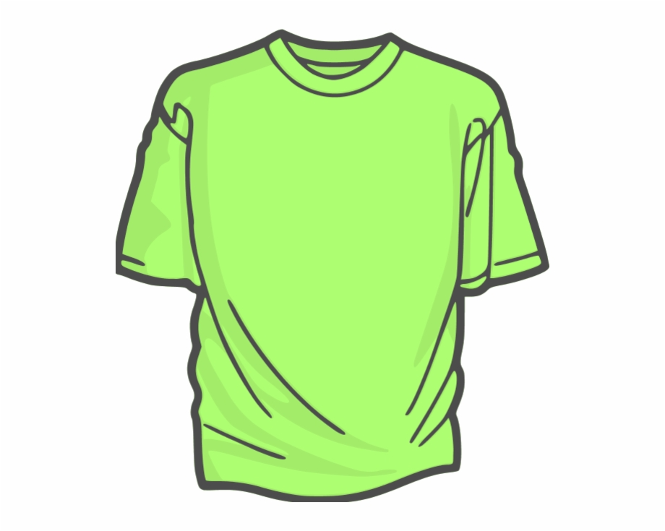
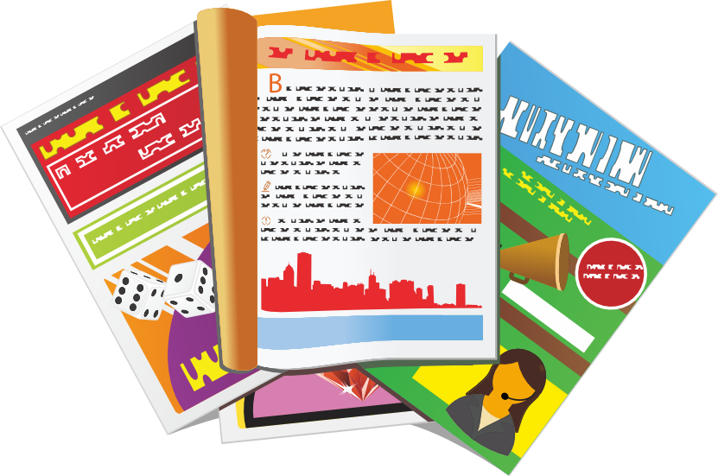
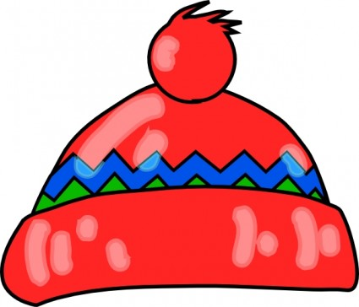
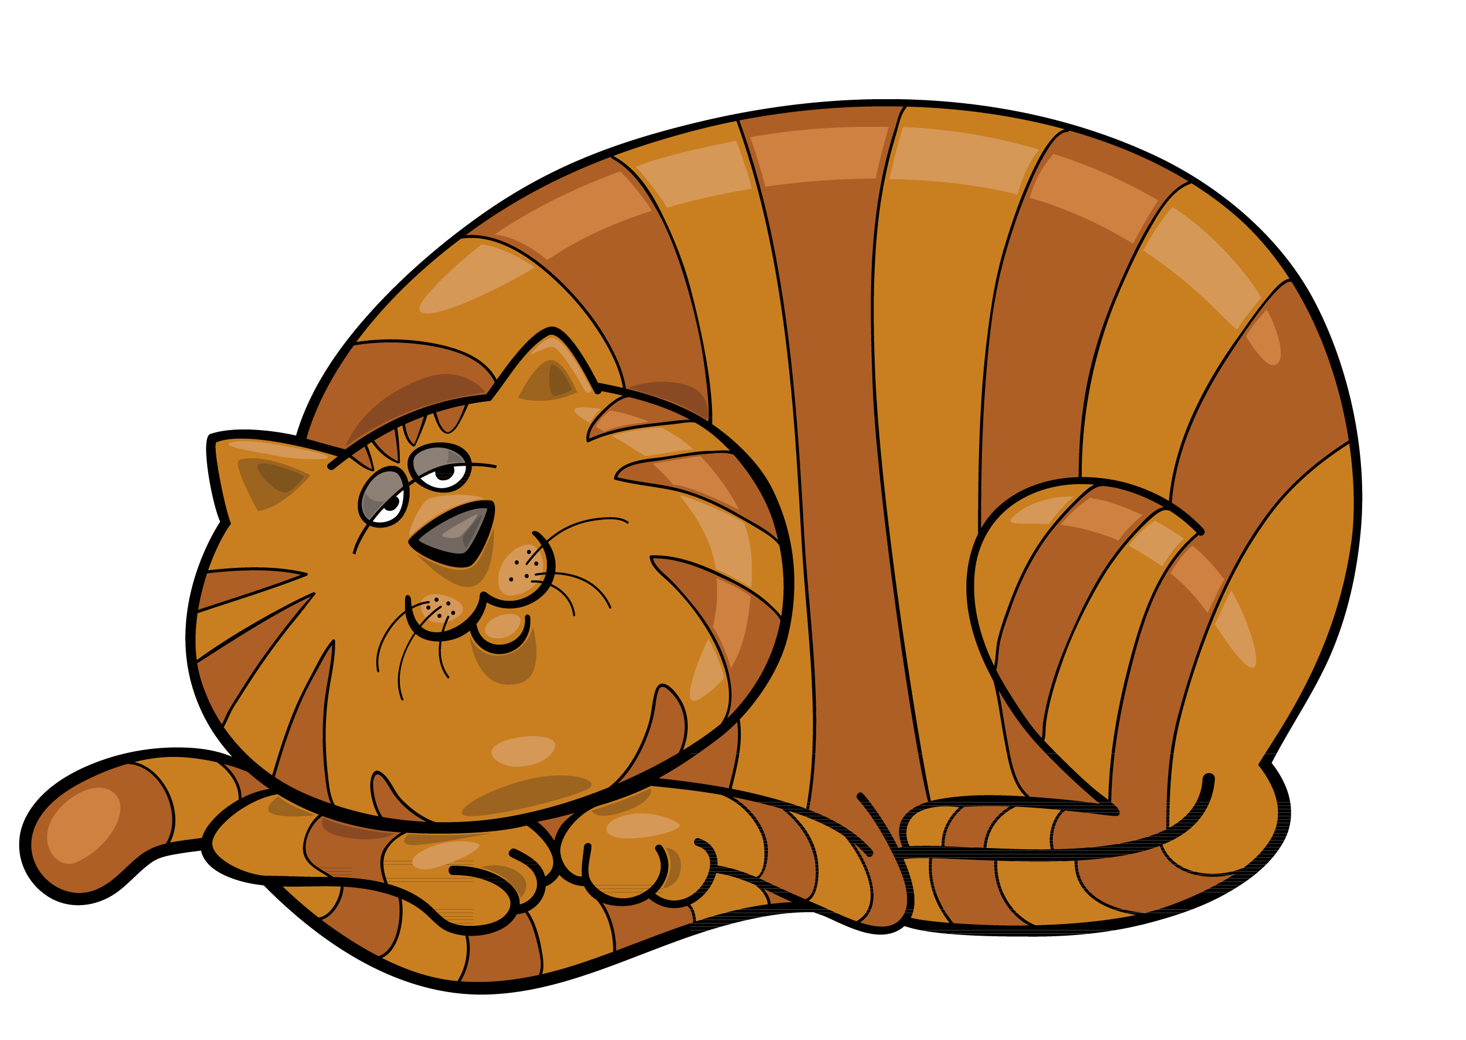
Expressing likes and saying what I and others do
Un spectacle !
jaune
Plural definite article ‘les’
SSC [r]
le spectacle de fin d’année – the end of year show
Notes:
Artwork by Steve Clarke. Pronoun pictures from NCELP (www.ncelp.org). All additional pictures selected from Pixabay and are
available under a Creative Commons license, no attribution required.
The AUDIO version of the lesson material includes additional audio for the new language
presented (phonics, vocabulary) and audio for the instructions on the slide.
In addition, it includes VIDEO clips of the phonics and the phonics’ source words. Pupils can be
encouraged to look at the shape of the mouth/lips on slides where these appear, and try to copy
it/them.
Phonics: [r] rue [598] triste [1843] moderne [1239] être [5] parler [106]
Vocabulary (new words in bold): adorer [2322] apporter [339] détester [2898] matin [442] langue [712] les [1] merci [1070] de rien [n/a]
Revisit 1: mois [179] janvier [939] février [1139] mars [868] avril [1022] mai [943] juin [931] juillet [1326] aout [1445] septembre [944] octobre [826] novembre [982] décembre [891] quand [119] anniversaire [2043] en [7]
Revisit 2: il y a [n/a] un [3] deux [41] trois [115] quatre [253] cinq [288] six [450] sept [905] huit [877] neuf [787] dix [372] onze [2447] douze [1664]
Londsale, D., & Le Bras, Y. (2009). A Frequency Dictionary of French: Core vocabulary for learners London: Routledge.
The frequency rankings for words that occur in this PowerPoint which have been previously introduced in these resources are given
in the SOW and in the resources that first introduced and formally re-visited those words.
For any other words that occur incidentally in this PowerPoint, frequency rankings will be provided in the notes field wherever
possible.
1

Slide 2
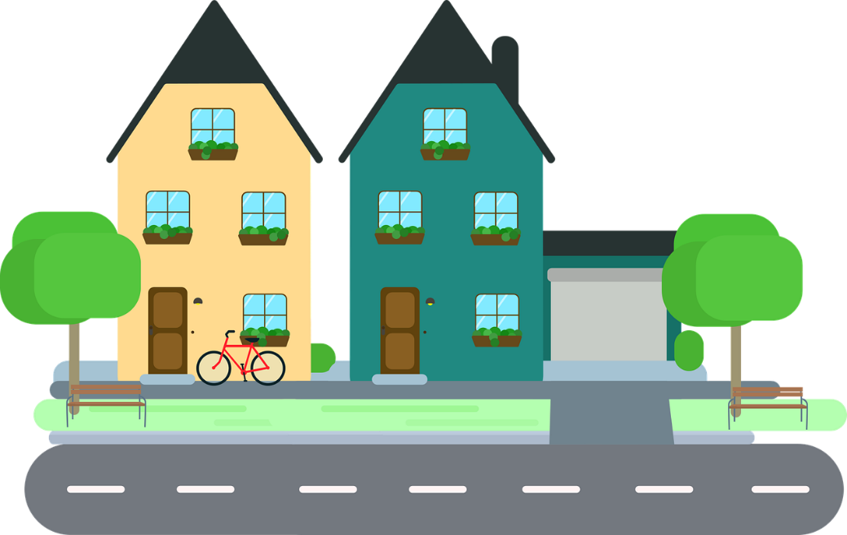
[r]
prononcer
rue
Notes:
Timing: 1 minute
Aim: To introduce SSC [r]
Procedure: 1. Present the letter(s) and say the [r] sound first, on its own. Students repeat it with you. 2. Bring up the word ”rue” on its own, say it, students repeat it, so that they have the opportunity to focus all of their attention on the connection between the written word and its sound.
3. Say the word and do the gesture, if using.
4. Roll back the animations and work through 1-3 again, but this time, dropping your voice completely to listen carefully to the students saying the [r] sound, pronouncing ”rue” and, if using, doing the gesture.
Gesture: https://www.signbsl.com/sign/road
The 1st video top left – trace the shape of a road with index fingers of both hands held parallel, tracing a road shape in the air away from the body.
Word frequency (1 is the most frequent word in French):
rue [144]
Source: Londsale, D., & Le Bras, Y. (2009). A Frequency Dictionary of French: Core vocabulary for learners London: Routledge.
2

Slide 3
[r]
prononcer
triste
moderne
rue
être
parler
Notes:
Timing: 2 minutes
Aim: To introduce SSC [r]
Procedure:
Introduce and elicit the pronunciation of the individual SSC [r] and then the source word again ‘rue’ (with gesture, if using). Then present and elicit the pronunciation of the five cluster words. The cluster words have been chosen for their high-frequency, from a range of word classes, with the SSC (where possible) positioned within a variety of syllables within the words (e.g. initial, 2nd, final etc.). Additionally, we have tried to use words that build cumulatively on previously taught SSCs (see the Phonics Teaching Sequence document) and do not include new SSCs. Where new SSCs are used, they are often consonants which have a similar symbol-sound correspondence in English.
Word frequency (1 is the most frequent word in French): rue [598] triste [1843] moderne [1239] être [5] parler [106] Source: Londsale, D., & Le Bras, Y. (2009). A Frequency Dictionary of French: Core vocabulary for learners London: Routledge.
3

Slide 4
[r]
⚠ There is no sound like this in English!
prononcer
French [r] is a raspy sound pronounced in the back of the throat.
Follow these steps to practise French [r]:
1. Open your mouth. Put your tongue flat and against the bottom teeth.
2. Close your throat as if to gargle and say ‘k’ several times.
3. Start again but don’t close your throat completely.
4. Instead of ‘k’, say “ra-ra-ra”. You should feel the throat vibrating.
Notes:
Timing: 3 minutes (two slides)
Aim: to build familiarity with movement in the mouth and throat when saying SSC [r].
Procedure:
1. Click to reveal step by step process of pronouncing [r].
2. Students should practise for a minute.
3. Move to the next slide.
4

Slide 5
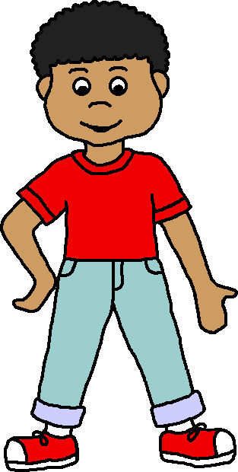
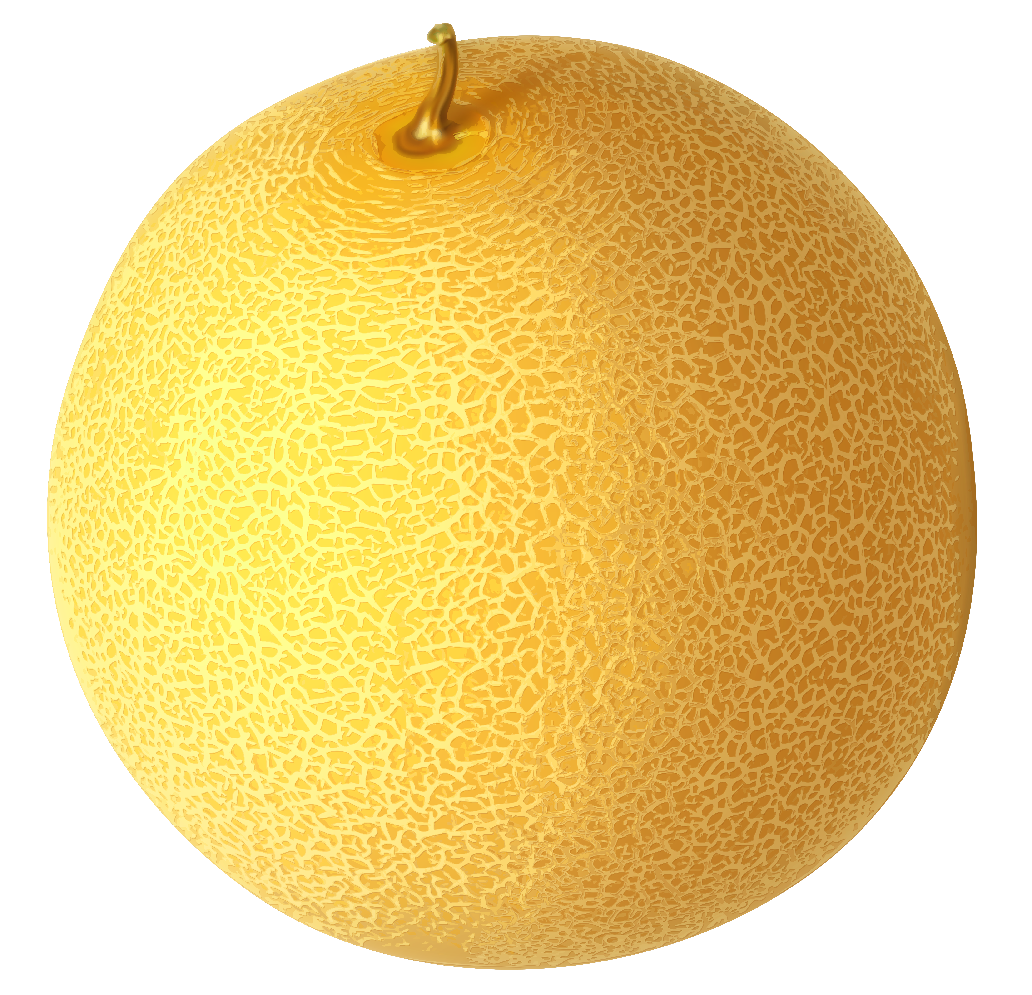
[r]
fabriquer – to create
Prononce le virelangue.
le fromage - cheese
prononcer
Frédéric, mon frère, fabrique trois fruits en fromage !
1
2
3
3
Notes:
Procedure:
Click to play the slowest version of the tongue twister.
Pupils read aloud themselves.
Click to listen to the two faster speeds, and pupils try to emulate.
Frequency of unknown words and cognates:
fabriquer [1231] fromage [4475]
Londsale, D., & Le Bras, Y. (2009). A Frequency Dictionary of French: Core vocabulary for learners London: Routledge.
5

Slide 6
[r]
Max compare l’anglais avec le français.
Lis les mots en anglais et en français.
Attention ! Il y a des différences !
prononcer
radio | radio
sport | sport
park | parc
response | réponse
group | groupe
person | personne
prepare | préparer
strict | strict
1
2
3
4
5
6
7
8
Notes:
Timing: 5 minutes
Aim: to practise pronouncing French [r] and noticing the difference physically in the mouth when making French and English [r] sounds.
Procedure:
Pupils say the English words, with their hands on their throats, paying particular attention to the pronunciation of [r]. They shouldn’t feel any vibration when pronouncing the [r].
Click on the letters to hear the French word. Pay attention to the pronunciation of the [r]. Before attempting to say the words, pupils should ‘warm up’ by saying the English letter ‘g’ a few times, feeling the vibration in their throats.
pupils repeat the French word as many times as is necessary with their hands on their throats. They should feel a vibration when saying the [r].
Transcript:
radio
sport
parc
réponse
groupe
personne
préparer
strict
Word frequency of unknown words and cognates (1 is the most frequent word in French): strict [1859]
Source: Londsale, D., & Le Bras, Y. (2009). A Frequency Dictionary of French: Core vocabulary for learners London: Routledge.
6

Slide 7
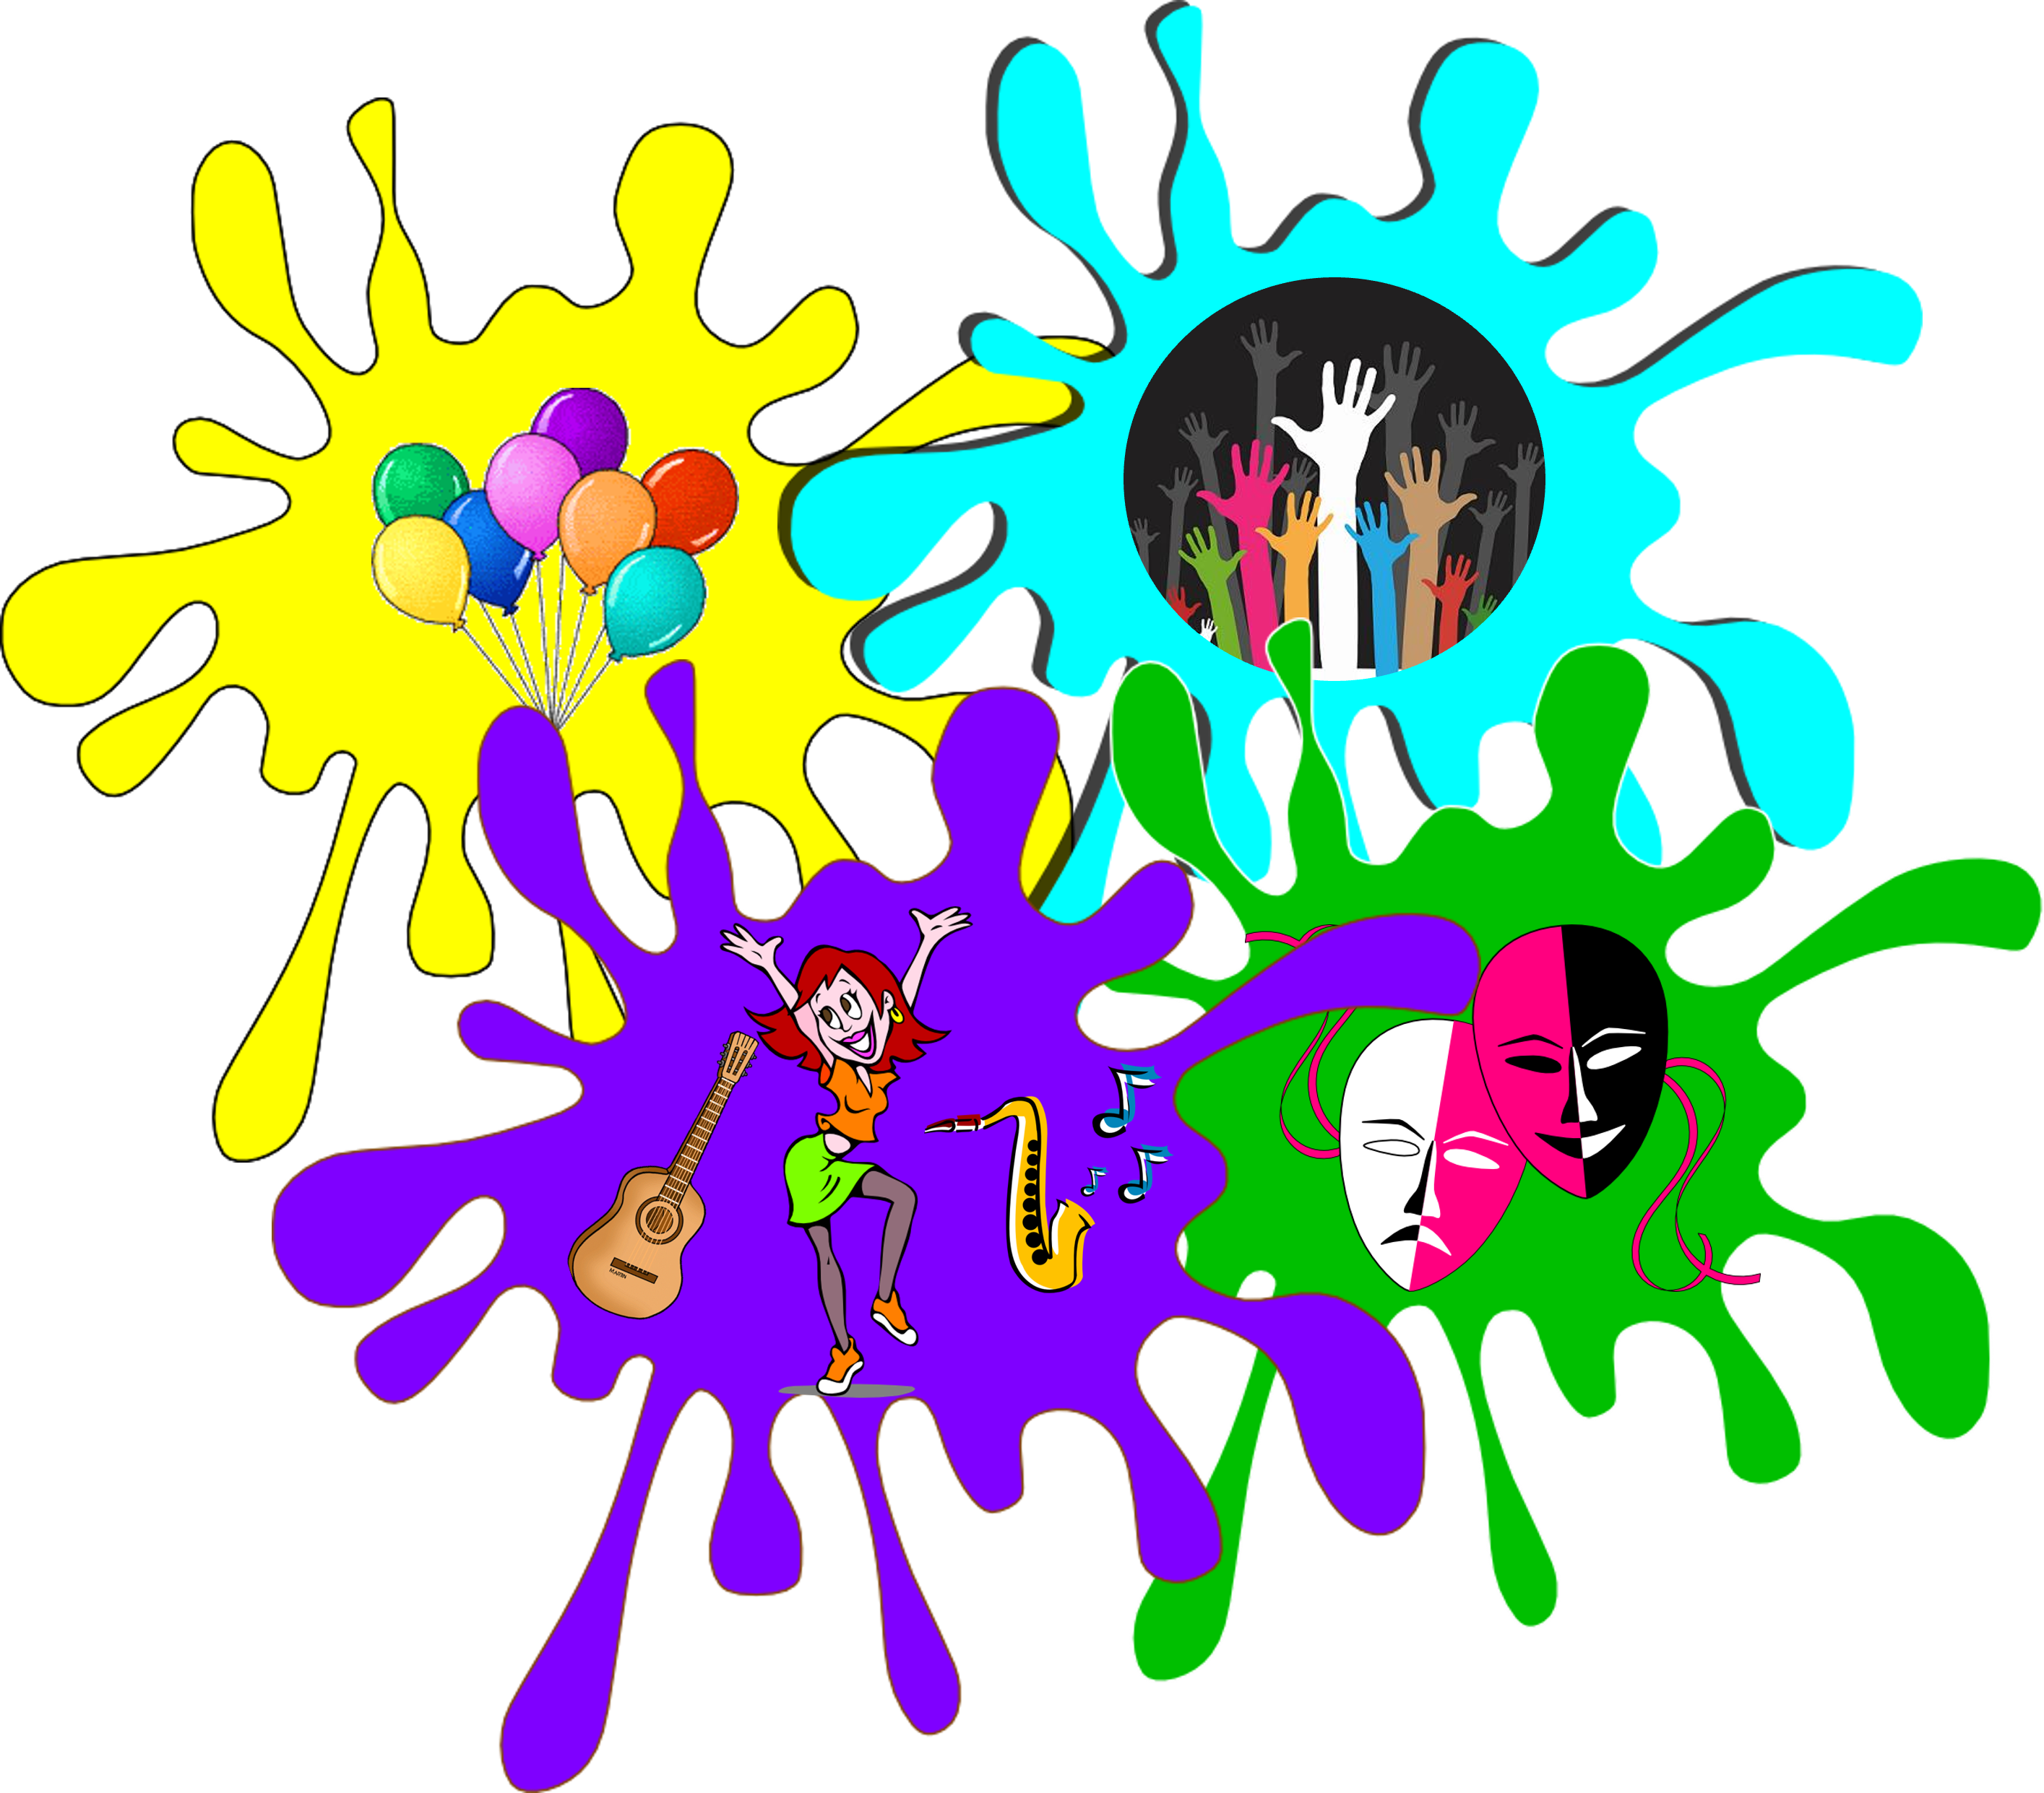
vocabulaire
Comment dit-on en français ?
mots
le spectacle
le matin
la chanson
les
détester
(the) song
apporter
(the) show
to bring, bringing
to love, loving
to hate, hating
you’re welcome!
(the) language
you’re welcome!
the (plural)
(the) morning
thank you
(the) morning
thank you
to love, loving
(the) show
the (plural)
(the) song
to hate, hating
to bring, bringing
(the) language
merci
adorer
de rien !
la langue
Notes:
Timing: 5 minutes
Aim: to present and practise written comprehension and read aloud of three items of previously taught vocabulary that we revisit this week and the seven new words.
Procedure: 1. Click for an English item. Elicit recognition and pronunciation of the French word from pupils.
2. Click to cover the French word with a picture.
3. Continue with the remaining items.
4. Optional at this stage: elicit the French from pupils, (English prompts reappear on each mouse click) this time without written French support.
7

Slide 8
Les
We usually add –s to nouns in French, to talk about more than one:
Il y a deux groupes.
Il y a quatre personnes.
There are two groups.
There are four people.
We know the word ‘des’ means some for both masculine and feminine nouns:
Voici des groupes.
Voici des personnes.
The plural word for ‘the’ is ‘les’. It is the same for both masculine and feminine nouns.
les groupes
les personnes
Notes:
Timing: 5 minutes (two slides)
Aim: to introduce the plural word for ‘the’ and recap the most common way to form plural nouns, and the word for ‘some’.
Procedure: 1. Click to present the information.
2. Elicit responses from pupils, following the animated question marks.

Slide 9
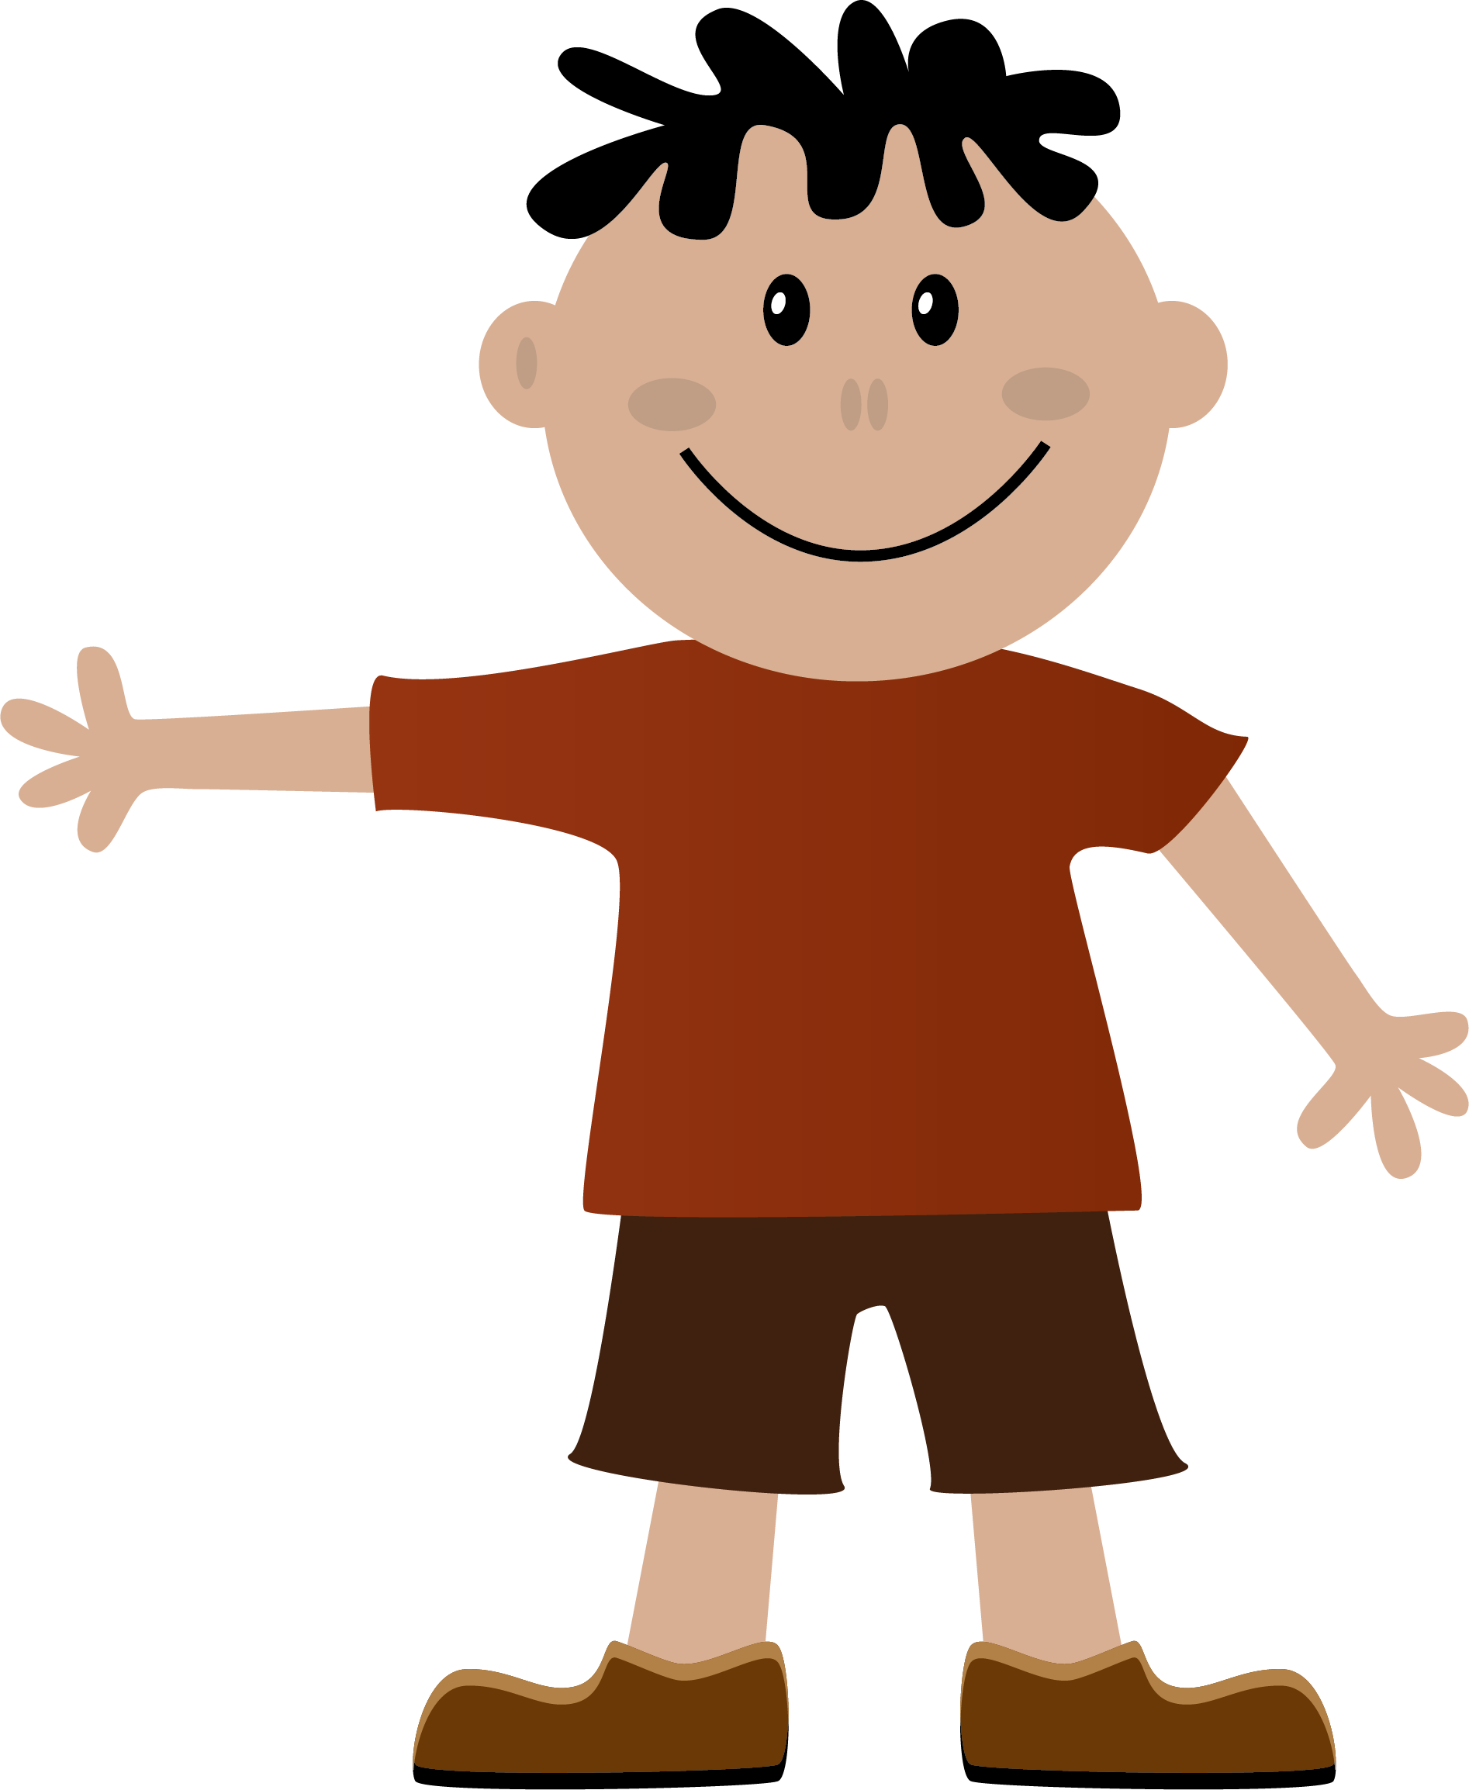
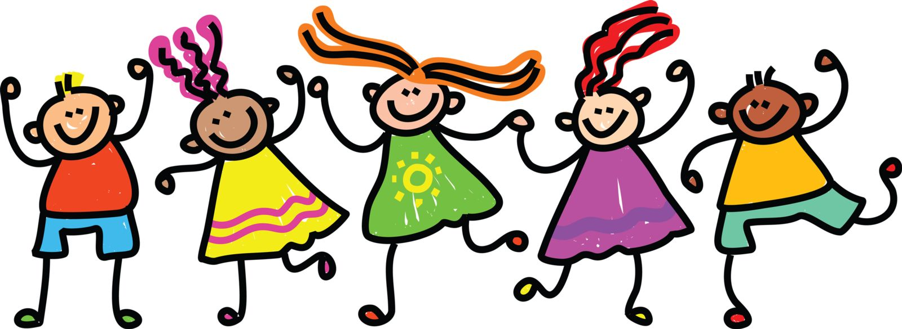
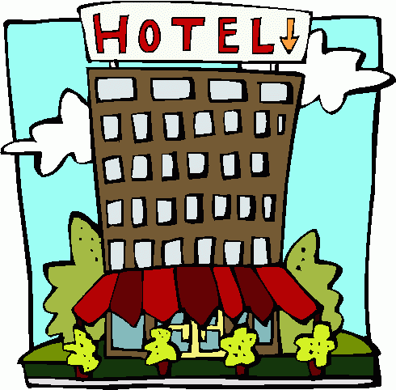
Les avec la liaison
Remember! Use l’ to mean ‘the’ for singular nouns that begin with a vowel or silent ‘h’:
We make a liaison after ‘les’ with plural forms of nouns that begin with a vowel or silent ‘h’:
l’ami
les amis
l’hôtel
les hôtels
l’image
les images
l’émission
les émissions
Notes:
Procedure: 1. Click to present the information.
2. Elicit responses from pupils, following the animated question marks.

Slide 10
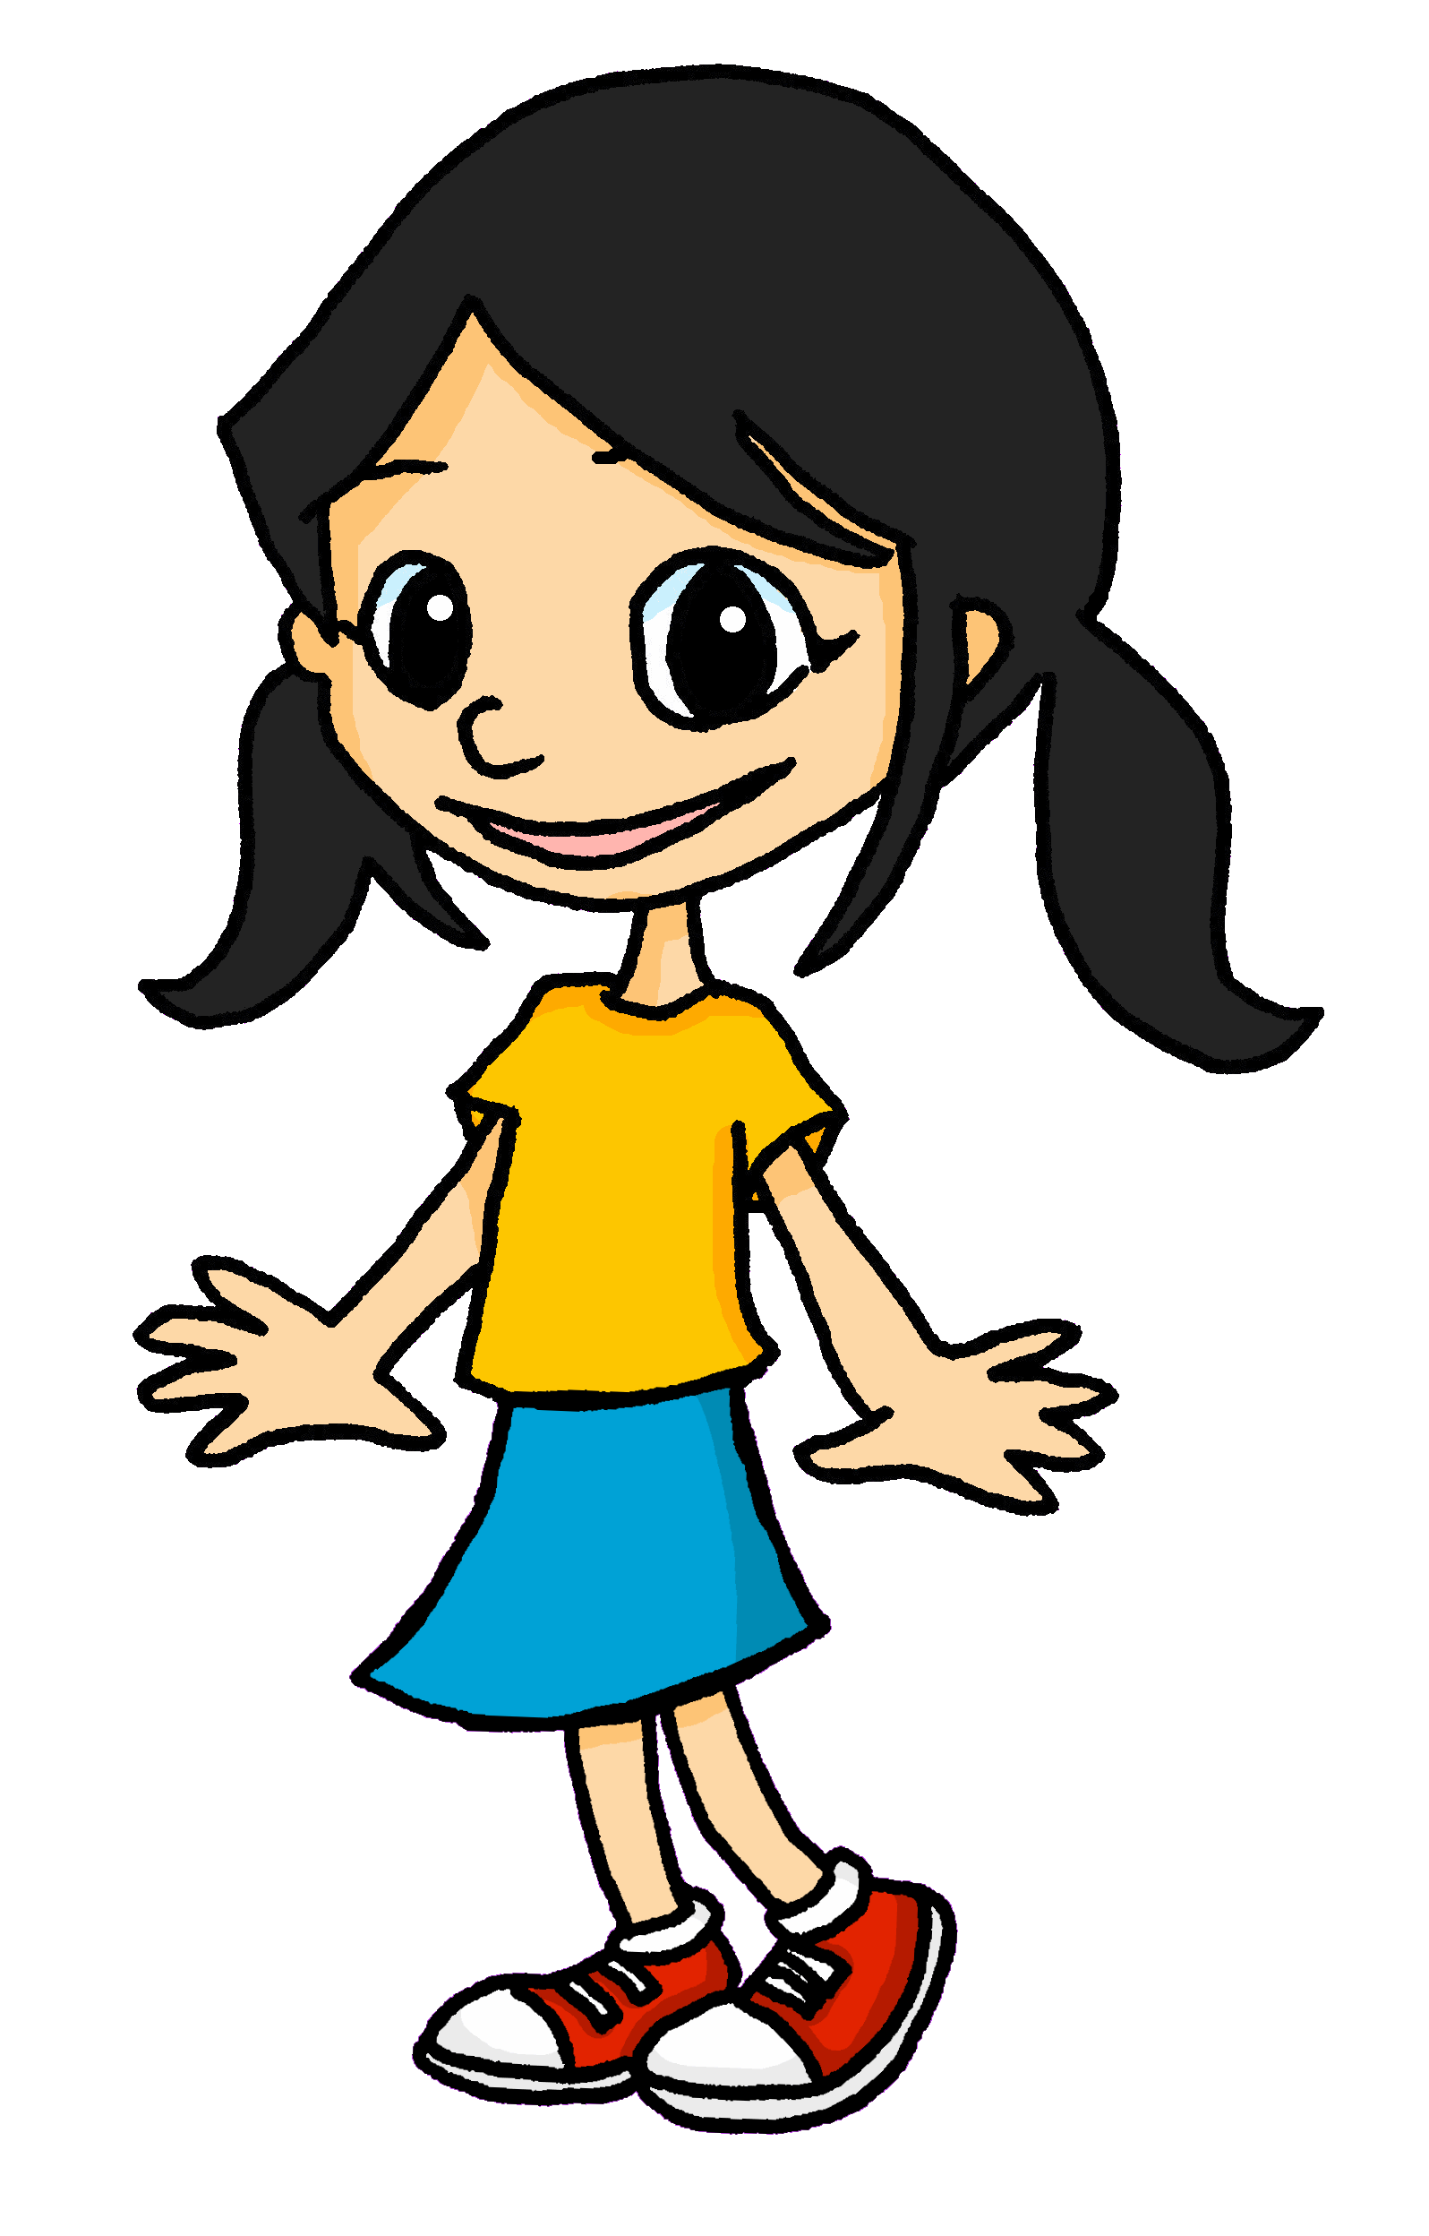
culture
Le spectacle de fin d’année
School assemblies are not very common in France but pupils like preparing a show (un spectacle) for the end of the year. They rehearse in the big hall or gym. Sometimes they wear a costume (un déguisement), too.
Eugénie is looking forward to the end of year show. What does she say about it?
Notes:
Timing: 1 minute
Aim: to present the context for the next two activities; to introduce a detail about French school life.
Procedure:
Read the slide information with pupils.
10

Slide 11
lire
Eugénie donne des opinions. Elle dit quoi exactement ?
J’aime le
spectacle.
J’aime l’
affiche.
1
spectacle | spectacles
5
affiches | affiche
J’adore les chansons.
Je déteste les tests.
2
6
chanson | chansons
tests | test
Je déteste les listes.
J’adore les langues.
3
listes | liste
7
langue | langues
J’adore les idées.
Je déteste les
matins.
4
idée | idées
8
matins | matin
Notes:
Timing: 5 minutes
Aim: Written recognition of the singular and plural forms of definite articles and connecting form with meaning.
Procedure:
1. Students write 1-8 in their books.
2. Students read the sentences and decide whether which noun is being described. Tell them they need to look at the definite article to get this information.
3. Click to reveal answers.
4. Ask students for the meanings of the sentences in English.
11

Slide 12
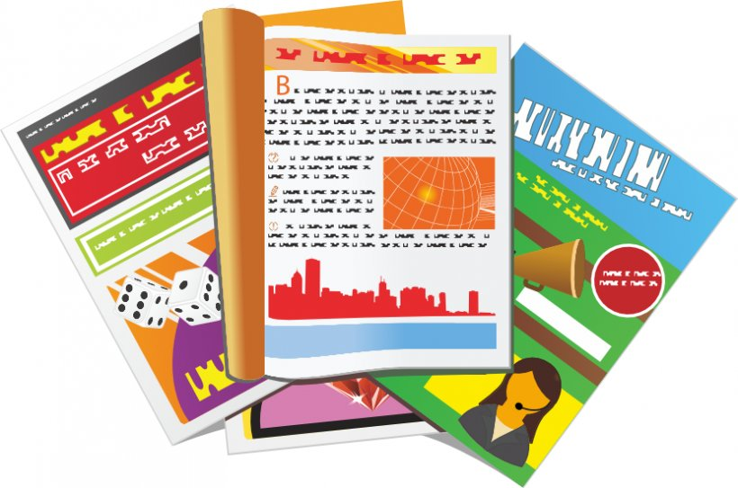
écouter
Eugénie is organising props for the show.
Eugénie apporte quoi ? Écoute. C’est ‘le’, ‘la’ ou ‘les’ ? Écris le mot.
la liste
le livre
4
1
écrire
les dessins
les magazines
5
2
le chat
les chaises
3
6
Notes:
Timing: 3 minutes
Aim: to practise aural recognition of the singular and plural forms of definite articles and connecting form with meaning.
Procedure:
Click on a number to hear an article said aloud.
Students write 1-6 and the French word for what the article refers to.
Click to reveal answers and spelling.
Transcript:
la
les
le
le
les
les
12

Slide 13
Au revoir !
jaune
Notes:
13

