Slide 1
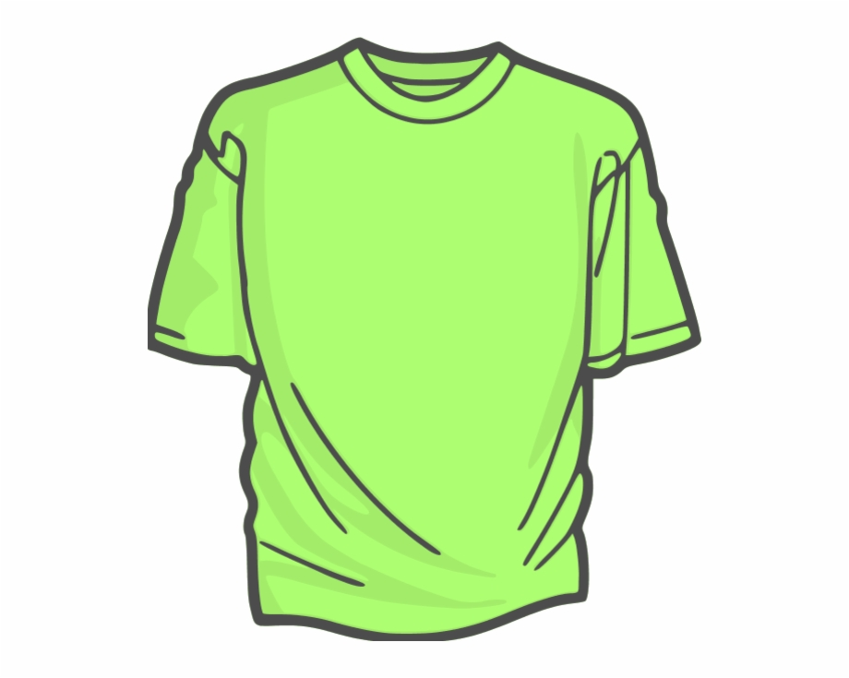
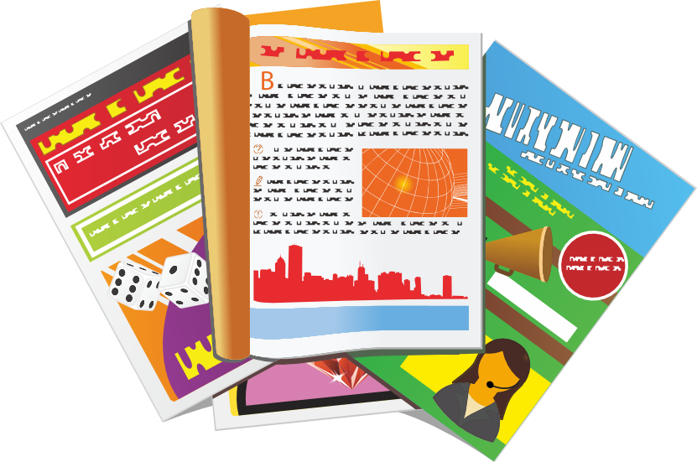
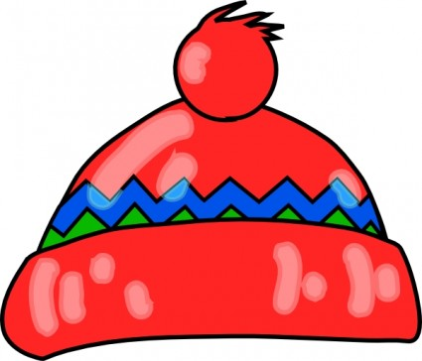
Describing me and others
Un spectacle !
jaune
le spectacle de fin d’année – the end of year show
Follow ups 1-5
Notes:
Artwork by Steve Clarke. Pronoun pictures from NCELP (www.ncelp.org). All additional pictures selected from Pixabay and are
available under a Creative Commons license, no attribution required.
The AUDIO version of the lesson material includes additional audio for the new language
presented (phonics, vocabulary) and audio for the instructions on the slide.
In addition, it includes VIDEO clips of the phonics and the phonics’ source words. Pupils can be
encouraged to look at the shape of the mouth/lips on slides where these appear, and try to copy
it/them.
Phonics: [r] rue [598] triste [1843] moderne [1239] être [5] parler [106]
Vocabulary (new words in bold): adorer [2322] apporter [339] détester [2898] matin [442] langue [712] les [1] merci [1070] de rien [n/a]
Revisit 1: mois [179] janvier [939] février [1139] mars [868] avril [1022] mai [943] juin [931] juillet [1326] aout [1445] septembre [944] octobre [826] novembre [982] décembre [891] quand [119] anniversaire [2043] en [7]
Revisit 2: il y a [n/a] un [3] deux [41] trois [115] quatre [253] cinq [288] six [450] sept [905] huit [877] neuf [787] dix [372] onze [2447] douze [1664]
Londsale, D., & Le Bras, Y. (2009). A Frequency Dictionary of French: Core vocabulary for learners London: Routledge.
The frequency rankings for words that occur in this PowerPoint which have been previously introduced in these resources are given
in the SOW and in the resources that first introduced and formally re-visited those words.
For any other words that occur incidentally in this PowerPoint, frequency rankings will be provided in the notes field wherever
possible.

Slide 2
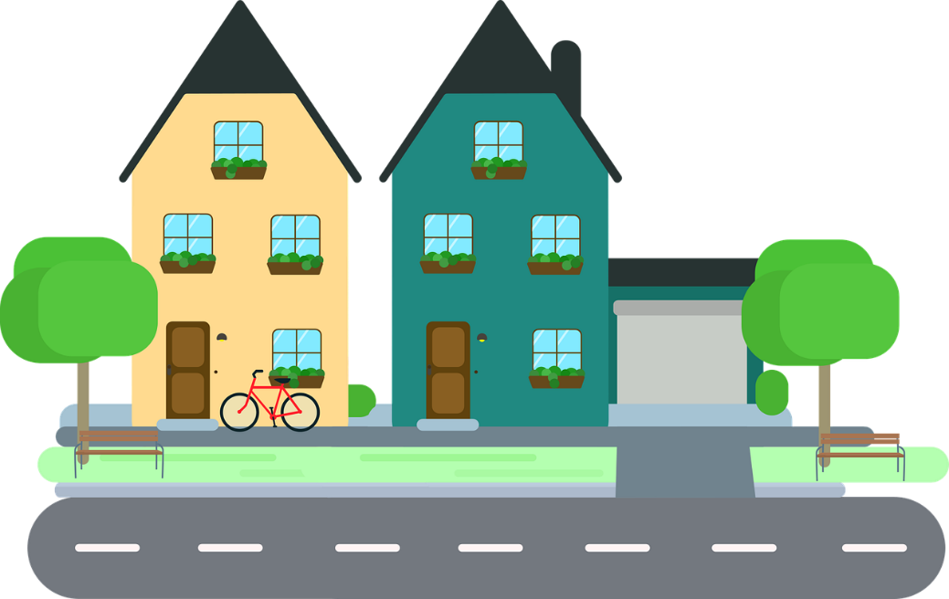
[r]
prononcer
rue
Notes:
Timing: 1 minute
Aim: To introduce SSC [r]
Procedure: 1. Present the letter(s) and say the [r] sound first, on its own. Students repeat it with you. 2. Bring up the word ”rue” on its own, say it, students repeat it, so that they have the opportunity to focus all of their attention on the connection between the written word and its sound.
3. Say the word and do the gesture, if using.
4. Roll back the animations and work through 1-3 again, but this time, dropping your voice completely to listen carefully to the students saying the [r] sound, pronouncing ”rue” and, if using, doing the gesture.
Gesture: https://www.signbsl.com/sign/road
The 1st video top left – trace the shape of a road with index fingers of both hands held parallel, tracing a road shape in the air away from the body.
Word frequency (1 is the most frequent word in French):
rue [144]
Source: Londsale, D., & Le Bras, Y. (2009). A Frequency Dictionary of French: Core vocabulary for learners London: Routledge.
2

Slide 3
[r]
prononcer
triste
moderne
rue
être
parler
Notes:
Timing: 2 minutes
Aim: To introduce SSC [r]
Procedure:
Introduce and elicit the pronunciation of the individual SSC [r] and then the source word again ‘rue’ (with gesture, if using). Then present and elicit the pronunciation of the five cluster words. The cluster words have been chosen for their high-frequency, from a range of word classes, with the SSC (where possible) positioned within a variety of syllables within the words (e.g. initial, 2nd, final etc.). Additionally, we have tried to use words that build cumulatively on previously taught SSCs (see the Phonics Teaching Sequence document) and do not include new SSCs. Where new SSCs are used, they are often consonants which have a similar symbol-sound correspondence in English.
Word frequency (1 is the most frequent word in French): rue [598] triste [1843] moderne [1239] être [5] parler [106] Source: Londsale, D., & Le Bras, Y. (2009). A Frequency Dictionary of French: Core vocabulary for learners London: Routledge.
3

Slide 4
Follow up 1:
L’amitié*
l’amitié- friendship
Vokabeln
Learning languages is about making friends.
You show kindness when you learn even a few words in another language.
Let’s remember some of the friendship sentences we have learnt already!
_ _ r _ _ _ _ r !
Bonjour !
Au revoir !
Ça va aujourd’hui ?
prononcer
_ _ _ _ _ _ r !
How’s it going
today ?
Note: all these phrases have [r]. Say them again and focus on the [r] sound.
Can you say other kind things?
Tu es drôle !
Joyeux anniversaire !
J’ai une carte pour toi !
You are funny!
C’est parfait !
Wow, that’s fast!
Happy birthday!
I have a card for you.
It’s perfect!
Waouh, c’est rapide !
Notes:
Timing: 5 minutes (two slides)
Aim: to introduce the idea that learning other languages opens the door to new friendships, and that a few kind words go a long way; to revisit some previously-taught language from this term that fits our category of ‘friendship sentences’. This is an idea we will return to now and then during the course.
Procedure:
Click to present the information on the slide.
Elicit the French from pupils for the English greetings and friendly statements.
Click to bring up the callout about the SSC [r]. Allow pupils a few moments to turn to those around them and say all of these phrases again, focusing on the [r] sound this time.
Remind pupils that we all need to hear kind words every day, in whatever language!
Click to move on to the next slide.

Slide 5
vocabulaire
Let’s practise two more.
mots
Écoute et répète.
merci
de rien
⚠ Literally, this means ‘of nothing’.
Notes:
Aim: to consolidate two of the new words for this week.
Procedure: 1. Click to present and say the words. 2. Pupils repeat.
3. Pupils turn to each other and exchange thank you and you’re welcome in French.
5

Slide 6
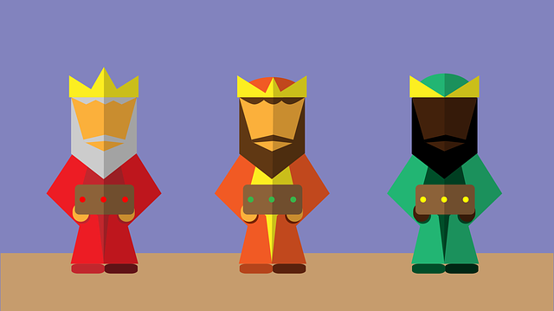
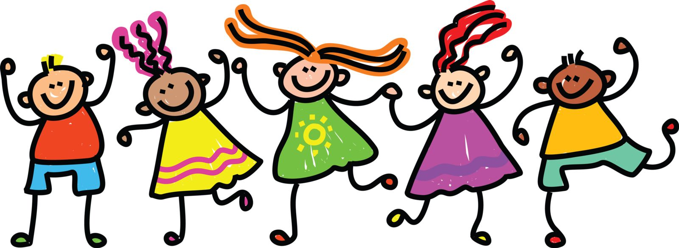
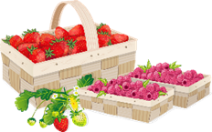
Follow up 2:
Lis le poème. Le mot correct, c’est quoi ?
froid | rois
En janvier les rois
En juillet le soleil
soleil | vacances
lire
crêpes | Chandeleur
plages | mer
En février les crêpes
En aout la mer
lapin | fleurs
amis | école
En mars les fleurs
En septembre les amis
Halloween | festivals
œufs | chocolat
En avril le chocolat
En octobre les festivals
feux d’artifice
| froid
En mai la fête des mères
fête des mères | jours fériés
En novembre le froid
musique | chansons
fraises | tennis
En juin le tennis
En décembre les chansons
Notes:
Timing: 5 minutes
Aim: to practise written recognition of singular and plural nouns and their connection to the corresponding definite article; to revisit months of the year, which are part of this week’s vocabulary to be revisited.
Procedure:
Ensure that pupils realise that they select the noun based on the article.
Pupils initially work in pairs, deciding which noun is correct.
They read each line aloud.
Elicit responses chorally from pupils, clicking to reveal the answer and bring up a picture to support meaning.
Clarify any meanings, as necessary.
Then click to replace the name of each month with its image and ask pupils to read the poem aloud again in pairs. Pupils will be producing the months from memory and reading aloud the rest of each phrase.
Frequency of unknown words and cognates:
crêpes [>5000] férié [>5000] festival [3858] fête [1490] feu d’artifice [n/a] fleur [2305] fraise [>5000] lapin [>5000] mer [921] mère [645] œuf [2685] plage [2693] roi [1364] soleil [1713] tennis [3867] vacances [1726]
Note that several of these words are taught in this SOW – either in Rouge, Bleu or Vert (i.e., fête, feu d’artifice, fleur, mère, plage, soleil, tennis).

Slide 7
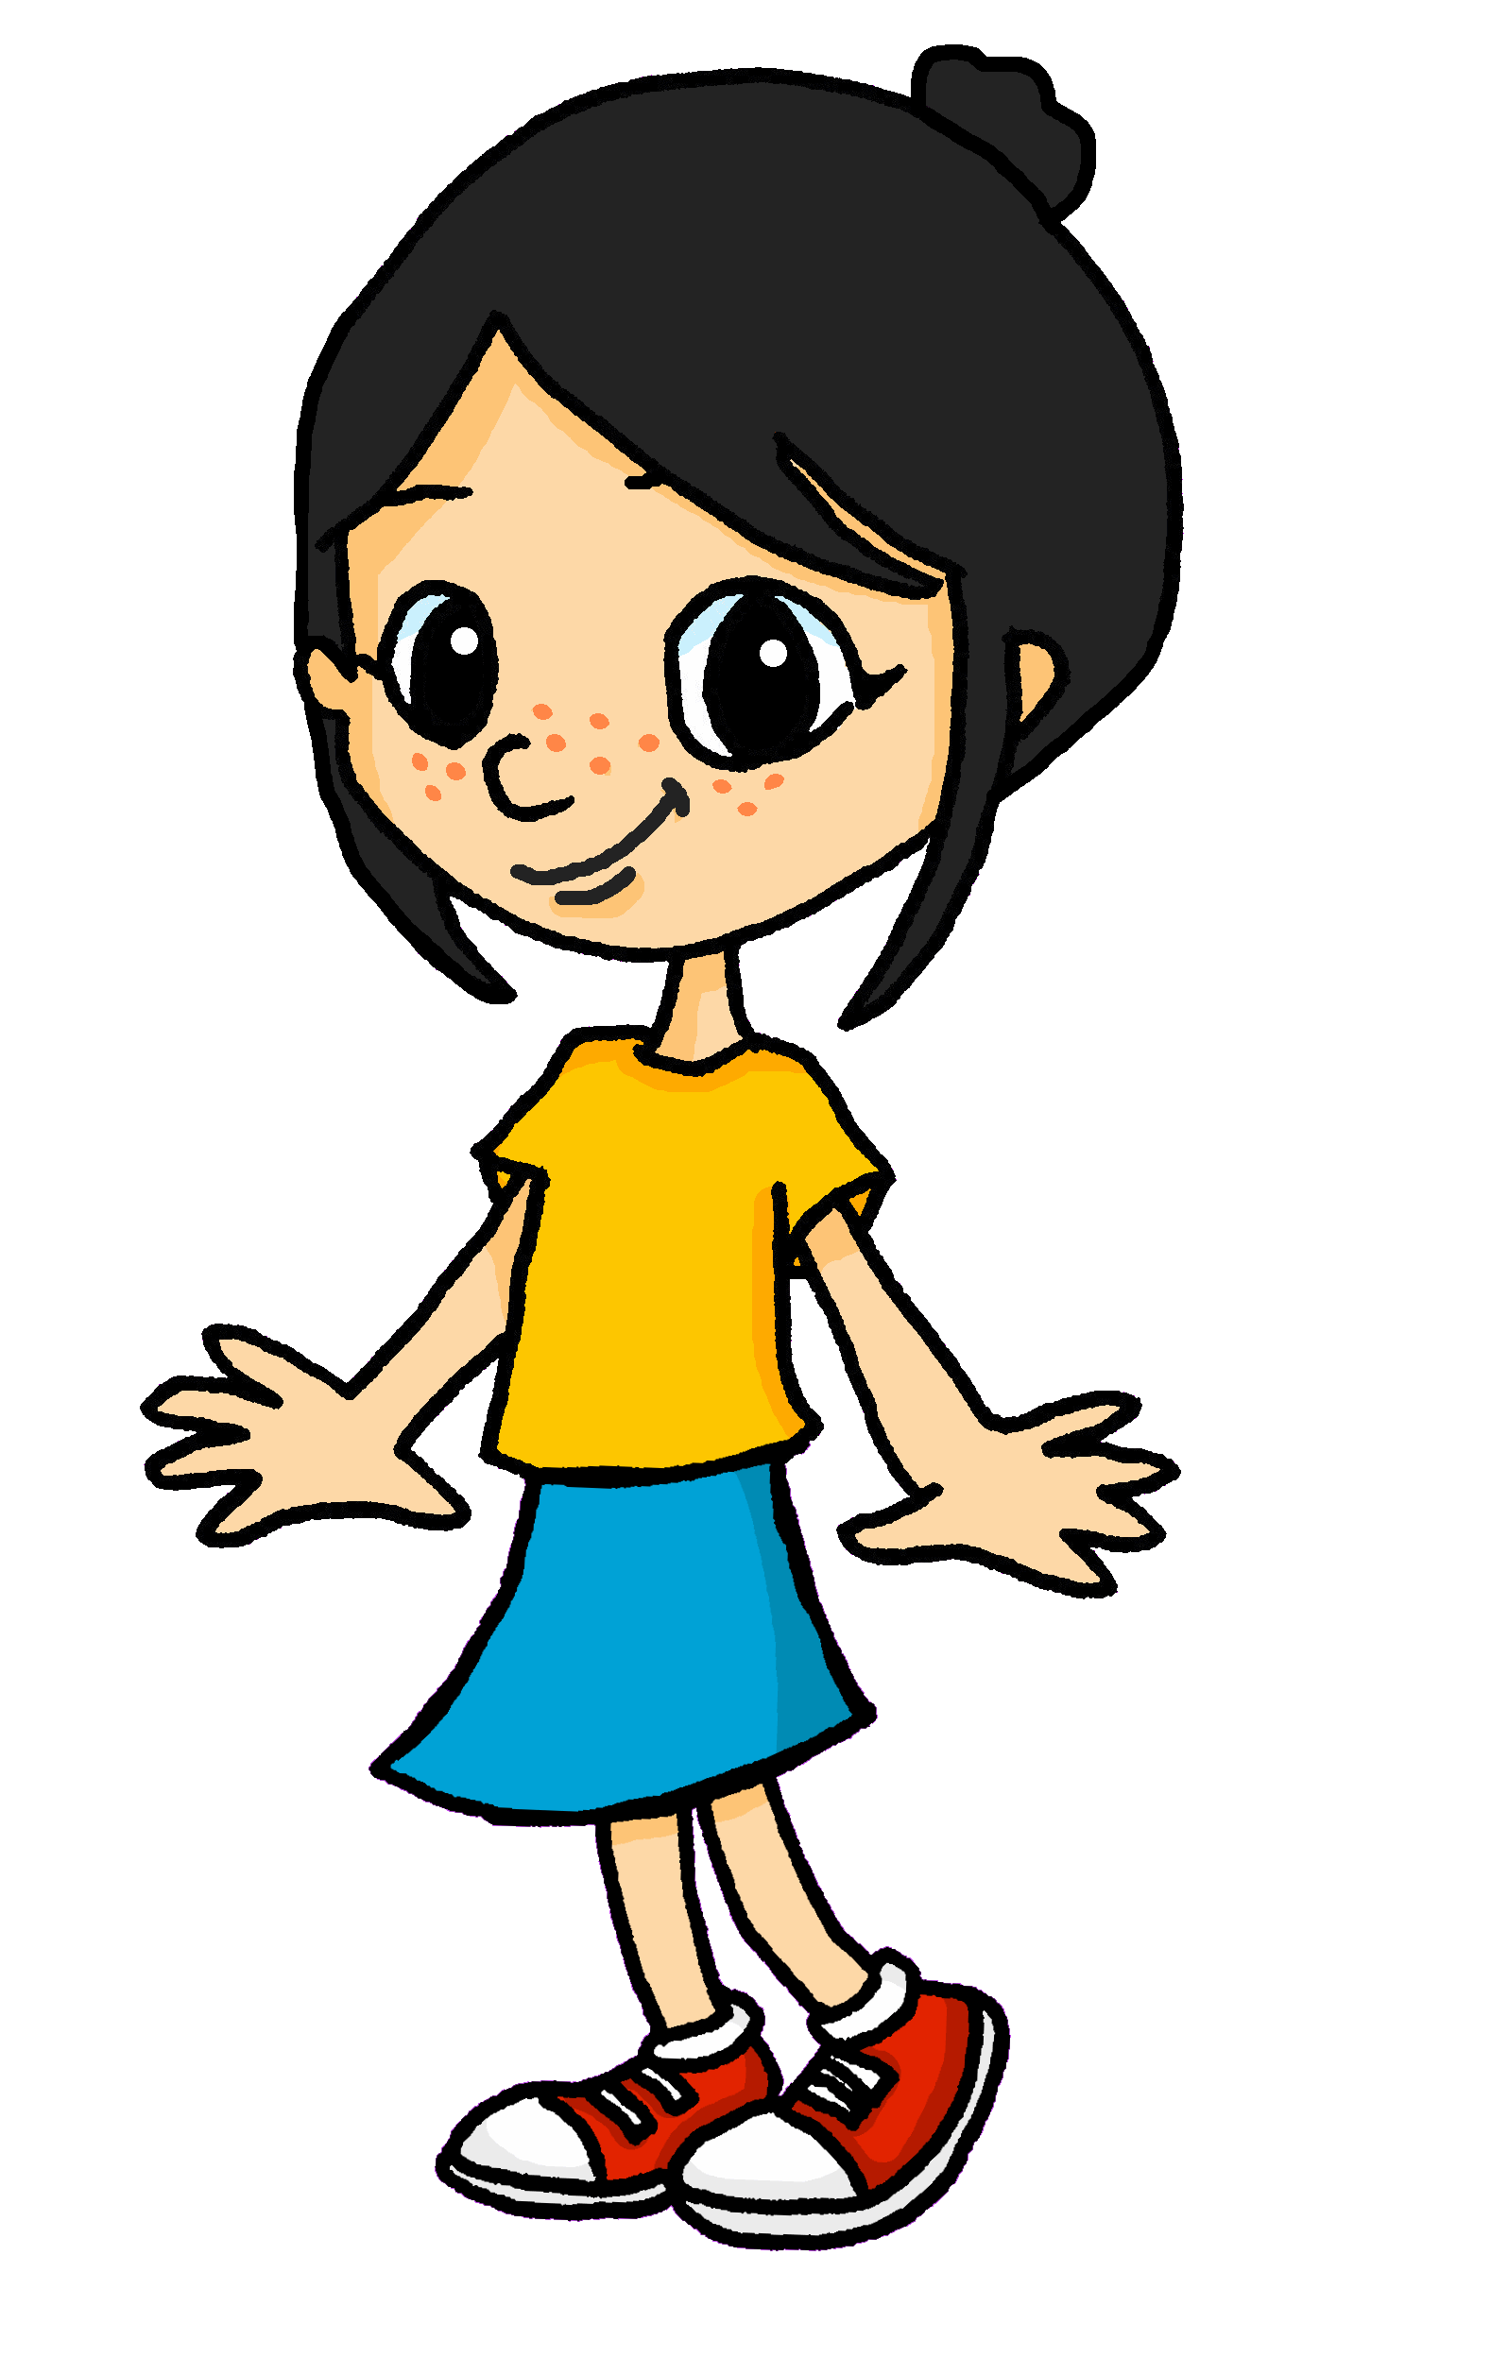
Follow up 3:
Eugénie décrit le spectacle. [1/2]
What is she saying?
⚠ Choose the answer based on liaison.
écouter
1
Voici les … magazines. | amis.
2
Voici les … dessins. | images.
3
Voici les … uniformes. | chats.
4
Voici les … photos. | affiches.
5
Voici les … idées. | messages.
6
Voici les … listes. | acteurs.
Notes:
Timing: 5 minutes (two slides)
Aim: to practise aural recognition of liaison after plural definite article ‘les’ and to connect this with meaning.
Procedure:
Pupils write 1-6.
Click on a button to hear a form of ‘voici les’, followed by a beep.
Based on the presence or absence of a liaison, pupils decide what comes next. Remind them it is the presence or absence of a -s- sound that will give them this information.
Click to check.
Full audio can be found on the next slide.
Transcript
1. Voici les [amis].
2. Voici les [dessins].
3. Voici les [chats].
4. Voici les [affiches].
5. Voici les [idées].
6. Voici les [listes].

Slide 8
Follow up 3:
Eugénie décrit le spectacle. [2/2]
Prononce les phrases.
prononcer
1
Voici les amis.
2
Voici les dessins.
3
Voici les chats.
4
Voici les affiches.
5
Voici les idées.
6
Voici les listes.
Notes:
[2/2]
Procedure:
Pupils pronounce each sentence.
Click to listen and check.
Transcript
1. Voici les amis.
2. Voici les dessins.
3. Voici les chats.
4. Voici les affiches.
5. Voici les idées.
6. Voici les listes.

Slide 9
Follow up 4:
Écoute et répète.
Écoute. Écris en anglais.
1
J’aime étudier avec des amis.
Max has learnt a lot of French this year. See if you can understand as much as he can.
écouter
I like studying with friends.
2
J’adore les langues.
I love languages.
⚠ Remember! I like + noun in French needs an article (le|la|l’|les). In English we often leave out the article.
parler
3
Je déteste les matins.
I hate mornings.
4
Je déteste apporter beaucoup de choses à l’école.
I hate bringing lots of things to school.
5
J’aime la musique mais je préfère le sport.
I like music but I prefer sport.
6
J’aime jouer avec des amis.
I like playing with friends.
Notes:
Timing: 5 minutes
Aim: to practise aural comprehension of vocabulary and structures from this and previous weeks.
Procedure:
Pupils write 1-6.
Click on a button to hear each sentence.
Pupils write the English meaning.
Click to reveal the French and then elicit the English meaning from pupils
Click to confirm the English meaning.
Transcript
1. J’aime étudier avec des amis.
2. J’adore les langues.
3. Je déteste les matins.
4. Je déteste apporter beaucoup de choses à l’école.
5. J’aime la musique mais je préfère le sport.
6. J’aime jouer avec des amis.

Slide 10
Follow up 5b:

Écris en anglais. Can you get at least 15 points?
mots
 | huit | onze | quatre
 | sept | cinq | trois
 | quand | aout | le mois
 | janvier | l’anniversaire | juillet
 | merci | la langue | de rien
 | adorer | apporter | le matin
8
11
4
vocabulaire
x3
7
5
3
when
August
(the) month
x2
January
(the) birthday
July
thank you
(the) language
you’re welcome
x1
to love, loving
to bring, bringing
(the) morning
Notes:
Timing: 5 minutes
Aim: to practise written comprehension of vocabulary from week 1, last week and this week.
Procedure: 1. Give pupils a blank grid. They fill in the English meanings of any of the words they know, trying to reach 15 points in total. 2. Remind pupils that adjectives can refer to male or female persons and they should note this in their translations. E.g. pleased (f), short (m).
Note: The most recently learnt and practised words are pink, words from the previous week are green and those from week 1 are blue, thus more points are awarded for them, to recognise that memories fade and more effort (heavy lifting!) is needed to retrieve them.

Slide 11
Follow up 5b:

Écris en français. Can you get at least 15 points?
mots
 | 2 | 9 | there is/there are
 | 12 | 8 | 4
 | August | (the) birthday | when
 | February | June | (the) month
 | to bring, bringing | you’re welcome | (the) language
 | the (m/fpl) | (the) morning | thank you
deux
neuf
il y a
vocabulaire
x3
douze
huit
quatre
aout
l’anniversaire
quand
x2
février
juin
le mois
apporter
de rien
la langue
x1
les
le matin
merci
Notes:
Timing: 5 minutes
Aim: to practise written comprehension of vocabulary from week 1, last week and this week.
Procedure: 1. Give pupils a blank grid. They fill in the French meanings of any of the words they know, trying to reach 15 points in total.
Note: The most recently learnt and practised words are pink, words from the previous week are green and those from week 1 are blue, thus more points are awarded for them, to recognise that memories fade and more effort (heavy lifting!) is needed to retrieve them.

Slide 12
vocabulaire
Follow up 5b - Écris en anglais : Can you get at least 15 points?
mots
 | huit | onze | quatre
 | sept | cinq | trois
 | quand | aout | le mois
 | janvier | l’anniversaire | juillet
 | merci | la langue | de rien
 | adorer | apporter | le matin
x3
x2
x1
Notes:
HANDOUT
12

Slide 13
vocabulaire
Follow up 5b - Écris en français : Can you get at least 15 points?
mots
 | 2 | 9 | there is/there are
 | 12 | 8 | 4
 | August | (the) birthday | when
 | February | June | (the) month
 | to bring, bringing | you’re welcome | (the) language
 | the (m/fpl) | (the) morning | thank you
x3
x2
la langue
x1
Notes:
HANDOUT
13

