Slide 1
Expressing likes and saying what I and others do
jaune
2-verb structures (aimer, détester)
SSC [-tion]
Notes:
Artwork by Steve Clarke. Pronoun pictures from NCELP (www.ncelp.org). All additional pictures selected from Pixabay and are
available under a Creative Commons license, no attribution required.
The AUDIO version of the lesson material includes additional audio for the new language
presented (phonics, vocabulary) and audio for the instructions on the slide.
In addition, it includes VIDEO clips of the phonics and the phonics’ source words. Pupils can be
encouraged to look at the shape of the mouth/lips on slides where these appear, and try to copy
it/them.
Phonics: [-tion] population [509] action [355] situation [223] international [282] solution [608] attention [482]
Vocabulary (new words in bold): détester [2898] écouter [429] écrire [382] étudier [960] lire [278] parler [106]
Revisit 1: chose [125] actif [1219] massif [1760] préféré [597] propre [237] sale [2906] sportif [2670] idéal [1429]
Revisit 2: à (meaning ‘to, at, on, in) [4] arriver [174] montrer [108] rester [100] voyage [904] souvent [287] en ce moment [n/a]
Londsale, D., & Le Bras, Y. (2009). A Frequency Dictionary of French: Core vocabulary for learners London: Routledge.
The frequency rankings for words that occur in this PowerPoint which have been previously introduced in these resources are given
in the SOW and in the resources that first introduced and formally re-visited those words.
For any other words that occur incidentally in this PowerPoint, frequency rankings will be provided in the notes field wherever
possible.
1

Slide 2
[-tion]
prononcer
Attention !
Notes:
Timing: 1 minute
Aim: To consolidate SSC [-tion]
Procedure: 1. Present the letter(s) and say the [-tion] sound first, on its own. Pupils repeat it with you. 2. Bring up the word ”Attention” on its own, say it, pupils repeat it, so that they have the opportunity to focus all of their attention on the connection between the written word and its sound.
3. Clarify the meaning (Watch out! Take care!).
3. A possible gesture for this word would be to hold up the right index finger up and waggle it quickly from side to side as a gesture of warning. 4. Roll back the animations and work through 1-3 again, but this time, dropping your voice completely to listen carefully to the pupils saying the [-tion] sound, pronouncing ”Attention” and, if using, doing the gesture.
2

Slide 3
[-tion]
prononcer
motion
pollution
Attention !
solution
population
Notes:
Timing: 2 minutes
Aim: to consolidate SSC [-tion]
Procedure:
1. Introduce and elicit the pronunciation of the individual SSC [-tion] and then the source word again ‘Attention !’ (with gesture, if using). 2. Then present and elicit the pronunciation of the four cluster words.
The cluster words have been mainly chosen for their high-frequency, from a range of word classes, with the SSC (where possible) positioned within a variety of syllables within the words (e.g. initial, 2nd, final etc.). Additionally, we have tried to use words that build cumulatively on previously taught SSCs (see the Phonics Teaching Sequence document) and do not include new SSCs. Where new SSCs are used, they are often consonants which have a similar symbol-sound correspondence in English.
Word frequency (1 is the most frequent word in French): attention [482] motion [855] pollution [3073] population [509] solution [608] Source: Londsale, D., & Le Bras, Y. (2009). A Frequency Dictionary of French: Core vocabulary for learners London: Routledge.
3

Slide 4
prononcer
Écoute. C’est –ssion ou –tion ?
The words in this activity are exact cognates, i.e., spelt the same in English.
A
B
A
B
 | [-tion] | [-ssion] | mot
1
2
3
4
 | [-tion] | [-ssion] | mot
5
6
7
8
addition
définition
discussion
communication
profession
émission
conversation
percussion
Notes:
Timing: 5 minutes
Aim: to practise aural recognition of cognates and predict the spelling of cognates that have the SSC –tion but may be spelt –ssion. Pupils should use their knowledge of English to help them with the spelling.
Procedure:
Click on each audio symbol to listen to the word.
Pupils write A or B for each OR they write the full word’s spelling if they want to challenge themselves.
Click for answers.
Elicit the pronunciation of each word before moving to the next item.
Transcript 1. addition
2. discussion
3. profession
4. conversation
5. définition
6. communication
7. émission
8. percussion
4

Slide 5
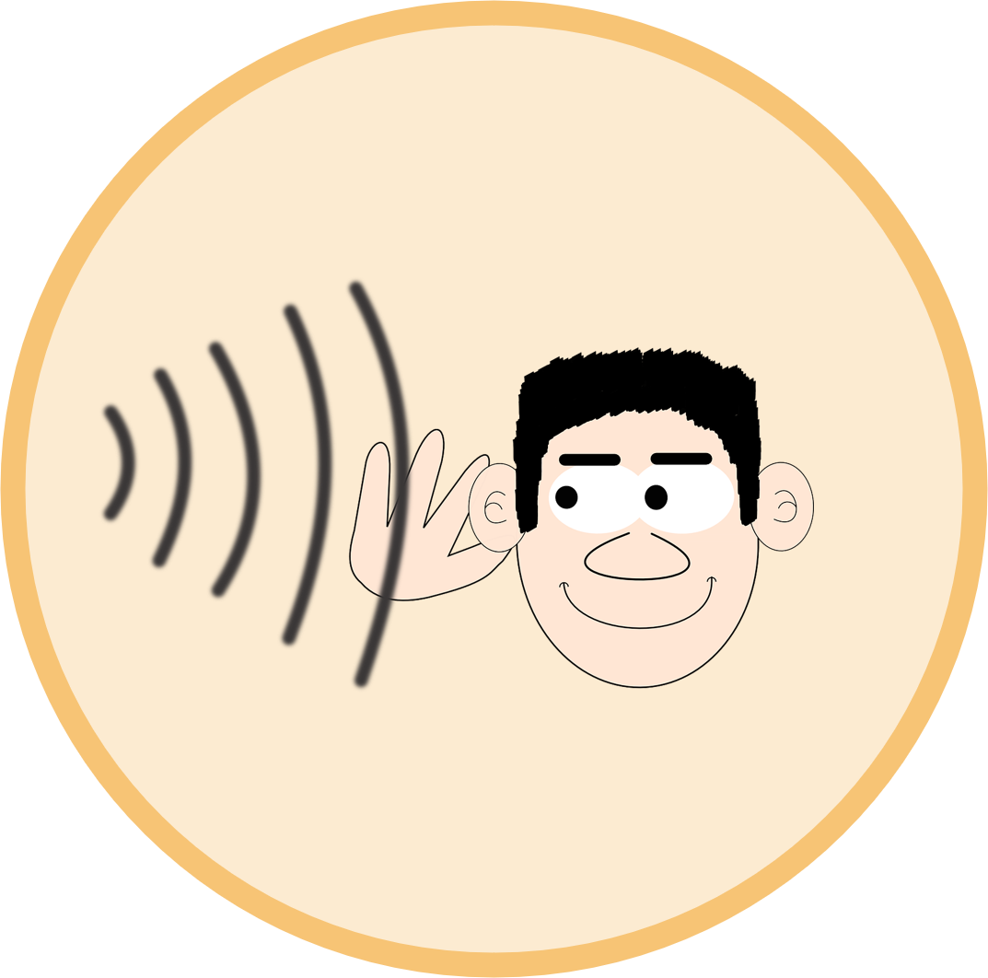
vocabulaire
Vocabulaire
mots
Comment dit-on ça en français ?
écouter
chercher
dessiner
avoir
enseigner
aimer
étudier
parler
être
détester
prononcer
poser
to pronounce, pronouncing
to have, having
to put, ask
to draw, drawing
to teach, teaching
to look for, looking for
to listen, listening
to speak, speaking
to like, liking
to study, studying
to hate, hating
to be, being
Notes:
Timing: 3 minutes
Aim: to practise written recognition and read aloud of 6 previously taught words and 2 new words.
Procedure:
Click for English prompt.
Elicit French from pupils.
Click to confirm.
Repeat with all items.
5

Slide 6
Knowing who does what
It is also the form of a verb you see in a dictionary.
[–er verbs]
We know the infinitive verb tells us the general meaning.
parler
to speak, speaking
To mean ‘I’ ‘you’ or ‘s/he’ with a verb, change the ending to match the pronoun:
Note that parle and parles sound the same because of the Silent Final Consonant.
Je parle français.
I speak French.
Tu parles français.
You speak French.
Il/Elle parle français.
He/She speaks French.
Notes:
Timing: 3 minutes
Aim: to recap 1st and 2nd and 3rd persons singular for –er verbs.
Procedure:
Click through the animations to present the information.
Remind pupils that the verb is never in the long (infinitive) form when used with a pronoun.
Remind them also that the infinitive gives information about the ‘what’, but not about the ‘who’. The information about who comes from the verb ending as well as the pronoun.
Elicit English translations for the French examples provided.

Slide 7
lire
Adèle écrit des messages à Sanaya. Elle décrit des activités à l’école.
C’est Adèle (je) ou Sanaya (tu) ?
1
4
I
Tu étudies beaucoup de choses.
I
Tu prononces bien le français.
you
you
2
5
J’ écoute des chansons en français.
I
Tu dessines des affiches en anglais et français.
I
you
you
3
6
Je pose des questions en classe.
I
J’ enseigne des mots en anglais à mon chat.
I
you
you
Notes:
Timing: 5 minutes
Aim: to practise written comprehension of question and statements.
Procedure:
Pupils write 1-6 and the correct English meaning from the two options given.
Click to reveal answers and elicit full sentence meanings from pupils, orally.
In the audio version, the full sentence answers are heard with the animated ticks.
7

Slide 8
Infinitive verbs
Remember that there are two ways to translate French infinitives into English:
You add ‘de’ to link adjective and verb.
C’est facile de parler français.
It’s easy to speak French.
Parler français, c’est facile !
Speaking French is easy!
Notes:
Timing: 3 minutes
Aim: to recap French infinitive –ER verbs and their two positions and two English translations.
Procedure:
Click through the animations to present the information.
Elicit English translations for the French examples provided.

Slide 9
Two-verb structures
When a sentence has two verbs, the 2nd verb is in infinitive form.
For example, this is how to say ‘I like speaking French’:
Note that when a noun follows aimer or détester, we always need an article in French:
This is the 1st verb.
This is the 2nd verb.
J’aime parler français.
J’aime le français.
I like French.
In English we usually say –ing in two-verb structures.
Je déteste étudier la poésie.
Je déteste la poésie.
I hate studying poetry.
I hate poetry.
Notes:
Timing: 3 minutes
Aim: to introduce two-verb structures with aimer and détester, and contrast these with opinion verbs + noun which require a definite article in French, where none is needed in English.
Procedure:
Click through the animations to present the information.
Elicit English translations for the French examples provided.

Slide 10
lire
Pierre décrit les activités de Max à l’école.
Is it what Max does or his opinion about what he does to learn French? Write 1-7 and A for activity or O+A for opinion + activity.
1
Il pose des questions à un ami.
6
Il cherche des mots en ligne.
A
A
Il écoute des chansons.
7
Il déteste étudier seul.
2
A
O+A
Il déteste dessiner des images.
asks a friend questions
3
O+A
A
listens to songs
looks for words online
Il aime présenter en français.
likes presenting in French
4
likes writing sentences
O+A
O+A
hates drawing pictures
5
Il aime écrire des phrases.
hates studying alone
O+A
O+A
Notes:
Timing: 5 minutes
Aim: to practise distinction between single verb and two-verb structures in form/meaning as well as written comprehension of this week’s vocabulary and a range of previously taught vocabulary.
Procedure:
1. Tell pupils that the dark blue boxes may be hiding a verb or nothing at all. Pupils write 1-7 for each sentence and note A or O+A, paying close attention to the form of the verb following the dark blue box.
2. Elicit the answers from pupils (and whole sentences for additional pronunciation practice)
3. Click to reveal the written answers.
4. In the audio version, click on the numbers to hear the full audio, if desired. Alternatively use it as a listen and check stage.
5. Click to bring up the table. Pupils write 3 x activities in English, and 2 things Max likes and hates doing.
6. Elicit answers and click to confirm.
10

Slide 11
Au revoir !
jaune
Notes:
11

