Slide 1
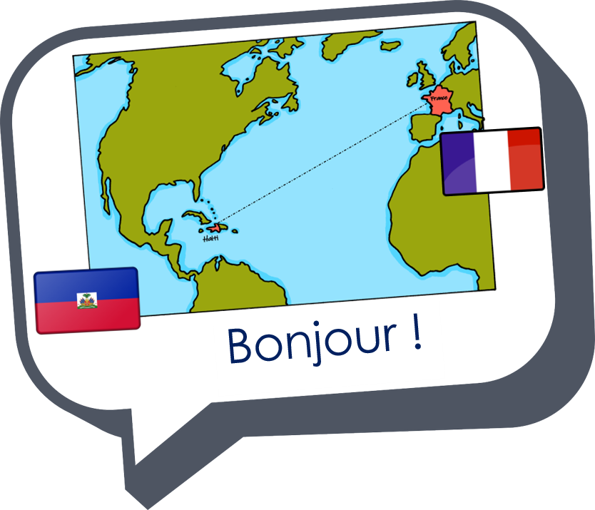

Expressing likes and saying what I and others do
jaune
Follow ups 1-5
Notes:
Artwork by Steve Clarke. Pronoun pictures from NCELP (www.ncelp.org). All additional pictures selected from Pixabay and are available under a Creative Commons license, no attribution required.
Phonics: [-tion] population [509] action [355] situation [223] international [282] solution [608] attention [482]
Vocabulary (new words in bold): détester [2898] écouter [429] écrire [382] étudier [960] lire [278] parler [106]
Revisit 1: chose [125] actif [1219] massif [1760] préféré [597] propre [237] sale [2906] sportif [2670] idéal [1429]
Revisit 2: à (meaning ‘to, at, on, in) [4] arriver [174] montrer [108] rester [100] voyage [904] souvent [287] en ce moment [n/a]
Londsale, D., & Le Bras, Y. (2009). A Frequency Dictionary of French: Core vocabulary for learners London: Routledge.
The frequency rankings for words that occur in this PowerPoint which have been previously introduced in these resources are given in the SOW and in the resources that first introduced and formally re-visited those words.
For any other words that occur incidentally in this PowerPoint, frequency rankings will be provided in the notes field wherever possible.

Slide 2



Follow up 1: C’est [-tion] ou [-ssion] ?
l’intrus – odd one out
Prononce les mots pour ton/ta partenaire.
Il/elle identifie l’intrus.
A
B
 | éducation | passion | situation
 | expression | solution | information
 | tradition | direction | session
The words in this activity are exact cognates, i.e., spelt the same in English.
1
2
3
 | communication | attention |confession
 | définition | compassion | conversation
 | addition | dictionnaire | impression
4
5
6
Notes:
Timing: 3 minutes
Aim: To revisit SSC [-tion] and focus on the identical pronunciation of French words ending in [-ssion].
Procedure:
Introduce the task. Explain that pupil B will turn away from the board, pupil A will pronounce 3 x words and B has to identify the odd one out – the one that has a different spelling from the other two. This relies on pupils’ knowledge of the spelling of these cognates which are identical to their English equivalents.
Pupil Bs turn away. Click for the table of words.
Pupil As pronounce the words. Pupils Bs write down the one they think is the odd one out for all three sets.
Pupil Bs turn back to face the board and the teacher elicits the responses and clicks to confirm.
Repeat steps 2 – 4 with Pupil As.
Use the audio attached to numbered buttons, if required.
Word frequency (1 is the most frequent word in French):
addition [>5000] attention [482] communication [1036] compassion [3699] confession [3878] conversation [1747] définition [1587] dictionnaire [4094] direction [582] éducation [995] expression [952] impression [825] information [317] passion [1866] session [2324] situation [223] solution [68] tradition [1371]
Source: Londsale, D., & Le Bras, Y. (2009). A Frequency Dictionary of French: Core vocabulary for learners London: Routledge.

Slide 3
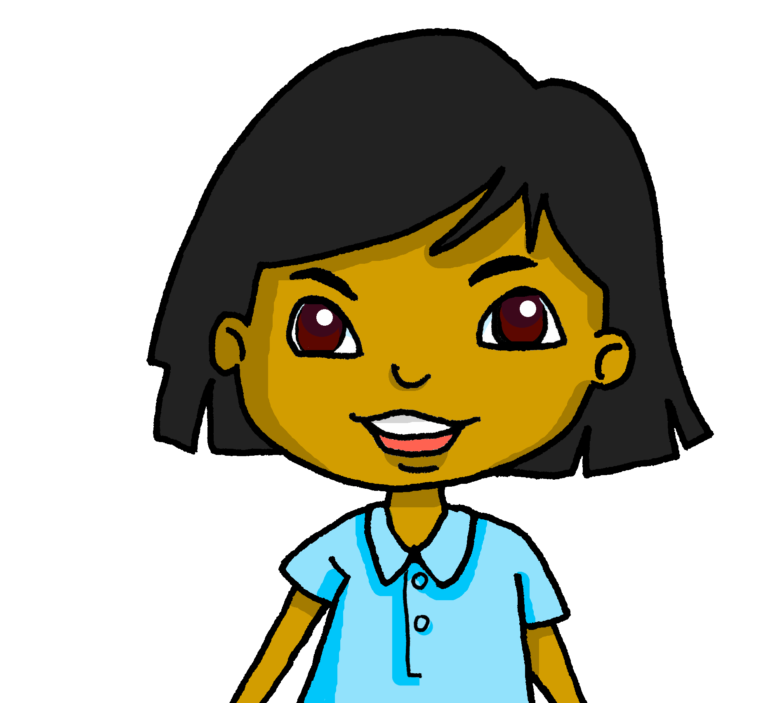


Follow up 2:
Sanaya parle de la classe de français.
Elle aime quoi ? Elle déteste quoi ?
C’est une chose ou une activité ? Écris en anglais.
écouter
 | chose | activité | en anglais
1
2
3
4
1
I like English but I prefer French.
2
I like reading magazines in French.
3
I hate studying for a test.
4
I like speaking with my partner.
5
I hate being scared.
6
I hate the ‘Happy birthday’ song.
Notes:
Timing: 5 minutes
Aim: to practise transcribing the missing vowels in unknown words.
Procedure:
Click to listen to each word.
Listen and write the missing letter(s).
Click to reveal answers.
Transcript:
J’aime l’anglais mais je préfère le français.
J’aime lire des magazines en français.
Je déteste étudier pour un test.
J’aime parler avec ma partenaire.
Je déteste avoir peur.
Je déteste la chanson ‘Joyeux anniversaire’.

Slide 4



Follow up 3
Lis les phrases et écris une phrase correspondante avec ‘aimer’ ou ‘détester’.
lire
C’est facile de parler en français.
J’aime parler en français.
C’est génial d’écouter des chansons en français.
J’aime écouter des chansons en français.
Exemple :
3
[I like speaking in French.]
[I like listening to (some) songs in French.]
écrire
Étudier avec des amis, c’est super !
J’aime étudier avec des amis.
1
4
C’est difficile de poser des questions.
Je déteste poser des questions.
[I like studying with (some) friends.]
[I hate asking questions.]
Chercher des infos en ligne, c’est idéal.
J’aime chercher des infos en ligne.
2
Enseigner des mots à mon chat, c’est drôle !
J’aime enseigner des mots à mon chat.
5
[I like looking for (some) info online.]
[I like teaching words to my cat.]
Notes:
Timing: 8 minutes
Aim: to practise written comprehension of French infinitive phrases and previously taught vocabulary; to practise written production of two-verb structures with aimer/détester.
Procedure:
1. Model the task with the example. Elicit the meaning of the French phrase first. Then elicit suggestions for translating the English sentence into French. Click to reveal.
2. Pupils write phrases 1-5 in their books.
3. Click to check answers.
4. In the audio version, the audio is triggered by the appearance of the French answer. This can work as a listen and check stage, too.

Slide 5





Questions
Remember that moi and toi mean ‘me’ and ‘you’ after prepositions like pour (for):
Pour moi ?
J’ai une carte pour toi, Hugo.
Also use toi in a question:
J’aime parler français. Et toi ?
I like speaking French. And you?
You can use moi in your answer:
Oui, moi aussi.
Yes, me too.
Notes:
Do before Follow up 4
Timing: 2 minutes
Procedure:
Read the grammar explanation about être. Make sure pupils are clear about the s/he/I pictures as these will come up often in future lessons.
Elicit English translation for the French examples provided. This is another opportunity to hear and see two of our new words.
5

Slide 6






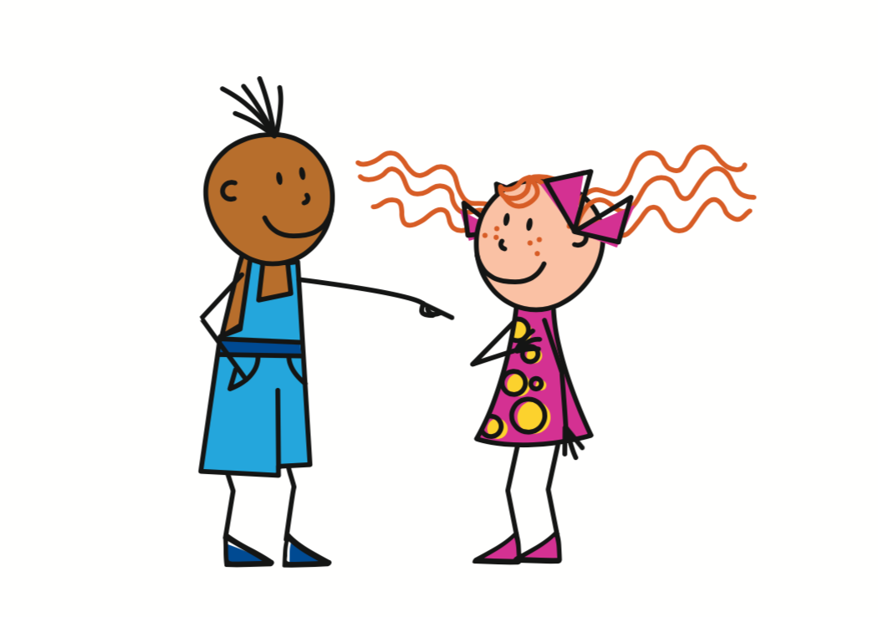





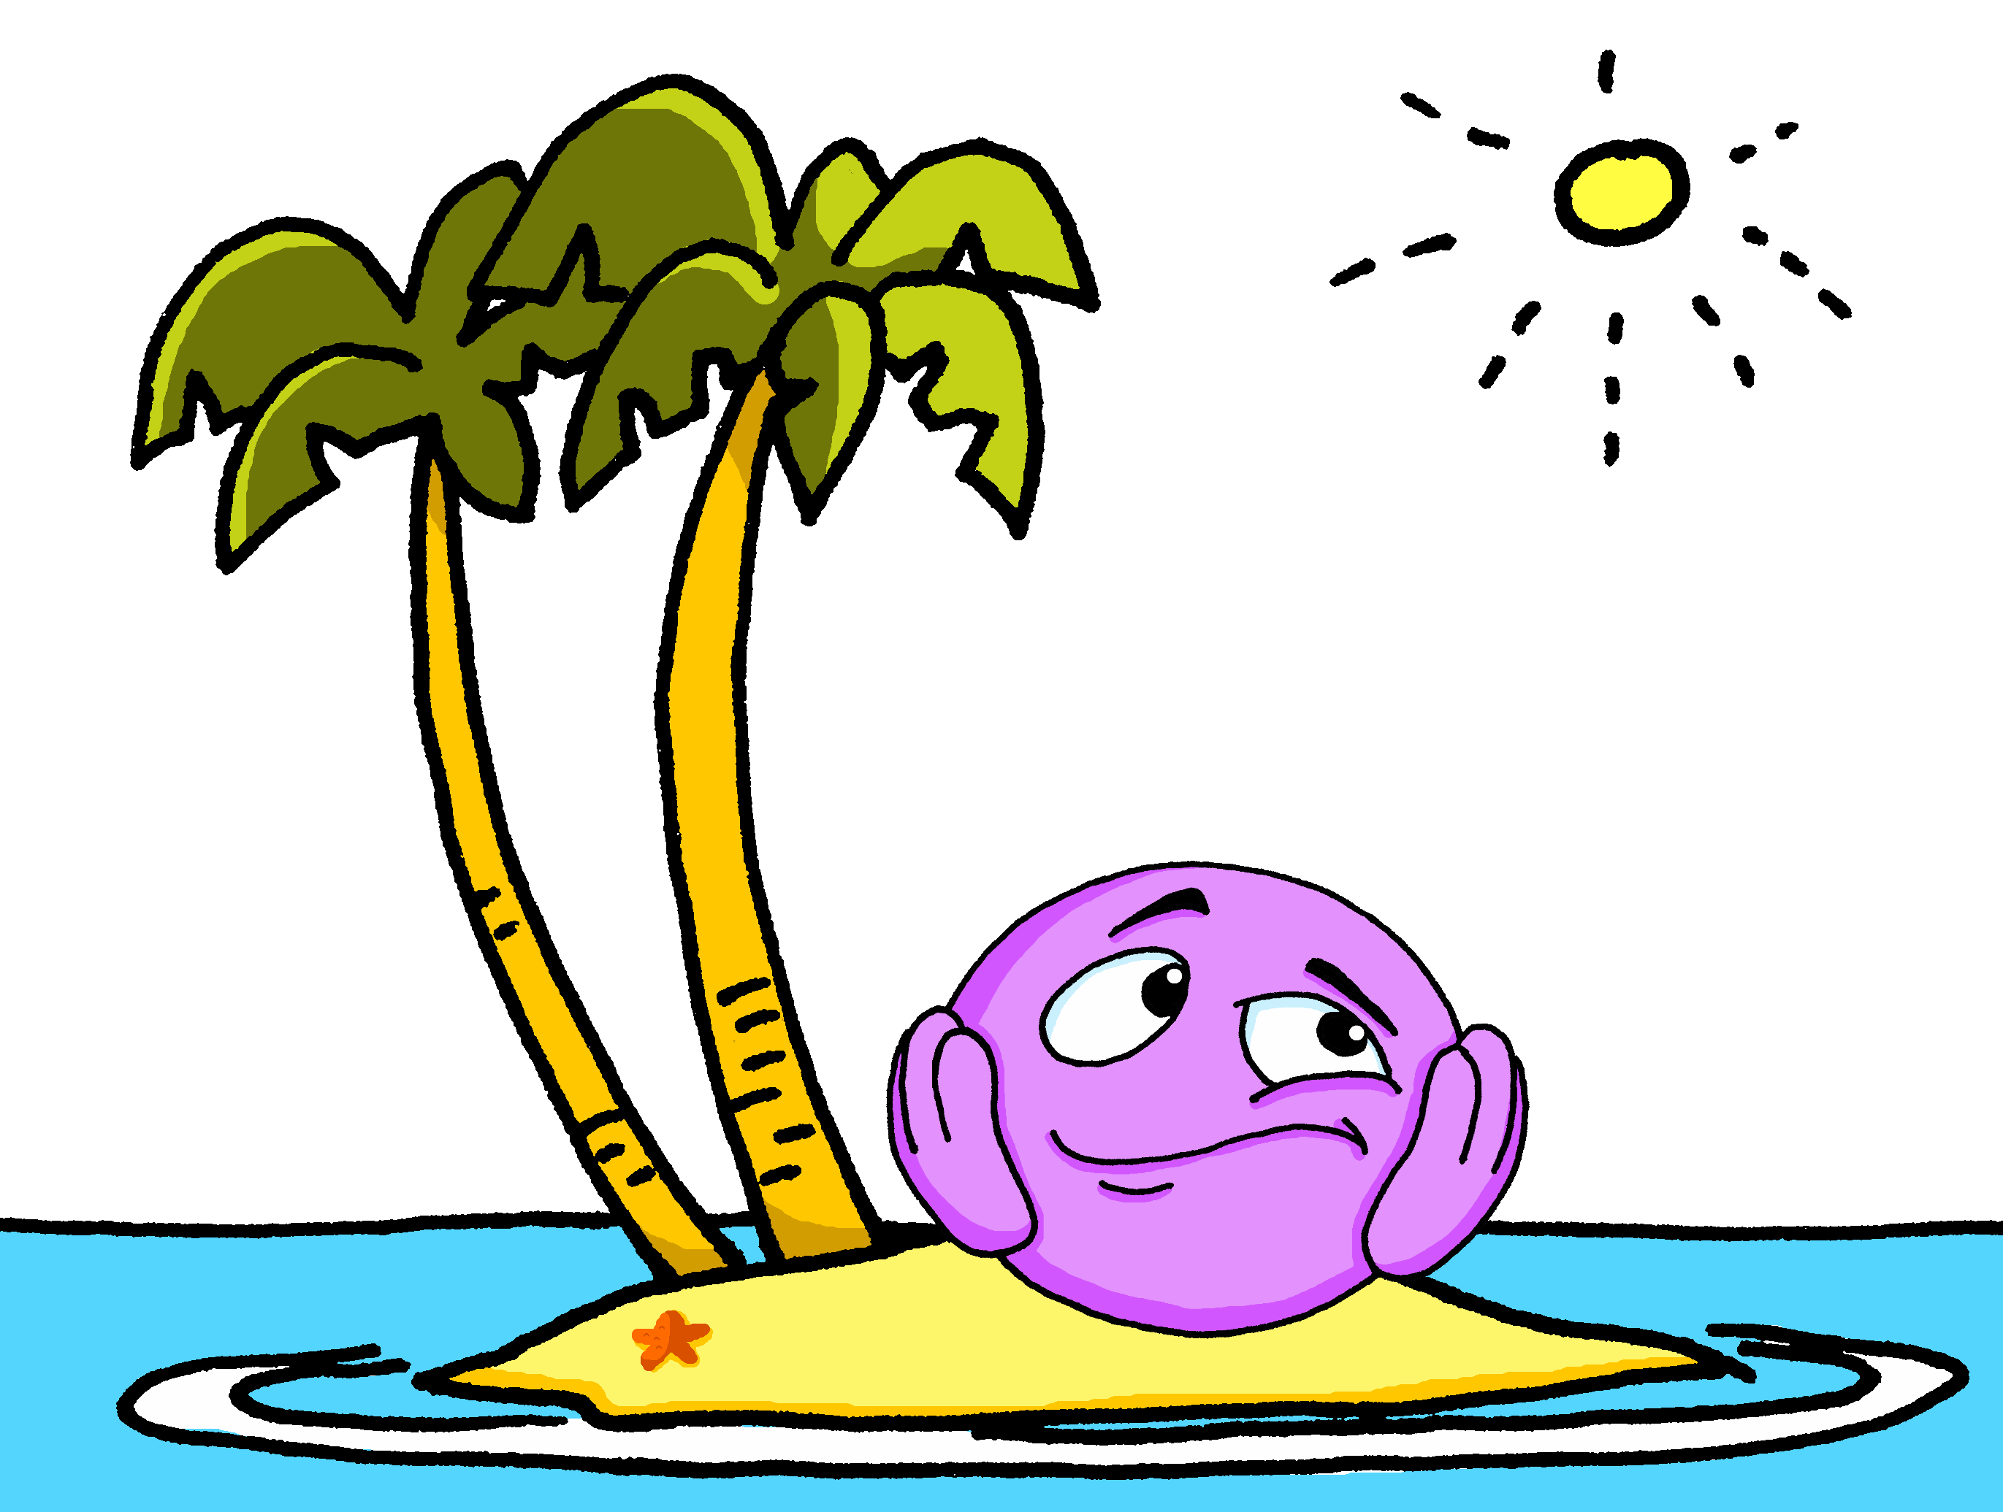

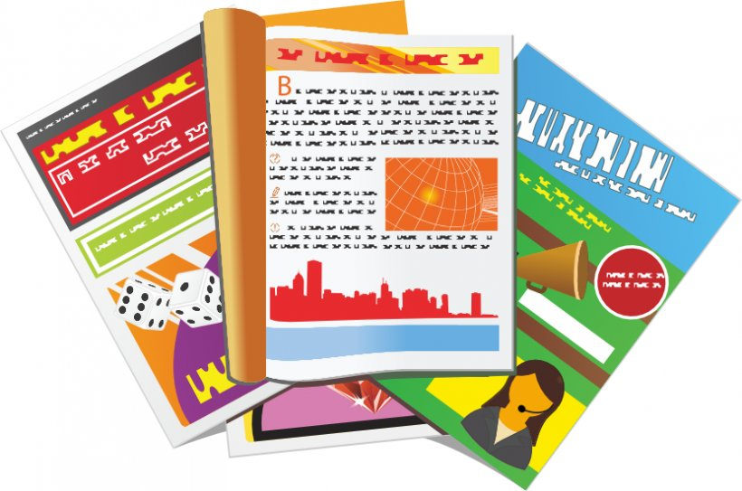






Follow up 4
J’aime écouter des chansons en français. Et toi ?
Oui, moi aussi
(mais je préfère…)
Parle en français.
A
B
parler
1
.
?
2
.
?
3
.
?
4
.
?
alone
words
words
words
?
5
.
?
6
.
online
Notes:
Timing: 5 minutes
Aim: to practise saying what people like/hate doing using two-verb sentences with aimer/détester.
Procedure:
1. Click to bring up the example. The questions are prompted by the pictures, but pupils can answer independently, depending on their own likes/dislikes. They can say: ‘Oui, moi aussi,’ or qualify with something else they prefer, or disagree and say they hate the activity.
2. Pupils take it in turns to start the interaction, until all six prompts have been used.
3. Click the audio buttons to hear sample interactions, if desired.

Slide 7




vocabulaire
Follow up 5- Écris en anglais : Can you get at least 15 points?
mots
 | rester | montrer | le voyage
 | à | en ce moment | souvent
 | sportive | massif | la chose
 | préféré | sale | propre
 | détester | écrire | écouter
 | lire | parler | étudier
to stay, remain
to show, showing
(the) trip, journey
x3
to, at, in, on
at the moment
often
sporty (f)
massive (m)
(the) thing
x2
favourite (m)
dirty (m/f)
clean (m/f)
to hate, hating
to write, writing
to listen, listening
x1
to read, reading
to speak, speaking
to study, studying
Notes:
Timing: 5-10 minutes
Aim: to practise written comprehension of vocabulary from this week and previous weeks.
Procedure:
Give pupils a blank grid. They fill in the English meanings of any of the words they know, trying to reach 15 points in total.
Note:
The most recently learnt and practised words are pink, words from the previous week are green and those from earlier are blue, thus more points are awarded for them, to recognise that memories fade and more effort (heavy lifting!) is needed to retrieve them.
7

Slide 8
Follow up 5:
Écris en français.
mots
 | often | at the moment | to arrive, arriving
 | to remain, stay | to show, showing | (the) trip, journey
 | favourite (f) | (the) thing | dirty
 | clean | sporty (m) | active (f)
 | to write, writing | to speak, speaking | to read, reading
 | to hate, hating | to study, studying | to listen, listening
vocabulaire
souvent
en ce moment
arriver
x3
rester
montrer
le voyage
préférée
la chose
sale
x2
propre
sportif
active
écrire
parler
lire
x1
détester
étudier
écouter
Notes:
Timing: 5-10 minutes
Aim: to practise written comprehension of vocabulary from this week and previous weeks.
Procedure:
Give pupils a blank grid. They fill in the French meanings of any of the words they know, trying to reach 15 points in total.
Note:
The most recently learnt and practised words are pink, words from the previous week are green and those from earlier are blue, thus more points are awarded for them, to recognise that memories fade and more effort (heavy lifting!) is needed to retrieve them.

Slide 9
vocabulaire
Écris en anglais : Can you get at least 15 points?
mots
 | rester | montrer | le voyage
 | à | en ce moment | souvent
 | sportive | massif | la chose
 | préféré | sale | propre
 | détester | écrire | écouter
 | lire | parler | étudier
x3
x2
x1
Notes:
HANDOUT 5a
9

Slide 10
vocabulaire
Écris en français : Can you get at least 15 points?
mots
 | often | at the moment | to arrive, arriving
 | to remain, stay | to show, showing | (the) trip, journey
 | favourite (f) | (the) thing | dirty
 | clean | sporty (m) | active (f)
 | to write, writing | to speak, speaking | to read, reading
 | to hate, hating | to study, studying | to listen, listening
x3
x2
x1
Notes:
HANDOUT 5b
10

