Slide 1
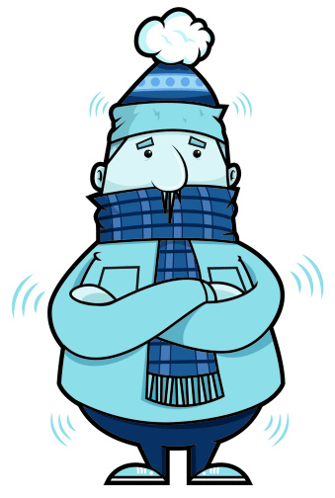
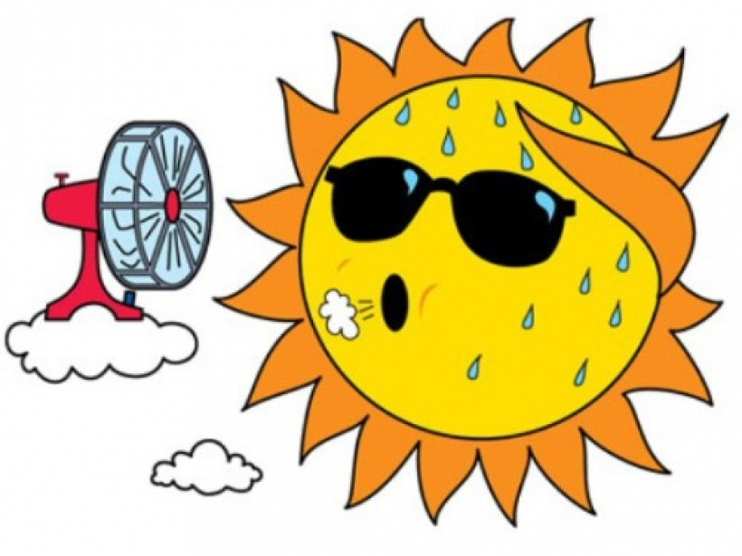
Describing things and people
J’ai froid !
J’ai chaud !
J’ai peur.
jaune
J’ai mal !
« Avoir » meaning ‘be’
SSC [j/soft g]
Notes:
Artwork by Steve Clarke. Pronoun pictures from NCELP (www.ncelp.org). All additional pictures selected from Pixabay and are
available under a Creative Commons license, no attribution required.
The AUDIO version of the lesson material includes additional audio for the new language
presented (phonics, vocabulary) and audio for the instructions on the slide.
In addition, it includes VIDEO clips of the phonics and the phonics’ source words. Pupils can be
encouraged to look at the shape of the mouth/lips on slides where these appear, and try to copy
it/them.
Phonics: [j] (soft g) jour [78] j’ai [8 - avoir] génial [3872] gymnastique [>5000] déjà [58]
Vocabulary: chaud [1852] froid [1307] peur [755] mal [277]
Revisit 1: elle² [38] il² [13] chanson [2142] livre [358] pratique [842] unique [402] utile [1003] comment [234]
Revisit 2: aimer [232] préférer [597] sport [2011] aussi [44] et [6] mais [30]
Londsale, D., & Le Bras, Y. (2009). A Frequency Dictionary of French: Core vocabulary for learners London: Routledge.
The frequency rankings for words that occur in this PowerPoint which have been previously introduced in these resources are given
in the SOW and in the resources that first introduced and formally re-visited those words.
For any other words that occur incidentally in this PowerPoint, frequency rankings will be provided in the notes field wherever
possible.
1

Slide 2
[j/soft g]
prononcer
jour
Notes:
Timing: 1 minute
Aim: To introduce SSC [j/soft g]
Procedure: 1. Present the letter(s) and say the [j/soft g] sound first, on its own. Students repeat it with you. 2. Bring up the word ”jour” on its own, say it, students repeat it, so that they have the opportunity to focus all of their attention on the connection between the written word and its sound.
3. Roll back the animations and work through 1-3 again, but this time, dropping your voice completely to listen carefully to the students saying the [j/soft g] sound, pronouncing ”jour” and, if using, doing the gesture.
Gesture suggestion:
https://www.signbsl.com/sign/day The sign is both palms facing inwards, towards each other, finger tips slightly overlapping – then pulled apart – the motion mimes the break of day with the sun rising.
Word frequency (1 is the most frequent word in French):
jour [78].
Source: Londsale, D., & Le Bras, Y. (2009). A Frequency Dictionary of French: Core vocabulary for learners London: Routledge.
2

Slide 3
[j/soft g]
⚠ [g] before a, o, u is a hard [g] sound. Before e and i, [g] is soft and sounds the same as [j].
prononcer
I have
j’ai
génial
jour
déjà
gymnastique
Notes:
Timing: 2 minutes
Aim: To introduce SSC [j/soft g]
Procedure:
1. Introduce and elicit the pronunciation of the individual SSC [j/soft g] and then the source word again ‘jour’ (with gesture, if using). 2. Then present and elicit the pronunciation of the four cluster words.
The cluster words have been chosen for their high-frequency, from a range of word classes, with the SSC (where possible) positioned within a variety of syllables within the words (e.g. initial, 2nd, final etc.). Additionally, we have tried to use words that build cumulatively on previously taught SSCs (see the Phonics Teaching Sequence document) and do not include new SSCs. Where new SSCs are used, they are often consonants which have a similar symbol-sound correspondence in English.
Word frequency: jour [78] j’ai [8 - avoir] génial [3872] gymnastique [>5000] déjà [58]
Source: Londsale, D., & Le Bras, Y. (2009). A Frequency Dictionary of French: Core vocabulary for learners London: Routledge.
3

Slide 4
écouter
Madame Vidal fait l’appel*.
fait l’appel – calls the register
Écoute. C’est [j]/soft [g] ou hard [g] ?
 | George
 | Gérard
 | Margot
 | Angélique
 | Juliette
 | Garice
 | Gaelle
[j, soft [g]] | [g]
Prononce les noms.
Ex
⚠ [g] before a, o, u is a hard [g] sound. Before e and i, [g] is soft and sounds the same as [j].
1
2
3
4
5
6
Notes:
Timing: 5 minutes
Aim: to consolidate [j, soft g] and [g].
Procedure:
Pupils write 1-6 and the two column headers.
Click to listen to the example.
Pupils decide which SSC they hear.
Click to reveal the answer and the name. Pupils pronoun the name.
Complete steps 1-4 for items 1-6.
Pupils then pronounce all the names again, in pairs.
Transcript: George
Gérard Margot
Angélique
Juliette
Garice
Gaelle
4

Slide 5
Avoir not être
You know that avoir means ‘to have, having’:
J’ai un livre.
I have a book.
Elle a une chanson.
She has a song.
In French, we sometimes also use avoir to mean ‘to be, being’:
J’ai froid.
I am cold.
⚠ These literally mean: I have cold. You have hot. He has fear. She has pain/ache/hurt.
Tu as chaud.
You are hot.
Il a peur.
He is scared.
Elle a mal.
She is in pain.
Notes:
Timing: 2 minutes
Aim: to present new uses of avoir expressions meaning ‘be’.
Procedure: 1. Click to present the information.
2. Elicit responses from pupils, following the animated question marks.

Slide 6
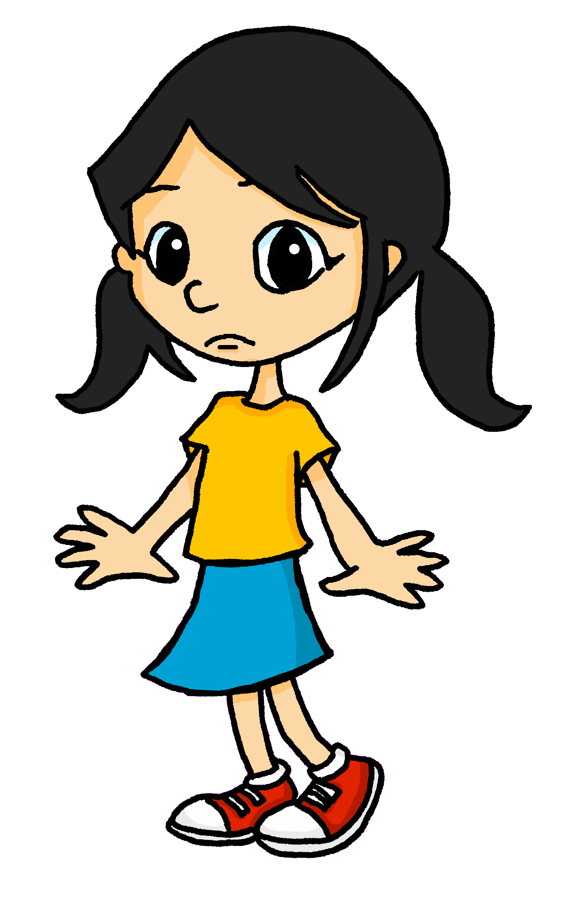
lire
Lis les phrases. Le mot correct, c’est quoi ?
1
Aujourd’hui, je reste au lit. J’ai mal !
2
En décembre et janvier, j’ai froid.
____ !
____.
En octobre, c’est l’ Halloween et j’ai peur.
Mon amie Juliette est absente. Elle a mal à la tête.
3
4
____.
___
Mon ami Gérard est courageux mais moi, j’ai peur.
5
En aout, je suis en France et j’ai chaud.
6
____.
____.
peur | mal | chaud | peur | froid | mal
Notes:
Timing: 5 minutes
Aim: to consolidate written comprehension of this week’s vocabulary and a range of previously taught vocabulary.
Procedure:
1. Pupils write 1-6 for each speech bubble they note the missing word.
2. Elicit the answers from pupils (for additional pronunciation practice)
3. Click to reveal the written answers.
4. Click on the speech bubble to hear the full audio, if desired. Alternatively use it as a listen and check stage.
6

Slide 7
écouter
Écoute. L’option correcte, c’est quoi ?
1
mal | livre | I have a book.
chaud | chaise | I am hot.
froid | idée | I have an idea.
main | mal | I am in pain/feeling bad.
peur | chanson | I have a song.
chat | chaud | I have a cat.
crayon | froid | I am cold.
peur | porte | I am scared.
____________________________________
2
____________________________________
3
____________________________________
4
____________________________________
5
____________________________________
6
____________________________________
7
____________________________________
8
____________________________________
Notes:
Timing: 10 minutes
Aim: to practise aural distinction between avoir + noun (with article) and avoir meaning ‘be’ with no article.
Procedure:
Pupils write 1-8.
They listen to each sentence and decide which word completes it, based on the presence or absence of an article.
They then either write or feed back orally the meaning of the sentence.
Click to reveal the correct end to the sentence and the English meaning.
Transcript:
J’ai un [livre].
J’ai [chaud].
J’ai une [idée].
J’ai [mal].
J’ai une [chanson].
J’ai un [chat].
J’ai [froid].
J’ai [peur].
7

Slide 8
Avoir mal
You know that avoir mal means ‘to be in pain’:
J’ai mal.
I am in pain.
Elle a mal.
She is in pain.
We can add a noun to say what hurts.
J’ai mal à la tête.
I have a headache.
Tu as mal à la bouche.
You have mouthache.
⚠ These literally mean: I have ache in the head.
I have pain in the mouth.
I have ache in the ear.
I have pain in the foot.
Il a mal à l’oreille.
He has an earache.
Elle a mal au pied.
She has a pain in the foot.
⚠ à + le → au
Notes:
Timing: 2 minutes
Aim: to present a further use of avoir mal to say what hurts.
Procedure: 1. Click to present the information.
2. Elicit responses from pupils, following the animated question marks.

Slide 9
écouter
Aujourd’hui, Eugénie a mal.
Écoute. Écris 1-6 le problème en anglais.
 | anglais
Ex
earache
1
sore hand
2
headache
3
mouthache / sore mouth
4
eyeache / sore eye
5
pain in the foot / sore foot
6
in pain
Notes:
Timing: 6 minutes
Aim: to practise aural recognition of previously taught parts of the body in the new context of saying what hurts.
Procedure:
Click to play audio.
Pupils write what hurts in English.
Click to correct.
Repeat for items 1-6.
Elicit and click to check answers.
Transcript:
J’ai mal à l’oreille.
J’ai mal à la main.
J’ai mal à la tête.
J’ai mal à la bouche.
J’ai mal à l’œil.
J’ai mal au pied.
Aïe ! J’ai mal !
9

Slide 10
Au revoir !
jaune
Notes:
10

