Slide 1
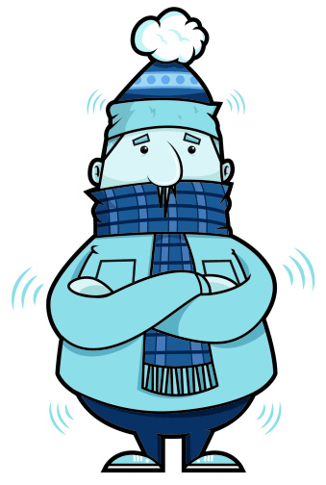
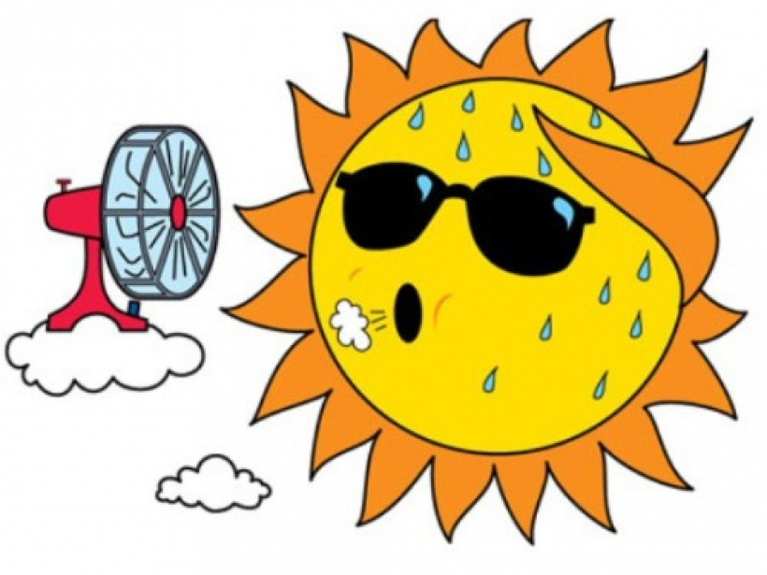
Describing things and people
J’ai froid !
J’ai chaud !
J’ai peur.
jaune
J’ai mal !
Follow ups 1-5
Notes:
Artwork by Steve Clarke. Pronoun pictures from NCELP (www.ncelp.org). All additional pictures selected from Pixabay and are
available under a Creative Commons license, no attribution required.
The AUDIO version of the lesson material includes additional audio for the new language
presented (phonics, vocabulary) and audio for the instructions on the slide.
In addition, it includes VIDEO clips of the phonics and the phonics’ source words. Pupils can be
encouraged to look at the shape of the mouth/lips on slides where these appear, and try to copy
it/them.
Phonics: [j] (soft g) jour [78] j’ai [8 - avoir] génial [3872] gymnastique [>5000] déjà [58]
Vocabulary: chaud [1852] froid [1307] peur [755] mal [277]
Revisit 1: elle² [38] il² [13] chanson [2142] livre [358] pratique [842] unique [402] utile [1003] comment [234]
Revisit 2: aimer [232] préférer [597] sport [2011] aussi [44] et [6] mais [30]
Londsale, D., & Le Bras, Y. (2009). A Frequency Dictionary of French: Core vocabulary for learners London: Routledge.
The frequency rankings for words that occur in this PowerPoint which have been previously introduced in these resources are given in the SOW and in the resources that first introduced and formally re-visited those words.
For any other words that occur incidentally in this PowerPoint, frequency rankings will be provided in the notes field wherever possible.

Slide 2
[j/soft g]
prononcer
jour
Notes:
Timing: 1 minute
Aim: To introduce SSC [j/soft g]
Procedure: 1. Present the letter(s) and say the [j/soft g] sound first, on its own. Students repeat it with you. 2. Bring up the word ”jour” on its own, say it, students repeat it, so that they have the opportunity to focus all of their attention on the connection between the written word and its sound.
3. Roll back the animations and work through 1-3 again, but this time, dropping your voice completely to listen carefully to the students saying the [j/soft g] sound, pronouncing ”jour” and, if using, doing the gesture.
Gesture suggestion:
https://www.signbsl.com/sign/day The sign is both palms facing inwards, towards each other, finger tips slightly overlapping – then pulled apart – the motion mimes the break of day with the sun rising.
Word frequency (1 is the most frequent word in French):
jour [78].
Source: Londsale, D., & Le Bras, Y. (2009). A Frequency Dictionary of French: Core vocabulary for learners London: Routledge.
2

Slide 3
[j/soft g]
⚠ [g] before a, o, u is a hard [g] sound. Before e and i, [g] is soft and sounds the same as [j].
prononcer
I have
j’ai
génial
jour
déjà
gymnastique
Notes:
Timing: 2 minutes
Aim: To introduce SSC [j/soft g]
Procedure:
1. Introduce and elicit the pronunciation of the individual SSC [j/soft g] and then the source word again ‘jour’ (with gesture, if using). 2. Then present and elicit the pronunciation of the four cluster words.
The cluster words have been chosen for their high-frequency, from a range of word classes, with the SSC (where possible) positioned within a variety of syllables within the words (e.g. initial, 2nd, final etc.). Additionally, we have tried to use words that build cumulatively on previously taught SSCs (see the Phonics Teaching Sequence document) and do not include new SSCs. Where new SSCs are used, they are often consonants which have a similar symbol-sound correspondence in English.
Word frequency: jour [78] j’ai [8 - avoir] génial [3872] gymnastique [>5000] déjà [58]
Source: Londsale, D., & Le Bras, Y. (2009). A Frequency Dictionary of French: Core vocabulary for learners London: Routledge.
3

Slide 4
Follow up 1a:
Prononce les mots avec [j, soft g].
Personne A parle. 🗣
Personne B écoute et coche. 📝✅
voyage
jeudi
magazine
organiser
intelligent
génial
image
anglais
message
Notes:
Timing: 5 minutes [2 slides]
Aim: To practise the pronunciation of previously taught words with the SSC [j, soft g].
Procedure:
Pupils will work in pairs to practise and recognise correct pronunciation.
Divide the class in A & B before explaining the task.
Click to bring up the instruction in French. Pupil A reads the words aloud and pupil B checks their pronunciation. There are 9 words in total.
NB. There is a handout at the end of the presentation or pupils can simply write 1-9 in their books and tick or cross.
Click once to make the fish appear (This animation is timed - don’t click again until all words have appeared). Pupil A pronounces ONLY the words that have [j, soft g]. They should leave 3 x words unpronounced.
Pupil B turns their back to the board, listens and ticks the words pronounced correctly.
Move to next slide for Personne B’s turn.

Slide 5
Follow up 1a:
Prononce les mots avec [j, soft g].
Personne B parle. 🗣
Personne A écoute et coche. 📝✅
joli
groupe
courageux
négatif
gymnastique
janvier
aujourd’hui
orange
grand
Notes:
[2/2]

Slide 6
Handout 1
Personne A écoute et coche. 📝✅
Personne B écoute et coche. 📝✅
joli
2. groupe
3. courageux
4. négatif
5. gymnastique
6. janvier
7. aujourd’hui
8. orange
9. grand
1. voyage
2. jeudi
3. magazine
4. organiser
5. intelligent
6. génial
7. image
8. anglais
9. message
Note: Your partner should not read aloud groupe, négatif or grand because they have the hard [g] sound.
Note: Your partner should not read aloud magazine, organiser or anglais because they have the hard [g] sound.
Notes:
HANDOUT to use for the answers, too.

Slide 7
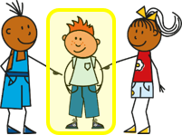
Follow up 2
Écoute. Écris le numéro correspondant pour chaque image.
écouter
1
2
3
4
5
6
7
8
9
E
I
D
F
A
H
L
G
J
A | B | C | D
E | F | G | H
I | J | K | L
Notes:
Timing: 5 minutes
Aim: to practise recognition of the newly learnt expressions with ‘avoir’ in the oral modality.
Procedure:
Click on the numbers to play the audio.
Pupils write 1 = A etc… (To challenge learners, there are three pictures too many, and some of the activities appear twice but with different parts of avoir).
Click to provide answers.
Transcript:
Tu as chaud. Il a froid. J’ai mal. Elle a mal au pied.
Tu as peur. J’ai mal à l’oreille.
Il a chaud. Tu as froid. Elle a mal à la main.
Note: If it is too challenging for pupils to listen out for the person AND the avoir expression, then use the version of the activity on the next slide.

Slide 8
Follow up 2 (alternative)
Écoute. Écris le numéro correspondant pour chaque image.
écouter
1
2
3
4
5
6
7
8
9
E
I
D
F
A
H
B
G
C
A | B | C
D | E | F
G | H | I
Notes:
Timing: 5 minutes
Aim: to practise recognition of the newly learnt expressions with ‘avoir’ in the oral modality.
Procedure:
Click on the numbers to play the audio.
Pupils write 1 = A etc… (To challenge learners, there are three pictures too many, and some of the activities appear twice but with different parts of avoir).
Click to provide answers.
Transcript:
Tu as chaud. Il a mal à l’œil.
J’ai mal. Elle a mal au pied.
Tu as peur. J’ai mal à l’oreille.
Il a mal à la main.
Tu as froid. Elle a mal à la tête.
Note: If it is too challenging for pupils to listen out for the person AND the avoir expression, then use the version of the activity on the next slide.

Slide 9
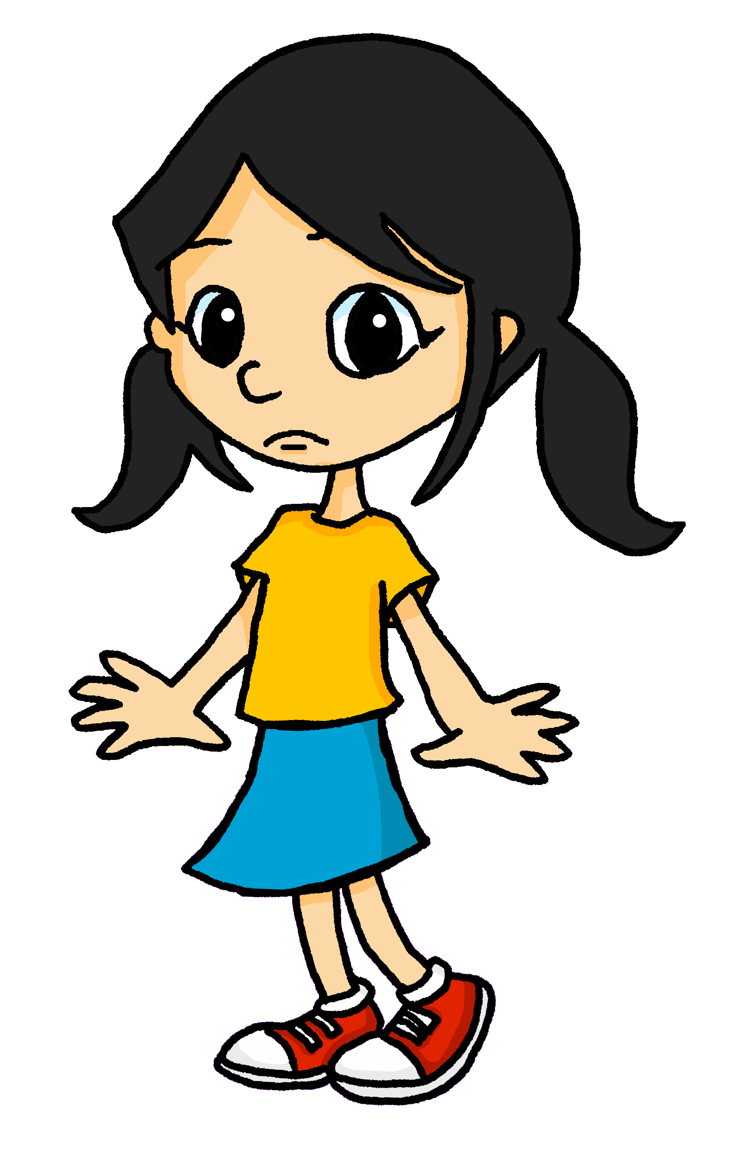
Follow up 3
.
Avoir ou être ? Écris le verbe correct.
.
Aujourd’hui…
1. Je suis heureuse.
écrire
lire
___
2. Je suis à l’école.
___
Mais mon ami…
3. est absent.
___
4. Il a mal.
___
5. Il a chaud.
___
6. Il a mal à la tête.
___
Et mon amie…
7. est très sérieuse.
___
8. Elle a peur.
___
Notes:
Timing: 5 minutes
Aim: to practise written production singular persons of avoir and être, selecting the right verb each time, according to the surrounding words.
Procedure:
Teachers read the instruction and clarify the meaning.
Pupils number 1 – 8 and write the correct verb each time.
Click to elicit from pupils and correct.
Elicit the meanings of the full sentences from pupils.

Slide 10
Follow up 4:
.
Parle avec ton/ta partenaire.
Listen to Eugénie. Then pretend to be her and tell your partner everything you’re feeling!
parler
60
S
0
une araignée – a spider
DÉBUT
Notes:
Timing: 5 minutes
Aim: to practise oral production of all of the avoir expressions from this week, together with previously taught parts of the body.
Procedure: 1. Click on Eugénie to hear her describe how she is feeling and the picture prompts to support the audio meaning.
2. Pupils then take it in turns to say each of the phrases, trying to say all 9 phrases within the 60 seconds. 3. If time allows pupils should repeat the task, with the other pupil starting first so that they both practise productive recall of all the language.
Transcript:
Aïe ! Aujourd’hui, j’ai mal ! J’ai chaud. J’ai froid. J’ai mal à la tête. J’ai mal à l’œil. J’ai mal à la bouche. J’ai mal à la main. J’ai mal au pied. En ce moment, je regarde une araignée et j’ai peur !

Slide 11
vocabulaire
Follow up 5 - Écris en anglais : Can you get at least 15 points?
mots
 | et | préférer | aimer
 | mais | le sport | aussi
 | utile | la chanson | elle
 | pratique | comment ? | il
 | tu as | le mal | elle a
 | la peur | froid | chaud
and
to prefer, preferring
to like, liking
x3
but
(the) sport
also, too
utile
(the) song
she, it
x2
practical
how ?
he, it
you have
(the) pain, ache
she has
x1
(the) fear
cold
hot
Notes:
Note: bleu and rouge are officially new words this week. They have not been explicitly practised yet, but pupils have seen rouge every week on the lesson title slide, and bleu is similar to blue, so it is anticipated that pupils may be fine with these, following this practice in Follow up 4.
Timing: 5-10 minutes
Aim: to practise written comprehension of vocabulary from this week and previous weeks.
Procedure: Give pupils a blank grid. They fill in the English meanings of any of the words they know, trying to reach 15 points in total.
Note: The most recently learnt and practised words are pink, words from the previous week are green and those from earlier are blue, thus more points are awarded for them, to recognise that memories fade and more effort (heavy lifting!) is needed to retrieve them.
11

Slide 12
Follow up 5
Écris en français : Can you get at least 15 points?
mots
 | (the) sport | also | and
 | to like, liking | to prefer, preferring | but
 | she, it | how? | practical
 | (the) song | useful | he, it
 | (the) ache, pain | cold | I have
 | (the) fear | he has | hot
vocabulaire
le sport
aussi
et
x3
aimer
préférer
mais
elle
comment ?
pratique
x2
la chanson
utile
il
le mal
froid
j’ai
x1
la peur
il a
chaud
Notes:
Timing: 5-10 minutes
Aim: to practise written comprehension of vocabulary from this week and previous weeks.
Procedure: Give pupils a blank grid. They fill in the French meanings of any of the words they know, trying to reach 15 points in total.
Note: The most recently learnt and practised words are pink, words from the previous week are green and those from earlier are blue, thus more points are awarded for them, to recognise that memories fade and more effort (heavy lifting!) is needed to retrieve them.

Slide 13
Handout 1
Personne A écoute et coche. 📝✅
Personne B écoute et coche. 📝✅
joli
2. groupe
3. courageux
4. négatif
5. gymnastique
6. janvier
7. aujourd’hui
8. orange
9. grand
1. voyage
2. jeudi
3. magazine
4. organiser
5. intelligent
6. génial
7. image
8. anglais
9. message
Note: Your partner should not read aloud groupe, négatif or grand because they have the hard [g] sound.
Note: Your partner should not read aloud magazine, organiser or anglais because they have the hard [g] sound.
Notes:
HANDOUT

Slide 14
vocabulaire
Follow up 5 - Écris en anglais : Can you get at least 15 points?
mots
 | et | préférer | aimer
 | mais | le sport | aussi
 | utile | la chanson | elle
 | pratique | comment ? | il
 | tu as | le mal | elle a
 | la peur | froid | chaud
x3
x2
x1
Notes:
HANDOUT
14

Slide 15
Follow up 5
Écris en français : Can you get at least 15 points?
mots
 | (the) sport | also | and
 | to like, liking | to prefer, preferring | but
 | she, it | how? | practical
 | (the) song | useful | he, it
 | (the) ache, pain | cold | I have
 | (the) fear | he has | hot
vocabulaire
x3
x2
x1
Notes:
HANDOUT

