Slide 1
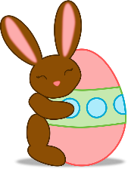
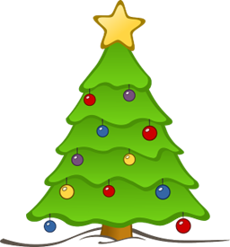
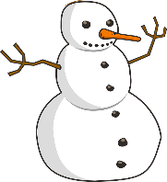
Describing things and people
jaune
C’est quand, ton anniversaire ?
SSC [qu]
Notes:
Artwork by Steve Clarke. Pronoun pictures from NCELP (www.ncelp.org). All additional pictures selected from Pixabay and are
available under a Creative Commons license, no attribution required.
The AUDIO version of the lesson material includes additional audio for the new language
presented (phonics, vocabulary) and audio for the instructions on the slide.
In addition, it includes VIDEO clips of the phonics and the phonics’ source words. Pupils can be
encouraged to look at the shape of the mouth/lips on slides where these appear, and try to copy
it/them.
Phonics: [qu] question [144] quatre [283] musique [1139] expliquer [252] unique [402]
Vocabulary: mois [179] janvier [939] février [1139] mars [868] avril [1022] mai [943] juin [931] juillet [1326] aout [1445] septembre [944] octobre [826] novembre [982] décembre [891] quand [119] anniversaire [2043] en [7]
Revisit 1: groupe [187] liste [924] personne [84] très [66] beaucoup (de) [150]
Revisit 2: jouer [219] ami, amie [467] en ligne [n/a] dehors [1217] mon, ma [60] ton, ta [330] voici [1103]
Londsale, D., & Le Bras, Y. (2009). A Frequency Dictionary of French: Core vocabulary for learners London: Routledge.
The frequency rankings for words that occur in this PowerPoint which have been previously introduced in these resources are given
in the SOW and in the resources that first introduced and formally re-visited those words.
For any other words that occur incidentally in this PowerPoint, frequency rankings will be provided in the notes field wherever
possible.
1

Slide 2
[qu]
prononcer
question
Notes:
Timing: 1 minute
Aim: To introduce SSC [qu]
Procedure: 1. Present the letter(s) and say the [qu] sound first, on its own. Students repeat it with you. 2. Bring up the word ”question” on its own, say it, students repeat it, so that they have the opportunity to focus all of their attention on the connection between the written word and its sound.
3. Say the word and do the gesture, if using.
4. Roll back the animations and work through 1-3 again, but this time, dropping your voice completely to listen carefully to the students saying the [qu] sound, pronouncing ”question” and, if using, doing the gesture.
Gesture: https://www.signbsl.com/sign/question
The 2nd video from the left – trace the shape of a question mark in the air
Word frequency (1 is the most frequent word in French):
question [144]
Source: Londsale, D., & Le Bras, Y. (2009). A Frequency Dictionary of French: Core vocabulary for learners London: Routledge.
2

Slide 3
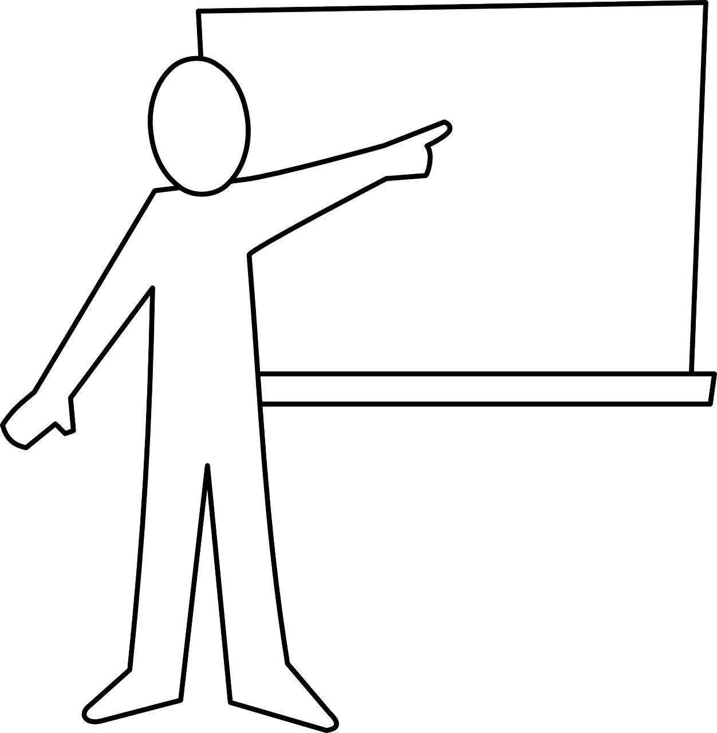
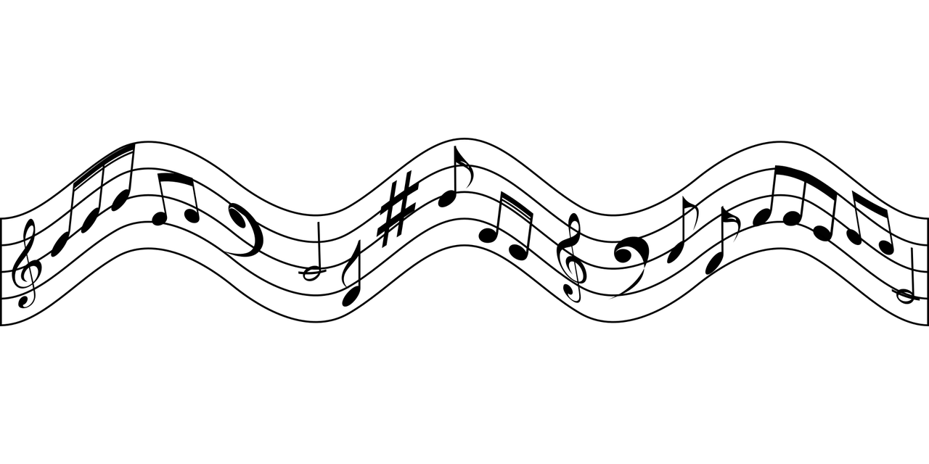
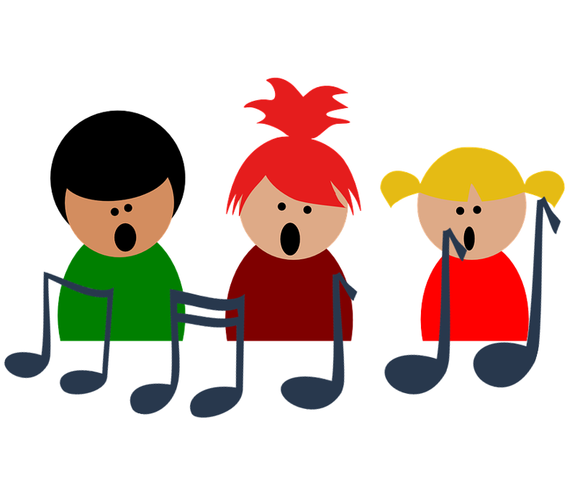
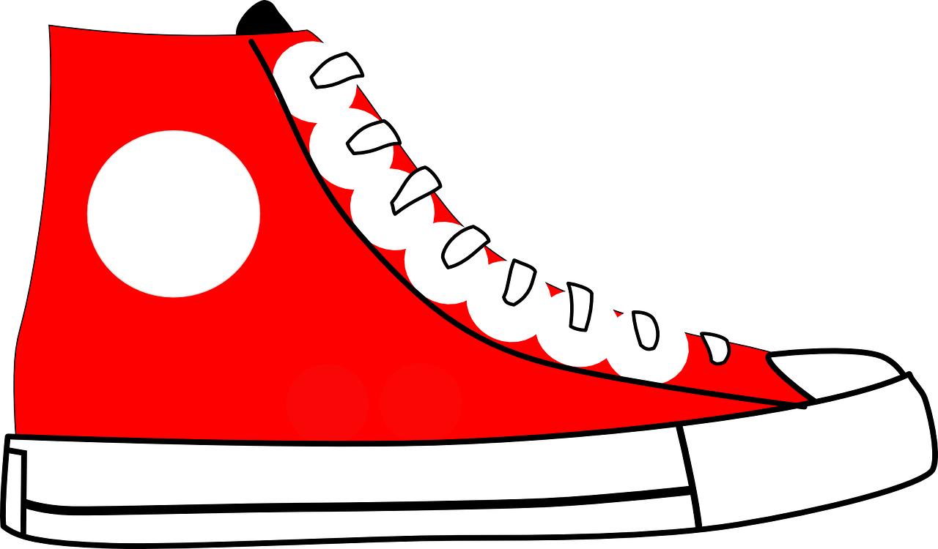
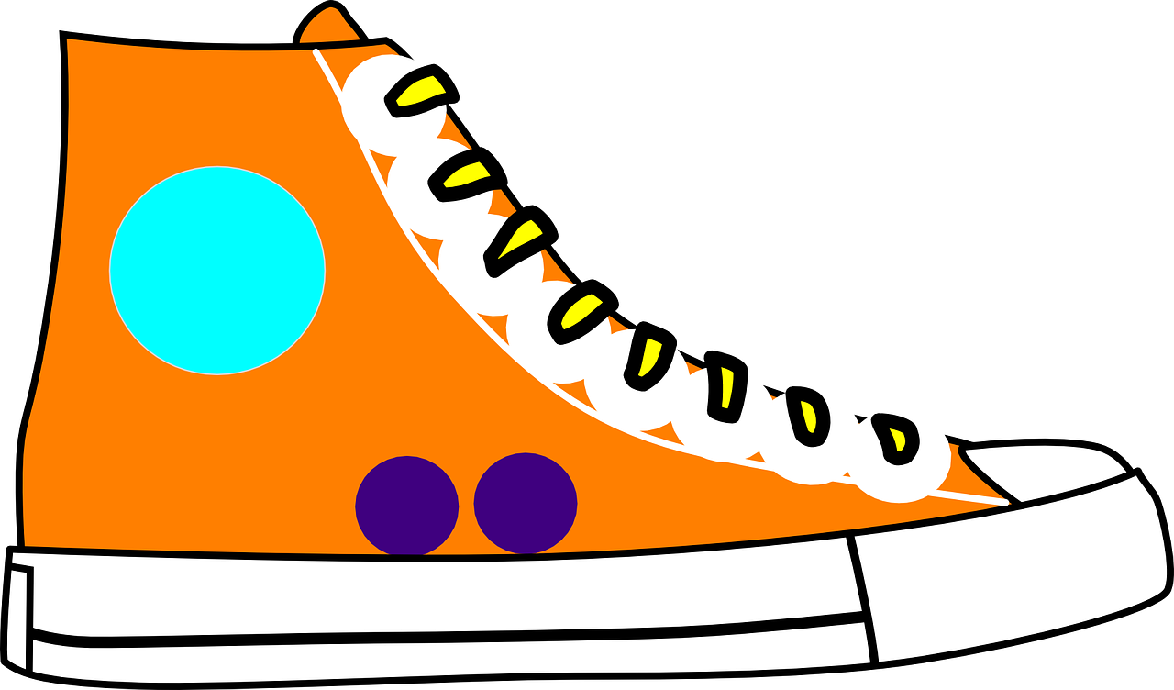
[qu]
prononcer
to explain
quatre
expliquer
question
musique
unique
Notes:
Timing: 2 minutes
Aim: To introduce SSC [qu]
Procedure:
1. Introduce and elicit the pronunciation of the individual SSC [qu] and then the source word again ‘question’ (with gesture, if using). 2. Then present and elicit the pronunciation of the four cluster words.
The cluster words have been chosen for their high-frequency, from a range of word classes, with the SSC (where possible) positioned within a variety of syllables within the words (e.g. initial, 2nd, final etc.). Additionally, we have tried to use words that build cumulatively on previously taught SSCs (see the Phonics Teaching Sequence document) and do not include new SSCs. Where new SSCs are used, they are often consonants which have a similar symbol-sound correspondence in English.
Word frequency: quatre [283] musique [1139] expliquer [252] unique [402] question [144] Source: Londsale, D., & Le Bras, Y. (2009). A Frequency Dictionary of French: Core vocabulary for learners London: Routledge.
3

Slide 4
prononcer
Écoute. Il y a combien de [qu] dans chaque phrase ?
1
///
Dominique a quatre questions.
2
//
Jacques préfère la musique pop.
3
///
Qui est Véronique ? Elle est unique.
4
////
Monique pratique la gymnastique chaque jour.
5
//
Madame Jaquet aime la pétanque.
Notes:
Timing: 5 minutes
Aim: to consolidate SSC [qu].
Procedure:
Pupils write 1-5.
Click to listen.
Pupils tally the number of [qu] they hear in each sentence.
Click to reveal the answers.
Transcript:
1. Dominique a quatre questions. 2. Jacques préfère la musique pop.
3. Qui est Véronique ? Elle est unique.
4. Monique pratique la gymnastique chaque jour.
5. Madame Jaquet aime la pétanque.
4

Slide 5
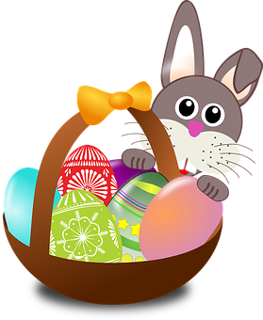
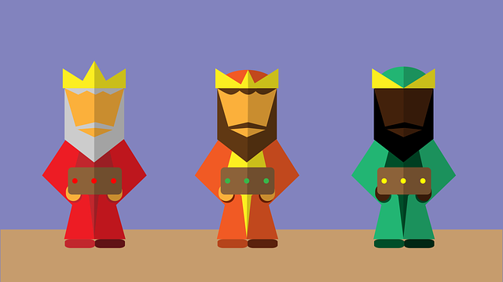
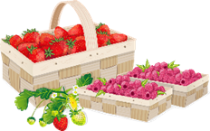
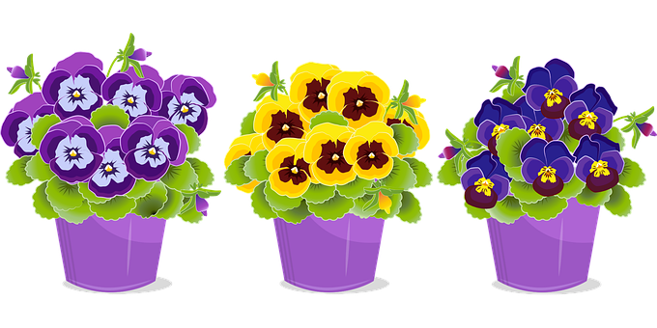
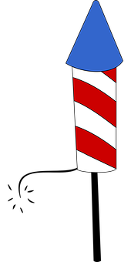
vocabulaire
Les mois
Which of the months are cognates? Be careful with your pronunciation, as some of them look like the English but sound quite different!
Notice that we don’t use capital letters for French months.
mots
Écoute et répète.
janvier
février
mars
avril
mai
juin
juillet
aout
septembre
octobre
novembre
décembre
Notes:
Timing: 3 minutes
Aim: to present and practise the months of the year.
Procedure:
Click to bring up the month of January and then again for the picture.
Repeat for all 12 months.
Click to bring up call-out about cognates.
5

Slide 6
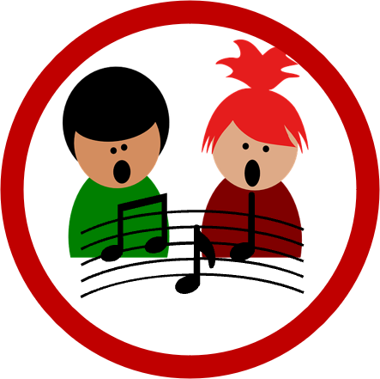
vocabulaire
Les mois
mots
Écoute et chante.
Notes:
Timing: 5 minutes
Aim: to revisit months in a song
Procedure:
Read and clarify the instruction.
Listen once for pupils to appreciate and become familiar with the rhythm.
Listen one more time and encourage pupils to sing along.
Link to video:
https://www.youtube.com/watch?v=qHFapUrSuVM&t=21s
6

Slide 7
parler
Le mois, c’est quoi ?
le mois - month
janvier
mars
février
February
Notes:
Timing: 5 minutes (12 slides)
Aim: to recap the 12 months.
Procedure:
Ask the question.
Read the three options and elicit the correct option from pupils.
Click to reveal the correct option.

Slide 8
parler
Le mois, c’est quoi ?
le mois - month
juin
avril
aout
April
Notes:
[2/12]

Slide 9
parler
Le mois, c’est quoi ?
le mois - month
aout
juin
juillet
July
Notes:
[3/12]

Slide 10
parler
Le mois, c’est quoi ?
le mois - month
janvier
juin
juillet
January
Notes:
[4/12]

Slide 11
parler
Le mois, c’est quoi ?
le mois - month
mai
mars
octobre
March
Notes:
[5/12]

Slide 12
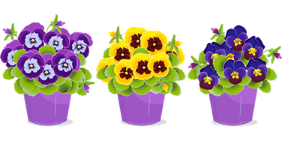
parler
Le mois, c’est quoi ?
le mois - month
mars
avril
mai
May
Notes:
[6/12]

Slide 13
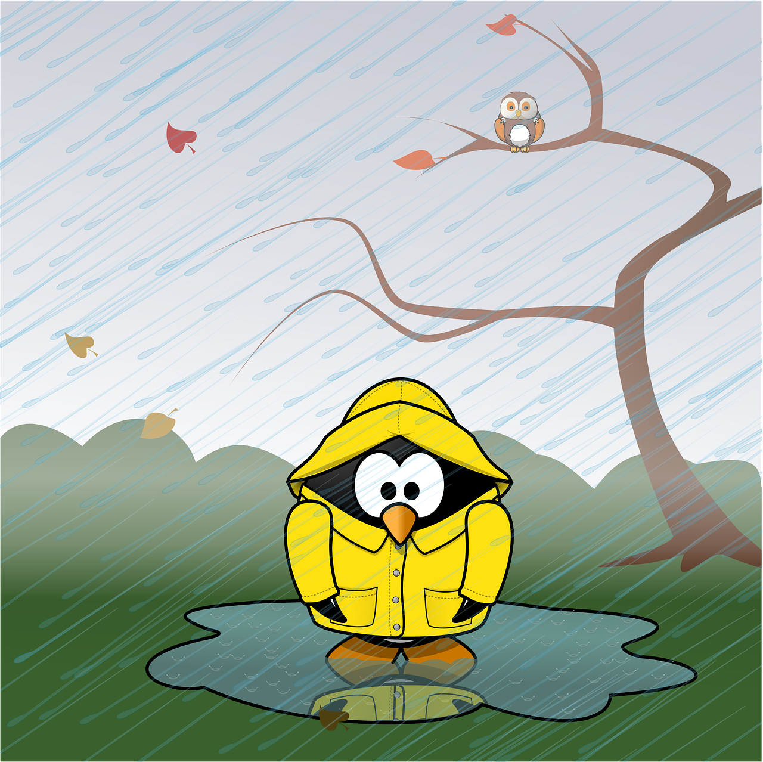
parler
Le mois, c’est quoi ?
le mois - month
octobre
novembre
septembre
November
Notes:
[7/12]

Slide 14
parler
Le mois, c’est quoi ?
le mois - month
avril
octobre
aout
August
Notes:
[8/12]

Slide 15
parler
Le mois, c’est quoi ?
le mois - month
décembre
septembre
octobre
December
Notes:
[9/12]

Slide 16
parler
Le mois, c’est quoi ?
le mois - month
novembre
septembre
octobre
September
Notes:
[10/12]

Slide 17
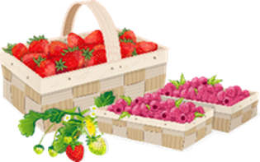
parler
Le mois, c’est quoi ?
le mois - month
juillet
janvier
juin
June
Notes:
[11/12]

Slide 18
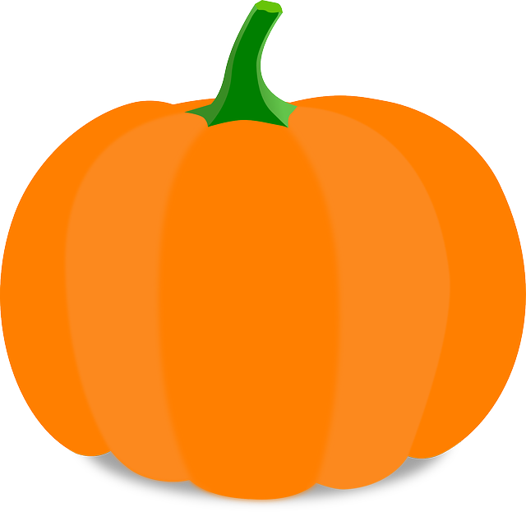
parler
Le mois, c’est quoi ?
le mois - month
septembre
décembre
octobre
October
Notes:
[12/12]

Slide 19
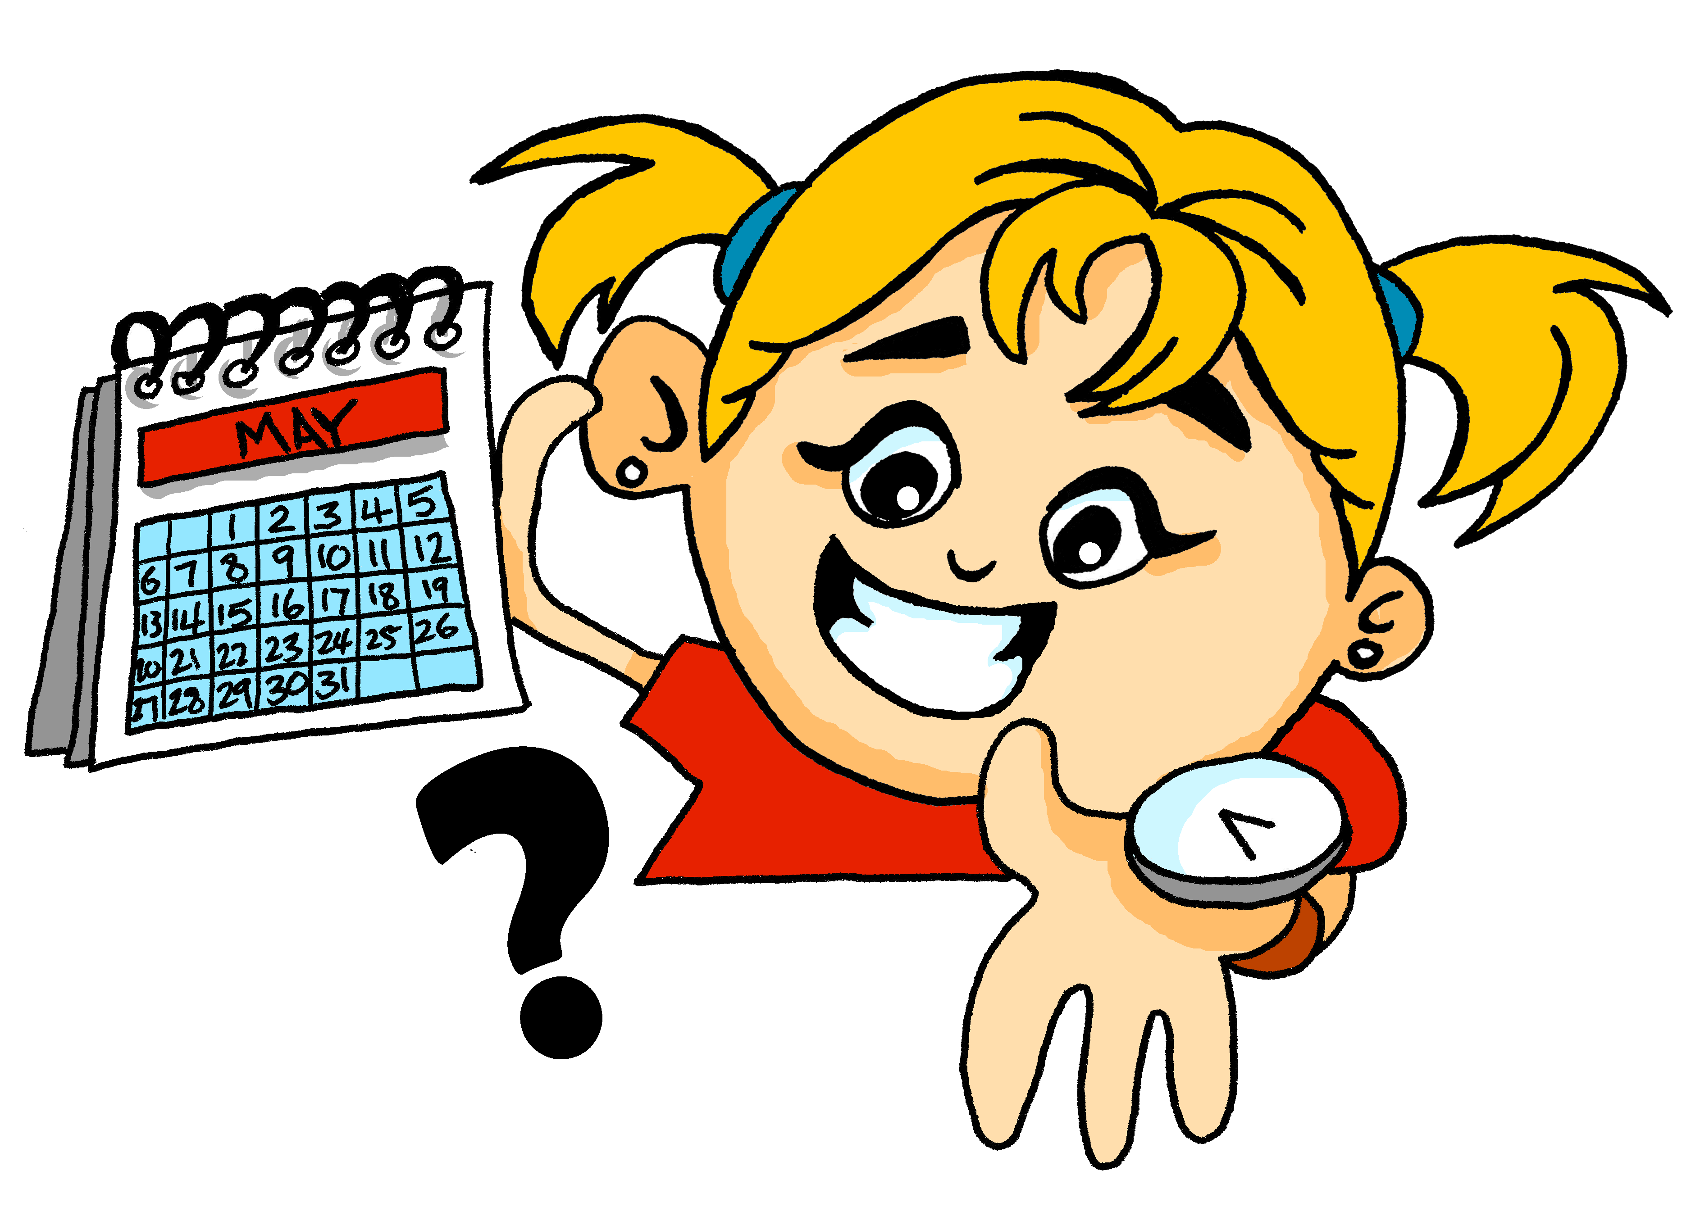
vocabulaire
mots
Quand ?
when?
Notes:
Timing: 1 minute
Aim: to present the question word quand ?
Procedure:
Pupils listen and repeat the key question word (include gesture if possible)
Display the word and get pupils to repeat one more time.
Elicit English meaning.
Gesture: turn to look at left wrist where a watch might be worn and tap once as you say ‘quand’.

Slide 20
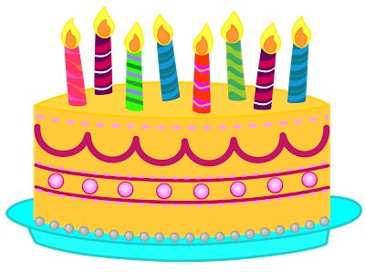
Quand ?
The ‘d’ is a Silent Final Consonant.
Use quand to ask when:
Quand est ton anniversaire ?
When is your birthday?
You can ask the same question like this:
Use this for informal conversations with friends and family.
C’est quand, ton anniversaire ?
Mon anniversaire est en février.
My birthday is in February.
Notes:
Timing: 2 minutes
Aim: to introduce formal and informal questions with quand.
Procedure:
Click to present the new information about quand.
2. Elicit the English for the French examples.

Slide 21
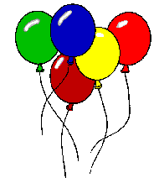
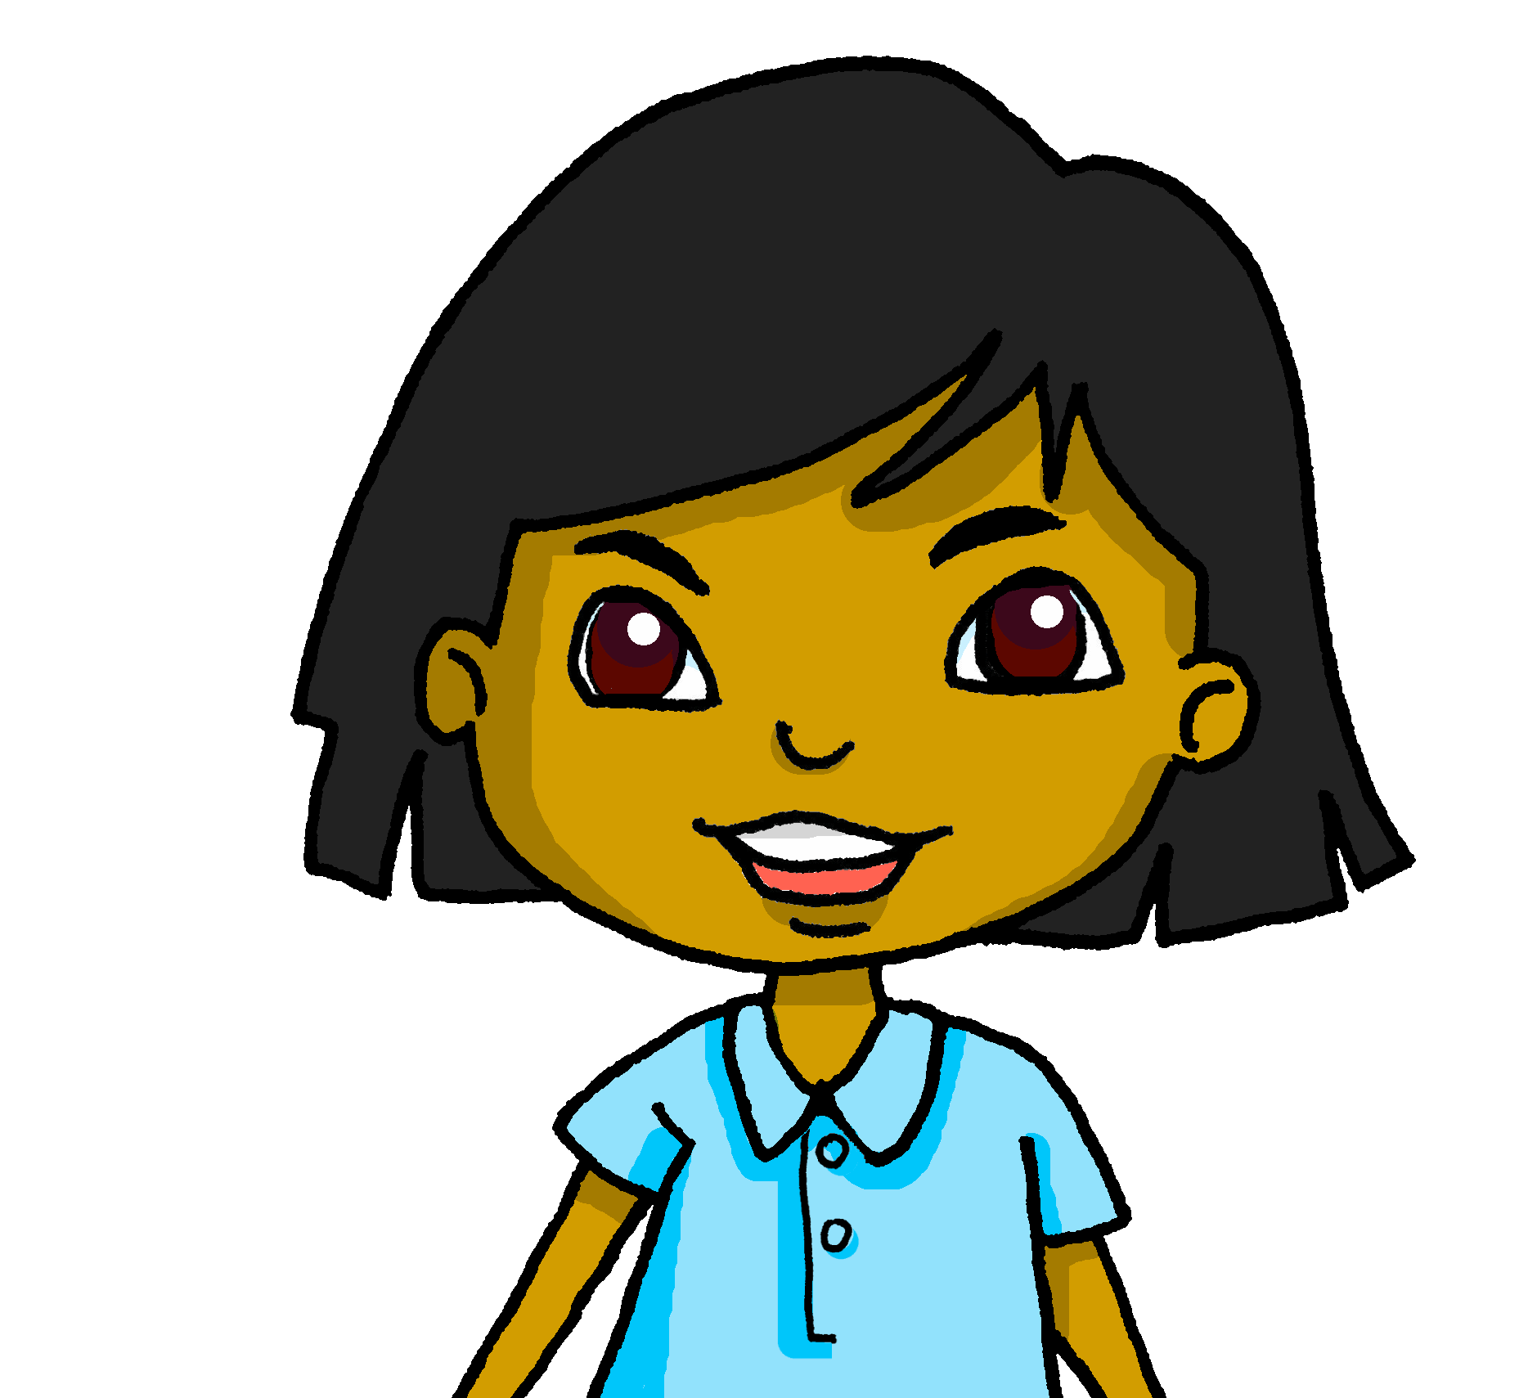
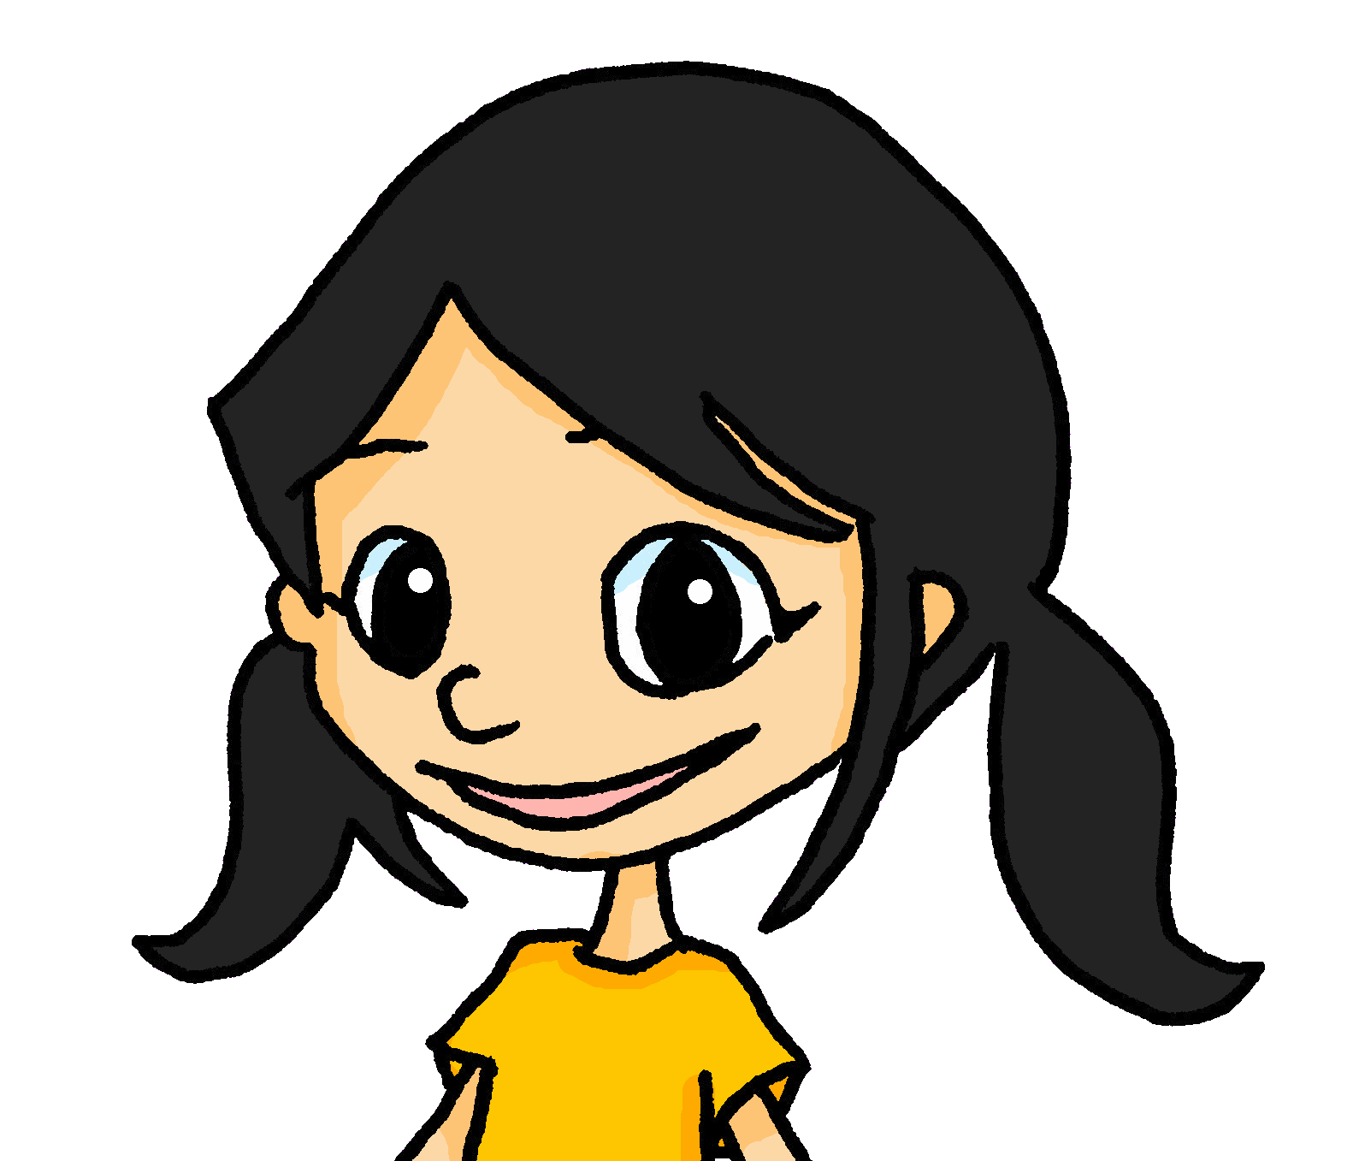
lire
C’est quand, ton anniversaire ?
Sanaya is finding out when people’s birthdays are and writing them on her calendar.
Lis et écris le mois.
8. Mon anniversaire est en mars.
1. Mon anniversaire est en novembre.
January | February | March | April
May | June | July | August
September | October | November | December
2. Mon anniversaire est en aout.
Clémentine
Adèle
Max
Sanaya
Eugénie
3. Mon anniversaire est en mai.
Léa
4. Mon anniversaire est en avril.
Eugénie
Léa
Pierre
Adèle
5. Mon anniversaire est en juin.
Pierre
6. Mon anniversaire est en octobre.
Yves
7. Mon anniversaire est en janvier.
Yves
Clémentine
Max
Notes:
Timing: 8 minutes
Aim: to practise written comprehension of months in short sentences about birthdays.
Procedure:
Pupils write 1 – 7 and the name of each month.
Click to bring up each person in the calendar so pupils can check their answers.
Ask pupils to guess when Sanaya’s birthday might be (it is one of the remaining months) – elicit the French février, mars, juillet, septembre, décembre, asking pupils which month they think it is.
Click to reveal Sanaya’s birthday sentence. Pupils identity this as ‘March’.
Click to reveal Sanaya on the calendar.
21

Slide 22
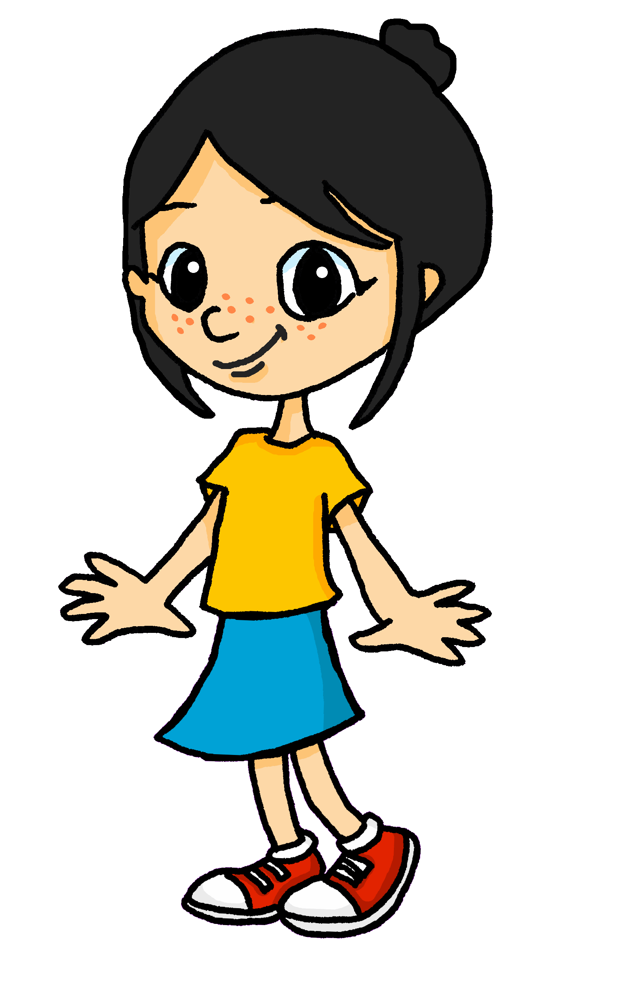
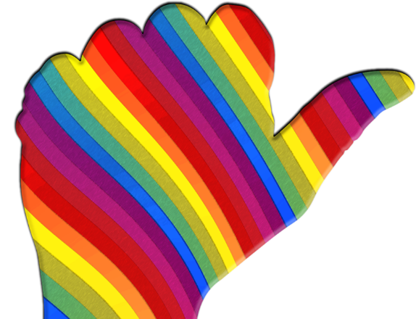
parler
Parle en français.
Many French-speaking children learn which months have 31 days by using their knuckles!
janvier(31)
mars (31)
mai (31)
juillet (31)
aout (31)
octobre (31)
décembre (31)
septembre
novembre
juin
février
avril
Notes:
Timing: 2 minutes Aim: to practise oral production of the months; to demonstrate how Frnech-speaking children learn which months have 31 days. Procedure: 1. Click to bring up the call out.
2. Click to reveal arrows and months one by one, with pupils repeating the months as they appear.
3. Play the animated sequence of months again. Pupils try to keep up with the animation, as they say the months. 4. Pupils say the year from start to finish independently using their knuckles.
Information source:
http://a-french-education.blogspot.com/2014/05/knuckle-down.html
22

Slide 23
Au revoir !
jaune
Notes:
23

