Slide 1
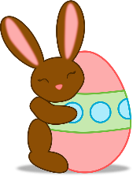
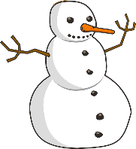
Describing things and people
jaune
Follow ups 1-5
Notes:
Artwork by Steve Clarke. Pronoun pictures from NCELP (www.ncelp.org). All additional pictures selected from Pixabay and are available under a Creative Commons license, no attribution required.
Phonics: [qu] question [144] quatre [283] musique [1139] expliquer [252] unique [402]
Vocabulary: mois [179] janvier [939] février [1139] mars [868] avril [1022] mai [943] juin [931] juillet [1326] aout [1445] septembre [944] octobre [826] novembre [982] décembre [891] quand [119]
anniversaire [2043] en [7]
Revisit 1: groupe [187] liste [924] personne [84] très [66] beaucoup (de) [150]
Revisit 2: jouer [219] ami, amie [467] en ligne [n/a] dehors [1217] mon, ma [60] ton, ta [330] voici [1103]
Londsale, D., & Le Bras, Y. (2009). A Frequency Dictionary of French: Core vocabulary for learners London: Routledge.
The frequency rankings for words that occur in this PowerPoint which have been previously introduced in these resources are given
in the SOW and in the resources that first introduced and formally re-visited those words.
For any other words that occur incidentally in this PowerPoint, frequency rankings will be provided in the notes field wherever
possible.

Slide 2
[qu]
prononcer
question
Notes:
Timing: 1 minute
Aim: To introduce SSC [qu]
Procedure: 1. Present the letter(s) and say the [qu] sound first, on its own. Students repeat it with you. 2. Bring up the word ”question” on its own, say it, students repeat it, so that they have the opportunity to focus all of their attention on the connection between the written word and its sound.
3. Say the word and do the gesture, if using.
4. Roll back the animations and work through 1-3 again, but this time, dropping your voice completely to listen carefully to the students saying the [qu] sound, pronouncing ”question” and, if using, doing the gesture.
Gesture: https://www.signbsl.com/sign/question
The 2nd video from the left – trace the shape of a question mark in the air
Word frequency (1 is the most frequent word in French):
question [144]
Source: Londsale, D., & Le Bras, Y. (2009). A Frequency Dictionary of French: Core vocabulary for learners London: Routledge.
2

Slide 3
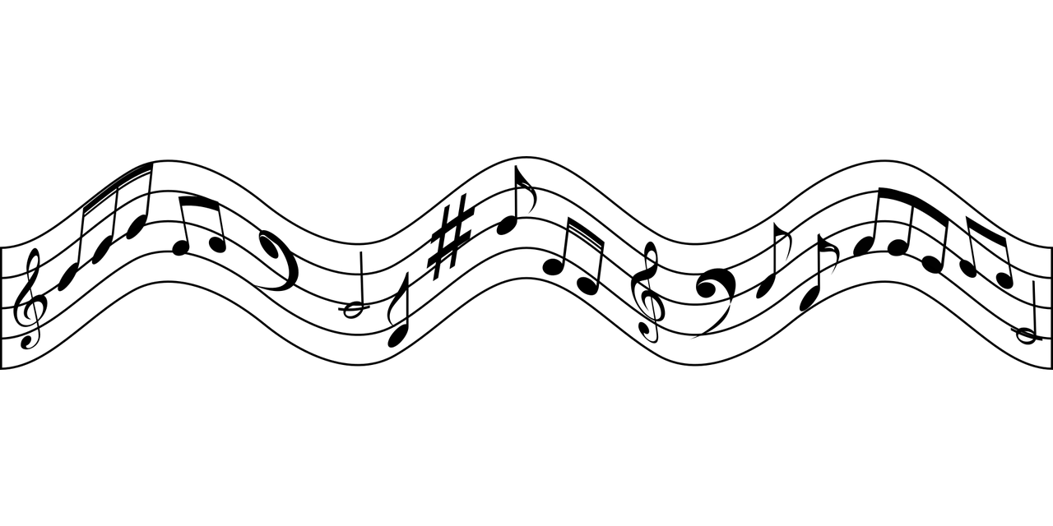
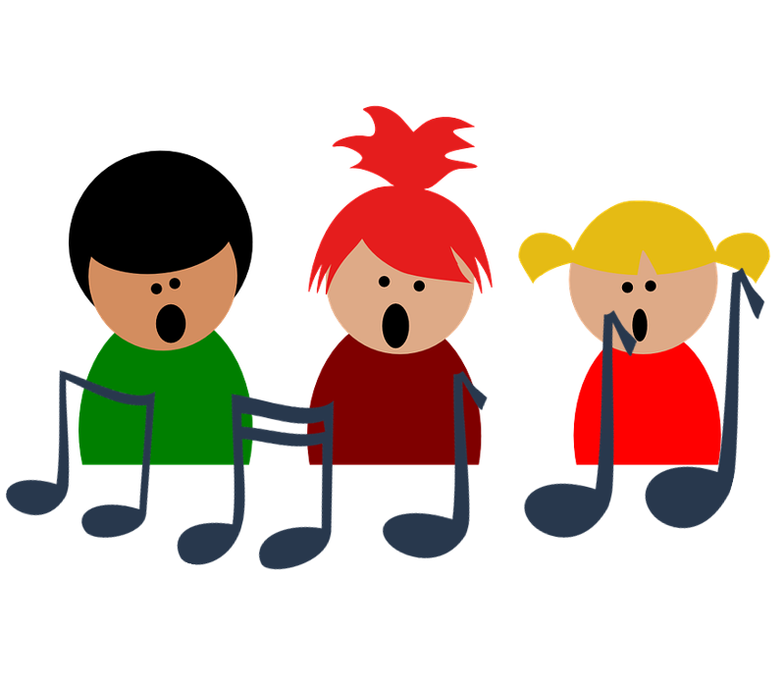
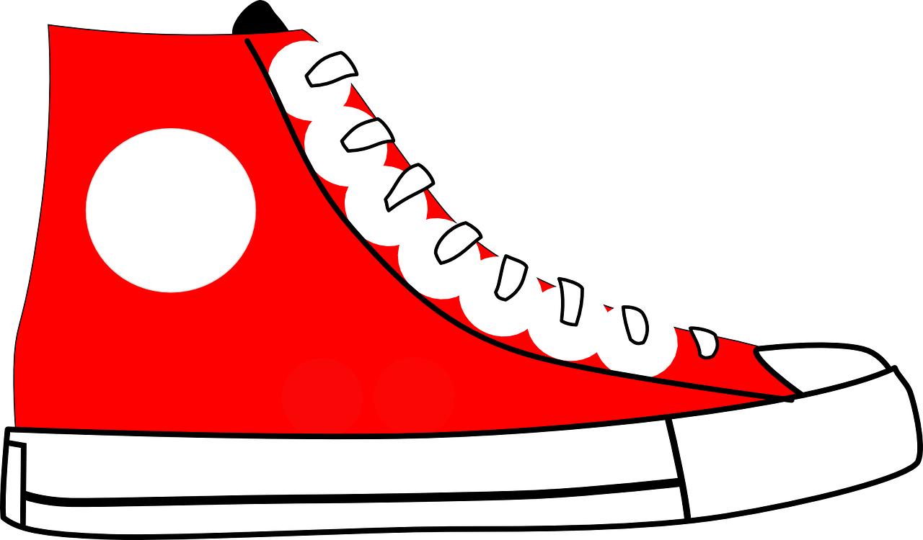
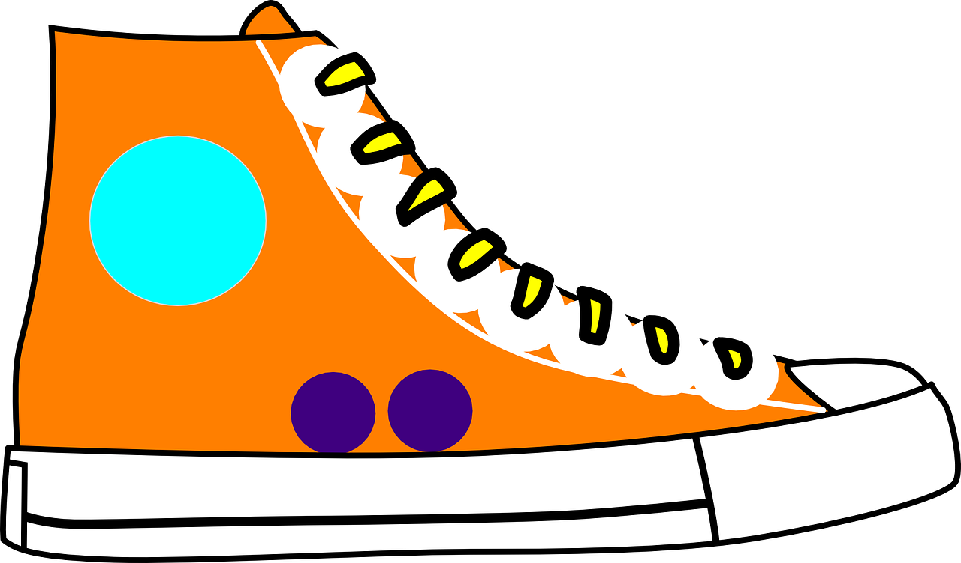
[qu]
prononcer
to explain
quatre
expliquer
question
musique
unique
Notes:
Timing: 2 minutes
Aim: To introduce SSC [qu]
Procedure:
1. Introduce and elicit the pronunciation of the individual SSC [qu] and then the source word again ‘question’ (with gesture, if using). 2. Then present and elicit the pronunciation of the four cluster words.
The cluster words have been chosen for their high-frequency, from a range of word classes, with the SSC (where possible) positioned within a variety of syllables within the words (e.g. initial, 2nd, final etc.). Additionally, we have tried to use words that build cumulatively on previously taught SSCs (see the Phonics Teaching Sequence document) and do not include new SSCs. Where new SSCs are used, they are often consonants which have a similar symbol-sound correspondence in English.
Word frequency: quatre [283] musique [1139] expliquer [252] unique [402] question [144] Source: Londsale, D., & Le Bras, Y. (2009). A Frequency Dictionary of French: Core vocabulary for learners London: Routledge.
3

Slide 4
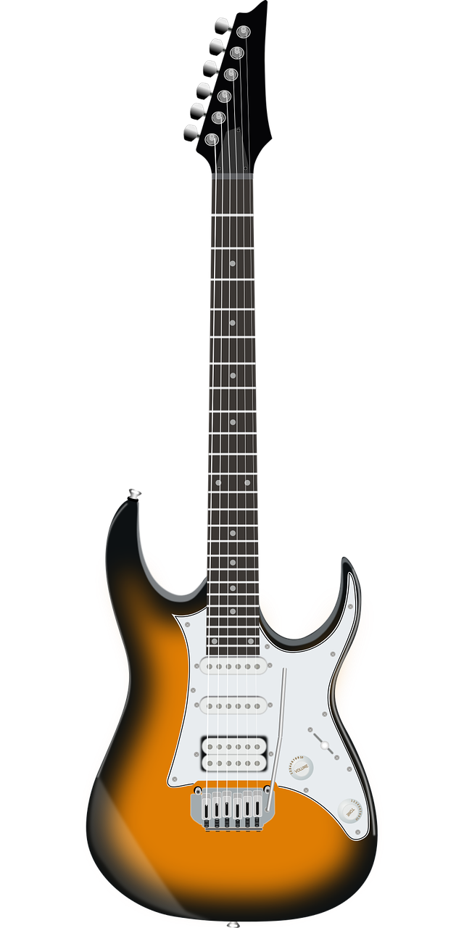
Follow up 1:
Prononce. Qui va avec chaque phrase ?
1
4
2
3
4
5
Dominique…
Jacques…
Véronique…
Monique…
Madame Jacquet…
…pratique la gymnastique chaque jour.
…est unique.
…préfère la musique pop.
…aime la pétanque.
…a quatre questions.
Notes:
Timing: 3 minutes
Aim: to practise read aloud of the SSC [qu] in short sentences.
Procedure:
Give pupils time to read the sentences aloud in pairs, working out which person belongs to which sentences.
Elicit the answers chorally, saying the name (e.g., Dominique…) and allowing pupils to finish the sentence in French.
Click on the name to reveal the answers.
If desired, click on the numbers to hear the full sentences pronounced.
Frequency of unknown words and cognates:
gymnastique [>5000] pétanque [>5000] pratiquer [1268]
Londsale, D., & Le Bras, Y. (2009). A Frequency Dictionary of French: Core vocabulary for learners London: Routledge.
Note that all these words are taught in upper KS2.

Slide 5
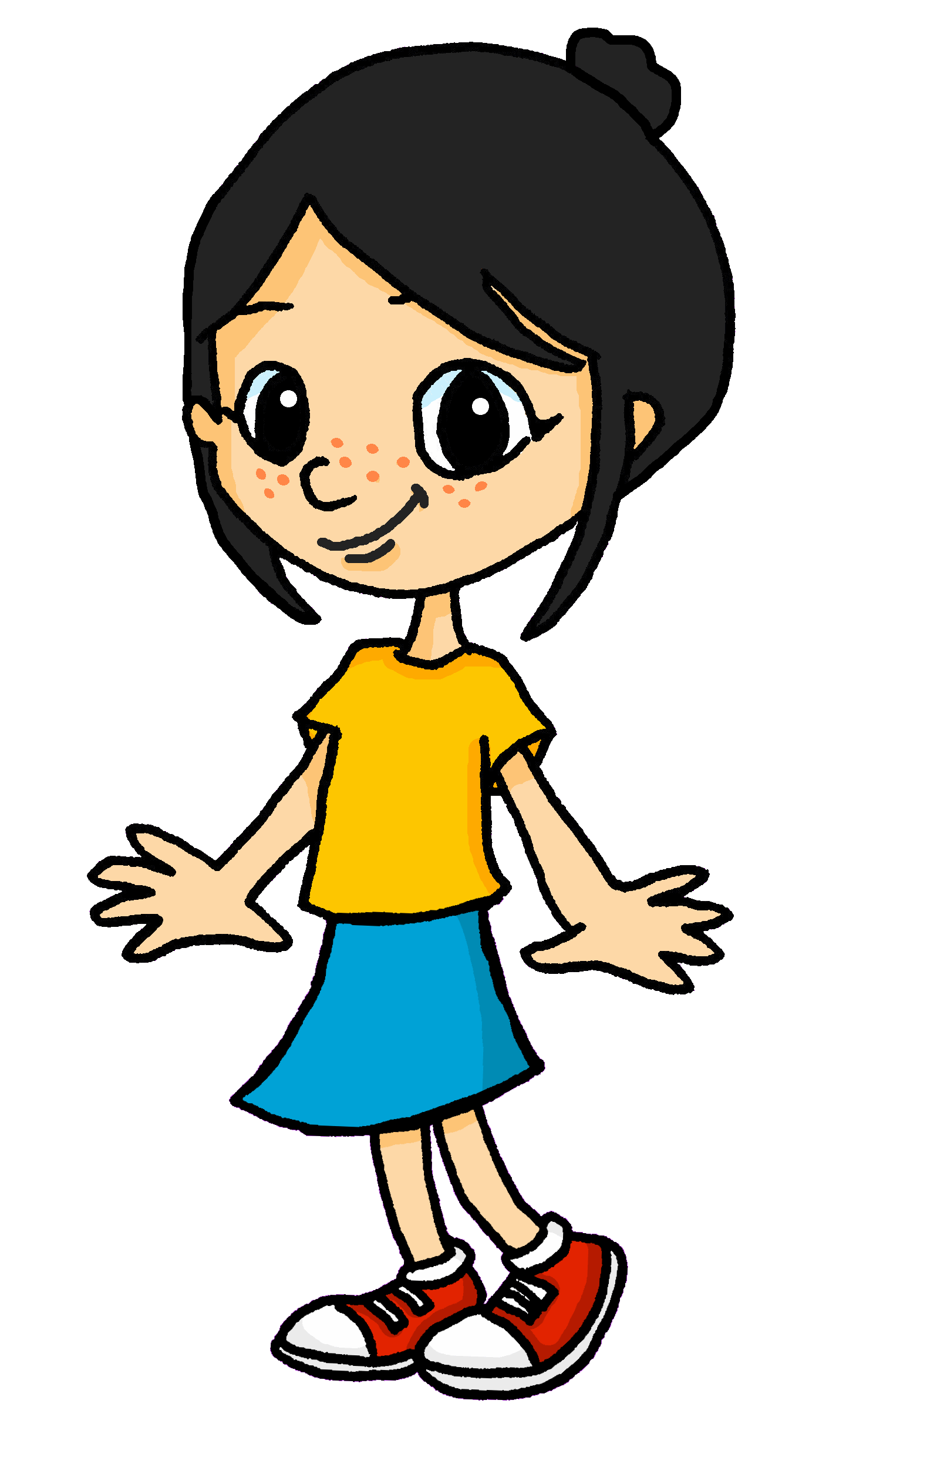
Follow up 2:
Écoute et identifie le mot correct.
The most common birthday month is August!
écouter
Ex
January | June | July
Écoute et écris en anglais.
1
I have | your | my
Ex
1
2
3
4
5
6
7
My birthday is in July.
2
October | when | what
Your birthday is in December.
3
month | March | week
Who has a birthday in October?
My friend has a birthday in March.
4
who | what | when
What month is it?
5
Wednesday | Tuesday | March
My birthday is on Tuesday.
6
birthday | Monday | Saturday
When is your birthday?
There are lots of birthdays in August.
7
August | April | May
qui ? – who?
Notes:
Timing: 5 minutes
Aim: to practise aural comprehension of this week’s new vocabulary (months) and revisited vocabulary.
Procedure:
(Part A) Click to listen to each audio item B-6. Pupils write down the word they hear mentioned (selecting from the 3 given) in each sentence.
Click to circle the correct answers.
(Part B) Pupils listen again to B-6 and try to translate the sentences they hear into English, in full this time. They might find it easier to make notes in German then think about English word order afterwards. E.g. er hat, März→He has birthday in March→ His birthday is in March.
Elicit possible translations then click to bring up English translations.
Note: Qui ? (who?) is introduced incidentally here, and glossed on the slide to help with the translation of number 2. Qui ? is formally introduced at the start of Y5 in Bleu/Vert SOW. However, some teachers may want to ask pupils about their birthdays. E.g., Qui a un anniversaire en janvier ? etc..
Transcript:
Exemple: Mon anniversaire est en juillet.
1. Ton anniversaire est en décembre.
2. Qui a un anniversaire en octobre ?
3. Mon ami a un anniversaire en mars.
4. Le mois, c’est quoi ?
5. Mon anniversaire est mardi.
6. C’est quand, ton anniversaire ?
7. Il y a beaucoup d’anniversaires en aout.

Slide 6
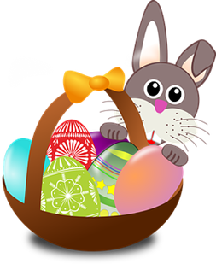
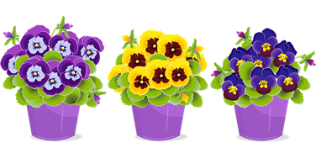
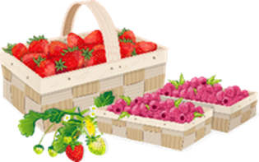
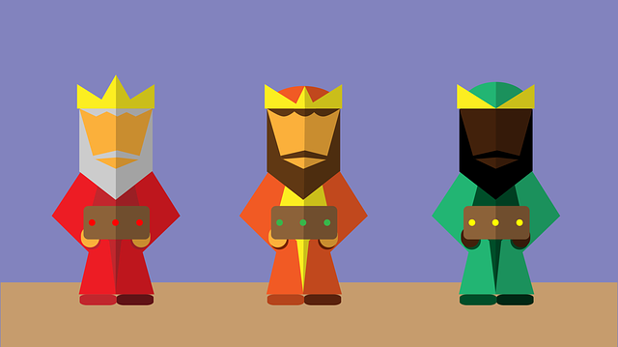
Follow up 3a:
Les mois
mots
Le mois, c’est quoi ?
vocabulaire
février
avril
novembre
mai
octobre
juin
September
February
June
May
April
March
January
December
November
August
October
July
mars
janvier
juillet
aout
septembre
décembre
Notes:
Timing: 3 minutes
Aim: to practise written recognition and read aloud of the months of the year.
Procedure: 1. Click for an English word to appear in the middle. Elicit the French translation from pupils. Emphasis here is on good pronunciation as well as finding the correct word.
2. Continue until all months have been introduced. 3. Elicit choral pronunciation of all months again, clicking to provide an emphasis animation. Encourage pupils to focus on pronunciation and avoid anglicism of the cognates.

Slide 7
Follow up 3b:
Écris en français.
A
écrire
mars
1. janvier février avril
B
octobre
quand
2. septembre novembre décembre
anniversaire
en
juillet
3. mai juin aout
février
ton
est
c’est
mon
juin
4. avril juillet
mai
anniversaire
5. février mars
janvier
avril
C’est quand, ton anniversaire ?
Question: Réponse:
Mon anniversaire est en février.
Notes:
Timing: 5 minutes
Aim: to practise written production of the months of the year and full sentence question and answer.
Procedure:
For activity A, pupils write down the missing month(s) in each sequence.
Click to display answers.
Click to bring up activity B. Here pupils must write a question and answer using every word in the circle once.
Click to bring up the question and answer.

Slide 8
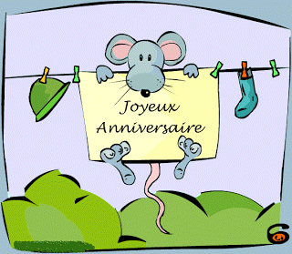
parler
Lis, prononce et chante.
In most French speaking countries, “Joyeux anniversaire” and “Bon anniversaire” are the most common ways to wish a happy birthday.
In Québec, in Canada, they also use “Bonne fête”.
Make the liaison between Joyeux and anniversaire.
Also hear the liaison between Bon and anniversaire.
fête means celebration or party.
Notes:
Do this before Follow up 4
Timing: 2 minutes Aim: to find out how to wish someone a happy birthday; to practise singing happy birthday.
Procedure: 1. Read the information with pupils.
2. Click to bring up the three birthday greetings.
3. Click to hear the audio and elicit repetition from pupils.
4. Click to bring up the callouts about liaison and the meaning of fête, which pupils will know from Rouge, if they did Rouge before Jaune.
5. Play the videos below, as desired.
Information source:
https://www.berlitz.com/blog/happy-birthday-french-song#:~:text=In%20most%20French%20speaking%20countries,also%20use%20%E2%80%9CBonne%20f%C3%AAte%E2%80%9D.
Song sources: 1. https://www.youtube.com/watch?v=l04BpnlteSY (this version just has the words ‘Joyeux anniversaire’ so it provides lot of repetition of this phrase and will be easy to join in with)
2. https://www.youtube.com/watch?v=DlE0C4BouGQ (this version is a 45 seconds chant with the Minions – part of this would make a very good group performance in class), using the following: Rhythmic chant: Aujourd’hui c’est ton anniversaire (repeated over and over, fast) Song: Joyeux anniversaire, Joyeux anniversaire, Joyeux anniversaire, Joyeux anniversaire. Start with the chant and then bring in the singing over the top at the same time, so the two are happening concurrently, as during the first part of the Minions clip.
8

Slide 9
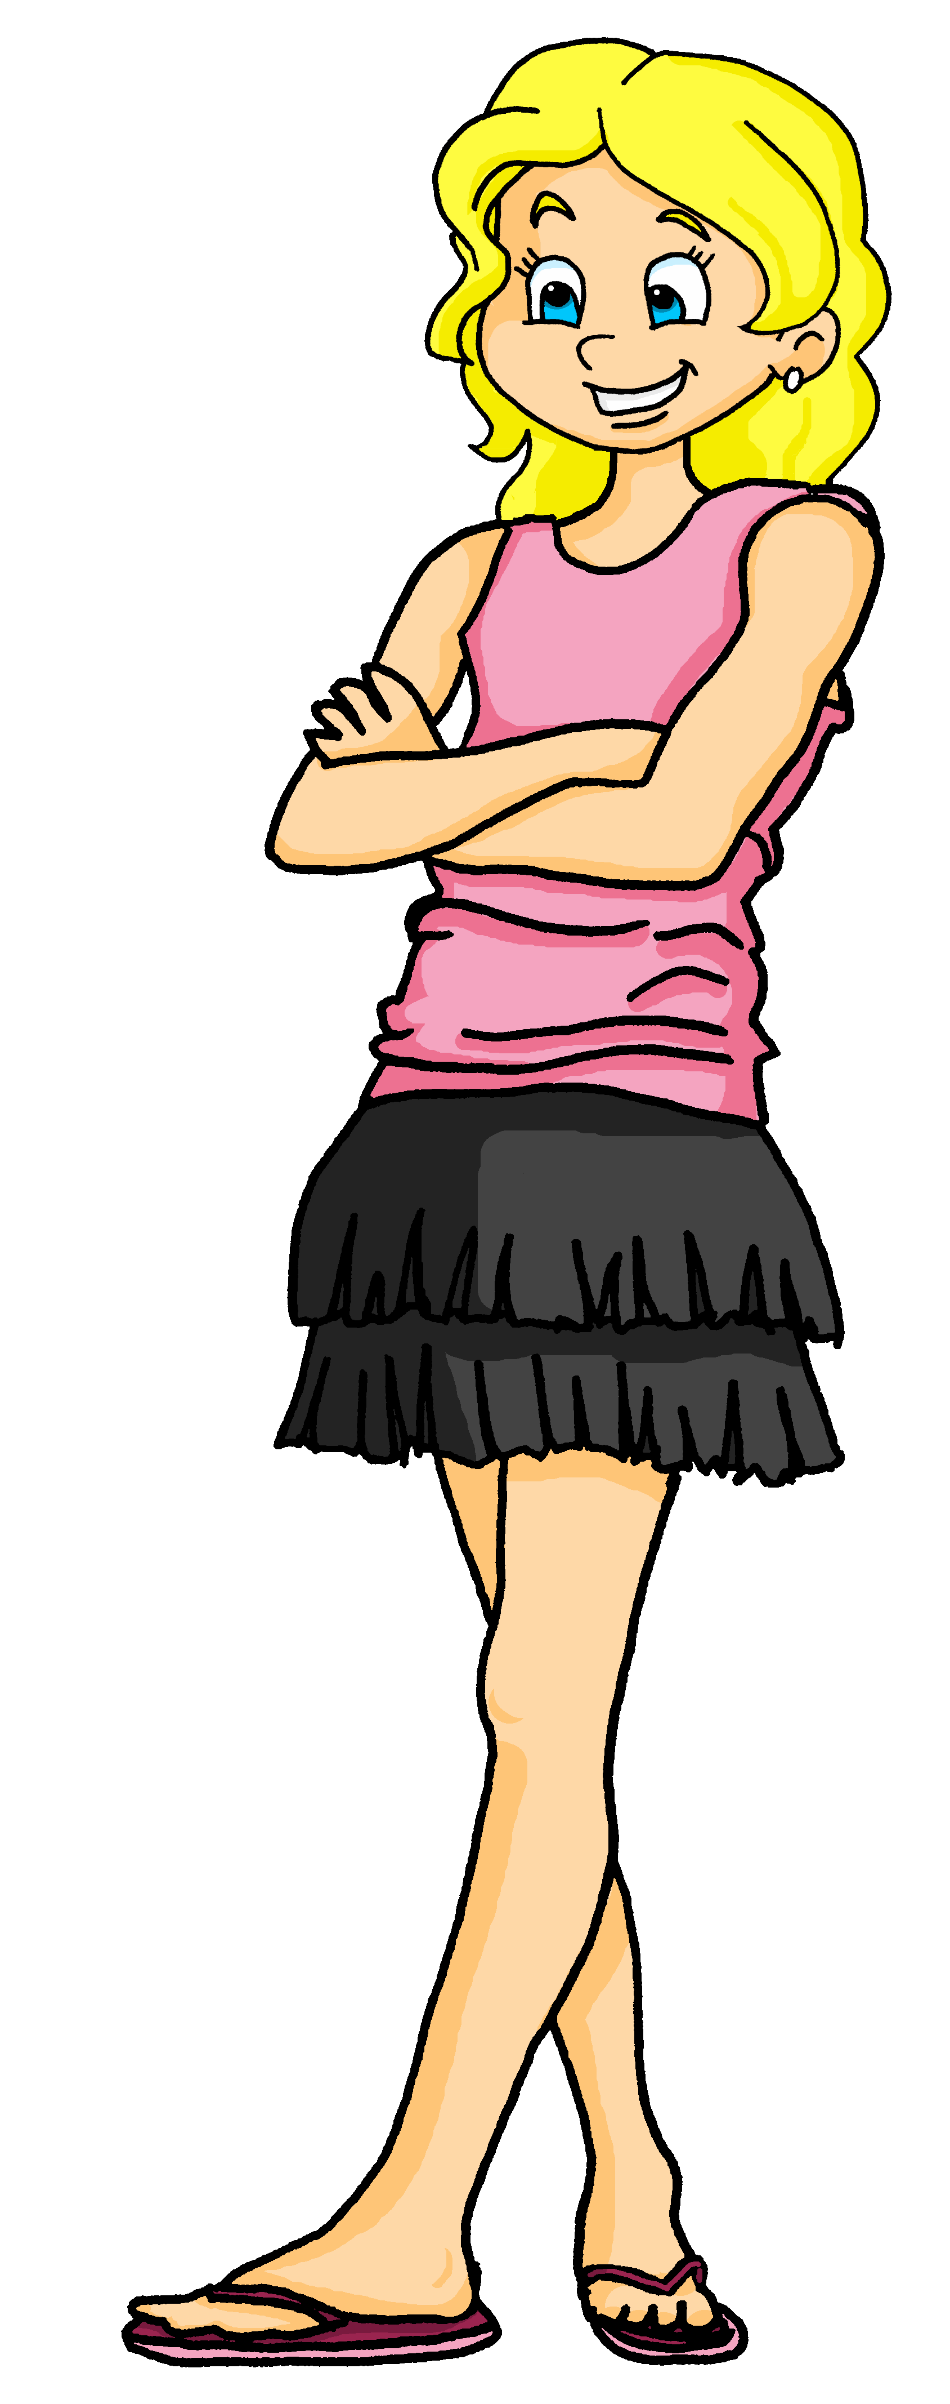
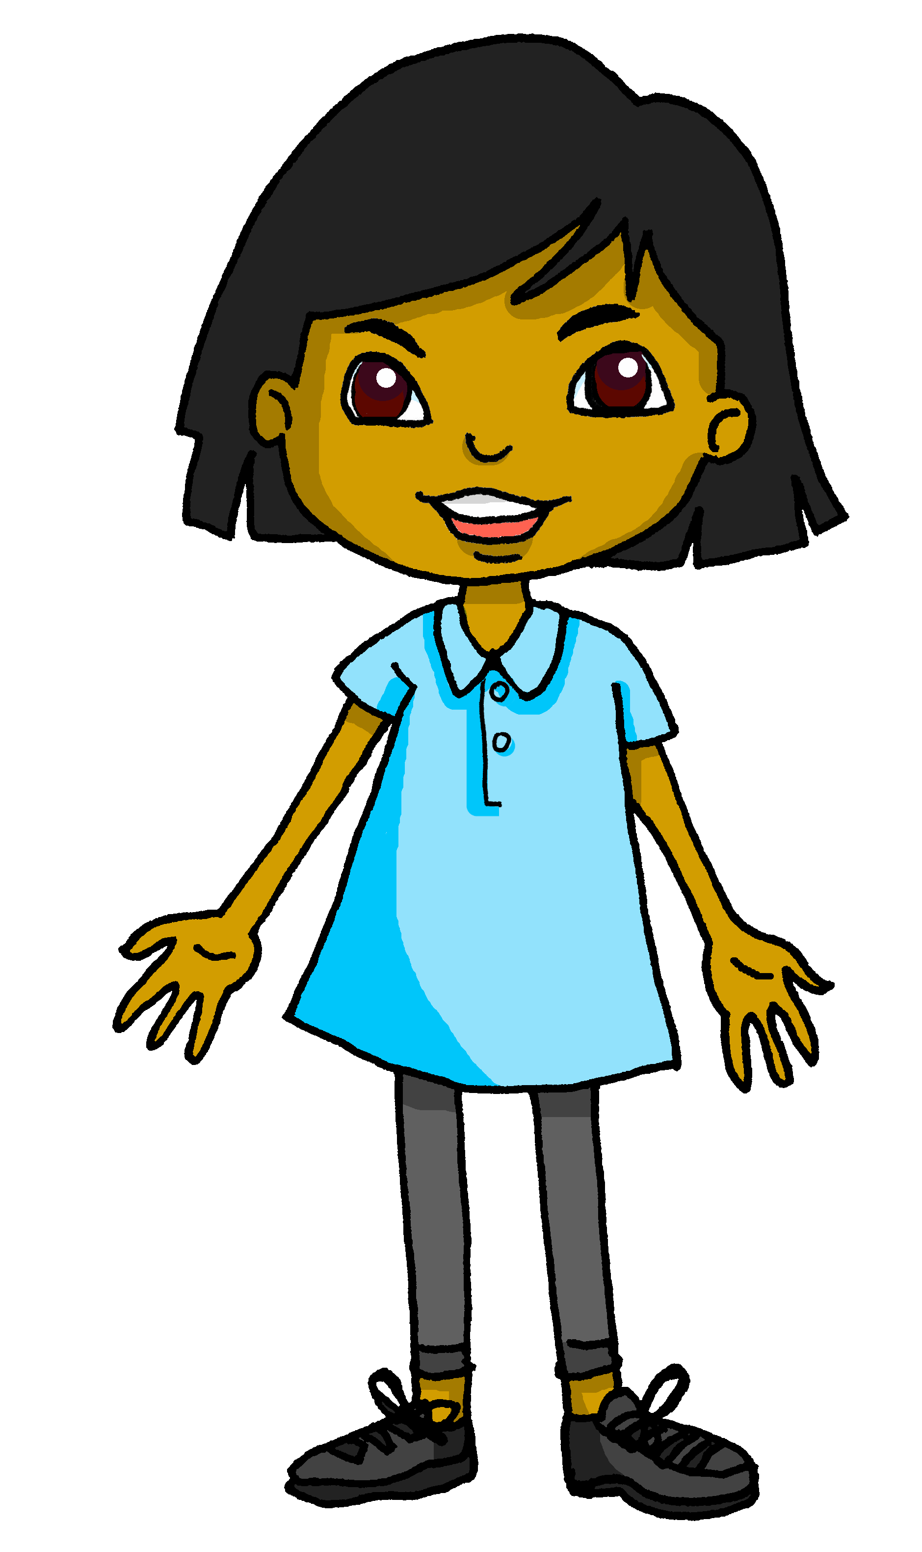
Follow up 4:
Pose des questions et note les réponses.
parler
janvier | février | mars | avril
mai | juin | juillet | aout
septembre | octobre | novembre | décembre
Emily
C’est quand, ton anniversaire ?
Mon anniversaire est en aout.
Tom
Is it someone’s birthday this month? If so, wish them a happy birthday in French:
Joyeux anniversaire !
Notes:
Timing: 5 minutes
Aim: to provide oral practice of asking and answering about birthdays.
Procedure:
Using the balloons, remind pupils how to ask ‘When is your birthday?’ and ‘My birthday is in…’. Take a few volunteers from around the class to ask and answer, ensuring pupils know to substitute their own month.
Explain that, like Sanaya did with her friends, the pupils are going to do a class birthday calendar and need to fill in names above each month.
Demonstrate how pupils should move around the classroom, asking and answering in French and jotting down names as they go. Click to bring up the 3 different names filled in on the calendar to show that they should note down names of classmates.
If time allows, ask for feedback using the questions: Qui a un anniversaire en mars ? and l’anniversaire de XXX, c’est quand ?
Finally, bring up the callout to teach how to say ‘Happy Birthday’ in French. Repeat together as a class. See if pupils can remember it in French each time there is a classmate’s birthday.
Additional Tasks:
Pupils could write up their findings about others in their class using full sentences. L’anniversaire de [Josh] est en septembre.
The class could make a large birthday calendar in French with everybody’s birthday to display on the wall of the classroom.
Pupils could have conversations in pairs about who has birthdays when, using the question they know.

Slide 10
Follow up 5:

Écris en anglais.
Can you get at least 15 points?
mots
 | mon | ta | l’amie
 | en ligne | dehors | jouer
 | très | la liste | voici
 | le groupe | la personne | beaucoup (de)
 | l’anniversaire | le mois | quand ?
 | aout | janvier | juillet
 | février | mars | juin
my (m)
your (f)
(the) friend (f)
vocabulaire
x3
on line
outside
to play, playing
very
(the) list
here is, this is
x2
(the) group
(the) person
a lot (of)
(the) birthday
(the) month
when?
August
January
July
x1
February
March
June
Notes:
Timing: 5 minutes
Aim: to practise written comprehension of vocabulary from this and revisited weeks.
Procedure: 1. Give pupils a blank grid. They fill in the English meanings of any of the words they know, trying to reach 15 points in total.
Note: The most recently learnt and practised words are pink, words from the previous week are green and those from week 1 are blue, thus more points are awarded for them, to recognise that memories fade and more effort (heavy lifting!) is needed to retrieve them.

Slide 11
Follow up 5:

Écris en français.
Can you get at least 15 points?
mots
 | online | (the) friend (m) | my (f)
 | your (m) | to play, playing | outside
 | here is, this is | (the) person | (the) group
 | very | a lot (of) | (the) list
 | December | August | July
 | January | September | when?
 | May | (the) birthday | (the) month
en ligne
l’ami
ma
vocabulaire
x3
ton
jouer
dehors
voici
la personne
le groupe
x2
très
beaucoup (de)
la liste
décembre
aout
juillet
x1
janvier
septembre
quand ?
mai
l’anniversaire
le mois
Notes:
Timing: 5 minutes
Aim: to practise written production of vocabulary from this and revisited weeks.
Procedure: 1. Give pupils a blank grid. They fill in the French meanings of any of the words they know, trying to reach 15 points in total.
Note: The most recently learnt and practised words are pink, words from the previous week are green and those from week 1 are blue, thus more points are awarded for them, to recognise that memories fade and more effort (heavy lifting!) is needed to retrieve them.

Slide 12
Handout
janvier | février | mars | avril
mai | juin | juillet | aout
septembre | octobre | novembre | décembre
janvier | février | mars | avril
mai | juin | juillet | aout
septembre | octobre | novembre | décembre
Notes:
HANDOUT

Slide 13
Follow up 5:

Écris en anglais.
Can you get at least 15 points?
mots
 | mon | ta | l’amie
 | en ligne | dehors | jouer
 | très | la liste | voici
 | le groupe | la personne | beaucoup (de)
 | l’anniversaire | le mois | quand ?
 | aout | janvier | juillet
 | février | mars | juin
vocabulaire
x3
x2
x1
Notes:
HANDOUT

Slide 14
Follow up 5:

Écris en français.
Can you get at least 15 points?
mots
 | online | (the) friend (m) | my (f)
 | your (m) | to play, playing | outside
 | here is, this is | (the) person | (the) group
 | very | a lot (of) | (the) list
 | December | August | July
 | January | September | when?
 | May | (the) birthday | (the) month
vocabulaire
x3
x2
x1
Notes:
HANDOUT

