Slide 1
Describing things and people
favourite
>
jaune
ma chose préférée
adjectives –if, -ive
SSC [ien]
Notes:
Artwork by Steve Clarke. Pronoun pictures from NCELP (www.ncelp.org). All additional pictures selected from Pixabay and are
available under a Creative Commons license, no attribution required.
The AUDIO version of the lesson material includes additional audio for the new language
presented (phonics, vocabulary) and audio for the instructions on the slide.
In addition, it includes VIDEO clips of the phonics and the phonics’ source words. Pupils can be
encouraged to look at the shape of the mouth/lips on slides where these appear, and try to copy
it/them.
Phonics: [-ien] chien [1744] ancien [392] bientôt [1208] combien? [800] bien [47]
Vocabulary: chose [125] actif [1219] massif [1760] préféré [597] propre [237] sale [2906] sportif [2670] idéal [1429]
Revisit 1: magazine [2033] porte [696] blanc [708] blanche [708] noir [572]
Revisit nouns: carte [955] chaise [3419] chambre [633] affiche [2886] lit [1837] un bureau [273]
Revisit 2: émission [1074] radio [1526] tante [3891] télévision [1179] grand² [59] petit² [138] de² [2]
Londsale, D., & Le Bras, Y. (2009). A Frequency Dictionary of French: Core vocabulary for learners London: Routledge.
The frequency rankings for words that occur in this PowerPoint which have been previously introduced in these resources are given
in the SOW and in the resources that first introduced and formally re-visited those words.
For any other words that occur incidentally in this PowerPoint, frequency rankings will be provided in the notes field wherever
possible.
1

Slide 2
[ien]
prononcer
good, well
bien
Notes:
Timing: 1 minute
Aim: to recap SSC [ien]
Procedure: 1. Present the letter(s) and say the [ien] sound first, on its own. Pupils repeat it with you. 2. Bring up the word ”bien” on its own, say it, pupils repeat it, so that they have the opportunity to focus all of their attention on the connection between the written word and its sound.
3. A possible gesture for this would be to give a thumbs up sign. 4. Roll back the animations and work through 1-3 again, but this time, dropping your voice completely to listen carefully to the pupils saying the [ien] sound, pronouncing ”bien” and, if using, doing the gesture.
Word frequency (1 is the most frequent word in French):
bien [47]
Source: Londsale, D., & Le Bras, Y. (2009). A Frequency Dictionary of French: Core vocabulary for learners London: Routledge.
2

Slide 3
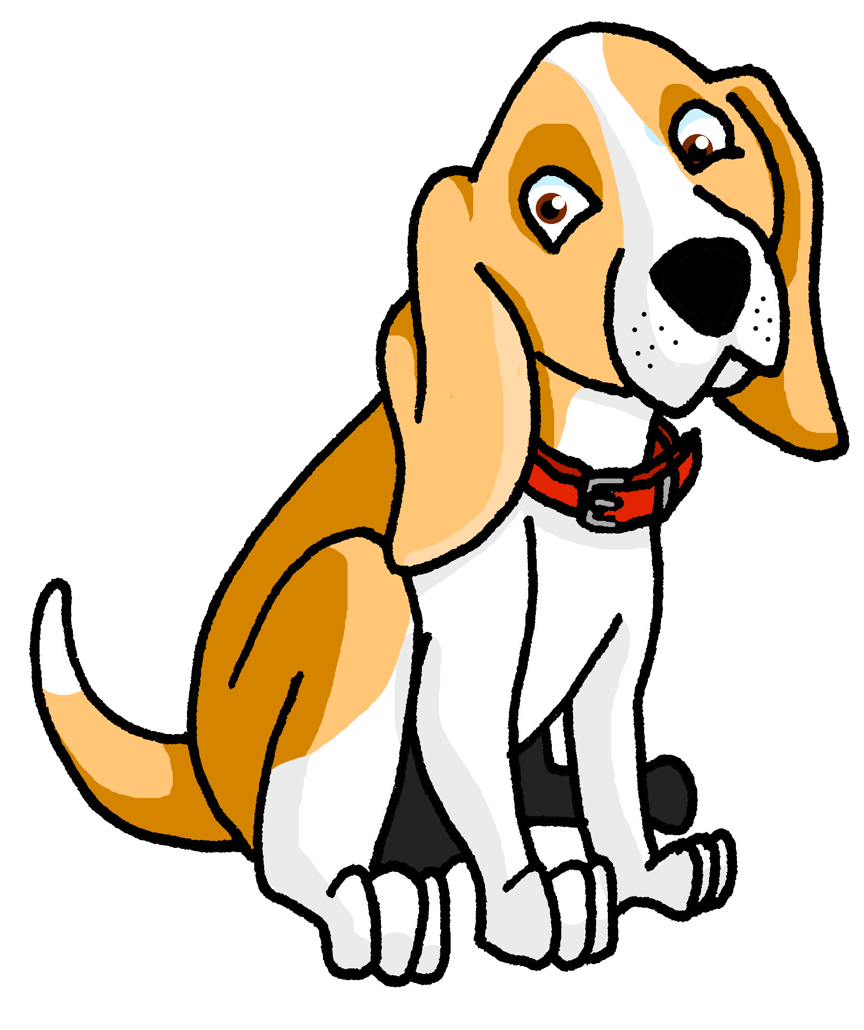
[ien]
prononcer
chien
ancien
bien
€ ?
bientôt
combien
Notes:
Timing: 2 minutes
Aim: to revisit SSC [ien]
Procedure:
1. Introduce and elicit the pronunciation of the individual SSC [ien] and then the source word again ‘bien’ (with gesture, if using). 2. Then present and elicit the pronunciation of the five cluster words.
The cluster words have been chosen for their high-frequency, from a range of word classes, with the SSC (where possible) positioned within a variety of syllables within the words (e.g. initial, 2nd, final etc.). Additionally, we have tried to use words that build cumulatively Word frequency (1 is the most frequent word in French): ancien [392] bien [47] bientôt [1208] chien [1744] combien? [800] Source: Londsale, D., & Le Bras, Y. (2009). A Frequency Dictionary of French: Core vocabulary for learners London: Routledge.
3

Slide 4
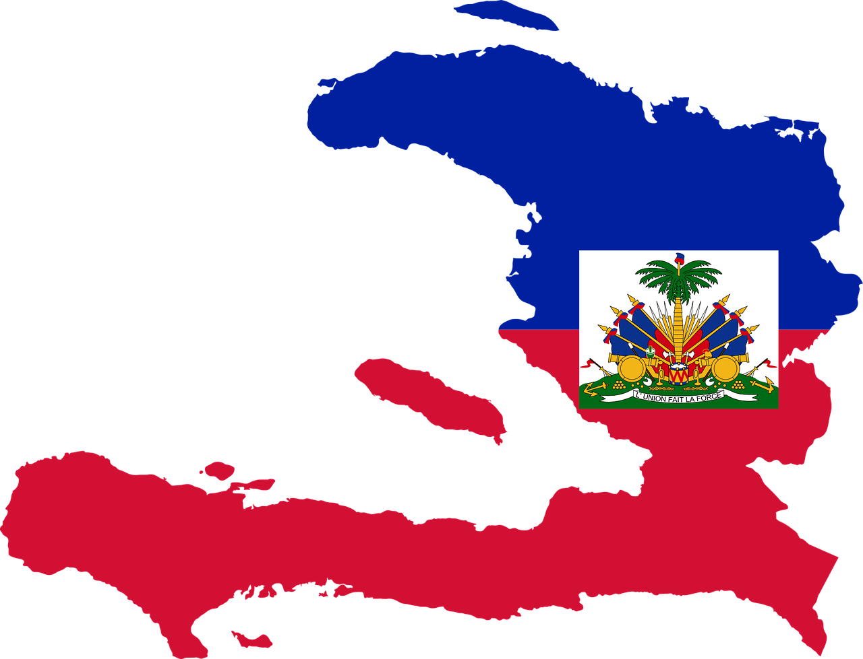
prononcer
. Écoute les noms des animaux. C’est [ien] ou [(a)in]?
Écoute les mots. Le pays correspondant, c’est quoi ?
. Écoute les noms
Puis, prononce les mots.
1
D
tunisien
A | B | C
D | E | F
2
E
nigérien
3
C
canadien
l’Algérie
l’Haïti
le Canada
⚠ Notice that [-(a)in] sounds the same as the final syllable of
[-ien].
4
A
algérien
5
B
haïtien
6
F
la Tunisie
le Niger
le Maroc
marocain
Notes:
Timing: 5 minutes
Aim: to consolidate SSC [ien].
Procedure:
Click to listen to each word.
Pupils match the nationality word to the country, writing the letter.
Click to correct the answers.
Pupils pronounce the nationality words again. Teachers can elicit by saying, e.g., ‘Comment dit-on ‘Tunisian’ en français ?’
Click to move to the next slide.
Transcript: tunisien
nigérien
canadien
algérien
haïtien
marocain
Word frequency (1 is the most frequent word in French): algérien [4163] canadien [611] haïtien [>5000] marocain [3469] nigérien [>5000] tunisien [>5000] Note: countries are not included in the source frequency dictionary. Source: Londsale, D., & Le Bras, Y. (2009). A Frequency Dictionary of French: Core vocabulary for learners London: Routledge.
4

Slide 5
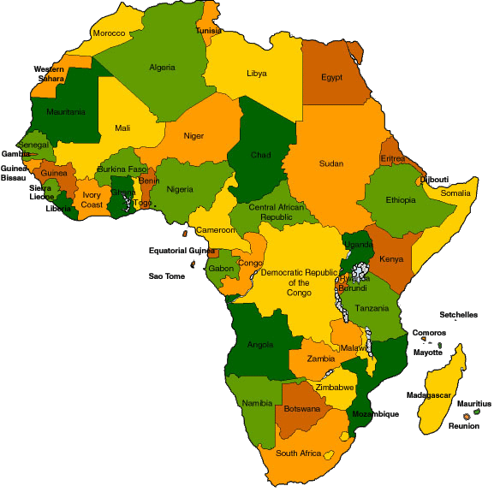
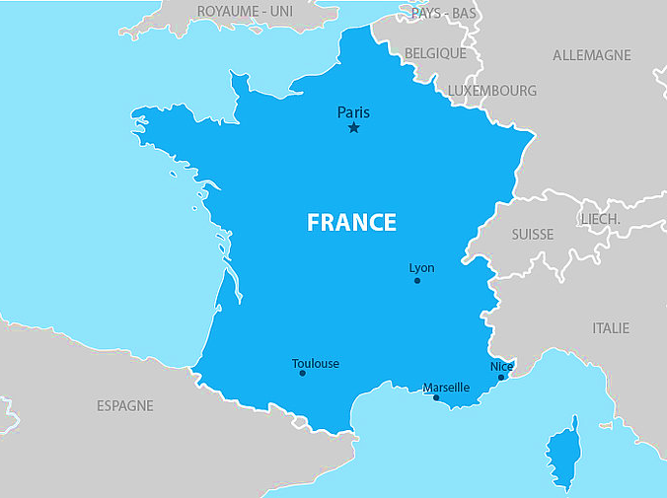
La Francophonie
We say ‘la Francophonie’ to mean French-speaking peoples and countries.
This is the official flag of ‘la Francophonie’.
There are 29 countries with French as an official language.
⚠ Look! You have seen this lots of times in your French lessons.
21 of these countries are in Africa.
5 are in Europe.
The other 3 are: Canada, Haiti and Vanuatu.
MONACO
11 other places belong to France and have French as the official language. In addition, many more countries also speak French amongst other languages. In total, 88 countries belong to ‘la Francophonie’.
Notes:
Timing: 2 minutes
Aim: to introduce pupils to the concept of ‘la Francophonie’.
Procedure:
Click to reveal each new piece of information.
Read the text aloud, so pupils can follow.
Note: the 11 French overseas territories are: French Guiana, Guadeloupe, Martinique, Mayotte, Réunion, French Polynesia, Saint Barthélemy, Saint Martin, Saint Pierre and Miquelon, Wallis and Futuna, New Caledonia.
Information source: https://www.berlitz.com/blog/french-speaking-countries
5

Slide 6
vocabulaire
Vocabulaire
mots
Le mot, c’est quoi en français ?
la chose
le magazine
actif
la tante
préféré
massif
favourite
clean
ideal
dirty
programme
poster
active
magazine
thing
sporty
massive
aunt
sale
propre
sportif
l’affiche
l’émission
idéal
Notes:
Timing: 5 minutes
Aim: to present and practise written comprehension and read aloud of previously taught words and the new vocabulary for this week.
Procedure: 1. Click for an English word. Elicit French translation from pupils.
2. Continue until the final word (trop) has been introduced. 3. Elicit choral pronunciation of all words again, clicking to provide an emphasis animation.
6

Slide 7
Adjectives
The –e often means we pronounce the final consonant.
Remember! Many French adjectives add –e to describe feminine nouns:
L’émission est intéressante.
The programme is interesting.
L’affiche est idéale.
The poster is ideal.
Adjectives ending in –if change to –ive to describe feminine nouns:
Le garçon est actif.
The boy is active.
Ma tante est active.
My aunt is active.
⚠ Remember: If adjectives already end in -e they are the same for masculine and feminine nouns. E.g. sale, propre.
In French we pronounce it with a long [i] sound.
Notes:
Timing: 3 minutes
Aim: to recap adjective agreement introduce a new pattern - -if → -ive.
Procedure:
Click through the animations to present the information.
Elicit English translations for the French examples provided.

Slide 8
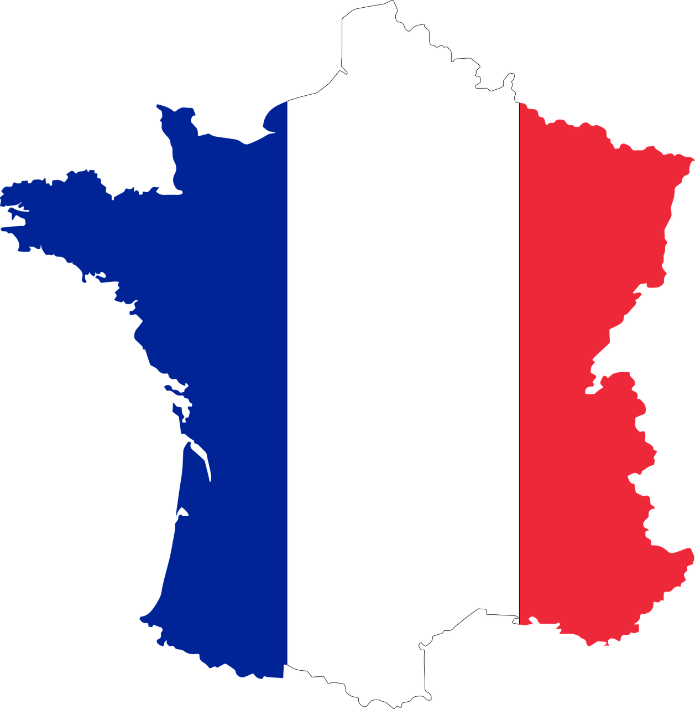
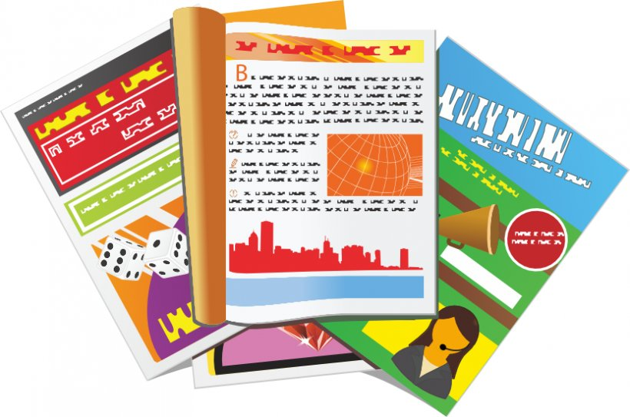
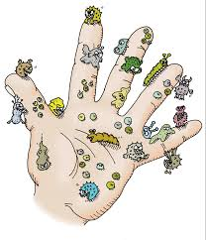
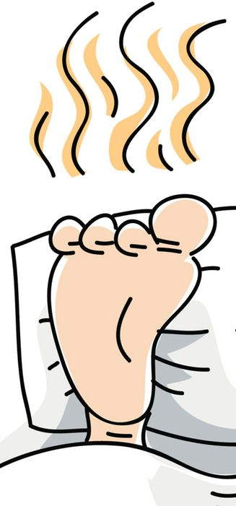
lire
Lis l’opinion. La chose, c’est quoi ? A ou B ?
A
B
1
Il est massif.
Le mot ‘it’, c’est
il ou elle ?
2
A
B
Elle est importante.
A
B
3
Il est idéal.
A
B
Elle est sportive.
4
A
B
Il est actif.
5
⚠ This could be either la main or le pied because ‘sale’ is spelt the same for both.
⚠ What about now you see the word for ‘it’?
A
B
6
Il est sale.
Notes:
Timing: 8 minutes
Aim: to practise written recognition of masculine and feminine adjectives and their connection to previously taught nouns.
Procedure:
Pupils look at the first adjective and decide which picture is referred to, A or B.
Click to correct the first item and clarify any misunderstandings.
Complete items 2-8.
Click to correct.
Click to bring up the 2nd instruction to decide which is the correct word for ‘it’.
Click to reveal the answers, elicit the English and ensure that pupils are clear that ‘il’ = he, it and ‘elle’ = both she and it.
Transcript: 1. Il est massif.
2. Elle est importante.
3. Il est idéal.
4. Elle est sportive. 5. Il est actif. 6. Il est sale.
8

Slide 9
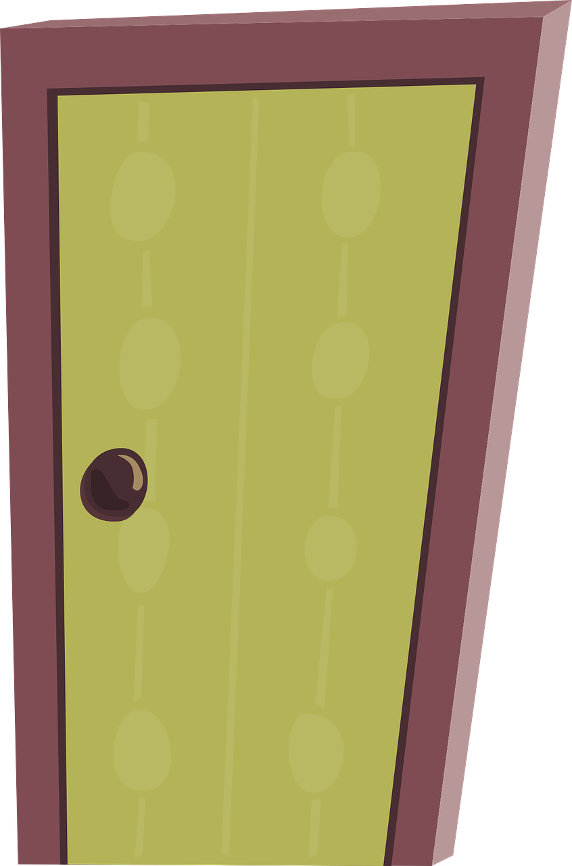
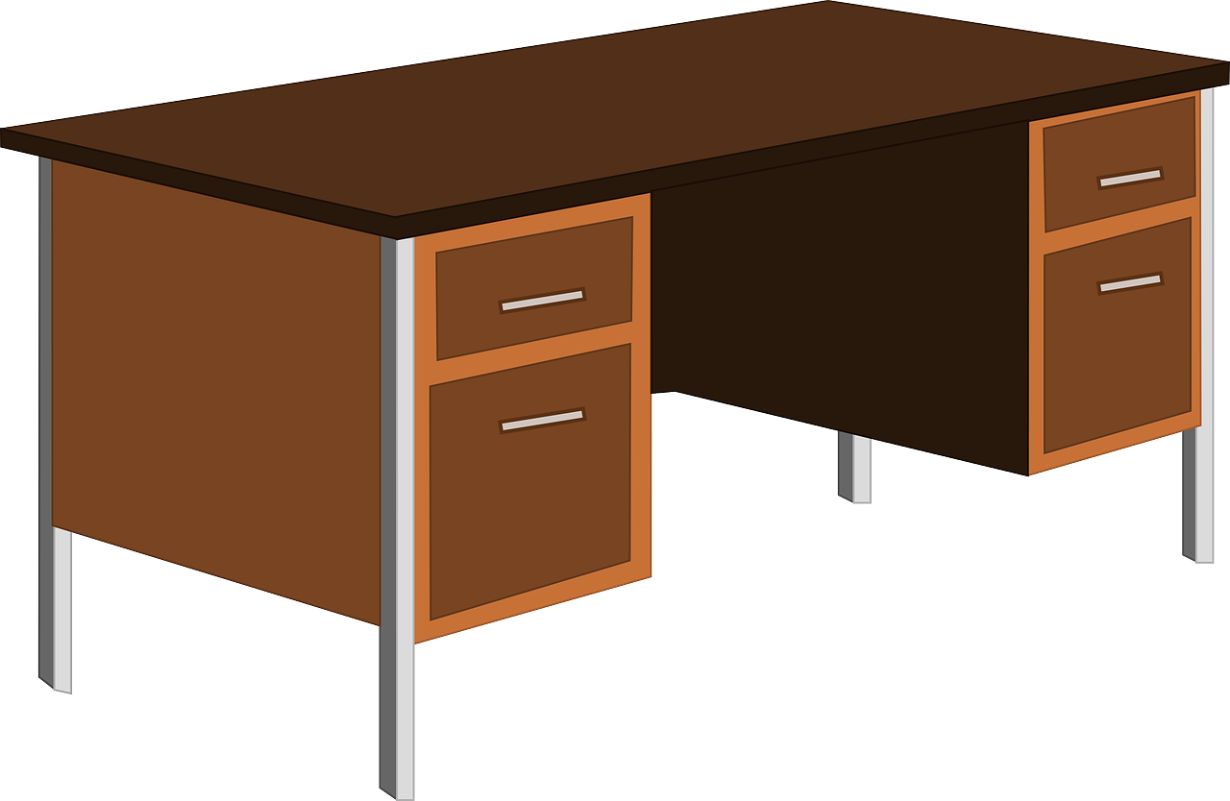
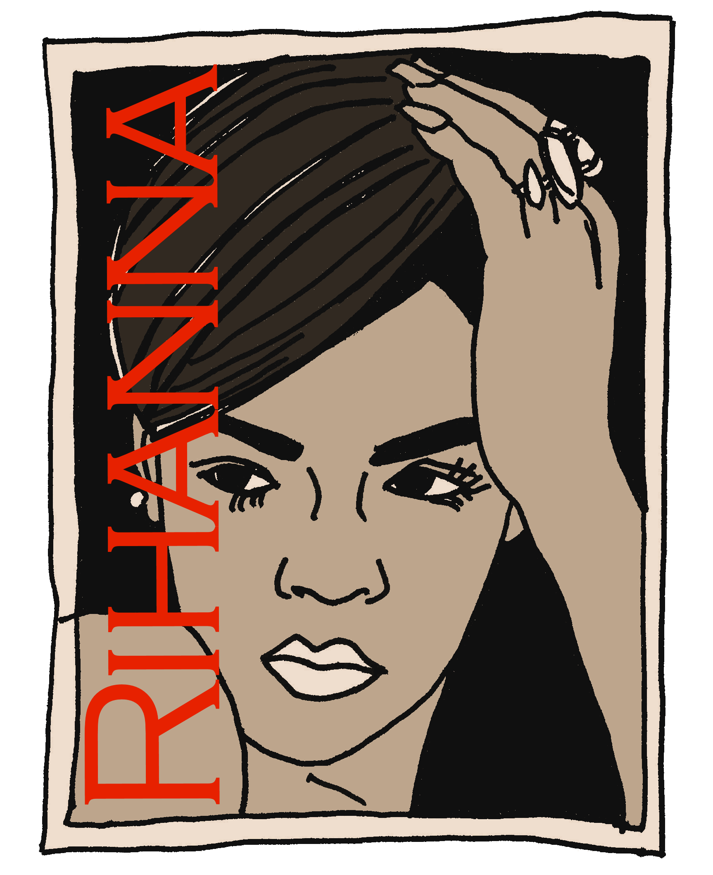
Saying ‘my’ and ‘your’ with singular nouns
Remember how to say ‘my’ before masculine and feminine nouns:
mon bureau
my desk
ma porte
my door
Use the adjective préféré to mean favourite:
mon livre préféré
ma chanson préférée
Remember to use ‘mon/ton’ before feminine nouns beginning with a vowel:
mon émission préférée
ton affiche préférée
my favourite programme
your favourite poster
Notes:
Timing: 2 minutes
Aim: to recap singular possessive adjectives ‘my’ and ‘your’ and the rule for using ‘mon, ton’ and adding –e to make some feminine nouns.
Procedure: 1. Click to present the information.
2. Elicit responses from pupils, following the animated question marks.

Slide 10
lire
Adèle parle avec Clémentine.
Lis les phrases. C’est Adèle (my) ou Clémentine your) ?
C’est quoi ? C’est comment ?
 |  | Adèle - my Clém. - your | Quoi ? | Description
E | Mon chat est très sale. | my | cat | very dirty
1 | Ta radio est petite. | your | radio | small
2 | Mon affiche préférée est massive. | my | favourite poster | massive
3 | Mon livre est en anglais. | my | book | in English
4 | Ta tante est amusante. | your | aunt | fun/funny
5 | Ta chambre est propre. | your | room | clean
6 | Ta grand-mère est sportive. | your | grandma | sporty
7 | Mon émission préférée est intéressante. | my | favourite programme | interesting
E
1
2
3
4
5
6
7
Notes:
Timing: 8 minutes
Aim: to practise understanding possessive adjective mon/ma and ton/ta. Attention to the meaning of the vocabulary is also needed to complete the second and third columns.
Procedure:
Do the example with pupils to model the first part of the task. Read the sentence and work out if it refers to ’Adèle’(my) or Clémentine (your).
Pupils then do items 1-7.
Teacher elicits answers ‘Adèle’ or ‘Clémentine’ and clicks to reveal.
Pupils then complete the remaining two columns with the object and the description of it (adjective).
Click to reveal answers one by one.
10

Slide 11
parler
Mon mot préféré est ‘aujourd’hui’ !
Ton mot préféré, c’est quoi ?
A
Mon mot préféré est ______ .
aujourd’hui !
Keep talking until you have mentioned all 8 words!
Mon mot préféré est ___________ .
affiche
B
A
Mon mot préféré est ___________ .
beaucoup de
chercher
oreille
beaucoup de
affiche
aujourd’hui
sportif
blanche
souvent
Notes:
Timing: 2 minutes
Aim: to practise saying what their favourite word is using the new adjective ‘preféré’; to practise previously taught vocabulary.
Procedure:
Model the task with pupils, using the sequence provided.
Pupils keep talking until they have used all the words.
Provide support as needed for the class or individuals.
If needed, the pronunciation of each word can be heard by clicking on the word.
11

Slide 12
Au revoir !
jaune
Notes:
12

