Slide 1
Describing things and people
favourite
>
jaune
Follow ups 1-5
Notes:
Artwork by Steve Clarke. Pronoun pictures from NCELP (www.ncelp.org). All additional pictures selected from Pixabay and are
available under a Creative Commons license, no attribution required.
The AUDIO version of the lesson material includes additional audio for the new language
presented (phonics, vocabulary) and audio for the instructions on the slide.
In addition, it includes VIDEO clips of the phonics and the phonics’ source words. Pupils can be
encouraged to look at the shape of the mouth/lips on slides where these appear, and try to copy
it/them.
Phonics: [-ien] chien [1744] ancien [392] bientôt [1208] combien? [800] bien [47]
Vocabulary: chose [125] actif [1219] massif [1760] préféré [597] propre [237] sale [2906] sportif [2670] idéal [1429]
Revisit 1: magazine [2033] porte [696] blanc [708] blanche [708] noir [572]
Revisit nouns: carte [955] chaise [3419] chambre [633] affiche [2886] lit [1837] un bureau [273]
Revisit 2: émission [1074] radio [1526] tante [3891] télévision [1179] grand² [59] petit² [138] de² [2]
Londsale, D., & Le Bras, Y. (2009). A Frequency Dictionary of French: Core vocabulary for learners London: Routledge.
The frequency rankings for words that occur in this PowerPoint which have been previously introduced in these resources are given
in the SOW and in the resources that first introduced and formally re-visited those words.
For any other words that occur incidentally in this PowerPoint, frequency rankings will be provided in the notes field wherever
possible.

Slide 2
[ien]
prononcer
good, well
bien
Notes:
Timing: 1 minute
Aim: to recap SSC [ien]
Procedure: 1. Present the letter(s) and say the [ien] sound first, on its own. Pupils repeat it with you. 2. Bring up the word ”bien” on its own, say it, pupils repeat it, so that they have the opportunity to focus all of their attention on the connection between the written word and its sound.
3. A possible gesture for this would be to give a thumbs up sign. 4. Roll back the animations and work through 1-3 again, but this time, dropping your voice completely to listen carefully to the pupils saying the [ien] sound, pronouncing ”bien” and, if using, doing the gesture.
Word frequency (1 is the most frequent word in French):
bien [47]
Source: Londsale, D., & Le Bras, Y. (2009). A Frequency Dictionary of French: Core vocabulary for learners London: Routledge.
2

Slide 3
[ien]
prononcer
chien
ancien
bien
€ ?
bientôt
combien
Notes:
Timing: 2 minutes
Aim: to revisit SSC [ien]
Procedure:
1. Introduce and elicit the pronunciation of the individual SSC [ien] and then the source word again ‘bien’ (with gesture, if using). 2. Then present and elicit the pronunciation of the five cluster words.
The cluster words have been chosen for their high-frequency, from a range of word classes, with the SSC (where possible) positioned within a variety of syllables within the words (e.g. initial, 2nd, final etc.). Additionally, we have tried to use words that build cumulatively Word frequency (1 is the most frequent word in French): ancien [392] bien [47] bientôt [1208] chien [1744] combien? [800] Source: Londsale, D., & Le Bras, Y. (2009). A Frequency Dictionary of French: Core vocabulary for learners London: Routledge.
3

Slide 4
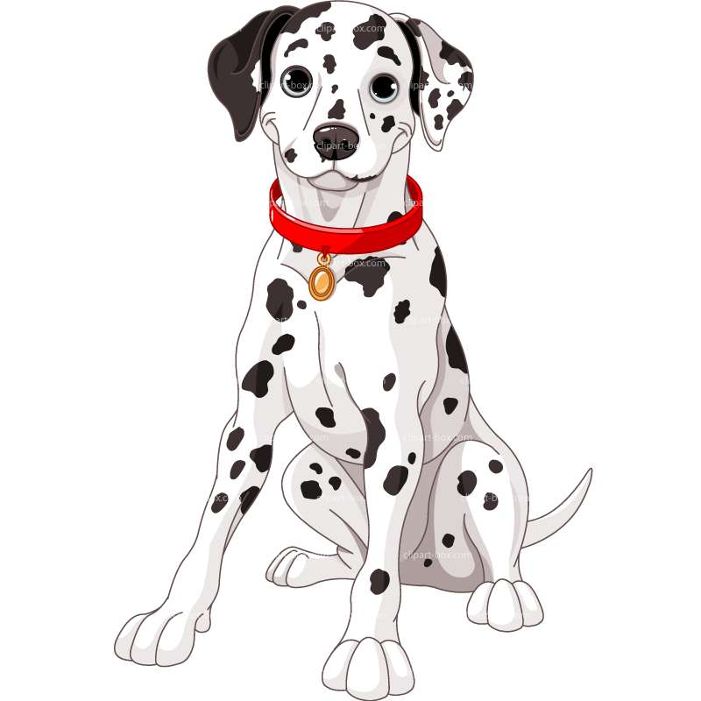
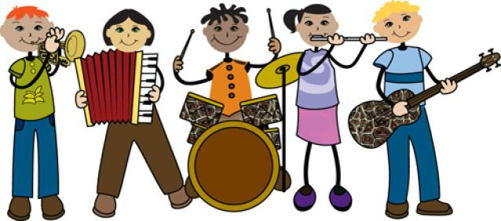
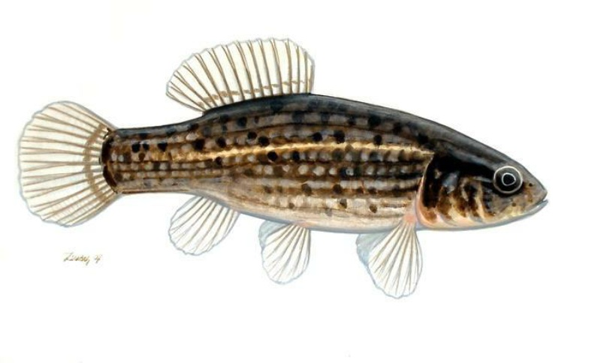
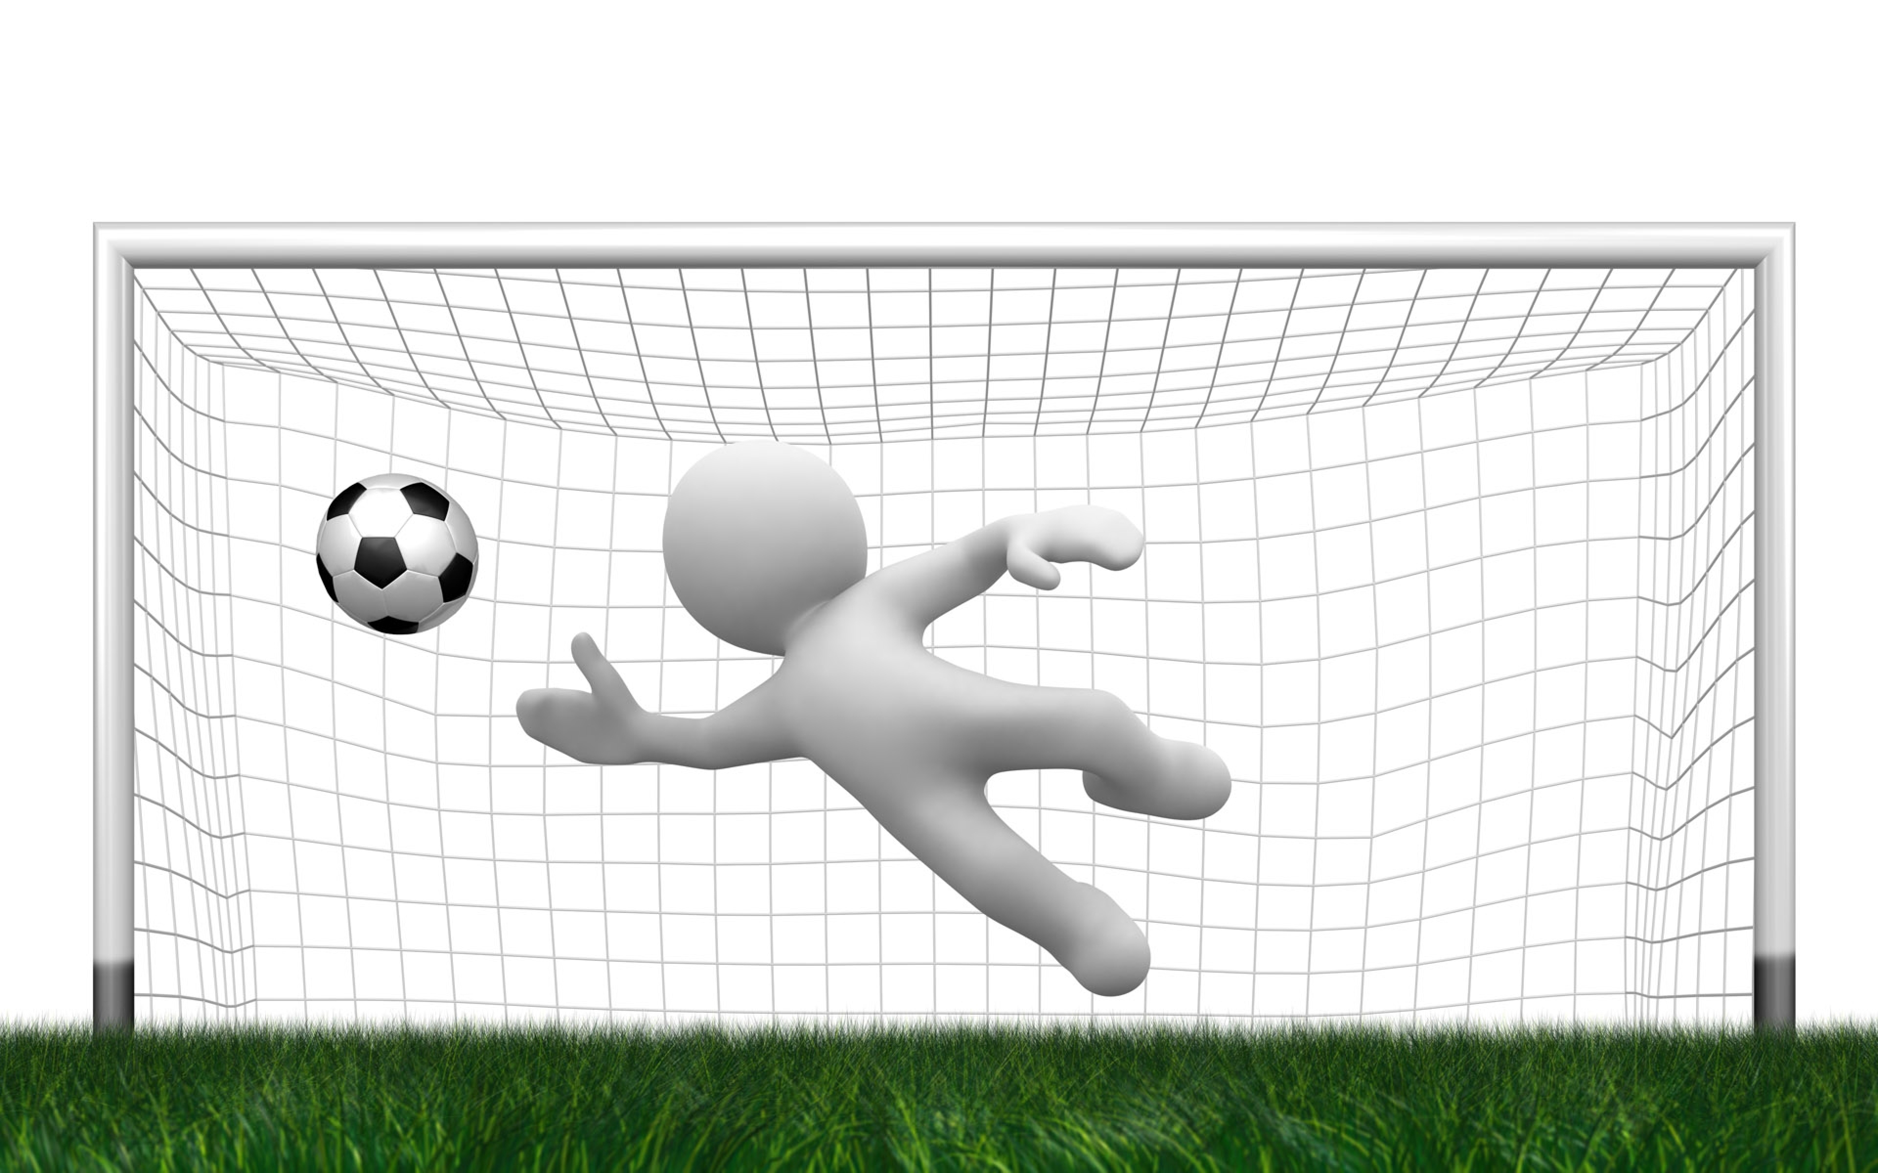
parler
Follow up 1:
Mon mot préféré est ‘dalmatien’ !
Ton mot préféré, c’est quoi ?
A
Mon mot préféré est ______ .
Bienvenue !
Keep talking until you have mentioned all 8 words!
Mon mot préféré est ___________ .
gardien de but
B
A
Mon mot préféré est ___________ .
de rien !
Bienvenue !
dalmatien
De rien !
comédien
musicien
poisson-chien
gardien de but
végétarien
Notes:
Timing: 5 minutes
Aim: to practise saying what their favourite word is using the new adjective ‘preféré’; to practise reading aloud unknown words with the SSC [ien]
Procedure:
Model the task with pupils, using the sequence provided.
Pupils keep talking until they have used all the words.
Provide support as needed for the class or individuals.
If needed, the pronunciation of each word can be heard by clicking on the image.
Note: poisson-chien is a type of fish called European mudminnow in English (not dog fish!). https://fr.wikipedia.org/wiki/Poisson-chien
4

Slide 5
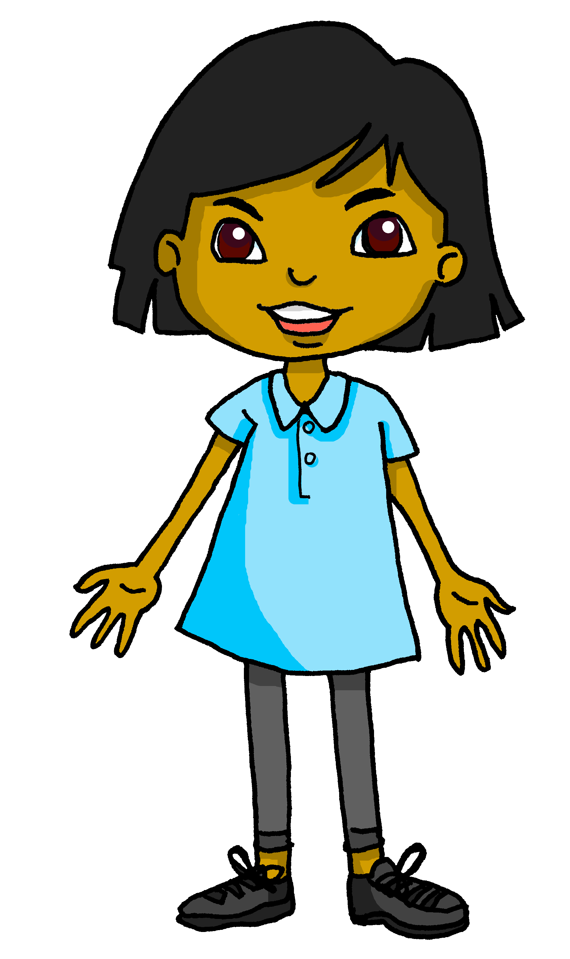
Follow up 2:
Adèle parle en ligne avec Sanaya. [1/2]
Écoute. La réponse correspondante, c’est quoi ?
écouter
1
A
Sept.
2
B
D
Oui, mon groupe préféré est BTS.
Oui.
3
C
Dynamite.
4
Notes:
Timing: 5 minutes (two slides)
Aim: to practise aural comprehension of a longer exchange.
Procedure:
1. Clarify the context; Adèle’s class is talking to Sanaya’s class in England. 2. Tell pupils they need to decide (as they listen) what Sanaya’s answer to each question is.
3. Then click to listen to each question. Pupils select the most appropriate answer from those given (A, B, C, D).
4. Move to the next slide.

Slide 6
Follow up 2:
Adèle parle en ligne avec Sanaya. [2/2]
B
écouter
Oui.
Tu aimes la musique ?
Tu as un groupe préféré ?
D
Oui, mon groupe préféré est BTS.
Il y a combien de personnes dans le groupe ?
A
Il y a sept personnes.
Tu as une chanson préférée ?
C
Oui, ma chanson préférée est Dynamite.
Notes:
Procedure:
1. Click the audio button to listen and read the full conversation. Alternatively, click on each individual line, if preferred.
2. Pupils read the conversation aloud in pairs.

Slide 7
Follow up 3:
Ta chose préférée, c’est quoi ?
.
Parle avec ton/ta partenaire. Pose des questions.
parler
Ton livre préféré, c’est quoi ?
Ta chanson préférée, c’est quoi ?
Ton émission préférée,
c’est quoi ?
A
A
A
Mon livre préféré est Gangsta Granny.
Ma chanson préférée est Firework.
Mon émission préférée est The Voice.
B
B
B
Notes:
Timing: 5 minutes (two slides)
Aim: to practise asking and answering questions about favourite things.
Procedure:
Use this slide to model the task.
Click to bring up the question and answer.
Move to the next slide to do the activity.

Slide 8
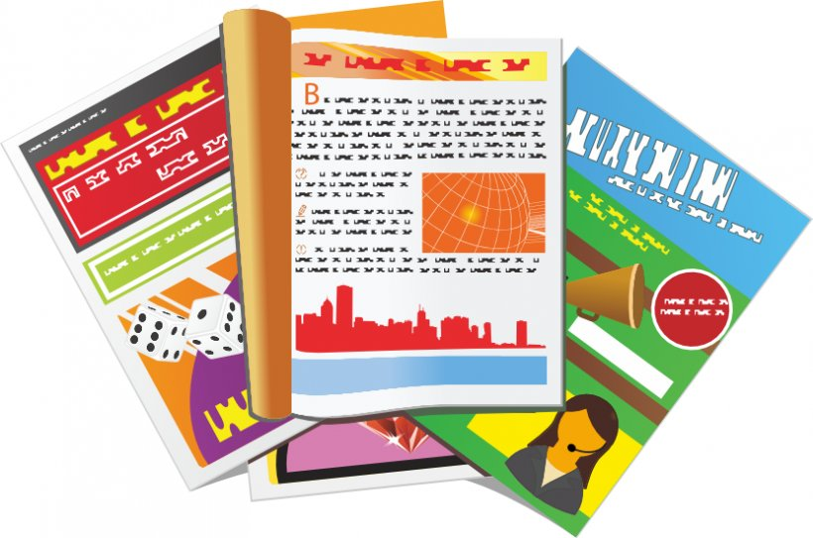
Follow up 3:
Ta chose préférée, c’est quoi ?
.
Parle avec ton/ta partenaire. Pose des questions.
parler
Mon
le film
Notes:
Timing: 5 minutes
Aim: to practise asking and answering questions about favourite things.
Procedure:
1. Pupil A asks: “Ton livre préféré, c’est quoi ? Pupil B responds, giving his/her favourite book: “Mon livre préféré est…”
2. Questions continue until everything has been asked about.
3. Then pupils swap roles.
Additional task suggestions: 1. Instead, pupils could take it in turns asking about any of the items.
2. For more support, teachers could put the nouns in French under the items (livre, magazine, jour, film, chanson, émission, affiche), or jumbled up at the bottom of the slide.

Slide 9
Follow up 4
Écris en anglais.
How many points can you get?
mots
 | la radio | l’émission | la tante
 | la télévision | petite | grand
 | de | la porte | blanche
 | le magazine | blanc | noir
 | sportif | active | sale
 | préféré | la chose | propre
 | massif | sportive | actif
(the) radio
(the) programme
(the) aunt
vocabulaire
x3
(the) tv
short, small (f)
tall, big (m)
of, from
(the) door
white (f)
x2
(the) magazine
white (m)
black (m)
sporty (m)
active (f)
dirty (m/f)
favourite (m)
(the) thing
clean (m/f)
x1
massive (m)
sporty (f)
active (m)
Notes:
Timing: 5 minutes
Aim: to practise written comprehension of vocabulary from week 1, last week and this week.
Procedure: 1. Give pupils a blank grid. They fill in the English meanings of any of the words they know, trying to reach 15 points in total. 2. Remind pupils that adjectives can refer to male or female persons and they should note this in their translations. E.g. pleased (f), short (m).
Note: The most recently learnt and practised words are pink, words from the previous week are green and those from week 1 are blue, thus more points are awarded for them, to recognise that memories fade and more effort (heavy lifting!) is needed to retrieve them.

Slide 10
Follow up 4
Écris en français. How many points can you get?
mots
 | (the) aunt | (the) programme | (the) radio
 | tall, big (f) | short, small (m) | (the) television
 | white (f) | black (f) | of, from
 | (the) door | (the) magazine | white (m)
 | sporty (m) | active (f) | sporty (f)
 | favourite (f) | clean (m/f) | dirty (m/f)
 | (the) thing | active (m) | massive (f)
la tante
l’émission
la radio
vocabulaire
x3
grande
petit
la télévision
blanche
noire
de
x2
la porte
le magazine
blanc
sportif
active
sportive
préférée
propre
sale
x1
la chose
actif
massive
Notes:
Timing: 5 minutes
Aim: to practise written comprehension of vocabulary from week 1, last week and this week.
Procedure: Give pupils a blank grid. They fill in the French meanings of any of the words they know, trying to reach 15 points in total.
Note: The most recently learnt and practised words are pink, words from the previous week are green and those from week 1 are blue, thus more points are awarded for them, to recognise that memories fade and more effort (heavy lifting!) is needed to retrieve them.

Slide 11
Follow up 5
Écris en français.
Écris en anglais.
mon
Voici _____ crayon.___ est blanc.
Il
Ma
écrire
1
_____ chanson préférée est ‘Brave’. Elle _____ unique.
Here is
is
est
_____ ___ my pencil. It ___ white.
4
song
My favourite _________ is ‘Brave’. ___ is unique.
It
Elle
J’aime la musique .___ est __________.
2
importante
I like
___ _____ music. It is important.
Voici
_______ mon _______ . ___ est ____ chose ___________.
5
livre
Il
ma
préférée
3
préférée
Ma personne _________ est ____ tante. Elle est drôle.
Here is ____ book. It is my favourite ___________.
my
ma
thing
My favourite person is my ______. She is ___________.
aunt
funny
Notes:
Timing: 5-10 minutes
Aim: to practise written production and comprehension of language from this week and previous weeks.
Procedure: 1. Pupils use both texts to work out which words are missing.
2. They write the missing words in English and in French from both texts.
3. Elicit the responses orally and click to reveal written answers.

Slide 12
Follow up 4
Écris en anglais. How many points can you get?
mots
 | la radio | l’émission | la tante
 | la télévision | petite | grand
 | de | la porte | blanche
 | le magazine | blanc | noir
 | sportif | active | sale
 | préféré | la chose | propre
 | massif | sportive | actif
vocabulaire
x3
x2
x1
Notes:
HANDOUT

Slide 13
Follow up 4
Écris en français. How many points can you get?
mots
 | (the) aunt | (the) programme | (the) radio
 | tall, big (f) | short, small (m) | (the) television
 | white (f) | black (f) | of, from
 | (the) door | (the) magazine | white (m)
 | sporty (m) | active (f) | sporty (f)
 | favourite (f) | clean (m/f) | dirty (m/f)
 | (the) thing | active (m) | massive (f)
vocabulaire
x3
x2
x1
Notes:
HANDOUT

