Slide 1
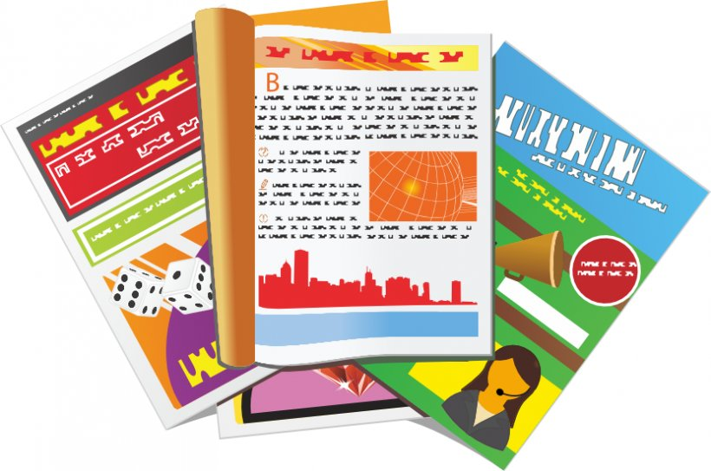
Describing things and people
jaune
il/elle meaning ‘it’
Soft [c], [ç]
Notes:
Artwork by Steve Clarke. Pronoun pictures from NCELP (www.ncelp.org). All additional pictures selected from Pixabay and are
available under a Creative Commons license, no attribution required.
The AUDIO version of the lesson material includes additional audio for the new language
presented (phonics, vocabulary) and audio for the instructions on the slide.
In addition, it includes VIDEO clips of the phonics and the phonics’ source words. Pupils can be
encouraged to look at the shape of the mouth/lips on slides where these appear, and try to copy
it/them.
Phonics: [SFe] [ç] (and soft -c) ici [167] français [251] garçon [1599] cinéma [1623] décider [165]
Vocabulary: elle² [38] il² [13] chanson [2142] livre [358] pratique [842] unique [402] utile [1003] comment [234]
Revisit 1: combien [800] bouche [1838] main [418] œil [474] oreille [1884] pied [626] tête [343] yeux [474] des [2]
Revisit 2: enseigner [2134] poser [218] anglais² [784] français² [251] grand-mère [3883] grand-père [3748] musique [1139] le [1] la [1]
Londsale, D., & Le Bras, Y. (2009). A Frequency Dictionary of French: Core vocabulary for learners London: Routledge.
The frequency rankings for words that occur in this PowerPoint which have been previously introduced in these resources are given
in the SOW and in the resources that first introduced and formally re-visited those words.
For any other words that occur incidentally in this PowerPoint, frequency rankings will be provided in the notes field wherever
possible.
1

Slide 2
[ç/c] soft ‘c’
prononcer
[here]
ici
Notes:
Timing: 1 minute
Aim: To introduce SSC [ç/c]
Procedure: 1. Present the letter(s) and say the [ç/c] sound first, on its own. Pupils repeat it with you. 2. Bring up the word ”ici” on its own, say it, pupils repeat it, so that they have the opportunity to focus all of their attention on the connection between the written word and its sound.
3. A possible gesture for this would be to point to the spot on which one is standing / indicate the room in which the lesson is taking place with a sweeping motion of one’s index finger. 4. Roll back the animations and work through 1-3 again, but this time, dropping your voice completely to listen carefully to the pupils saying the [ç/c] sound, pronouncing ”ici” and, if using, doing the gesture.
2

Slide 3
[ç/c] soft ‘c’
Remember! ‘c’ is soft (like ‘s’) before e or i, and hard before a, o, u.
prononcer
cinéma
décider
[here]
français
garçon
ici
To make ‘c’ soft before a, o, u, ç (cedilla) is used.
Notes:
Timing: 2 minutes
Aim: to consolidate SSC [ç/c]
Procedure:
1. Introduce and elicit the pronunciation of the individual SSC [ç/c] and then the source word again ‘ici’ (with gesture, if using). 2. Then present and elicit the pronunciation of the five cluster words.
The cluster words have been chosen for their high-frequency, from a range of word classes, with the SSC (where possible) positioned within a variety of syllables within the words (e.g. initial, 2nd, final etc.). Additionally, we have tried to use words that build cumulatively on previously taught SSCs (see the Phonics Teaching Sequence document) and do not include new SSCs. Where new SSCs are used, they are often consonants which have a similar symbol-sound correspondence in English.
Word frequency (1 is the most frequent word in French): français [251] garçon [1599] cinéma [1623] décider [165] ici [167]. Source: Londsale, D., & Le Bras, Y. (2009). A Frequency Dictionary of French: Core vocabulary for learners London: Routledge.
3

Slide 4
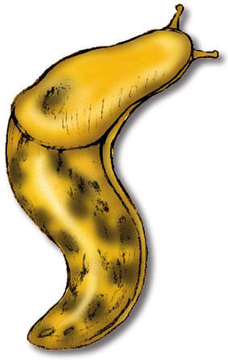
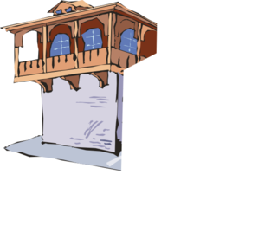
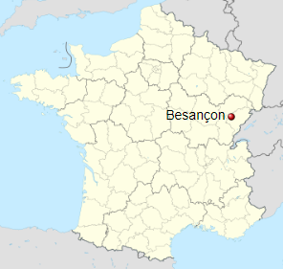
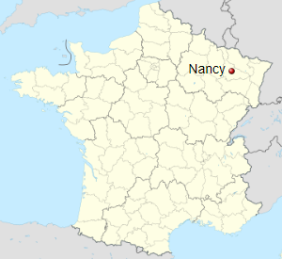
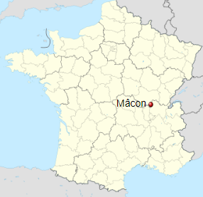
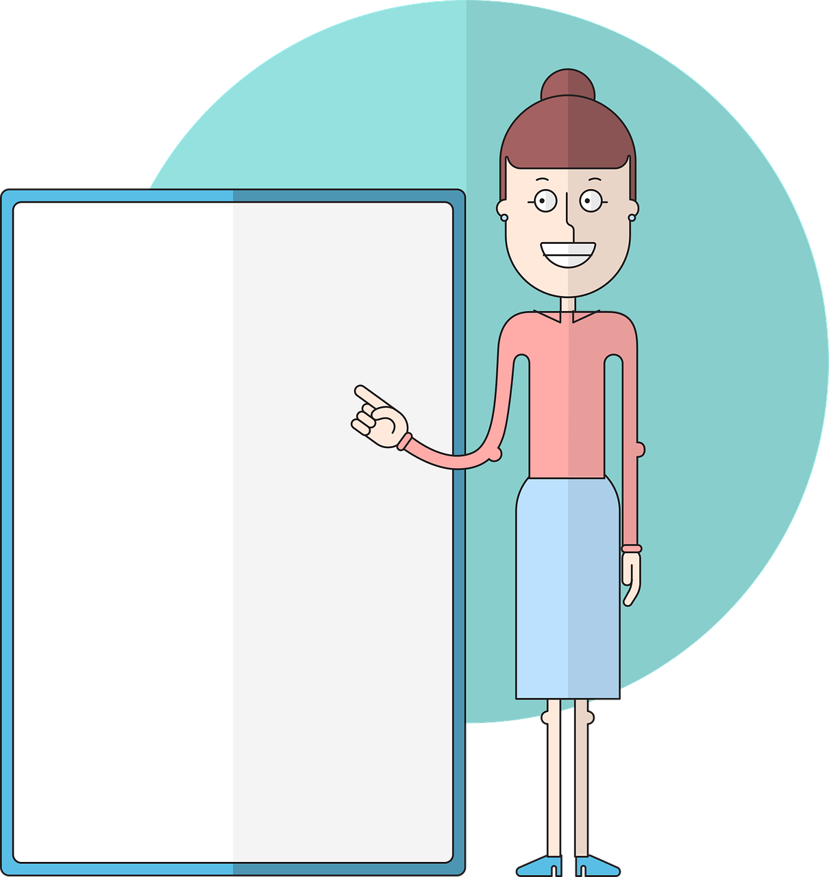
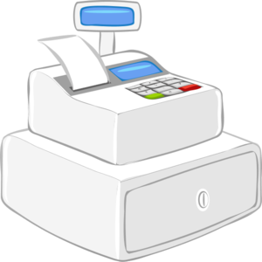
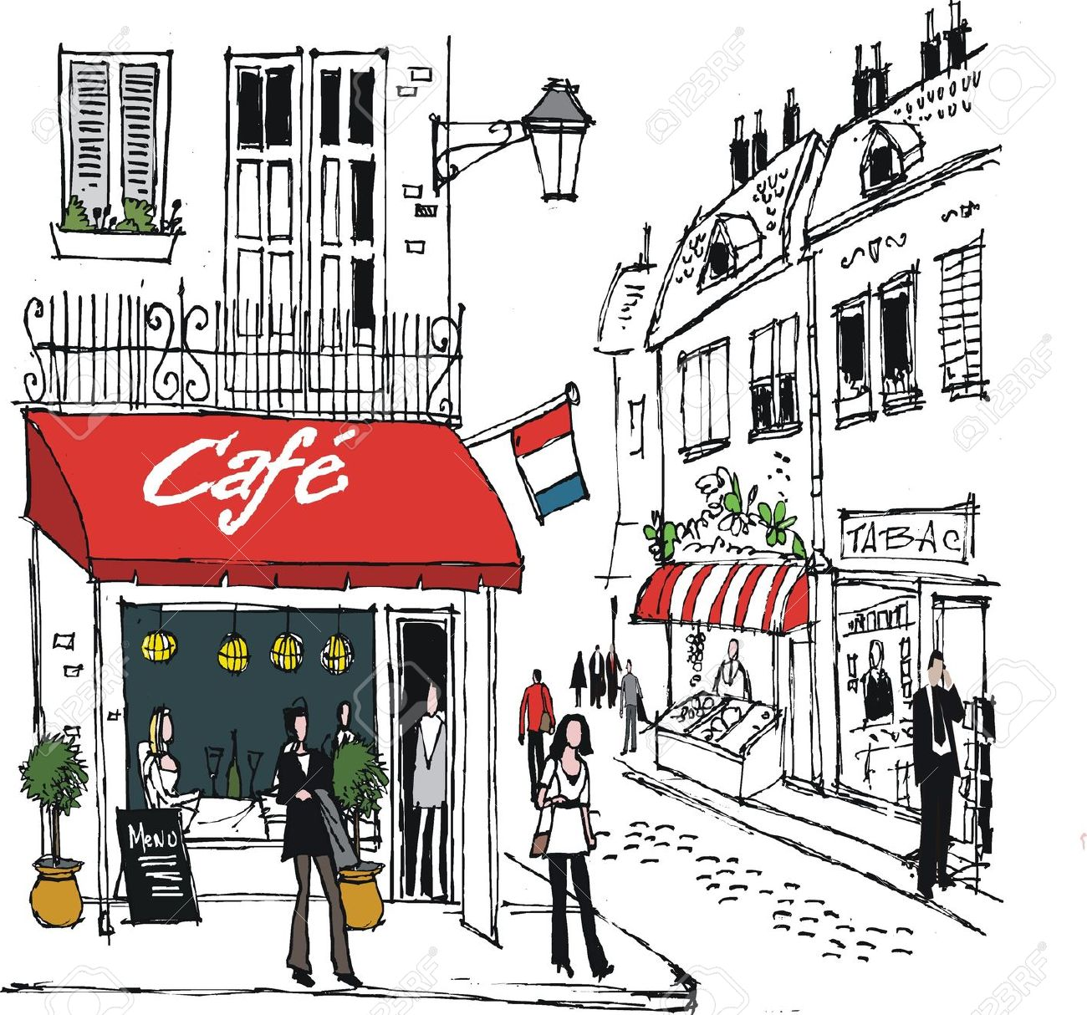
prononcer
Prononce les mots pour ton/ta partenaire.
Il/elle identifie l’intrus.
l’intrus – odd one out
B
 | maçon | avocat | policier
 | escargot | insecte | limace
 | façade | façon | balcon
1
2
3
way, manner
A
 | Besançon | Nancy |Mâcon
 | leçon | école | français
 | caisse | café | centre
4
5
6
Notes:
Timing: 3 minutes
Aim: To revisit SSC [c/ç] and [c].
Procedure:
Introduce the task. Explain that pupil B will turn away from the board, pupil A will pronounce 3 x words and B has to identify the odd one out – the one that has a different [c] sound from the other two.
Pupil Bs turn away. Click for the table of words.
Pupil As pronounce the words. Pupils Bs write down the one they think is the odd one out for all three sets.
Pupil Bs turn back to face the board and the teacher elicits the responses and clicks to confirm.
Repeat steps 2 – 4 with Pupil As.
Word frequency (1 is the most frequent word in French): avocat [1188] balcon [>5000] café [1886] caisse [1881] centre [491] escargot [>5000] façade [4029] façon [[248] insecte [>5000] leçon [1300] limace [>5000] maçon [>5000] policier [1265]
Source: Londsale, D., & Le Bras, Y. (2009). A Frequency Dictionary of French: Core vocabulary for learners London: Routledge.
4

Slide 5
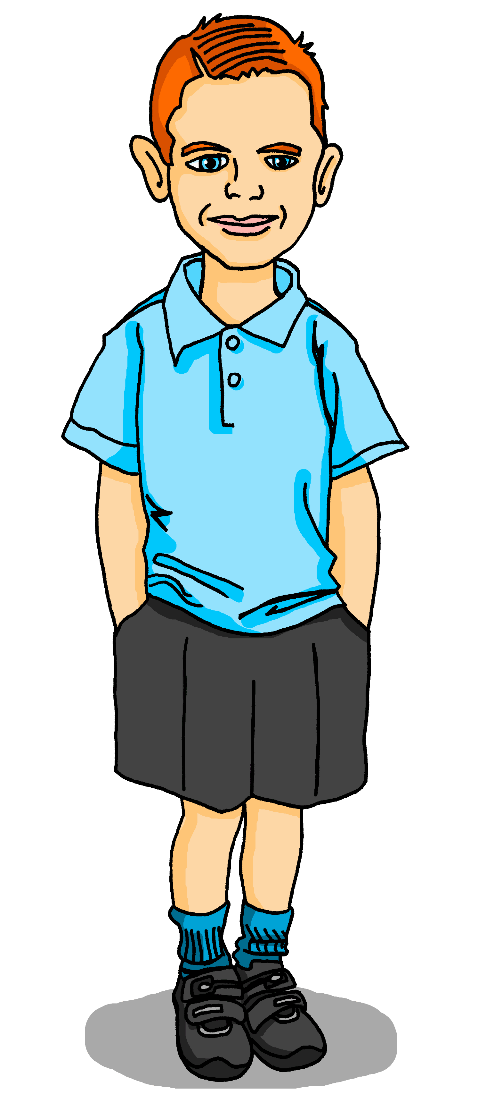
lire
Pierre aide* Max avec le vocabulaire. [1/2]
aider – to help
mots
vocabulaire
le livre
la chanson
unique
pratique
utile
comment ?
00
00
00
00
00
c_ _ _ _ _ t ?
how?
00
u_ _ _e
useful
00
00
_ _ l_ _ _ e
book
e_ _ _
she, it
il
i_ he, it
p_ _ _ _ _ _ _
practical
_ _ c_ _ _ _ _n
song
u_ _ _ _e
unique
elle
Notes:
Timing: 5 minutes [2 slides] 1/2
Aim: to introduce new vocabulary for this week.
Procedure: 1. Pupils either work in pairs or chorally as a class, reading the French words out loud.
2. Click to start the animation sequence.
3. Pupils call out the French & English (e.g. elle – she, it) before the flashcard disappears.
NB. Teacher can do another round to check comprehension, eliciting English meaning of the words on the board (i.e. pratique, c’est quoi en anglais ?), before moving to next slide.
Note: i) In the audio version of the lesson, you can click on each word on the board to hear the pronunciation.
ii) Each mini flashcard animation sequence is started on a mouse click.
5

Slide 6
lire
Pierre aide* Max avec le vocabulaire. [2/2]
aider – to help
elle
comment ?
la chanson
pratique
le livre
utile
il
c_ _ _ _ _ t ?
how?
00
00
00
00
00
00
00
00
_ _ l_ _ _ _
book
u_ _ _ e
useful
e_ _ _
she, it
i _
he, it
p_ _ _ _ _ _e
practical
u _ _ _ _e
unique
_ _ c_ _ _ _ _n
song
unique
Notes:
2/2
Procedure: 1. Pupils either work in pairs or chorally as a class, saying the French words out loud, using the hints in the flashcard(s).
2. Click to start the animation sequence.
3. Pupils call out the English & French (e.g. song – la chanson) before the flashcard disappears. The French words appears on the board after the flashcards has disappeared completely.
Note: Each flashcard animation sequence is started on a mouse click.
Note: Further rounds of learning can be facilitated by one pupil turning away from the board, and his/her partner asking him/her the meanings (‘XXXX, c’est quoi en français/anglais ?’). This activity can work from L2 → L1 or L1 → L2.
6

Slide 7
Saying ‘the’ in French
Remember that to say ‘the’ in French we say ‘le’ for masculine nouns and ‘la’ for feminine nouns:
Remember! English just has one word: ‘the’
J’aime le livre.
I like the book.
J’aime la chanson.
I like the song.
You can’t guess if a word is masculine or feminine, you have to learn the gender of each noun.
Notes:
Timing: 2 minutes
Aim: to recap the use of ‘le’ and ‘la’ to mean ‘the’ with masculine / feminine nouns.
Procedure:
Click through the animations to present the knowledge orally and in writing.
Elicit the English meanings for the French examples.

Slide 8
écouter
Max aime quoi ?
.
Écoute les messages de Max. Il aime quoi ?
1
5
sport | musique
moto | cheval
2
6
word
chanson | livre
chanson | mot
3
7
magazine | télévision
voyage | visite
4
8
groupe | personne
réponse | message
Notes:
Timing: 7 minutes
Aim: to practise aural distinction between ‘le’ and ‘la’ and the connection between article and noun with new and previously taught nouns.
Procedure:
Explain to pupils that the messages are not complete but that they will still know what Max’s likes are by listening out for the article le/la.
Click to play audio.
Pupils write the noun that Max likes, dependent on the article they hear.
Click to check the answer for number 1 and clarify any misunderstandings.
Repeat for items 2-8.
Click to check answers.
Optional: teachers may want to elicit Max’s likes again, orally. E.g., Max aime quoi ? Par exemple, il aime…?
Transcript:
J’aime la [musique].
J’aime le [livre].
J’aime le [magazine].
J’aime la [personne].
J’aime la [moto].
J’aime la [chanson].
J’aime le [voyage].
J’aime le [message].
8

Slide 9
Saying ‘it’ in French
Remember that to say ‘he’ and ‘she’ in French we say ‘il’ and ‘elle’:
Comment ? means how? but il/elle est comment ? (It is how?) means What is it like?
Pierre a un livre.
He has a book.
Il a un livre.
We also use ‘il’ and ‘elle’ to mean ‘it’:
We use ‘il’ for masculine nouns and ‘elle’ for feminine nouns:
Il est comment ?
Le livre est utile.
Il est utile.
It is useful.
Elle est comment ?
La chanson est unique.
Elle est unique.
It is unique.
Remember! Adjectives already ending in –e are spelt the same for masculine and feminine nouns.
Notes:
Timing: 2 minutes
Aim: to introduce the use of il / elle to mean ‘it’ with masculine / feminine nouns
Procedure:
Click through the animations to present the new knowledge orally and in writing.
Elicit the English meanings for the French examples.

Slide 10
lire
What is ‘it’?
The word ‘it’ is a pronoun. This means it replaces a noun:
 |  | What is ‘it’ ? | What is it like?
1 | The pencil is useful. | the pencil | It is useful.
2 | The song is unique. | the song | It is unique.
3 | The motorbike is fast. | the motorbike | It is fast.
4 | The book is practical. | the book | It is practical.
In English there is only one word for it, no matter which noun it replaces.
 |  | What is ‘it’ ? | What is it like?
1 | Le crayon est utile. | le crayon | Il est utile.
2 | La chanson est unique. | la chanson | Elle est unique.
3 | la moto est rapide. | la moto | Elle est rapide.
4 | Le livre est pratique. | le livre | Il est pratique.
In French, the word for ‘it’ changes. It is ‘il’ if the noun it replaces is masculine and ‘elle’ for a feminine noun.
1
2
3
4
Notes:
Timing: 7 minutes
Aim: to reinforce the knowledge that the word for ‘it’ in French varies depending on the noun it replaces, while in English it does not.
Procedure:
Pupils identify the noun that ‘it’ replaces in each of the English sentences.
Then they answer the question what is ‘it’ like? to focus on the repetition of ‘it’ for all four English sentences.
2. Do the same for the French sentences.
3. Teacher highlights the difference between the two languages and emphasises the need to think about the gender of the noun being replaced in French.
10

Slide 11
Au revoir !
jaune
Notes:
11

