Slide 1
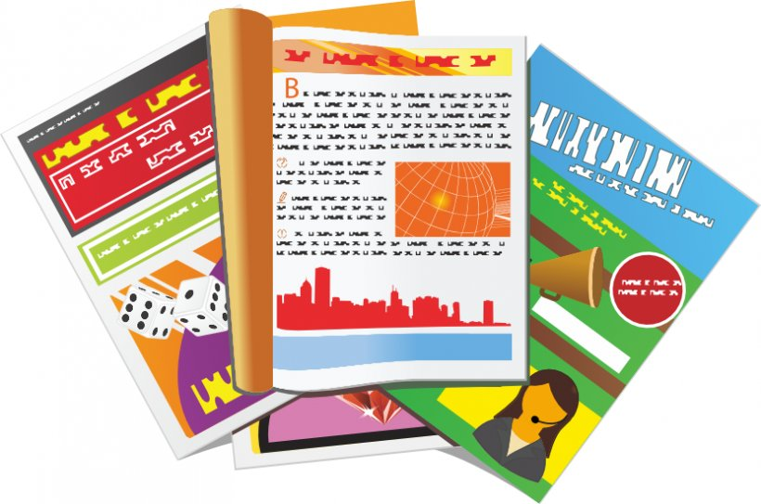
Describing things and people
jaune
Follow ups 1-5
Notes:
Artwork by Steve Clarke. Pronoun pictures from NCELP (www.ncelp.org). All additional pictures selected from Pixabay and are
available under a Creative Commons license, no attribution required.
The AUDIO version of the lesson material includes additional audio for the new language
presented (phonics, vocabulary) and audio for the instructions on the slide.
In addition, it includes VIDEO clips of the phonics and the phonics’ source words. Pupils can be
encouraged to look at the shape of the mouth/lips on slides where these appear, and try to copy
it/them.
Phonics: [SFe] [ç] (and soft -c) ici [167] français [251] garçon [1599] cinéma [1623] décider [165]
Vocabulary: elle² [38] il² [13] chanson [2142] livre [358] pratique [842] unique [402] utile [1003] comment [234]
Revisit 1: combien [800] bouche [1838] main [418] œil [474] oreille [1884] pied [626] tête [343] yeux [474] des [2]
Revisit 2: enseigner [2134] poser [218] anglais² [784] français² [251] grand-mère [3883] grand-père [3748] musique [1139] le [1] la [1]
Londsale, D., & Le Bras, Y. (2009). A Frequency Dictionary of French: Core vocabulary for learners London: Routledge.
The frequency rankings for words that occur in this PowerPoint which have been previously introduced in these resources are given
in the SOW and in the resources that first introduced and formally re-visited those words.
For any other words that occur incidentally in this PowerPoint, frequency rankings will be provided in the notes field wherever
possible.

Slide 2
Follow up 1
Prononce les mots. La catégorie, c’est quoi ?
pays | musique | description | école | médias
prononcer
le Canada
la chanson
nécessaire
le crayon
le magazine
la Belgique
le piano
calme
la classe
le livre
mots
la France
chanter
facile
la leçon
l’émission
vocabulaire
le crayon
le magazine
la classe
le livre
le Canada
nécessaire
calme
la leçon
la chanson
l’émission
la France
le piano
facile
la Belgique
chanter
Notes:
Timing: 5 minutes
Aim: to practise pronunciation of known words and unknown cognates; to practise written comprehension of vocabulary by categorising into themes.
Procedure:
Tell pupils they need to pronounce all the words and also group them into 5 categories, each with three words.
Do the first one with pupils. Say: ‘Le pays, c’est quoi en anglais ?’ Country – bien. Il y a trois pays ….Pays numéro un, c’est… ?
Pupils work in pairs to say all the words and decide which words belong in which category.
Elicit the answers and click on each word to move it to its correct category.

Slide 3
Follow up 2
It – il ou elle ?
Lis. Pierre décrit des choses. Écris A ou B.
lire
 |  | a | b
1 | Elle est pratique.
2 | Il est important.
3 | Il est rapide.
 |  | a | b
4 | Elle est jolie.
5 | Il est unique.
6 | Il est utile.
1
4
2
5
3
6
Notes:
Timing: 5 minutes
Aim: written recognition of gender agreement with il / elle meaning ‘it’.
Procedure:
1. Teacher to check pupils know the gender of nouns before they do the activity. Ensure that pupils realise that this is the only way they can identify the correct answer.
2. Write 1-6 and choose if the pronoun refers to the noun in picture ‘a’ or ‘b’.
3. Click to reveal the answers.
4. Note: in the audio version, click the numbered buttons to hear the full sentences, if required.

Slide 4
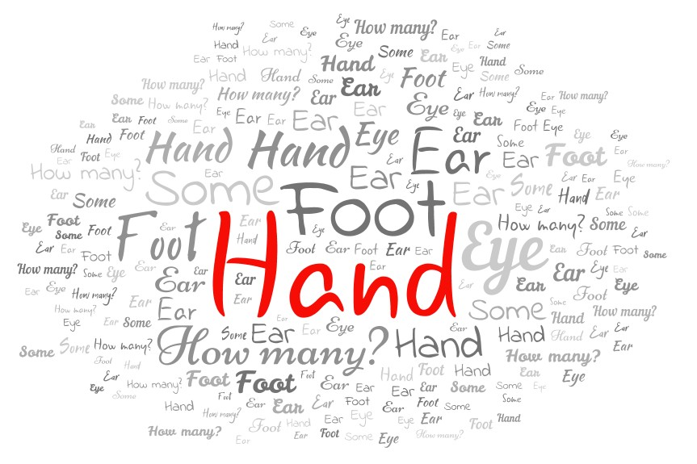
Follow up 3a:
Écoute et écris en anglais. [1/2]
.
écouter
E
(the) hand
1
(the) foot
2
(the) mouth
3
(the) eye
4
(the) ear
5
some
6
how many?
Notes:
Timing: 5 minutes (two slides)
Aim: to practise aural comprehension of revisited vocabulary.
Procedure:
Slide 1 - Click to listen. Pupils write the correct word or phrase in English. The word cloud is a scaffold as all the words are there.
Click to reveal answers.
Transcript:
Exemple : la main
le pied
la bouche
l’œil
l’oreille
des
combien ?

Slide 5
Follow up 3b:
.
Écoute et écris en anglais. [2/2]
1. This is my ________________. _____ is funny.
2. Hervé, my dad, _________________ _____________.
3. Adèle _______________ sport. _____ is _____________.
4. Me, I like ____ __________ ‘Brave’. __________ is unique.
5. My _________________ is French _______ she speaks _________.
6. She has ____ _________ in English. ________ is _______ useful.
écouter
grandad
He
teaches
music
prefers
It
practical
the song
It
grandma
but
English
a book
It
very
Notes:
Timing: 5 minutes
Aim: to practise aural comprehension of revisited vocabulary.
Procedure:
Slide 2 - Pupils listen to the example and 1-5 and write the missing English words.
Click to reveal answers.
Transcript:
Voici mon grand-père. Il est drôle.
Hervé, mon père, enseigne la musique.
Adèle préfère le sport. Il est pratique.
Moi, j’aime la chanson ‘Brave’. Elle est unique.
Ma grand-mère est française mais elle parle anglais.
Elle a un livre en anglais. Il est très utile.

Slide 6
Follow up 4:
Tu préfères... ou...?
. Écoute les noms des animaux. C’est [ien] ou [(a)in]?
Parle avec ton/ta partenaire.
parler
1
You can change the name of the song and the book if you like!
Elle est unique.
‘Brave’
‘Matilda’
Tu préfères la chanson ‘Brave’ ou le livre ‘Matilda’ ?
Je préfère la chanson ‘Brave’.
A
Elle est comment ?
B
Add an opinion if you can. E.g., il/elle est unique.
Ask ‘What is it like?’
Notes:
Timing: 5 minutes (two slides)
Aim: to practise giving preferences and opinions, if possible, using the correct word for ‘it’.
Procedure:
Click to model an example question and answer.
Move to the next slide.

Slide 7
Follow up 4:
Tu préfères... ou...?
Add an opinion if you can. E.g., il/elle est unique.
. Écoute les noms des animaux. C’est [ien] ou [(a)in]?
Parle avec ton/ta partenaire.
parler
1
2
3
le film
‘Brave’
‘Matilda’
‘Spiderman’
‘Fireflies’
4
5
6
‘Gangsta Granny’
‘Okido’
‘The Voice’
‘Happy’
7
8
9
Mon
Fri
le jour
le jour
‘Beano’
‘The Voice’
Notes:
Procedure:
Pupils ask and answer questions about preferences using the picture prompts. They can change the names of the items to something they know their partner will know. The teacher could also change the names of the items as s/he will know about the individuals in the class. Note: there are no answers provided as pupils will answer according to their own preferences.

Slide 8
vocabulaire
Écris en anglais : Can you get at least 15 points?
Follow up 5:
mots
 | le | enseigner | la grand-mère
 | la | poser | le grand-père
 | l’anglais | la musique | le français
 | la tête | la bouche | le pied
 | la main | l’œil | deux yeux
 | l’oreille | la tête | combien ?
 | le livre | la chanson | comment ?
 | pratique | utile | unique
the (m)
to teach, teaching
(the) grandma
the (f)
to put, ask (a question)
(the) grandad
x3
(the) English
(the) music
(the) French
(the) head
(the) mouth
(the) foot
(the) hand
(the) eye
two eyes
x2
(the) ear
(the) head
how many?
(the) book
(the) song
how?
x1
practical (m/f)
useful (m/f)
unique (m/f)
Notes:
Timing: 5 minutes
Aim: to practise written comprehension of vocabulary from week 1, last week and this week.
Procedure: 1. Give pupils a blank grid. They fill in the English meanings of any of the words they know, trying to reach 15 points in total. 2. Remind pupils that adjectives can refer to male or female persons and they should note this in their translations. E.g. pleased (f), short (m).
Note: The most recently learnt and practised words are pink, words from the previous week are green and those from week 1 are blue, thus more points are awarded for them, to recognise that memories fade and more effort (heavy lifting!) is needed to retrieve them.
8

Slide 9
vocabulaire
Écris en français : Can you get at least 15 points?
Follow up 5:
mots
 | (the) grandad | (the) grandma | (the) French
 | (the) music | to put, ask (a questions) | (the) English
 | the (m) | to teach, teaching | the (f)
 | (the) eye | (the) hand | (the) head
 | (the) ear | (the) foot | some
 | how many? | (the) mouth | two eyes
 | useful | unique | how?
 | (the) song | (the) book | practical
le grand-père
la grand-mère
le français
la musique
poser
l’anglais
x3
le
enseigner
la
l’œil
la main
la tête
l’oreille
le pied
des
x2
combien ?
la bouche
deux yeux
utile
unique
comment ?
x1
la chanson
le livre
pratique
Notes:
Timing: 5 minutes
Aim: to practise written production of vocabulary from this week, and previously taught vocabulary.
Procedure: 1. Give pupils a blank grid. They fill in the French meanings of any of the words they know, trying to reach 15 points in total.
Note: The most recently learnt and practised words are pink, words from the previous week are green and those from week 1 are blue, thus more points are awarded for them, to recognise that memories fade and more effort (heavy lifting!) is needed to retrieve them.
9

Slide 10
vocabulaire
Écris en anglais: Can you get at least 15 points?
Follow up 5:
mots
 | le | enseigner | la grand-mère
 | la | poser | le grand-père
 | l’anglais | la musique | le français
 | la tête | la bouche | le pied
 | la main | l’œil | deux yeux
 | l’oreille | la tête | combien ?
 | le livre | la chanson | comment ?
 | pratique | utile | unique
x3
x2
x1
Notes:
HANDOUT
10

Slide 11
vocabulaire
Écris en français: Can you get at least 15 points?
Follow up 5:
mots
 | (the) grandad | (the) grandma | (the) French
 | (the) music | to put, ask (a questions) | (the) English
 | the (m) | to teach, teaching | the (f)
 | (the) eye | (the) hand | (the) head
 | (the) ear | (the) foot | some
 | how many? | (the) mouth | two eyes
 | useful | unique | how?
 | (the) song | (the) book | practical
x3
x2
x1
Notes:
HANDOUT
11

