Slide 1
Describing things and people
jaune
Adjectives after the noun
SFe – Silent Final [e]
Notes:
Artwork by Steve Clarke. Pronoun pictures from NCELP (www.ncelp.org). All additional pictures selected from Pixabay and are
available under a Creative Commons license, no attribution required.
The AUDIO version of the lesson material includes additional audio for the new language
presented (phonics, vocabulary) and audio for the instructions on the slide.
In addition, it includes VIDEO clips of the phonics and the phonics’ source words. Pupils can be
encouraged to look at the shape of the mouth/lips on slides where these appear, and try to copy
it/them.
Phonics: revisit [SFe] timide [3835] monde [77] moderne [1239] centre [491] douze [1664]
Frequency of new words:
Vocabulary: groupe [187] liste [924] personne [84] très [66] beaucoup (de) [150]
Revisit 1: il y a [n/a] un [3] deux [41] trois [115] quatre [253] cinq [288] six [450] sept [905] huit [877] neuf [787] dix [372] onze [2447] douze [1664]
Revisit 2: organiser [791] préparer [368] visiter [1378] parc [1240] université [1192] musée [2216] visite [1072] avec [23]
Londsale, D., & Le Bras, Y. (2009). A Frequency Dictionary of French: Core vocabulary for learners London: Routledge.
The frequency rankings for words that occur in this PowerPoint which have been previously introduced in these resources are given
in the SOW and in the resources that first introduced and formally re-visited those words.
For any other words that occur incidentally in this PowerPoint, frequency rankings will be provided in the notes field wherever
possible.
1

Slide 2
écouter
Écoute. Écris les mots en anglais dans le bon ordre.
. Écoute les noms des animaux. C’est [ien] ou [(a)in]?
five seven four
1
four seven five
to prepare to visit to organise
2
to organise to prepare to visit
visit museum university
3
visit museum university
ten twelve two
4
twelve ten two
5
parc avec Marc
park Marc with
she has he has there is/are
6
she has there is/are he has
Notes:
Timing: 5 minutes
Aim: to revisit previously taught vocabulary, first through listening and then oral production
Procedure:
Pupils first listen to sets of three French words at a time. They listen and write the three English words in the order that they hear them in French.
The teacher goes through answers with pupils. The correct order of the words is revealed by animation.
3. Then, as a group, pupils say the French words aloud in the order that they see the English words on the board. The teacher plays the audio after each time they do this, so that pupils are given immediate feedback on their oral production.
Note: pupils could also be challenged to turn away from the board to complete part one of the activity without seeing the answer options. They would then turn back to check their answers and do the oral recall part of the activity.
Transcript:
quatre, sept, cinq
organiser, preparer, visiter
la visite, le musée, l’université
dix, douze, deux
le parc, avec, Marc
elle a, il y a, il a
2

Slide 3
vocabulaire
Vocabulaire
mots
le groupe
la liste
la personne
très
beaucoup (de/d’)
very
Notes:
Timing: 5 minutes
Aim: to present and practise written comprehension and read aloud of the new vocabulary for this week.
Procedure: 1. Click for a French word. Elicit pronunciation from pupils.
2. Click for the English meaning and picture prompt. Elicit the French word again.
3. Present all five words like this, in order.
4. Click for one English meaning to disappear. Elicit the English meaning from pupils. Continue with the remaining items.
5. Click for the French word to disappear. Elicit the French from pupils. Continue with the remaining items.
3

Slide 4
Adjectives following the noun
Remember that French adjectives normally come after the noun.
very
très
In French we say what it is and then what it is like.
a careful cat
un chat prudent
^
^
⚠ Remember: Many adjectives add -e to describe feminine nouns. You then pronounce the final consonant.
a careful person
une personne prudente
a brave group
un groupe courageux
⚠ Remember: Adjectives that end in -eux change to –euse to describe singular feminine nouns.
a brave person
une personne courageuse
Notes:
Timing: 3 minutes
Aim: to recap postnominal adjective agreement and remind pupils about the gender agreement pattern for adjectives ending –eux.
Procedure:
Click through the animations to present the information.
Elicit English translations for the French examples provided.
Callout 1 highlights the difference between English and French.
Callout 2 reminds pupils about gender agreement of adjectives.
Callout 2 reminds pupils about –eux changing to –euse.

Slide 5
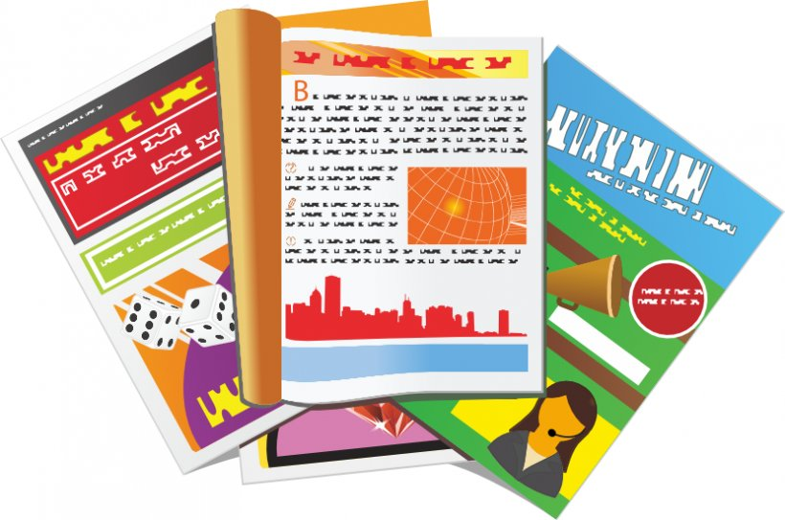
parler
Choisis l’adjectif correct et prononce les phrases.
. Écoute les noms des animaux. C’est [ien] ou [(a)in]?
lire
une question important | importante
un groupe différent | différente
une porte blanc | blanche
un magazine français | française
une personne
indépendant | indépendante
un t-shirt blanc | blanche
Notes:
Timing: 3 minutes
Aim: to reinforce the idea that many adjectives add an –e to describe a feminine noun. We also revisit the two forms for white (blanc/blanche) learnt last week.
Procedure:
Ensure that pupils understand the task.
Elicit each phrase chorally from pupils and click to confirm the correct adjective form.
5

Slide 6
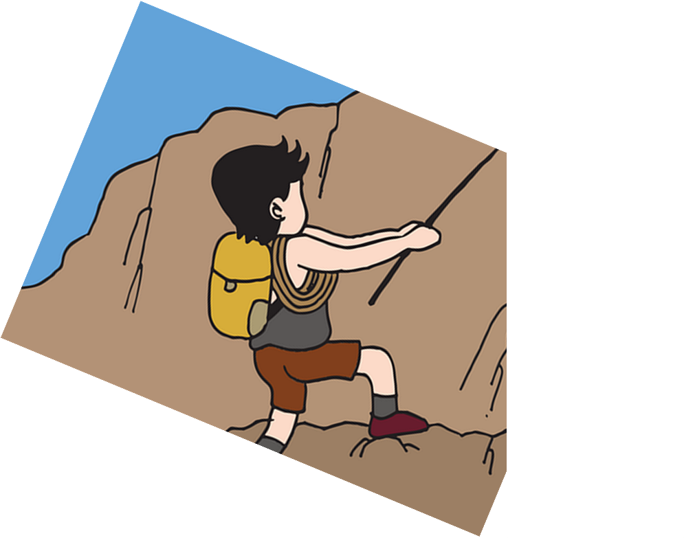
parler
. [(a)in]?
Parle en français.
1. He has your French word.
lire
anglais
française
français
5
mot
carte
message
4
ta
mon
un
ton
3
ai
a
as
y a
2
Elle
Tu
Il
J’
1
Notes:
Timing: 7 minutes [8 slides]
Aim: to use correct forms of avoir, determiner, noun and adjective.
Procedure:
Tell students they need to use the words, starting from the bottom, to climb up the mountain (so that they translate the sentence!).
Ask students to work in pairs to practise first.
Click to trigger the timer (15 seconds per sentence).
Ask a volunteer from a pair to say the French sentence out loud.
Click on the English sentence to hear the French translation.
Repeat with the next 5 sentences (there are 6 in total).
Transcript:
Il a ton mot français.
6

Slide 7
parler
2. You have my green hat.
lire
blanc
verte
vert
5
crayon
texte
chapeau
4
ton
mon
ma
un
3
ai
as
a
y a
2
Elle
Tu
Il
J’
1
Notes:
[2/8]
Transcript:
Tu as mon chapeau vert.
7

Slide 8
parler
3. I have a funny aunt.
lire
importante
différente
drôle
5
tante
émission
grand-mère
4
ta
une
un
la
3
ai
a
as
y a
2
Elle
Tu
J’
Il
1
Notes:
[3/8]
Transcript:
J’ai une tante drôle.
8

Slide 9
parler
4. Does he have an important question?
lire
important
difficile
importante
5
livre
question
magazine
4
le
la
un
une
3
ai
a
as
aime
2
Il
Tu
Elle
J’
1
Notes:
[4/8]
Transcript:
Il a une question importante ?
9

Slide 10
parler
5. There is a happy group.
lire
heureux
curieux
heureuse
5
personne
ami
groupe
4
un
le
une
la
3
ai
y a
aime
a
2
Elle
Tu
Il
J’
1
Notes:
[5/8]
Transcript:
Il y a un groupe heureux.
10

Slide 11
parler
6. She likes your white bedroom.
lire
blanc
noir
blanche
idéale
5
chambre
chaise
bureau
4
ton
mon
un
ta
3
aimes
aime
a
y a
2
J’
Il
Elle
Tu
1
Notes:
[6/8]
Transcript:
Elle aime ta chambre blanche.
11

Slide 12
parler
7. He has lots of messages.
lire
5
messages
voyages
mots
idées
4
des
deux
beaucoup de/d’
3
aimes
a
aime
y a
2
J’
Elle
Il
Tu
1
Notes:
[7/8]
Transcript:
Il a beaucoup de messages.
12

Slide 13
parler
8. There are lots of ideas there.
lire
ici
là
5
idées
voyages
mots
messages
4
des
deux
beaucoup de/d’
3
aimes
y a
aime
a
2
J’
Elle
Il
Tu
1
Notes:
[8/8]
Transcript:
Il y a beaucoup d’idées l$à$.
13

Slide 14
Écris en français.
.
1
There are lots of answers here.
écrire
Il y a beaucoup de réponses ici.
2
I have a very easy question.
J’ai une question très facile.
3
She has an important list...
Elle a une liste importante…
4
…but he has an interesting question and a different idea.
mais il a une question intéressante et une idée différente.
5
Do you have your radio?
Tu as ta radio?
Notes:
Timing: 9 minutes
Aim: to practise written produce of vocabulary and grammar structures practised in this and previous lessons (j’ai and tu as, vocabulary knowledge, order of nouns & adjectives, indefinite articles (un/une), adjective agreement).
Procedure:
1. Recap the grammar points outline above as ‘things to remember’ before students begin the task.
2. Ask pupils to translate the first sentence. Give the them time and give feedback before they complete the remaining sentences.
3. Click to reveal answers.
Note that teachers might choose to provide parts of the sentences on slide and leave only certain words for pupils to write independently. In addition, as most of these words were previously taught, learners who need additional support could refer to previous Knowledge Organisers, if needed.
Differentiation: For an activity with more support for learners, note that teachers could use this slide for transcription practice (they could further differentiate this by providing parts of the sentences and leaving only certain words or letters for transcription).

Slide 15
Au revoir !
jaune
Notes:
15

