Slide 1
Describing things and people
jaune
Follow ups 1-5
Notes:
Artwork by Steve Clarke. Pronoun pictures from NCELP (www.ncelp.org). All additional pictures selected from Pixabay and are available under a Creative Commons license, no attribution required.
Phonics: revisit [SFe] timide [3835] monde [77] moderne [1239] centre [491] douze [1664]
Frequency of new words:
Vocabulary: groupe [187] liste [924] personne [84] très [66] beaucoup (de) [150]
Revisit 1: il y a [n/a] un [3] deux [41] trois [115] quatre [253] cinq [288] six [450] sept [905] huit [877] neuf [787] dix [372] onze [2447] douze [1664]
Revisit 2: organiser [791] préparer [368] visiter [1378] parc [1240] université [1192] musée [2216] visite [1072] avec [23]
Londsale, D., & Le Bras, Y. (2009). A Frequency Dictionary of French: Core vocabulary for learners London: Routledge.
The frequency rankings for words that occur in this PowerPoint which have been previously introduced in these resources are given in the SOW and in the resources that first introduced and formally re-visited those words.
For any other words that occur incidentally in this PowerPoint, frequency rankings will be provided in the notes field wherever possible.

Slide 2
prononcer
[SFe]
Silent Final -e
timide
⚠ Remember: The Silent Final -e means you pronounce the final consonant.
[shy]
Notes:
Timing: 1 minute
Aim: to present and practise SSC Silent Final –e.
Procedure:
Introduce and elicit the pronunciation of the individual SSC [SFe] the source word ‘timide’ with gesture, if using.
Click to bring on the picture and get pupils to repeat (with gesture, if using).
Move to the next slide to present and practise the cluster words.
Suggested gesture: Bring up the palm of one hand in a gesture of covering / hiding the face. This is like the 4th video on the BSL site, here: https://www.signbsl.com/sign/shy
2

Slide 3
prononcer
[SFe]
monde
timide
douze
[shy]
centre
moderne
Notes:
Timing: 2 minutes
Aim: To introduce/consolidate SSC [SFe]
Procedure:
1. Practise the pronunciation of the individual SSC [SFe] and then the source word again ‘timide’ (with gesture, if using). 2. Then present and elicit the pronunciation of the four cluster words.
Frequency: monde [77] moderne [1239] centre [491] vie [132] douze [1664] timide [3835] Source: Londsale, D., & Le Bras, Y. (2009). A Frequency Dictionary of French: Core vocabulary for learners London: Routledge.
3

Slide 4
Follow up 1
. [(a)in]?
Prononce les phrases. L’adjectif, c’est avec ‘e’ ou sans ‘e’ ?
1
Il prépare une visite importante.
prononcer
_
_
2
Je regarde une émission très intéressante.
3
_
Tu es une personne indépendante.
4
_
C’est un groupe différent.
5
_
J’ai un message très important pour toi.
6
_
Tu as ton magazine français ?
Notes:
Timing: 5 minutes
Aim: to practise use of postnominal adjective agreement in a sentence context, using the determiner and/or prior knowledge of the noun gender to determine whether there is an SFe.
Procedure:
Pupils work in pairs to practise saying the full sentences.
Click on each number to hear them pronounced.
Click to reveal the presence or absence of SFe.
Teacher to ask a few comprehension questions to check comprehension – e.g. what does the speaker say you are wearing? Who is watching and what?

Slide 5
Follow up 2
Écoute et écris les mots en anglais.
. [(a)in]?
écouter
………………
question | message
E
E
my | your | a | the
important
1
my | your | a | the
funny
group | person
1
………………
2
interesting
answer | magazine
2
my | your | a | the
………………
3
………………
visit | trip, journey
3
my | your | a | the
difficult
⚠ difficile is the same for m and f nouns BUT you heard mon not ma.
different
4
my | your | a | the
………………
sport | music
4
white
5
5
my | your | a | the
………………
door | bed
Notes:
Timing: 5 minutes
Aim: to practise aural comprehension of revisited nouns, articles and adjectives.
Procedure:
Read the instruction in French.
Do [E] with the pupils. Click to listen. Pupils circle the correct article and the corresponding noun, and write the missing adjective in English.
Click for answer.
Complete items 1-5 and click to correct with the class. NB: Number 3 could be either noun as rapide doesn’t change. A ? appears and teachers can click the audio button to hear that in this instance, it is ‘chanson’, and the next click wiggles the ‘song’ to confirm this.
The 2nd set of audio buttons to the right has the full phrases, if desired. As an extension activity, teachers could elicit the French phrases from the English answers on the slide, and then click to listen and check.
Transcript 1:
le [message] important
une [personne] drôle
ta [réponse] intéressante mon [voyage] difficile
le [sport] différent
ma [porte] blanche

Slide 6
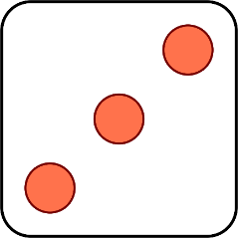
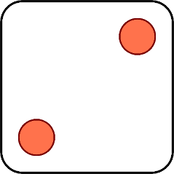
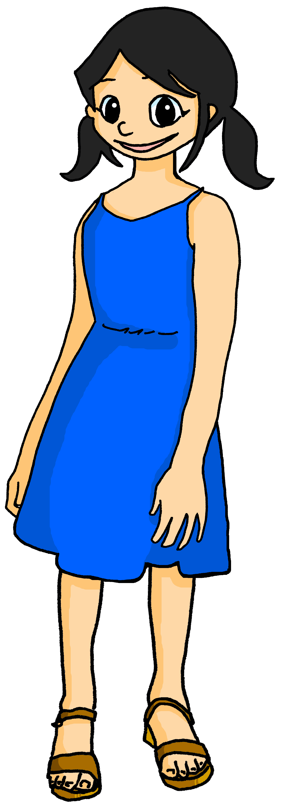
Follow up 3
Parle en français.
. [(a)in]?
Elle/Il regarde
Je visite
Tu as
parler
Tu prépares
J’aime
Elle/Il organise
[the] émission sérieuse
[a] voyage idéal
[the] magazine anglais
[a] texte difficile
[a] jeu facile
[the] question française
[a] parc différent
[a] visite intéressante
[the] musée important
1 | S/he
2 | You
3 | I
4 | S/he
5 | You
6 | I
1 | see/watch
2 | prepare
3 | organise
4 | have
5 | visit
6 | like
Notes:
Timing: 5 minutes (1 of two versions)
Aim: to practise oral production of singular persons of 5 –ER verbs and avoir; indefinite articles, and recognition of previously taught nouns and adjectives.
Procedure: 1. Click to ‘roll’ the dice.
2. Pupils translate the pronouns and verbs and nouns whose numbers correspond to the respective dice to make a short sentence. They say the answer chorally and use one of the French options to form a logical sentence.
3. Click to reveal the correct verb phrase.
4. Repeat until all six combinations have been said.
Note: the version on the next slide is more challenging and requires pupils to translate additionally the English noun phrases.

Slide 7
Follow up 3
Parle en français.
. [(a)in]?
Elle/Il regarde
Tu as
Je visite
Tu prépares
Elle/Il organise
parler
J’aime
[the] serious programme
[an] ideal trip
[the] English magazine
[a] difficult text
[an] easy game
[the] French question
[a] different park
[an] interesting visit
[the] important museum
1 | S/he
2 | You
3 | I
4 | S/he
5 | You
6 | I
1 | see/watch
2 | prepare
3 | organise
4 | have
5 | visit
6 | like
Notes:
(2 of two versions)

Slide 8
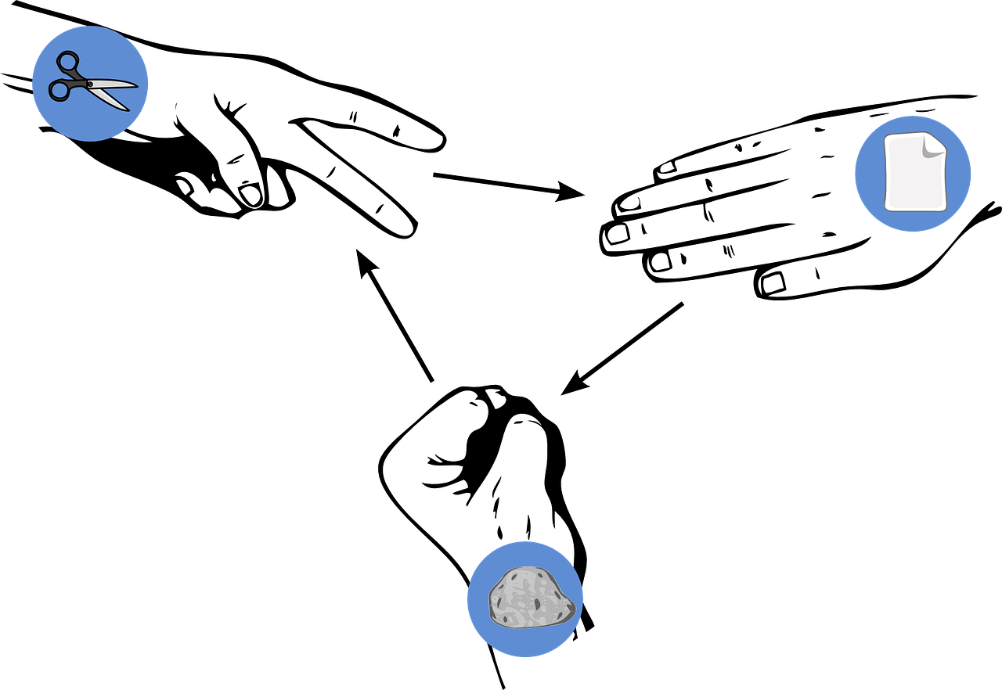
Follow up 4
Pierre-papier-ciseaux*
Choose three objects and write three sentences in French saying what you have: ‘I have…’
écrire
parler
Choose three more objects and write three sentences saying what your partner has: ‘You have…’
Read your sentences. If your partner has the same sentence as you, play rock-paper-scissors. The loser must write/say a different sentence. Play until you have successfully said all your sentences.
Exemple:
J’ai un chat noir.
J’ai un chat noir, aussi !
J’ai une chaise blanche.
Partenaire A
Partenaire B
[a black cat]
*Rock-paper-scissors
Notes:
Timing: 5-10 minutes (two rounds of speaking activity)
Aim: to practise oral production and comprehension of singular nouns with indefinite articles and adjectives, and two parts of the verb AVOIR.
Note: This slide shows how the speaking task is intended to work. The stages are animated to support the teacher in modelling the task.
Procedure:
After modelling this example, display the next slide with 10 item choices.
Partner As ask first and Bs answer.
Then swap roles for Round 2.

Slide 9
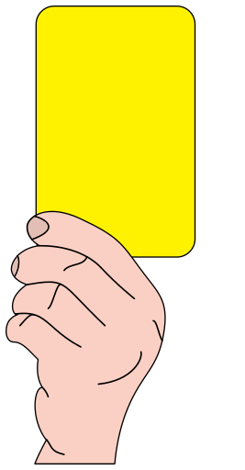
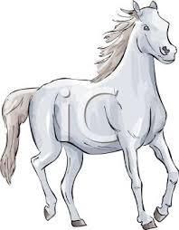
Follow up 4
pierre-papier-ciseaux*
écrire
parler
[a funny programme]
[a black door]
[an English game]
[a serious person]
[an interesting sport]
Ça va ?
[an independent group]
[a different card]
[a French question]
[an important list]
[a white horse]
*rock-paper-scissors
Notes:
DISPLAY THIS SLIDE FOR PUPILS DURING THE TASK.

Slide 10
vocabulaire
Follow up 5 - Écris en anglais : Can you get at least 15 points?
mots
 | le parc | organiser | préparer
 | le musée | l’université | visiter
 | avec | la visite | à
 | sept | douze | onze
 | cinq | huit | neuf
 | Il y a | beaucoup (de/d’) | très
 | la liste | la personne | le groupe
(the) park
to organise
to prepare
(the) museum
(the) university
to visit
x3
with
(the) visit
to, at, in, on
seven
twelve
eleven
x2
five
eight
nine
there is/are
a lot (of)
very
x1
(the) list
(the) person
(the) group
Notes:
Timing: 5-10 minutes
Aim: to practise written comprehension of vocabulary from this week and previous weeks.
Procedure: Give pupils a blank grid. They fill in the English meanings of any of the words they know, trying to reach 15 points in total.
Note: The most recently learnt and practised words are pink, words from the previous week are green and those from earlier are blue, thus more points are awarded for them, to recognise that memories fade and more effort (heavy lifting!) is needed to retrieve them.
10

Slide 11
vocabulaire
Follow up 5 - Écris en français : Can you get at least 15 points?
mots
 | (the) museum | (the) park | to, at, in
 | with | (the) university | (the) visit
 | to organise | to prepare | to visit
 | nine | eleven | twelve
 | three | four | two
 | (the) list | a lot (of) | very
 | There is, are | (the) person | (the) group
le musée
le parc
à
avec
l’université
la visite
x3
organiser
préparer
visiter
neuf
onze
douze
x2
trois
quatre
deux
la liste
beaucoup de/d’
très
x1
la personne
Il y a
le groupe
Notes:
Timing: 5-10 minutes
Aim: to practise written comprehension of vocabulary from this week and previous weeks.
Procedure: Give pupils a blank grid. They fill in the French meanings of any of the words they know, trying to reach 15 points in total.
Note: The most recently learnt and practised words are pink, words from the previous week are green and those from earlier are blue, thus more points are awarded for them, to recognise that memories fade and more effort (heavy lifting!) is needed to retrieve them.
11

Slide 12
vocabulaire
Écris en anglais : Can you get at least 15 points?
mots
 | le parc | organiser | préparer
 | le musée | l’université | visiter
 | avec | la visite | à
 | sept | douze | onze
 | cinq | huit | neuf
 | Il y a | beaucoup (de/d’) | très
 | la liste | la personne | le groupe
x3
x2
x1
Notes:
HANDOUT 5.1
12

Slide 13
vocabulaire
Écris en français : Can you get at least 15 points?
mots
 | (the) museum | (the) park | to, at, in
 | with | (the) university | (the) visit
 | to organise | to prepare | to visit
 | nine | eleven | twelve
 | three | four | two
 | (the) list | a lot (of) | very
 | There is, are | (the) person | (the) group
x3
x2
x1
Notes:
HANDOUT 5.2
13

