Slide 1
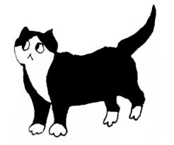
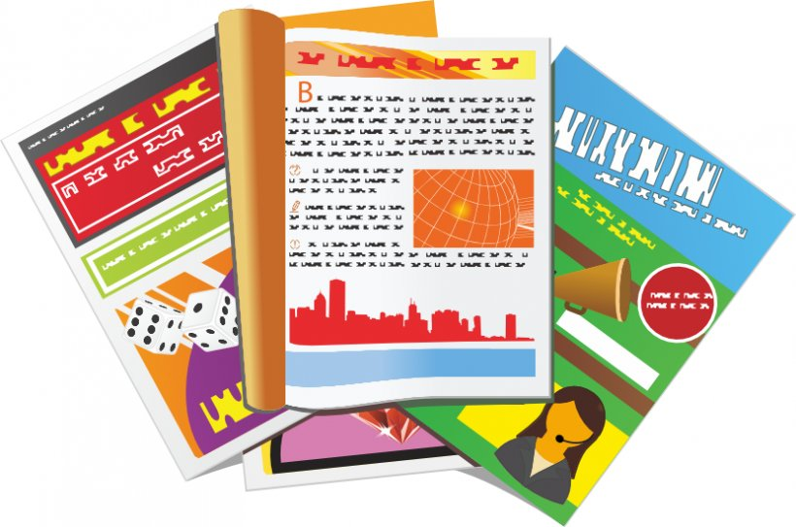
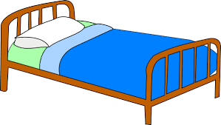
Describing things and people
jaune
Adjectives after the noun
SFe – Silent Final e
Notes:
Artwork by Steve Clarke. Pronoun pictures from NCELP (www.ncelp.org). All additional pictures selected from Pixabay and are
available under a Creative Commons license, no attribution required.
The AUDIO version of the lesson material includes additional audio for the new language
presented (phonics, vocabulary) and audio for the instructions on the slide.
In addition, it includes VIDEO clips of the phonics and the phonics’ source words. Pupils can be
encouraged to look at the shape of the mouth/lips on slides where these appear, and try to copy
it/them.
Phonics: [SFe] timide [3835] monde [77] moderne [1239] centre [491] douze [1664]
Frequency of new words:
Vocabulary: magazine [2033] porte [696] blanc [708] blanche [708] noir [572] revisit nouns: carte [955] chaise [3419] chambre [633] affiche [2886] lit [1837] bureau [273]
Revisit 1: à (meaning ‘to, at, on, in) [4] arriver [174] montrer [108] rester [100] voyage [904] souvent [287] en ce moment [n/a]
Revisit 2: chercher [336] dessiner [2086] présenter [209] prononcer [706] image [659] mot [220] pays [114] texte [631] facile [822] intéressant [1244]
Londsale, D., & Le Bras, Y. (2009). A Frequency Dictionary of French: Core vocabulary for learners London: Routledge.
The frequency rankings for words that occur in this PowerPoint which have been previously introduced in these resources are given
in the SOW and in the resources that first introduced and formally re-visited those words.
For any other words that occur incidentally in this PowerPoint, frequency rankings will be provided in the notes field wherever
possible.
1

Slide 2
prononcer
[SFe]
Silent Final -e
timide
⚠ Remember: The Silent Final -e means you pronounce the final consonant.
[shy]
Notes:
Timing: 1 minute
Aim: to present and practise SSC Silent Final –e.
Procedure:
Introduce and elicit the pronunciation of the individual SSC [SFe] the source word ‘timide’ with gesture, if using.
Click to bring on the picture and get pupils to repeat (with gesture, if using).
Move to the next slide to present and practise the cluster words.
Suggested gesture: Bring up the palm of one hand in a gesture of covering / hiding the face. This is like the 4th video on the BSL site, here: https://www.signbsl.com/sign/shy
2

Slide 3
prononcer
[SFe]
monde
timide
douze
[shy]
centre
moderne
Notes:
Timing: 2 minutes
Aim: To introduce/consolidate SSC [SFe]
Procedure:
1. Practise the pronunciation of the individual SSC [SFe] and then the source word again ‘timide’ (with gesture, if using). 2. Then present and elicit the pronunciation of the four cluster words.
Frequency: monde [77] moderne [1239] centre [491] vie [132] douze [1664] timide [3835] Source: Londsale, D., & Le Bras, Y. (2009). A Frequency Dictionary of French: Core vocabulary for learners London: Routledge.
3

Slide 4
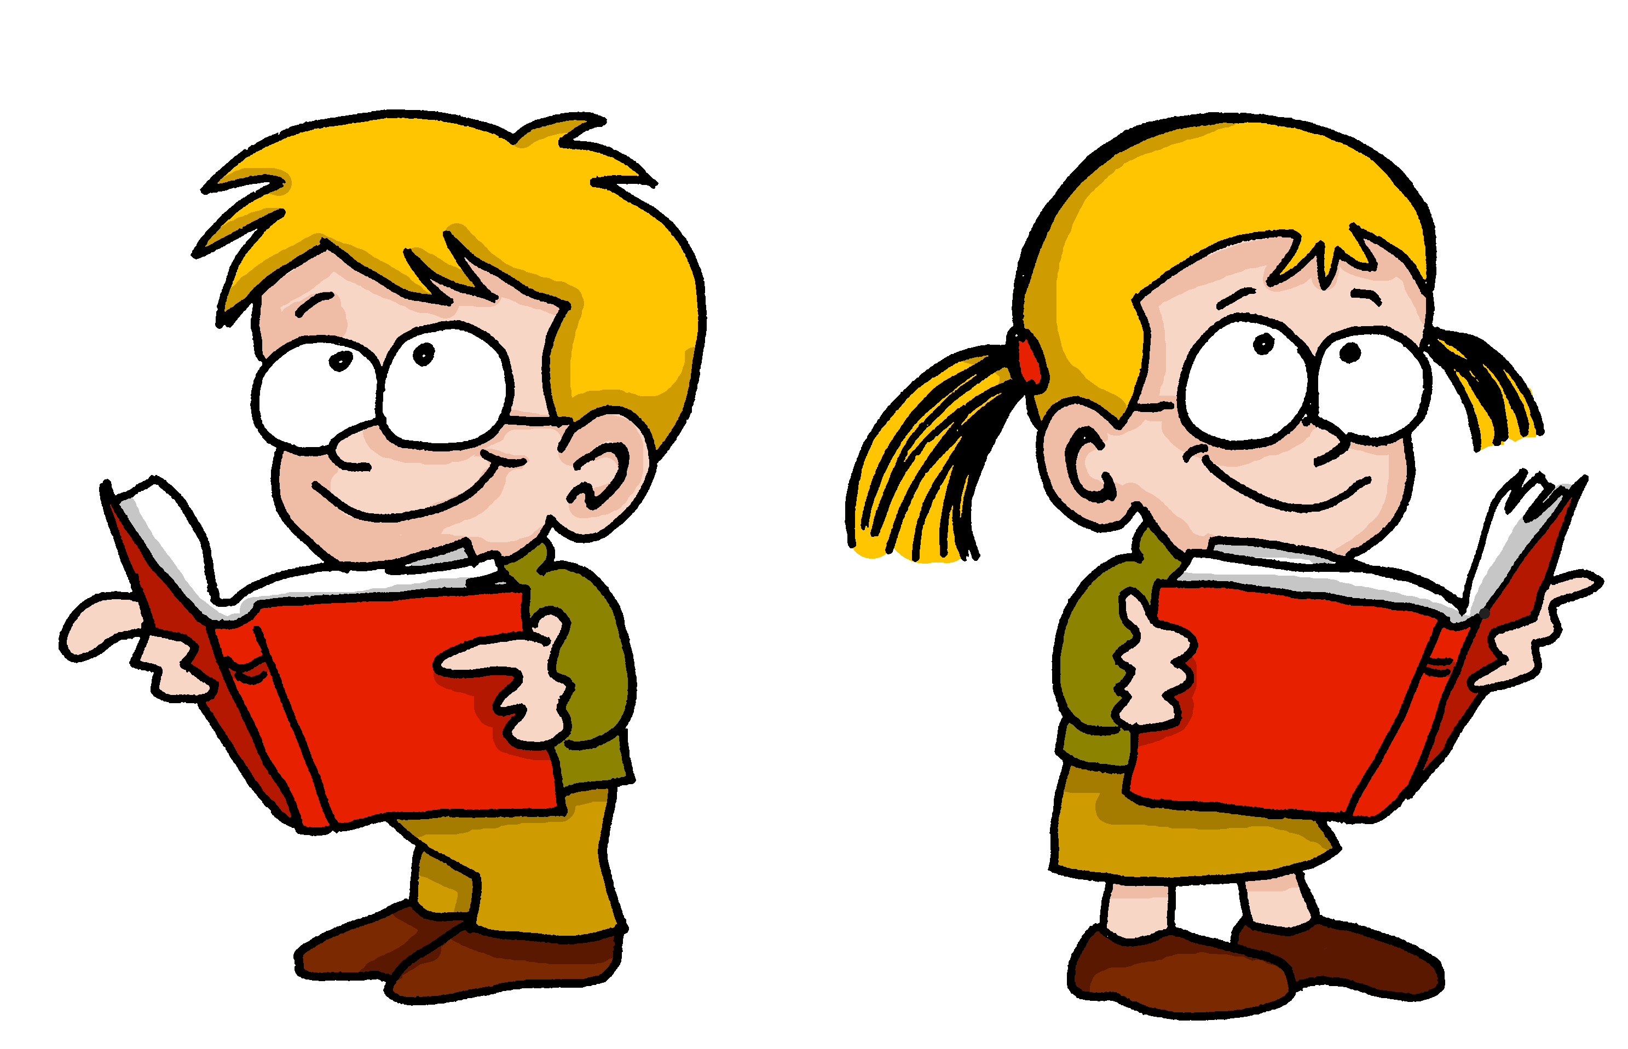
écouter
[SFe]
Écoute. C’est avec ‘e’ ou sans ‘e’ ?
intéressant
1
?
Notes:
Timing: 5 minutes (9 slides)
Aim: to practise aural recognition of the presence of SFe contrasted with SFC (Silent Final Consonant) when there is no ‘e’.
Procedure:
Click to listen to the word.
Pupils respond ‘avec ‘e’’ if they decide there is a SFe and ‘sans ‘e’’ if they decided there is no ‘e’.
Click to remove the rectangle to see the presence or absence of ‘e’.
Click again to bring up the corresponding emoji, and ensure that pupils are clear about the meaning of the word (i.e. interesting – for a masculine noun/male person)
Repeat steps 1-4 for the next 7 slides.
Transcript: intéressant
4

Slide 5
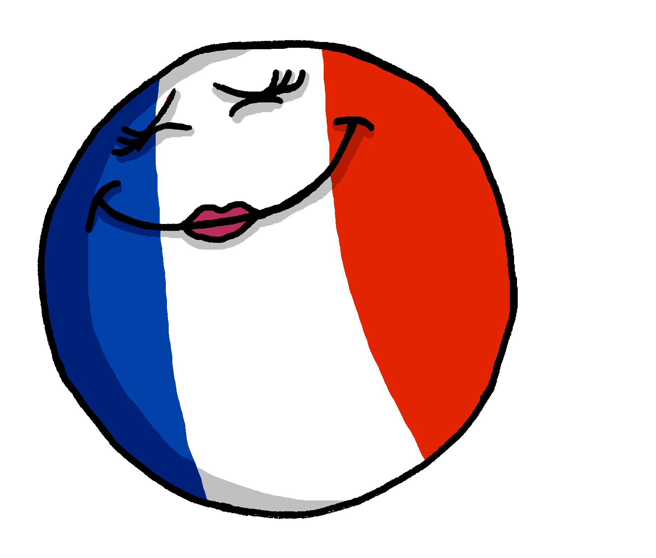
écouter
[SFe]
Écoute. C’est avec ‘e’ ou sans ‘e’ ?
⚠ Remember: If you hear the final consonant (d, p, s, t) there is usually a Silent Final -e.
française
2
?
Notes:
[2/9]
Transcript: française
5

Slide 6
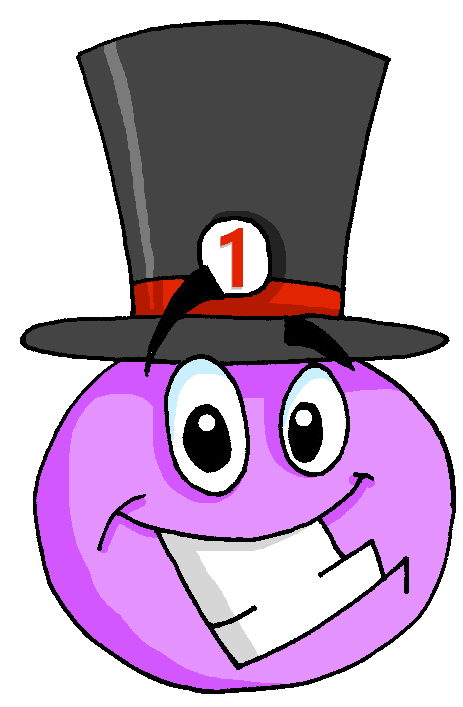
écouter
[SFe]
Écoute. C’est avec ‘e’ ou sans ‘e’ ?
important
3
?
Notes:
[3/9]
Transcript: important
6

Slide 7
écouter
[SFe]
Écoute. C’est avec ‘e’ ou sans ‘e’ ?
blanc
4
?
[white]
Notes:
[4/9]
Transcript: blanc
7

Slide 8
écouter
[SFe]
Écoute. C’est avec ‘e’ ou sans ‘e’ ?
anglaise
5
?
Notes:
[3/9]
Transcript: anglaise
8

Slide 9
écouter
[SFe]
Écoute. C’est avec ‘e’ ou sans ‘e’ ?
porte
6
?
[door]
Notes:
[6/9]
Transcript: porte
9

Slide 10
écouter
[SFe]
Écoute. C’est avec ‘e’ ou sans ‘e’ ?
⚠ Remember: some adjectives already have an ‘e’ already. Don’t add another ‘e’!
facile
7
?
Notes:
[7/9]
Transcript: facile
10

Slide 11
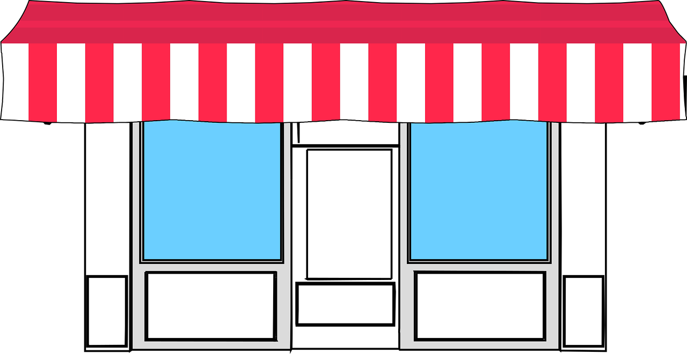
écouter
[SFe]
Écoute. C’est avec ‘e’ ou sans ‘e’ ?
[shop]
magasin
8
?
Notes:
[8/9]
Transcript: magasin
11

Slide 12
écouter
[SFe]
Écoute. C’est avec ‘e’ ou sans ‘e’ ?
magazine
9
?
Notes:
[9/9]
Transcript: magazine
12

Slide 13
vocabulaire
Vocabulaire
mots
la porte
le magazine
[door]
noir
blanc
blanche
Use blanche to mean white for feminine nouns.
Notes:
Timing: 5 minutes
Aim: to present and practise written comprehension and read aloud of the new vocabulary for this week.
Procedure: 1. Click for a French word. Elicit pronunciation from pupils.
2. Click for the English meaning and picture prompt. Elicit the French word again.
3. Present all five words like this, in order.
4. Click for one English meaning to disappear. Elicit the English meaning from pupils. Continue with the remaining items.
5. Click for the French word to disappear. Elicit the French from pupils. Continue with the remaining items.
13

Slide 14
Adjectives following the noun [1/2]
In English, adjectives come before the noun.
In French, adjectives normally come after the noun.
In French we say what it is and then what it is like.
a black bed
un lit noir
⚠ Remember: Many adjectives add -e to describe feminine nouns. But noir and noire sound the same.
a black door
une porte noire
an interesting magazine
un magazine intéressant
an interesting question
une question intéressante
Remember to pronounce the final consonant!
Notes:
Timing: 3 minutes (two slides)
Aim: to introduce postnominal adjective agreement.
Procedure:
Click through the animations to present the information.
Elicit English translations for the French examples provided.
Callout 1 highlights the difference between English and French.
Callout 2 reminds pupils about gender agreement of adjectives but where the m and f forms sound the same.
Callout 2 reminds pupils that many m and f adjectives sound different – add –e and pronounce the final consonant.

Slide 15
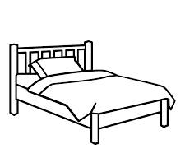
Adjectives following the noun [2/2]
Use blanc to mean white with a masculine noun:
un lit blanc
a white bed
Use blanche to mean white with a feminine noun:
une porte blanche
a white door
Instead of adding –e, we add –he to blanc.
Notes:
Timing: 3 minutes
Aim: to introduce postnominal adjective agreement.
Procedure:
Click through the animations to present the information.
Elicit English translations for the French examples provided.
Callout 1 highlights the difference between English and French.
Callout 2 reminds pupils about gender agreement of adjectives.
Callout 2 reminds pupils about no change for adjectives ending in –e.

Slide 16
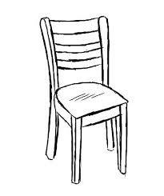
écouter
Écoute. Identifie la chose et écris en anglais.
1
a French magazine
2
an important drawing
3
a white door
4
a black chair
noir
prudent
5
a careful cat
français
6
a white bed
important
blanc
Notes:
Timing: 5 minutes
Aim: Aural recognition of adjectives.
Procedure:
Pupils write 1-6 in their books.
Pupils write down the English for the noun and the adjective that they hear.
Check answers on the following slide.
Transcript
J’ai un magazine français.
J’ai un dessin important. J’ai une porte blanche. J’ai une chaise noire.
J’ai un chat prudent.
J’ai un lit blanc.
16

Slide 17
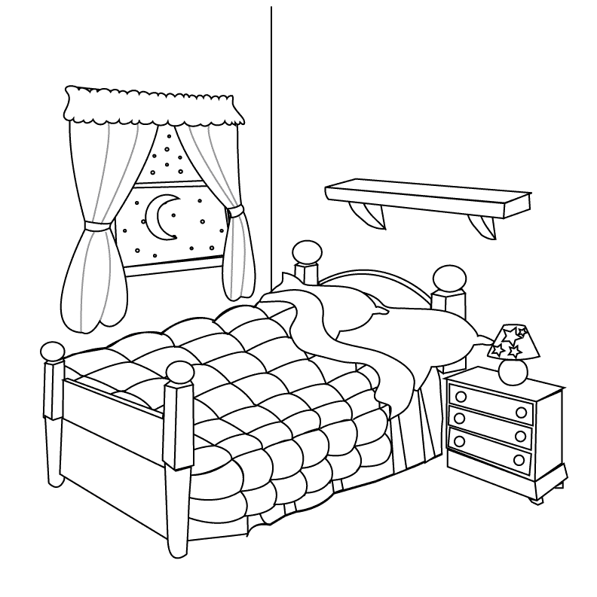
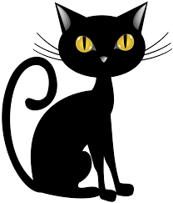
parler
Which adjectives change their spelling and sound to match the feminine noun?
lire
une question difficile
un magazine difficile
une amie indépendante
⚠ Remember: Adjectives that already end in -e stay the same.
⚠ Remember: Adjectives that already end in -e stay the same.
un chat noir
une porte noire
une chambre blanche
noir adds ‘-e’ but noir and noire sound the same.
Notes:
Timing: 3 minutes
Aim: to reinforce the idea that many adjectives add an –e to describe a feminine noun.
Procedure:
Ask the question and elicit ‘française’ and ‘grise’ from pupils.
Click to bring up the callout reminding pupils that adjectives already ending in ‘e’ stay the same.
Click again to draw attention to the feminine form of noir (noire) which adds an accent as well as an ‘e’ but importantly there is no pronunciation change.
Click for an emphasis effect for each noun phrase and elicit English meanings from pupils – this will practise the cross-linguistic difference in word order again. 5. Click on the text for each item to hear the audio, if desired.
17

Slide 18
lire
Lis. Le mot correct, c’est quoi ?
1
un message | une chambre
importante
2
une chaise | un bureau
noire
3
une porte | un lit
blanc
4
un texte | une réponse
facile
5
une carte | un magazine
anglais
6
une porte | un dessin
différente
Notes:
Timing: 7 minutes
Aim: to practise written recognition of masculine and feminine forms, their connection to nouns of the matching gender, and comprehension of both nouns and adjectives.
Procedure:
Teacher reads the instruction in French.
Pupils decide which noun it is, based on the form of the adjective.
Elicit the answers from pupils. Note that both answers are right for numbers 5 and 6.
Then click to hear the full phrase, if desired.
Ask questions to elicit comprehension, e.g., what is important? what kind of book is it? - teachers can ask these questions in a jumbled order for greater challenge.
Transcript:
une maison importante une peluche grise
un livre anglais
un animal cher
une tortue rapide, un stakeboard rapide
une chanson moderne, un sac moderne
18

Slide 19
Au revoir !
jaune
Notes:
19

