Slide 1
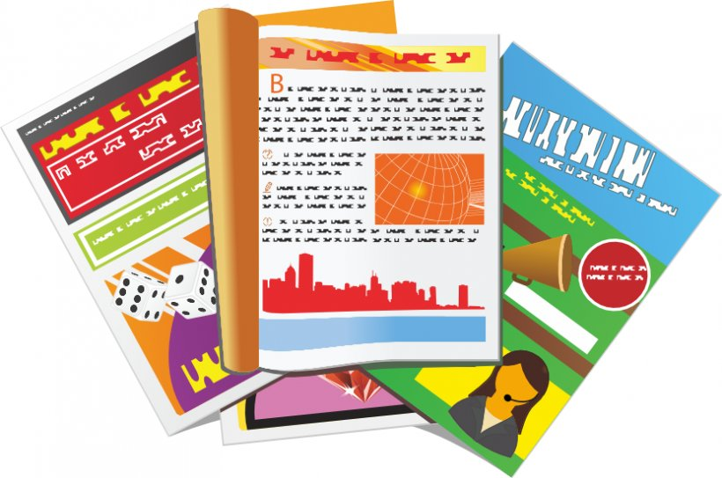
Describing things and people
jaune
Follow ups 1-5
Notes:
Artwork by Steve Clarke. Pronoun pictures from NCELP (www.ncelp.org). All additional pictures selected from Pixabay and are available under a Creative Commons license, no attribution required.
Phonics: [SFe] timide [3835] monde [77] moderne [1239] centre [491] douze [1664]
Frequency of new words:
Vocabulary: magazine [2033] porte [696] blanc [708] blanche [708] noir [572] revisit nouns: carte [955] chaise [3419] chambre [633] affiche [2886] lit [1837] bureau [273]
Revisit 1: à (meaning ‘to, at, on, in) [4] arriver [174] montrer [108] rester [100] voyage [904] souvent [287] en ce moment [n/a]
Revisit 2: chercher [336] dessiner [2086] présenter [209] prononcer [706] image [659] mot [220] pays [114] texte [631] facile [822] intéressant [1244]
Londsale, D., & Le Bras, Y. (2009). A Frequency Dictionary of French: Core vocabulary for learners London: Routledge.
The frequency rankings for words that occur in this PowerPoint which have been previously introduced in these resources are given
in the SOW and in the resources that first introduced and formally re-visited those words.
For any other words that occur incidentally in this PowerPoint, frequency rankings will be provided in the notes field wherever
possible.

Slide 2
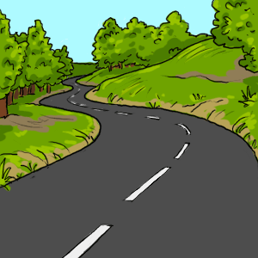
Follow up 1
Écoute. C’est avec ‘e’ ou sans ‘e’ ?
prononcer
Puis, prononce les mots.
e f f o r t
r o u t e
s o u p e
p o i n t
c l i e n t
p a r e n t
t i m i d e
g r o u p e
1
_
5
_
2
_
6
_
_
_
3
7
4
_
8
_
Notes:
Timing: 3 minutes
Aim: to practise aural distinction between words with SFe and SFC.
Procedure:
Read the instruction.
Do the first one with pupils.
They can write down either [e] or [--].
Elicit responses chorally, and click to reveal the answers.
Transcript:
effort route soupe point client
parent timide groupe
Frequency: effort [388] route [512] soupe [4563] point [>5000] client [917] parent [546] timide [3835] groupe [187]

Slide 3
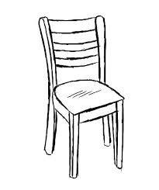
Follow up 2: Écris en français.
Write as many phrases as you can to combine these nouns and adjectives. Remember to agree the adjectives with feminine nouns.
écrire
noir
français
intéressant
important
blanc
Notes:
Timing: 5 minutes
Aim: to practise written production of noun/adjective phrases.
Procedure:
Pupils write as many combinations of nouns and adjectives as they can in four minutes (a total of 25 combinations is possible!)
Elicit some examples from pupils orally and/or type them up on a slide or on the board.

Slide 4
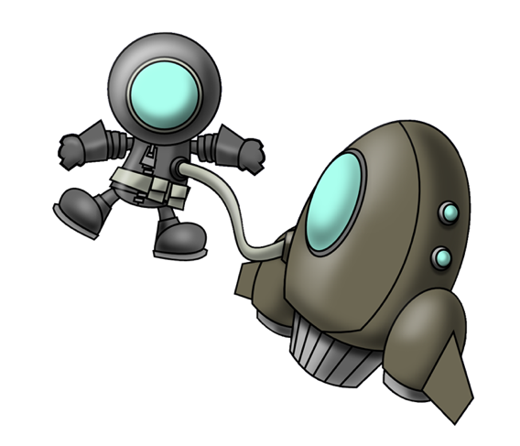
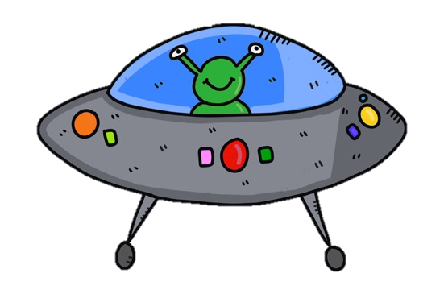
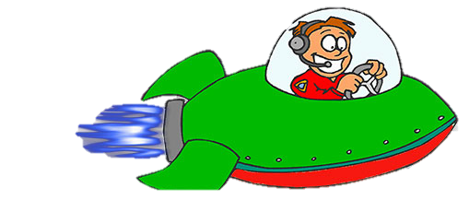
Follow up 3
blanche
la porte
Écris les mots en anglais.
Puis, lis les mots de ta liste en français.
lire
facile
blanc
rester
le voyage
en ce moment
noir
à
souvent
chercher
montrer
Notes:
Timing: 5 minutes
Aim: to revisit 12 items of previously-taught vocabulary in both receptive and productive modes of language use.
Procedure:
Ask pupils to write the numbers 1-12. That way, if they miss one of the words, they can leave that number out and go on to the next one.
Teacher clicks on the screen to trigger each animation.
Pupils write a list with an English translation of each word that appears. They should challenge themselves not to write the French.
Teachers checks the answers to ensure that all pupils have the correct list of 12 words in English.
Afterwards, pupils orally translate each English word on their list into French, working with a partner (either taking turns or each trying to do all twelve). Partners can give each other feedback.
Note: the teacher can speed up the activity by clicking to end one word’s animation and begin the next. In this way s/he can adapt it to suit the class.
English words (in the order in which French words appear on the slide)
trip, journey
often
door
white (m)
black
to, at, on, in
to look for, looking for
to stay, remain
easy
montrer
at the moment
white (f)

Slide 5
Avoir [to have, having]
The verb avoir means ‘to have’ or ‘having’:
I
je becomes j’ before a vowel.
j’ai
To say I have, use ______.
J’ai un texte.
I have a text.
you
tu as
Tu as une image.
To say you have, use _____.
You have an image.
Notes:
DO BEFORE FOLLOW UP 4
Timing: 2 minutes (two slides)
Aim: to recap the verb avoir (to have), I have, you have and how to form intonation questions.
Procedure:
Click fairly quickly to present the information (as this is revision).
Elicit the English at each stage from pupils after presenting the French examples.

Slide 6
Asking questions
Remember! To change a statement into a yes/no question, raise your voice at the end:
J’ai un magazine.
J’ai un magazine ?
I have a magazine.
Do I have a magazine ?
Tu as un magazine.
Tu as un magazine ?
You have a magazine.
Do you have a magazine?
In English, we add ‘do’, in French we just make our voice go up.
Notes:
Timing: 2 minutes
Aim: to revisit how to form intonation questions.
Procedure:
Click to present the information.
Elicit the English at each stage from pupils after presenting the French examples.

Slide 7
Follow up 4
Parle avec ton/ta partenaire.
Tu as un bureau ?
Oui, j’ai un bureau.
Exemple:
parler
Partenaire A
Partenaire B
1
Ask your partner if s/he has these things and circle the ones s/he has:
When asked, say you have these:
Tu as une affiche ?
Oui, j’ai une affiche.
Partenaire B
Partenaire A
2
Ask your partner if s/he has these things and circle the ones s/he has:
When asked, say you have these:
Notes:
Timing: 5-10 minutes (two rounds of speaking activity)
Aim: to practise oral production and comprehension of singular and plural nouns with indefinite articles and/or numbers.
Note: This slide shows how the speaking task is intended to work. The stages are animated to support the teacher in modelling the task.
Procedure:
After modelling this example, give out the task sheets (at the end of this PPT).
Partner As ask first and Bs answer.
Then swap roles for Round 2.

Slide 8
vocabulaire
Follow up 5 - Écris en anglais : Can you get at least 15 points?
mots
 | le mot | dessiner | présenter
 | le pays | chercher | à
 | rester | en ce moment | souvent
 | le voyage | montrer | arriver
 | blanche | le magazine | la porte
 | noire | blanc | noir
(the) word
to draw, drawing
to present, presenting
x3
to look for
to, at, on, in
(the) country
to stay, remain
at the moment
often
x2
(the) trip, journey
to show, showing
to arrive, arriving
white(f)
(the) magazine
(the) door
x1
black (f)
white (m)
black (m)
Notes:
Timing: 5-10 minutes
Aim: to practise written comprehension of vocabulary from this week and previous weeks.
Procedure: Give pupils a blank grid. They fill in the English meanings of any of the words they know, trying to reach 15 points in total.
Note: The most recently learnt and practised words are pink, words from the previous week are green and those from earlier are blue, thus more points are awarded for them, to recognise that memories fade and more effort (heavy lifting!) is needed to retrieve them.
8

Slide 9
vocabulaire
Follow up 5 - Écris en français : Can you get at least 15 points?
mots
 | (the) country | to present, presenting | (the) word
 | to, at, in, on | to draw, drawing | to look for
 | to show | (the) trip, journey | often
 | to arrive | at the moment | to stay, remain
 | black (f) | black (m) | white (f)
 | (the) door | (the) magazine | white (m)
le pays
présenter
le mot
à
dessiner
chercher
x3
montrer
le voyage
souvent
arriver
en ce moment
rester
x2
noire
noir
blanche
x1
blanc
la porte
le magazine
Notes:
Timing: 5-10 minutes
Aim: to practise written comprehension of vocabulary from this week and previous weeks.
Procedure: Give pupils a blank grid. They fill in the French meanings of any of the words they know, trying to reach 15 points in total.
Note: The most recently learnt and practised words are pink, words from the previous week are green and those from earlier are blue, thus more points are awarded for them, to recognise that memories fade and more effort (heavy lifting!) is needed to retrieve them.
9

Slide 10
Follow up 4
Partenaire A
Round 1
Round 2
parler
Ask your partner if s/he has these things and circle the ones s/he has:
When asked, say you have these:
Notes:
HANDOUT – PARTENAIRE A

Slide 11
Follow up 4
Partenaire B
Round 1
Round 2
parler
Ask your partner if s/he has these things and circle the ones s/he has:
When asked, say you have these:
Notes:
HANDOUT – PARTENAIRE B

Slide 12
vocabulaire
Écris en anglais : Can you get at least 15 points?
mots
 | le mot | dessiner | présenter
 | le pays | chercher | à
 | rester | en ce moment | souvent
 | le voyage | montrer | arriver
 | blanche | le magazine | la porte
 | noire | blanc | noir
x3
x2
x1
Notes:
HANDOUT 5.1
12

Slide 13
vocabulaire
Écris en français : Can you get at least 15 points?
mots
 | (the) country | to present, presenting | (the) word
 | to, at, in, on | to draw, drawing | to look for
 | to show | (the) trip, journey | often
 | to arrive | at the moment | to stay, remain
 | black (f) | black (m) | white (f)
 | (the) door | (the) magazine | white (m)
x3
x2
x1
Notes:
HANDOUT 5.2
13

