Slide 1
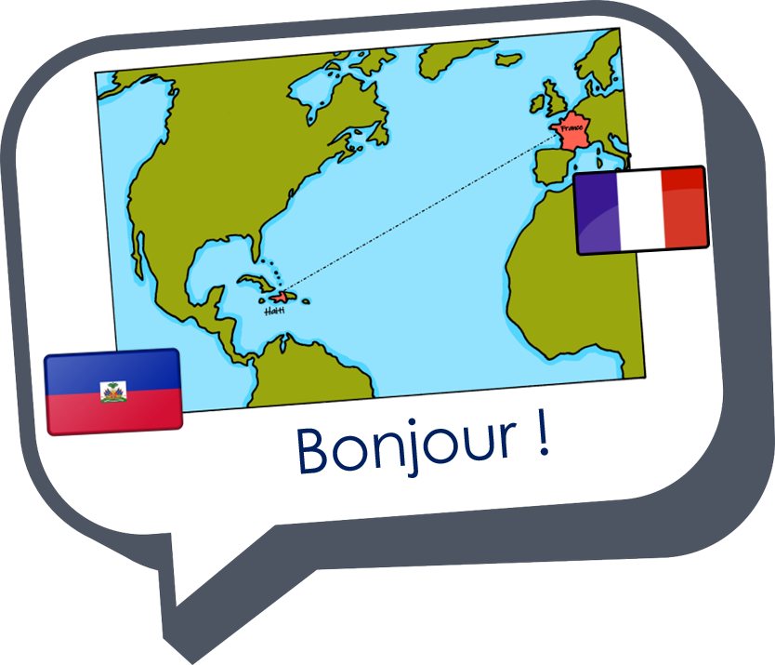
Describing me and others
Un poème
jaune
Follow ups 1-5
Term 3 Week 13
Notes:
Artwork by Steve Clarke. Pronoun pictures from NCELP (www.ncelp.org). All additional pictures selected from Pixabay and are
available under a Creative Commons license, no attribution required.
The AUDIO version of the lesson material includes additional audio for the new language
presented (phonics, vocabulary) and audio for the instructions on the slide.
In addition, it includes VIDEO clips of the phonics and the phonics’ source words. Pupils can be
encouraged to look at the shape of the mouth/lips on slides where these appear, and try to copy
it/them.
Vocabulary: Revisit vocabulary
Revisit 1: adorer [2322] apporter [339] détester [2898] matin [442] langue [712] les [1] merci [1070] de rien [n/a]
Revisit 2: groupe [187] liste [924] personne [84] très [66] beaucoup (de) [150]
Londsale, D., & Le Bras, Y. (2009). A Frequency Dictionary of French: Core vocabulary for learners London: Routledge.
The frequency rankings for words that occur in this PowerPoint which have been previously introduced in these resources are given
in the SOW and in the resources that first introduced and formally re-visited those words.
For any other words that occur incidentally in this PowerPoint, frequency rankings will be provided in the notes field wherever
possible.
Frequency of unknown words and cognates:
poème [3031]
Londsale, D., & Le Bras, Y. (2009). A Frequency Dictionary of French: Core vocabulary for learners London: Routledge.

Slide 2
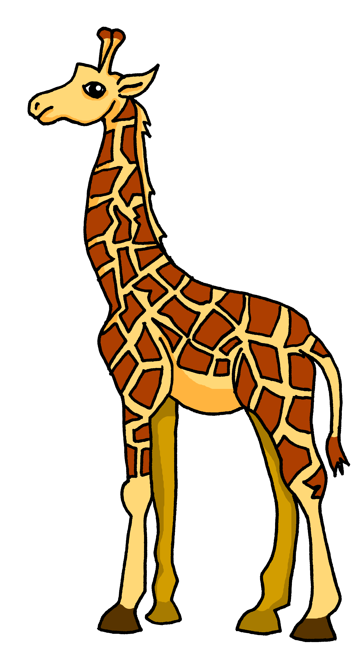
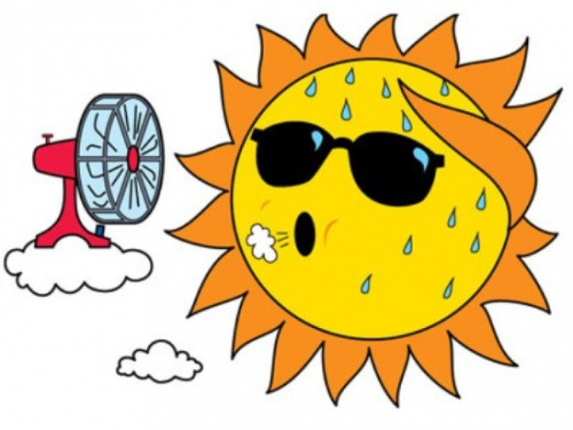
Follow up 1
Adapte le poème.
écrire
animal
chose
adjectif
La panthère est noire comme le charbon.
Quand elle a peur ou froid,
sa couleur ne change pas,
mais elle est rapide comme un avion.
La panthère est unique et spéciale.
ours (m)
gorille (m)
La girafe
jaune
une banane
tortue (f)
girafe (f)
tigre (m)
hérisson (m)
léon (m)
chameau (m)
tête
chaud
une danseuse
bouche
mal
gracieuse
banane
La girafe
grand(e)
rouge
actif
petit(e)
jaune
massif
drôle
vert
intéressant
joli(e)
blanc
curieux/se
joli(e)
noir
courageux/se
Notes:
Timing: 15 minutes (over 3-4 follow up sessions this week)
Aim: to write their own version of the poem.
Procedure:
Tell pupils they are going to write their own version of the poem in French. Get them excited about this!
Click through the animations to model how to adapt a stanza.
There are easy and more challenging ways to do these variations on a theme. E.g. OR Choose two or three nouns (the animals OR the adjectives)
OR Change only one stanza
OR Change everything except the essential structure (Remind them about the message of the poem. They could write about their different people in their lives and what makes them unique).
Pupils can use ideas from the table, use KOs or a dictionary.
NB. This could be done as a collaborative writing exercise.

Slide 3
Follow up 1
Adapte le poème.
écrire
La panthère est noire comme le charbon.
Quand elle a peur ou froid,
sa couleur ne change pas,
mais elle est rapide comme un avion 🛫.
La panthère est unique et spéciale.
La baleine bleue
est grande comme un bus 🚌.
Parce qu'elle est super
et nage dans la mer 🌊,
la baleine bleue est unique et spéciale.
Le flamant est blanc,
quand il est jeune
Mais à certaines heures
il est rose comme une fleur.
Comme la panthère,
le flamant est unique et spécial.
La pieuvre est curieuse comme un ours 🐻
et avec ses huit bras 💪
et trois cœurs 💗,
la pieuvre est aussi
unique et spéciale.
Notes:
Ideas for which words to consider changing.

Slide 4
follow up 4

Écris en anglais. Can you get at least 15 points?
mots
 | la liste | la personne | beaucoup (de)
 | très | de rien | le groupe
 | adorer | le matin | les
 | merci | apporter | la langue
 | la peur | moi, aussi | et toi ?
 | chaud | froid | le tort
vocabulaire
(the) list
(the) person
a lot (of)
x3
very
you’re welcome
(the) group
to love, loving
(the) morning
the (mfpl)
x2
thank you
to bring, bringing
(the) language
(the) fear
me, too
and you?
x1
hot
cold
(the) wrong
Notes:
Timing: 5 minutes
Aim: to practise written production of vocabulary from this week and this week’s revisited sets.
Procedure: 1. Give pupils a blank grid. They fill in the English meanings of any of the words they know, trying to reach 15 points in total.
Note: The most recently learnt and practised words are pink, words from the first revisit are green and those from the second revisit are blue, thus more points are awarded for them, to recognise that memories fade and more effort (heavy lifting!) is needed to retrieve them.

Slide 5
follow up 5

Écris en français. Can you get at least 15 points?
mots
 | (the) person | very | a lot (of)
 | you’re welcome | (the) group | (the) list
 | (the) language | the (mfpl) | thank you
 | to love, loving | to bring, bringing | (the) morning
 | (the) wrong | and you? | me, too
 | cold | (the) fear | hot
vocabulaire
la personne
très
beaucoup de
x3
de rien
le groupe
la liste
la langue
les
merci
x2
adorer
apporter
le matin
le tort
et toi ?
moi, aussi
x1
le froid
la peur
chaud
Notes:
Timing: 5 minutes
Aim: to practise written production of vocabulary from this week and this week’s revisited sets.
Procedure: Give pupils a blank grid. They fill in the French meanings of any of the words they know, trying to reach 15 points in total.
Note: The most recently learnt and practised words are pink, words from the first revisit are green and those from the second revisit are blue, thus more points are awarded for them, to recognise that memories fade and more effort (heavy lifting!) is needed to retrieve them.

Slide 6
follow up 4

Écris en anglais. Can you get at least 15 points?
mots
 | la liste | la personne | beaucoup (de)
 | très | de rien | le groupe
 | adorer | le matin | les
 | merci | apporter | la langue
 | la peur | moi, aussi | et toi ?
 | chaud | froid | le tort
vocabulaire
x3
x2
x1
Notes:
HANDOUT

Slide 7
follow up 5

Écris en français. Can you get at least 15 points?
mots
 | (the) person | very | a lot (of)
 | you’re welcome | (the) group | (the) list
 | (the) language | the (mfpl) | thank you
 | to love, loving | to bring, bringing | (the) morning
 | (the) wrong | and you? | me, too
 | cold | (the) fear | hot
vocabulaire
x3
x2
x1
Notes:
HANDOUT

