Slide 1
Describing me and others
Un poème
jaune
Term 3 Week 12
Notes:
Artwork by Steve Clarke. Pronoun pictures from NCELP (www.ncelp.org). All additional pictures selected from Pixabay and are
available under a Creative Commons license, no attribution required.
The AUDIO version of the lesson material includes additional audio for the new language
presented (phonics, vocabulary) and audio for the instructions on the slide.
In addition, it includes VIDEO clips of the phonics and the phonics’ source words. Pupils can be
encouraged to look at the shape of the mouth/lips on slides where these appear, and try to copy
it/them.
Phonics: Revisit SSC
Vocabulary: bleu [1216] jaune [2585] rouge [987] vert [1060]
Revisit 1: détester [2898] écouter [429] écrire [382] étudier [960] lire [278] parler [106]
Revisit 2: magazine [2033] porte [696] blanc [708] blanche [708] noir [572]
Revisit nouns: carte [955] chaise [3419] chambre [633] affiche [2886] lit [1837] bureau [273]
Londsale, D., & Le Bras, Y. (2009). A Frequency Dictionary of French: Core vocabulary for learners London: Routledge.
The frequency rankings for words that occur in this PowerPoint which have been previously introduced in these resources are given
in the SOW and in the resources that first introduced and formally re-visited those words.
For any other words that occur incidentally in this PowerPoint, frequency rankings will be provided in the notes field wherever
possible.
Frequency of unknown words and cognates:
poème [3031]
Londsale, D., & Le Bras, Y. (2009). A Frequency Dictionary of French: Core vocabulary for learners London: Routledge.
1

Slide 2
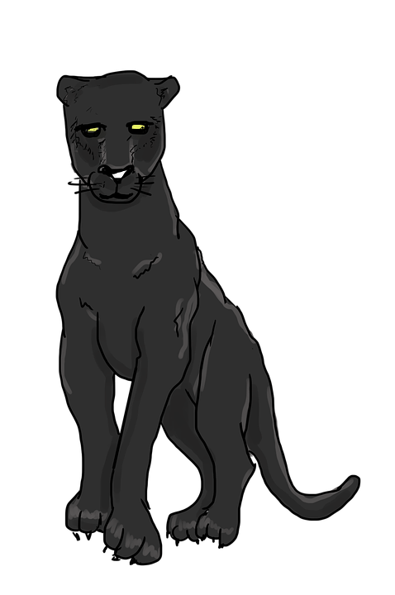
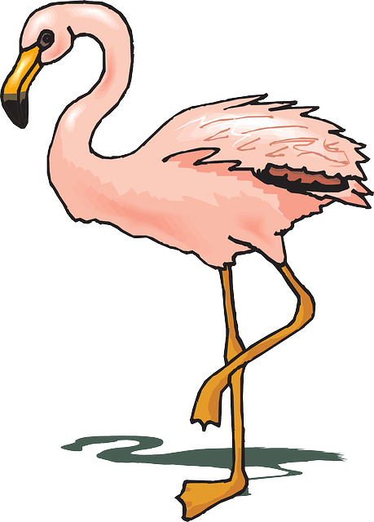
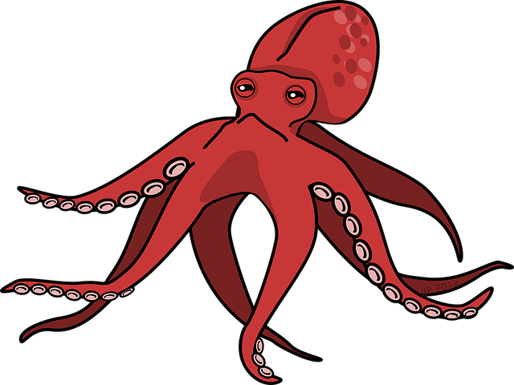
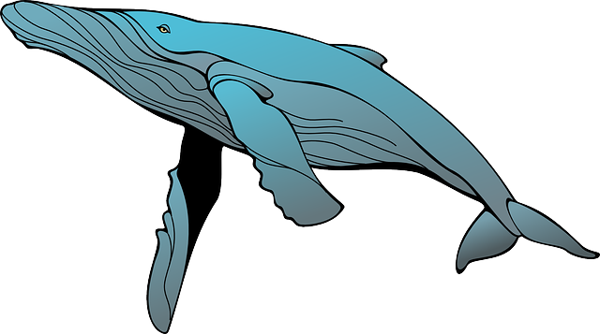
vocabulaire
Écoute et répète.
l’animal, c’est quoi ?
mots
a
b
c
d
la pieuvre
la baleine
le flamant
la panthère
Notes:
Timing: 4 minutes
Aim: to introduce the four animals which will feature in this sequence (week 12 and 13)
Procedure: 1.Teachers read the instruction and click to bring up each animal and get pupils to repeat chorally.
2. Click to bring up further question: l’animal, c’est quoi ? Elicit answers from pupils – le flammant, c’est A.
NB. We haven’t formally introduced the alphabet so teachers can model by practising ‘a’, ‘bé’, ‘cé’, ‘dé’, or simply elicit the animal in English from pupils.
NB. Further rounds of learning can be facilitated by one pupil turning away from the board, and his/her partner asking him/her the meanings (‘Comment dit-on X en français ?’). This activity can work from L2 → L1 or L1 → L2.
2

Slide 3
vocabulaire
La couleur, c’est quoi ?
mots
c
a
b
d
e
rose
bleu
rouge
noir
vert
Notes:
Timing: 3 minutes
Aim: to practice written comprehension of 5 colours.
Procedure: 1. Teachers read the instruction ‘La couleur, c’est quoi ?’.
2. Pupils can practise reading the colours aloud before providing with an answer.
3. Starting from left to write, elicit answers from pupils.
NB. bleu, rouge, vert have been introduced in Rouge, not Jaune so far. Rose is also new but the connection to the flower makes this one straightforward in context for English native speakers.
NB. Further rounds of learning can be facilitated by one pupil turning away from the board, and his/her partner asking him/her the meanings (‘Comment dit-on en …?’). This activity can work from L2 → L1 or L1 → L2.
NB. Teachers can also ask what colours they know (blanc, blanche, noir) – if pupils have done Rouge before Jaune, they will also know ‘gris, jaune’.
3

Slide 4
vocabulaire
_____________ est rose.
L’animal, c’est quoi ?
Le flamant
mots
a
b
c
d
le flamant
la panthère
la pieuvre
la baleine
_______________ est rouge.
_____________ est noire.
La pieuvre
La panthère
_______________ est bleue.
‘rose’ is both masculine and feminine.
La baleine
Notes:
Timing: 3 minutes
Aim: to revisit adjectival agreement.
Procedure: 1. Teachers read the instruction and draw pupils’ attention to the speech bubble. Pupils can work in pairs to say the sentence aloud.
2. Repeat x4.
NB. A speech bubble clarifies that ‘rose’ does not change and it’s both the masculine and feminine form.
4

Slide 5
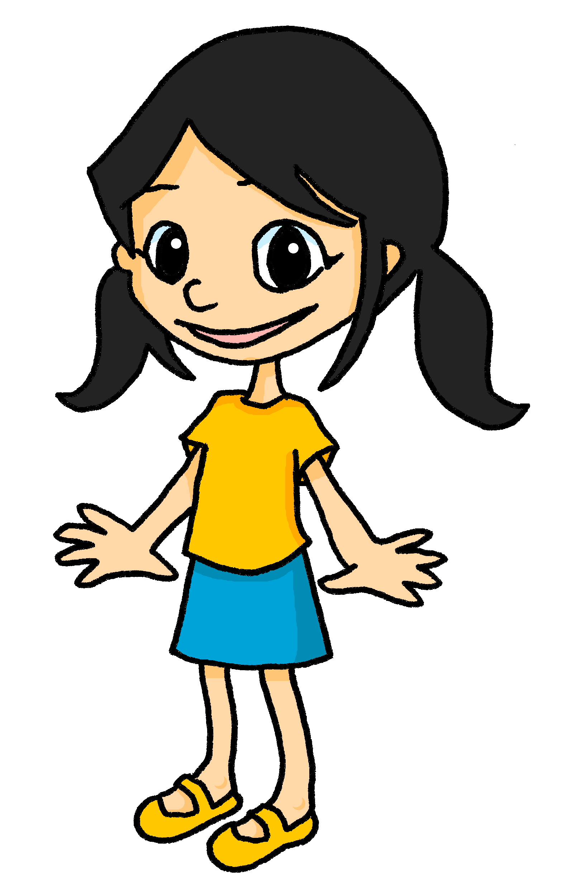
lire
Le poème préféré d’Eugénie
Le titre en anglais, c’est quoi ?
Mon poème préféré est ‘Unique et spécial’.
Notes:
Timing: 2 minutes
Aim: To introduce the context of the lesson – A poem titled ‘Unique et spécial’.
Procedure:
Clarify the context and elicit translation of Eugénie’s speech bubble.
Click to bring up question & visual support. Once it’s clear the lesson is about the story of some very unique animals, tell pupils they are going to listen to part of the story in French. Get them excited about this! ☺
Frequency of unknown words and cognates:
poème [3031] spécial [726]
Londsale, D., & Le Bras, Y. (2009). A Frequency Dictionary of French: Core vocabulary for learners London: Routledge.
5

Slide 6
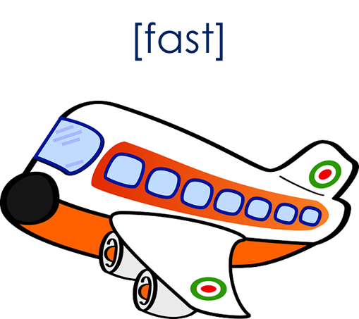
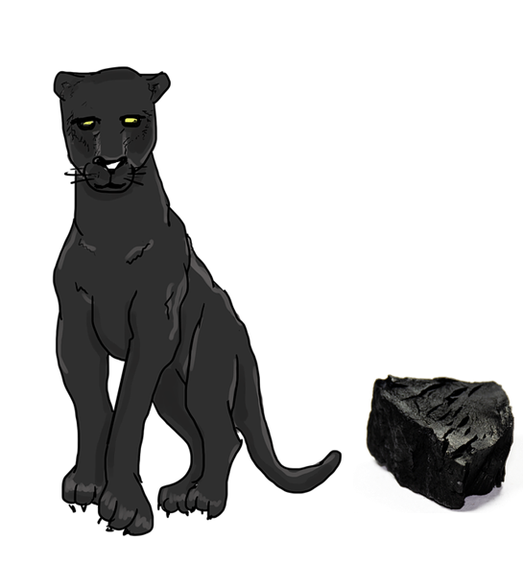
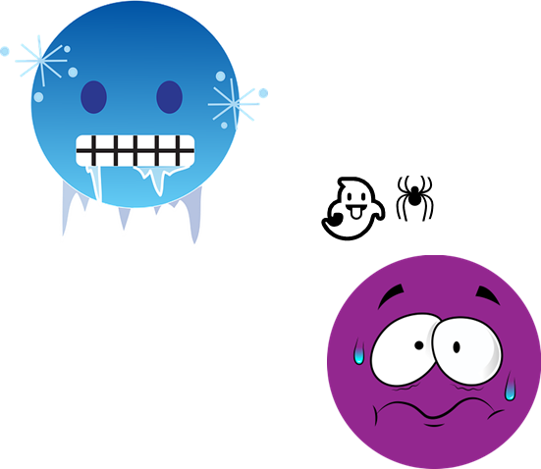
écouter
Écoute et lis le poème.
(le) charbon = charcoal
son = his, her, its
rapide = fast
comme = as, like
la carte correspondante, c’est quoi ?
lire
La panthère est noire comme le charbon*.
Quand elle a peur ou froid,
sa* couleur ne change pas,
mais elle est rapide comme un avion 🛫.
La panthère est unique et spéciale.
Notes:
Timing: 12 minutes [4 slides]
Aim: to listen and read the story, using visual prompts to reinforce comprehension.
Procedure:
Give out the cards with images before explaining the activity. Pupils can work in pairs or individually.
Read the instruction and click to bring up the question. Ensure pupils understand they need to show you the correct picture to go with the scene of the story they are listening to, and reading.
Click to bring up each sentence.
To check understanding, pupils show you the correct card (three per stanza).
Click to bring up answer.
Frequency of unknown words and cognates:
charbon [2935] comme [32] rapide [672] poème [3031] son, sa [26] spécial [726]
Londsale, D., & Le Bras, Y. (2009). A Frequency Dictionary of French: Core vocabulary for learners London: Routledge.
6

Slide 7
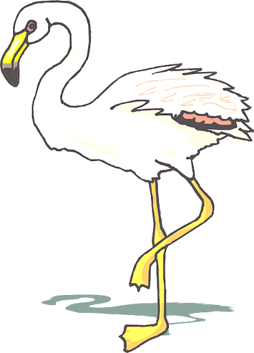
écouter
Écoute et lis le poème.
à certaines heures – at certain times
(la) fleur – flower
la carte correspondante, c’est quoi ?
lire
Le flamant est blanc,
quand il est jeune.
Mais à certaines heures
il est rose comme une fleur.
Comme la panthère,
le flammant est unique et spécial.
Notes:
Frequency of unknown words and cognates:
certain [110] fleur [2305] heure [99]
Londsale, D., & Le Bras, Y. (2009). A Frequency Dictionary of French: Core vocabulary for learners London: Routledge.
7

Slide 8
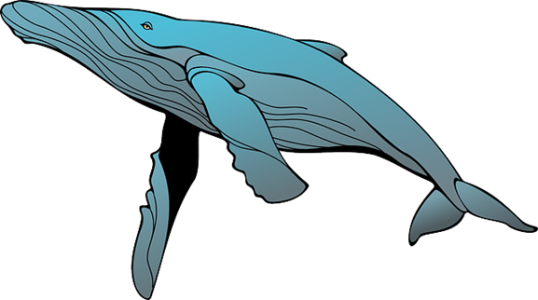
écouter
Écoute et lis le poème.
comme – like, as
parce que – because
la carte correspondante, c’est quoi ?
nager – to swim
lire
(la) mer – sea
La baleine bleue
est grande comme un bus.
Parce qu’elle est super
et nage dans la mer,
La baleine bleue est unique et spéciale.
Notes:
Frequency of unknown words and cognates:
bus [4027] mer [921] nager [>5000] parce que [n/a] super [2993]
Londsale, D., & Le Bras, Y. (2009). A Frequency Dictionary of French: Core vocabulary for learners London: Routledge.
8

Slide 9
écouter
Écoute et lis le poème.
(l’) ours = bear
ses = his, her, its
(le) bras = arm
la carte correspondante, c’est quoi ?
lire
(le) cœur = heart
La pieuvre est curieuse comme un ours
et avec ses huit bras
et trois cœurs
La pieuvre est aussi
unique et spéciale.
8
Notes:
Frequency of unknown words and cognates:
bras [1253] cœur [568] ours [4800] ses [26 – son, sa]
Londsale, D., & Le Bras, Y. (2009). A Frequency Dictionary of French: Core vocabulary for learners London: Routledge.
9

Slide 10
parler
C’est comment, le poème ?
Le message, c’est quoi ?
60
Le poème est…
positif
heureux
drôle sérieux
different important intéressant
utile
et aussi…
S
0
DÉBUT
Notes:
Timing: 4 minutes
Aim: to appreciate the poem and respond to it by exchanging their opinion with a partner; to revisit previously taught adjectives in a new context.
Procedure:
Teachers to read the instruction and model the exchange. For example: ‘Le poème est positif…’.
Give pupils a minute to exchange their opinion, using two adjectives.
Click to bring up further question: Le message, c’est quoi ? and ensure meaning is clear. This is an opportunity to gather ideas on what they think the message of the poem is about (‘We’re all different, with different characteristics and abilities, and yet of equal value’.).
Give pupils a minute to exchange their opinion on the message of the poem.
10

Slide 11
Au revoir !
jaune
Notes:
11

Slide 12
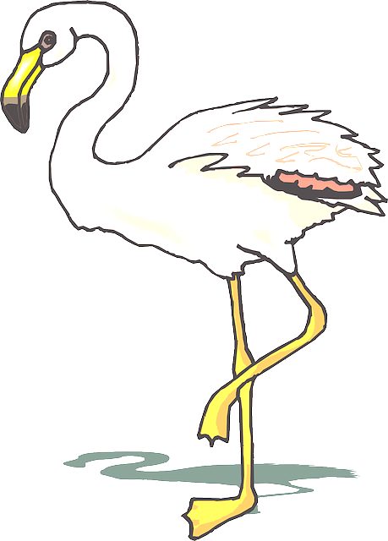
[fast]
👻
🕷
Notes:
There are 12 cards altogether.
They can be photocopied smaller than this.
Also, pupils can have just 1 x set 12 pictures between two – to work in pairs.

Slide 13
8

Slide 14
Unique et spécial
La panthère est noire comme le charbon.
Quand elle a peur ou froid,
sa couleur ne change pas,
mais elle est rapide comme un avion.
La panthère est unique et spéciale.
Le flamant est blanc,
quand il est jeune
Mais à certaines heures
il est rose comme une fleur.
Comme la panthère,
le flamant est unique et spécial.
La baleine bleue
est grande comme un bus.
Parce qu'elle est super
et nage dans la mer,
la baleine bleue est unique et spéciale.
La pieuvre est curieuse comme un ours
et avec ses huit bras
et trois cœurs,
la pieuvre est aussi
unique et spéciale.

