Slide 1
What do I know now?
Bonjour ! Ça va ?
jaune
Term 3 quiz
Notes:
Artwork by Steve Clarke. Pronoun pictures from NCELP (www.ncelp.org). All additional pictures selected from Pixabay and are
available under a Creative Commons license, no attribution required.
This lesson contains assessments to check progress in language learnt in the first 23 weeks of the course.
The frequency rankings for words that occur in this PowerPoint which have been previously introduced in these resources are given in the SOW and in the resources that first introduced and formally re-visited those words. For any other words that occur incidentally in this PowerPoint, frequency rankings will be provided in the notes field wherever possible.
Londsale, D., & Le Bras, Y. (2009). A Frequency Dictionary of French: Core vocabulary for learners London: Routledge.
1

Slide 2
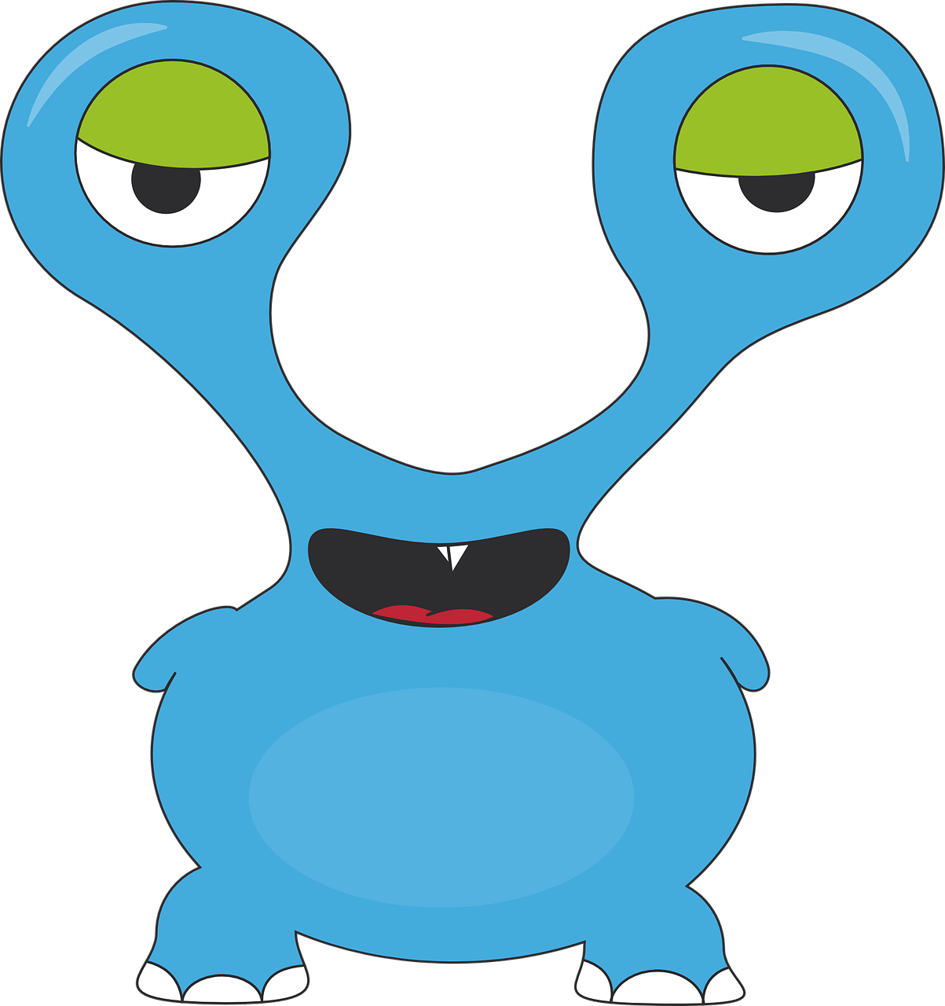
écouter
Torion is from another planet. They like earth and speaking French but often forget word meanings, spellings and things like gender and verb forms. Help Torion by answering the questions in this quiz.
A For each question, put a cross (x) under the English meaning that matches what you hear.
You will hear each French word twice. Choose one correct answer only.
 | A | B | C | D
1. | unique | useful | active | black
 | ☐ | ☐ | ☐ | ☐
2. | to ask ( a question) | to prepare | to present | to pronounce
 | ☐ | ☐ | ☐ | ☐
3. | white | clean | practical | dirty
 | ☐ | ☐ | ☐ | ☐
4. | fear | language | thing | door
 | ☐ | ☐ | ☐ | ☐
1
2
3
4
Notes:
Timing: 20-25 minutes (all assessment slides)
Aim: to practise aural comprehension of vocabulary taught in weeks 1-23 of the course.
Procedure:
1. Click the audio buttons to play each item. (The words are recorded twice with a pause to allow pupils to process the information).
2. Pupils can either write 1C, etc.. or if they have the assessment on a print out they can put a X in the correct box.
3. Note that the first item can be completed, with support from the teacher, as an example. It is NOT included in the overall total marks.
3. After items 1-4, continue to the next slide to complete the remainder of the task.
Transcript:
1. utile ….. utile
2. poser…..poser
3. propre…..propre
4. porte……porte
5. mars….mars
6. apporter….apporter
7. il…….il
8. magazine…..magazine
2

Slide 3
écouter
 | A | B | C | D
5. | May | morning | March | month
 | ☐ | ☐ | ☐ | ☐
6. | to bring | to love | to study | to look for
 | ☐ | ☐ | ☐ | ☐
7. | she, it | it is | here is | he, it
 | ☐ | ☐ | ☐ | ☐
 | hand | pain | magazine | shop
 | ☐ | ☐ | ☐ | ☐
5
6
7
8
Notes:
[2/2]
Transcript:
1. utile ….. utile
2. poser…..poser
3. propre…..propre
4. porte……porte
5. mars….mars
6. apporter….apporter
7. il…….il
8. magazine…..magazine
3

Slide 4
écouter
B For each question, put a cross (x) under the type of word you hear. You will hear each French word twice. Choose one correct answer only.
This word is a good example of …
 | A | B | C | D
1. | an object ☐ | a question word ☐ | a colour ☐ | a person ☐
2. | a family member ☐ | an activity ☐ | a question word ☐ | a colour ☐
3. | clothing ☐ | a month ☐ | a day of the week ☐ | politeness ☐
4. | a greeting ☐ | a time of day ☐ | a colour ☐ | a month ☐
5. | a number ☐ | an object ☐ | politeness ☐ | a time of day ☐
 | a day of the week ☐ | an object ☐ | a number ☐ | a person ☐
1
2
3
4
5
6
Notes:
Procedure:
1. Click the audio buttons to play each item. (The words are recorded twice with a pause to allow pupils to process the information).
2. Pupils can either write 1C, etc.. or if they have the assessment on a printout, they can put a X in the correct box.
3. When complete, continue to the reading.
Transcript:
combien…….combien
noir……noir
février…..février
matin…..matin
de rien…..de rien
quatre……quatre
4

Slide 5
lire
C Help Torion to translate the underlined French word to complete each English sentence.
1. C’est mon livre. It is my _____________ .
2. L’activité est sportive. The activity is _____________.
3. Je montre mon dessin. I ___________ my picture.
4. Le groupe est là ? Is the group ________ ?
5. Tu prépares une chanson. You are preparing a __________.
6. Il déteste les listes. He hates _____________ .
7. C’est ma langue préférée. It is my favourite ___________.
8. Il joue avec la personne. He plays ________ the person.
9. Écrire, c’est facile ! ____________ is easy!
10. C’est ton anniversaire ? Is it your _____________ ?
Notes:
Aim: to practise written recall of previously taught vocabulary.
Procedure:
Ensure that the task is clear.
Pupils could write 1 – 10 and the individual English word meanings (or they could fill in if they have printed assessment sheets).
5

Slide 6
lire
D Help Torion to put a cross (x) under the word that best fits each category. Choose one correct answer only.
This word is a good example of …
 | A | B | C | D
1. something to watch | musique ☐ | émission ☐ | radio ☐ | œil ☐
2. a place | merci ☐ | main ☐ | mois ☐ | musée ☐
3. a colour | oreille ☐ | image ☐ | bouche ☐ | blanche ☐
4. a part of the body | pied ☐ | pays ☐ | moto ☐ | cheval ☐
5. a person | mot ☐ | mardi ☐ | tante ☐ | tête ☐
6. a number | drôle ☐ | douze ☐ | dimanche ☐ | midi ☐
Notes:
Aim: to practise written recall of previously taught vocabulary.
Procedure:
Ensure that the task is clear.
Pupils could write 1 A etc (or they could fill in if they have printed assessment sheets).
6

Slide 7
lire
E Help Torion to put a cross (x) next to each word which could appear beside the word in bold in a sentence and make sense. For each question, you could put 1, 2, 3 or 4 crosses.
1. | a) enseigner | ☐ | le français |  | 2. | a) rester | ☐ | dehors
 | b) organiser | ☐ | le livre |  |  | b) avoir | ☐ | ☐
 | c) arriver | ☐
 | c) lire | ☐ |  |  |  | c) étudier | ☐ | ☐
 | d) prononcer | ☐
 | d) le pont | ☐ |  |  |  | d) être | ☐ | ☐
3. une visite | a) active | ☐ |  | 4. le voyage | a) unique | ☐
 | b) onze | ☐ |  |  | b) yeux | ☐
 | c) intéressante | ☐ |  |  | c) très | ☐
 | d) elle | ☐ |  |  | d) monsieur | ☐
Notes:
Aim: to practise written recall of previously taught vocabulary.
Procedure:
Ensure that the task is clear.
Pupils could write 1 A etc (or they could fill in if they have printed assessment sheets).
7

Slide 8
écrire
E Translate the underlined English words to complete the French sentence.
1. There are eight things. Il y a _______ __________. (write two words)
2. The motorbike is modern. La moto est _____________. (write one word)
3. I have a cake on the table. J’ ______ un gâteau _____ la table. (write two words)
4. It’s practical. C’est_____________. (write one word)
5. When is it? January? C’est __________ ? En __________ ? (write two words)
6. The desk is white. Le bureau est _____________. (write one word)
7. It’s my favourite text. C’est mon texte ____________. (write one word)
8. There are a lot of people. Il y a ______________ ____ personnes. (write two words)
9. What is he like? Il est ____________ ? (write one word)
10. The cat is massive. Le chat est ____________. (write one word)
Total marks available (Vocabulary): 44
Notes:
Aim: to practise written production of previously taught vocabulary.
Procedure:
Ensure that the task is clear.
Pupils could write 1 – 10 and the individual English word meanings (or they could fill in if they have printed assessment sheets).
8

Slide 9
lire
Grammar
A Put a (X) next to the word(s) that complete(s) the sentence.
1. | Aujourd’hui, c’ _________ samedi. Today is Saturday. | ☐ il y a ☐ a ☐ est
2. | Ma grand-mère ________ chaud. My grandma is hot. | ☐ il y a ☐ a ☐ est
3. | Il ________ deux télévisions. He has two tvs. | ☐ il y a ☐ a ☐ est
4. | Dans le pays _________ trois langues. In the country there are three languages. | ☐ il y a ☐ a ☐ est
5. | Elle ______ mal. She is in pain. | ☐ il y a ☐ a ☐ est
6. | Sous la chaise __________ un message. Under the chair there is a message. | ☐ il y a ☐ a ☐ est
Notes:
Aim: to practise written understanding of previously taught grammar features.
Procedure:
Ensure that the task is clear.
Pupils could write 1 – 6 and the correct English pronoun (or they could fill in if they have printed assessment sheets).
9

Slide 10
lire
Grammar
B Put a (X) next to the person the sentence is about.
1 | ☐ I ☐ you _{[singular]} ☐ she/he | …joues ici. |  | 3 | ☐ I ☐ you _{[singular]} ☐ she/he | …suis courageux.
2 | ☐ I ☐ you _{[singular]} ☐ she/he | …as un crayon. |  | 4 | ☐ I ☐ you _{[singular]} ☐ she/he | … visites l’université.
C Put a (X) by the correct start of each sentence.
1. | ☐ Elle … ☐ Elle aime … | chanter. |  | 6. | ☐ Tu … ☐ Tu détestes… | le sport.
Notes:
Aim: to practise written understanding of previously taught grammar features.
Procedure:
Ensure that the tasks are clear.
Pupils could write 1 - 4 and the correct English pronoun (or they could fill in if they have printed assessment sheets).
3. For C, pupils could write the start of the sentence or tick the box, if they have the printed assessment.
10

Slide 11
lire
Grammar
D Write the words in each box in the correct order.
1. | texte | le | différent | Correct order: ______________________________________
2. | une | massive| chambre | Correct order:______________________________________
3. | actif | septembre| le | Correct order:______________________________________
E Write the correct French word for ‘it’ to complete the sentence.
1. | J’aime le lit. ____ est grand. | I like the bed. It is big.
2. | Tu préfères l’affiche. ________ est petite. | You prefer the poster. It is small.
écrire
Notes:
Aim: to practise written understanding of previously taught grammar features.
Procedure:
Ensure that the task is clear.
Pupils write the words in the right order.
11

Slide 12
écrire
Grammar
F Write the correct article in the blanks to complete the French translations of the English sentences.
1. | Il y a _____________ questions. (f) | There are some questions.
2. | J’écoute ___________ réponse. (f) | I’m listening to the answer.
3. | Il aime _____________ bananes. (f) | He likes (the) bananas.
4. | C’est ________ amie. (f) | It’s a (female) friend.
5. | Voici ________ grand-père. (m) | Here is your grandad.
6. | Elle déteste ________ jour (m) jeudi. | She hates the day Thursday.
7. | C’est __________ idée. (f) | It’s your idea.
8. | Voici ______ parc (m) sale. | Here is a dirty park.
Total marks available (Grammar): 24
Notes:
Aim: to practise written production of previously taught grammar features.
Procedure:
Ensure that the task is clear.
Pupils could write the answers only (or they could fill in if they have printed assessment sheets).
12

Slide 13
Au revoir !
jaune
Notes:
13

Slide 14
écouter
Torion is from another planet. They like earth and speaking French but often forget word meanings, spellings and things like gender and verb forms. Help Torion by answering the questions in this quiz.
A For each question, put a cross (x) under the English meaning that matches what you hear.
You will hear each French word twice. Choose one correct answer only.
 | A | B | C | D
1. | unique | useful | active | black
 | ☐ | ☐ | ☐ | ☐
2. | to ask ( a question) | to prepare | to present | to pronounce
 | ☐ | ☐ | ☐ | ☐
3. | white | clean | practical | dirty
 | ☐ | ☐ | ☐ | ☐
4. | fear | language | thing | door
 | ☐ | ☐ | ☐ | ☐
1
2
3
4
Notes:
Timing: 20-25 minutes (all assessment slides)
Aim: to practise aural comprehension of vocabulary taught in weeks 1-23 of the course.
Procedure:
1. Click the audio buttons to play each item. (The words are recorded twice with a pause to allow pupils to process the information).
2. Pupils can either write 1C, etc.. or if they have the assessment on a print out they can put a X in the correct box.
3. Note that the first item can be completed, with support from the teacher, as an example. It is NOT included in the overall total marks.
3. After items 1-4, continue to the next slide to complete the remainder of the task.
Transcript:
1. utile ….. utile
2. poser…..poser
3. propre…..propre
4. porte……porte
5. mars….mars
6. apporter….apporter
7. il…….il
8. magazine…..magazine
14

Slide 15
écouter
 | A | B | C | D
5. | May | morning | March | month
 | ☐ | ☐ | ☐ | ☐
6. | to bring | to love | to study | to look for
 | ☐ | ☐ | ☐ | ☐
7. | she, it | it is | here is | he, it
 | ☐ | ☐ | ☐ | ☐
 | hand | pain | magazine | shop
 | ☐ | ☐ | ☐ | ☐
5
6
7
8
Notes:
[2/2]
Transcript:
1. utile ….. utile
2. poser…..poser
3. propre…..propre
4. porte……porte
5. mars….mars
6. apporter….apporter
7. il…….il
8. magazine…..magazine
15

Slide 16
écouter
B For each question, put a cross (x) under the type of word you hear. You will hear each French word twice. Choose one correct answer only.
This word is a good example of …
 | A | B | C | D
1. | an object ☐ | a question word ☐ | a colour ☐ | a person ☐
2. | a family member ☐ | an activity ☐ | a question word ☐ | a colour ☐
3. | clothing ☐ | a month ☐ | a day of the week ☐ | politeness ☐
4. | a greeting ☐ | a time of day ☐ | a colour ☐ | a month ☐
5. | a number ☐ | an object ☐ | politeness ☐ | a time of day ☐
 | a day of the week ☐ | an object ☐ | a number ☐ | a person ☐
1
2
3
4
5
6
Notes:
Procedure:
1. Click the audio buttons to play each item. (The words are recorded twice with a pause to allow pupils to process the information).
2. Pupils can either write 1C, etc.. or if they have the assessment on a printout, they can put a X in the correct box.
3. When complete, continue to the reading.
Transcript:
combien…….combien
noir……noir
février…..février
matin…..matin
de rien…..de rien
quatre……quatre
16

Slide 17
lire
C Help Torion to translate the underlined French word to complete each English sentence.
1. C’est mon livre. It is my _____________ .
2. L’activité est sportive. The activity is _____________.
3. Je montre mon dessin. I ___________ my picture.
4. Le groupe est là ? Is the group ________ ?
5. Tu prépares une chanson. You are preparing a __________.
6. Il déteste les listes. He hates _____________ .
7. C’est ma langue préférée. It is my favourite ______________.
8. Il joue avec la personne. He plays ________ the person.
9. Écrire, c’est facile ! ____________ is easy!
10. C’est ton anniversaire ? Is it your _____________ ?
book
sporty
show
there
song
(the) lists
language
with
Writing
birthday
Notes:
Aim: to practise written recall of previously taught vocabulary.
Procedure:
Ensure that the task is clear.
Pupils could write 1 – 10 and the individual English word meanings (or they could fill in if they have printed assessment sheets).
17

Slide 18
lire
D Help Torion to put a cross (x) under the word that best fits each category. Choose one correct answer only.
This word is a good example of …
 | A | B | C | D
1. something to watch | musique ☐ | émission ☐ | radio ☐ | œil ☐
2. a place | merci ☐ | main ☐ | mois ☐ | musée ☐
3. a colour | oreille ☐ | image ☐ | bouche ☐ | blanche ☐
4. a part of the body | pied ☐ | pays ☐ | moto ☐ | cheval ☐
5. a person | mot ☐ | mardi ☐ | tante ☐ | tête ☐
6. a number | drôle ☐ | douze ☐ | dimanche ☐ | midi ☐
Notes:
Aim: to practise written recall of previously taught vocabulary.
Procedure:
Ensure that the task is clear.
Pupils could write 1 A etc (or they could fill in if they have printed assessment sheets).
18

Slide 19
lire
E Help Torion to put a cross (x) next to each word which could appear beside the word in bold in a sentence and make sense. For each question, you could put 1, 2, 3 or 4 crosses.
1. | a) enseigner | ☐ | le français |  | 2. | a) rester | ☐ | dehors
 | b) organiser | ☐ | le livre |  |  | b) avoir | ☐ | ☐
 | c) arriver | ☐
 | c) lire | ☐ |  |  |  | c) étudier | ☐ | ☐
 | d) prononcer | ☐
 | d) le pont | ☐ |  |  |  | d) être | ☐ | ☐
3. une visite | a) active | ☐ |  | 4. le voyage | a) unique | ☐
 | b) onze | ☐ |  |  | b) yeux | ☐
 | c) intéressante | ☐ |  |  | c) très | ☐
 | d) elle | ☐ |  |  | d) monsieur | ☐
Notes:
Aim: to practise written recall of previously taught vocabulary.
Procedure:
Ensure that the task is clear.
Pupils could write 1 A etc (or they could fill in if they have printed assessment sheets).
19

Slide 20
écrire
E Translate the underlined English words to complete the French sentence.
1. There are eight things. Il y a _______ __________. (write two words)
2. The motorbike is modern. La moto est _____________. (write one word)
3. I have a cake on the table. J’ ______ un gâteau _____ la table. (write two words)
4. It’s practical. C’est_____________. (write one word)
5. When is it? January? C’est __________ ? En __________ ? (write two words)
6. The desk is white. Le bureau est _____________. (write one word)
7. It’s my favourite text. C’est mon texte ____________. (write one word)
8. There are a lot of people. Il y a ______________ ____ personnes. (write two words)
9. What is he like? Il est _________________ ? (write one word)
10. The cat is massive. Le chat est ____________. (write one word)
huit choses
moderne
ai
sur
pratique
quand
janvier
blanc
préféré
beaucoup de
comment
massif
Total marks available (Vocabulary): 44
Notes:
Aim: to practise written production of previously taught vocabulary.
Procedure:
Ensure that the task is clear.
Pupils could write 1 – 10 and the individual English word meanings (or they could fill in if they have printed assessment sheets).
20

Slide 21
lire
Grammar
A Put a (X) next to the word(s) that complete(s) the sentence.
1. | Aujourd’hui _________ samedi. Today is Saturday. | ☐ il y a ☐ a ☐ est
2. | Ma grand-mère ________ chaud. My grandma is hot. | ☐ il y a ☐ a ☐ est
3. | Elle ________ deux télévisions. She has two tvs. | ☐ il y a ☐ a ☐ est
4. | Dans le pays _________ trois langues. In the country there are three languages. | ☐ il y a ☐ a ☐ est
5. | Elle ______ mal. She is in pain. | ☐ il y a ☐ a ☐ est
6. | Sous la chaise __________ un message. Under the chair there is a message. | ☐ il y a ☐ a ☐ est
Notes:
Aim: to practise written understanding of previously taught grammar features.
Procedure:
Ensure that the task is clear.
Pupils could write 1 – 6 and the correct English pronoun (or they could fill in if they have printed assessment sheets).
21

Slide 22
lire
Grammar
B Put a (X) next to the person the sentence is about.
1 | ☐ I ☐ you _{[singular]} ☐ she/he | …joues ici. |  | 3 | ☐ I ☐ you _{[singular]} ☐ she/he | …suis courageux.
2 | ☐ I ☐ you _{[singular]} ☐ she/he | …as un crayon. |  | 4 | ☐ I ☐ you _{[singular]} ☐ she/he | … visites l’université.
C Put a (X) by the correct start of each sentence.
1. | ☐ Elle … ☐ Elle aime … | chanter. |  | 6. | ☐ Tu … ☐ Tu détestes… | le sport.
Notes:
Aim: to practise written understanding of previously taught grammar features.
Procedure:
Ensure that the tasks areclear.
Pupils could write 1 - 4 and the correct English pronoun (or they could fill in if they have printed assessment sheets).
3. For C, pupils could write the start of the sentence or tick the box, if they have the printed assessment.
22

Slide 23
lire
Grammar
D Write the words in each box in the correct order.
1. | texte | le | différent | Correct order: ______________________________________
2. | une | massive| chambre | Correct order:______________________________________
3. | actif | professeur| le | Correct order:______________________________________
le texte différent
une chambre massive
le professeur actif
E Write the correct French word for ‘it’ to complete the sentence.
1. | J’aime le lit. ____ est grand. | I like the bed. It is big.
2. | Tu préfères l’affiche. ________ est petite. | You prefer the poster. It is small.
Il
écrire
Elle
Notes:
Aim: to practise written understanding of previously taught grammar features.
Procedure:
Ensure that the task is clear.
Pupils write the words in the right order.
23

Slide 24
écrire
Grammar
F Write the correct article in the blanks to complete the French translations of the English sentences.
1. | Il y a _____________ questions. (f) | There are some questions.
2. | J’écoute ___________ réponse. (f) | I’m listening to the answer.
3. | Il aime _____________ bananes. (f) | He likes (the) bananas.
4. | C’est ________ amie. (f) | It’s a (female) friend.
5. | Voici ________ grand-père. (m) | Here is your grandad.
6. | Elle déteste ________ jour (m) jeudi. | She hates the day Thursday.
7. | C’est __________ idée. (f) | It’s your idea.
8. | Voici ______ parc (m) sale. | Here is a dirty park.
des
la
les
une
ton
le
ton
un
Total marks available (Grammar): 24
Notes:
Aim: to practise written production of previously taught grammar features.
Procedure:
Ensure that the task is clear.
Pupils could write the answers only (or they could fill in if they have printed assessment sheets).
24

