Slide 1
Saying how many and describing things
Mon monstre
jaune
des (some)
combien de
SSC [(a)in]
Notes:
Artwork by Steve Clarke. Pronoun pictures from NCELP (www.ncelp.org). All additional pictures selected from Pixabay and are
available under a Creative Commons license, no attribution required.
The AUDIO version of the lesson material includes additional audio for the new language
presented (phonics, vocabulary) and audio for the instructions on the slide.
In addition, it includes VIDEO clips of the phonics and the phonics’ source words. Pupils can be
encouraged to look at the shape of the mouth/lips on slides where these appear, and try to copy
it/them.
Phonics: introduce [(a)in] fin [111] lapin [>5000] main [418] train [232] vingt [1273]
Vocabulary (new words in bold): combien [800] bouche [1838] main [418] nez [2661] œil [474] pied [626] tête [343] yeux [474] beaucoup (de) [150] des [2]
Revisit 1: aimer [232] préférer [597] sport [2011] aussi [44] et [6] mais [30]
Revisit 2: --
Londsale, D., & Le Bras, Y. (2009). A Frequency Dictionary of French: Core vocabulary for learners London: Routledge.
The frequency rankings for words that occur in this PowerPoint which have been previously introduced in these resources are given
in the SOW and in the resources that first introduced and formally re-visited those words.
For any other words that occur incidentally in this PowerPoint, frequency rankings will be provided in the notes field wherever
possible.
1

Slide 2
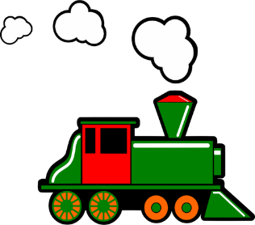
prononcer
[(a)in]
train
Notes:
Timing: 1 minute
Aim: To re-introduce SSC [(a)in]
Procedure:
Introduce and elicit the pronunciation of the individual SSC [(a)in] and then the source word ‘train’ (with gesture, if using).
Click to bring on the picture and get students to repeat (with gesture, if using).
Note: gesture for train – fist closed, arm by side, forearm at right angle to body, thrust fist forward miming the movement of a fast train
https://www.signbsl.com/sign/train – scroll down to the noun train videos.
Word frequency (1 is the most frequent word in French):
train [232]. Source: Londsale, D., & Le Bras, Y. (2009). A Frequency Dictionary of French: Core vocabulary for learners London: Routledge.
2

Slide 3
prononcer
[(a)in]
train
vingt
fin
main
lapin
Notes:
Timing: 2 minutes
Aim: To consolidate SSC [ain/in].
Procedure:
1. Introduce and elicit the pronunciation of the individual SSC [(a)in] and then the source word again ‘train’ (with gesture, if using). 2. Then present and elicit the pronunciation of the five cluster words.
The cluster words have mainly been chosen for their high-frequency, from a range of word classes, with the SSC (where possible) positioned within a variety of syllables within the words (e.g. initial, 2nd, final etc.).
Note: gesture for train – fist closed, arm by side, forearm at right angle to body, thrust fist forward miming the movement of a fast train
https://www.signbsl.com/sign/train – scroll down to the noun train videos.
Word frequency (1 is the most frequent word in French): fin [111] lapin [>5000] main [418] train [232] vingt[1273] Source: Londsale, D., & Le Bras, Y. (2009). A Frequency Dictionary of French: Core vocabulary for learners London: Routledge.
3

Slide 4
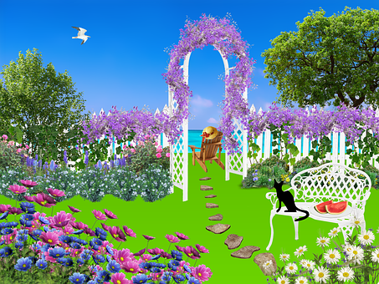
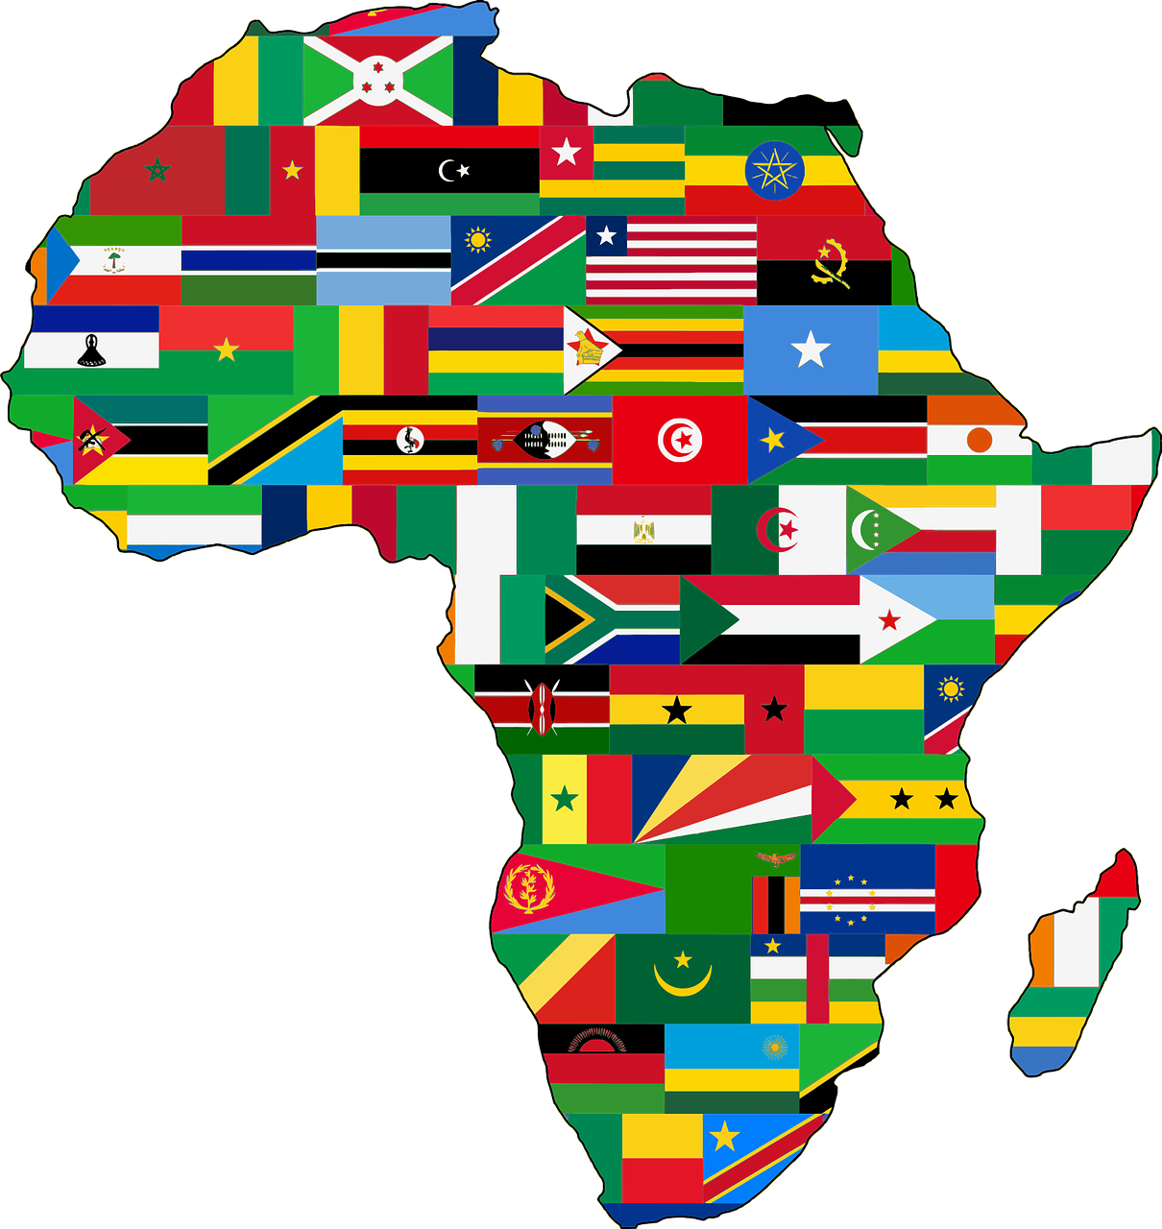
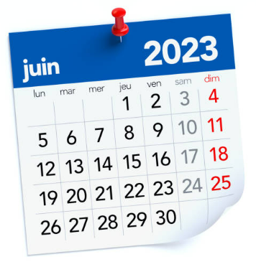
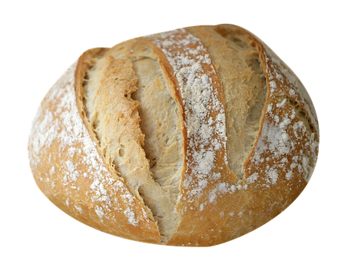
. Écoute les noms des animaux. C’est [ien] ou [(a)in]?
Écris cinq mots. Ton ou ta partenaire devine.
parler
30
américain
cousin
jardin
inviter
pain
magasin
africain
S
juin
médecin
inventer
internet
cinq
0
DÉBUT
Notes:
Timing: 5 minutes
Aim: to practise reading aloud words with [(a)in] with some previously taught vocabulary & unknown words (pictures provided to support meaning).
Procedure:
Read the explanation and ensure pupils understand the task.
Start the timer.
Pupils try to guess their partner’s 5 words by saying them aloud, before the 30 seconds is up.
Swap roles and repeat the game.
Frequency of unknown words and cognates:
africain [>5000] américan [>5000] cousin [3387] internet [>5000] inventer [>5000] inviter [>5000] jardin [2284] juin [931] magasin [1736] médecin [827] pain [2802]
Source: Davies, M. & Davies, K. (2018). A frequency dictionary of Spanish: Core vocabulary for learners (2nd ed.). Routledge: London

Slide 5
vocabulaire
Jean-Michel rêve. C’est un rêve bizarre !
le rêve - the dream
mots
Il y a un monstre ! Le monstre a…
une tête
un œil
une oreille
une bouche
une main
un pied
Notes:
Timing: 5 minutes Aim: to set the scene for this week’s lesson, J-M’s dream; and to introduce vocabulary for this week.
Procedure: 1. Read the title and ensure understanding.
2. Click to bring up the speech bubble and elicit the French, prompting: ‘Un monstre, c’est quoi ? → a monster, très bien ☺.
3. Click to bring up new items of vocabulary individually. Pupils listen and repeat, then teacher prompts C’est quoi, une bouche ? → A mouth, super ! ☺.
Frequency of unknown words and cognates:
rêver [1678]
Source: Davies, M. & Davies, K. (2018). A frequency dictionary of Spanish: Core vocabulary for learners (2nd ed.). Routledge: London
5

Slide 6
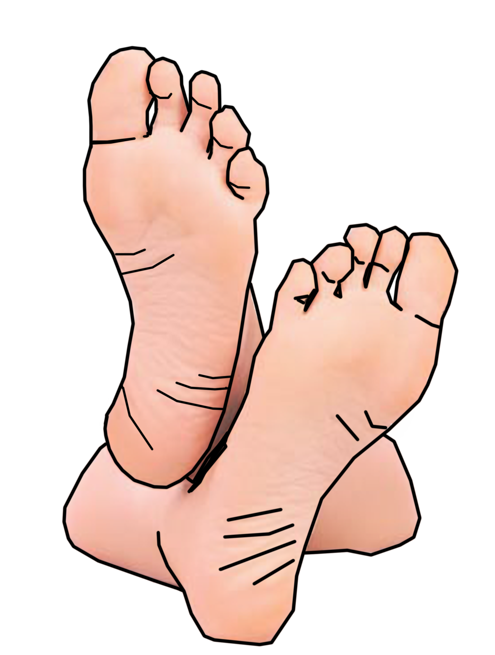
des (some)
Remember! To mean ‘a/an’ for masculine nouns, use ‘un’:
Il y a un pied.
There is a foot.
To mean ‘a/an for feminine nouns, use ‘une’:
Il y a une main.
There is a hand.
To mean ‘some’ (plural), use ‘des’ for all nouns:
Add –s to make many French nouns plural, as in English.
Il y a des pieds.
There are some feet.
Il y a des mains.
There are some hands.
⚠Attention !
The plural of œil (eye) is yeux (eyes).
Il y a des yeux.
There are some eyes.
Notes:
Timing: 2 minutes
Aim: to revisit singular indefinite articles and introduce the plural indefinite article ‘des’, meaning some.
Procedure:
Click to present the information.
Elicit the English meanings of the examples.
6

Slide 7
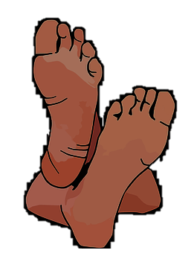
écouter
Jean-Michel dessine des monstres.
[A] Écris 1 ou 1+ 📝.
[B] Écris le numéro. 📝
1
1+
2
1
5
E
2
4
E
E
3
1+
4
1
3
1
E
5
1+
E
6
1
6
7
7
E
E
E
1+
8
8
1+
Notes:
Timing: 5 minutes
Aim: to practise aural comprehension of vocabulary and articles.
Procedure:
1. Explain the scenario. J-M is drawing some monsters. Is he planning to draw one or more of each body part? 1. Click on numbers to play each item.
2. Pupils listen and note 1 (singular) or 1+ (plural-some).
3. Click to correct.
4. Click again to bring up part B. Pupils listen again and identify each body part – they can write 1-8 and the body part in English.
5. Click to correct in number order. Teachers can ask – Numéro 1, c’est quoi ?
Differentiation:
For increased challenge, ask pupils to turn away from the board and make notes in English after listening to each item. Then at the end they turn back to the board and complete part B. For more support, provide English true/false statements, and remove the pictures. E.g.
some feet.
For even more support, provide a choice of two statements each time (removing the pictures from the slide). E.g.
Some feet. | A/one foot.
Transcript:
des pieds un œil
des têtes
une oreille
des bouches
une main
des yeux
des images
7

Slide 8
Combien de (how many)
⚠Attention !
There must be a ‘de’ between combien and the noun, but we don’t translate this in English.
Combien de means ‘how many’:
Il y a combien de pieds ?
How many feet are there?
Il y a dix pieds.
There are ten feet.
Notes:
Timing: 2 minutes
Aim: to introduce the word ‘combien’ with one meaning ‘how many’ and how to use it in an intonation question.
Procedure:
Click to present the information.
Elicit the English meanings of the examples.
8

Slide 9
lire
C’est une question ou c’est une phrase ?
⚠Attention !
There is no punctuation!
1
Il y a cinq mains.
4
Il y a des yeux.
2
Il y a combien de bouches ?
5
Il y a six oreilles.
3
Il y a combien de têtes ?
6
Il y a combien de pieds ?
Notes:
Timing: 3 minutes
Aim: to recognise a ‘how many’ question by the presence or ‘de’.
Procedure:
Teacher reads the instruction in French.
Pupils decide whether each item is a question or statement, depending on the presence or absence of ‘de’.
Elicit the answers from pupils (note they will only be able to say ‘c’est une question’ or ‘c’est une phrase’.
Then click to hear the full sentence and to reveal the written versions.
Transcript:
Il y a cinq mains. Il y a combien de bouches ? Il y a combien de têtes ? Il y a des yeux. il y a six oreilles. Il y a combien de pieds ?
9

Slide 10
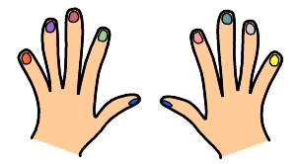
parler
Tu as combien de doigts* ?
le doigt - finger
trois
3
huit
8
deux
neuf
2
9
quatre
sept
4
7
30
dix
un
10
1
cinq
5
six
6
DÉBUT
Notes:
Timing: 3 minutes
Aim: to consolidate numbers in oral production.
Procedure:
Teacher reads the instruction in French.
Pupils work in pairs to say the numbers in order (1-10). They have 30 seconds.
Click to trigger the timer.
To bring up the answers, each number disappears on click, and the correct answer appears (with audio, in the audio version).
10

Slide 11
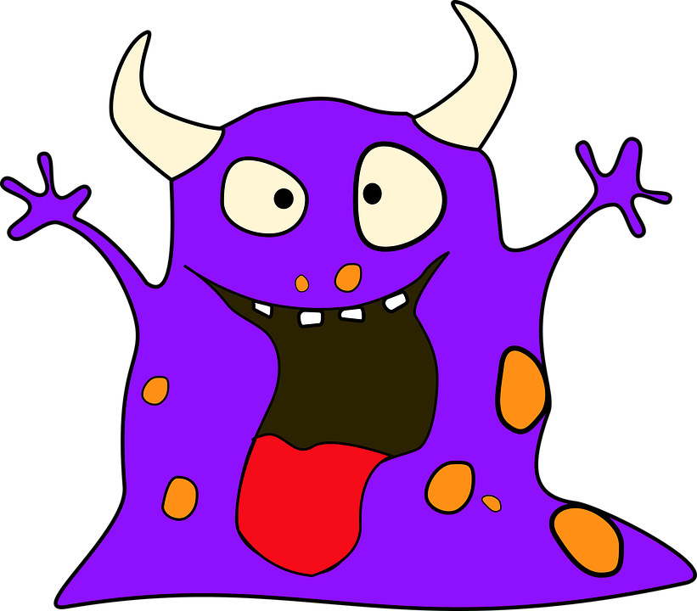
lire
Complète la phrase.
[1/5]
douze
mains.
Il y a
deux
œil.
dix
oreilles.
Notes:
Timing: 3 minutes (5 slides)
Aim: to practise comprehension of numbers, plural indefinite articles and this week’s new vocabulary.
Procedure:
Elicit the full sentence response, which takes account of information given by the picture (i.e. the number of eyes).
Click on the picture to hear the full sentence response.
Repeat steps 1-3 with the remaining four slides.
Transcript:
Il y a deux mains.

Slide 12
lire
Complète la phrase.
[2/5]
six
pieds.
Il y a
sept
oreilles.
des
yeux.
Notes:
[2/5]
Transcript:
Il y a des yeux.

Slide 13
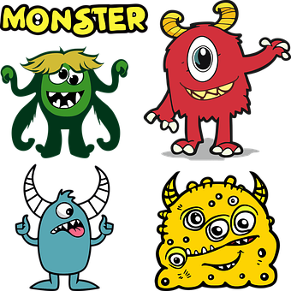
lire
Complète la phrase.
[3/5]
neuf
yeux.
Il y a
huit
bouches.
dix
pieds.
Notes:
[3/5]
Transcript:
Il y a neuf bouches.

Slide 14
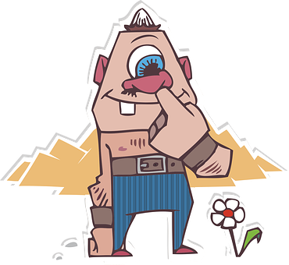
lire
Complète la phrase.
[4/5]
cinq
pieds.
Il y a
trois
oreilles.
deux
œil.
Notes:
[4/5]
Transcript:
Il y a deux oreilles.

Slide 15
lire
Complète la phrase.
[5/5]
quatre
pieds.
Il y a
six
têtes.
cinq
yeux.
Notes:
[5/5]
Transcript:
Il y a cinq têtes.

Slide 16
Au revoir !
jaune
Notes:
16

