Slide 1
Saying how many and describing things
jaune
Follow ups 1-5
Notes:
Artwork by Steve Clarke. Pronoun pictures from NCELP (www.ncelp.org). All additional pictures selected from Pixabay and are available under a Creative Commons license, no attribution required.
Phonics: introduce [(a)in] fin [111] lapin [>5000] main [418] train [232] vingt [1273]
Vocabulary (new words in bold): combien [800] bouche [1838] main [418] nez [2661] œil [474] pied [626] tête [343] yeux [474] beaucoup (de) [150] des [2]
Revisit 1: aimer [232] préférer [597] sport [2011] aussi [44] et [6] mais [30]
Revisit 2: --
Londsale, D., & Le Bras, Y. (2009). A Frequency Dictionary of French: Core vocabulary for learners London: Routledge.
The frequency rankings for words that occur in this PowerPoint which have been previously introduced in these resources are given in the SOW and in the resources that first introduced and formally re-visited those words.
For any other words that occur incidentally in this PowerPoint, frequency rankings will be provided in the notes field wherever possible.

Slide 2
prononcer
[(a)in]
train
Notes:
Timing: 1 minute
Aim: To introduce SSC [(a)in]
Procedure:
Introduce and elicit the pronunciation of the individual SSC [(a)in] and then the source word ‘train’ (with gesture, if using).
Click to bring on the picture and get students to repeat (with gesture, if using).
Note: gesture for train – fist closed, arm by side, forearm at right angle to body, thrust fist forward miming the movement of a fast train
https://www.signbsl.com/sign/train – scroll down to the noun train videos.
Word frequency (1 is the most frequent word in French):
train [232]. Source: Londsale, D., & Le Bras, Y. (2009). A Frequency Dictionary of French: Core vocabulary for learners London: Routledge.
2

Slide 3
prononciation
[(a)in]
train
vingt
fin
main
lapin
Notes:
Timing: 2 minutes
Aim: To consolidate SSC [ain/in].
Procedure:
1. Introduce and elicit the pronunciation of the individual SSC [(a)in] and then the source word again ‘train’ (with gesture, if using). 2. Then present and elicit the pronunciation of the five cluster words.
The cluster words have mainly been chosen for their high-frequency, from a range of word classes, with the SSC (where possible) positioned within a variety of syllables within the words (e.g. initial, 2nd, final etc.).
Word frequency (1 is the most frequent word in French): fin [111] lapin [>5000] main [418] train [232] vingt [1273] Source: Londsale, D., & Le Bras, Y. (2009). A Frequency Dictionary of French: Core vocabulary for learners London: Routledge.
3

Slide 4
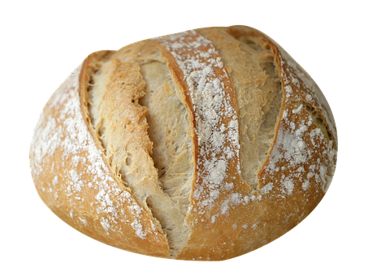
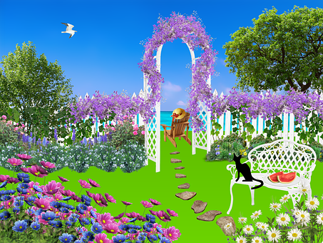
Follow up 1:
[(a)in]
. Écoute les noms des
Écoute le poème.
. Écoute les noms des animaux. C’est [ien] ou [(a)in]?
Il y a combien de mots avec le son [(a)in] ?
Alain, le lapin
invite cinq copains
son cousin germain
Valentin, le chien
à manger du pain
dans le grand jardin.
Alain
lapin
invite
cinq
copains
5
cousin
germain
*
Valentin
chien
pain
jardin
Il y a 11 mots avec le son [(a)in].
cousin germain – first cousin
Notes:
Timing: 4 minutes
Aim: to practise aural recognition of the [(a)in] sound; to practise reading aloud a short poem with many examples of this sound.
Procedure:
Click on the audio symbol to hear the poem.
Pupils tally the number of [(a)in] sounds they hear in total.
Click to reveal the answer.
Pupils practise reading aloud the poem in pairs.

Slide 5
Combien (how many)
Remember! To say how many of something there are, use
‘il y a’ + number or des (some):
Il y a deux pieds.
There are two feet.
Il y a trois yeux.
There are three eyes.
⚠ Remember the liaison, here.
Il y a des oreilles.
There are some ears.
⚠ Remember the liaison, here.
Notes:
Do before Follow up 2.
Timing: 2 minutes
Aim: to revisit how to say how many using ‘il y a’ + number or des (some); to remember the liaison when the article des (or number ending is –s or –x) comes before a noun beginning with a vowel.
Procedure:
Present the information, using the animated sequence.
Elicit English translation for the French examples provided.

Slide 6
Follow up 2
. Écoute les noms des animaux. C’est [ien] ou [(a)in]?
C’est un, une ou des ?
parler
m
f
pl
Notes:
Timing: 5 minutes (two slides)
Aim: to revise gender and word knowledge. Procedure: 1. The nouns appear as pictures with word (without article) on separate mouse clicks. Say the word (chorally) with its indefinite article. 2. On second click, the noun moves into the ‘appropriately gendered’ mouth.
Transcript: une bouche un pied des têtes
des yeux
des mains
une oreille un œil
des oreilles une main

Slide 7
Follow up 3:
Jean-Michel rêve encore une fois*.
encore une fois – once again
Écoute et décide.
Vrai ou faux ? Écris bien la phrase.
écouter
There is | There are
des dessins
un dessin
E
E
une question
une question
1
1
des mots
des mots
2
2
3
3
des monstres
un monstre
4
4
une bouche
une bouche
5
5
des mains
une main
6
6
une tête
des têtes
7
7
des pieds
des pieds
Notes:
Timing: 8 minutes
Aim: to practise aural comprehension of ‘il y a’ and its correct translation into English.
Procedure:
Read the title and click to bring up the instructions in French. Pupils write 1-7.
Do the example (E). Make it clear that the meaning of ‘il y a’ in English is dependent on the number (singular/plural) of the noun that follows.
Do 1-7 and click to correct.
Pupils listen again – Does the list coincide with J-M’s dream? Is each item the same or different? Pupils tick or cross. Pupils also transcribe what they hear, as they are able.
Click to correct.
Transcript
[Exemple] Il y a un dessin.
[1] Il y a une question.
[2] Il y a des mots.
[3] Il y a un monstre.
[4] Il y a une bouche.
[5] Il y a une main.
[6] Il y a des têtes.
[7] Il y a des pieds.
Frequency of unknown words and cognates:
rêver [1678]

Slide 8
Follow up 4
Parle avec ton/ta partenaire.
a)in]?
⚠ Remember the difference between ‘there is/are’ – il y a and he/it has – il a…
Exemple :
parler
Say the monster has these features il a… | Write here what your partner says the monster has
1) | 1)
Partenaire A
A
Il a des mains.
Partenaire A écrit…
some hands
five heads
Partenaire B
Say it has these things il a ... | Write here what your partner says the monster has
1) | 1)
Partenaire B écrit…
B
five heads
some hands
Il a cinq têtes.
Notes:
Timing: 5-10 minutes (3 slides, two rounds of speaking activity)
Aim: to practise oral production and comprehension of singular and plural nouns with indefinite articles and/or numbers.
Note: This slide shows how the speaking task is intended to work. The stages are animated to support the teacher in modelling the task.
Procedure:
After modelling this example, give out the task sheets (at the end of this PPT).
Partner As speak first and Bs write.
Then swap roles for Round 2.
Two answer slides follow this slide.

Slide 9
Follow up 4A
Réponses
Round 1
Partenaire B écrit…
parler
Say it has these things il a ...
some hands
a/one head
three mouths
six feet
an/one eye
Write here what your partner says it has
1)
2)
3)
4)
5)
Il a des mains.
1
Il a une tête.
some hands
2
a head
Il a trois bouches.
3
three mouths
Il a six pieds.
4
six feet
Il a un œil.
an eye
5
Notes:
ANSWER SLIDE ROUND 1 – DO NOT DISPLAY DURING THE ACTIVITY
Aim: to practise oral production and comprehension of singular and plural nouns with indefinite articles and/or numbers.
Procedure:
Elicit the English from partners B
Elicit the French from partners A
Move to the next slide to give feedback for Round 2.

Slide 10
Follow up 4
Réponses
Round 2
Partenaire A écrit…
parler
Say it has these things il a ...
five heads
three feet
some ears
twelve eyes
a mouth
Il a cinq têtes.
Write here what your partner says it has
1)
2)
3)
4)
5)
1
Il a trois pieds.
five heads
2
three feet
Il a des oreilles.
3
some ears
Il a douze yeux.
4
twelve eyes
⚠ Remember the liaison z-yeux to make the pronunciation softer, here.
Il a une bouche.
a mouth
5
Notes:
ANSWER SLIDE ROUND 2 – DO NOT DISPLAY DURING THE ACTIVITY
Aim: to practise oral production and comprehension of singular and plural nouns with indefinite articles and/or numbers.
Procedure:
Elicit the English from partners A.
Elicit the French from partners B.

Slide 11
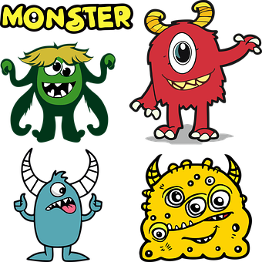
Follow up 5:

Choisis et décris un monstre.
. Écoute les
écrire
[My monster has… and…]
[It also has… and…]
2
Exemple : 📝
4
Mon monstre a deux pieds et une tête.
Il a aussi une bouche et sept yeux.
5
3
⚠ Remember the liaison z-yeux to make the pronunciation softer, here.
Notes:
Timing: 8 minutes
Aim: Production of il a, indefinite articles and numbers.
Procedure:
Students to choose one monster to produce full sentences using the vocabulary from the lesson.
2. Read the example together.
Unknown words and/or cognates:
choisir [561]

Slide 12
vocabulaire
Follow up EXTRA - Écris en anglais : Can you get at least 15 points?
mots
 | mais | préférer | et
 | le sport | aimer | aussi
 | cinq | deux | trois
 | sept | douze | neuf
 | des | la bouche | combien (de) ?
 | la main | le pied | l’œil
 | la tête | des yeux | l’oreille
but
to prefer, preferring
and
x3
sport
to like, liking
also, too
five
two
three
x2
twelve
seven
nine
some
(the) mouth
how many?
(the) hand
(the) foot
(the) eye
x1
(the) head
(the) eyes
(the) ear
Notes:
Timing: 5-10 minutes
Aim: to practise written comprehension of vocabulary from this week and previous weeks.
Procedure: Give pupils a blank grid. They fill in the English meanings of any of the words they know, trying to reach 15 points in total.
Note: The most recently learnt and practised words are pink, words from the previous week are green and those from earlier are blue, thus more points are awarded for them, to recognise that memories fade and more effort (heavy lifting!) is needed to retrieve them.
12

Slide 13
vocabulaire
Follow up EXTRA - Écris en français : Can you get at least 15 points?
mots
 | also | but | and
 | to like, liking | to prefer, preferring | (the) sport
 | four | eleven | eight
 | nine | seven | five
 | (the) hand | (the) ear | (the) head
 | (the) mouth | (the) foot | (the) eye
 | some | how many ? | (some) eyes
aussi
mais
et
x3
aimer
préférer
le sport
quatre
onze
huit
x2
neuf
sept
cinq
la main
l’oreille
la tête
la bouche
le pied
l’œil
x1
des
combien de…?
des yeux
Notes:
Timing: 5-10 minutes
Aim: to practise written comprehension of vocabulary from this week and previous weeks.
Procedure: Give pupils a blank grid. They fill in the French meanings of any of the words they know, trying to reach 15 points in total.
Note: The most recently learnt and practised words are pink, words from the previous week are green and those from earlier are blue, thus more points are awarded for them, to recognise that memories fade and more effort (heavy lifting!) is needed to retrieve them.
13

Slide 14
Follow up 4
Partenaire B écrit…
Partenaire A
Round 1
Round 2
parler
Say it has these things il a ...
1. some hands
2. a/one head
3. three mouths
4. six feet
5. an/one eye
Write here what your partner says it has
1)
2)
3)
4)
5)
Notes:
HANDOUT – PARTENAIRE A

Slide 15
Follow up 4
Partenaire B écrit…
Partenaire B
Round 1
Round 2
parler
Write here what your partner says it has
1)
2)
3)
4)
5)
Say it has these things il a ...
1. five heads
2. three feet
3. some ears
4. twelve eyes
5. a mouth
Notes:
HANDOUT – PARTENAIRE B

Slide 16
vocabulaire
Écris en anglais : Can you get at least 15 points?
mots
 | mais | préférer | et
 | le sport | aimer | aussi
 | cinq | deux | trois
 | sept | douze | neuf
 | des | la bouche | combien (de) ?
 | la main | le pied | l’œil
 | la tête | des yeux | l’oreille
x3
x2
x1
Notes:
HANDOUT EXTRA 1
16

Slide 17
vocabulaire
Écris en français : Can you get at least 15 points?
mots
 | also | but | and
 | to like, liking | to prefer, preferring | (the) sport
 | four | eleven | eight
 | nine | seven | five
 | (the) hand | (the) ear | (the) head
 | (the) mouth | (the) foot | (the) eye
 | some | how many ? | (some) eyes
x3
x2
x1
Notes:
HANDOUT EXTRA 2
17

