Slide 1
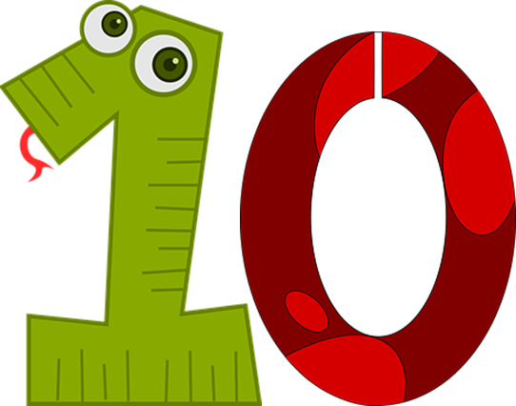
Saying how many and describing things
jaune
Follow ups 1-5
Notes:
Artwork by Steve Clarke. Pronoun pictures from NCELP (www.ncelp.org). All additional pictures selected from Pixabay and are
available under a Creative Commons license, no attribution required.
The AUDIO version of the lesson material includes additional audio for the new language presented (phonics, vocabulary) and audio for the instructions
on the slide.
In addition, it includes VIDEO clips of the phonics and the phonics’ source words. Pupils can be encouraged to look at the shape of the mouth/lips on
slides where these appear, and try to copy it/them.
Phonics: introduce liaison after x- and s-: deux enfants, trois oranges
Vocabulary (new words in bold): il y a [n/a] un [3] deux [41] trois [115] quatre [253] cinq [288] six [450] sept [905] huit [877] neuf [787] dix [372] onze [2447] douze [1664] Revisit 1: jouer [219] ami, amie [467] en ligne [n/a] dehors [1217] mon, ma [60] ton, ta [330] voici [1103]
Revisit 2: --
Londsale, D., & Le Bras, Y. (2009). A Frequency Dictionary of French: Core vocabulary for learners London: Routledge.
The frequency rankings for words that occur in this PowerPoint which have been previously introduced in these resources are given in the SOW and in the resources that first introduced and formally re-visited those words. For any other words that occur incidentally in this PowerPoint, frequency rankings will be provided in the notes field wherever possible.

Slide 2
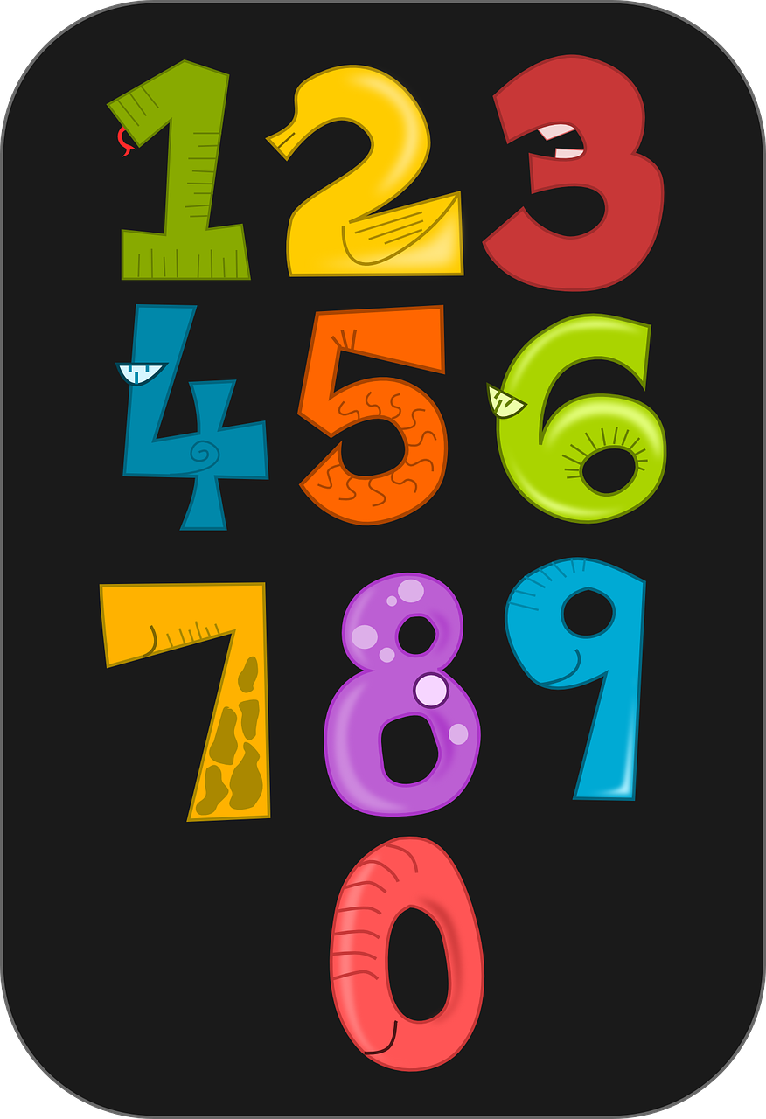
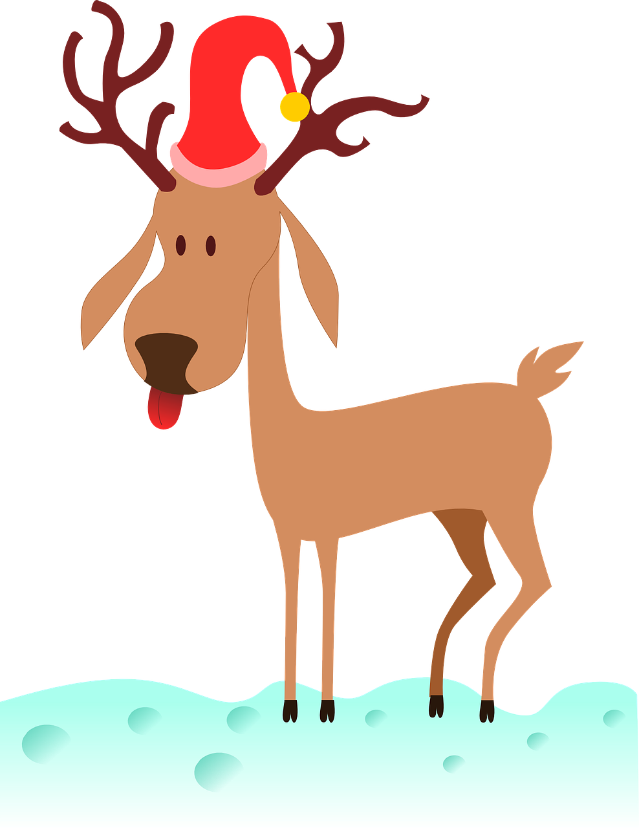
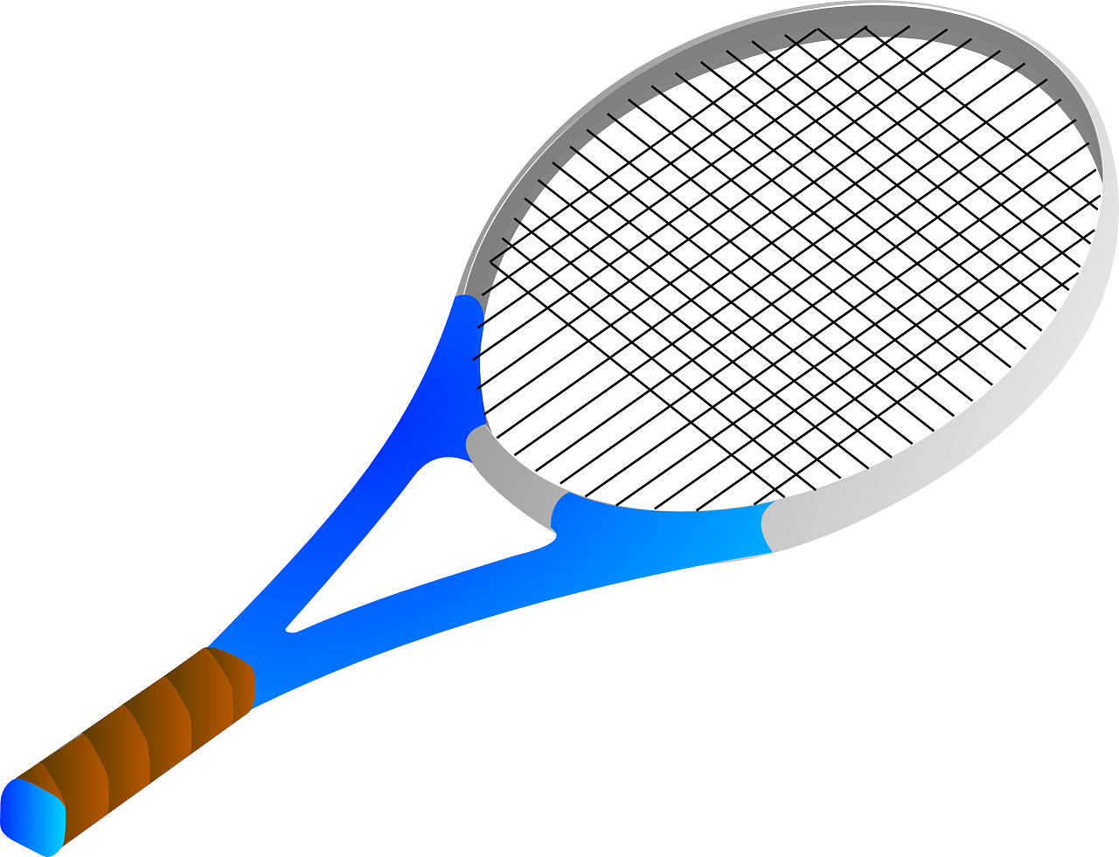
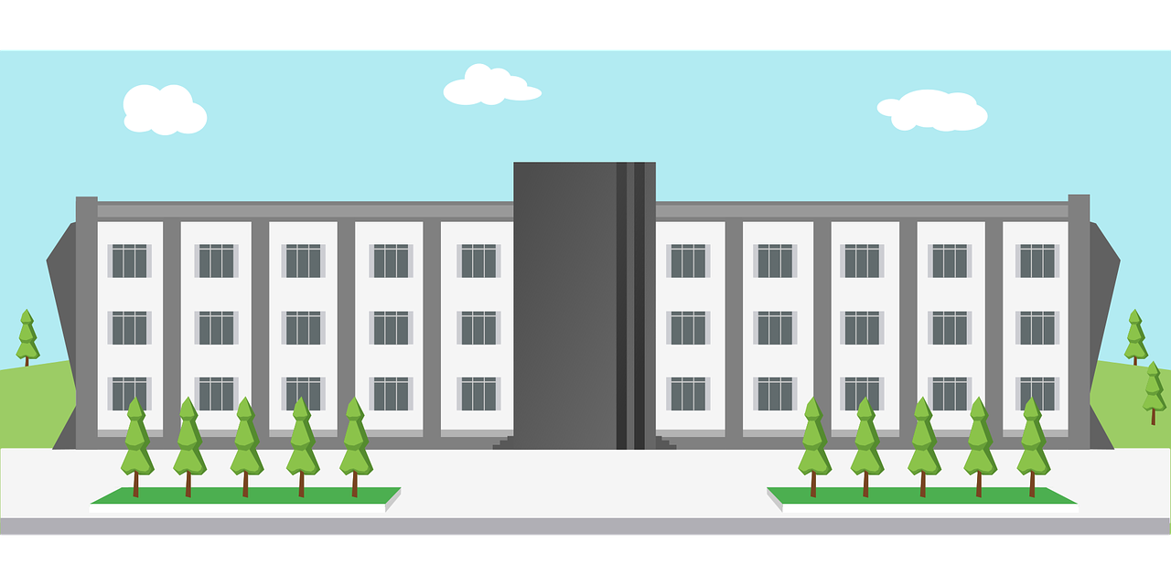
Follow up 1
⚠Remember:
s- and x- before a vowel sound like ‘z’.
Prononce les phrases. Il y a une liaison ?
prononcer
 | six affiches
 | trois chaises
 | deux lits
 | dix mots
 | trois universités
 | six chats
 | trois émissions
 | deux images
 | dix idées
 | deux sports
six affiches
trois émissions
deux images
dix idées
trois universités
Notes:
Timing: 3 minutes
Aim: to practise s- and x-liaison in with numbers and previously taught nouns.
Procedure:
Do the first one with pupils.
Remind them of the liaison rules, using the callouts. Click to remove them.
Give pupils time in pairs to practise pronunciation.
Elicit responses chorally, and click to reveal liaison or no liaison, and to hear the audio.
Transcript:
six affiches trois chaises
deux lits
dix mots
trois universités six chats
trois émission
deux images
dix idées
deux sports

Slide 3
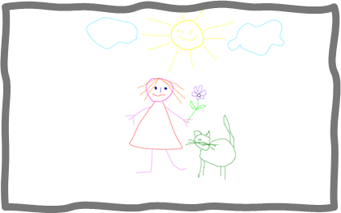
Avoir
⚠ To talk about something in the plural (more than one), French often adds ‘s’ to the end of nouns.
[to have | having]
We have seen that the verb avoir means ‘to have’.
I have
j’ai
J’ai deux dessins.
I have two drawings.
you have
tu as
Tu as sept messages.
You have seven messages.
he has
il a
Il a cinq crayons.
He has five pencils.
she has
elle a
Elle a huit amis.
She has eight friends.
⚠ Remember also this expression:
there is there are
il y a
Il y a neuf chats.
There are nine chats.
Notes:
Do before Follow up 2.
Timing: 2 minutes
Aim: to revisit singular persons of avoir, il y a and introduce plural marking of regular nouns.
Procedure:
Present the information, using the animated sequence.
Elicit English translation for the French examples provided.

Slide 4
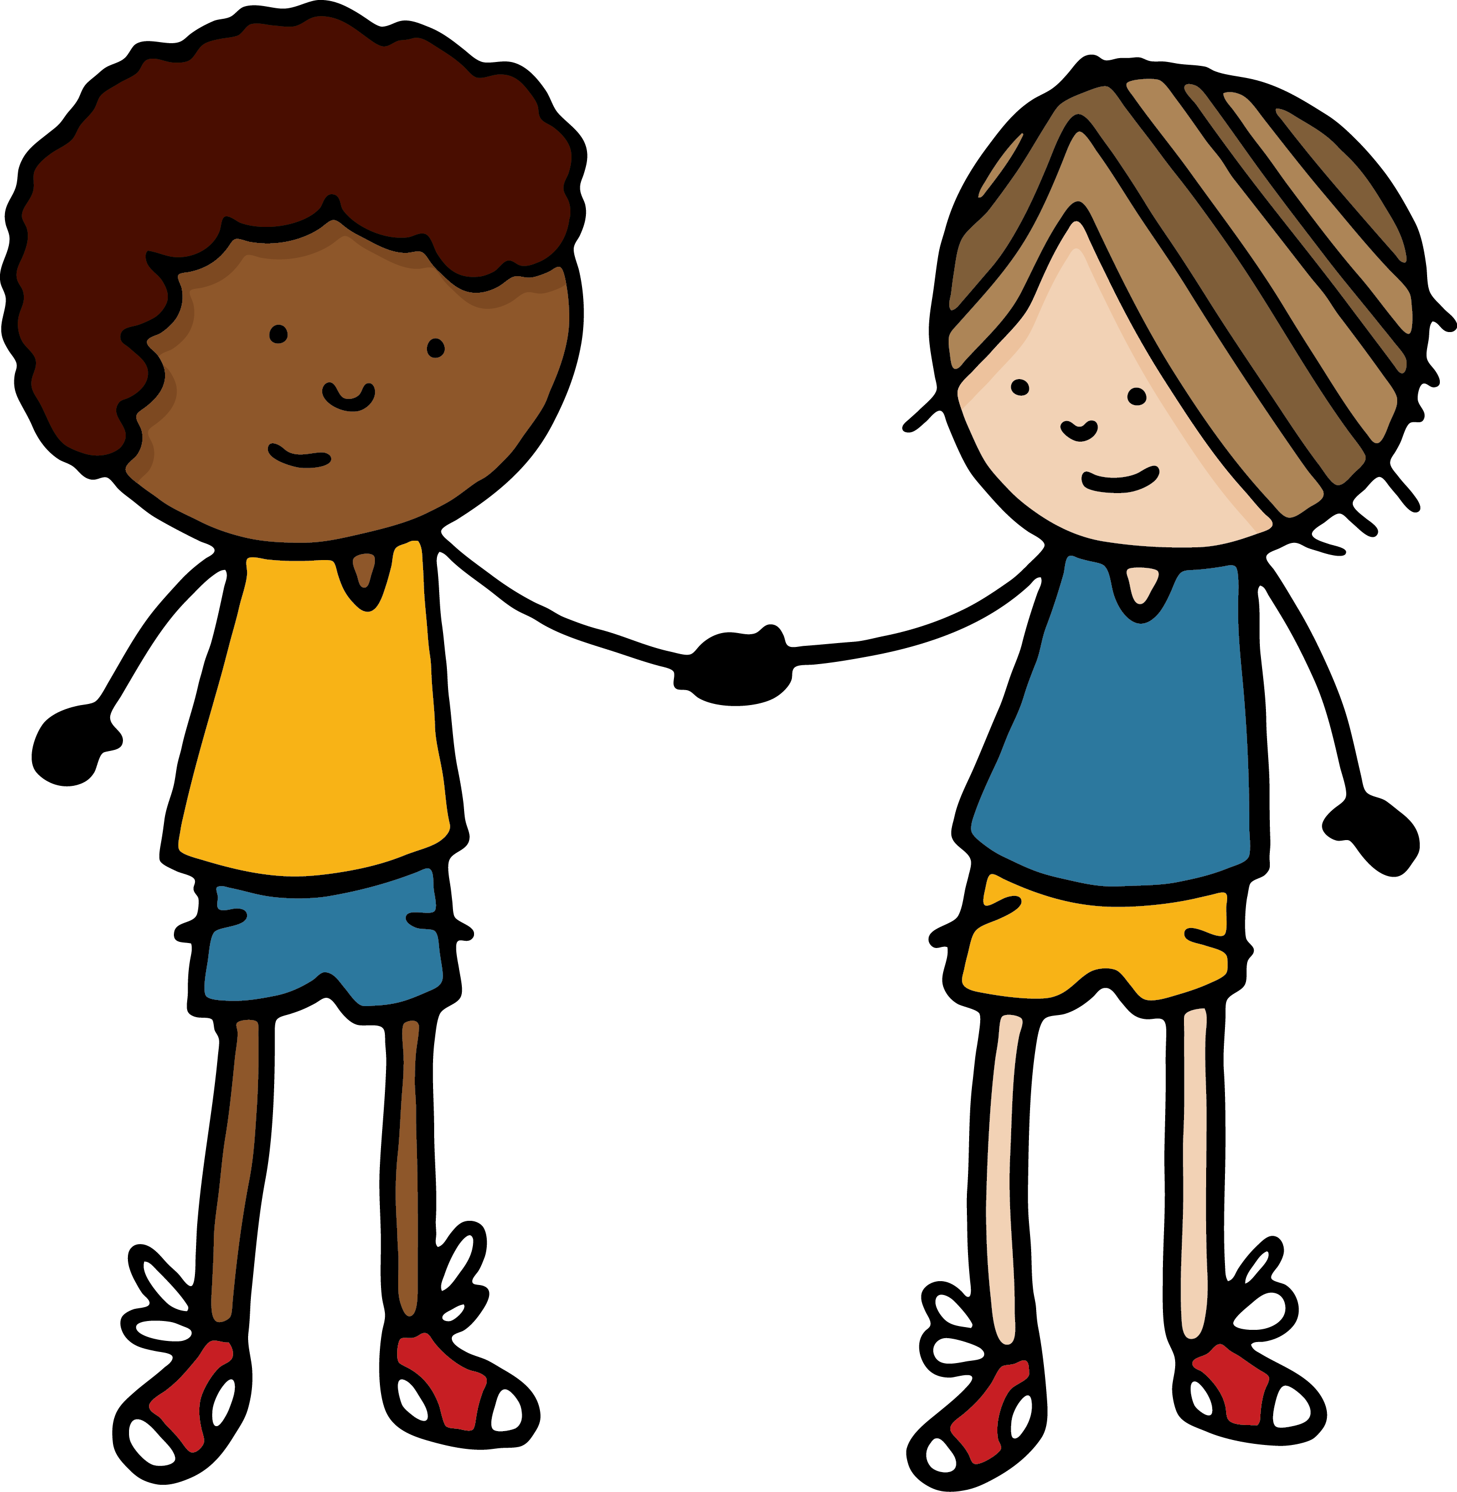
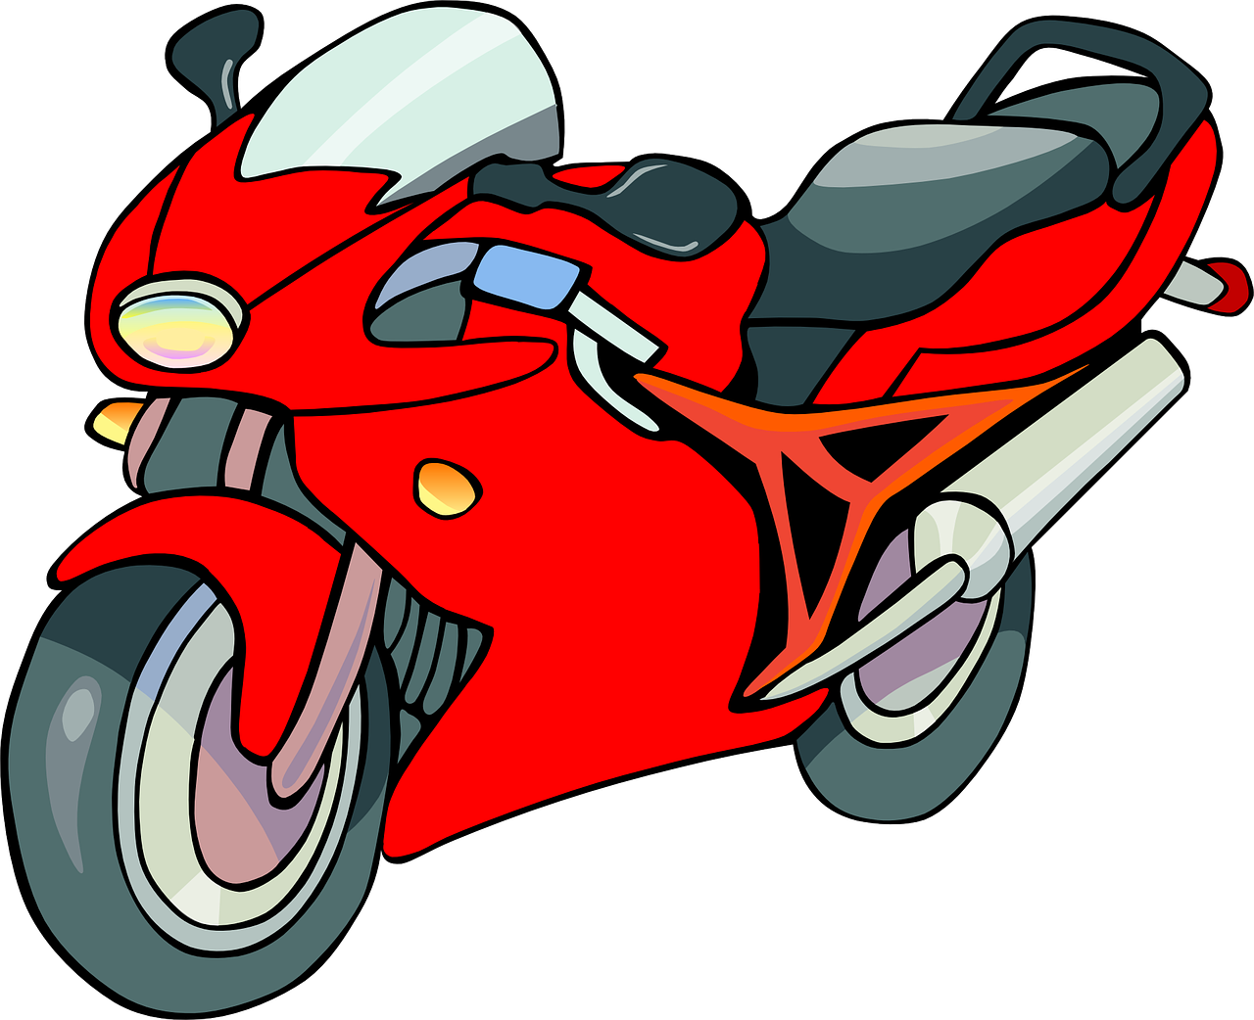
Follow up 2
Écoute. Trouve l’image correcte et écris le nombre.
A
B
Écoute. La phrase correcte, c’est quoi ?
écouter
A
B
A | B
C | D
E | F
He has… | There are…
There are… | There is…
I have… | You have…
There are… | He has…
You have… | She has…
He has… | There are…
4
11
1
2
3
2
5
4
5
3
1
6
Notes:
Timing: 5 minutes
Aim: to practise aural comprehension of singular parts of avoir, il y , numbers and revisited vocabulary.
Procedure:
(Part A)
Read the instruction in French.
Do [1] with the pupils. Click to listen. Pupils write the correct letter A or B.
Click for answer.
Complete items 2-6 and click to correct with the class.
(Part B)
Click to listen again.
Write the item letter with the correct number of items mentioned.
Click to correct.
Transcript:
Il y a trois motos. Il y a un lit.
J’ai quatre dessins.
Il a onze crayons. Tu as cinq questions. Il y a deux amis.

Slide 5
vocabulaire
Follow up 3a - Écris en anglais : Can you get at least 15 points?
mots
 | ton | ta | voici
 | ma | mon | dehors
 | l’amie | jouer | en ligne
 | trois | un, une | deux
 | douze | cinq | onze
 | sept | neuf | quatre
 | il y a | dix | huit
your (m)
your (f)
here is, this is
x3
my (f)
my (m)
outside
(the) friend (f)
to play, playing
online
x2
three
a/an, one (m), (f)
two
twelve
five
eleven
x1
seven
nine
four
there is, there are
ten
eight
Notes:
Timing: 5-10 minutes
Aim: to practise written comprehension of vocabulary from this week and previous weeks.
Procedure: Give pupils a blank grid. They fill in the English meanings of any of the words they know, trying to reach 15 points in total.
Note: The most recently learnt and practised words are pink, words from the previous week are green and those from earlier are blue, thus more points are awarded for them, to recognise that memories fade and more effort (heavy lifting!) is needed to retrieve them.
5

Slide 6
vocabulaire
Follow up 3b - Écris en français : Can you get at least 15 points?
mots
 | your (m) | your (f) | here is, this is
 | my (f) | my (m) | outside
 | (the) friend (f) | to play, playing | online
 | three | a/an, one (m), (f) | two
 | twelve | five | eleven
 | seven | nine | four
 | there is, there are | ten | eight
ton
ta
voici
x3
ma
mon
dehors
l’amie
jouer
en ligne
x2
trois
un, une
deux
douze
cinq
onze
x1
sept
neuf
quatre
Il y a
dix
huit
Notes:
Timing: 5-10 minutes
Aim: to practise written comprehension of vocabulary from this week and previous weeks.
Procedure: Give pupils a blank grid. They fill in the French meanings of any of the words they know, trying to reach 15 points in total.
Note: The most recently learnt and practised words are pink, words from the previous week are green and those from earlier are blue, thus more points are awarded for them, to recognise that memories fade and more effort (heavy lifting!) is needed to retrieve them.
6

Slide 7
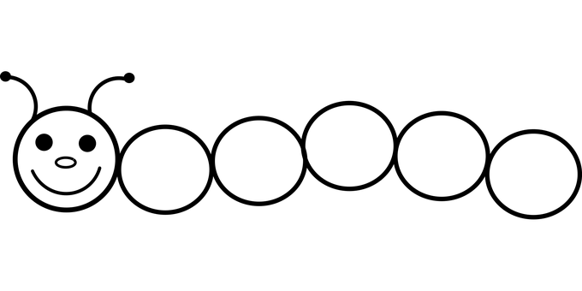
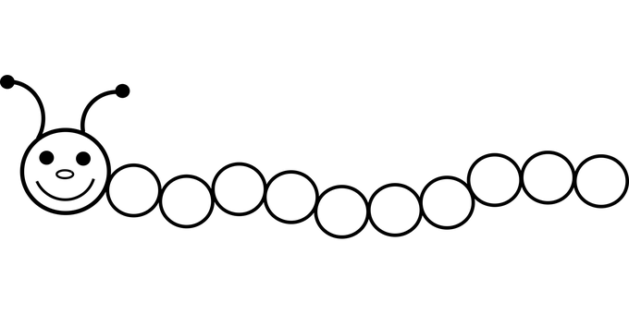
Follow up 4a:
Parle avec ton ou ta partenaire.
parler
2
3
4
1
1
5
5
2
7
8
9
6
8
6
10
2
4
10
3
5
4
3
12
11
10
9
8
7
6
6
4
1
3
5
7
9
2
3
1
6
1
1
1
1
5
4
Notes:
Timing: 5 minutes (two slides, two activities)
Aim: to practise oral production of numbers 1-12.
Procedure:
Model number 1 with pupils chanting the numbers 1-5 as a class.
Pupils work in pairs to follow the different patterns of numbers 2-6.
Click on the audio buttons to hear the full sequences. Encourage pupils to join in to increase fluency in production.
Additional task suggestions:
Pupils could do each sequence backwards.
Pupils could make up their own sequence for their partner (using only numbers 1-12).

Slide 8
Parle avec ton ou ta partenaire.
Follow up 4b
A
A
parler
A
A
Notes:
Timing: 5 minutes (two slides, if desired)
Aim: to practise oral production of ‘il y a’, numbers and plural forms of familiar nouns’ connecting them to meaning.
The aim of both activities is to identify a character (A, B, C, D), but with slight differences.
Pupil B chooses one of options (ABCD) but doesn’t tell his/her partner which one.
Pupil A asks questions to determine which one B has chosen. E.g. Il y a trois chats ?
Pupil A makes notes and after several questions can ask: Tu es A ?
When A has correctly identified the person, they swap roles.
Notes:
Pupils A and B will both see this set of cards (so the slide can be projected for the whole group, so no printing needed).
There is a 2nd set of cards for a further round of activity, if time allows.

Slide 9
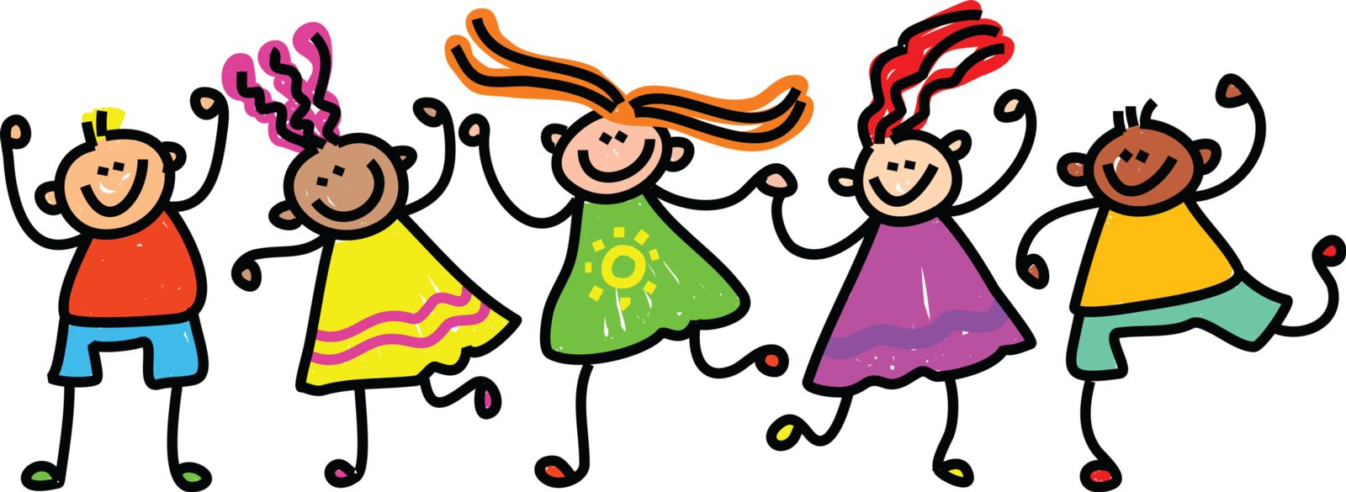
Parle avec ton ou ta partenaire.
A
A
parler
A
A
Notes:
[2/2]

Slide 10
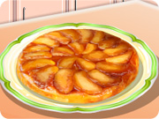
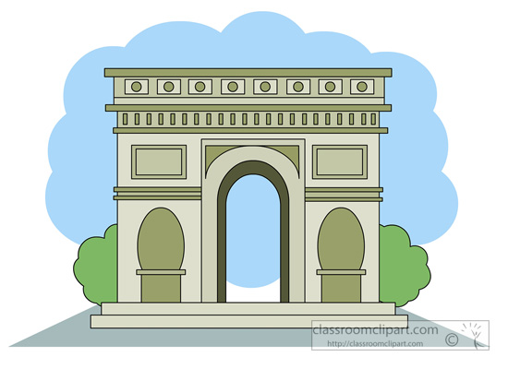
Follow up 5a: Écris en français.
Écris les numéros en français.
écrire
i
q
+
=
c _ n _
1
=
s _ _ t
+
e
p
2
=
o _ _ e
+
n
z
3
u
i
+
=
h _ _ t
4
o
u
d _ _ _ e
+
=
z
5
Notes:
Timing: 5 minutes
Aim: to practise written production of numbers.
Procedure:
Pupils work out the Maths sums and write the answers as French numbers.
Click to reveal the written answers.
Additional Task suggestions: 1. More confident pupils could write out the whole sums in French words e.g. deux + trois = cinq.
2. Pupils could write their own word sums for others to complete.
Note: to listen to how the full sums sound in French, click the numbered buttons.

Slide 11
Follow up 5b
A
Écoute. Il y a quoi ? Écris en anglais.
écouter
1
There is a/one bed.
Il y a un lit.
2
There are eleven drawings.
Il y a onze dessins.
3
There are nine messages.
Il y a neuf messages.
4
There are eight texts.
Il y a huit textes.
5
There are four words.
Il y a quatre mots.
6
There is a/one poster.
Il y a une affiche.
7
There are twelve friends.
Il y a douze amis.
8
There are seven cats.
Il y a sept chats.
Notes:
Timing: 5 minutes
Aim: to practise aural comprehension of numbers and previously taught vocabulary.
Procedure:
Read the instruction in French.
Do [1] with the pupils. Click to listen. Pupils write the English.
Click for answer.
Complete items 2-8 and click to correct with the class.
Transcript:
Il y a un lit
Il y a onze dessins.
Il y a neuf messages.
Il y a huit textes.
Il y a quatre mots.
Il y a une affiche.
Il y a douze amis.
Il y a sept chats.

Slide 12
vocabulaire
Écris en anglais : Can you get at least 15 points?
mots
 | ton | ta | voici
 | ma | mon | dehors
 | l’amie | jouer | en ligne
 | trois | un, une | deux
 | douze | cinq | onze
 | sept | neuf | quatre
 | il y a | dix | huit
x3
x2
x1
Notes:
HANDOUT
12

Slide 13
vocabulaire
Écris en français : Can you get at least 15 points?
mots
 | your (m) | your (f) | here is, this is
 | my (f) | my (m) | outside
 | (the) friend (f) | to play, playing | online
 | three | a/an, one (m), (f) | two
 | twelve | five | eleven
 | seven | nine | four
 | there is, there are | ten | eight
x3
x2
x1
Notes:
HANDOUT
13

