Slide 1
Saying what I and others do
L o n d r e s
jaune
Follow ups 1-5
Notes:
Artwork by Steve Clarke. Pronoun pictures from NCELP (www.ncelp.org). All additional pictures selected from Pixabay and are available under a Creative Commons license, no attribution required.
Phonics: introduce [oi] voir [69] avoir [8] au revoir [4/1274] pourquoi ? [193] trois [115]
Vocabulary: à (meaning ‘to, at, on, in’)[4] arriver [174] montrer [108] rester [100] voyage [904] souvent [287] en ce moment [n/a]
Revisit 1: émission [1074] radio [1526] tante [3891] télévision [1179] grand2 [59] petit2 [138] de2 [2]
Revisit 2: chaque [151] jour [78] revisit days of the week
Londsale, D., & Le Bras, Y. (2009). A Frequency Dictionary of French: Core vocabulary for learners London: Routledge.
Londsale, D., & Le Bras, Y. (2009). A Frequency Dictionary of French: Core vocabulary for learners London: Routledge.
The frequency rankings for words that occur in this PowerPoint which have been previously introduced in these resources are given in the SOW and in the resources that first introduced and formally re-visited those words.
For any other words that occur incidentally in this PowerPoint, frequency rankings will be provided in the notes field wherever possible.

Slide 2
prononcer
[oi]
voir
[to see, seeing]
Notes:
Timing: 3 minutes (two slides)
Aim: to introduce SSC [oi].
Procedure:
Introduce and elicit the pronunciation of the individual SSC [oi] and the source word ‘voir’.
Click to bring on the picture and get students to repeat (with gesture, if using).
Present and practise the cluster words.
Gesture: gesture for voir
https://www.signbsl.com/sign/see (scroll down to the correct definition of ‘see’ and we recommend the 1st video of these three) – right index finger comes up to the eye and then points away from the body as if tracing the path of sight from the eyes towards an object in view.
2

Slide 3
prononcer
[oi]
voir
to have, having
avoir
Au revoir !
[to see, seeing]
[why?]
trois
pourquoi ?
Notes:
Timing: 2 minutes
Aim: to recap SSC [oi].
Procedure:
Introduce and elicit the pronunciation of the individual SSC [oi] and the source word ‘voir’.
Click to bring on the picture and get students to repeat (with gesture, if using).
Present and practise the cluster words.
Gesture: gesture for voir
https://www.signbsl.com/sign/see (scroll down to the correct definition of ‘see’ and we recommend the 1st video of these three) – right index finger comes up to the eye and then points away from the body as if tracing the path of sight from the eyes towards an object in view.
3

Slide 4
Follow up 1:
. Écoute les noms des animaux. C’est [ien] ou [(a)in]?
[oi]
Écoute et répète.
Regardez-moi !
Les yeux sur toi !
Écoutez-moi !
On baisse la voix !
On fait un choix !
Je sais pourquoi !
Excusez-moi !
Notes:
Timing: 4 minutes
Aim: to practise oral production of the SSC [oi] and reinforce positive classroom routines.
Procedure:
Click to start the video.
Encourage pupils to listen and join in with Marie-Odile when she asks pupils to repeat.
Note that we don’t expect pupils to learn these phrases off by heart. We include this comptine to practise examples of the [oi] SSC. However, they will recognise the verbs regarder and écouter (from prior learning) and excuser (as cognate).
Link to video on youtube:
https://www.youtube.com/watch?v=slZeu9gWeBE
French and English meanings: Regardez-moi ! Look at me! Les yeux sur toi ! Eyes on you! Écoutez-moi ! Listen to me! On baisse la voix ! Lower your voice! On fait un choix ! We make a choice! Je sais pourquoi ! I know why! Excusez-moi ! Excuse me!

Slide 5
Follow up 2
Écoute. C’est A, B ou C ?
 | A | B | C
 | You are talking to your friend. | She is talking to your friend. | You are talking to my friend.
 | I am listening to a radio programme. | He is preparing a radio programme. | He is presenting a radio programme.
 | My aunt is staying in London. | My aunt is arriving in London. | My mum is staying in London.
 | You are showing the message. | She is showing the message. | Is she showing the message?
 | He prefers a visit to the university. | You prefer a visit to the university. | Do you prefer a visit to the university?
 | She is playing or she is drawing. | Is she playing or drawing? | Is he playing or drawing?
écouter
1
2
3
4
5
6
Notes:
Timing: 5 minutes
Aim: to practise aural comprehension of a range of the new and revisited language from this week.
Procedure: 1. Read the teacher instruction for the activity.
2. Click to listen to the first item
3. Pupils write down the correct letter (A. B or C) of the English translation.
4. Click to reveal the correct column A, B or C.
5. Complete items 2-6 and click to correct.
Transcript: 1. Tu parles à mon ami. 2. Il prépare une émission de radio.
3. Ma tante reste à Londres.
4. Elle montre le message 5. Tu préfères une visite à l’université ? 6. Elle joue ou elle dessine ?

Slide 6
Asking questions
Remember! To ask an information question (e.g. what?) raise your voice and put a question word at the end:
The –s on the end of the verb is a SFC!
Tu montres quoi ?
Je montre mon idée.
What do you show / are you showing?
I show / am showing my idea.
In English, we usually put question words at the start:
Tu restes où ?
Je reste à Paris.
Where do you stay / are you staying?
I stay / I am staying in Paris.
Notes:
Timing: 1 minute
Aim: to revisit how to form intonation questions and intonation questions + wh-words.
Procedure:
Click to present the information.
Elicit the English at each stage from pupils after presenting the French examples.

Slide 7
Follow up 3: Exemple.
L o n d r e s
. Écoute les noms des animaux. C’est [ien] ou [(a)in]?
Parle en français.
parler
I am organising a trip to London at the moment.
30
Tu organises quoi ?
S
J’ organise un voyage à Londres en ce moment.
0
DÉBUT
Notes:
Timing: 5 minutes (four slides)
Aim: to practise spoken production of language from this and revisited weeks.
Procedure:
1. Use this slide to model the requirements of the task.
2. Pupils work in pairs.
3. Click for the French question and the answer prompt in English.
4. Pupil A (pink words) and B (blue words) give the French version of the full sentence answer, saying one word each.
5. Click on each word to reveal it.
Additional challenge:
Pupils work in groups of three. Pupil A: asks the question and transcribes the answer in French.
Pupils B/C: use the English prompt to respond in French, one word at a time.

Slide 8
Follow up 3: [1/3]
. Écoute les noms des animaux. C’est [ien] ou [(a)in]?
Parle en français.
parler
I am listening to a programme on the radio.
30
Tu écoutes quoi ?
S
J’ écoute une émission à la radio.
0
DÉBUT
Notes:
[2/4]

Slide 9
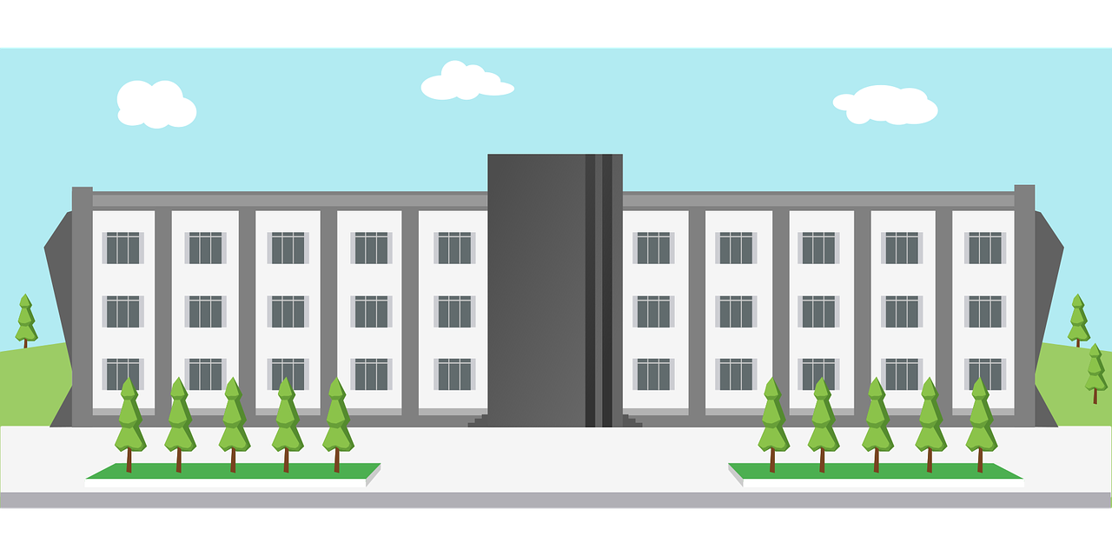
Follow up 3: [2/3]
. Écoute les noms des animaux. C’est [ien] ou [(a)in]?
Parle en français.
parler
I teach music at the university.
30
Tu enseignes où ?
S
J’ enseigne la musique à l’université.
0
DÉBUT
Notes:
[3/4]

Slide 10
Follow up 3: [3/3]
. Écoute les noms des animaux. C’est [ien] ou [(a)in]?
Parle en français.
parler
I am staying in Paris and I am showing my idea to Mr Poitier.
30
Tu restes où ?
S
Je reste à Paris et je montre mon idée à Monsieur Poitier.
0
DÉBUT
Notes:
[4/4]

Slide 11
vocabulaire
Follow up 4a - Écris en anglais : Can you get at least 15 points?
mots
 | de | le jour | chaque
 | dimanche | jeudi | mardi
 | lundi | mercredi | vendredi
 | l’émission | la radio | la télévision
 | la tante | grand | petit
 | à | en ce moment | souvent
 | montrer | rester | arriver
from, of
(the) day
each, every
Sunday
Thursday
Tuesday
x3
Monday
Wednesday
Friday
(the) programme
(the) radio
(the) television
x2
(the) aunt
tall, big
short, small
x1
to, at, on, in
at the moment
often
to show, showing
to stay, staying
to arrive, arriving
Notes:
Timing: 5-10 minutes
Aim: to practise written comprehension of vocabulary from this week and previous weeks.
Procedure: Give pupils a blank grid. They fill in the English meanings of any of the words they know, trying to reach 15 points in total.
Note: The most recently learnt and practised words are pink, words from the previous week are green and those from earlier are blue, thus more points are awarded for them, to recognise that memories fade and more effort (heavy lifting!) is needed to retrieve them.
11

Slide 12
vocabulaire
Follow up 4b - Écris en français : Can you get at least 15 points?
mots
 | Sunday | Thursday | Tuesday
 | Monday | Wednesday | Friday
 | from, of | (the) day | each, every
 | (the) aunt | tall, big (f) | short, small (m)
 | (the) radio | (the) programme | (the) television
 | to arrive, arriving | to remain, stay | to show, showing
 | to, at, on, in | at the moment | often
dimanche
jeudi
mardi
lundi
mercredi
vendredi
x3
de
le jour
chaque
la tante
grande
petit
x2
la radio
l’émission
la télévision
x1
arriver
rester
montrer
à
en ce moment
souvent
Notes:
Timing: 5-10 minutes
Aim: to practise written comprehension of vocabulary from this week and previous weeks.
Procedure: Give pupils a blank grid. They fill in the French meanings of any of the words they know, trying to reach 15 points in total.
Note: The most recently learnt and practised words are pink, words from the previous week are green and those from earlier are blue, thus more points are awarded for them, to recognise that memories fade and more effort (heavy lifting!) is needed to retrieve them.
12

Slide 13
Follow up 5

le chef - boss
Écris en français et en anglais.
Mylène
Ma _______ Mylène ____ journaliste.
___________ elle __________ à Paris.
_____ ________ une émission de télévision ____ _____ _____________.
Jeudi ____ _________ le texte ___ M. Poitier, le chef*.
____ ______ quatre jours __ Paris.
_____ chante souvent ___ ___ radio, aussi.
____ aunt Mylène is a _________.
On Wednesday ____ is arriving ___ ________.
She is preparing __ ____________ ______________ at the moment.
___ ________ she is showing ___ _______ to Mr Poitier, the boss.
She is staying for ____ ________ in Paris.
She _______ sings on the ________, too.
écrire
tante
est
My
journalist
1
she
Mercredi
arrive
2
in Paris
Elle prépare
a television
3
en ce moment
programme
elle montre
à
On Thursday
the
4
text
four days
5
Elle reste
à
Elle
à la
often
6
radio
Notes:
Timing: 5-10 minutes
Aim: to practise written production of this week’s two verb forms, new vocabulary and written comprehension of other new and revisited vocabulary.
This is a jigsaw translation task.
Procedure:
Students write the missing words in both French and English to complete the sentences.
Teacher clicks to provide the written answers and/or clicks the audio buttons to hear the full French sentences.
Differentiation: 1. For a different challenge (i.e. to practise spelling rather than full written recall of the missing French words), the task could be completed as a transcription task initially, by listening to the full sentences and writing the words.
2. Then pupils could complete the English part of the jigsaw.

Slide 14
vocabulaire
Écris en anglais : Can you get at least 15 points?
mots
 | de | le jour | chaque
 | dimanche | jeudi | mardi
 | lundi | mercredi | vendredi
 | l’émission | la radio | la télévision
 | la tante | grand | petit
 | à | en ce moment | souvent
 | montrer | rester | arriver
x3
x2
x1
Notes:
HANDOUT
14

Slide 15
vocabulaire
Écris en français : Can you get at least 15 points?
mots
 | Sunday | Thursday | Tuesday
 | Monday | Wednesday | Friday
 | from, of | (the) day | each, every
 | (the) aunt | tall, big (f) | short, small (m)
 | (the) radio | (the) programme | (the) television
 | to arrive, arriving | to remain, stay | to show, showing
 | to, at, on, in | at the moment | often
x3
x2
x1
Notes:
HANDOUT
15

