Slide 1
Describing me and others
jaune
ER-verbs
mon, ma, ton, ta
verbs of opinion
SSC [ai]
Notes:
Artwork by Steve Clarke. Pronoun pictures from NCELP (www.ncelp.org). All additional pictures selected from Pixabay and are
available under a Creative Commons license, no attribution required.
The AUDIO version of the lesson material includes additional audio for the new language
presented (phonics, vocabulary) and audio for the instructions on the slide.
In addition, it includes VIDEO clips of the phonics and the phonics’ source words. Pupils can be
encouraged to look at the shape of the mouth/lips on slides where these appear, and try to copy
it/them.
Phonics: introduce [ai] vrai [292] maison [325] aider [413] aimer [242] semaine [245]
Frequency of new words:
Vocabulary: aimer [232] préférer [597] sport [2011] et [6] mais [30]
Revisit 1: enseigner [2134] poser [218] anglais² [784] français² [251] grand-mère [3883] grand-père [3748] musique [1139] le [1] la [1]
Revisit 2: moi [132] toi [510] carte [955] 2298] idéal [1429] de1 [6] pour [10]
Londsale, D., & Le Bras, Y. (2009). A Frequency Dictionary of French: Core vocabulary for learners London: Routledge.
The frequency rankings for words that occur in this PowerPoint which have been previously introduced in these resources are given
in the SOW and in the resources that first introduced and formally re-visited those words.
For any other words that occur incidentally in this PowerPoint, frequency rankings will be provided in the notes field wherever
possible.
1

Slide 2
prononcer
[ai]
vrai
Notes:
Timing: 3 minutes (two slides)
Aim: to present [ai]
Procedure:
Present the letter(s) and say the [ai] sound first, on its own. Students repeat it with you.
2. Bring up the word ”vrai” on its own, say it, students repeat it, so that they have the opportunity to focus all of their attention on the connection between the written word and its sound.
3. Repeat again, along with the picture, and with gesture, if using.
4. Roll back the animations and work through 1-3 again, but this time, dropping your voice completely to listen carefully to the students saying the [ai] sound, pronouncing ”vrai” and, if using, doing the gesture.
Suggested gesture: gesture for vrai – either mime a tick Or use the BSL (4th video is the best one): https://www.signbsl.com/sign/true
Word frequency (1 is the most frequent word in French):
vrai [292]
Source: Londsale, D., & Le Bras, Y. (2009). A Frequency Dictionary of French: Core vocabulary for learners London: Routledge.
2

Slide 3
prononcer
[ai]
vrai
to like, liking
to help, helping
aimer
aider
week
maison
semaine
Notes:
Aim: to consolidate SSC [ai]
Procedure:
1. Introduce and elicit the pronunciation of the individual SSC [ai] and then the source word again ‘vrai’ (with gesture, if using). 2. Then present and elicit the pronunciation of the five cluster words.
Word frequency (1 is the most frequent word in French): aider [413] aimer [232] maison [325] semaine [245] vrai [292] Source: Londsale, D., & Le Bras, Y. (2009). A Frequency Dictionary of French: Core vocabulary for learners London: Routledge.
Word frequency (1 is the most frequent word in French):
vrai [292].
Source: Londsale, D., & Le Bras, Y. (2009). A Frequency Dictionary of French: Core vocabulary for learners London: Routledge.
3

Slide 4
parler
Prononce les mots.
Choose 5 words in secret.
Your partner has 20 seconds to work out your 5 words by saying as many as possible. If s/he says a word without the sound [ai][è], play passes over.
20
mais
décembre
français
mère
écouter
anglais
dictionnaire
vrai
maison
aimer
S
café
saison
problème
chaise
musée
grand-mère
télévision
aider
grand-père
parfait
0
DÉBUT
Notes:
Timing: 5 minutes
Aim: to practise pronunciation of words with [ai][è] with either taught words, SSC cluster words or cognates.
Procedure:
Pupil A chooses 5 of the 20 words.
Pupil B must say as many words as possible in the 20 second time limit in order to identity his/her partner’s 5 words.
If B pronounces a word without the [ai][è] SSC, the play swaps over immediately.
Swap roles and repeat the activity.
4

Slide 5
vocabulaire
.
Écoute et répète.
mots
aimer
préférer
le sport
[to like,
liking]
[to prefer, preferring]
et
mais
aussi
[but]
[also, too]
Notes:
Timing: 5 minutes
Aim: to introduce new vocabulary for this week.
Procedure: 1. Teacher clicks to present the French words one by one. Pupils can repeat. (1 minute)
2. Pupils either work individually or in pairs, reading the French words out loud and looking at the English meanings (1 minute). 3. Then the teacher removes the English words or pictures (one by one) and pupils try to recall the English orally (chorally), looking at the French (1 minute).
4. When teacher clicks, the French words re-appear (with audio in the audio version). 5. Then the French meanings are removed (one by one) and pupils try to recall them orally (again, chorally), looking at the English (1 minute) 6. Further rounds of learning can be facilitated by one pupil turning away from the board, and his/her partner asking him/her the meanings (‘Comment dit-on XXX en anglais/français ?’). This activity can work from L2 → L1 or L1 → L2.

Slide 6
Saying ‘my’ and ‘your’
We know there are different words for my and your because nouns are either masculine or feminine.
mon père
my dad
ma mère
my mum
Also make the liaison when speaking.
We have seen that when the noun starts with a vowel, we always use ‘mon’ or ‘ton’, even when the noun is feminine:
Voici mon amie.
Voici mon ami.
Voici mon amie.
Voici mon ami.
This is my (male) friend.
This is my (female) friend.
Voici ton idée.
Voici ton hôtel.
Voici ton école.
Voici ton hôtel.
This is your hotel.
This is also true for most words that start with ‘h’.
This is your idea.
Notes:
Timing: 2 minutes
Aim: to recap singular possessive adjectives ‘my’ and ‘your’ and the rule for using ‘mon, ton’ with nouns that begin with a vowel or ‘h’.
Procedure: 1. Click to present the information.
2. Elicit responses from pupils, following the animated question marks.

Slide 7
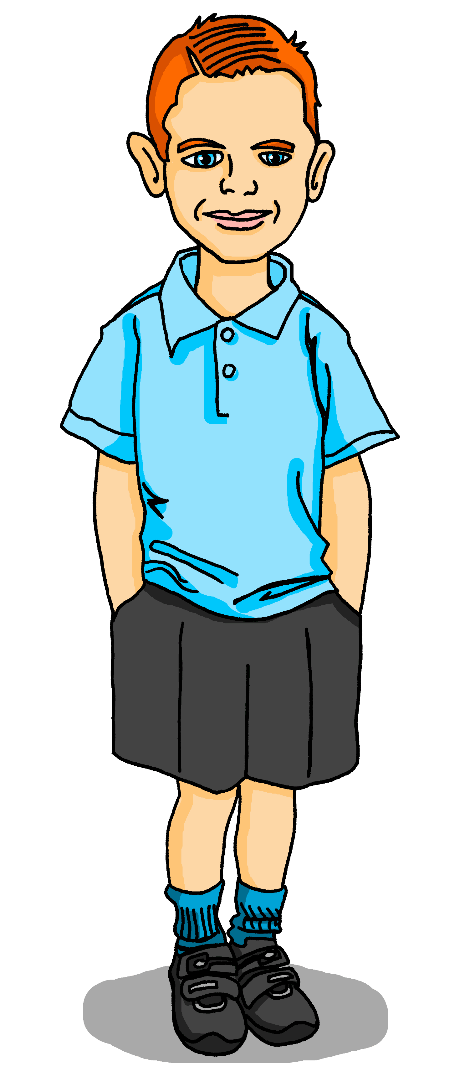
parler
Prononce la phrase.
Max likes lots of things.
1
J’aime mon ami.
Remember that je → j’ in front of a vowel.
Notes:
Timing: 2 minutes (4 slides)
Aim: to practise pronunciation of ‘mon’, with and without liaison.
Procedure:
Click to bring up Max’s sentence.
Pupils read aloud.
Click the numbered button to listen and check.
Draw pupils’ attention to the liaison.
5. Repeat steps 1-4 for the next three slides.
Transcript: J’aime mon ami.
7

Slide 8
parler
Prononce la phrase.
2
J’aime mon chat.
Remember that je → j’ in front of a vowel.
Notes:
(2/4)
Transcript: J’aime mon chat.
8

Slide 9
parler
Prononce la phrase.
3
J’aime mon dessin.
Notes:
(3/4)
Transcript: J’aime mon dessin.
9

Slide 10
parler
Prononce la phrase.
Use mon with feminine nouns that start with a vowel.
4
J’aime mon affiche.
Notes:
(4/4)
Transcript: J’aime mon affiche.
10

Slide 11
Verbs of opinion
Use the –er verbs aimer (to like) and préférer (to prefer) to give opinions:
J’aime la musique mais je préfère le sport.
⚠ Verbs like préférer change the 2nd [é] → [è] in je, tu, il/elle. Others you may see like this are répéter, compléter.
I like music but I prefer sport.
Tu aimes la semaine et tu aimes aussi le weekend.
You like the week and you also like the weekend.
Remember that aussi follows the verb but also goes inbetween the pronoun and verb.
Notes:
Timing: 2 minutes
Aim: To present information about verbs of opinion in French and English, to draw attention to a spelling change with préférer and remind pupils about the position of aussi.
Procedure:
Click to present the information.
Elicit the English meanings of the examples.
11

Slide 12
lire
Lis les messages de Max. C’est Max (je) ou Pierre (tu) ?
.
E
1
2
Tu préfères l’anglais mais je préfère le français.
J’ aime le sport et j’ aime aussi la musique.
Tu aimes le sport mais tu préfères la musique.
 | Max (I) | | | Pierre (you) | |
Ex.
1
2
3
4
5
3
4
5
J’ aime la radio et tu aimes aussi la radio.
Mais je préfère la télé et toi, non.
Dessiner, c’est idéal pour toi. Tu aimes le dessin.
Notes:
Timing: 8 minutes
Aim: to practise written comprehension of two –ER verbs (of opinion) in the 1st and 2nd persons singular and of new and previously taught vocabulary.
Procedure:
Read the instruction and ensure the context is clear.
Work through the example with pupils. Click to remove the smudge and reveal the pronoun, click again to tick the table and again to identify ‘like’ or ‘prefer’ as the verb. Elicit the English meaning of the message orally from all pupils.
Work through 1 – 5. Pupils could work on a hand out of the table OR just write 1-5 with 4 columns and fill in the ticks and images themselves.
Click to correct each answers as per the instruction for 2.
In the audio version, if desired, click to hear full versions of each message.
12

Slide 13
Vokabeln
L’amitié*
l’amitié- friendship
Learning languages is about making friends.
You show kindness when you learn even a few words in another language.
Let’s remember some of the friendship sentences we have learnt already!
Salut !
Bonjour !
_ _ _ _ _ !
_ _ _ _ ?
_ _ _ _ _ _ _ !
Ça va ?
What kind things can you say about people’s things ?
Tu es content(e) avec ton texte ?
Tu es mon ami(e).
Are you pleased with your text?
J’aime ton dessin.
C’est joli !
You are my friend.
C’est super !
I like your drawing.
It’s pretty.
It’s super!
Notes:
Timing: 3 minutes
Aim: to introduce or recap the idea that learning other languages opens the door to new friendships, and that a few kind words go a long way; to revisit some previously-taught language from last term and this term that fits our category of ‘friendship sentences’. This is an idea we will return to now and then during the course.
Procedure:
Click to present the information on the slide.
Elicit the French from pupils for the English greetings and friendly statements.
Allow pupils a few moments to turn to those around them and greet them and say something kind about their work or about them themselves.
Remind pupils that we all need to hear kind words every day, in whatever language!
13

Slide 14
Au revoir !
jaune
Notes:
14

