Slide 1
Saying what I and others do
Ma famille et mon ami(e)
jaune
possessive adjectives mon, ma, ton, ta
SSC [é/et/ez/er] vs.
[è/ê] vs. [e]
Notes:
Artwork by Steve Clarke. Pronoun pictures from NCELP (www.ncelp.org). All additional pictures selected from Pixabay and are
available under a Creative Commons license, no attribution required.
The AUDIO version of the lesson material includes additional audio for the new language presented (phonics, vocabulary) and audio for the instructions
on the slide.
In addition, it includes VIDEO clips of the phonics and the phonics’ source words. Pupils can be encouraged to look at the shape of the mouth/lips on
slides where these appear, and try to copy it/them.
Phonics: revisit [é] [è] and [e] - répéter [630] frère [1043] cheval [2220]
Vocabulary (new words in bold): jouer [219] ami, amie [467] en ligne [n/a] dehors [1217] mon, ma [60] ton, ta [330] voici [1103]
Revisit 1: organiser [791] préparer [368] visiter [1378] parc [1240] université [1192] musée [2216] visite [1072] avec [23]
Revisit 2: tu as [8] question [144] réponse [456] où [48] dans [11] sur [16] sous [122]
Londsale, D., & Le Bras, Y. (2009). A Frequency Dictionary of French: Core vocabulary for learners London: Routledge.
The frequency rankings for words that occur in this PowerPoint which have been previously introduced in these resources are given in the SOW and in the resources that first introduced and formally re-visited those words. For any other words that occur incidentally in this PowerPoint, frequency rankings will be provided in the notes field wherever possible.
1

Slide 2
prononcer
[è]
[é]
[e]
frère
répéter
cheval
(brother)
Notes:
Timing: 2 minutes
Aim: to recap SSC [è] and [é] and [e].
Procedure:
Introduce and elicit the pronunciation of the individual SSC [è] and the source words ‘frère’, ‘répétér’, which has two spellings of the same sound and SFe.
Click to bring on the picture and get students to repeat (with gesture, if using).
Present and practise the cluster words.
Gesture suggestions: gesture for répéter – hand with thumb and two fingers pointing forwards doing a three downwards motions, one for each syllable of the word.
https://www.signbsl.com/sign/repeat (the 2nd video marked again: repeat with the female signer)
gesture for frère – hands in fists, brought together so knuckles are touching, 2-3 swift up and down movements. https://www.signbsl.com/sign/brother (all 3 videos are similar) gesture for timide – right hand (fingers open palm facing self) brought up towards face as though to cover it https://www.signbsl.com/sign/shy (1st video)
2

Slide 3
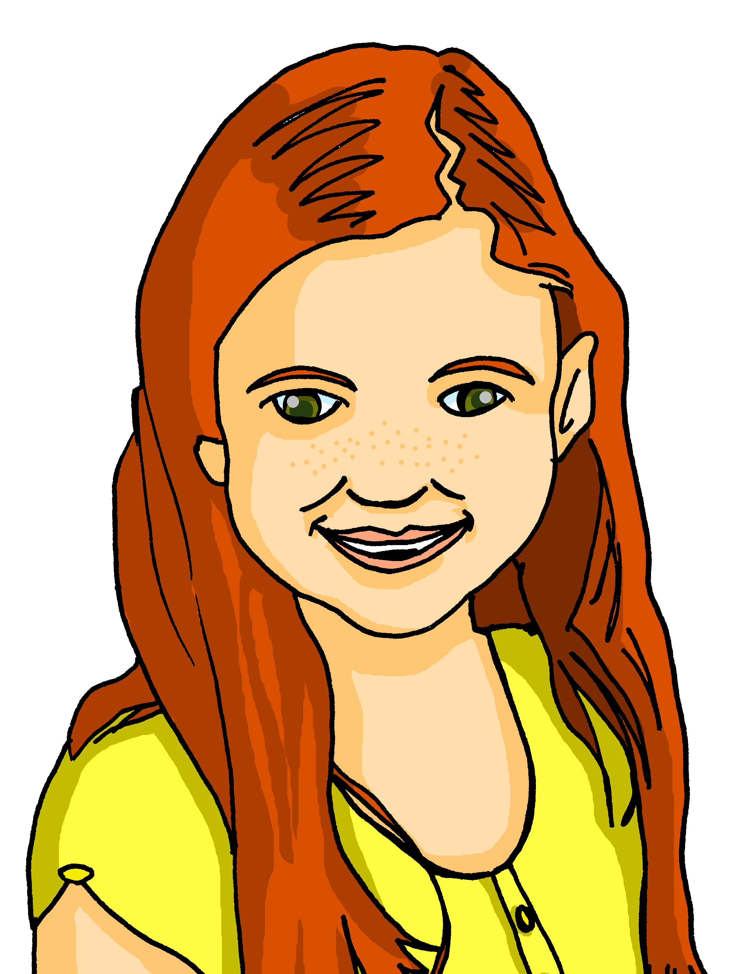
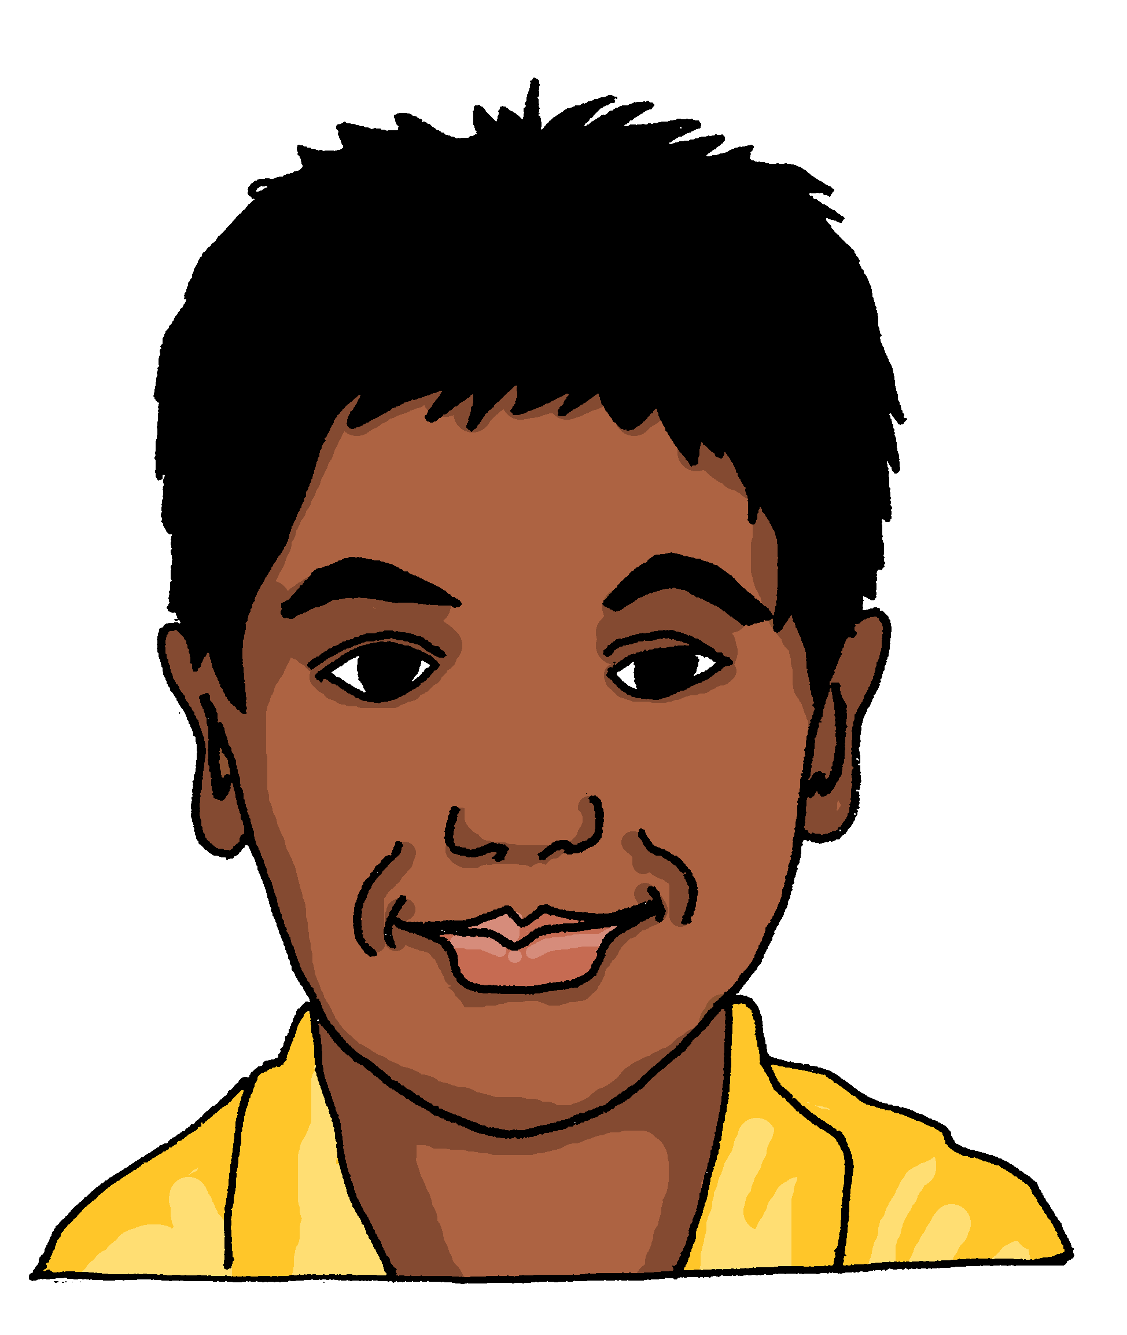
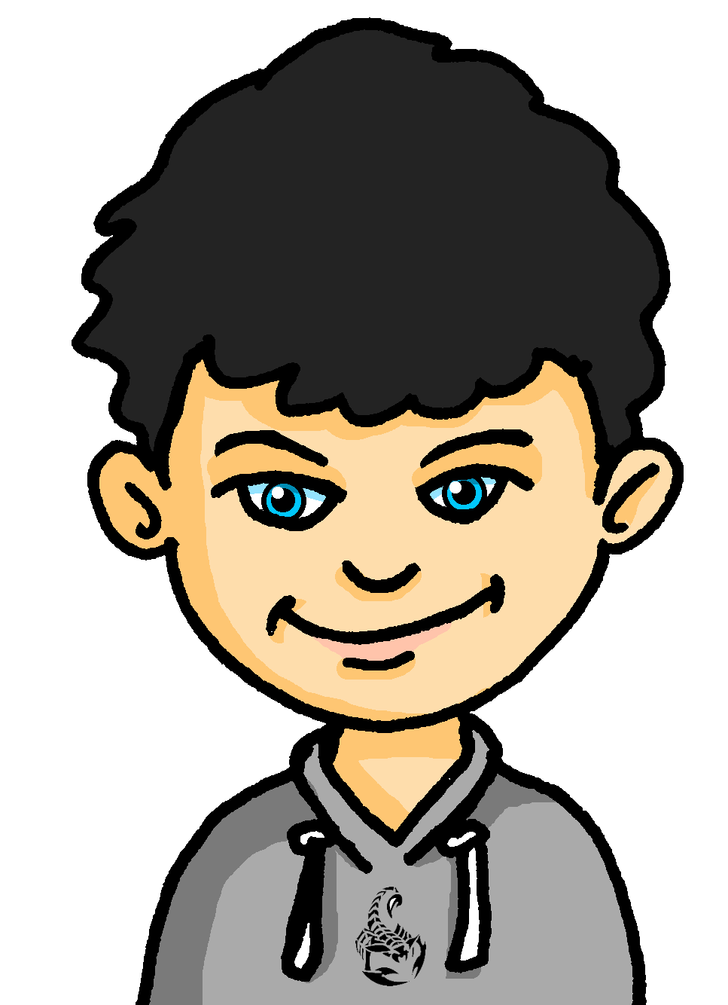
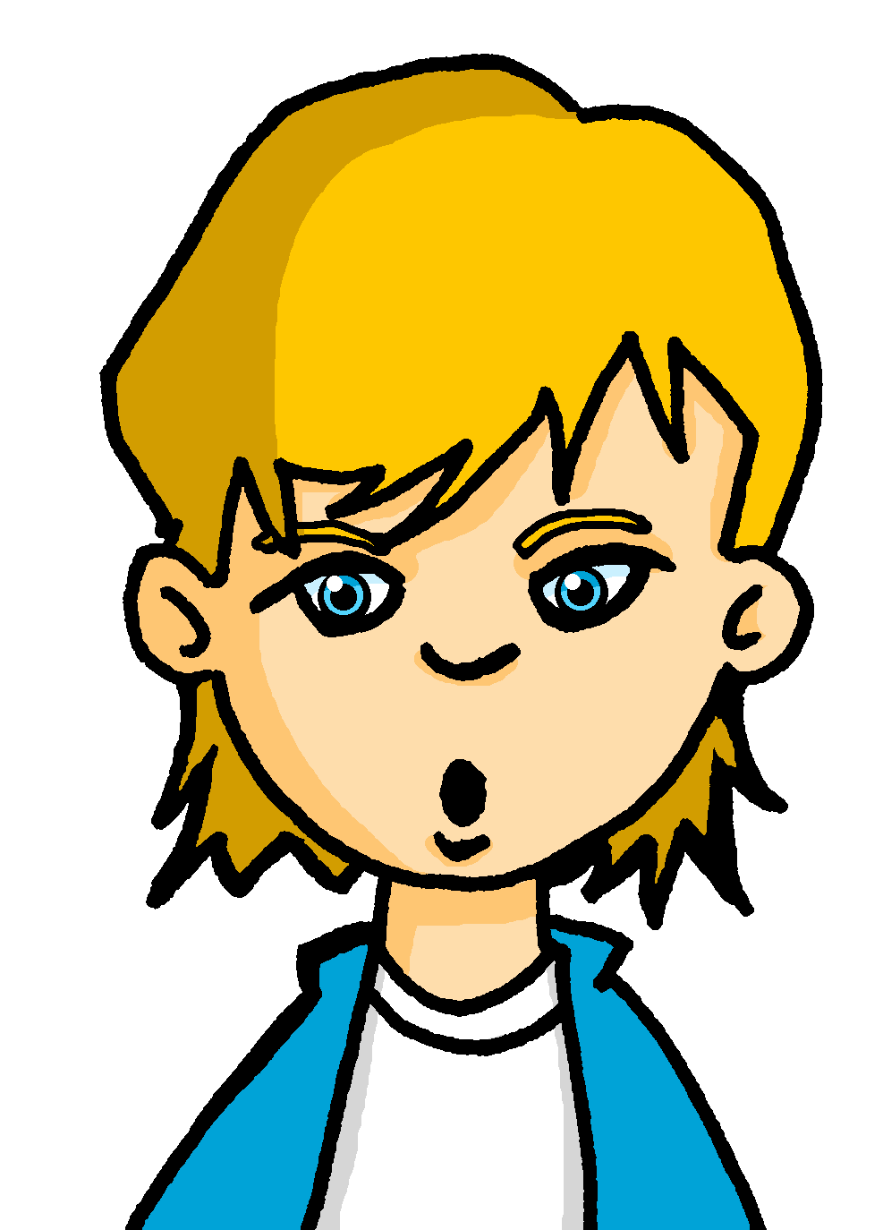
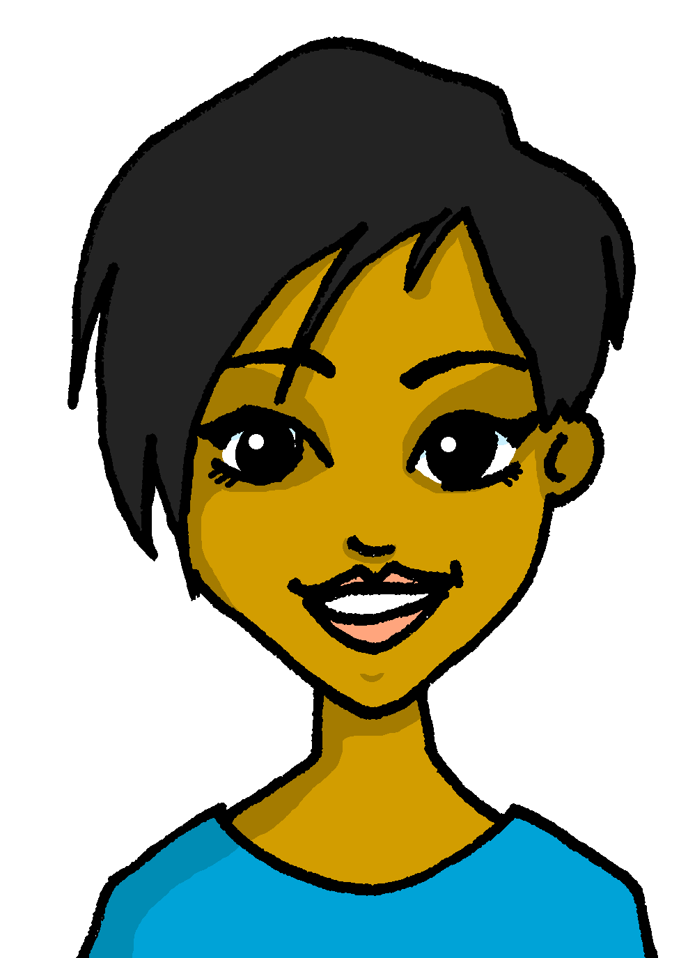
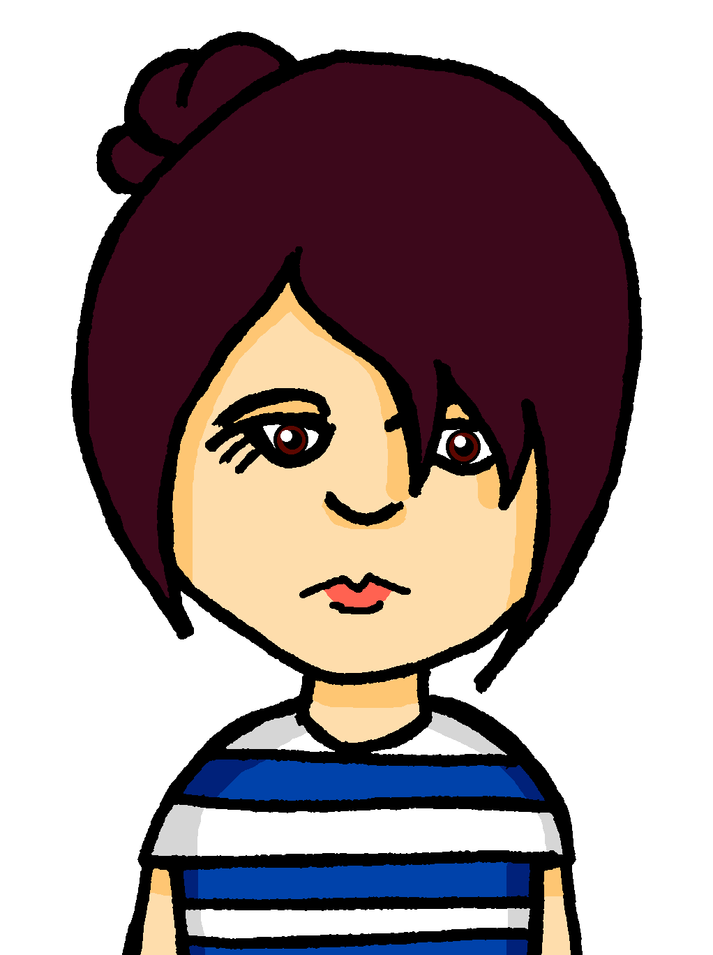
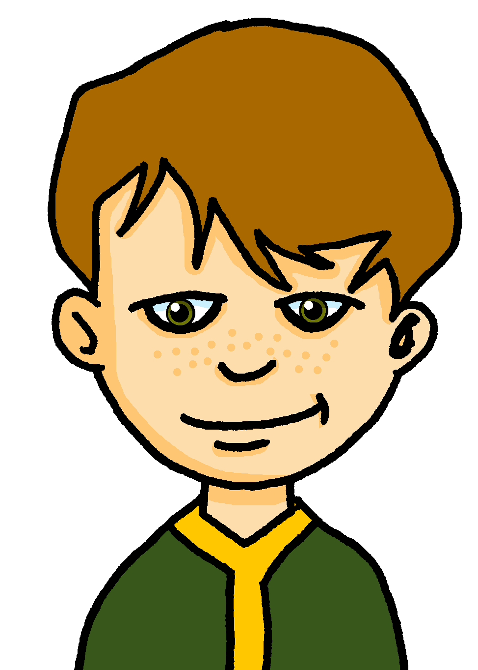
prononcer
Dans la classe de Max
Everyone has chosen a French name!
Écoute et complète les noms.
C’est [é], [è], ou [e] ?
1
D e n i s
2
A m é l i e
3
B e n o i t
4
F i d è l e
5
6
C l é m e n t
N a t a l è n e
7
R o s e l i ne
8
9
E u g è n e
F é l i c i t é
Notes:
Timing: 5 minutes
Aim: to practise aural distinction of three SSC [è] and [é] and [e].
Procedure:
1. Explain the scenario. Max is an English penfriend of Pierre. He lives in England, is English and he is learning French. He and his classmates have chosen French names. (This is something pupils in the class might like to do as well).
2. Pupils write 1 – 9.
3. Click to listen to each name.
4. Pupils write either the full name or just the missing letters.
(Note: Some pupils might benefit from a pre-printed sheet with gaps to fill in, others might want to challenge themselves to turn away from the board to do the activity.)
5. Click to reveal the missing letters.
6. Elicit the pronunciation of all names from pupils, chorally.
3

Slide 4
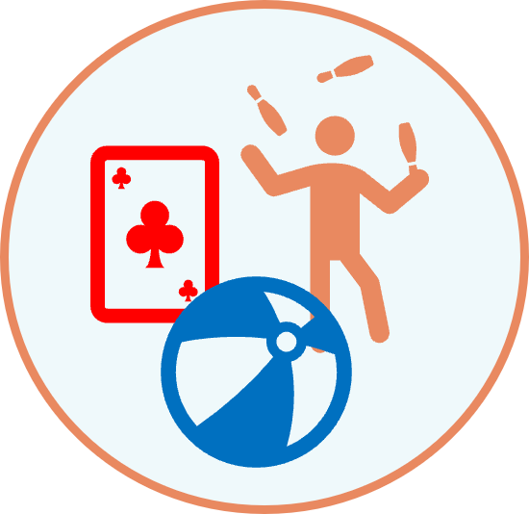
vocabulaire
Lis en anglais et prononce en français.
mots
jouer
here is, this is
voici
to play, playing
online
en ligne
outside
dehors
(the) friend (m)
l’ami
(the) friend (f)
l’amie
Notes:
[1/3]
Timing: 5 minutes (three slides)
Aim: to introduce new vocabulary.
Procedure 1. Pupils either work by themselves or in pairs, reading out the words and recapping their English meaning (1 minute). 2. Then, on the next slide, students try to recall the English orally (chorally), looking at the French (1 minute). 3. Then, on the following slide, they to recall the French meanings orally (again, chorally), looking at the English (1 minute).
Notes:
Note that images/words won’t disappear and appear in this activity as in previous resources.
4

Slide 5
vocabulaire
C’est quoi en anglais ?
mots
to p_ _ _, p_ _ _ _ _ _
h_ _ _ i_, t_ _ _ i_
voici
to play, playing
jouer
here is, this is
o_ _ _ _ _
en ligne
o_ _ _ _ _ _
dehors
online
outside
(the) friend (m)
l’ami
(t_ _) f_ _ _ _ _ (f)
l’amie
(t_ _) f_ _ _ _ _ (m)
(the) friend (f)
Notes:
[2/3]
Procedure: 1. Students try to recall the English orally (chorally), looking at the French (1 minute). 2. Elicit answers and click to reveal
3. Then, in the following slide, they to recall the French meanings orally (again, chorally), looking at the English (1 minute).
5

Slide 6
vocabulaire
C’est quoi en français ?
mots
v_ _ _ _
to play, playing
jouer
here is, this is
voici
j_ _ _ _
e_ l_ _ _ _
outside
d_ _ _ _ _
online
en ligne
dehors
l’amie
(the) friend (m)
l’_ _ _
(the) friend (f)
l’_ _ _ _
l’ami
Notes:
[3/3]
Procedure: 1. Students recall the French meanings orally (again, chorally), looking at the English (1 minute)
2. Click to reveal the answers.
6

Slide 7
Saying ‘my’ and ‘your’
We know that all French nouns have gender, and are masculine or feminine.
We know that there are different words for ‘the’ because of this:
When the noun starts with a vowel, always use ‘mon’ and ‘ton’: mon ami – my male friend mon amie – my female friend This just makes the words flow better.
le chat
the cat
la musique
the music
le texte
the text
la carte
the card
For the same reason, there are also different words for ‘my’ and ‘your’:
mon chat
my cat
ma musique
my music
ton texte
your text
ta carte
your card
The French words for ‘my’ and ‘your’ agree with the gender of the noun that follows.
Notes:
Timing: 2 minutes
Aim: to recap singular definite articles and to introduce singular possessive adjectives ‘my’ and ‘your’.
Procedure: 1. Click to present the new information.
2. Elicit responses from pupils, following the animated question marks.

Slide 8
écouter
C’est quoi ?
Écoute et décide.
masculine
feminine
 |  | livre | radio
 |  | bureau | chambre
 |  | grand-père | tante
 |  | texte | télévision
 |  | dessin | chaise
 |  | message | carte
1
Voici ta…
2
Voici mon…
3
Voici ton…
4
Voici ma…
5
Voici mon…
6
Voici ta…
Notes:
Timing: 5 minutes
Aim: to practise aural connection of mon, ma, ton, ta with nouns of the correct gender; to practise written comprehension of the possessive adjectives and previously taught nouns in short, simple sentences.
Procedure:
1. Ensure pupils are clear about the task.
2. Click to play number 1 and work through as an example. Pupils listen and decide which noun it must be, based on the form of the possessive adjective they hear.
Note: the table headings masculine and feminine reduce the cognitive load to allow pupils to focus all their attention on connecting the mon/ton with masculine and ma/ta with feminine nouns.
3. Click to reveal the answer.
4. Continue with items 2 – 6 and reveal answers. Full sentence audio is attached to the answer ticks.
5. Click to bring up the sentence beginnings and elicit the English meaning for each sentence, to practise written comprehension of voici, the possessive adjectives and to revisit previously taught nouns.
Transcript:
Voici ta [radio] Voici mon [bureau] Voici ton [grand-père] Voici ma [télévision] Voici mon [dessin] Voici ta [carte]
8

Slide 9
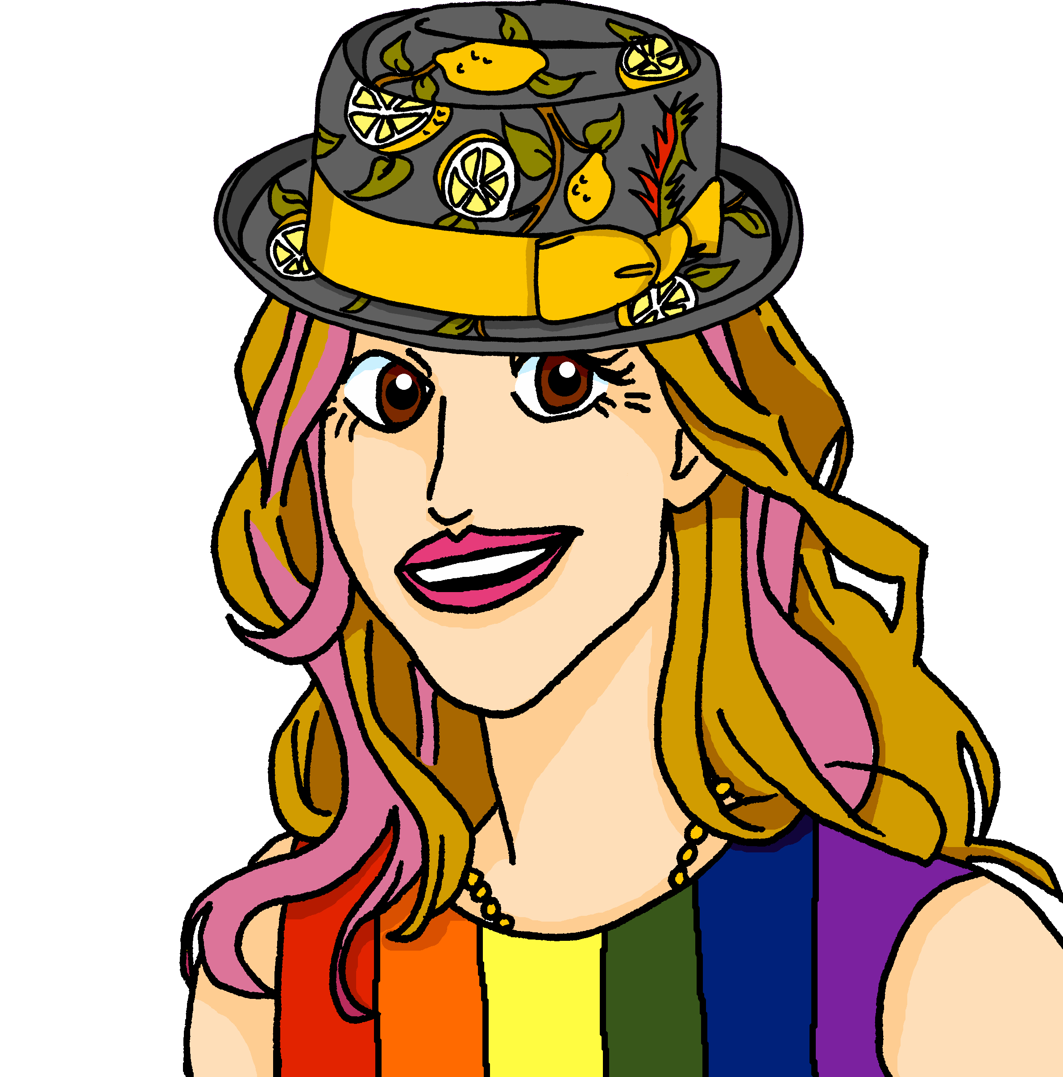
lire
C’est qui* ?
Pierre écrit des messages à Jean-Michel.
qui = who
Ma tante
est drôle.
1
père (m) | tante (f)
Ma tante parle anglais.
2
1
2
Mon père enseigne en ligne.
3
3
Mon père regarde la télé.
4
4
[1/2]
Notes:
Timing: 5 minutes (two slides)
Aim: to practise gender agreement with mon/ma and ton/ta.
Note: Invariable adjectives are used so that the possessive adjective is the only clue to the gender of the noun.
Procedure:
Students write 1-8 and write the noun that matches each possessive adjective.
Answers are revealed on clicks.
English translations can also be elicited.
4. If desired, full sentence audio is heard upon clicking the dark blue audio buttons.

Slide 10
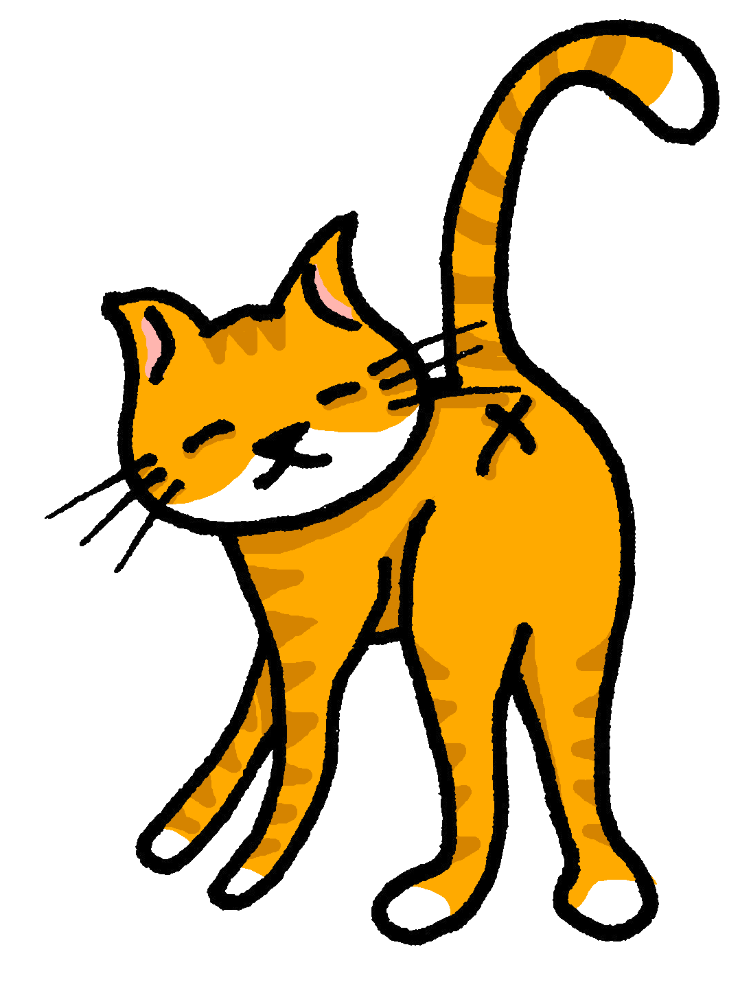
lire
C’est qui* ?
Clémentine écrit des questions à Adèle.
qui = who
Ton chat joue dehors ?
5
mère (f) | chat (m)
Ta mère présente en ligne ?
6
5
6
Ton chat écoute une émission à la radio ?
7
7
Ta mère visite l‘université, aujourd‘hui ?
8
8
[2/2]
Notes:
[2/2]

Slide 11
Au revoir !
jaune
Notes:
11

