Slide 1
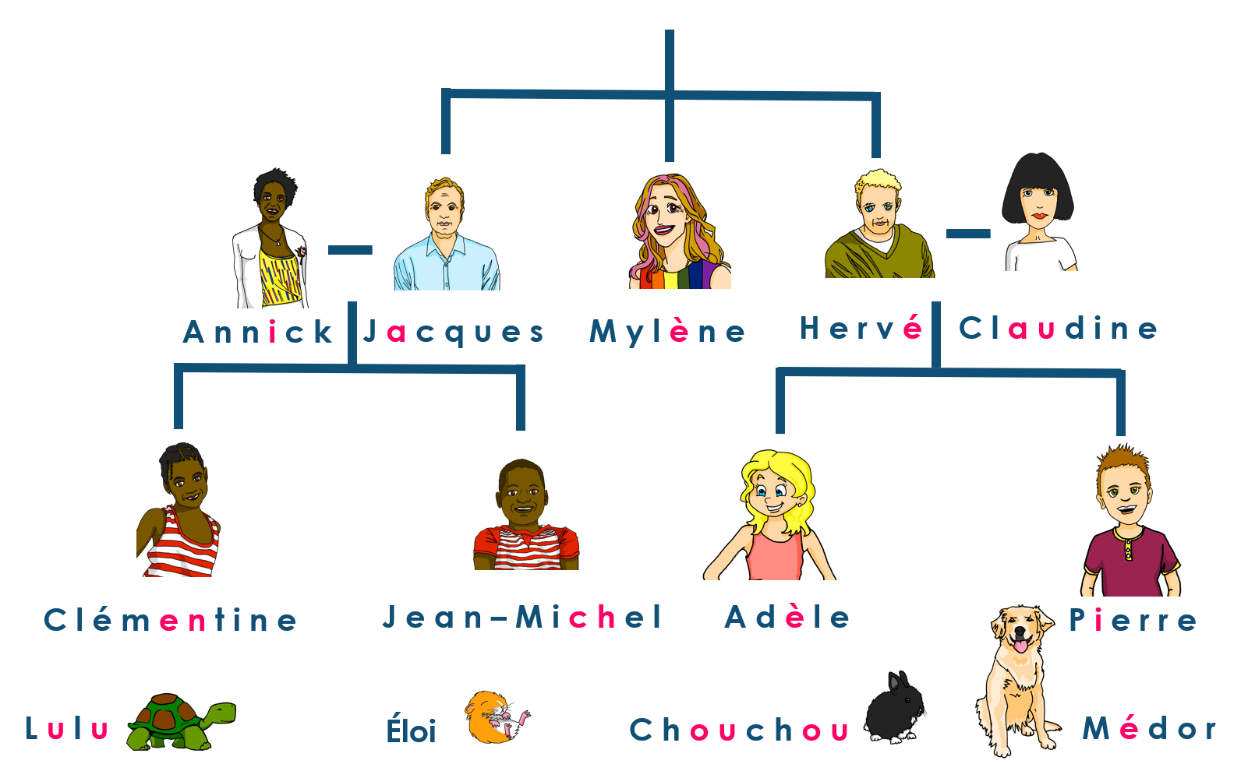
Describing me and others
Mylène, la tante d’Adèle
jaune
Follow ups 1-5
Notes:
Artwork by Steve Clarke. Pronoun pictures from NCELP (www.ncelp.org). All additional pictures selected from Pixabay and are
available under a Creative Commons license, no attribution required.
The AUDIO version of the lesson material includes additional audio for the new language presented (phonics, vocabulary) and audio for the instructions
on the slide.
In addition, it includes VIDEO clips of the phonics and the phonics’ source words. Pupils can be encouraged to look at the shape of the mouth/lips on
slides where these appear, and try to copy it/them.
Phonics: SSC Phonics: introduce [è] [ê] - fête [1490] tête [343] frère [1043] être [5], problème [188]
Vocabulary (new words in bold): émission [1074] radio [1526] tante [3891] télévision [1179] grand² [59] petit² [138] de¹ [2]
Revisit 1: chercher [336] dessiner [2086] présenter [209] prononcer [706] image [659] mot [220] pays [114] texte [631] facile [822] intéressant [1244]
Revisit 2: avoir [8] j’ai, il a, elle a, quoi [297] chat [3138] crayon [>5000] dessin [2624] message [792]
Londsale, D., & Le Bras, Y. (2009). A Frequency Dictionary of French: Core vocabulary for learners London: Routledge.
The frequency rankings for words that occur in this PowerPoint which have been previously introduced in these resources are given in the SOW and in the resources that first introduced and formally re-visited those words. For any other words that occur incidentally in this PowerPoint, frequency rankings will be provided in the notes field wherever possible.
Serpent: Shesmax, CC BY-SA 4.0 <https://creativecommons.org/licenses/by-sa/4.0>, via Wikimedia Commons
Roi: Punx, CC BY-SA 4.0 <https://creativecommons.org/licenses/by-sa/4.0>, via Wikimedia Commons
Woman: Lyly, CC BY-SA 3.0 <https://creativecommons.org/licenses/by-sa/3.0>, via Wikimedia Commons
Floats: Honeydew, CC BY-SA 3.0 <https://creativecommons.org/licenses/by-sa/3.0>, via Wikimedia Commons
Affiche: Édouard John Menta (1858 - 1914), Public domain, via Wikimedia Commons
Bataille de fleurs, Zil, CC BY-SA 3.0 <https://creativecommons.org/licenses/by-sa/3.0>, via Wikimedia Commons
Femme de fleurs: Zil, CC BY-SA 3.0 <https://creativecommons.org/licenses/by-sa/3.0>, via Wikimedia Commons
Femme de fleurs2: Zil, CC BY-SA 3.0 <https://creativecommons.org/licenses/by-sa/3.0>, via Wikimedia Commons
Des tetes: Jean-François Bouillet, CC BY-SA 2.0 <https://creativecommons.org/licenses/by-sa/2.0>, via Wikimedia Commons

Slide 2
prononcer
[è|ê]
[è] and [ê] sound almost the same. [ê] is a little longer and deeper.
to be, being
fête
être
frère
(brother)
(party, celebration)
tête
problème
(head)
Notes:
Timing: 2 minutes
Aim: to recap SSC [è] and [ê] which are almost the same sound.
Procedure:
Introduce and elicit the pronunciation of the individual SSC [è] and the source word ‘xxx’, which has both spellings of the sound.
Click to bring on the picture and get students to repeat (with gesture, if using).
Present and practise the cluster words.
Gesture: gesture for fête: raise both hands in the air (middle three fingers facing down in a partial fist, with thumb and pinkie facing upwards) and move up and down alternate left and right to suggest a celebration-style dance.
Source: https://www.signbsl.com/sign/party (the 3rd video from the right is the best one, in my view)
2

Slide 3
Follow up 1:
Écoute et écris la lettre correspondante.
C’est [e] ou [è|ê] ?
 | [e] | [è|ê]
1
2
3
4
5
 | [e] | [è|ê]
6
7
8
9
10
le grand-père
le problème
petit
la fête
de
la grand-mère
être
le cheval
la tête
le père
Notes:
Timing: 3 minutes
Aim: to practise aural differentiation between [e] and [è|ê]; to practise accurate spelling of previously taught words.
Procedure:
Pupils listen and decide whether they hear [e] or [è|ê].
They may also write the full word if they are able.
Click to correct each answer.
Transcription: le grand-père
petit
de
être
la tête
le problème la fête
la grand-mère
le cheval
le père

Slide 4
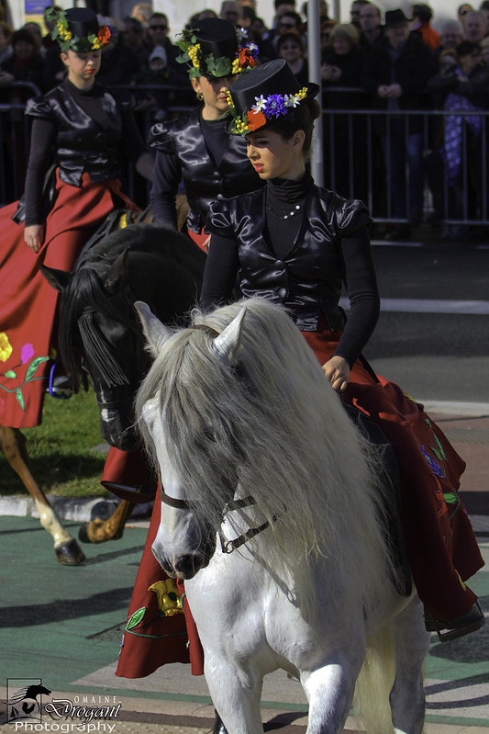
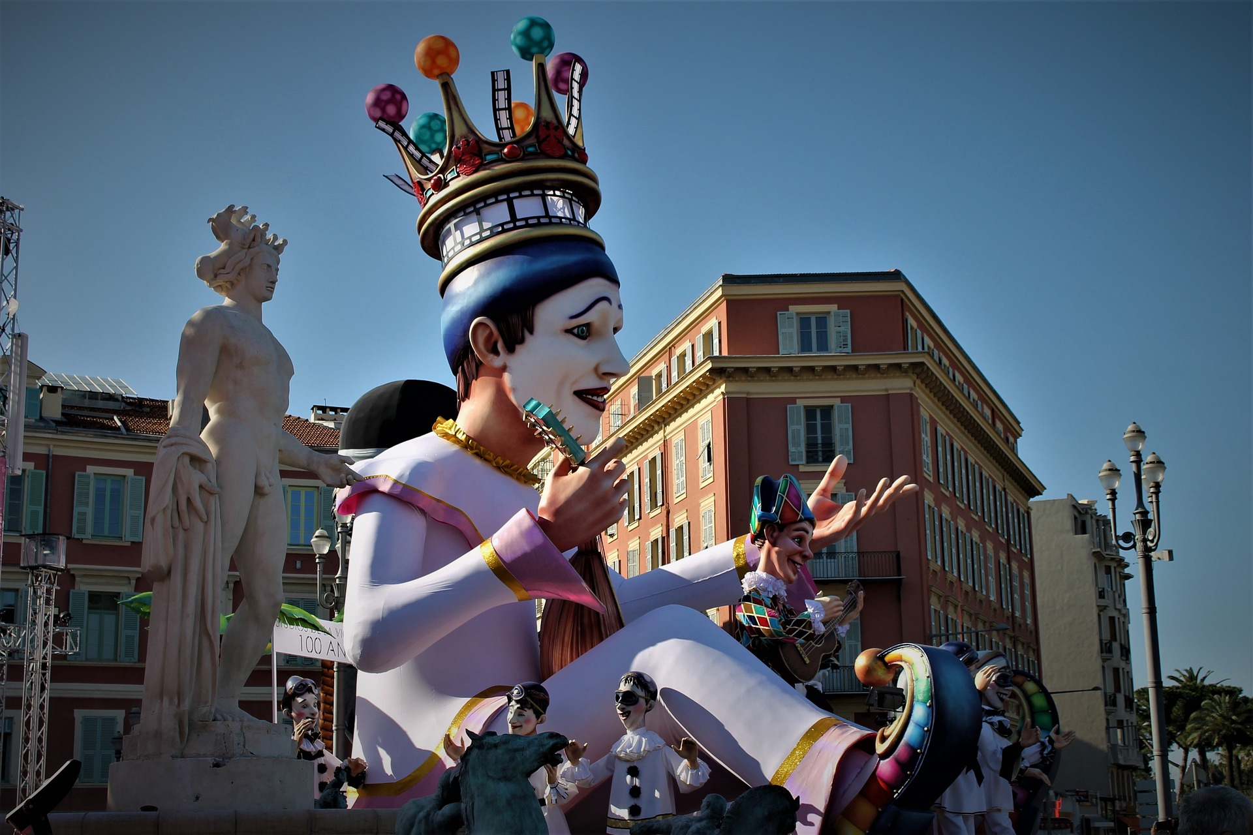
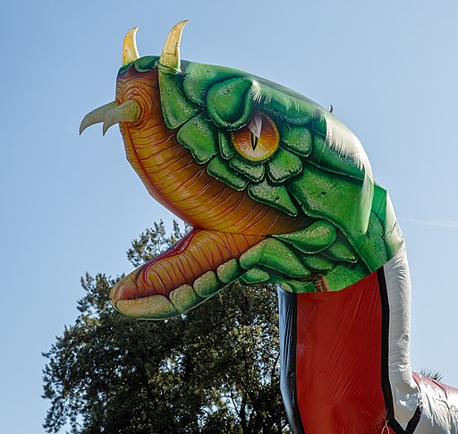
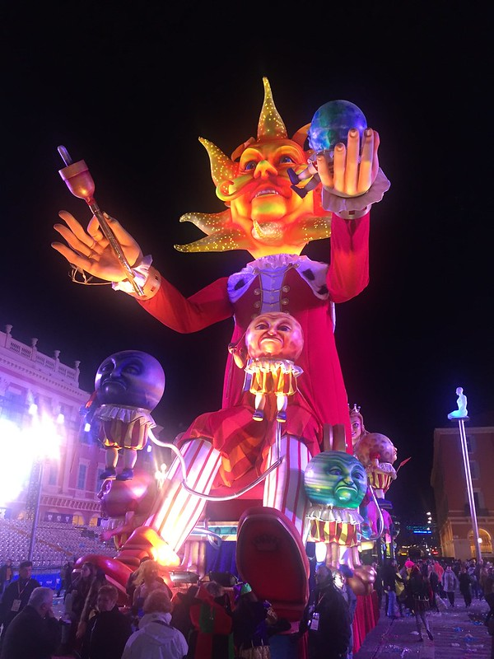
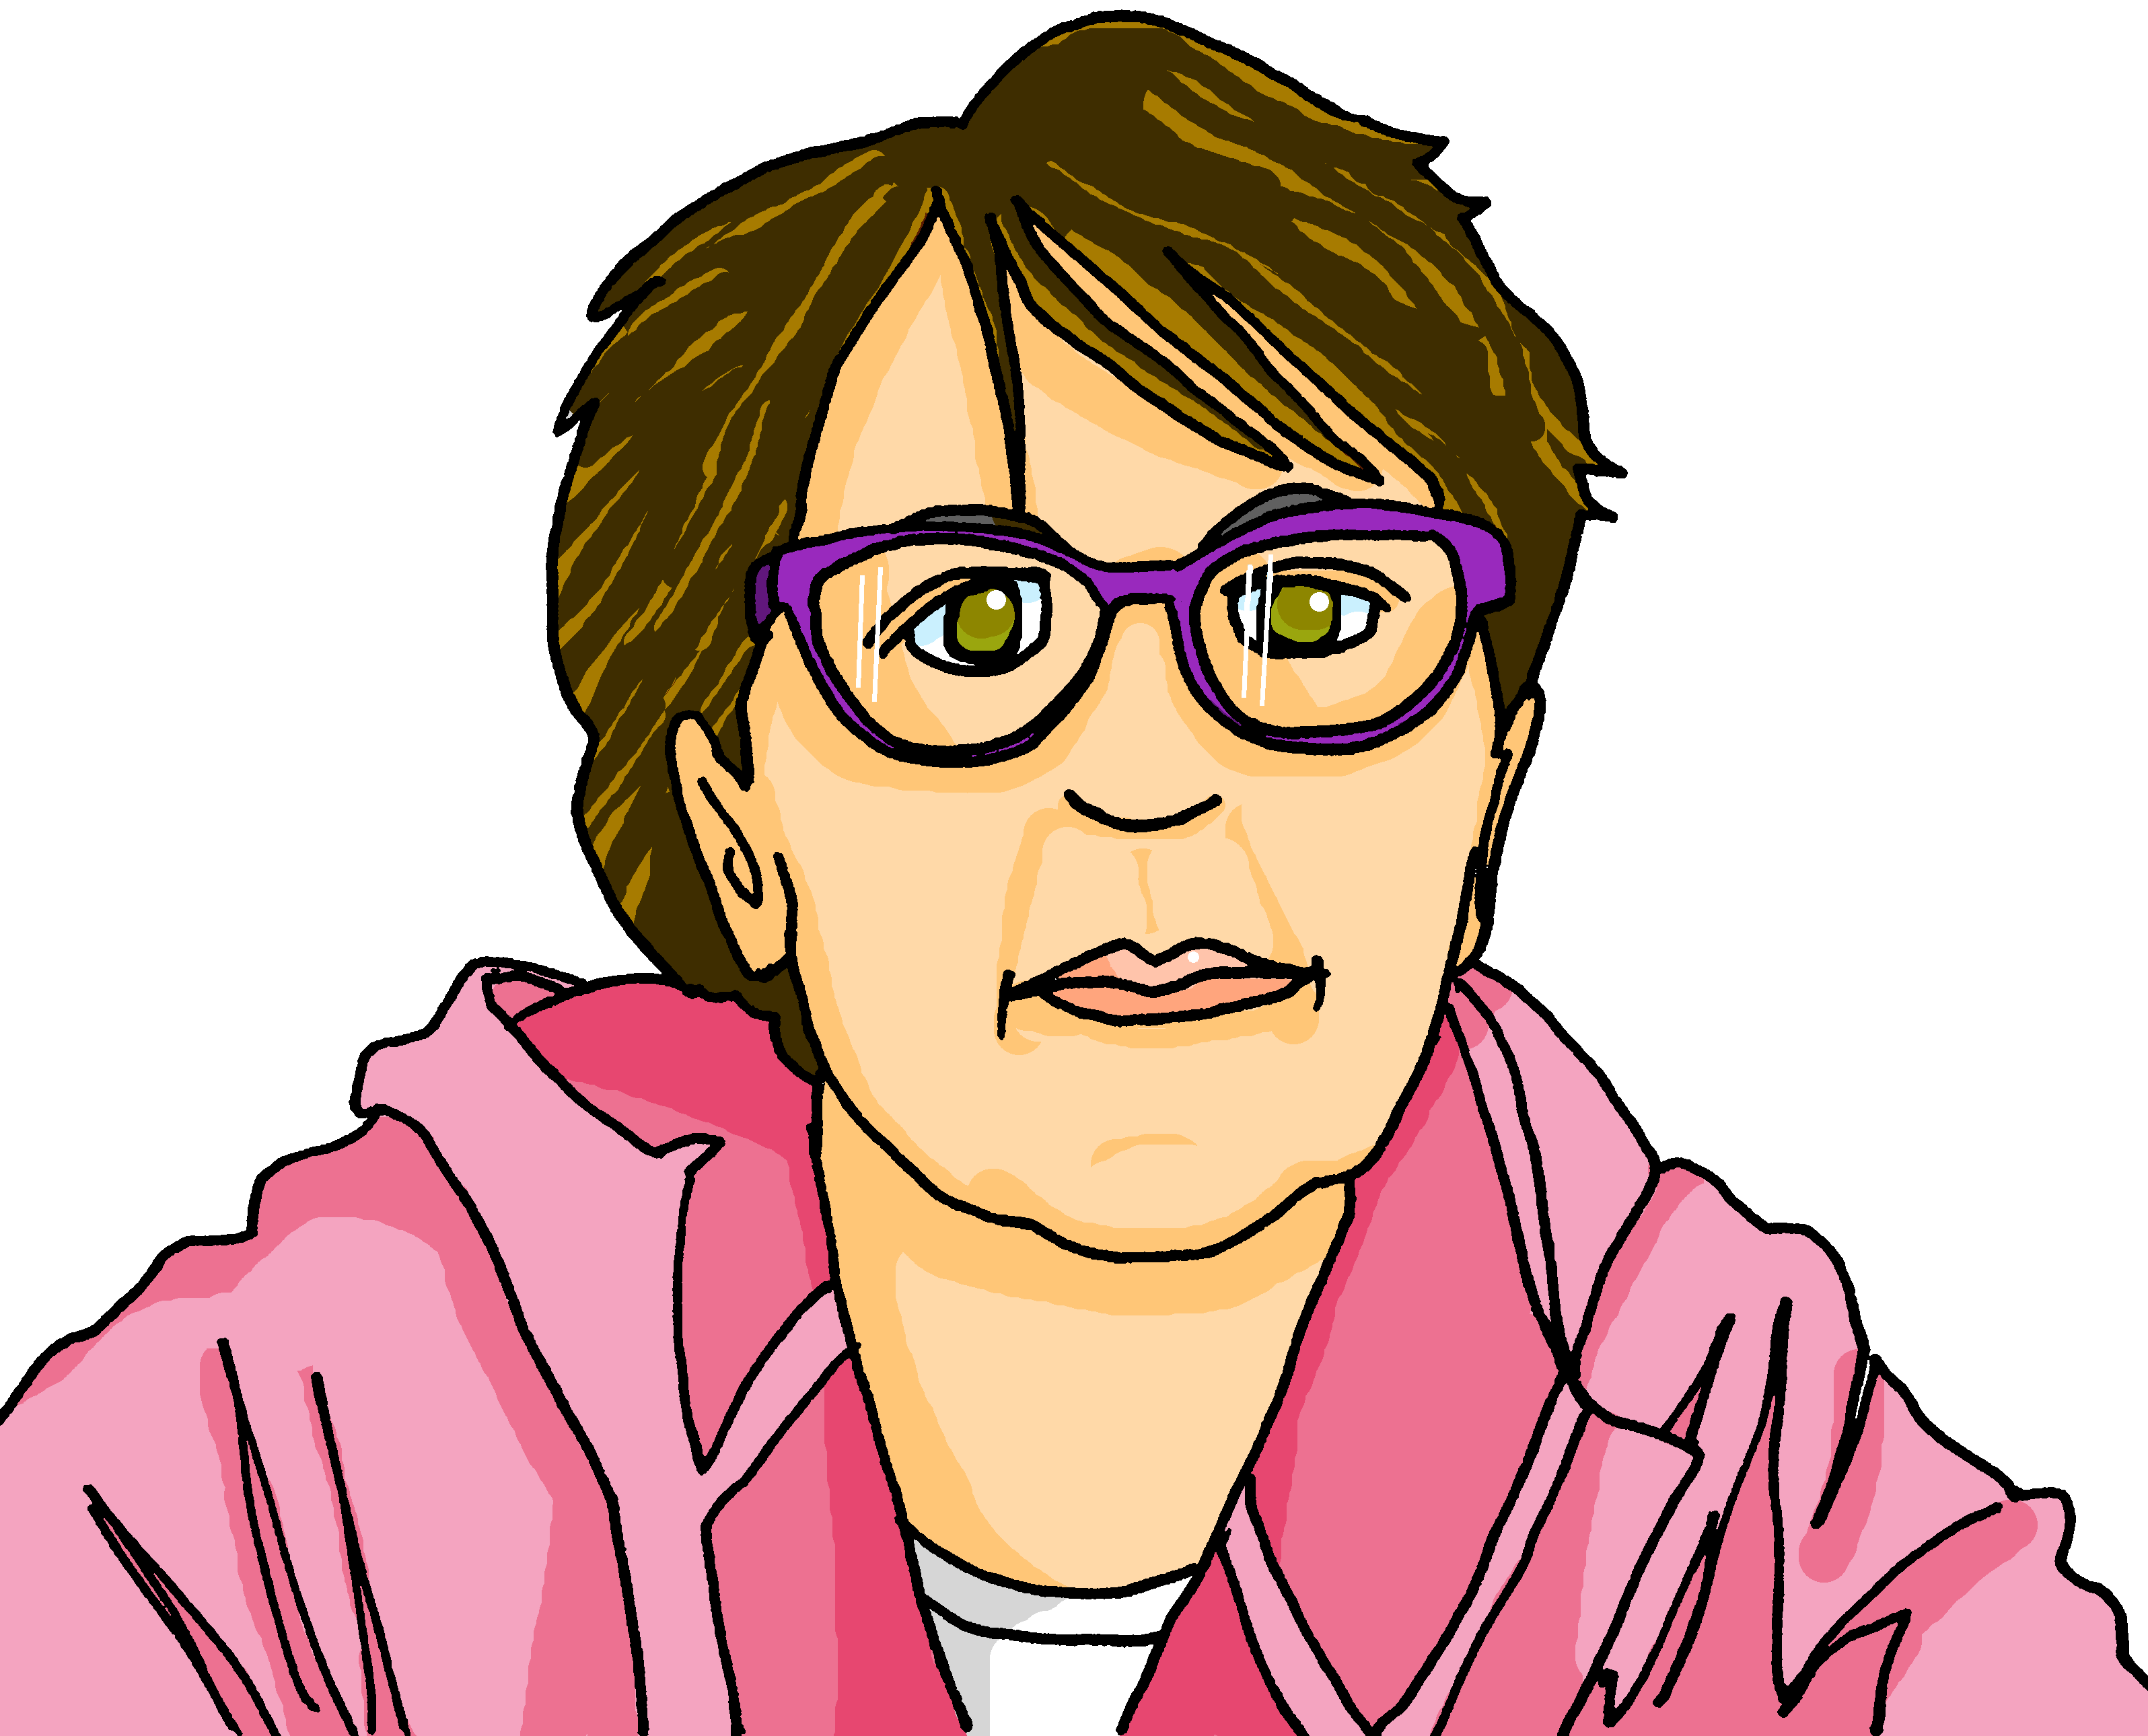
Follow up 2
. Écoute les noms des animaux. C’est [ien] ou [(a)in]?
Écoute. Écris en anglais.
 | Image ? (A, B, C) | en anglais ?
A
B
écouter
Ex
D
The aunt is short.
1
A
The tv programme is interesting.
C
D
E
2
F
The grandma is tall.
3
E
The animal is big.
4
G
B
The horse is small.
5
G
The person is red.
F
6
C
The head is big.
Notes:
Timing: 1 minute
Aim: to practise aural comprehension of the new vocabulary for this week.
Procedure:
1. Click to listen.
2. Pupils write or say the English meaning.
3. Click to correct.
Transcript:
Exemple: La tante est petite.
L’émission de télévision est intéressante.
la grand-mère est grande.
l’animal est grand.
Le cheval est petit.
La personne est rouge.
5. La tante est petite. 6. La tête est grande.
Image attribution: Horse: https://www.flickr.com/photos/domainededrogant/24726913013/ [https://creativecommons.org/licenses/by/2.0/]
Red figurine: https://www.flickr.com/photos/airlines470/32863812481[https://creativecommons.org/licenses/by/2.0/]
Serpent: Shesmax, CC BY-SA 4.0 <https://creativecommons.org/licenses/by-sa/4.0>, via Wikimedia Commons
Roi: Punx, CC BY-SA 4.0 <https://creativecommons.org/licenses/by-sa/4.0>, via Wikimedia Commons

Slide 5
vocabulaire
Follow up 3 - Écris en anglais : Can you get at least 15 points?
mots
 | il a | le chat | elle a
 | avoir | quoi ? | le dessin
 | le mot | prononcer | intéressant
 | facile | dessiner | chercher
 | petite | la télévision | petit
 | la tante | la radio | grande
 | grand | l’émission | de
he has
(the) cat
she has
x3
to have, having
what?
(the) drawing
(the) word
to pronounce
interesting (m)
x2
easy
to draw, drawing
to look for
small (f)
(the) television
small (m)
(the) aunt
(the) radio
tall, big (f)
x1
tall, big (m)
(the) programme
of
Notes:
Timing: 5-10 minutes
Aim: to practise written comprehension of vocabulary from this week and previous weeks.
Procedure: Give pupils a blank grid. They fill in the French meanings of any of the words they know, trying to reach 15 points in total.
Note: The most recently learnt and practised words are pink, words from the previous week are green and those from week 1 are blue, thus more points are awarded for them, to recognise that memories fade and more effort (heavy lifting!) is needed to retrieve them.
5

Slide 6
vocabulaire
Follow up 4 - Écris en français : Can you get at least 15 points?
mots
 | (the) cat | (the) drawing | to have, having
 | she has | he has | what?
 | easy (m/f) | interesting (m) | (the) word
 | to look for | to draw | to pronounce
 | of | short, small (m) | tall, big (f)
 | (the) aunt | tall, big (m) | short, small (f)
 | (the) programme | (the) television | (the) radio
le chat
le dessin
avoir
x3
elle a
il a
quoi ?
facile
intéressant
le mot
x2
chercher
dessiner
prononcer
de
petit
grande
la tante
grand
petite
x1
l’émission
la télévision
la radio
Notes:
Timing: 5-10 minutes
Aim: to practise written comprehension of vocabulary from this week and previous weeks.
Procedure: Give pupils a blank grid. They fill in the French meanings of any of the words they know, trying to reach 15 points in total.
Note: The most recently learnt and practised words are pink, words from the previous week are green and those from week 1 are blue, thus more points are awarded for them, to recognise that memories fade and more effort (heavy lifting!) is needed to retrieve them.
6

Slide 7
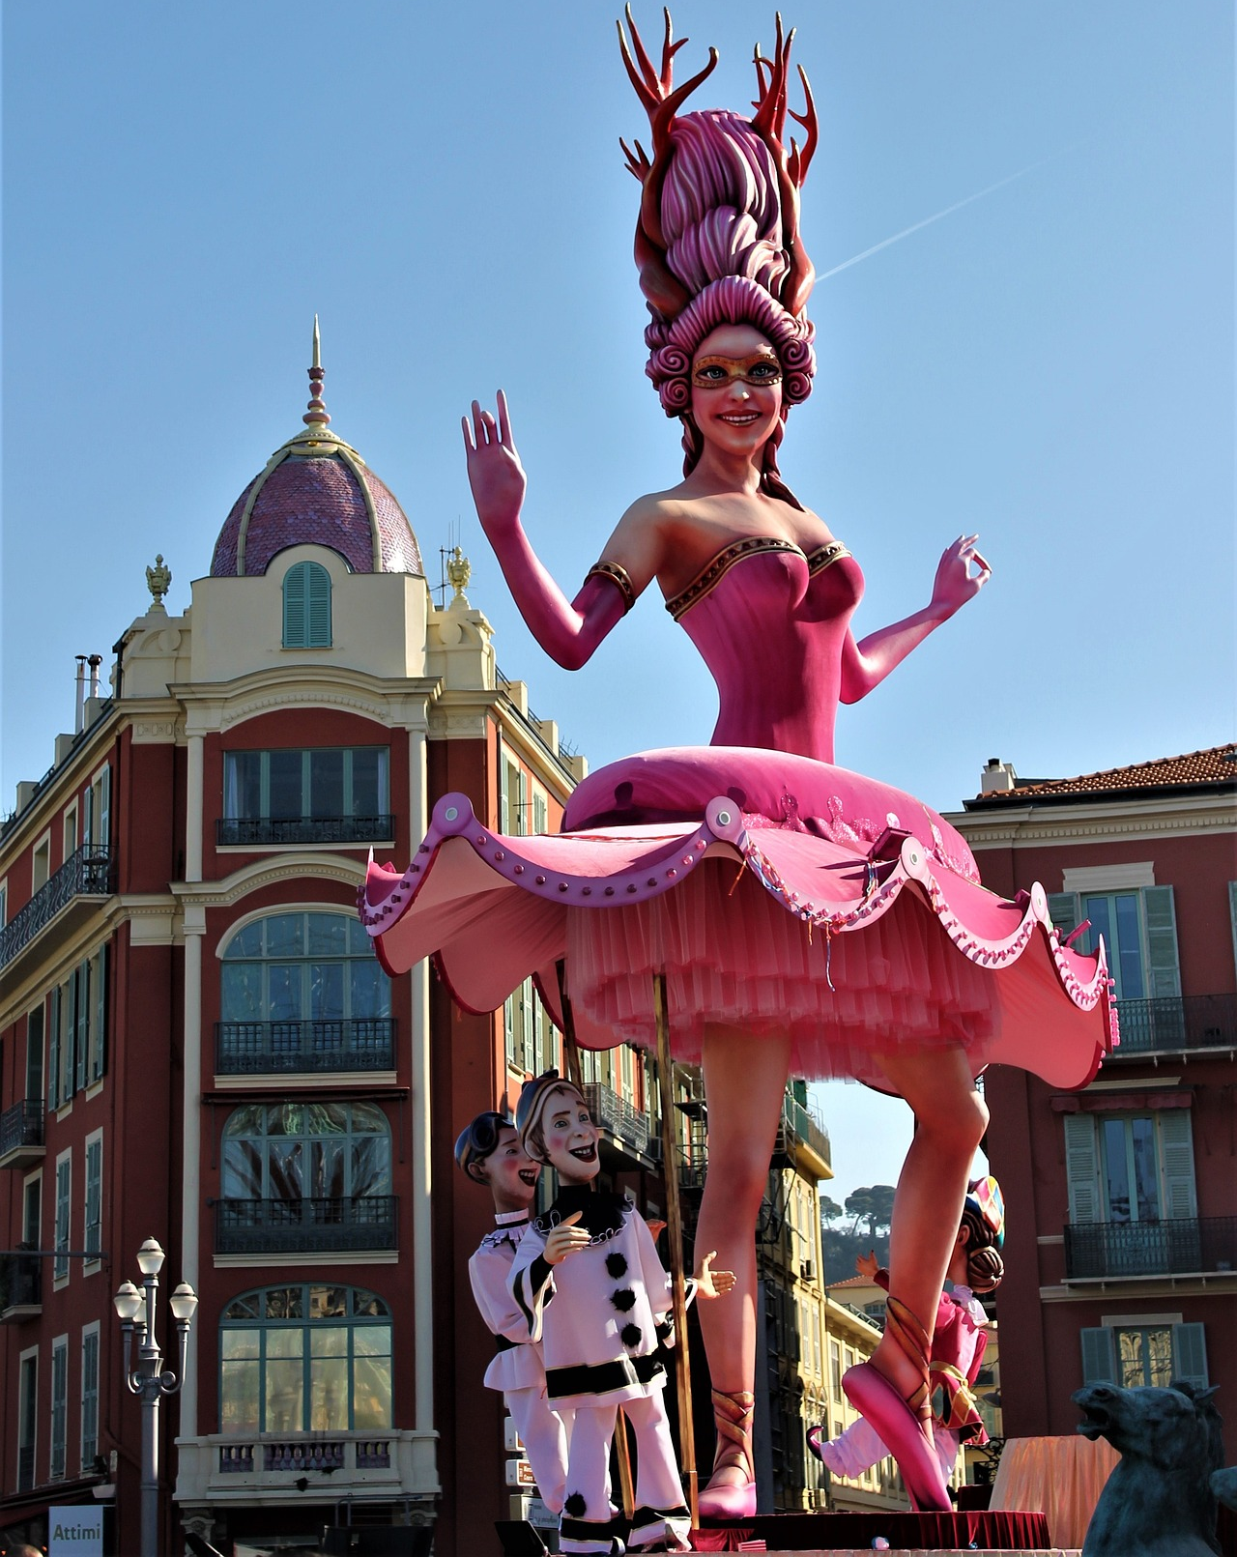
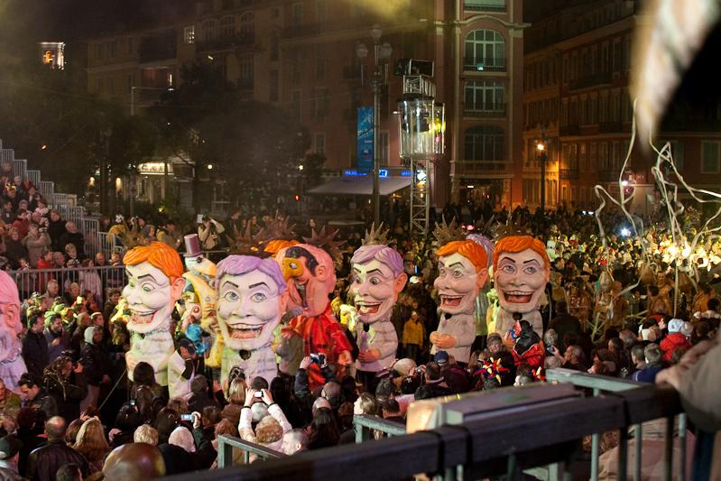
Follow up 5
Écris des phrases.
la personne = the person
1
4
The chair ist big.
The teacher is short.
écrire
La chaise est grande.
Le professeur est petit.
2
5
The person is tall.
The animal is big.
La personne est grande.
L’animal est grand
3
The poster is small.
6
The carnival is big.
L’affiche est petite.
Le carnaval est grand.
Notes:
Timing: 5 minutes
Aim: to practise written production of simple sentences describing pictures and using correct adjective agreement.
Procedure:
Click for each word to appear
Pupils produce the word with the correct article ‘le’, ‘la’ or ‘l’.
Click again for it to disappear into the corresponding pacperson’s mouth.
Attributions: 2] Olivier2000 at French Wikipedia., CC BY-SA 1.0 via Wikimedia Commons

Slide 8
vocabulaire
Écris en anglais : Can you get at least 15 points?
mots
 | il a | le chat | elle a
 | avoir | quoi ? | le dessin
 | le mot | prononcer | intéressant
 | facile | dessiner | chercher
 | petite | la télévision | petit
 | la tante | la radio | grande
 | grand | l’émission | de
x3
x2
x1
Notes:
HANDOUT
8

Slide 9
vocabulaire
Écris en français : Can you get at least 15 points?
mots
 | (the) cat | (the) drawing | to have, having
 | she has | he has | what?
 | easy (m/f) | interesting (m) | (the) word
 | to look for | to draw | to pronounce
 | of | short, small (m) | tall, big (f)
 | (the) aunt | tall, big (m) | short, small (f)
 | (the) programme | (the) television | (the) radio
x3
x2
x1
Notes:
HANDOUT
9

