Slide 1
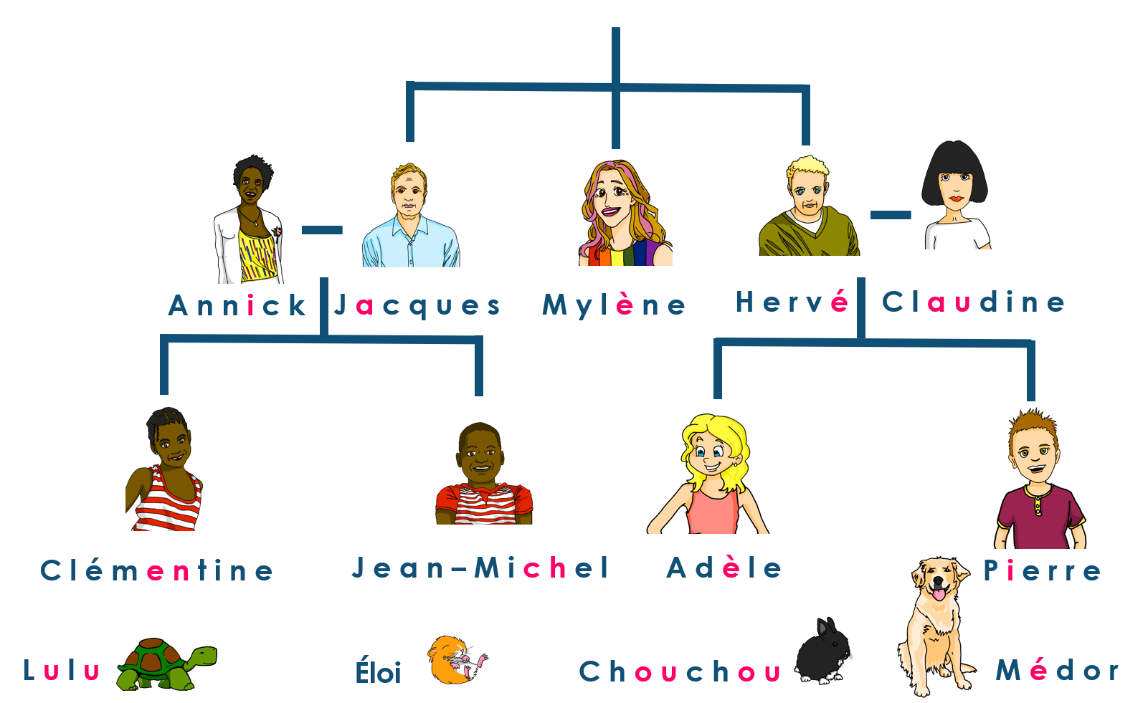
Describing me and others
Hervé est professeur de musique
jaune
Follow ups 1-5
Notes:
Artwork by Steve Clarke. Pronoun pictures from NCELP (www.ncelp.org). All additional pictures selected from Pixabay and are
available under a Creative Commons license, no attribution required.
The AUDIO version of the lesson material includes additional audio for the new language presented (phonics, vocabulary) and audio for the instructions
on the slide.
In addition, it includes VIDEO clips of the phonics and the phonics’ source words. Pupils can be encouraged to look at the shape of the mouth/lips on
slides where these appear, and try to copy it/them.
Phonics: SSC Revisit: closed [eu(t,x,s)] un peu [91]
Introduce: open [eu(r,l,f,ne,ve)] peur [755] jeune [152] neuf [787] acteur [1552] seul [102]
Vocabulary (new words in bold): enseigner [2134] poser [218] anglais1 [784] français2 [251] grand-mère [3883] grand-père [3748] musique [1139] le [1] la [1]
Revisit 1: --
Revisit 2: affiche [2886] bureau [273] chaise [3419] chambre [633] idée [239] lit [1837] un [3] une [3] (revisit moto, cheval)
Londsale, D., & Le Bras, Y. (2009). A Frequency Dictionary of French: Core vocabulary for learners London: Routledge.
The frequency rankings for words that occur in this PowerPoint which have been previously introduced in these resources are given in the SOW and in the resources that first introduced and formally re-visited those words. For any other words that occur incidentally in this PowerPoint, frequency rankings will be provided in the notes field wherever possible.

Slide 2
closed [eu]
open [eu]
prononcer
un peu
peur
It sounds like the ‘ur’ in ‘hurt’.
[a bit]
[fear]
This is a closed vowel. When you say this sound, your tongue is near the top of your mouth.
This is an open vowel. When you say this sound, your tongue is near the bottom of your mouth.
Notes:
Timing: 2 minutes
Aim: to recap closed and open [eu].
Procedure:
Click to bring up the closed [eu]. Repeat the SSC [eu] with the class.
Click to bring up the phrase ‘un peu’ (with gesture, if using).
Click to bring up the English translation and picture.
Pupils to practise saying the phrase several times.
Click to bring up the callout about closed vowel tongue position.
Click to bring up the open [eu]. Repeat the SSC with the class.
Click to bring up the word ‘peur’ (with gesture, if using).
Click to bring up the English translation and picture, and the callout hint about ‘hurt’.
Say this SSC several times with the class.
Click to bring up the call out about open SSC [eu].
Practise alternating between ‘peu’ and ‘peur’ several times.

Slide 3
prononcer
Follow up 1:
You will hear words with closed [eu] and open [eu].
Écoute. L’intrus, c’est quoi ?
 | acteur | ambitieux | adieu
 | bleu | beurre | boxeur
 | deux | neuf | heure
 | dangereuse | jeune | délicieux
 | seul | sœur | ceux
 | fleuve | fleur | feu
1
2
3
4
5
6
Notes:
Timing: 5 minutes
Aim: To practise aural distinction of French words with the SSC closed and open [eu] in sets of three words. Some words are known, others are cognates, some will be taught later in the SOW.
Procedure:
Do the first one to model the task.
Click to listen.
Pupils try to note down (in French) the odd one out.
Click to reveal the answer, drawing pupils’ attention to the closed [eu] in ambitieux and adieu but the open [eu] in acteur, which makes it the odd one out.
Continue with items 2-7.
Elicit answers from pupils and click to confirm the answers.
Transcript: acteur | ambitieux | adieu
bleu | beurre | boxeur
deux | neuf | heure
dangereuse | délicieux | jeune
seul | sœur | ceux
fleuve | fleur | feu
3

Slide 4
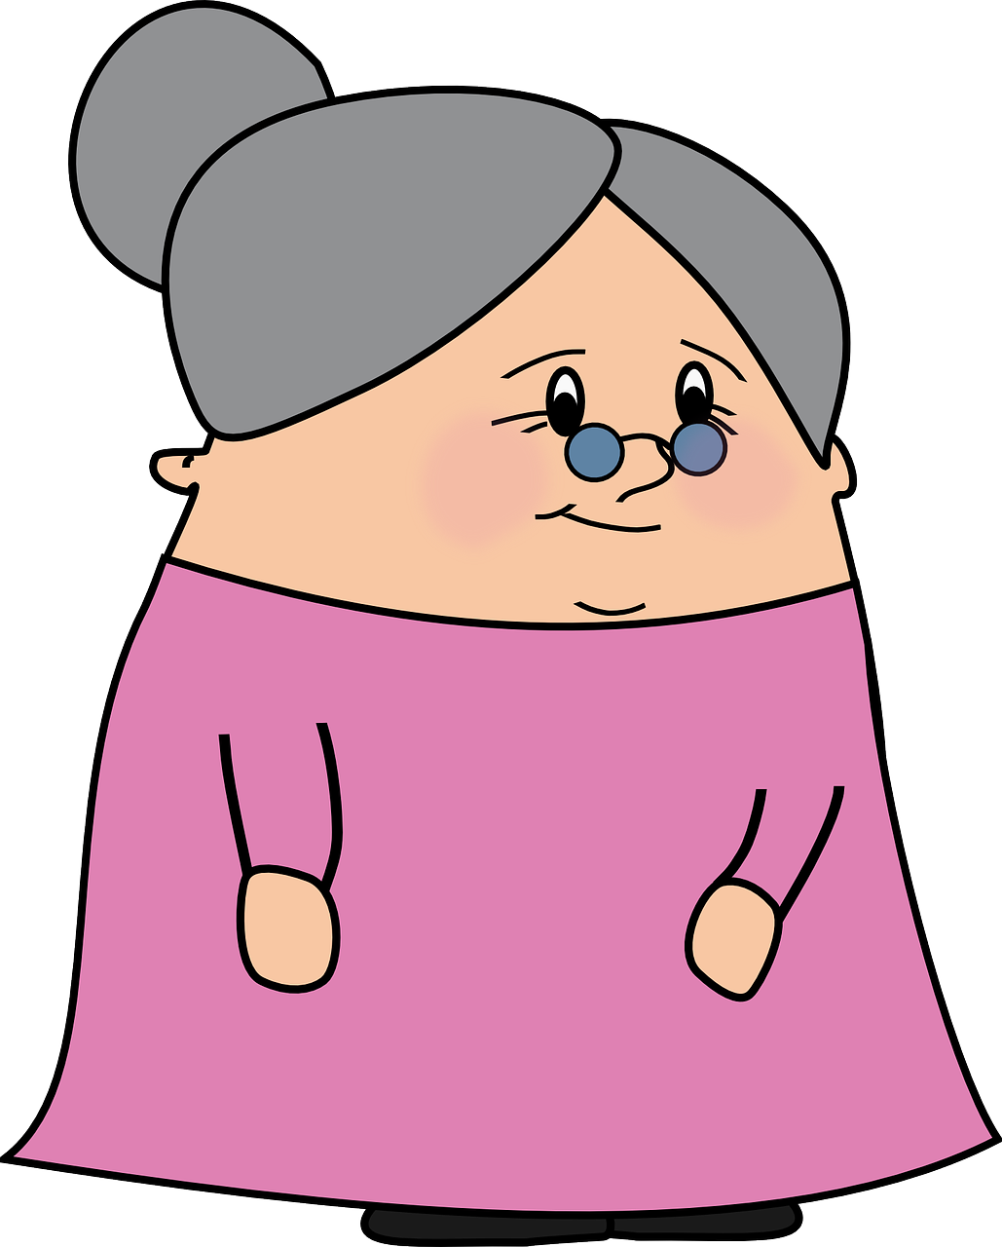
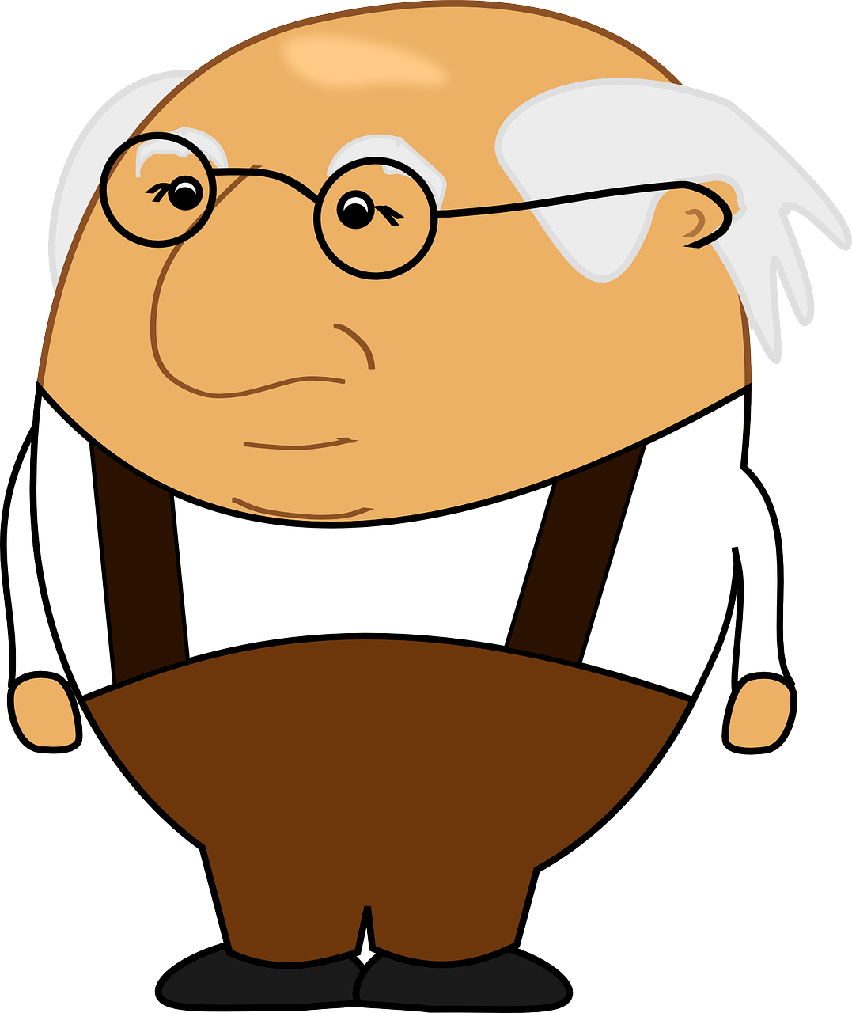
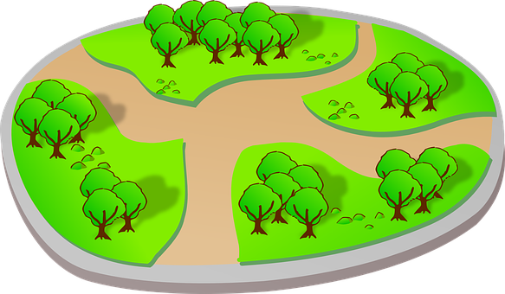
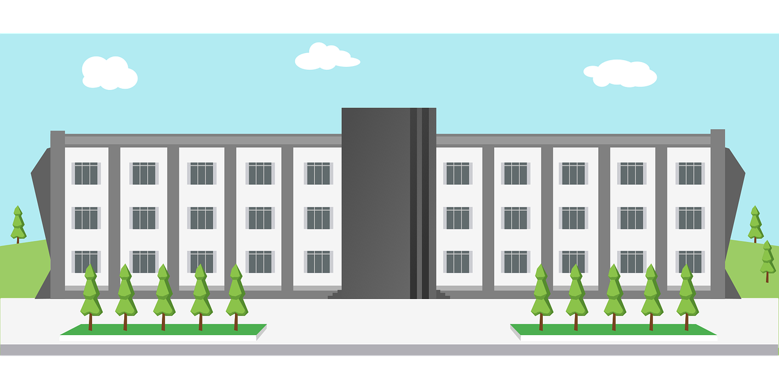
Follow up 2:
Trouve l’intrus.
parler
A
D
la
le
la
le
l’
l’
B
E
la
le
le
le
l’
le
C
F
la
le
le
l’
l’
le
Notes:
Timing: 5 minutes
Aim: To identify the odd one out by identifying the gender of each noun.
Procedure:
See if students can infer what to do from the near cognate intrus in the task instructions.
Call letters A-E and ask ‘C’est où, l’intrus ?’
Students answer with the French word.
Click to reveal answers and articles.
Note: this activity relies on knowing the gender and article of each of these previously taught words.
Word frequency of unknown words: intrus [>5000]
Source: Londsale, D., & Le Bras, Y. (2009). A Frequency Dictionary of French: Core vocabulary for learners London: Routledge.

Slide 5
Follow up 3
C’est le ou la (ou l’) ?
mots
vocabulaire
[la]
[le]
(the) desk
(the) grandma
(the) picture
(the) word
(the) idea
(the) chair
(the) university
(the) bed
(the) bedroom
(the) grandad
(the) music
(the) poster
(the) French
(the) country
(the) English
[l’]
(the) museum
[l’]
Notes:
Timing: 5 minutes
Aim: to practise aural production of and distinction between le and la; to produce previously taught vocabulary orally and from memory
Procedure:
Click for each word to appear
Pupils produce the word with the correct article ‘le’, ‘la’ or ‘l’.
Click again for it to disappear into the corresponding pacperson’s mouth.

Slide 6
Follow up 4:
Parle en français.
Personne A
Personne B
parler
1. Le [père] a une idée. 2. La [prof d’anglais] prépare une présentation.
3. La [grand-mère] pose une question.
4. Le [chat] parle en français.
5. Le [grand-père] cherche le chat.
Notes:
Timing: 10 minutes
Aim: oral production and aural recognition of definite articles. Note: this activity could also be a writing task on mini whiteboards.
Procedure:
1. Pupils work in pairs. Partner A faces the board, partner B turns away with a copy of their role card on paper or a separate screen (see the handout at the end of this presentation).
2. Partner A reads each sentence to their partner but does not say out loud the word that is crossed out.
3. On their sheet, Partner B ticks the noun that matches the word for the that partner A said. They then write the sentence in the appropriate gaps.
4. Partner B turns back and checks their solution against the answer slide.
5. Pupils swap roles.
Differentiation: for additional support teachers can pre-provide some of the words, e.g., the object nouns, leaving pupils to write only the correct subject noun from memory and transcribe the verb they hear.

Slide 7
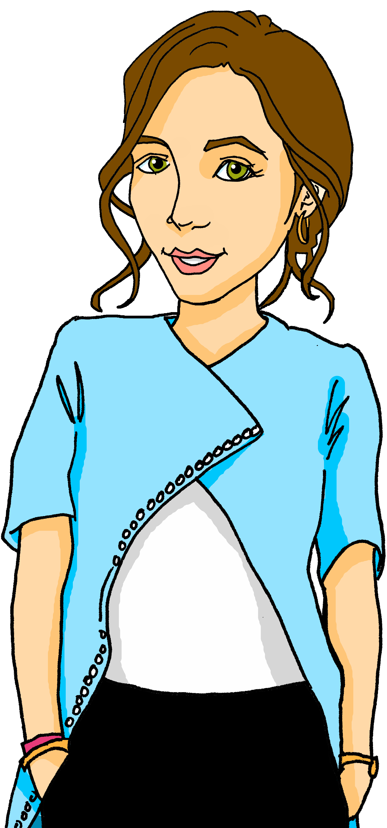
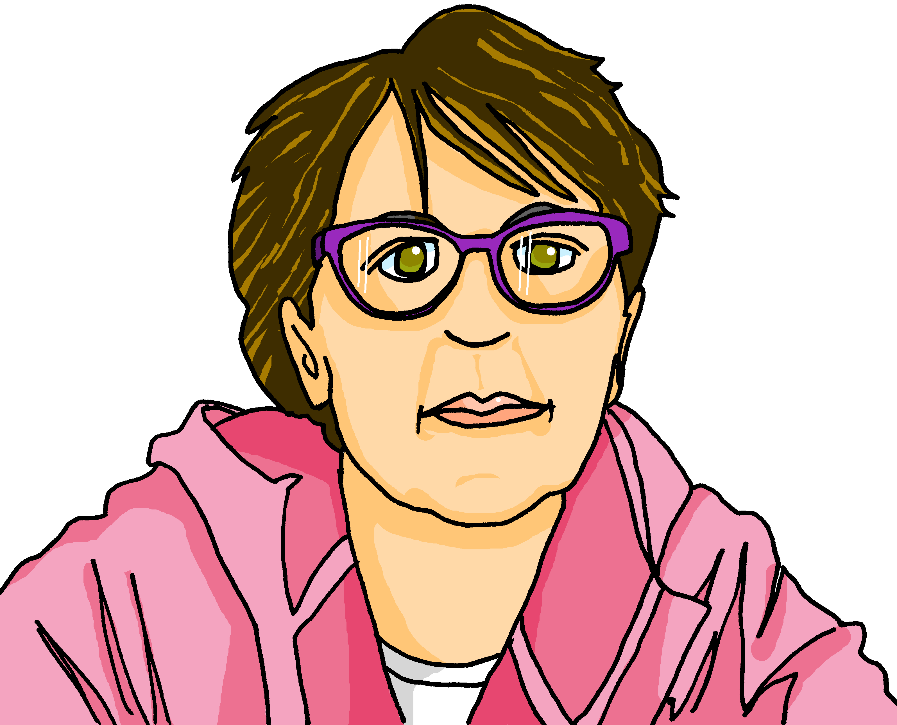
Follow up 4: Personne B – les réponses
parler
1.
1
Le
père
a
une
idée.
prof d’anglais
2.
2
La
prépare
une
présentation.
grand-mère
3.
3
La
pose
une
question.
4.
4
Le
chat
parle
en
français.
grand-père
5.
cherche
5
Le
le
chat.
Notes:
Answers 1. Le [père] a une idée. 2. La [prof d’anglais] prépare une présentation.
3. La [grand-mère] pose une question.
4. Le [chat] parle en français.
5. Le [grand-père] cherche le chat.

Slide 8
Follow up 4:
Parle en français.
Personne B
Personne A
parler
1. Le [père] enseigne la musique. 2. La [mère] organise une visite. 3. Le [grand-père] parle en anglais.
4. La [prof] pose une question.
5. Le [chat] répète la question.

Slide 9
Follow up 4: Personne A – les réponses
parler
1.
1.
1
Le
père
enseigne
la
musique.
2.
2.
2
La
mère
organise
une
visite.
grand-père
3.
3.
3
Le
parle
en
anglais.
4.
4.
4
La
prof
pose
une
question.
5.
5.
5
Le
chat
répète
la
question.
Notes:
Answers 1. Le [père] enseigne la musique. 2. La [mère] organise une visite. 3. Le [grand-père] parle en anglais.
4. La [prof] pose une question.
5. Le [chat] répète la question.

Slide 10
vocabulaire
Follow up 5 - Écris en anglais : Can you get at least 15 points?
mots
 | le lit | le cheval | la moto
 | l’idée | la réponse | la question
 | l’affiche | une | un
 | le bureau | la chambre | la chaise
 | la grand-mère | enseigner | l’anglais
 | le grand-père | poser | le français
 | le | la | la musique
(the) bed
(the) horse
(the) motorbike
x3
(the) idea
(the) answer
(the) question
(the) poster
a (f)
a (m)
x2
(the) desk
(the) bedroom
(the) chair
(the) grandma
to teach, teaching
(the) English
to put (down), ask (a question)
(the) grandad
(the) French
x1
the (m)
the (f)
(the) music
Notes:
Timing: 5-10 minutes
Aim: to practise written comprehension of vocabulary from this week and previous weeks.
Procedure: Give pupils a blank grid. They fill in the French meanings of any of the words they know, trying to reach 15 points in total.
Note: The most recently learnt and practised words are pink, words from the previous week are green and those from week 1 are blue, thus more points are awarded for them, to recognise that memories fade and more effort (heavy lifting!) is needed to retrieve them.
10

Slide 11
vocabulaire
Follow up 5 - Écris en français : Can you get at least 15 points?
mots
 | (the) motorbike | (the) question | (the) answer
 | (the) idea | (the) bed | (the) horse
 | (the) desk | (the) chair | (the) bedroom
 | a/an (m) | a/an (f) | (the) poster
 | (the) English | (the) French | (the) music
 | the (f) | (the) grandad | (the) grandma
 | to teach, teaching | to put (down), ask (a question) | the (m)
la moto
la question
la réponse
x3
l’idée
le lit
le cheval
le bureau
la chaise
la chambre
x2
un
une
l’affiche
l’anglais
le français
la musique
la
le grand-père
la grand-mère
x1
enseigner
poser
le
Notes:
Timing: 5-10 minutes
Aim: to practise written comprehension of vocabulary from this week and previous weeks.
Procedure: Give pupils a blank grid. They fill in the French meanings of any of the words they know, trying to reach 15 points in total.
Note: The most recently learnt and practised words are pink, words from the previous week are green and those from week 1 are blue, thus more points are awarded for them, to recognise that memories fade and more effort (heavy lifting!) is needed to retrieve them.
11

Slide 12
Follow up 4: Personne B - handout
parler
1.
2.
3.
4.
5.
Notes:
Handout

Slide 13
Follow up 4: Personne A - handout
parler
1.
2.
3.
4.
5.
Notes:
Handout

Slide 14
vocabulaire
Écris en anglais : Can you get at least 15 points?
mots
 | le lit | le cheval | la moto
 | l’idée | la réponse | la question
 | l’affiche | une | un
 | le bureau | la chambre | la chaise
 | la grand-mère | enseigner | l’anglais
 | le grand-père | poser | le français
 | le | la | la musique
x3
x2
x1
Notes:
HANDOUT
14

Slide 15
vocabulaire
Écris en français : Can you get at least 15 points?
mots
 | (the) motorbike | (the) question | (the) answer
 | (the) idea | (the) bed | (the) horse
 | (the) desk | (the) chair | (the) bedroom
 | a/an (m) | a/an (f) | (the) poster
 | (the) English | (the) French | (the) music
 | the (f) | (the) grandad | (the) grandma
 | to teach, teaching | to put (down), ask (a question) | the (m)
x3
x2
x1
Notes:
HANDOUT
15

