Slide 1
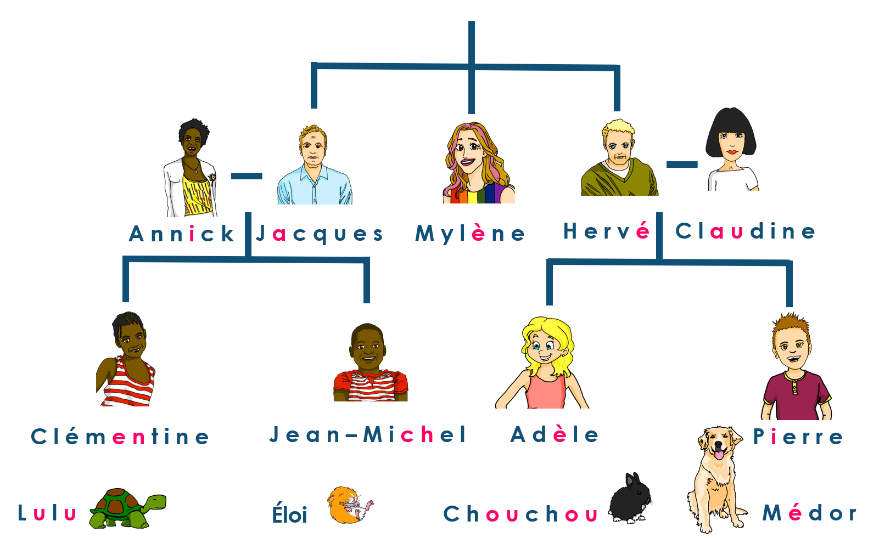
Describing me and others
Claudine est guide touristique
jaune
Follow ups 1-5
Notes:
Artwork by Steve Clarke. Pronoun pictures from NCELP (www.ncelp.org). All additional pictures selected from Pixabay and are
available under a Creative Commons license, no attribution required.
The AUDIO version of the lesson material includes additional audio for the new language presented (phonics, vocabulary) and audio for the instructions
on the slide.
In addition, it includes VIDEO clips of the phonics and the phonics’ source words. Pupils can be encouraged to look at the shape of the mouth/lips on
slides where these appear, and try to copy it/them.
Phonics: SSC [et] [ez] - et [6] nez [2661] Vocabulary (new words in bold): organiser [791] préparer [368] visiter [1378] parc [1240] université [1192] musée [2216] visite [1072] avec [23]
Revisit 1: --
Revisit 2: Revisit days of the week, sérieux [412] heureux [764] curieux [2424] courageux [2198 semaine [245]
Londsale, D., & Le Bras, Y. (2009). A Frequency Dictionary of French: Core vocabulary for learners London: Routledge.
The frequency rankings for words that occur in this PowerPoint which have been previously introduced in these resources are given in the SOW and in the resources that first introduced and formally re-visited those words. For any other words that occur incidentally in this PowerPoint, frequency rankings will be provided in the notes field wherever possible.

Slide 2
Follow up 1:
[é] [-er] [et] [-ez]
. Écoute les noms des animaux. C’est [ien] ou [(a)in]?
Écoute et répète. Ou silence !
If you hear the [é] sound, repeat the word. If not, ‘Silence !’
1
2
3
4
[é|-er|et|-ez]
5
6
7
8
9
10
Notes:
Silence ! Pupils keep silent unless they think the word has the target SSC, in which case they repeat the word. Timing: 5 minutes
Aim: to practise aural distinction of the [é] sound.
Procedure:
Click to play each word.
Pupils keep silent unless they think the word has the target SSC, in which case they repeat the word.
If pupils speak when they should keep silent OR keep silent when they should repeat, the teacher gets a point. Otherwise the class gets a point. Play first to 5 points in each round.
The teacher can play more than one round by playing the audio in different number order each time.
Transcript: café
parler
avec
volontaire présenter semaine papier
préférér
arriver curieux
Frequency of unknown words and cognates: arrive [174] café [1886] papier [951] préférer [597] volontaire [1675]

Slide 3
Follow up 2:
Pierre décrit les activités de Claudine et d’Hervé.
. Écoute les noms des animaux. C’est [ien] ou [(a)in]?
Écoute. Écris en anglais.
écouter
1
2
3
4
day | activity
day | activity
organise visit
to museum
prepare
presentation
5
Mon
Mon
talk to Adèle
and Pierre
look for picture for brochure
6
Tues
Wed
look for park for a group of tourists
visit a university with Pierre
7
Thurs
Fri
prepare a list of activities
organise a football match
Sun
weekend
8
Notes:
Timing: 5 minutes
Aim: to practise aural comprehension of new and revisited vocabulary and structures.
Procedure:
Pupils write two headers: Claudine | Hervé
Click to listen.
Pupils write the activity and the day of the week in English.
Transcript: Lundi il prépare une présentation.
Lundi elle organise une visite à un musée.
Mardi elle parle avec Adèle et Pierre.
Mercredi il cherche une image pour une brochure.
Vendredi il visite une université avec Pierre.
Jeudi elle cherche un parc pour un groupe de touristes.
Dimanche elle prépare une liste d’activités.
Le weekend il organise un match de football.

Slide 4
Follow up 3:
. Écoute les noms des animaux. C’est [ien] ou [(a)in]?
Écris en anglais.
mots
1. un musée
5. il organise
9. je visite
vocabulaire
2. avec
6. dimanche
10. une université
3. une visite
7. et
11. mardi
4. lundi
8. tu prépares
12. jeudi
Notes:
Timing: 5 minutes
Slide 1/2
Aim: to practise new and revisited vocabulary.
Procedure:
1. Click to make the words disappear one by one. Pupils write down the number and the English translation. They have 4 seconds before the word disappears completely.
2. Use the next slide to elicit and then display the English translations.

Slide 5
Follow up 3:
. Écoute les noms des animaux. C’est [ien] ou [(a)in]?
Which words are cognates?
Parle en français.
mots
1. un musée
5. il organise
9. je visite
vocabulaire
a museum
he organises
I visit
2. avec
6. dimanche
10. une université
with
Sunday
a university
3. une visite
7. et
11. mardi
a visit
and
Tuesday
4. lundi
8. tu prépares
12. jeudi
Monday
you prepare
Thursday
Notes:
2/2
Procedure
Elicit and display the English translations one by one.
Ask pupils to think about which words here are cognates. Define cognates: words that share most of the same letters, look very similar and have the same meaning, (even though they will often sound rather different).
Elicit and then click to highlight all the cognates.
Click for all the French words to disappear.
Ask pupils to work in pairs to recall the words in French. They should try to remember genders too.
Click again for all words to reappear for pupils to check.
Click on each word to hear the audio, if required.

Slide 6
Follow up 4:
. Écoute les noms des animaux. C’est [ien] ou [(a)in]?
Écris 5 phrases en français.
[I visit] [You visit] [I organise] [S/he organises] [I prepare] [You prepare] [I look for] S/he looks for]
[I pronounce] [You pronounce] [I draw] [S/he draws]
un pays
un texte
un mot
un musée
un parc
une image une université
une visite
avec Josh avec Emily
en anglais
en français
écrire
parler
If you like, make your sentences longer using et (and).
Je visite un pays et tu visites une université.
Notes:
Timing: 5 minutes
Aim: to practise written production of verb forms from this week and last week and written recognition of other revisited vocabulary.
Procedure: 1. Explain the task. Pupils will write five sentences using five different verb forms, translating from English into French, and then selecting appropriate sentence endings from the French items in the blue box on the right.
2. Click to bring up an example. Elicit the English: I visit a country and you visit a university. 3. Pupils write their 5 sentences.
4. Pupils read each other their sentences and the listening partners interprets into English.
Note: there is an option to extend sentences using ‘et’. We will practise creating more compound sentences during the next few weeks.

Slide 7
vocabulaire
Follow up 5 - Écris en anglais : Can you get at least 15 points?
mots
 | courageux | curieuse | sérieux
 | dimanche | une semaine | heureuse
 | lundi | mercredi | vendredi
 | samedi | jeudi | mardi
 | une visite | organiser | une université
 | et | visiter | avec
 | un musée | préparer | un parc
brave (m)
curious (f)
serious (m)
x3
Sunday
a week
happy (f)
Monday
Wednesday
Friday
x2
Saturday
Thursday
Tuesday
a visit
to organise, organising
a university
and
to visit, visiting
with
x1
a museum
to prepare, preparing
a park
Notes:
Timing: 5-10 minutes
Aim: to practise written comprehension of vocabulary from this week and previous weeks.
Procedure: Give pupils a blank grid. They fill in the French meanings of any of the words they know, trying to reach 15 points in total.
Note: The most recently learnt and practised words are pink, words from the previous week are green and those from week 1 are blue, thus more points are awarded for them, to recognise that memories fade and more effort (heavy lifting!) is needed to retrieve them.
7

Slide 8
vocabulaire
Follow up 5 - Écris en français : Can you get at least 15 points?
mots
 | brave (f) | curious (m) | serious (f)
 | Sunday | a week | happy (m)
 | Thursday | Friday | Saturday
 | Monday | Tuesday | Wednesday
 | a park | with | and
 | a visit | to prepare, preparing | a museum
 | to visit, visiting | to organise, organising | a university
courageuse
curieux
sérieuse
x3
dimanche
une semaine
heureux
jeudi
vendredi
samedi
x2
lundi
mardi
mercredi
un parc
avec
et
une visite
préparer
un musée
x1
visiter
organiser
une université
Notes:
Timing: 5-10 minutes
Aim: to practise written comprehension of vocabulary from this week and previous weeks.
Procedure: Give pupils a blank grid. They fill in the French meanings of any of the words they know, trying to reach 15 points in total.
Note: The most recently learnt and practised words are pink, words from the previous week are green and those from week 1 are blue, thus more points are awarded for them, to recognise that memories fade and more effort (heavy lifting!) is needed to retrieve them.
8

Slide 9
vocabulaire
Écris en anglais : Can you get at least 15 points?
mots
 | courageux | curieuse | sérieux
 | dimanche | une semaine | heureuse
 | lundi | mercredi | vendredi
 | samedi | jeudi | mardi
 | une visite | organiser | une université
 | et | visiter | avec
 | un musée | préparer | un parc
x3
x2
x1
Notes:
HANDOUT
9

Slide 10
vocabulaire
Écris en français : Can you get at least 15 points?
mots
 | brave (f) | curious (m) | serious (f)
 | Sunday | a week | happy (m)
 | Thursday | Friday | Saturday
 | Monday | Tuesday | Wednesday
 | a park | with | and
 | a visit | to prepare, preparing | a museum
 | to visit, visiting | to organise, organising | a university
x3
x2
x1
Notes:
HANDOUT
10

