Slide 1
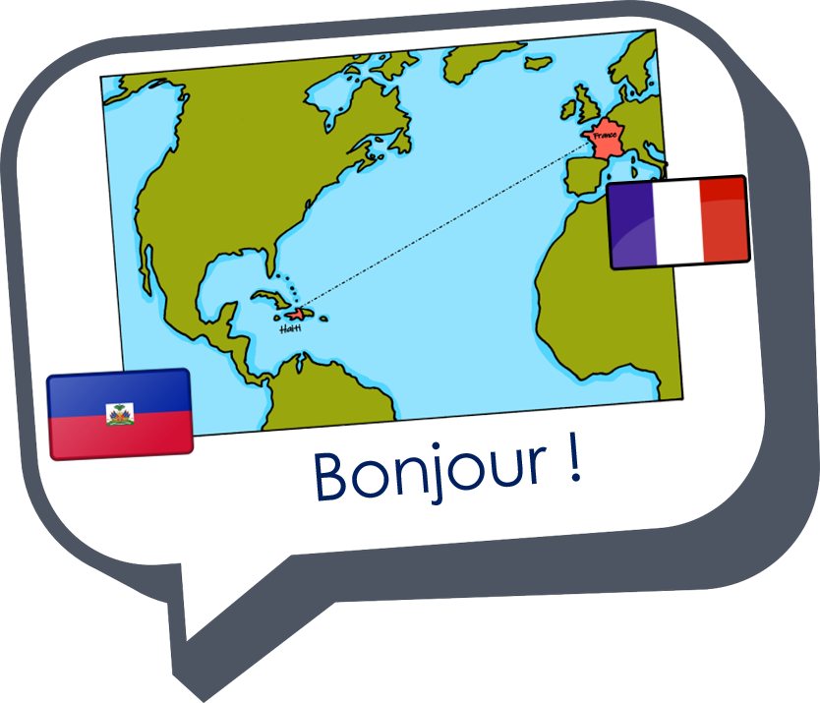
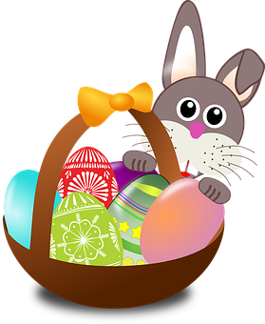
Saying how many and describing things
jaune
Phonics quiz
Easter activities
Notes:
Artwork by Steve Clarke. Pronoun pictures from NCELP (www.ncelp.org). All additional pictures selected from Pixabay and are
available under a Creative Commons license, no attribution required.
This lesson contains a phonics assessment to check progress in SSC practised in the 2nd term of this year’s course.
The frequency rankings for words that occur in this PowerPoint which have been previously introduced in these resources are given in the SOW and in the resources that first introduced and formally re-visited those words. For any other words that occur incidentally in this PowerPoint, frequency rankings will be provided in the notes field wherever possible.
1

Slide 2
prononcer
[er]
[ez]
prononcer
terminer
rendez-vous
Notes:
Prior preparation: print out one set of phonics slides and cut in half; print out sufficient pupil feedback sheets to have one per pupil.
Timing: 1 minute per pupil
Aim: to assess pupils’ ability to read aloud the SSC taught this term. Procedure: 1. Give out the independent task that pupils will work on during the lesson. 2. Listen to individual pupils reading the words aloud. Mark in real time.
3. If desired, teachers can listen to the audio versions in preparation.
Note:
there are no follow up lessons this week, so it would be possible to continue the speaking assessments in the follow up time during this week, as needed.
if preferred, and the resources are available, pupils could record their answers (e.g. on computer or ipad) though this would involve the teacher listening back to assess them.
Word frequency (1 is the most frequent word in French):
terminer [415] rendez-vous [1873]
Source: Londsale, D., & Le Bras, Y. (2009). A Frequency Dictionary of French: Core vocabulary for learners London: Routledge.
2

Slide 3
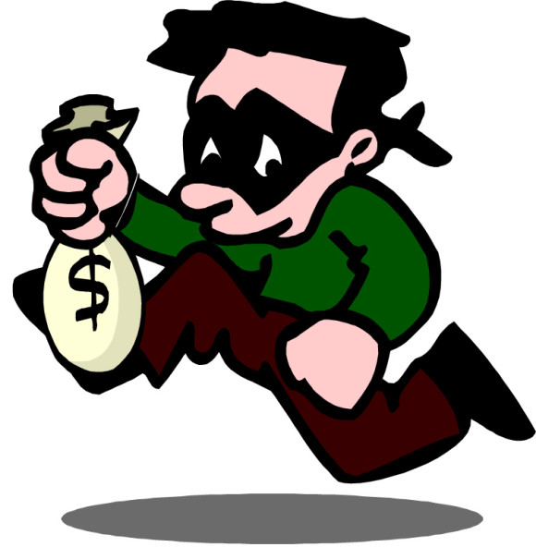
prononcer
[eu]
[ê]
open
prononcer
[honest]
voleur
honnête
Notes:
Word frequency (1 is the most frequent word in French):
voleur [3163] honnête [2405]
Source: Londsale, D., & Le Bras, Y. (2009). A Frequency Dictionary of French: Core vocabulary for learners London: Routledge.
3

Slide 4
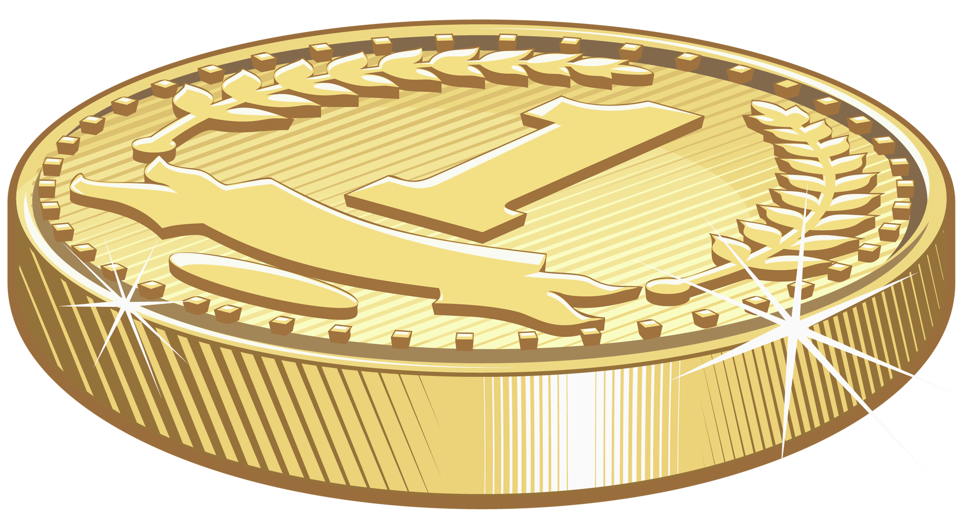
prononcer
[ai]
[oi]
prononcer
[coin]
[cloth]
monnaie
toile
Notes:
Word frequency (1 is the most frequent word in French):
monnaie [1932] toile [3502]
Source: Londsale, D., & Le Bras, Y. (2009). A Frequency Dictionary of French: Core vocabulary for learners London: Routledge.
4

Slide 5
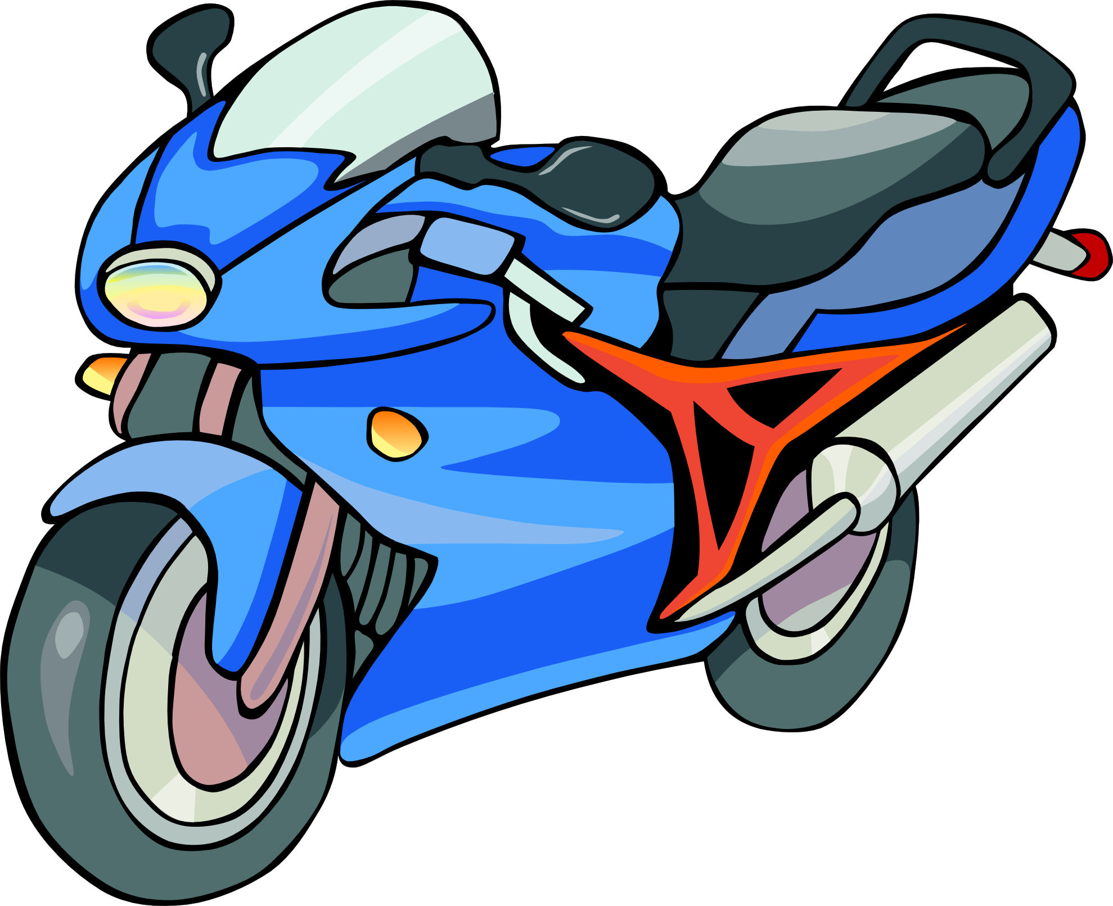
prononcer
[u]
prononcer
C’est une moto.
culotte
Notes:
Word frequency (1 is the most frequent word in French):
culotte [>5000]
Source: Londsale, D., & Le Bras, Y. (2009). A Frequency Dictionary of French: Core vocabulary for learners London: Routledge.
5

Slide 6
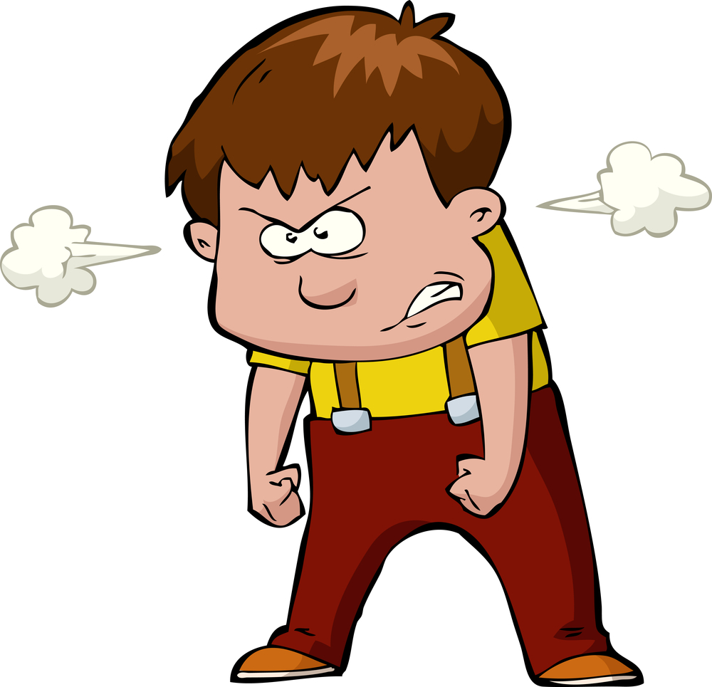
prononcer
[SFC]
[eu]
closed
prononcer
frais
furieux
Notes:
Word frequency (1 is the most frequent word in French):
frais [691] furieux [4239]
Source: Londsale, D., & Le Bras, Y. (2009). A Frequency Dictionary of French: Core vocabulary for learners London: Routledge.
6

Slide 7
prononcer
[(e)au]
[ou]
prononcer
[skin]
[bowl]
peau
coupe
Notes:
Word frequency (1 is the most frequent word in French):
peau [2122] coupe [2925]
Source: Londsale, D., & Le Bras, Y. (2009). A Frequency Dictionary of French: Core vocabulary for learners London: Routledge.
7

Slide 8
pronunciar
Pupil name:
Pupil name:
SSC and word | px
terminer
rendez-vous
voleur
honnête
monnaie
toile
C’est une moto.
culotte
frais
furieux
peau
coupe
SSC and word | px
terminer
rendez-vous
voleur
honnête
monnaie
toile
C’est une moto.
culotte
frais
furieux
peau
coupe
Notes:
Pupil feedback and assessment sheet
8

Slide 9
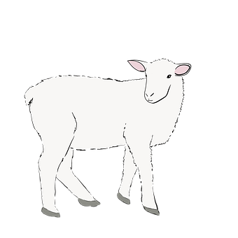
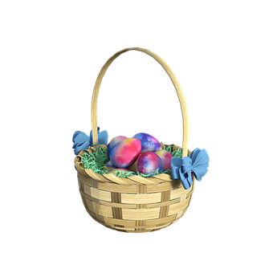
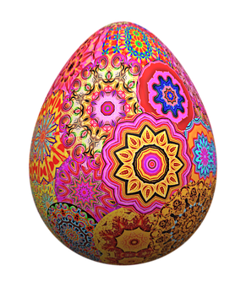
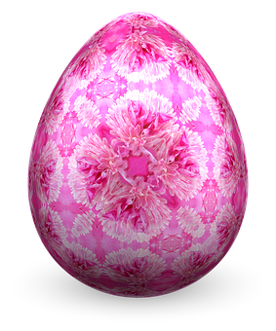
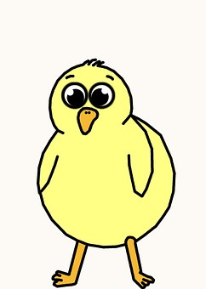
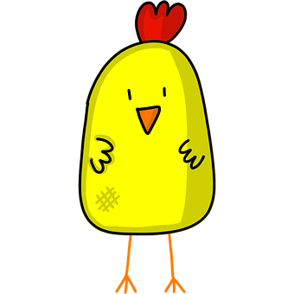
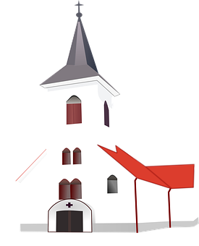
Activité
1. Fill in the missing numbers on the eggs.
3. Count the Easter pictures and write how many you see.
Quoi ? | Combien ?
poussins
agneaux
paniers
jonquilles
lapins
églises
œufs
cinq [5]
un
deux
trois
quatre
cinq
six
sept
huit [8]
2. Match each chick to an egg. Write the English translations below.
quatre [4]
A
B
C
douze [12]
aime
chante
joue
parles
dessine
écoutes
sept [7]
deux [2]
je
j’
je
tu
il
tu
onze [11]
I sing
I like
he plays
you listen
I draw
you speak
_________
_________
________
_________
_____________
__________
Notes:
Timing: 10-15 mins (independent)
Aim: to provide written practice of French numbers 1-12 and reading comprehension of singular verb endings and meanings.
This activity is designed as a worksheet for pupils to complete independently after completing assessments. Worksheet at end of this presentation. Answers on this slide. It should be used in conjunction with the next slide for activity 3.
Pupils fill in the missing French numbers to complete the sequence.
Pupils match a chick to an appropriate egg by looking at the pronouns and verb endings. They then write the English translation below each chick.
Pupils count up the number of each type of Easter picture on the next slide in a kind of ‘I spy’ activity and write the number in French.

Slide 10
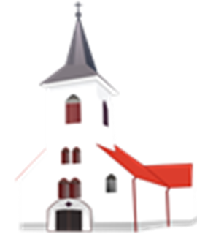
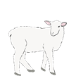
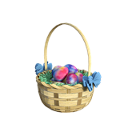
Un, deux, trois… Je vois quoi ?
Notes:
‘I spy’ slide to be used for Activity 3 on previous slide/ worksheet.

Slide 11
Activité
1. Fill in the missing numbers on the eggs.
3. Count the Easter pictures and write how many you see.
Quoi ? | Combien ?
poussins
agneaux
paniers
jonquilles
lapins
églises
œufs
un
trois
cinq
sept
cinq [5]
2. Match each chick to an egg. Write the English translations below.
A
B
C
aime
chante
joue
parles
dessine
écoutes
je
j’
je
tu
il
tu
_________
_________
________
_________
_____________
___________
Notes:
HANDOUT

Slide 12
Teacher audio version
SSC and word | px
terminer
rendez-vous
voleur
honnête
monnaie
toile
C’est une moto.
culotte
frais
furieux
peau
coupe
Notes:
Teacher audio version for preparation
12

