Slide 1
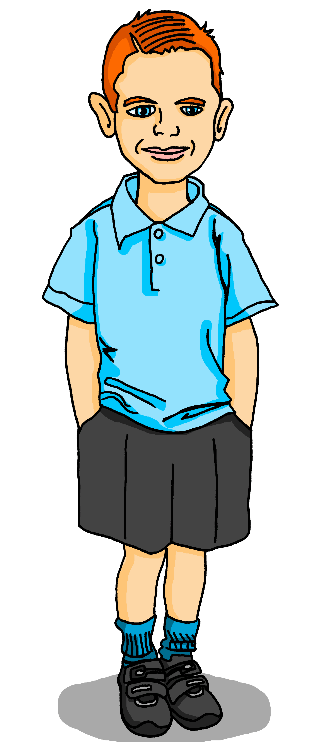
Saying what I and others have
jaune
Follow ups 1-5
Notes:
Artwork by Steve Clarke. Pronoun pictures from NCELP (www.ncelp.org). All additional pictures selected from Pixabay and are available under a Creative Commons license, no attribution required.
Frequency of new vocabulary and phonics:
Phonics: [ch] dimanche [1235] marché [280] chercher [336] chat [3138] bouche [1838]
Vocabulary: avoir [8] j’ai, il a, elle a, quoi [297] chat [3138] crayon [>5000] dessin [2624] message [792]
Revisit 1: ce (c') [12] lundi [1091] mardi [1044] mercredi [1168] jeudi [1112] vendredi [1086] samedi [1355] dimanche [1235] aujourd’hui [233]
Londsale, D., & Le Bras, Y. (2009). A Frequency Dictionary of French: Core vocabulary for learners London: Routledge.
The frequency rankings for words that occur in this PowerPoint which have been previously introduced in these resources are given in the SOW and in the resources that first introduced and formally re-visited those words.
For any other words that occur incidentally in this PowerPoint, frequency rankings will be provided in the notes field wherever possible.

Slide 2
Follow up 1
.
Écoute.
Tally the number of times you hear [ch] in each sentence.
////
écouter
1
Aujourd’hui, c’est dimanche.
/
Today it’s Sunday.
2
Il achète un chocolat chaud.
///
He buys a hot chocolate.
3
Je cherche un chien.
///
I’m looking for a dog.
4
Elle a une affiche et une chaise.
//
She has a poster and a chair.
5
Un cheval et un chat marchent au marché.
////
A horse and a cat walk to the market.
Notes:
Timing: 5 minutes
Aim: to practise aural recognition of SSC [ch].
Procedure: 1. Click to listen to each sentence. 2. Pupils note each instance of [ch] 3. Click to reveal the written sentence and the answer. 4. Allow pupils to tell you the meanings of the words they know. Click again to reveal the English meaning.
Transcript:
Aujourd’hui, c’est dimanche. Il achète un chocolat chaud. Je cherche un chien. Elle a une affiche et une chaise. Un cheval et un chat marchent au marché.

Slide 3
Follow up 2
.
Écoute et lis les phrases. C’est quoi ?
1
[mardi | heureux]
écouter
C’est un jour.
2
[une chaise | un chat]
C’est dans une salle de classe.
[un lit | un bureau]
3
C’est pour écrire.
[un cheval | un chat]
4
C’est un animal. C’est petit.
5
C’est pour regarder.
[un crayon | un dessin]
C’est dans une chambre.
6
[un lit | un cheval]
Notes:
Timing: 5 minutes
Aim: to practise aural/written comprehension of a range of new and previously taught vocabulary.
Procedure: 1. Click to listen and read each clue. 2. Pupils select the noun that is described.
3. Elicit the answers orally and click to reveal the answers.
Transcript:
1. C’est un jour.
2. C’est dans une salle de classe. 3. C’est pour écrire. 4. C’est un animal. C’est petit.
5. C’est pour regarder. 6. C’est dans une chambre.

Slide 4
Follow up 3
.
Écoute. Pierre parle. Qui a quoi ?
1
[dessin|affiche]
écouter
Pierre (I have)
 | ______
 | ______
 | ______
 | ______
2
[chaise | message]
3
[chambre | chat]
drawing
chair
4
[bureau | chaise]
desk
horse
5
[affiche | dessin]
Adèle (she has)
 | ______
 | ______
 | ______
 | ______
6
[crayon | chaise]
bedroom
7
[chambre| cheval]
poster
pencil
8
[chat | affiche]
cat
Notes:
Timing: 5 minutes
Aim: to practise aural comprehension of j’ai and il a and correctly connect indefinite articles with nouns of the correct gender.
Procedure: 1. Click to listen. 2. Pupils decide if Adèle says ‘I have’ or ‘he has’ and select the noun that is described.
3. They write the noun in English under the correct name heading.
4. Elicit the answers orally and click to bring up full sentence audio and to reveal the answers.
Transcript:
1. J’ai un [dessin].
2. J’ai une [chaise]. 3. Elle a une [chambre]. 4. J’ai un [bureau]. 5. Elle a une [affiche]. 6. Elle a un [crayon]. 7. J’ai un [cheval]. 8. Elle a un [chat].

Slide 5
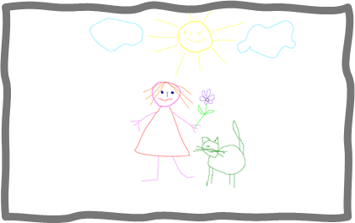
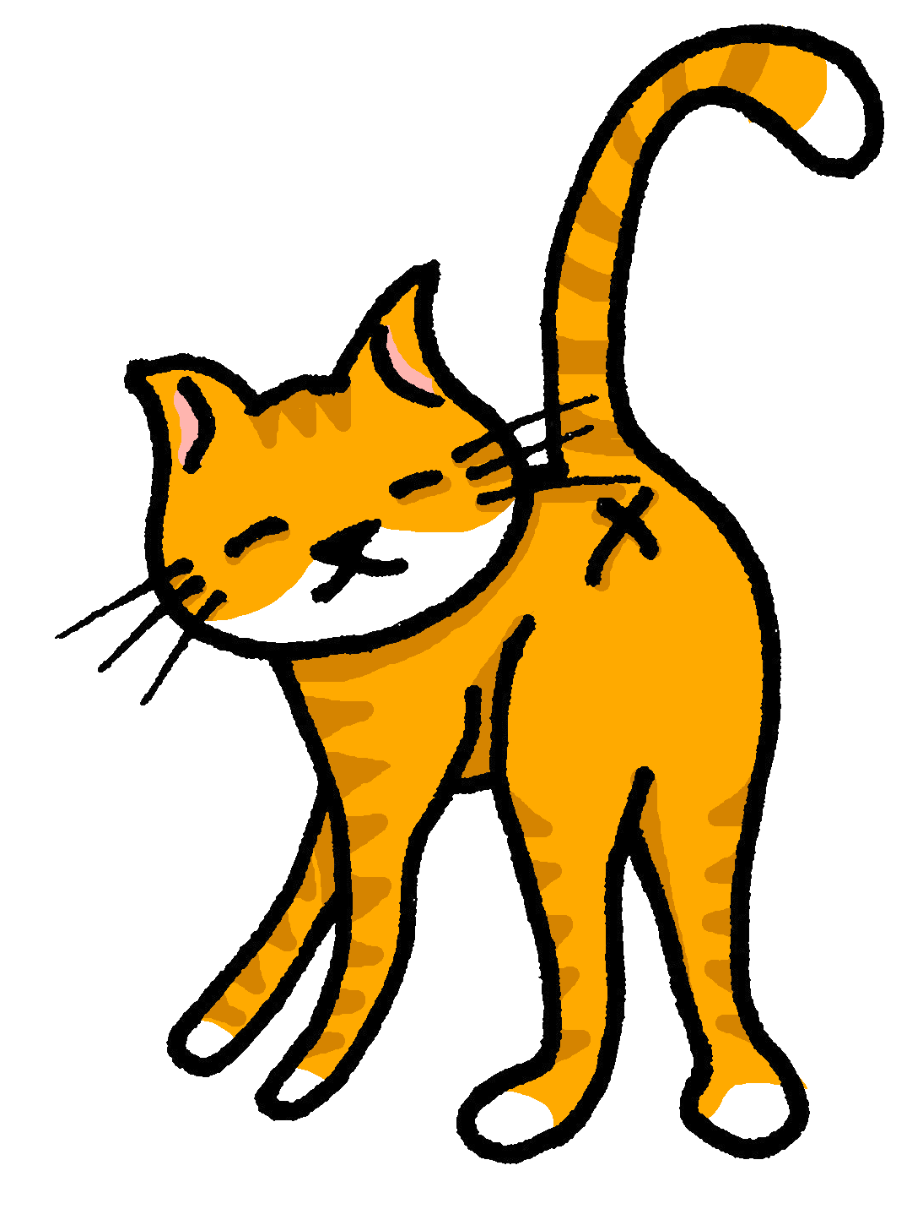
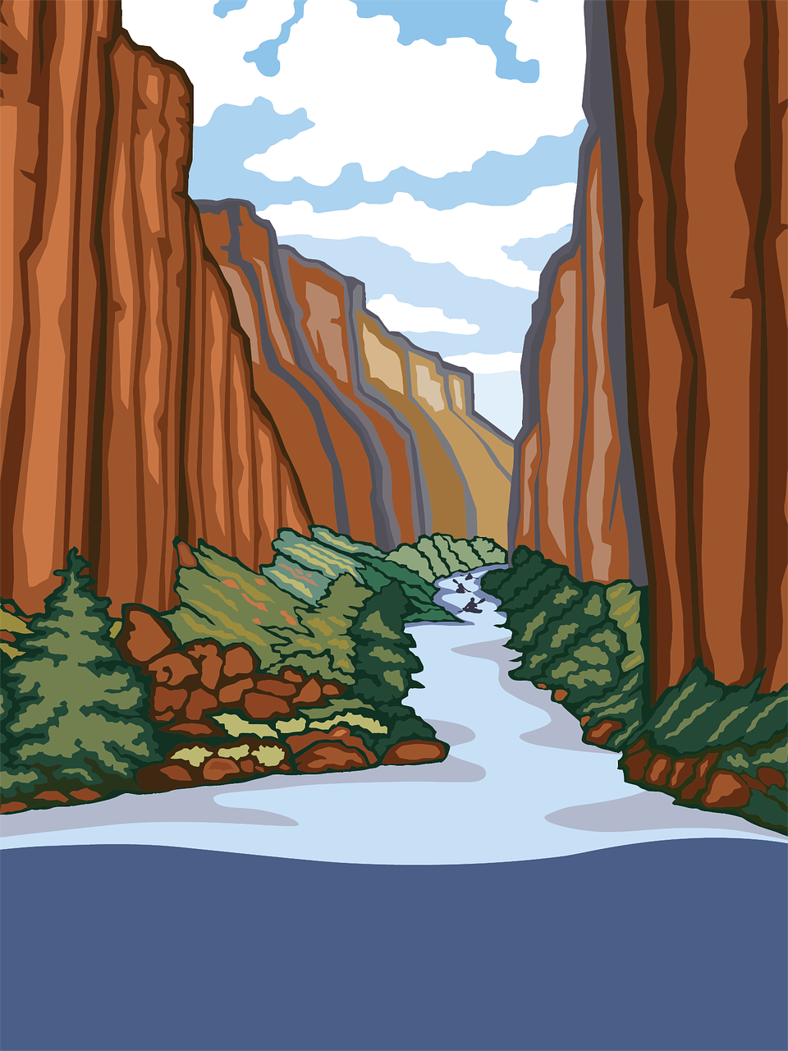
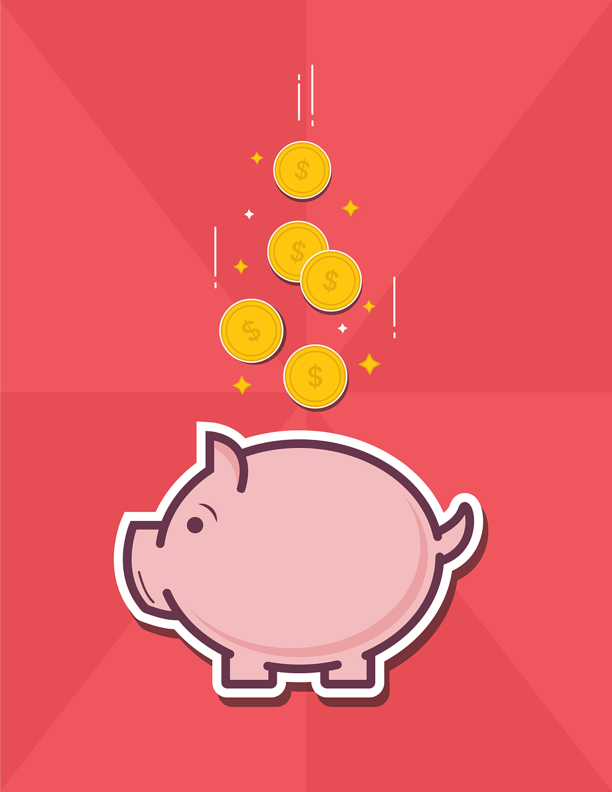
Follow up 4:

Écris des phrases.
Tu es Pierre. Écris six phrases.
écrire
 | I have | she has
1
2
3
4
5
6
1. J’ai un message.
2. Elle a un dessin.
3. Elle a un crayon.
4. J’ai un chat.
5. J’ai une affiche.
6. Elle a une chaise.
Notes:
Timing: 10 minutes (or 5 minutes for 3 sentences)
Aim: to practise written production of this week’s new language.
Procedure:
Tell pupils they need to write as if they are Pierre.
Click for written versions of the sentences.

Slide 6
Follow up 5
.
Parle avec un/une partenaire.
Exemple :
J’ai …
parler
…un chat.
a cat
 | Pierre (I have…) | Adèle (She has…)
1 | un chat | une chaise
2
1 | I have …………………
2
Note: in Round 1, the speaker is Pierre, so Pierre = I have, Adèle = she has.
Notes:
Timing: 5 minutes
Aim: to practise oral production of j’ai and il a, and oral comprehension of known vocabulary.
Procedure: 1. Model the task using the example. Click to demonstrate each stage.
2. Give out the handouts (they are found at the end of this PPT). 2. Pupil As start by saying either j’ai or il a.
3. Pupil Bs listen and finish their partner’s sentence correctly.
4. Pupil As complete the English sentence meanings appropriately.
5. Pupils swap roles.

Slide 7
Follow up 5: Les réponses pour A
Les réponses pour la personne A.
parler
1 | I have…………………..
2 | She has………………….
3 | She has………………….
4 | I have…………………..
5 | I have………………….
6 | She has………………….
a drawing
 | Pierre (I have…) | Adèle (She has…)
1 | …un dessin. | …une banane.
2 | …un bureau. | …un message.
3 | …un chat. | …un cheval.
4 | …une chaise. | …un crayon.
5 | …une idée. | …un dessin.
6 | …une moto. | …une affiche.
a message
a horse
a chair
an idea
a poster
Notes:
ANSWERS A

Slide 8
Follow up 5: Les réponses pour B
Les réponses pour la personne B.
parler
 | Adèle (I have…) | Pierre (He has…)
1 | …une chaise. | …un crayon.
2 | …une moto. | …un cheval.
3 | …un message. | …un chat.
4 | …une banane. | …une chambre.
5 | …une affiche. | …un bureau.
6 | …un dessin. | …une idée.
1 | I have…………………..
2 | I have………………….
3 | He has………………….
4 | He has…………………..
5 | He has………………….
6 | I have………………….
a chair
a motorbike
a cat
a bedroom
a desk
a drawing
Notes:
ANSWERS B

Slide 9
vocabulaire
Follow up Extra: Écris en anglaise : Can you get at least 15 points?
mots
 | aujourd’hui | lundi | c’est
 | vendredi | mercredi | jeudi
 | samedi | mardi | dimanche
 | j’ai | avoir | elle a
 | un crayon | quoi ? | il a
 | un chat | un message | un dessin
today
Monday
it is, this/that is
Friday
Wednesday
Thursday
x2
Saturday
Tuesday
Sunday
I have
to have, having
she has
a pencil
what?
he has
x1
a cat
a message
a drawing
Notes:
Timing: 5 minutes
Aim: to practise written comprehension of vocabulary from week 1, last week and this week.
Procedure: 1. Give pupils a blank grid. They fill in the English meanings of any of the words they know, trying to reach 15 points in total. 2. Remind pupils that adjectives can refer to male or female persons and they should note this in their translations. E.g. pleased (f), short (m).
Note: The most recently learnt and practised words are pink, words from the previous week are green and those from week 1 are blue, thus more points are awarded for them, to recognise that memories fade and more effort (heavy lifting!) is needed to retrieve them.
9

Slide 10
vocabulaire
Follow up Extra: Écris en français : Can you get at least 15 points?
mots
 | Thursday | Saturday | Wednesday
 | Friday | Sunday | Tuesday
 | it is | today | Monday
 | a message | a drawing | a pencil
 | she has | what? | a cat
 | to have, having | I have | he has
jeudi
samedi
mercredi
vendredi
dimanche
mardi
x2
c’est
aujourd’hui
lundi
un message
un dessin
un crayon
elle a
quoi
un chat
x1
avoir
j’ai
Il a
Notes:
Timing: 5 minutes
Aim: to practise written comprehension of vocabulary from week 1, last week and this week.
Procedure: 1. Give pupils a blank grid. They fill in the French meanings of any of the words they know, trying to reach 15 points in total. 2. Remind pupils that adjectives can refer to male or female persons and they should note this in their translations. E.g. pleased (f), short (m).
Note: The most recently learnt and practised words are pink, words from the previous week are green and those from week 1 are blue, thus more points are awarded for them, to recognise that memories fade and more effort (heavy lifting!) is needed to retrieve them.
10

Slide 11
Follow up 5: Handout A
Now your turn to listen to your partner. Do you hear j’ai or il a ? Say the correct noun.
Start each sentence in French. Write the English meaning of what your partner says.
parler
1 | I have…………………..
2 | She has………………….
3 | She has………………….
4 | I have…………………..
5 | I have………………….
6 | She has………………….
 | Adèle (J’ai…) | Pierre (Il a…)
1 | …une chaise. | …un crayon.
2 | …une moto. | …un cheval.
3 | …un message. | …un chat.
4 | …une banane. | …une chambre.
5 | …une affiche. | …un bureau.
6 | …un dessin. | …une idée.
Note: in Round 1, the speaker is Pierre, so Pierre = I have, Adèle = she has.
Notes:
Handout for person A

Slide 12
Follow up 5: Handout B
Listen to your partner. Do you hear j’ai or il a ? Say the correct noun.
parler
 | Pierre (J’ai…) | Adèle (Elle a…)
1 | …un dessin. | …une banane.
2 | …un bureau. | …un message.
3 | …un chat. | …un cheval.
4 | …une chaise. | …un crayon.
5 | …une idée. | …un dessin.
6 | …une moto. | …une affiche.
Start each sentence in French. Write the English meaning of what your partner says.
1 | I have…………………..
2 | I have………………….
3 | He has………………….
4 | He has…………………..
5 | He has………………….
6 | I have………………….
Note: in Round 2, the speaker is Adèle, so Adèle = I have, Pierre = he has.
Notes:
Handout for person B

Slide 13
vocabulaire
Follow up Extra: Écris en anglais : Can you get at least 15 points?
mots
 | aujourd’hui | lundi | c’est
 | vendredi | mercredi | jeudi
 | samedi | mardi | dimanche
 | j’ai | avoir | elle a
 | un crayon | quoi ? | il a
 | un chat | un message | un dessin
x2
x1
Notes:
Handout 1
13

Slide 14
vocabulaire
Follow up Extra: Écris en français : Can you get at least 15 points?
mots
 | Thursday | Saturday | Wednesday
 | Friday | Sunday | Tuesday
 | it is | today | Monday
 | a message | a drawing | a pencil
 | she has | what? | a cat
 | to have, having | I have | he has
x2
x1
Notes:
Handout 2
14

