Slide 1
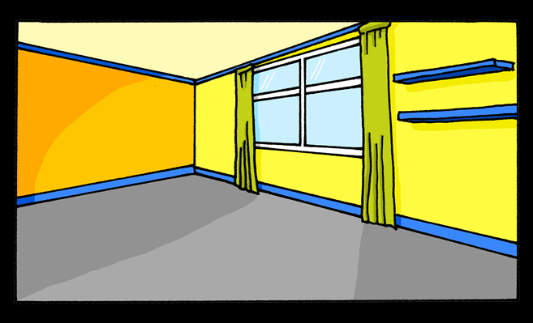
Saying what I and others have
C’est une chambre.
jaune
Gender & indefinite articles un / une
Liaison : c’est un / une
Term 1 Week 8
Notes:
Artwork by Steve Clarke. Pronoun pictures from NCELP (www.ncelp.org). All additional pictures selected from Pixabay and are
available under a Creative Commons license, no attribution required.
The AUDIO version of the lesson material includes additional audio for the new language
presented (phonics, vocabulary) and audio for the instructions on the slide.
In addition, it includes VIDEO clips of the phonics and the phonics’ source words. Pupils can be
encouraged to look at the shape of the mouth/lips on slides where these appear, and try to copy
it/them.
Phonics: [un] un [3] lundi [1091] jungle [4891] brun [>5000] commun [780]
[un] vs. [une]
liaison - c'est un/une
Frequency of new words:
Vocabulary: affiche [2886] bureau [273] chaise [3419] chambre [633] idée [239] lit [1837] un [3] une [3]
(revisit moto, cheval)
Revisit 1: jeune [152] joli [2398] drôle [2166] difficile [296]
Londsale, D., & Le Bras, Y. (2009). A Frequency Dictionary of French: Core vocabulary for learners London: Routledge.
The frequency rankings for words that occur in this PowerPoint which have been previously introduced in these resources are given
in the SOW and in the resources that first introduced and formally re-visited those words.
For any other words that occur incidentally in this PowerPoint, frequency rankings will be provided in the notes field wherever
possible.
1

Slide 2
[un]
un
prononcer
[un] is nasal before a consonant and at the end of words.
[a/an, one]
Notes:
Timing: 2 minutes
Aim: to present SSC [un].
Procedure:
Click to bring up the SSC [un]. Repeat the SSC [un] with the class.
Click to bring up the English translation and picture.
Pupils to practise saying the SSC several times.
Click to bring up the callout about nasal vowels.

Slide 3
[un]
un
prononcer
lundi
jungle
Mon
brun
commun
[common]
[a/an, one]
Notes:
Timing: 2 minutes
Aim: to practise the pronunciation of nasal [un] in four cluster words.
Procedure:
Click to bring up the SSC [un]. Repeat the SSC [un] with the class.
Click to bring up the English translation and picture.
Click to bring up each cluster word in turn: lundi, jungle, brun, commun.
The pictures appear after the words to give a further opportunity for word repetition.

Slide 4
Gender in French
This is grammatical, not biological gender! A table (une table) is not female, it is a feminine noun.
Indefinite articles: a/an
In French, things, as well as people and animals, are either masculine or feminine. We say that they have gender.
[un] is oral before a vowel. Practise the different sounds: un – une – un - une
To say a (or an) in French use un before a masculine noun and une before a feminine noun.
Many feminine nouns end in –e but you have to learn the gender of each noun when you learn the word.
Masculine
Feminine
un
__ univers
une
a universe
___ banane
a banane
un
__ cheval
a table
a horse
une
___ table
un
a bed
une
an idea
__ lit
___ idée
Notes:
Timing: 3 minutes
Aim: to introduce grammatical gender and singular indefinite articles (un/une).
Procedure:
Click to present the new information about gender and indefinite articles in French.
Click to bring up three examples of masculine nouns with their indefinite article ‘un’.
Click to bring up three examples of feminine nouns with their indefinite article ‘une’.
Click to provide one pattern (feminine nouns often end in –e) but reinforce the fact that there are exceptions and in French you need to learn the gender of each noun when you learn the word.
These example nouns are all taken from the SSC source/cluster words from weeks 1-8 except table [866] and idée [239] and lit [1837]. Table is a cognate, idée and lit are part of the new vocabulary for this week.
Vocabulary: table [1019]
Londsale, D., & Le Bras, Y. (2009). A Frequency Dictionary of French: Core vocabulary for learners London: Routledge.

Slide 5
écouter
.
Écoute. C’est un ou une ?
animaux. C’est [ien] ou [(a)in]?
Écris de 1 à 8 ‘un’ ou ‘une’. Puis, complète le mot.
 | un / une | français | anglais
 | un | b u r e a u | desk
 | un | c h e v a l | horse
 | une | c h a i s e | chair
 | un | c h a m b r e | bedroom
 | une | i d é e | idea
 | une | l i t | bed
 | un | m o t o | motorbike
 | un | a f f i c h e | poster
1
___
_
2
___
_
3
___
_
_
4
___
_
_
5
___
_
6
___
_
7
___
_
_
8
___
_
_
Notes:
Timing: 6 minutes
Aim: to practise aural recognition of singular indefinite articles un and une, and several familiar SSC (a, u, o, i, e); to introduce the new vocabulary for this week.
NB: Note that pupils have not yet been introduced to the SSC [ch]. However, they have practised the word ‘cheval’ and it is provided here, before chaise and chambre to help pupils connect the sound and spelling of ‘ch’.
Procedure:
Click to play audio.
Pupils write the article un or une.
Repeat for items 2-8.
Click to check answers.
Click to listen again.
This time pupils write the words (or just the missing letters).
Click to check answers.
Transcript:
un bureau
un cheval
une chaise
une chambre
une idée
un lit
une moto
une affiche
5

Slide 6
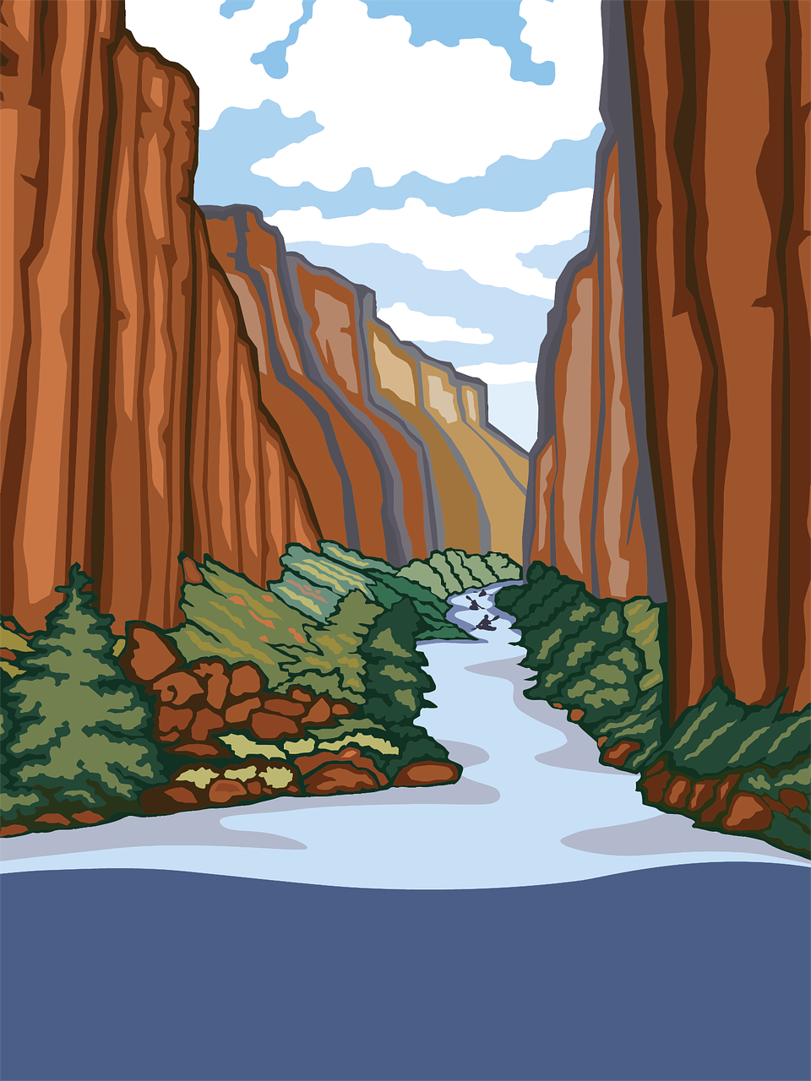
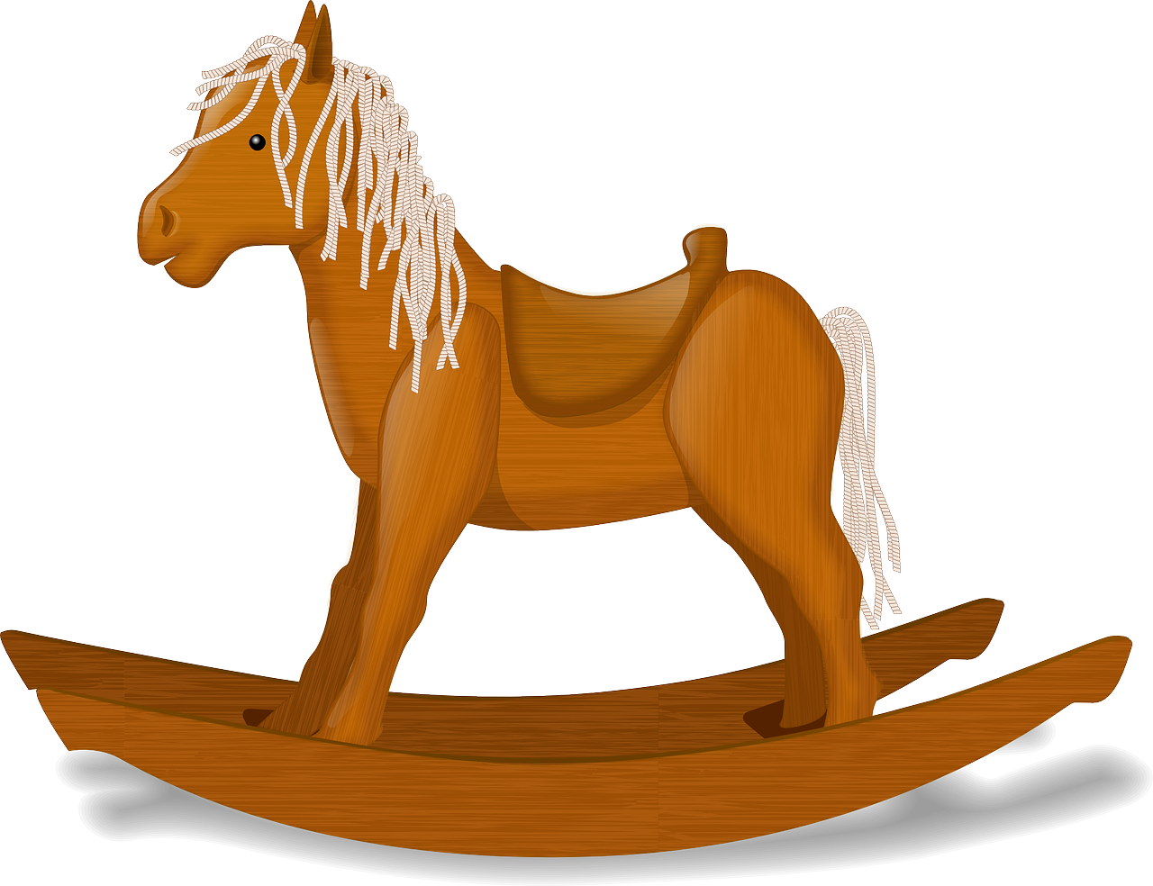
vocabulaire
.
Écoute et répète.
mots
une idée
une moto
une chaise
une chambre
un lit
un bureau
une affiche
un cheval
a bed
an idea
a motobike
a bedroom
a poster
a desk
a horse
a chair
Notes:
Timing: 4 minutes
Aim: to present and practise written comprehension and read aloud of the new vocabulary for this week.
Procedure: 1. Click for an English prompt.
2. Elicit the French article from pupils (un or une) and say the French word for pupils to repeat. In some cases, pupils will be able to read the new word aloud themselves. Note that they haven’t yet learnt enough SSC to be able to be confident about pronouncing all of these words from the written form. However, they should be able to do cheval, moto, lit, idée. They may need some support with the other words, even though they have just heard them in the previous activity. 3. Continue until all 8 items have been seen and heard.
6

Slide 7
Liaison
As you know c’est means it is or it’s.
C’est drôle !
It’s funny!
The ‘t’ is a Silent Final Consonant.
But…
C’est un bureau.
It’s a desk.
Because the ‘t’ is followed by a vowel you pronounce it.
This is called liaison.
Notes:
Timing: 2 minutes
Aim: to introduce t-liaison with c’est before a vowel.
Procedure:
Click to present the new information about liaison.
2. Elicit the English for the French examples.

Slide 8
vocabulaire
Écoute et répète.
mots
C’est samedi.
It’s Saturday.
Sat
Notes:
Timing: 6 minutes (nine slides)
Aim: to practise SFC ‘t’ before a consonant and t-liaison before a vowel (the indefinite article un/une).
Procedure:
Click to bring up the sentence.
Click the audio button to hear the sentence.
Pupils repeat.
Elicit English meaning and click to reveal English and picture.
Continue with the next seven slides.
Transcript: C’est samedi.
8

Slide 9
vocabulaire
Écoute et répète.
mots
C’est un lit.
It’s a bed.
Notes:
[2/9]
Transcript:
C’est un lit.
9

Slide 10
vocabulaire
Écoute et répète.
mots
C’est difficile.
It’s difficult.
Notes:
[3/9]
Transcript: C’est difficile.
10

Slide 11
vocabulaire
Écoute et répète.
mots
C’est une affiche.
It’s a poster.
Notes:
[3/9]
Transcript:
C’est une affiche.
11

Slide 12
vocabulaire
Écoute et répète.
mots
C’est une chambre.
It’s a bedroom.
Notes:
[5/9]
Transcript:
C’est une chambre.
12

Slide 13
vocabulaire
Écoute et répète.
mots
C’est un bureau.
It’s a desk.
Notes:
[6/9]
Transcript:
C’est un bureau.
13

Slide 14
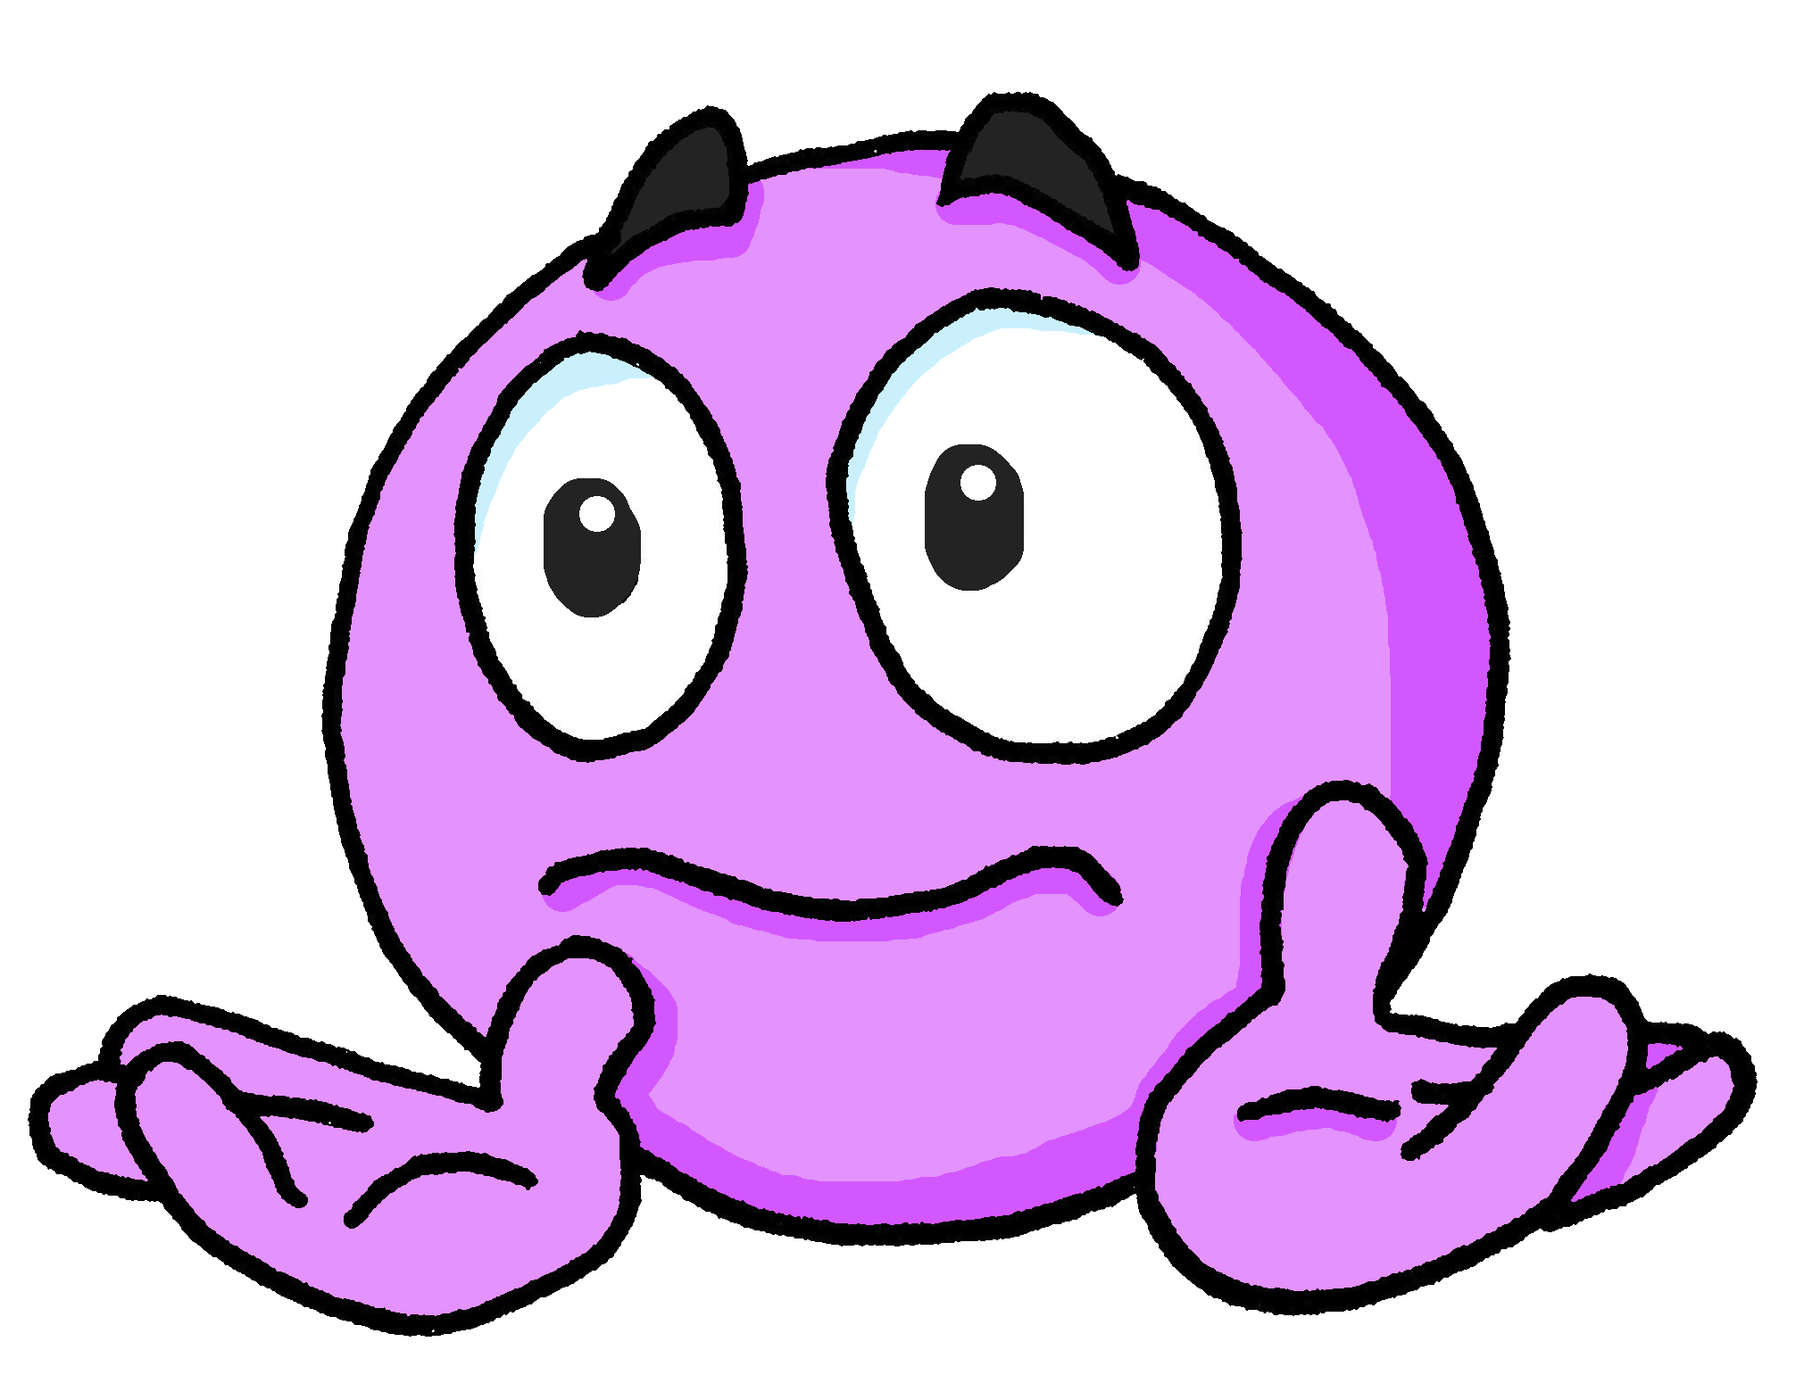
vocabulaire
Écoute et répète.
mots
C’est différent.
It’s different.
Notes:
[7/9]
Transcript: C’est différent.
14

Slide 15
vocabulaire
Écoute et répète.
mots
C’est une chaise.
It’s a chair.
Notes:
[8/9]
Transcript:
C’est une chaise.
15

Slide 16
vocabulaire
Écoute et répète.
mots
C’est une idée.
It’s an idea.
Notes:
[9/9]
Transcript:
C’est une idée.
16

Slide 17
écouter
.
Écoute.
What is Pierre saying about these things?
Write 1 – 8 and the correct end of the sentence.
C’est…
Tue
1
[Tuesday]
1
[funny]
2
C’est…
2
C’est…
3
[different]
3
4
C’est…
4
[pretty]
[indépendant]
5
C’est…
5
[young]
6
C’est…
6
[difficult]
Notes:
Timing: 5 minutes
Aim: to detect the presence or absence of a t-liaison with c’est, and connect this with meaning.
Procedure:
Students write 1-6.
Click on a button to hear a form of ‘c’est’, followed by a beep.
Based on the presence or absence of a liaison, students decide what comes next. Remind them it is the presence or absence of a -t- sound that will give them this information – they won’t be able to tell the answer from the picture!
Click to bring up a 2nd set of audio buttons to check answers.
Click to reveal answers.
Transcript:
C’est [mardi].
C’est [une chambre].
C’est [différent].
C’est [indépendant].
C’est [une affiche].
C’est [un lit].
17

Slide 18
Au revoir !
jaune
Notes:
18

