Slide 1
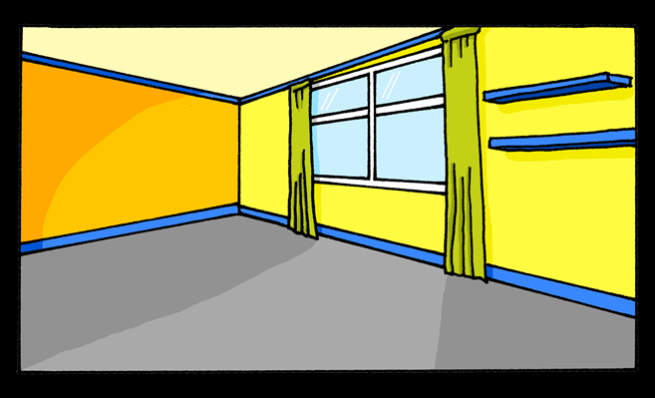
Saying what I and others have
C’est une chambre.
jaune
Follow ups 1-5
Notes:
Artwork by Steve Clarke. Pronoun pictures from NCELP (www.ncelp.org). All additional pictures selected from Pixabay and are available under a Creative Commons license, no attribution required.
Phonics: [un] un [3] lundi [1091] jungle [4891] brun [>5000] commun [780]
[un] vs. [une]
liaison - c'est un/une
Frequency of new words:
Vocabulary: affiche [2886] bureau [273] chaise [3419] chambre [633] idée [239] lit [1837] un [3] une [3]
(revisit moto, cheval)
Revisit 1: jeune [152] joli [2398] drôle [2166] difficile [296]
Londsale, D., & Le Bras, Y. (2009). A Frequency Dictionary of French: Core vocabulary for learners London: Routledge.
The frequency rankings for words that occur in this PowerPoint which have been previously introduced in these resources are given in the SOW and in the resources that first introduced and formally re-visited those words.
For any other words that occur incidentally in this PowerPoint, frequency rankings will be provided in the notes field wherever possible.

Slide 2
Follow up 1:
.
Prononce les mots.
[un]
[une]
parler
60
lagune
prune
brun
dune
S
jungle
quelqu’un
lacune
un
0
DÉBUT
Notes:
Timing: 5 minutes
Aim: to practise applying knowledge of SSC [un] and [une] to unknown words.
Procedure: 1. Start the timer. Pupil A tries to read aloud all of the words differentiating between [un] and [une], within the 60 seconds allowed.
2. Pupil B listens. If Pupil A [un] instead of [une] or vice versa by mistake, Pupil B can direct him/her to start again from the beginning. 3. They swap roles and repeat the task.
Note: ensure pupils know they don’t need to rush. They have 10 seconds per word. If preferred, remove the timer altogether.
Frequency of unknown words and cognates:
lagune [>5000] prune [>5000] brun [>5000] dune [>5000] jungle [4891] quelqu’un [772] lacune [4268] un [3]
Londsale, D., & Le Bras, Y. (2009). A Frequency Dictionary of French: Core vocabulary for learners London: Routledge.

Slide 3
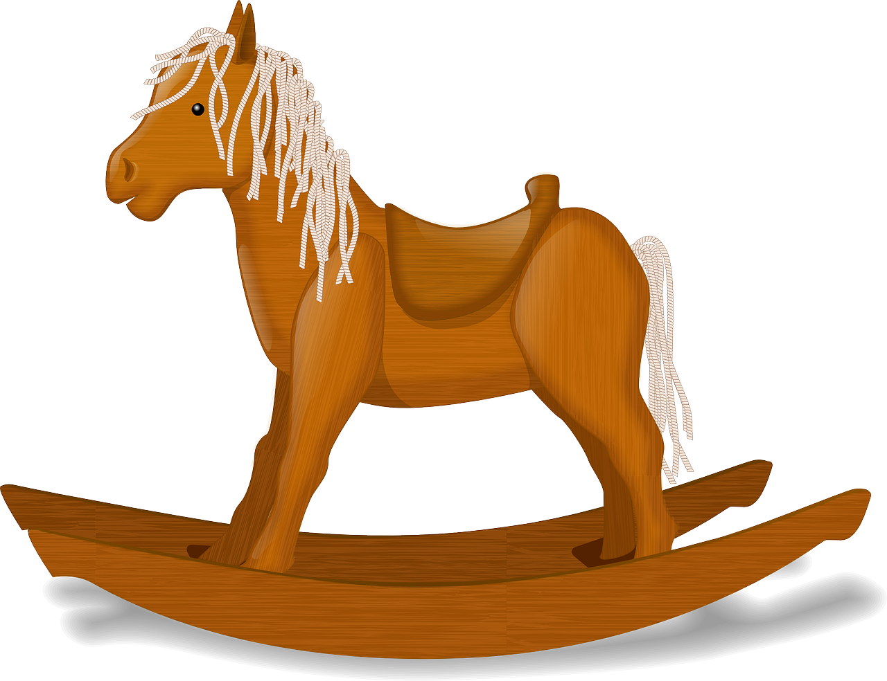
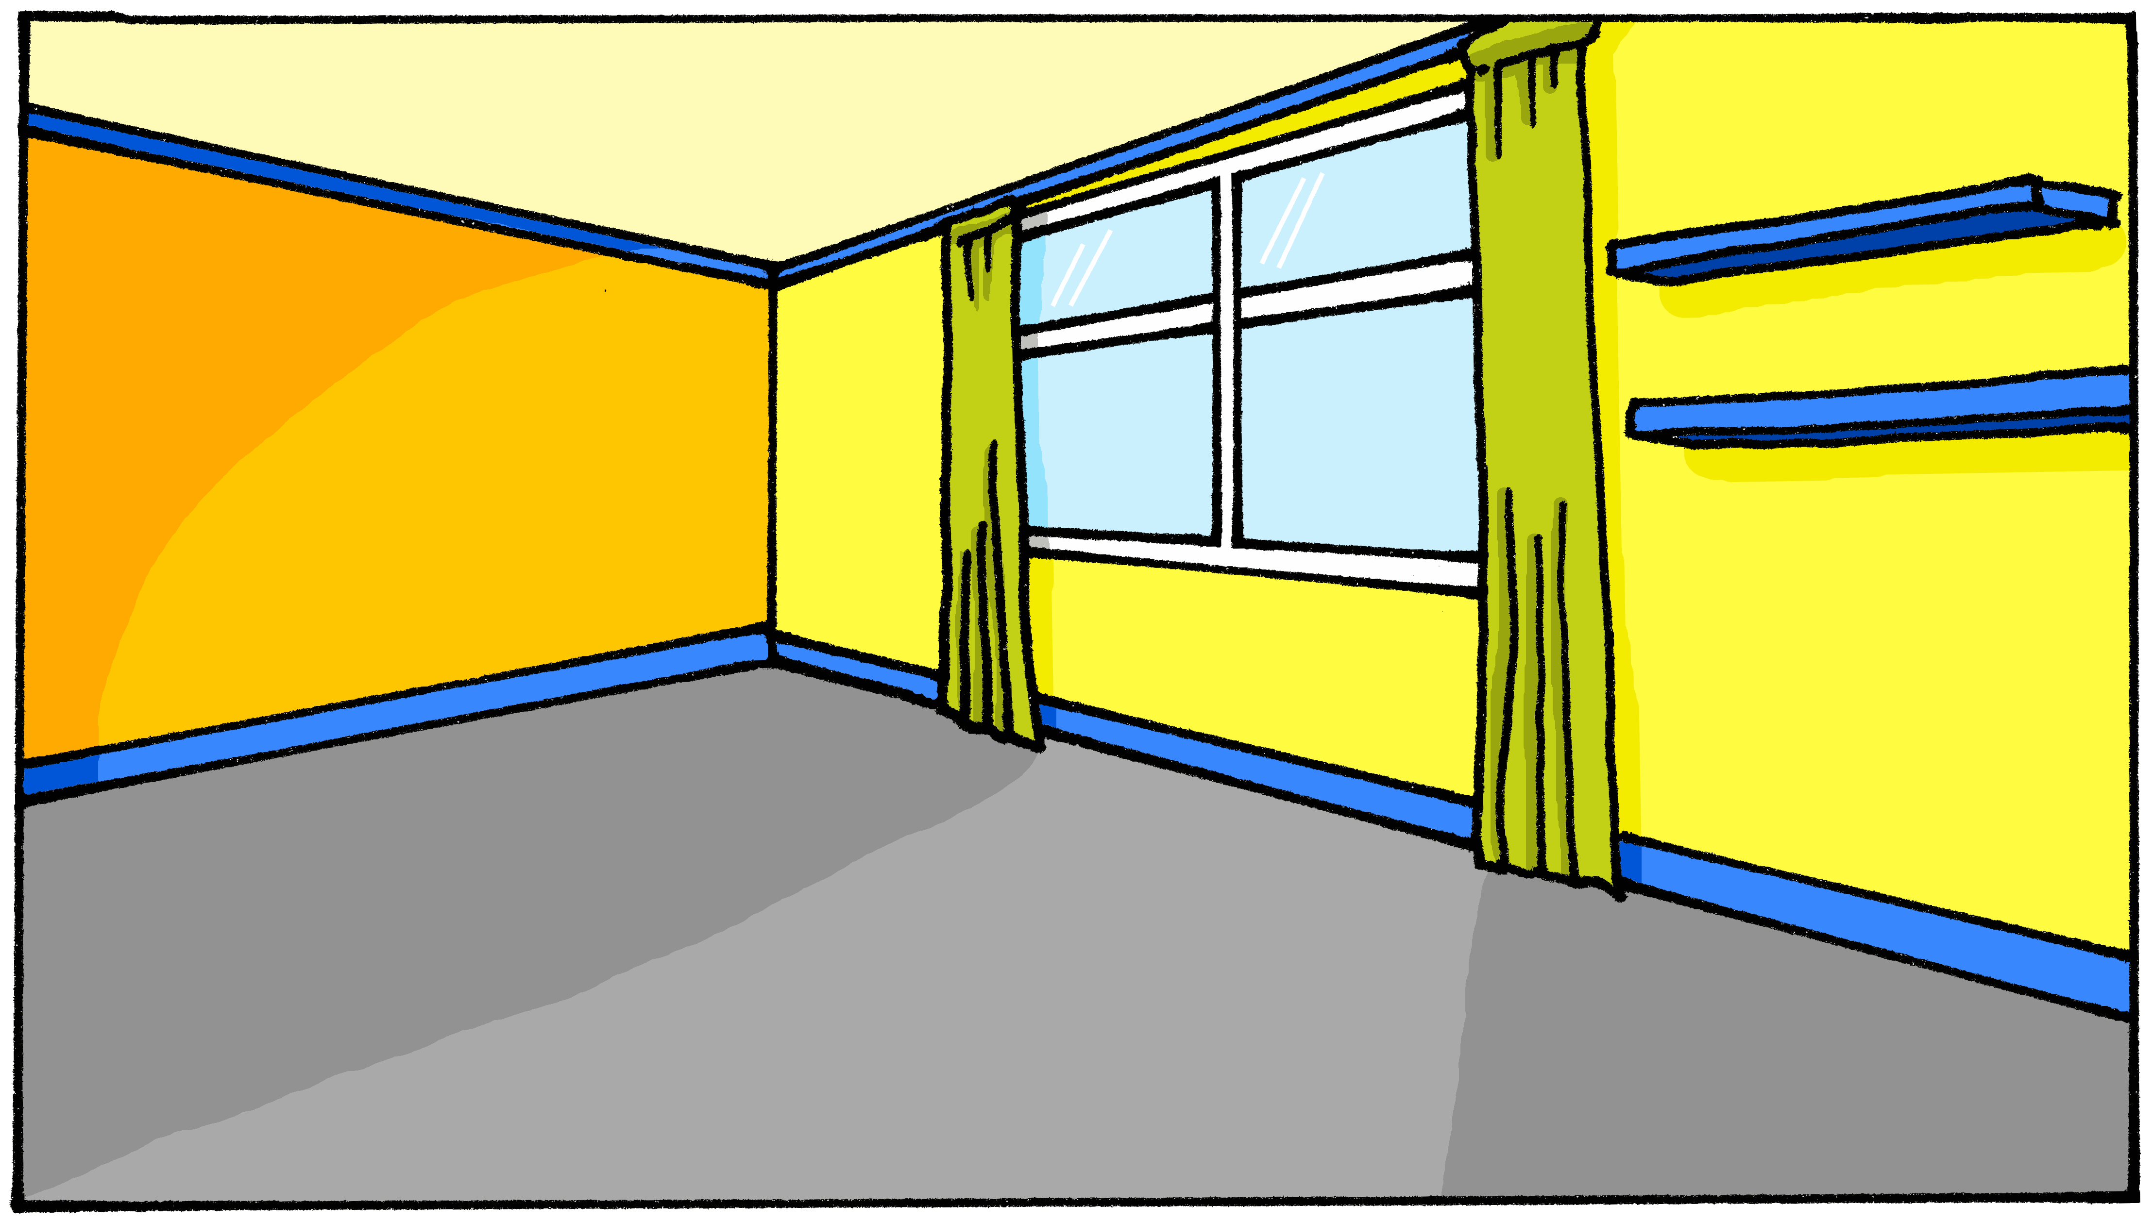
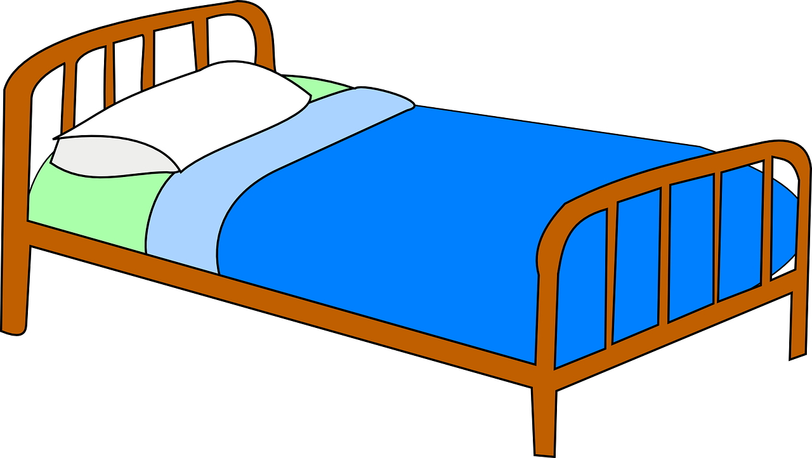
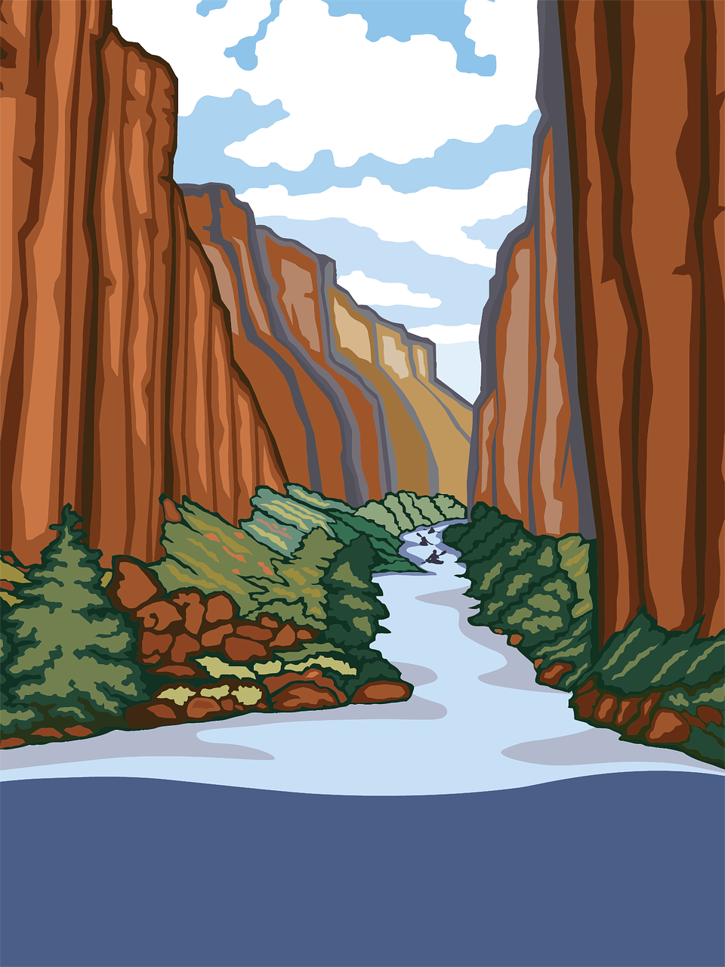
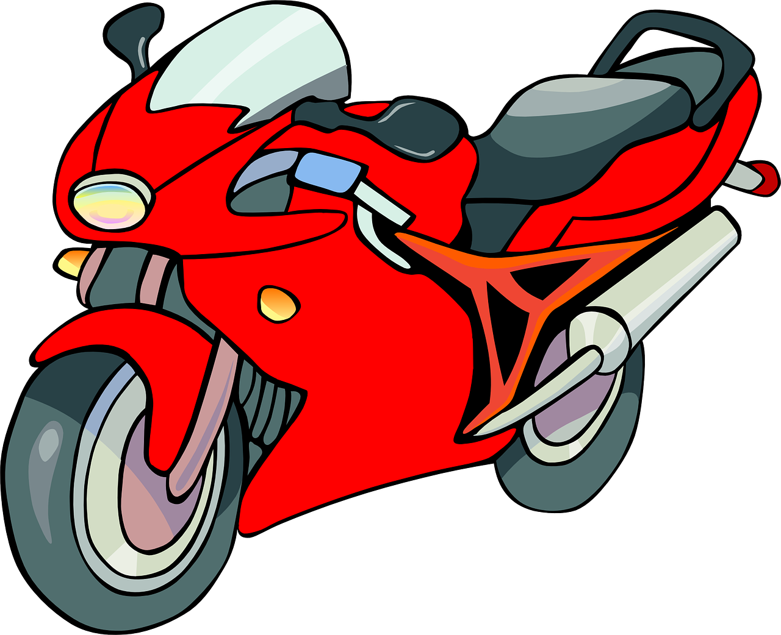
Follow up 2:
.
C’est un ou une ?
mots
vocabulaire
[un]
[une]
___ bureau [a desk]
___ idée [an idea]
___ cheval [a horse]
___ affiche [a poster]
___ moto [a motorbike]
___ chambre [a bedroom]
___ chaise [a chair]
___ lit [a bed]
Notes:
Timing: 5 minutes
Aim: to practise aural production of and distinction between un and une; to have a further opportunity to encounter the new vocabulary for this week in sound and writing, and with English meanings.
Procedure:
Click for each word to appear with audio (without article).
Pupils say ‘un’ or ‘une’, depending on their knowledge of the noun’s grammatical gender.
Click again for it to disappear into the corresponding pacperson’s mouth.
Order of items:
un lit un cheval une affiche une idée une chambre un bureau une moto une chaise

Slide 4
Follow up 3:
Parle avec un/une partenaire.
If you don’t hear –t say the option that starts with a consonant.
If you hear –t say the option that starts with a vowel.
Exemple :
Don’t pronounce the –t!
Pronounce the –t when it’s in bold!
parler
un lit.
difficile.
C’est…
C’est…
Complete the sentence in English.
1 | C’est… (It is …………………).
2 | C’est… (It is …………………).
1 | un lit | dimanche
2 | difficile | important
a bed
difficult
Complete the sentence in English.
Notes:
Timing: 5 minutes
Aim: to practise oral production of t-liaison (or silent final consonant –t) with c’est before vowels and consonants.
Procedure: 1. Model the task using the example. Click to demonstrate each state.
2. Give out the handouts (at the end of this PPT). 2. Pupil As start by saying either C’est with SFC or C’est + t-liaison.
3. Pupil Bs listen and finish their partner’s sentence correctly.
4. Pupil As complete the English sentence meanings appropriately.
5. Pupils swap roles.

Slide 5
Follow up 3: Round 1 [Réponses]
Personne A:
Personne B:
parler
1 | C’est… (It is …………………).
2 | C’est… (It is …………………).
3 | C’est… (It is …………………).
4 | C’est… (It is …………………).
5 | C’est… (It is …………………).
6 | C’est… (It is …………………).
1 | …une chaise. | …mercredi.
2 | …différent. | aujourd’hui.
3 | …drôle. | …un cheval.
4 | …une affiche. | …joli.
5 | …une chambre. | …difficile.
6 | …important. | …lundi.
a chair
different
funny
a poster
a bedroom
Monday
Notes:
ANSWERS Round 1

Slide 6
Follow up 3: Round 2 [Réponses]
Personne B:
Personne A:
parler
1 | C’est… (It is …………………).
2 | C’est… (It is …………………).
3 | C’est… (It is …………………).
4 | C’est… (It is …………………).
5 | C’est… (It is …………………).
6 | C’est… (It is …………………).
1 | …difficile. | …une affiche.
2 | …un bureau. | sérieux.
3 | …une chaise. | …courageux.
4 | …vendredi. | …un lit.
5 | …dimanche. | …une idée.
6 | …curieux. | …un cheval.
difficult
a desk
brave
Friday
an idea
a horse
Notes:
ANSWERS Round 2

Slide 7
Follow up 4:

Écris des réponses.
C’est un cheval ?
C’est une chambre ?
écrire
1 _____________________________
4 _____________________________
Non, c’est une moto.
Oui, c’est une chambre.
C’est un lit ?
C’est vendredi ?
2 _____________________________
5 _____________________________
Non, c’est une chaise.
Non, c’est jeudi.
THU
C’est un lit ?
C’est une idée ?
3 _____________________________
6 _____________________________
Non, c’est un bureau.
Oui, c’est une idée.
Notes:
Timing: 10 minutes (or 5 minutes for 3 sentences)
Aim: to practise written production of this week’s new language.
Procedure:
1. Tell pupils they need to answer the yes/no questions in full sentences in French, and according to the pictures. 2. Elicit the meaning of the first question: Is it a horse? 3. Ensure pupils are clear how to answer: No, it’s a motorbike 4. Elicit the French for ‘no’, ‘it is’, ‘a motorbike’. 5. Given pupils a minute to write their sentence. 6. Reveal the answer. 7. Continue for items 2 – 6.

Slide 8
vocabulaire
Follow up 5 - Écris en anglais : Can you get at least 15 points?
mots
 | jeune | drôle | jolie
 | difficile | joli | prudente
 | oui | une moto | un univers
 | non | il | elle
 | une chambre | une chaise | un cheval
 | une idée | un | une
 | un bureau | une affiche | un lit
young (m/f)
funny (m/f)
pretty (f)
x3
difficult (m/f)
pretty (m)
careful (f)
yes
a motorbike (f)
a universe (m)
x2
no
he
she
a bedroom (f)
a chair (f)
a horse (m)
an idea (m)
a/an (m)
a/an (f)
x1
a desk (m)
a poster (f)
a bed (m)
Notes:
Timing: 5 minutes
Aim: to practise written comprehension of vocabulary from this week and previous weeks.
Procedure: 1. Give pupils a blank grid. They fill in the English meanings of any of the words they know, trying to reach 15 points in total. 2. Remind pupils that adjectives can refer to male or female persons and they should note this in their translations. E.g. pleased (f), short (m).
Note: The most recently learnt and practised words are pink, words from the previous week are green and those from week 1 are blue, thus more points are awarded for them, to recognise that memories fade and more effort (heavy lifting!) is needed to retrieve them.
8

Slide 9
vocabulaire
Follow up 5 - Écris en français : Can you get at least 15 points?
mots
 | pretty (m) | careful (f) | difficult (m/f)
 | funny (m/f) | young (m/f) | pretty (f)
 | no | a universe (m) | he
 | she | yes | a motorbike (f)
 | a bed (m) | an idea | a/an (m)
 | a horse (m) | a poster (f) | a desk
 | a chair (f) | a bedroom (f) | a/an (f)
joli
prudente
difficile
x3
drôle
jeune
jolie
non
un univers
il
x2
elle
oui
une moto
un lit
une ideé
un
un cheval
une affiche
un bureau
x1
une chaise
une chambre
une
Notes:
Timing: 5 minutes
Aim: to practise written comprehension of vocabulary from this week and previous weeks.
Procedure: 1. Give pupils a blank grid. They fill in the English meanings of any of the words they know, trying to reach 15 points in total. 2. Remind pupils that adjectives can refer to male or female persons and they should note this in their translations. E.g. pleased (f), short (m).
Note: The most recently learnt and practised words are pink, words from the previous week are green and those from week 1 are blue, thus more points are awarded for them, to recognise that memories fade and more effort (heavy lifting!) is needed to retrieve them.
9

Slide 10
Follow up 3: Handout A
Now your turn to listen to your partner. Do you hear –t? If so, choose and say the sentence ending which starts with a vowel.
Start each sentence. Pronounce the –t when it’s bold, otherwise for a Silent Final Consonant.
parler
1 | C’est… (It is …………………).
2 | C’est… (It is …………………).
3 | C’est… (It is …………………).
4 | C’est… (It is …………………).
5 | C’est… (It is …………………).
6 | C’est… (It is …………………).
1 | …difficile. | …une affiche.
2 | …un bureau. | sérieux.
3 | …une chaise. | …courageux.
4 | …vendredi. | …un lit.
5 | …dimanche. | …une idée.
6 | …curieux. | …un cheval.
Notes:
HANDOUT

Slide 11
Follow up 3: Handout B
Now you start each sentence. Pronounce the –t when it’s bold, otherwise for a Silent Final Consonant.
Listen to your partner. Do you hear –t? If so, choose and say the sentence ending which starts with a vowel.
parler
1 | …une chaise. | …mercredi.
2 | …différent. | aujourd’hui.
3 | …drôle. | …un cheval.
4 | …une affiche. | …joli.
5 | …une chambre. | …difficile.
6 | …important. | …lundi.
1 | C’est… (It is …………………).
2 | C’est… (It is …………………).
3 | C’est… (It is …………………).
4 | C’est… (It is …………………).
5 | C’est… (It is …………………).
6 | C’est… (It is …………………).
Notes:
HANDOUT

Slide 12
vocabulaire
Écris en anglais : Can you get at least 15 points?
mots
 | jeune | drôle | jolie
 | difficile | joli | prudente
 | oui | une moto | un univers
 | non | il | elle
 | une chambre | une chaise | un cheval
 | une idée | un | une
 | un bureau | une affiche | un lit
x3
x2
x1
Notes:
FOLLOW UP 5 HANDOUT
12

Slide 13
vocabulaire
Follow up 5 - Écris en français : Can you get at least 15 points?
mots
 | pretty (m) | careful (f) | difficult (m/f)
 | funny (m/f) | young (m/f) | pretty (f)
 | no | a universe (m) | he
 | she | yes | a motorbike (f)
 | a bed (m) | an idea | a/an (m)
 | a horse (m) | a poster (f) | a desk
 | a chair (f) | a bedroom (f) | a/an (f)
x3
x2
x1
Notes:
Timing: 5 minutes
Aim: to practise written comprehension of vocabulary from this week and previous weeks.
Procedure: 1. Give pupils a blank grid. They fill in the English meanings of any of the words they know, trying to reach 15 points in total. 2. Remind pupils that adjectives can refer to male or female persons and they should note this in their translations. E.g. pleased (f), short (m).
Note: The most recently learnt and practised words are pink, words from the previous week are green and those from week 1 are blue, thus more points are awarded for them, to recognise that memories fade and more effort (heavy lifting!) is needed to retrieve them.
13

