Slide 1
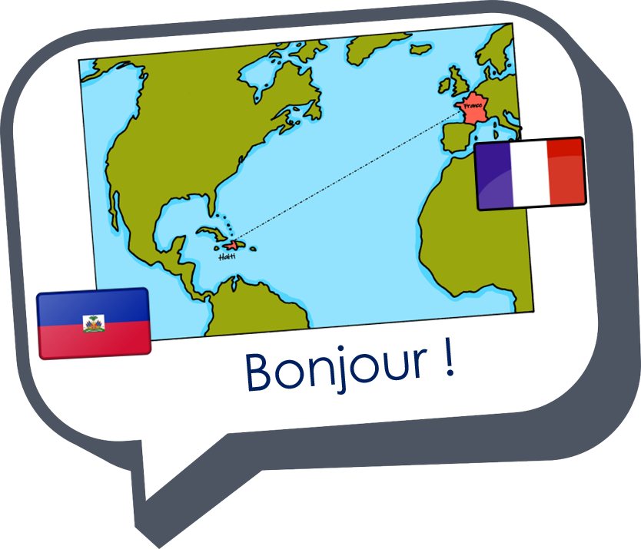
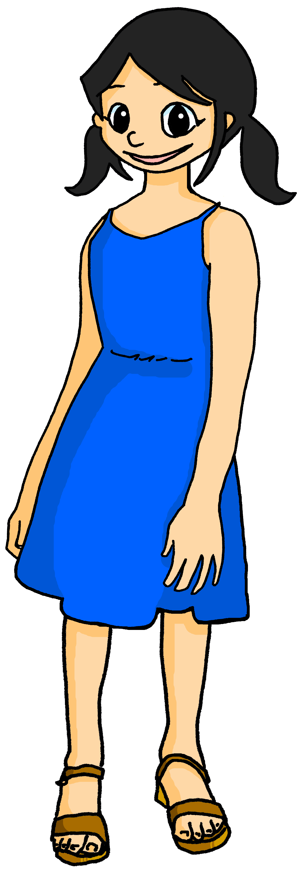
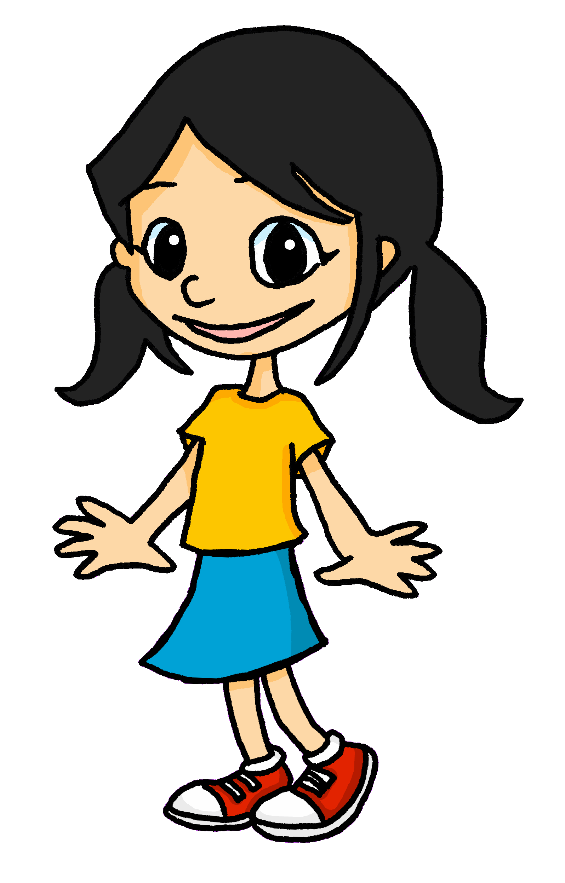
Describing me and others
jaune
Review of « Être » : je suis, tu es, il/elle est
Adjectival agreement (-eux, -euse)
Closed and open [eu]
Notes:
Artwork by Steve Clarke. Pronoun pictures from NCELP (www.ncelp.org). All additional pictures selected from Pixabay and are
available under a Creative Commons license, no attribution required.
The AUDIO version of the lesson material includes additional audio for the new language
presented (phonics, vocabulary) and audio for the instructions on the slide.
In addition, it includes VIDEO clips of the phonics and the phonics’ source words. Pupils can be
encouraged to look at the shape of the mouth/lips on slides where these appear, and try to copy
it/them.
Phonics: closed and open [eu], review of SFC with –t, -s, -d, -x and introduction to C-a-R-e-F-u-L, consonants that are pronounced.
Frequency of new words:
Phonics: peur [755] jeune [152] neuf [787] acteur [1552] seul [102]
Vocabulary: sérieux [412] heureux [764] curieux [2424] courageux [2198] semaine [245] and revisit days of the week
Londsale, D., & Le Bras, Y. (2009). A Frequency Dictionary of French: Core vocabulary for learners London: Routledge.
The frequency rankings for words that occur in this PowerPoint which have been previously introduced in these resources are given
in the SOW and in the resources that first introduced and formally re-visited those words.
For any other words that occur incidentally in this PowerPoint, frequency rankings will be provided in the notes field wherever
possible.
1

Slide 2
closed [eu]
open [eu]
prononcer
un peu
peur
It sounds like the ‘ur’ in ‘hurt’.
[a bit]
[fear]
This is a closed vowel. When you say this sound, your tongue is near the top of your mouth.
This is an open vowel. When you say this sound, your tongue is near the bottom of your mouth.
Notes:
A little audio still to embed here.
Timing: 2 minutes
Aim: to revisit closed [eu] and introduce open [eu].
Procedure:
Click to bring up the closed [eu]. Repeat the SSC [eu] with the class.
Click to bring up the phrase ‘un peu’ (with gesture, if using).
Click to bring up the English translation and picture.
Pupils to practise saying the phrase several times.
Click to bring up the callout about closed vowel tongue position.
Click to bring up the open [eu]. Repeat the SSC with the class.
Click to bring up the word ‘peur’ (with gesture, if using).
Click to bring up the English translation and picture, and the callout hint about ‘hurt’.
Say this SSC several times with the class.
Click to bring up the call out about open SSC [eu].
Practise alternating between ‘peu’ and ‘peur’ several times.

Slide 3
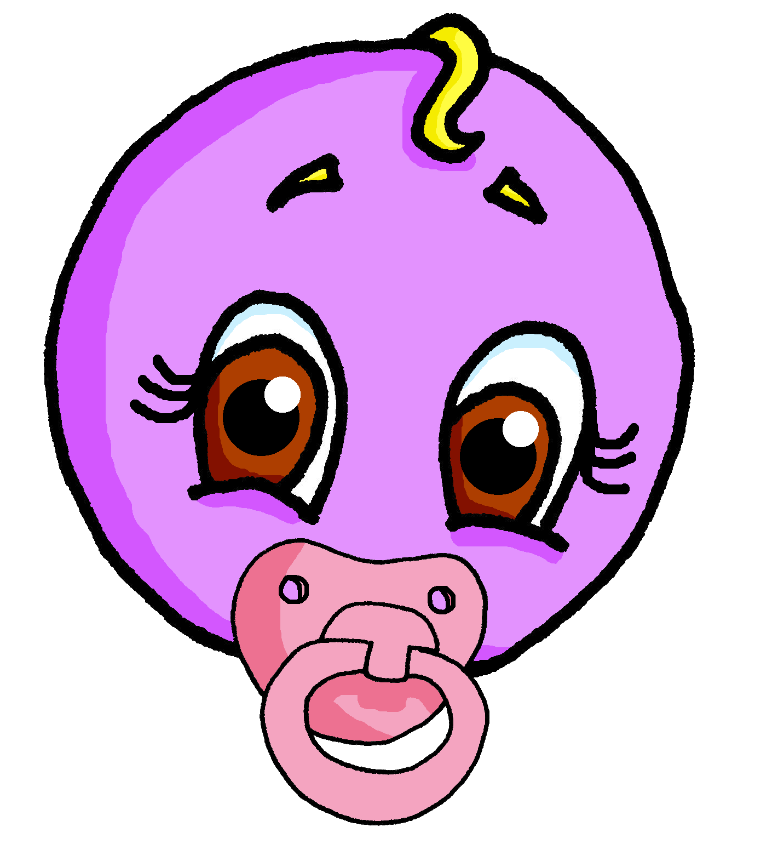
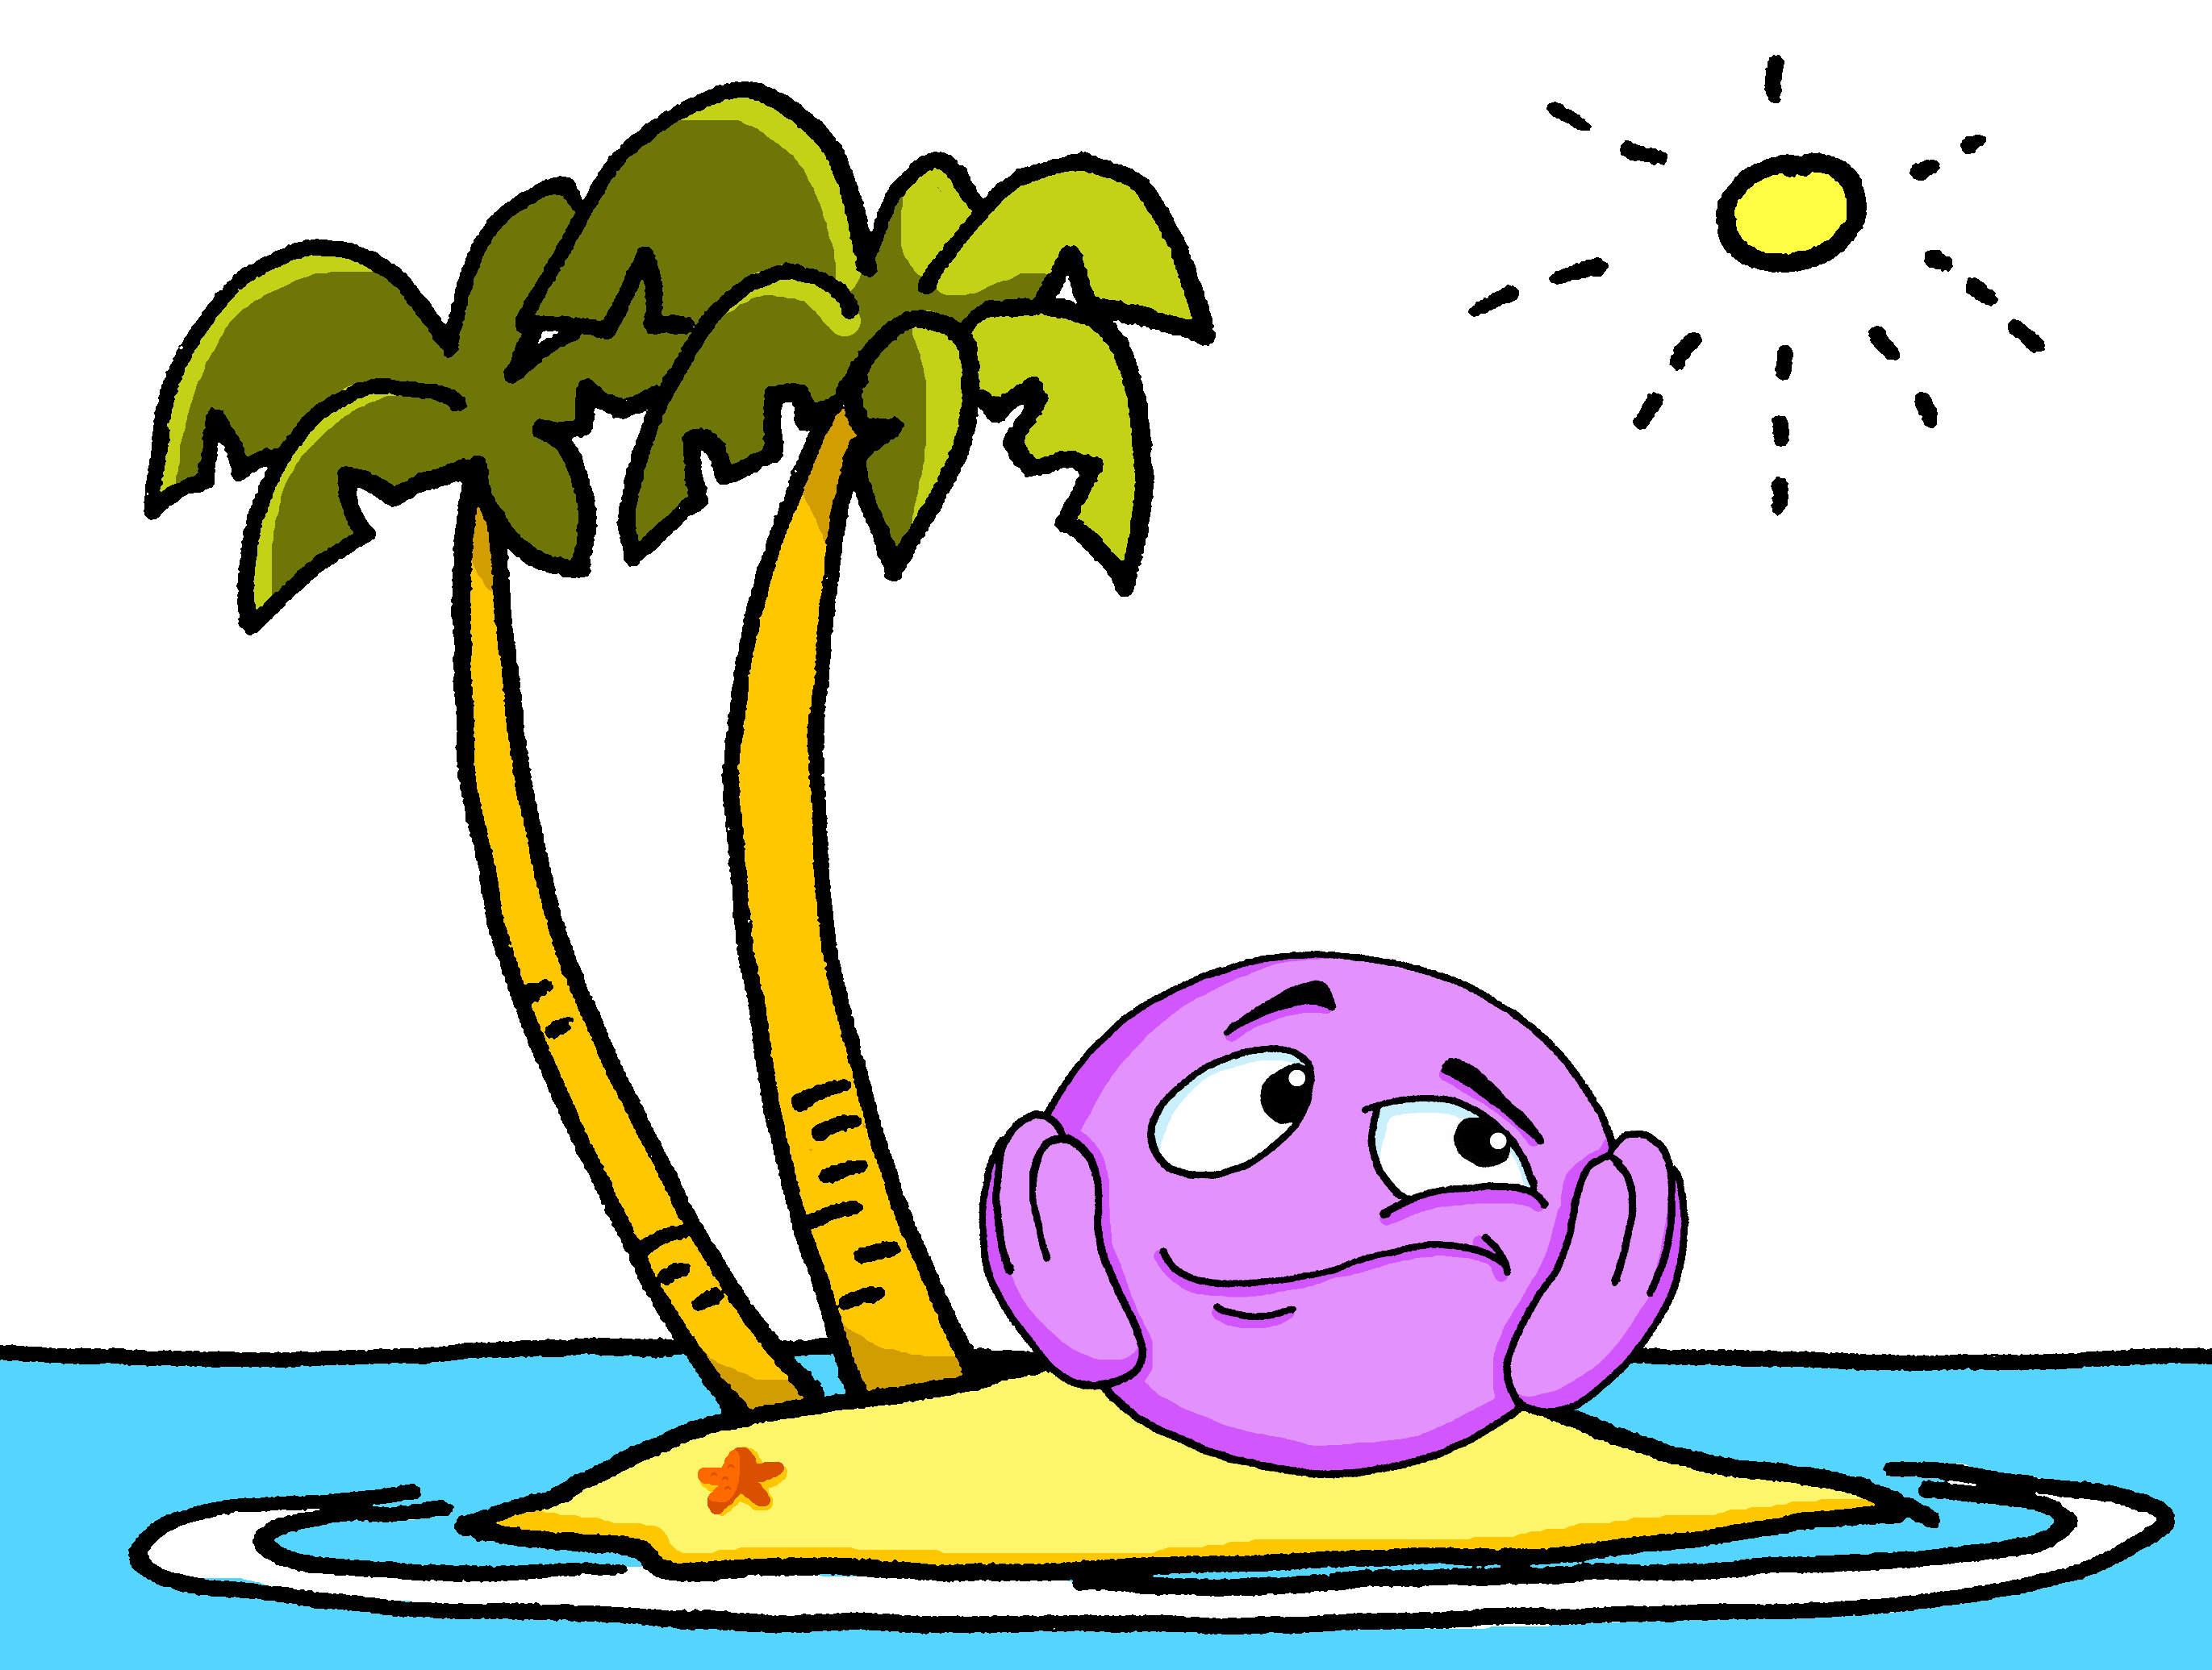
open [eu]
prononcer
jeune
seul
Notes:
A little audio still to embed here.
Timing: 2 minutes (two slides)
Aim: to practise open SSC [eu] in words where [eu] is followed by –l, -f, -r, -n(e).
Procedure:
Elicit the pronunciation of the individual SSC [eu].
Click to bring on the first picture and word and elicit the pronunciation from pupils. Note: jeune and seul are already known.
Move to next slide.
3

Slide 4
open [eu]
prononcer
neuf
acteur
[eu] is open when followed by r, f, l, but closed before x, s.
Notes:
A little audio still to embed here.
Timing: 2 minutes (two slides)
Aim: to practise open SSC [eu] in words where [eu] is followed by –l, -f, -r, -n(e).
Procedure:
Click to present neuf and acteur and practise these with pupils, e.g. by prompting with the English and eliciting choral responses.
Finally, click to bring up the callout. This provides a link to the vocabulary for this week, which are adjectives ending in –eux, with closed [eu].
4

Slide 5
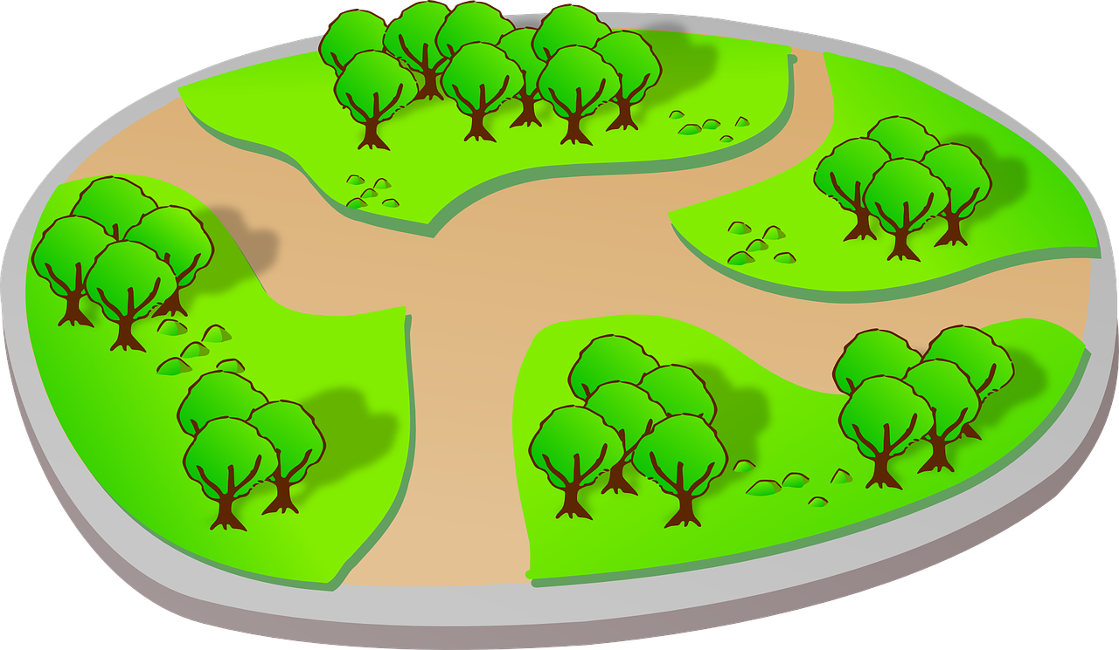
[SFC] Silent final consonant
prononcer
You have practised [SFC] in words ending in -t, -s, -d, -x :
petit
mais
grand
deux
[but]
Be C-a-R-e-F-u-L with words ending in -c, -r, -f, -l. You often pronounce these!
parc
peur
neuf
seul
Notes:
Timing: 1 minute
Aim: to recap [SFC] with –t, -s, -d, -x and introduce awareness of consonants –c, -r, -f, and –l, which are often pronounced.
Procedure:
Click through the animations to present the information.
parc [1240]
Londsale, D., & Le Bras, Y. (2009). A Frequency Dictionary of French: Core vocabulary for learners London: Routledge.
5

Slide 6
vocabulaire
Écoute et répète.
mots
sérieux
curieux
serious (m)
curious (m)
Notes:
Timing: 2 minutes (two slides)
Aim: to present and practise new vocabulary for this week.
Procedure:
Click to bring up the word. Say the word.
Click for the English meaning. Say the French word again. Pupils repeat.
Click to bring up the picture. Say the word again, together with pupils this time.
Click for the reminder of the pronounced –s for the feminine form.
Continue with the next four slides.
6

Slide 7
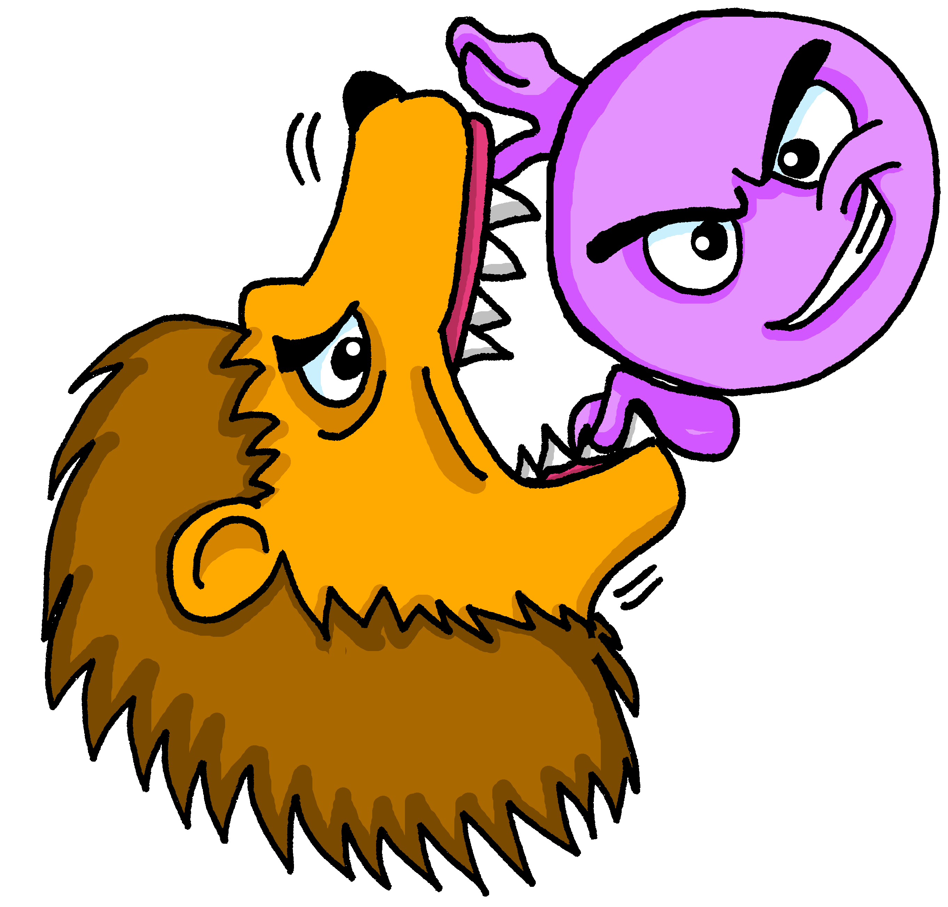
vocabulaire
Écoute et répète.
mots
courageux
heureux
brave (m)
happy (m)
Notes:
Timing: 4 minutes (five slides)
Aim: to present and practise new vocabulary for this week.
Procedure:
Click to bring up the word. Say the word.
Click for the English meaning. Say the French word again. Pupils repeat.
Click to bring up the picture. Say the word again, together with pupils this time.
Click for the reminder of the pronounced –s for the feminine form.
Continue with the next four slides.
7

Slide 8
vocabulaire
Lis et identifie.
mots
brave (m)
curieux
courageux
Notes:
Timing: 2 minutes (four slides)
Aim: to practise written comprehension and pronunciation of this week’s new vocabulary.
Procedure:
Click to bring up the English word and picture prompt.
Click to bring up two options.
Pupils say the correct word.
Click to reveal answer tick.
Continue with next slides.
8

Slide 9
vocabulaire
Lis et identifie.
mots
serious (m)
sérieux
curieux
Notes:
[2/4]
9

Slide 10
vocabulaire
Lis et identifie.
mots
happy (m)
heureux
sérieux
Notes:
[3/4]
10

Slide 11
vocabulaire
Lis et identifie.
mots
curious (m)
courageux
curieux
Notes:
[4/4]
11

Slide 12
Using adjectives
This [eu] is closed, too.
Adjectives ending in -eux change to -euse when describing feminine nouns.
This [eu] is closed, like deux.
-eux ending is often like –ous in English.
Je suis sérieux.
I (a boy) am serious.
Masculine
Tu es sérieux.
You (a boy) are serious.
An ‘e’ at the end means you do pronounce the ‘s’.
Il est sérieux.
He is serious.
Je suis sérieuse.
I (a girl) am serious.
Feminine
Tu es sérieuse.
You (a girl) are serious.
Elle est sérieuse.
She is serious.
Notes:
Timing: 3 minutes
Procedure:
Read the grammar explanation about adjective agreement.
Elicit English translation for the French examples provided.
Draw pupils’ attention to the SFC ‘s’ and to the change you hear when an ‘e’ is added to the feminine form.

Slide 13
vocabulaire
Écoute et répète.
mots
The ‘e’ at the end means you do pronounce the ‘s’. This ‘e’ is called Silent Final ‘e’ [Sfe].
sérieux
sérieuse
serious (m)
serious (f)
Notes:
Timing: 2 minutes (four slides)
Aim: to present and practise new vocabulary for this week in masculine and feminine forms.
Procedure:
Click to bring up the word. Say the word.
Click for the English meaning. Say the French word again. Pupils repeat.
Click to bring up the picture. Say the word again, together with pupils this time.
Click for the reminder of the pronounced –s for the feminine form.
Continue with the next four slides.
13

Slide 14
vocabulaire
Écoute et répète.
mots
curieux
curieuse
curious (m)
curious (f)
Notes:
[2/4]
14

Slide 15
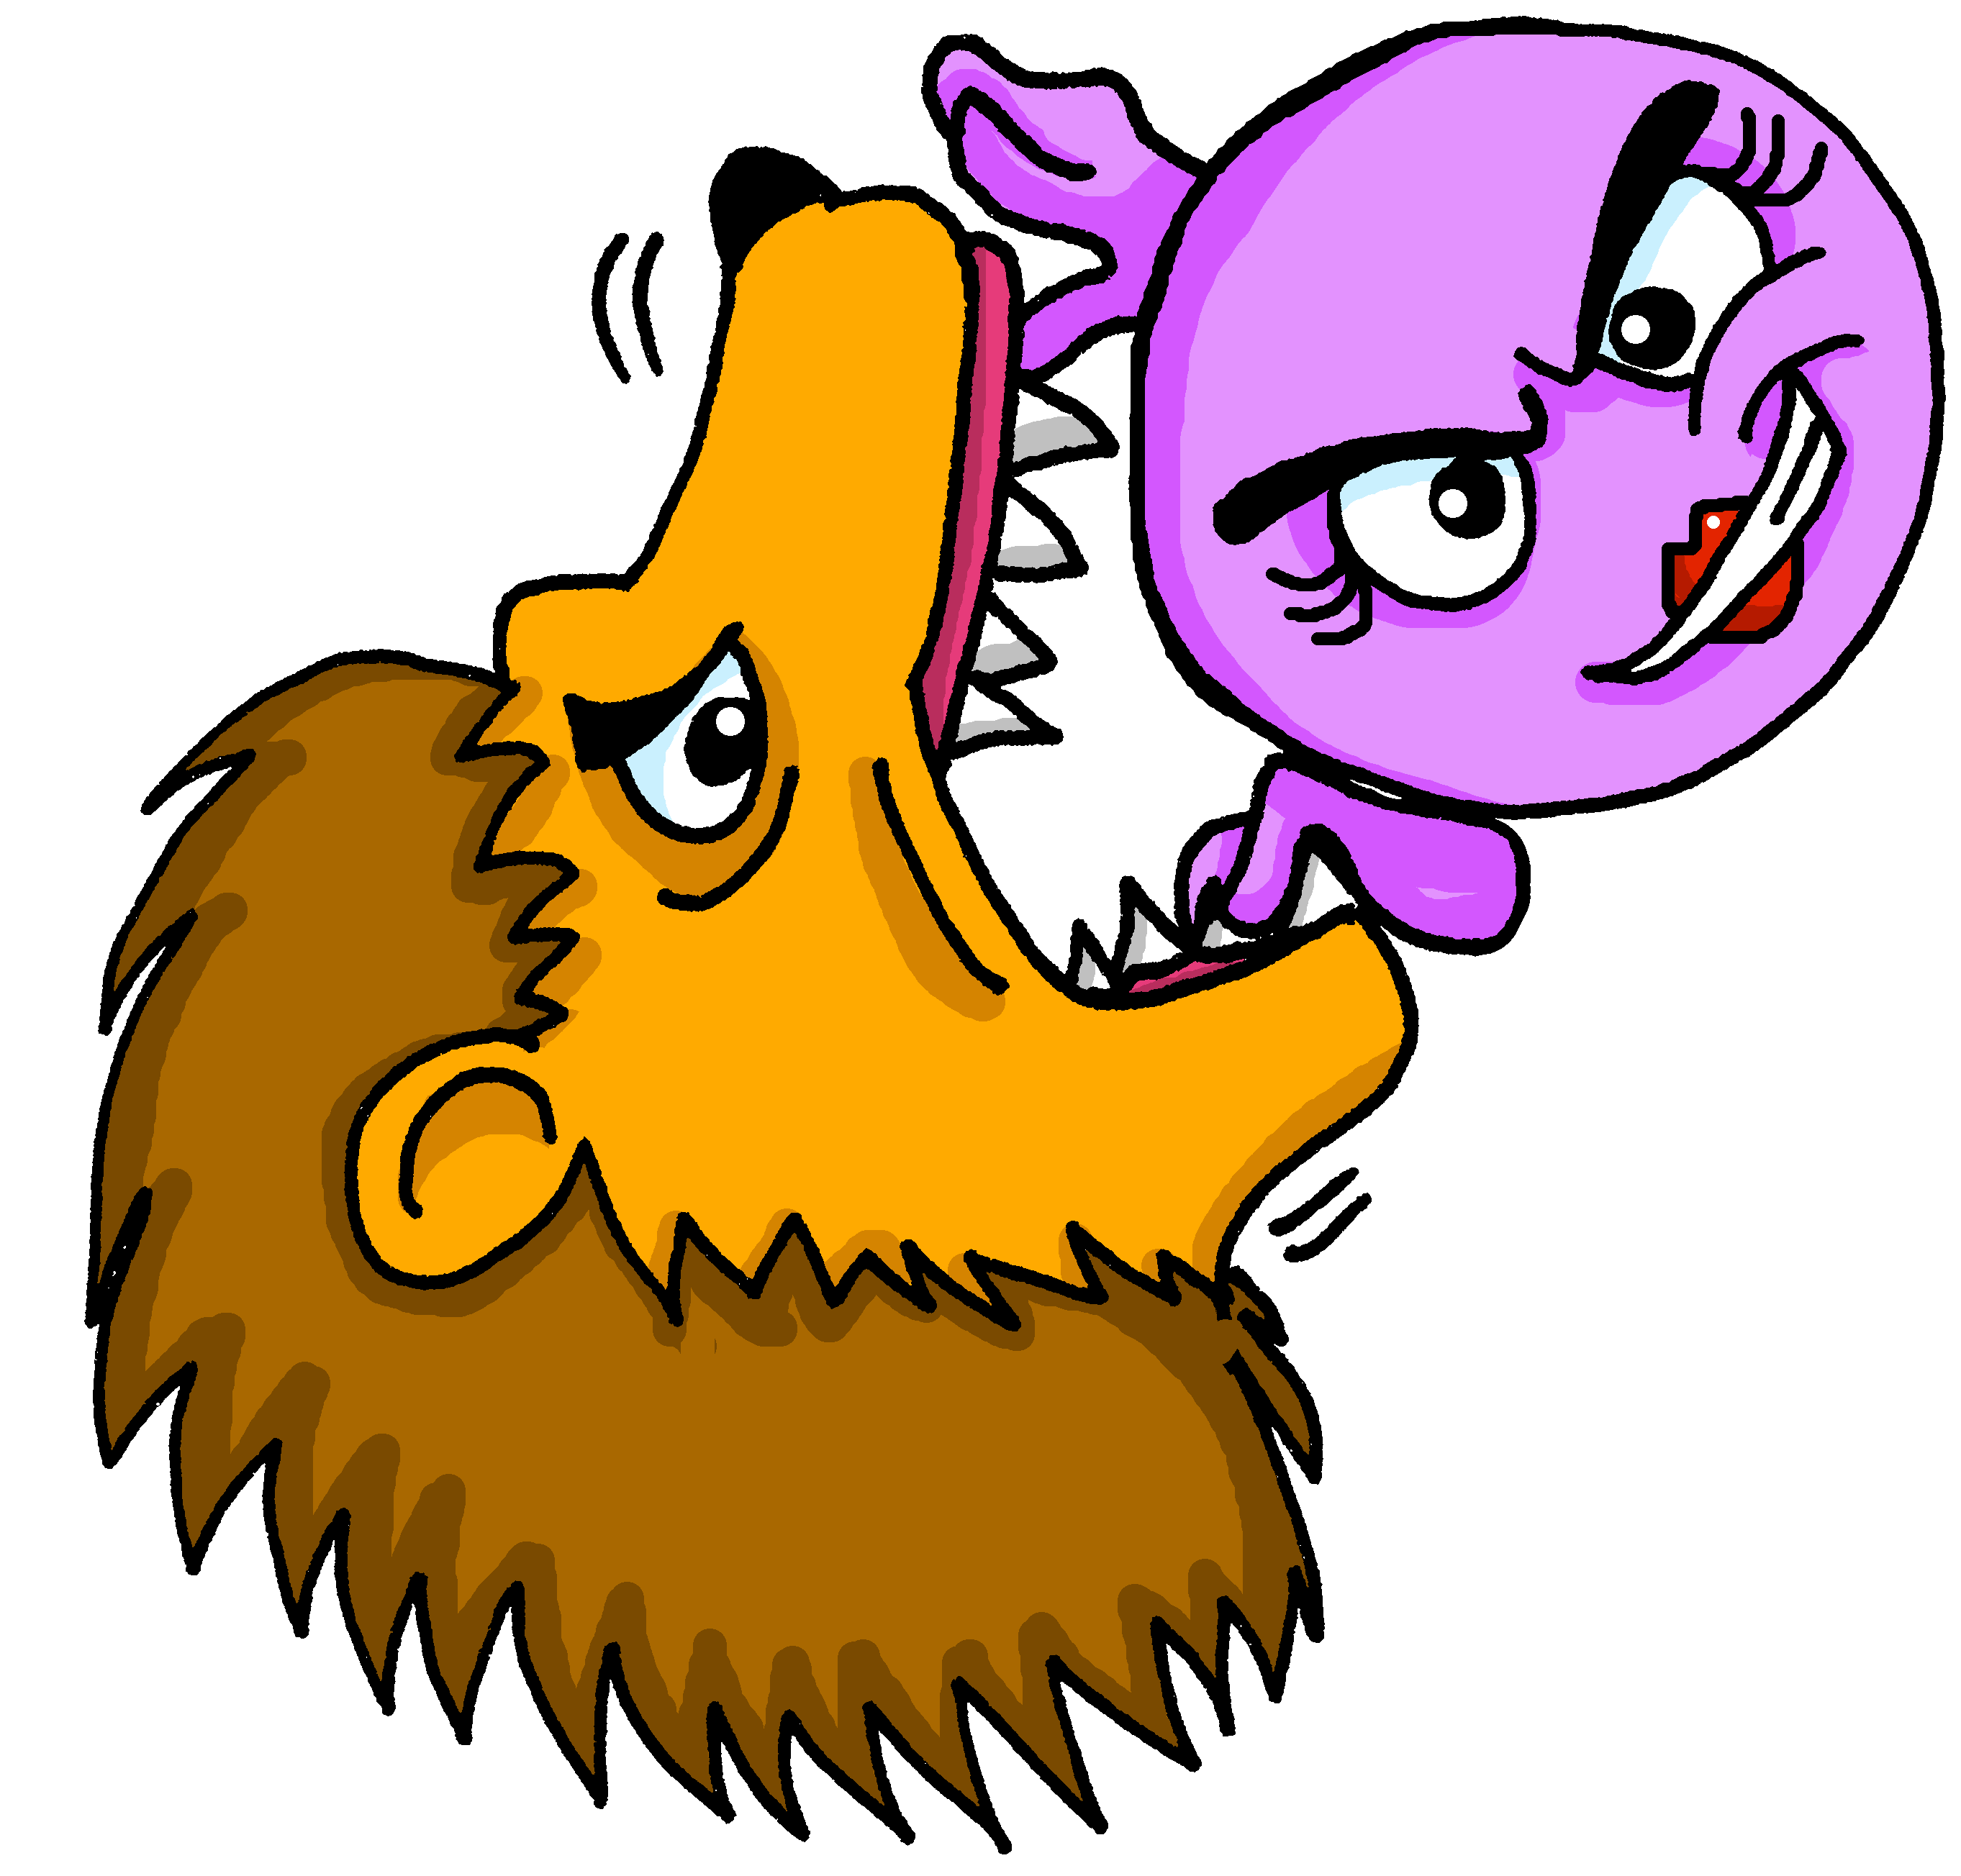
vocabulaire
Écoute et répète.
mots
courageux
courageuse
brave (m)
brave (f)
Notes:
[3/4]
15

Slide 16
vocabulaire
Écoute et répète.
mots
heureux
heureuse
happy (m)
happy (f)
Notes:
[4/4]
16

Slide 17
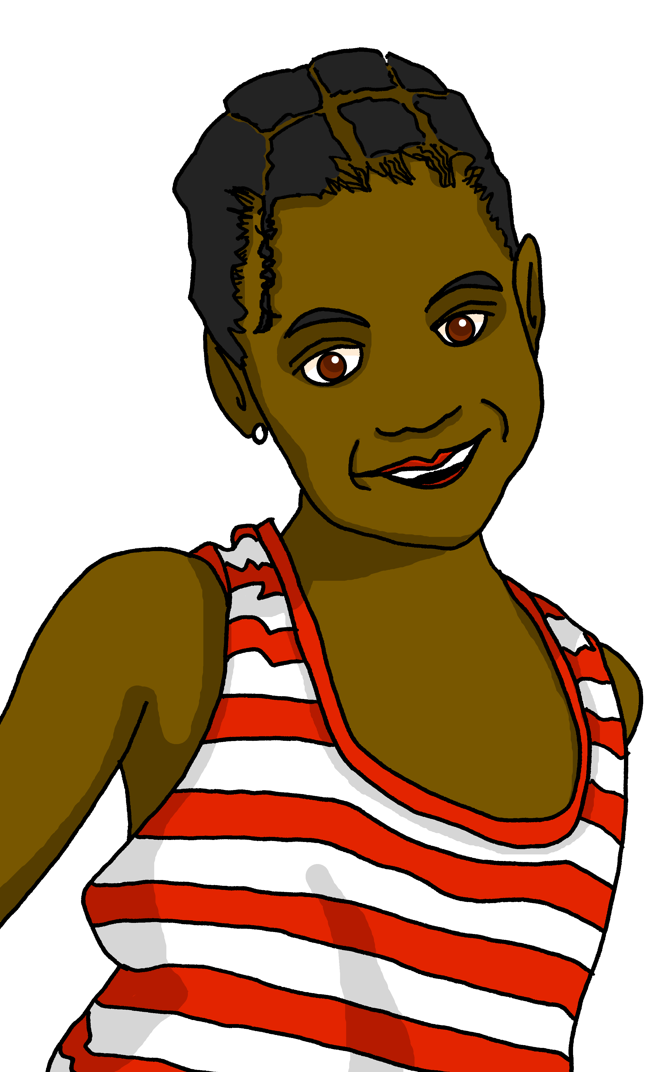
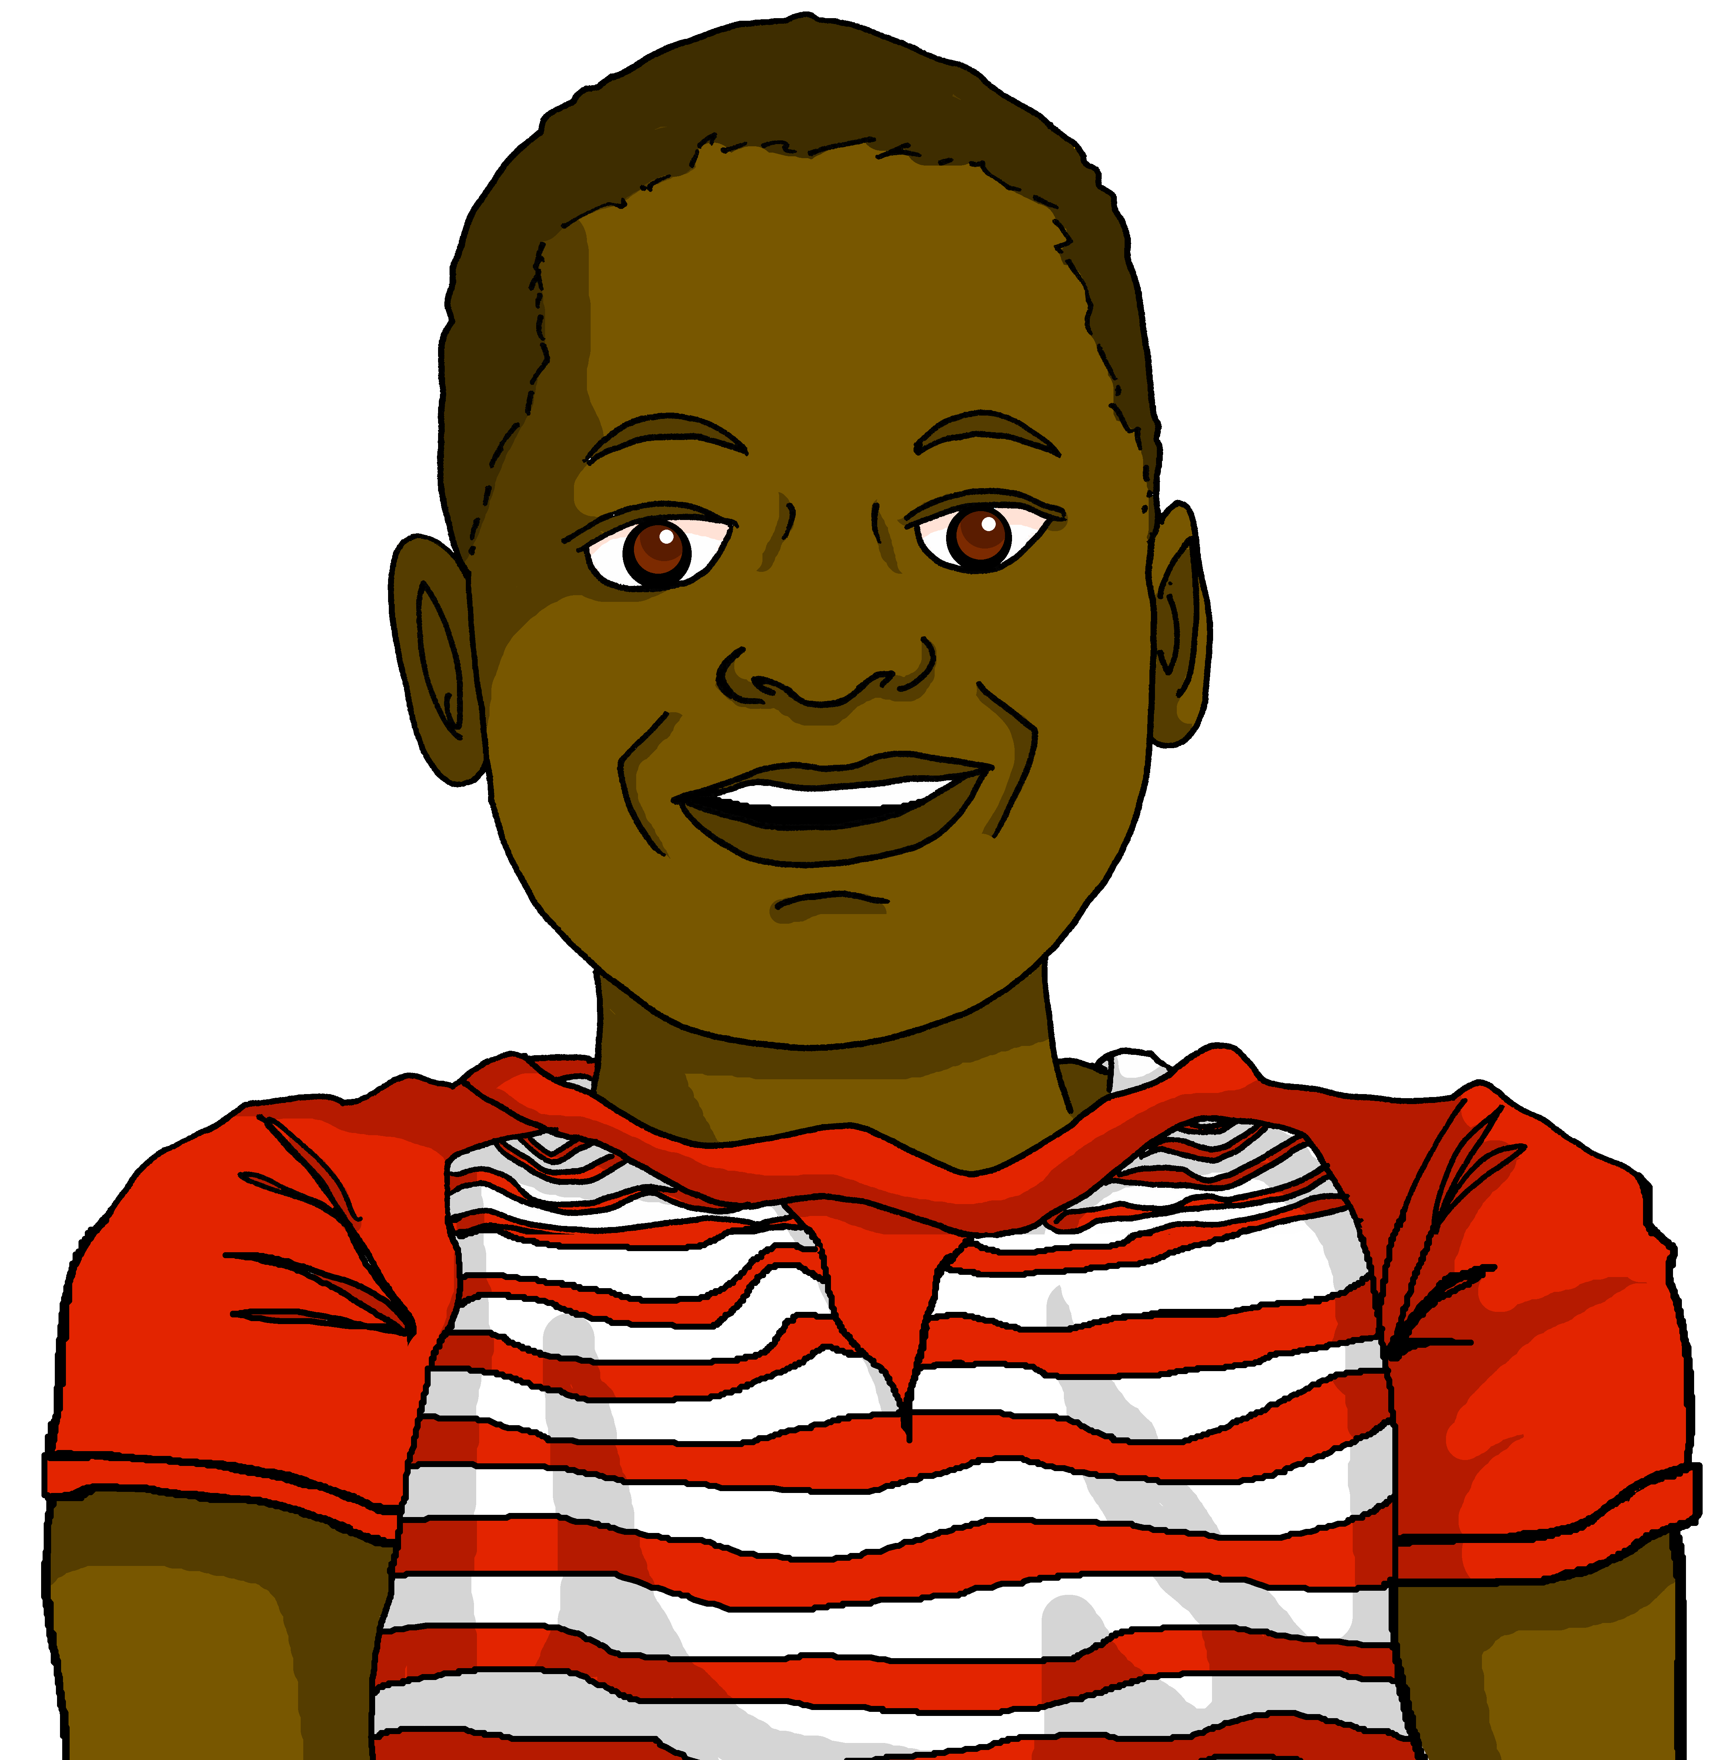
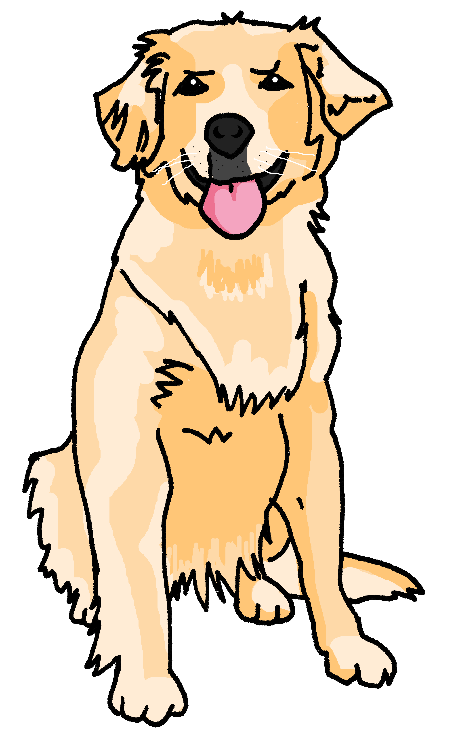
Écoute. Jean-Michel parle. Écris les phrases.
C’est Clémentine (female) ou Médor (male)?
écouter
1
Il est curieux.
Clémentine
___
_______
2
Elle est courageuse.
___
_______
brave
……………………………………………………....
independent
3
Elle est indépendante.
___
_______
happy
4
Il est sérieux.
___
______
Médor
5
Elle est heureuse.
___
_______
curious
……………………………………………………....
6
Il est différent.
serious
___
______
different
Notes:
Timing: 5 minutes
Aim: to practise aural recognition of masculine –eux and feminine –euse adjective endings in known words and practise their written production.
Procedure:
Ensure pupils understand the task. They will hear the phrase without the pronoun. They will be able to write the whole phrase by paying attention to the adjective ending.
Click on each audio symbol to listen to the sentence.
Pupils write 1-6 and the full phrase.
Click to reveal the full sentences.
Pupils then write what they know about the two members of the family in English.
Click to reveal answers.
Transcript [il] est curieux. [elle] est courageuse. [elle] est indépendante. [il] est sérieux. [elle] est heureuse. [il] est différent.

Slide 18
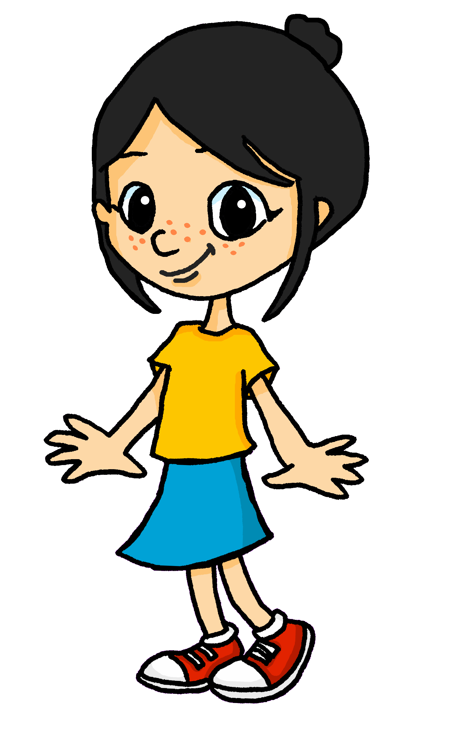
Lis le texte et écris les mots.
Léa is reading a French-English storybook to her little sister Eugénie. She needs to translate the English for Eugénie. Can you help?
écrire
C‘est lundi.
Je suis courageux mais tu es anxieux.
[Monday].
C‘est mardi.
Je suis curieux
mais tu es prudent.
[Tuesday].
[I am]
[I am]
[you are]
[you are]
Notes:
Timing: 7 minutes (five slides)
Aim: to practise written production of previously taught language; to practise written comprehension of known language in a longer context.
Procedure:
Ensure pupils understand the task. They need to write the French words for the English.
Click to reveal the answers.
Continue through the next three slides.
Frequency of cognates: anxieux [>5000]
Londsale, D., & Le Bras, Y. (2009). A Frequency Dictionary of French: Core vocabulary for learners London: Routledge.

Slide 19
Lis le texte et écris les mots.
écrire
C‘est mercredi.
Je suis sérieux
mais tu es drôle.
[It’s]
C‘est jeudi.
Je suis content
mais tu es triste.
[It’s]
[serious]
[pleased]
[funny].
[sad].

Slide 20
Lis le texte et écris les mots.
écrire
C‘est vendredi.
Je suis nerveux
mais tu es calme.
[Friday].
C‘est samedi.
Je suis indépendant
mais tu es différent.
[Saturday].
[I am]
[I am]
[you are]
[you are]
Notes:
Frequency of cognates: nerveux [3735] calme [1731]
Londsale, D., & Le Bras, Y. (2009). A Frequency Dictionary of French: Core vocabulary for learners London: Routledge.

Slide 21
Lis le texte et écris les mots.
écrire
C‘est dimanche.
Je suis heureux
et tu es heureux. Hourra !
[It’s Sunday].
[happy]
[happy].

Slide 22
Lis le texte en français et en anglais.
Eugénie wants to hear the whole story again, in French and in English! Can you help Léa to tell it?
parler
lire
C’est lundi. Je suis courageux mais tu es anxieux. C’est mardi. Je suis curieux mais tu es prudent. C’est mercredi. Je suis sérieux mais tu es drôle. C’est jeudi. Je suis content mais tu es triste. C’est vendredi. Je suis nerveux mais tu es calme. C’est samedi. Je suis indépendant mais tu es différent. C’est dimanche. Je suis heureux et tu es heureux. Hourra !
It’s Monday. I am brave but you are anxious.
It’s Tuesday. I am curious but you are careful.
It’s Wednesday. I am serious but you are funny.
It’s Thursday. I am pleased but you are sad.
It’s Friday. I am nervous but you are calm.
It’s Saturday. I am independent but you are different.
It’s Sunday. I am happy and you are happy. Hurrah!
Notes:
Procedure:
In pairs pupils practise reading a line aloud for their partner, who translates into English.
They swap roles each line.
Teacher clicks to reveal the English translation each time.

Slide 23
Au revoir !
jaune
Notes:
23

