Slide 1
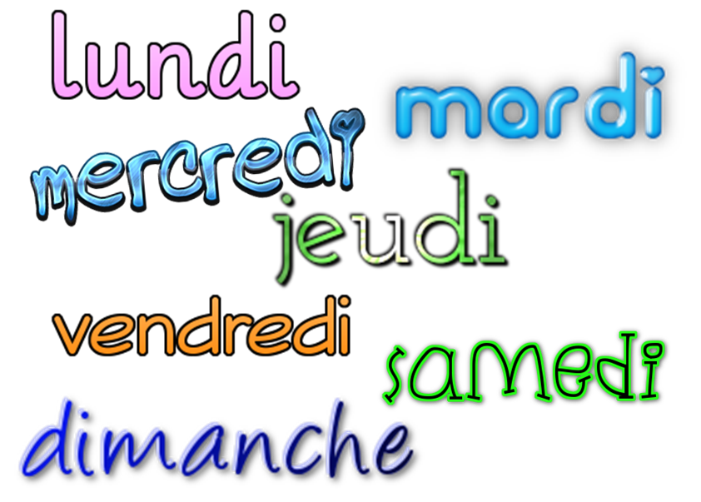
Describing me and others
jaune
SSC [eu]
Ce|C’est (it is, it’s)
Days of the week
Notes:
Artwork by Steve Clarke. Pronoun pictures from NCELP (www.ncelp.org). All additional pictures selected from Pixabay and are available under a Creative Commons
license, no attribution required.
The AUDIO version of the lesson material includes additional audio for the new language
presented (phonics, vocabulary) and audio for the instructions on the slide.
In addition, it includes VIDEO clips of the phonics and the phonics’ source words. Pupils can be
encouraged to look at the shape of the mouth/lips on slides where these appear, and try to copy
it/them.
Phonics: [eu] and [SFC] with words ending in -x
Frequency of new words:
Phonics: deux [41] un (petit) peu [91] un jeu [291]
Vocabulary: ce (c') [12] lundi [1091] mardi [1044] mercredi [1168] jeudi [1112] vendredi [1086] samedi [1356] dimanche [1235] aujourd’hui [233]
Londsale, D., & Le Bras, Y. (2009). A Frequency Dictionary of French: Core vocabulary for learners London: Routledge.
The frequency rankings for words that occur in this PowerPoint which have been previously introduced in these resources are given in the SOW and in the resources
that first introduced and formally re-visited those words.
For any other words that occur incidentally in this PowerPoint, frequency rankings will be provided in the notes field wherever possible.
1

Slide 2
[eu]
prononciation
deux
Notes:
Timing: 1 minute
Aim: To introduce SSC [eu]
Procedure:
Introduce and elicit the pronunciation of the individual SSC [eu].
Click to bring up the source word ‘deux’ (with gesture, if using).
Say the word and bring up the reminder that the final –t is silent.
Pupils to practise saying the word several times.
Note:
a gesture for ‘deux’ might be to do the British Sign Language gesture for two: https://www.signbsl.com/sign/two Note: if teachers want to avoid a backwards ‘v’ they could instead use the front-facing peace ‘v’ symbol.

Slide 3
[SFC]
prononciation
Silent final consonant
deux
Notes:
Timing: 1 minute
Aim: to revisit [SFC], this time with a new consonant ‘x’. Pupils have now encountered SFC with –t, -s, -d and now –x.
Procedure:
Repeat the source word ‘deux’ with gesture, if using.
Bring your fingers to your lips to signal [SFC].
Elicit from students the other SFCs they remember, with examples of words. E.g. petit, mais, grand.
3

Slide 4
[eu]
prononciation
un (petit) peu
[a little bit]
Notes:
Timing: 2 minutes (three slides)
Aim: to introduce two cluster words with the SSC [eu] for further practice.
Procedure:
Repeat the SSC [eu].
Click to bring up the cluster word/phrase ‘un petit peu’ (with gesture, if using).
Click to bring up the English translation.
Pupils to practise saying the phrase several times.
Note:
a gesture for ‘un petit peu’ might be to mimic the gesture from the picture.
pupils have already learnt ‘petit’ and in week 8 they will learn ‘un/une’ meaning ‘a’.

Slide 5
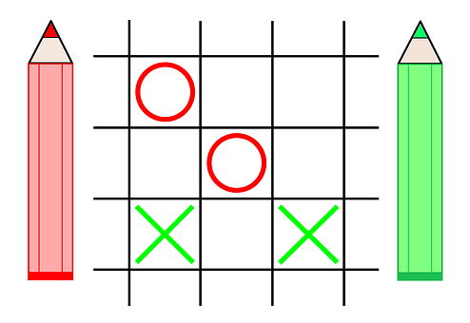
[eu]
prononciation
un jeu
[a game]
Notes:
Procedure:
Repeat the SSC [eu].
Click to bring up the cluster word ‘un jeu’ (with gesture, if using).
Click to bring up the English translation.
Pupils to practise saying the phrase several times.
Note:
a gesture for ‘un jeu’ might be to use the BSL for ‘game’, as shown here: https://www.youtube.com/watch?v=5Hg3s6pxusM
alternatively, agree a suitable gesture with the class.

Slide 6
vocabulaire
Écoute et répète.
mots
N O V E M B R E | lundi | mardi | mercredi | jeudi | vendredi | samedi | dimanche
 | 01 | 02 | 03 | 04 | 05 | 06 | 07
 | 08 | 09 | 10 | 11 | 12 | 13 | 14
 | 15 | 16 | 17 | 18 | 19 | 20 | 21
 | 22 | 23 | 24 | 25 | 26 | 27 | 28
 | 29 | 30
In France, the first day of the week is Monday (lundi) and the last day of the week is Sunday (dimanche).
lundi
mardi
Monday
Tuesday
Notes:
Timing: 4 minutes (three slides)
Aim: to present and practise new vocabulary for this week.
Procedure:
Click to bring up the word. Say the word.
Click for the English meaning. Say the French word again. Pupils repeat.
Repeat steps 1 and 2 with the 2nd word.
Click to bring up the callout.
5. Continue with the next slide.
6

Slide 7
vocabulaire
Écoute et répète.
mots
N O V E M B R E | lundi | mardi | mercredi | jeudi | vendredi | samedi | dimanche
 | 01 | 02 | 03 | 04 | 05 | 06 | 07
 | 08 | 09 | 10 | 11 | 12 | 13 | 14
 | 15 | 16 | 17 | 18 | 19 | 20 | 21
 | 22 | 23 | 24 | 25 | 26 | 27 | 28
 | 29 | 30
Careful with spelling mercredi! The ‘c’ is in an ‘r’ sandwich. m – e – r – c – r – e – d - i
The [eu] in jeudi is the same sound as in deux, un petit peu, un jeu.
mercredi
jeudi
Wednesday
Thursday
Notes:
[2/3]
7

Slide 8
vocabulaire
Écoute et répète.
mots
N O V E M B R E | lundi | mardi | mercredi | jeudi | vendredi | samedi | dimanche
 | 01 | 02 | 03 | 04 | 05 | 06 | 07
 | 08 | 09 | 10 | 11 | 12 | 13 | 14
 | 15 | 16 | 17 | 18 | 19 | 20 | 21
 | 22 | 23 | 24 | 25 | 26 | 27 | 28
 | 29 | 30
In French the days of the week are only capitalised at the start of a sentence or phrase.
vendredi
samedi
dimanche
Friday
Saturday
Sunday
Notes:
[3/3]
8

Slide 9
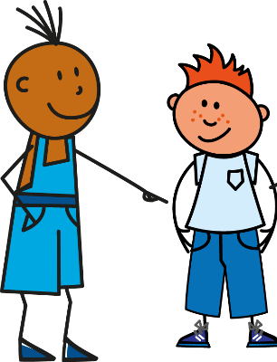
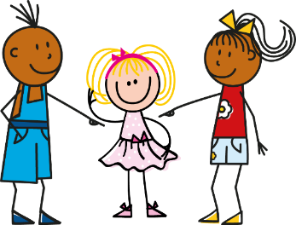
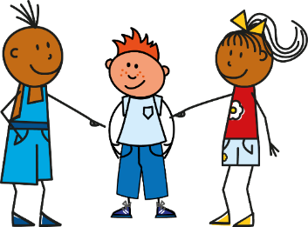
être
[to be | being]
Remember, the verb être means ‘to be’.
You already know the parts I am, you are and he/she is:
Je suis
Tu es
Il est
Elle est
I am
You are
He is
She is
It is is also part of the verb ‘to be’:
Remember: in French, use an extra space in front of any two-part punctuation marks!
Ce means it. Ce est becomes c’est to make it easier to say.
Remember: change a statement into a question by raising your voice at the end.
C’est
It is
C’est ici ?
Oui, c’est ici !
Non, c’est là !
Is it here?
Yes, it is here!
No, it is there!
Notes:
Timing: 2 minutes
Aim: to revisit parts of être and introduce ce|c’est.
Procedure:
Click to animate the explanation.
Elicit English translations for the French examples provided.

Slide 10
lire
Complète la phrase.
C’est…
lundi.
lundi
mardi.
mercredi.
Notes:
Timing: 8 minutes (7 slides)
Aim: to practise written comprehension and read out of the new vocabulary.
Procedure:
Teacher initiates the phrase C’est…
Pupils respond orally with the correct day, using the partially obscured day as their clue.
Teacher clicks to confirm the answer, and elicits English meaning.
Repeat for the next slides.
10

Slide 11
lire
Complète la phrase.
C’est…
jeudi.
dimanche
vendredi.
dimanche.
Notes:
[2/7]
11

Slide 12
lire
Complète la phrase.
Oui
C’est jeudi ?
Non
c’est…
jeudi
lundi.
dimanche.
jeudi.
Notes:
[3/7]
Note: For slides 3 – 7, the teacher asks questions, e.g. C’est jeudi ? (Is it Thursday) and pupils respond ‘Oui, c’est (same day)’ or ‘Non, c’est (different day)’.
12

Slide 13
lire
Complète la phrase.
Oui
C’est mardi ?
Non
c’est…
samedi.
mercredi
mercredi.
mardi.
Notes:
[4/7]
13

Slide 14
lire
Complète la phrase.
Oui
C’est lundi ?
Non
c’est…
mardi
lundi.
mardi.
mercredi.
Notes:
[5/7]
14

Slide 15
lire
Complète la phrase.
Oui
C’est vendredi ?
Non
c’est…
vendredi
jeudi.
vendredi.
samedi.
Notes:
[6/7]
15

Slide 16
lire
Complète la phrase.
Oui
C’est samedi ?
Non
c’est…
mercredi.
samedi
vendredi.
samedi.
Notes:
[7/7]
16

Slide 17
écouter
Écoute. Madame Vidal parle.
Bonjour, tout le monde ! Aujourd’hui, c’est…?
C’est lundi ? Écris en anglais.
 | Tuesday | Wednesday | Monday | Thursday
 | Wednesday | Friday | Sunday | Saturday
 | Tuesday | Sunday | Wednesday | Thursday
 | Wednesday | Saturday | Monday | Friday
 | Thursday | Monday | Sunday | Tuesday
 | Sunday | Monday | Tuesday | Saturday
Ex
1
2
3
4
5
Notes:
Timing: 7 minutes
Aim: to practise aural identification of the days of the week in French.
Procedure:
1. Ensure pupils are clear about the task.
2. Click to play the example. Ask pupil to write the day of the week in English.
3. Click to reveal the answer.
4. Repeat with items 1-5.
Transcript:
Ex. Aujourd’hui, c’est mardi. 1. Aujourd’hui, c’est dimanche.
2. Aujourd’hui, c’est mercredi.
3. Aujourd’hui, c’est vendredi.
4. Aujourd’hui, c’est lundi.
5. Aujourd’hui, c’est samedi.
17

Slide 18
Les jours de la semaine (The days of the week)
parler
Notes:
Timing: 5 minutes
Aim: to practise oral production of the days of the week (in a song that constrains the time and helps to speed up production).
Procedure:
Click to play the song.
Encourage pupils to join in when they can.
Link to song: https://www.youtube.com/watch?v=x-G1kkJR65Q
Notes: i) the song is just the days (repeated over and over) but the tune is catchy after a while and the harmonies make it not unpleasant to listen to, despite the minion-type voices!
ii) we recommend opening the link in a separate window just prior to the start of the lesson and playing through the adverts, leaving the song paused at the start ready to go, when needed.

Slide 19
parler
Au revoir.
Notes:
Timing: 30 seconds
Aim: to recap a further item of vocabulary from week 3, this week’s revisited week.
Procedure:
Click to bring up words and images.
Ensure pupils are clear about the meaning.
Repeat with the class to bring the lesson to an end.
19

Slide 20
Au revoir !
jaune
Notes:
20

