Slide 1
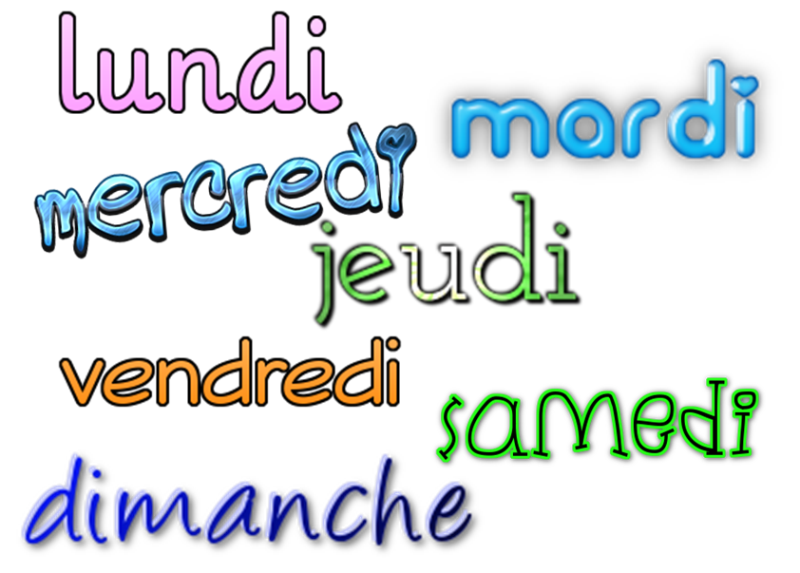
Describing me and others
jaune
Follow ups 1-5
Notes:
Artwork by Steve Clarke. Pronoun pictures from NCELP (www.ncelp.org). All additional pictures selected from Pixabay and are available under a Creative Commons license, no attribution required.
Phonics: [eu] and [SFC] with words ending in -x
Frequency of new words:
Phonics: deux [41] un (petit) peu [91] un jeu [291]
Vocabulary: ce (c') [12] lundi [1091] mardi [1044] mercredi [1168] jeudi [1112] vendredi [1086] samedi [1356] dimanche [1235] aujourd’hui [233]
Londsale, D., & Le Bras, Y. (2009). A Frequency Dictionary of French: Core vocabulary for learners London: Routledge.
The frequency rankings for words that occur in this PowerPoint which have been previously introduced in these resources are
given in the SOW and in the resources that first introduced and formally re-visited those words.
For any other words that occur incidentally in this PowerPoint, frequency rankings will be provided in the notes field wherever possible.

Slide 2
Follow up 1
[eu]
deux
Écoute.
prononcer
How many [eu] do you hear?
 | [eu] | en anglais
Je veux un jeu bleu. |  | I want a blue game.
C’est jeudi et il est nerveux. |  | It’s Thursday and he is nervous.
Oh ! Ici c’est silencieux et mystérieux. |  | Oh! It’s silent and mysterious here.
Mathieu est anglais. |  | Mathieu is English.
Eugénie habite dans la banlieue. |  | Eugénie lives in the suburbs.
1
2
3
4
5
habite – lives | la banlieue - suburbs
Notes:
Timing: 5 minutes
Aim: to practise aural recognition of this week’s SSC [eu] in full sentences.
Procedure:
Click on each audio symbol to listen to the sentence.
Pupils tally the [eu] they hear.
Click for the answers, the French sentence and then the English (which pupils may offer suggestions for, as we include some written cognates here).
Transcript 1. Je veux un jeu bleu. 2. C’est jeudi et il est nerveux. 3. Oh! Ici c’est silencieux et mystérieux. 4. Mathieu est anglais. 5. Eugénie habite dans la banlieue.

Slide 3
Follow up 2
Écoute.
Écoute. Écris en anglais.
Fill in the missing English words.
écouter
E
today
1. Today is ____________.
2. ___ ___ ___________? No, it’s _____________.
3. ___ ___ Thursday ________ ? Or _________?
4. It is _____________ and ___ ___ alone.
5. ______ ____ _____ difficult.
6. You are ___________today! Is it _____________?
Sunday
1
Saturday
Is it
Monday
Wednesday
2
it is
Is it
today
3
It is Monday.
Friday
Today it’s Sunday.
Tuesday
I
am
4
5
Wednesday
Today
you
are
6
It’s Tuesday today.
different
Saturday
Notes:
Timing: 5 minutes
Aim: to practise aural comprehension of this week’s new vocabulary and revisiting adjectives from week 2-6. Connecting sound with meaning.
Procedure:
(Part A) Click to listen. Pupils write the correct word or phrase in English. The word cloud is a scaffold as all the words are there.
Click to reveal answers.
(Part B) Pupils listen to the example and 1-5 and write the missing English words.
Click to reveal answers.
Transcript:
Exemple: aujourd’hui
1. samedi
2. c’est
3. c’est lundi
4. Aujourd’hui, c’est dimanche.
5. mercredi
6. c’est mardi, aujourd’hui
Transcript:
1. Aujourd’hui, c’est dimanche.
2. C’est lundi ? Non, c’est mercredi !
3. Aujourd’hui, c’est jeudi ? ou vendredi ? 4. C’est mardi et je suis seul.
5. Aujourd’hui tu es difficile !
6. Tu es différent aujourd’hui. C’est samedi ?

Slide 4
Follow up 3
C’est quoi* en anglais ?
parler
60
S
0
quoi – what
DÉBUT
Notes:
Timing: 2 minutes
Aim: to practise pronunciation and meaning recall of this week’s new and revisited vocabulary.
Procedure:
Pupils work in pairs. Pupil A calls out a word in English to test his/her partner, who must find and say the word in French as quickly as possible.
To complete a ‘round’ in 60 seconds, all words must have been translated once.
Click ‘début’ to start the timer.
Then swap roles and repeat the activity.
quoi [297]
Londsale, D., & Le Bras, Y. (2009). A Frequency Dictionary of French: Core vocabulary for learners London: Routledge.

Slide 5
Follow up 4
Écoute et chante.
chanter
lundi, lundi, mardi
lundi, mardi, mercredi, jeudi
jeudi, jeudi, vendredi vendredi, samedi, dimanche
Notes:
Aim: to practise oral production then oral recall of the days of the week in a song; the timing of the song offers a low stakes, enjoyable way to compel faster recall.
Procedure:
Read instruction in French.
Click to hear the first line of the song. Pupils repeat.
Click 2nd button to hear line 2, together. Pupils repeat, (multiple times, as necessary).
Click 3rd button to hear line 3. Pupils repeat.
Click 4th button to hear and repeat line 4 of the song.
Encourage them to translate it so they are sure they know what the lines mean.
Click the music icon right of the slide to hear and practise all four lines of the song, once through.
Click the icon again to play the whole song. Pupils join in and sing along. Repeat as desired!
Click to bring up starbursts to cover parts of the words. There are three successive clicks to cover increasing amounts of the text.
Pupils try to sing each time through with more of the text obscured.
Final challenge – pupils turn away from the board entirely or shut their eyes and sing.
Note: the tune is the theme tune to the Flintstones, which pupils may or may not be familiar. It should not matter, as the tune is catchy. ☺

Slide 6
Follow up 5
.
Écris en français.
l _ n d _
v e n d r e d i
l u n d i
v _ n d r _ d _
écrire
m _ r d _
m a r d i
s a m e d i
s _ m _ d _
m _ r c r _ d i
m e r c r e d i
d i m a n c h e
d _ m _ n c h _
j e u d i
j _ _ d _
Notes:
Timing: 5 - 10 minutes
Aim: to practise written production of the days of the week.
Pupils write full words.
Elicit answers from pupils orally and click to bring up the answers.

