Slide 1
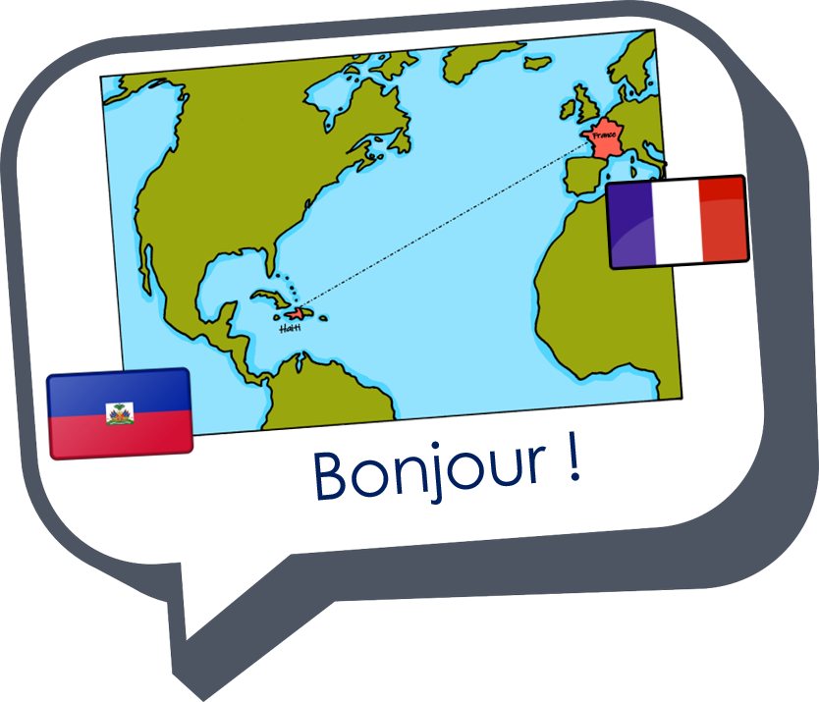
Describing me and others
jaune
Follow ups 1-5
Notes:
Artwork by Steve Clarke. Pronoun pictures from NCELP (www.ncelp.org). All additional pictures selected from Pixabay and are
available under a Creative Commons license, no attribution required.
Phonics: [an/en] and [a], also [SFC] with final -t
Frequency of new words:
Phonics: enfant [126] maman [2168]
Vocabulary: difficile [296] drôle [2166] jeune [152] joli [2398]
Londsale, D., & Le Bras, Y. (2009). A Frequency Dictionary of French: Core vocabulary for learners London: Routledge.
The frequency rankings for words that occur in this PowerPoint which have been previously introduced in these resources are
given in the SOW and in the resources that first introduced and formally re-visited those words.
For any other words that occur incidentally in this PowerPoint, frequency rankings will be provided in the notes field wherever
possible.

Slide 2
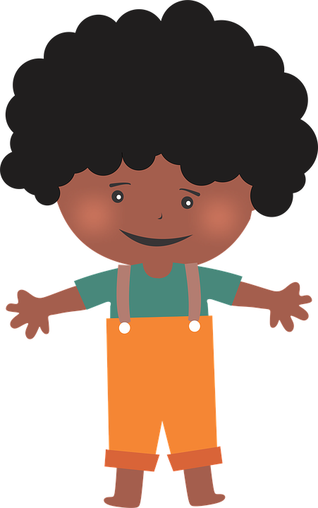
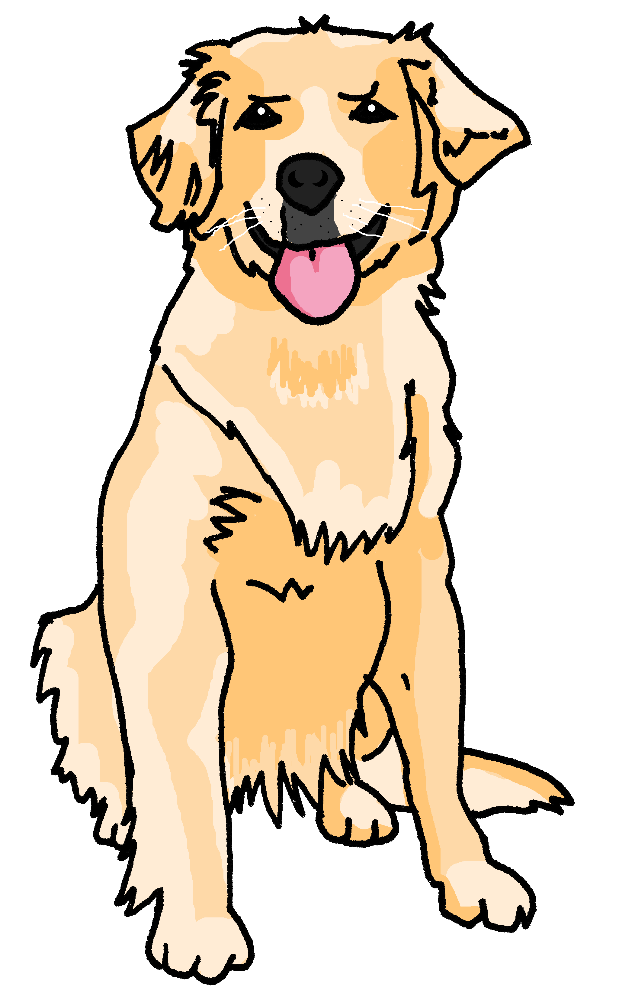
Follow up 1
[an/en]
enfant
Écoute.
Does the word have [an/en]?
 |  |  | en anglais
océan |  |  | ocean
vendredi |  |  | Friday
jaune |  |  | yellow
chanter |  |  | to sing, singing
gomme |  |  | rubber
chien |  |  | dog
lundi |  |  | Monday
ennuyeux |  |  | boring
1
2
3
4
5
6
7
8
Notes:
Timing: 5 minutes
Aim: to practise aural recognition of this week’s SSC [an/en] and differentiate from other similar sounds, in a set of unfamiliar words.
Procedure:
Click on each audio symbol to listen to the word.
Pupils tick if they hear [an|en] and cross if not.
Click for the answer ticks, the French word and then the English word (which pupils may offer suggestions for, as we include some written cognates here).
Transcript [1] océan [2] vendredi [3] jaune [4] chanter [5] gomme [6] chien
[7] lundi [8] ennuyeux

Slide 3
Follow up 2
Say each word in French when you see the English.
mots
drôle
jeune
suis
ici
jolie
pretty, attractive (f.)
être
pretty, attractive (m.)
to be, being
young (m/f)
difficult (m/f)
funny (m/f)
Hello! (m.)
Hi!
here
Super !
is
am
I
Bonjour !
Salut !
joli
je
est
difficile
Notes:
Timing: 5 minutes
Aim: to practise written comprehension and spoken pronunciation of vocabulary for this week and the revisited week.
Procedure:
1. Click for English prompt. Pupils need to locate the correct French word and pronounce it, chorally.
2. Click for target word to be highlighted. 3. Repeat for all 12 items.

Slide 4
Creating questions
To turn a statement into a question, just raise your voice at the end.
Je suis ici.
Je suis ici ?
I am here.
Am I here?
Il est là.
Il est là ?
He is there.
Is he there?
Notice that there is a space before a ? in French and also before a ! e.g. Salut !
Elle est là.
Elle est là ?
She is there.
Is she there?
Notes:
Use this recap ahead of FOLLOW UP 4.
Timing: 1 minute
Aim: to recap how to form intonation questions from statements.
Procedure:
Click to present information.
2. Elicit English translations for the French examples provided.

Slide 5
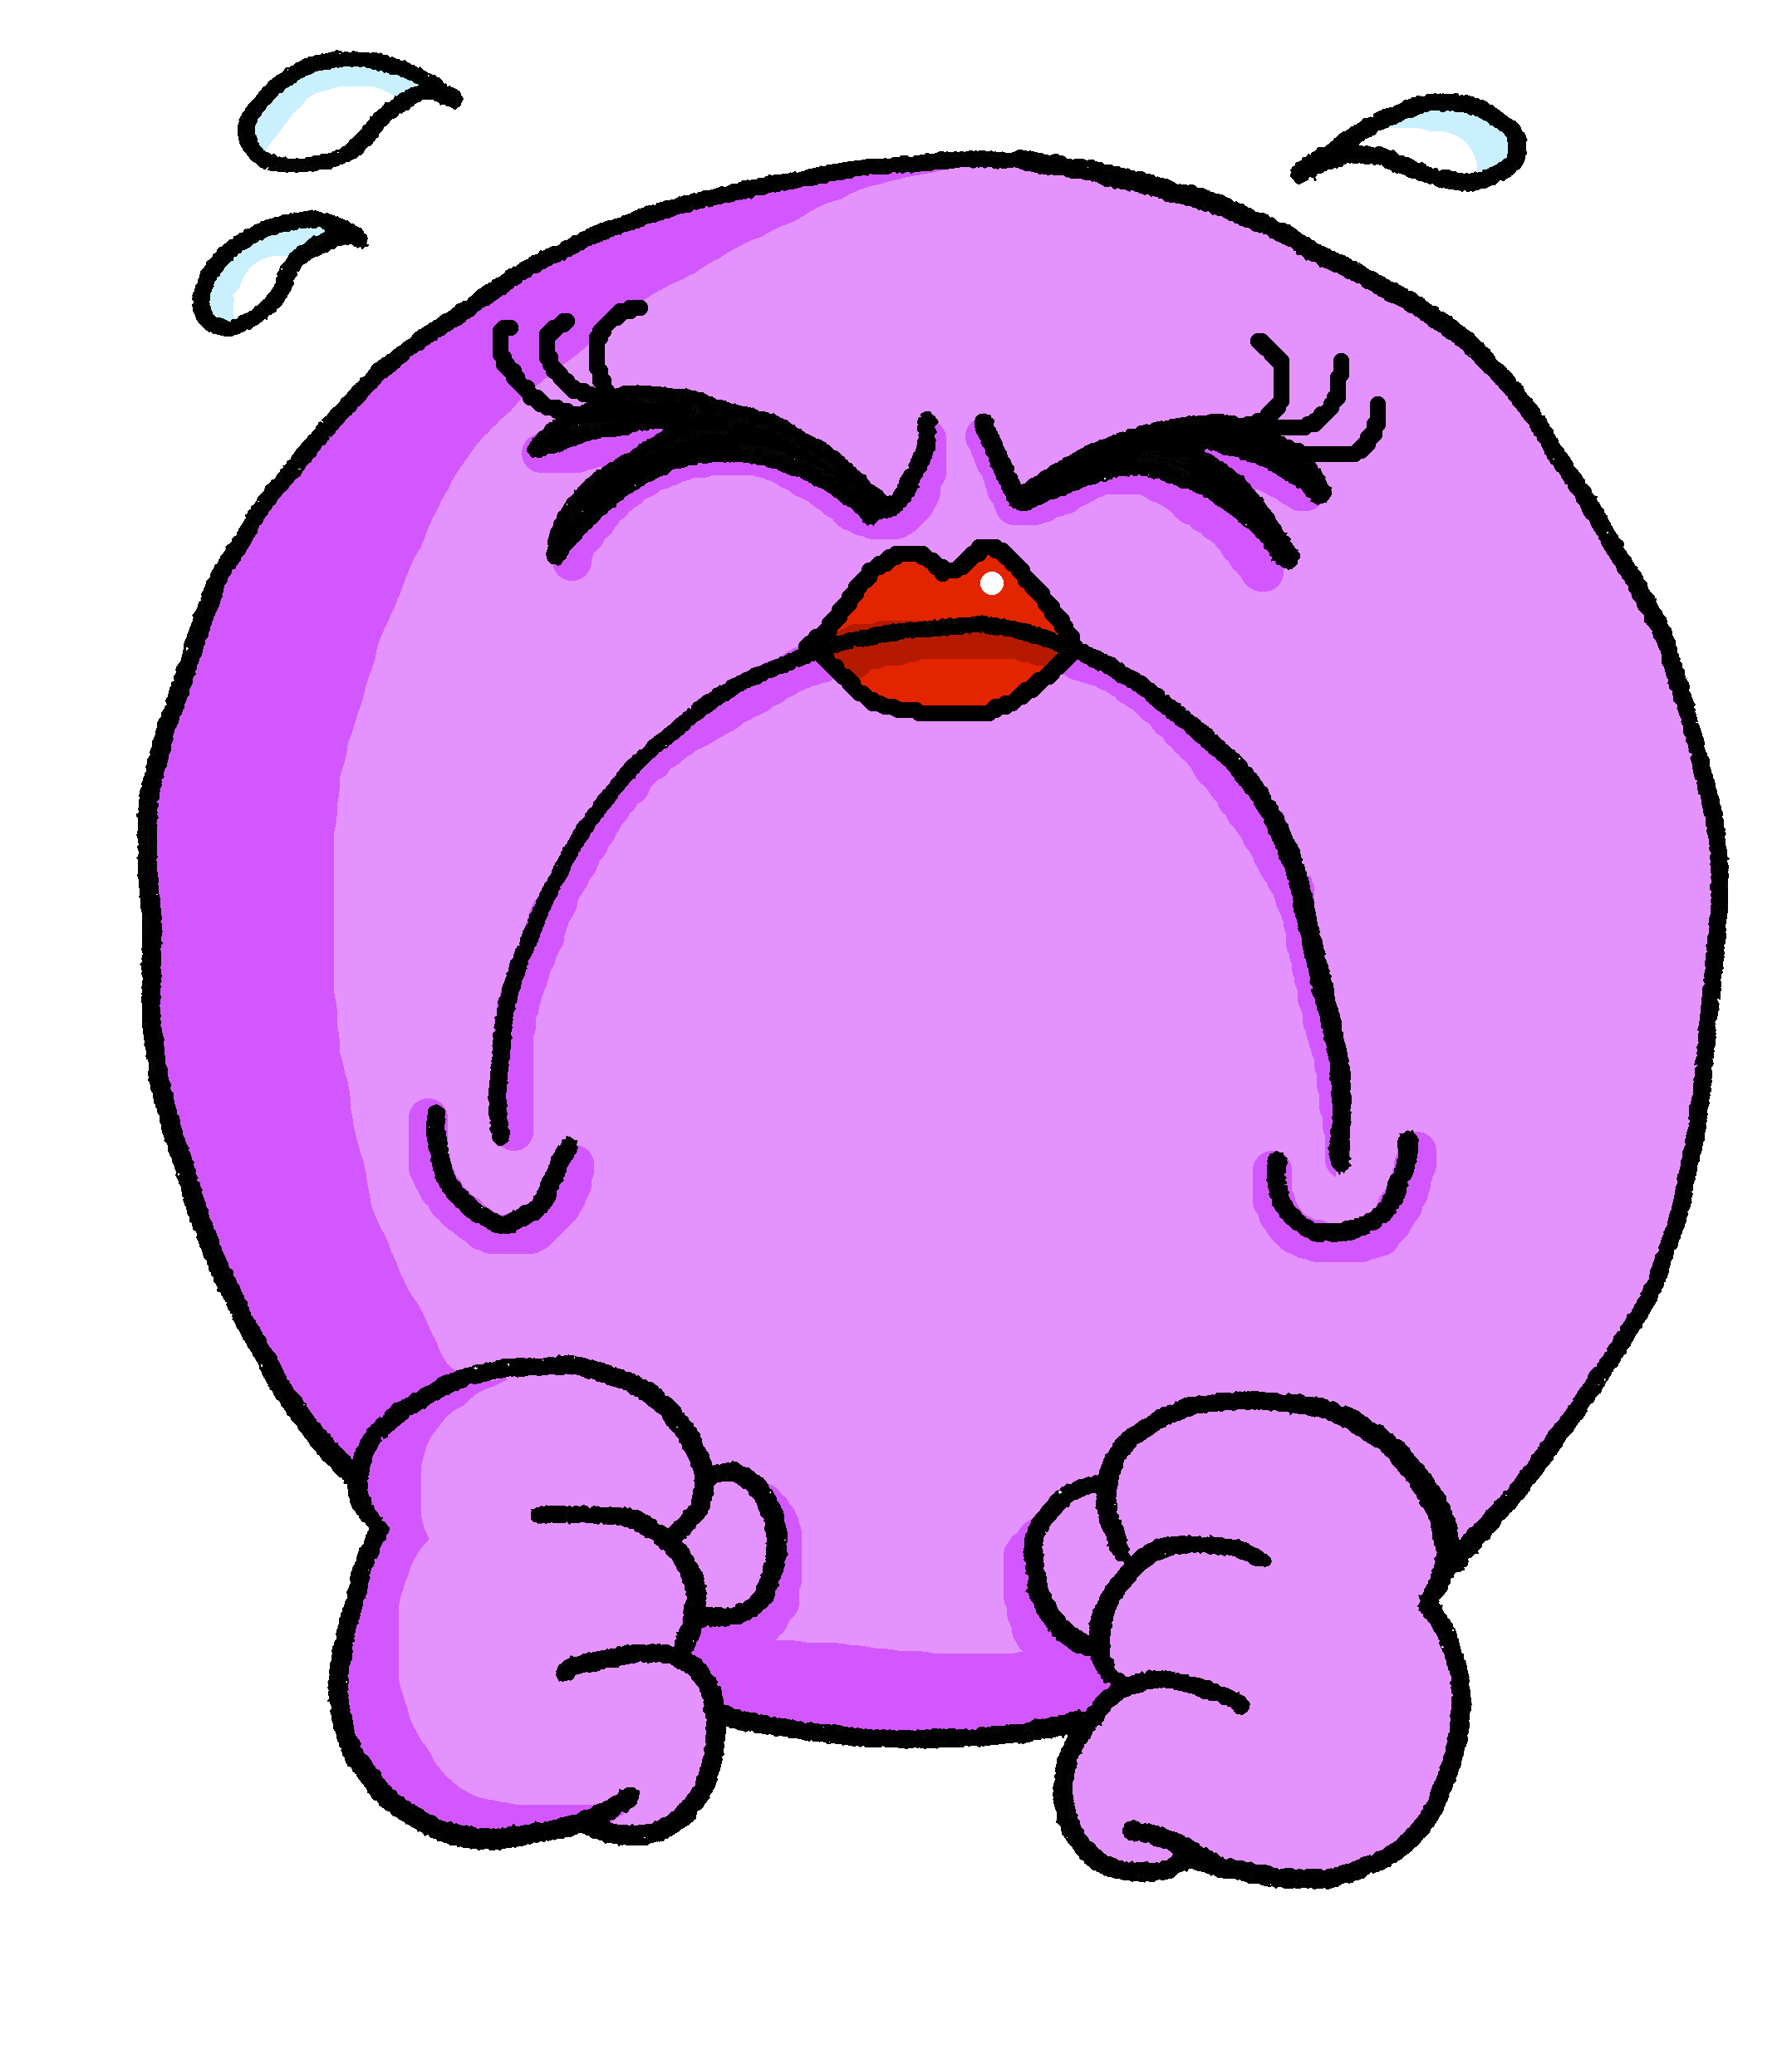
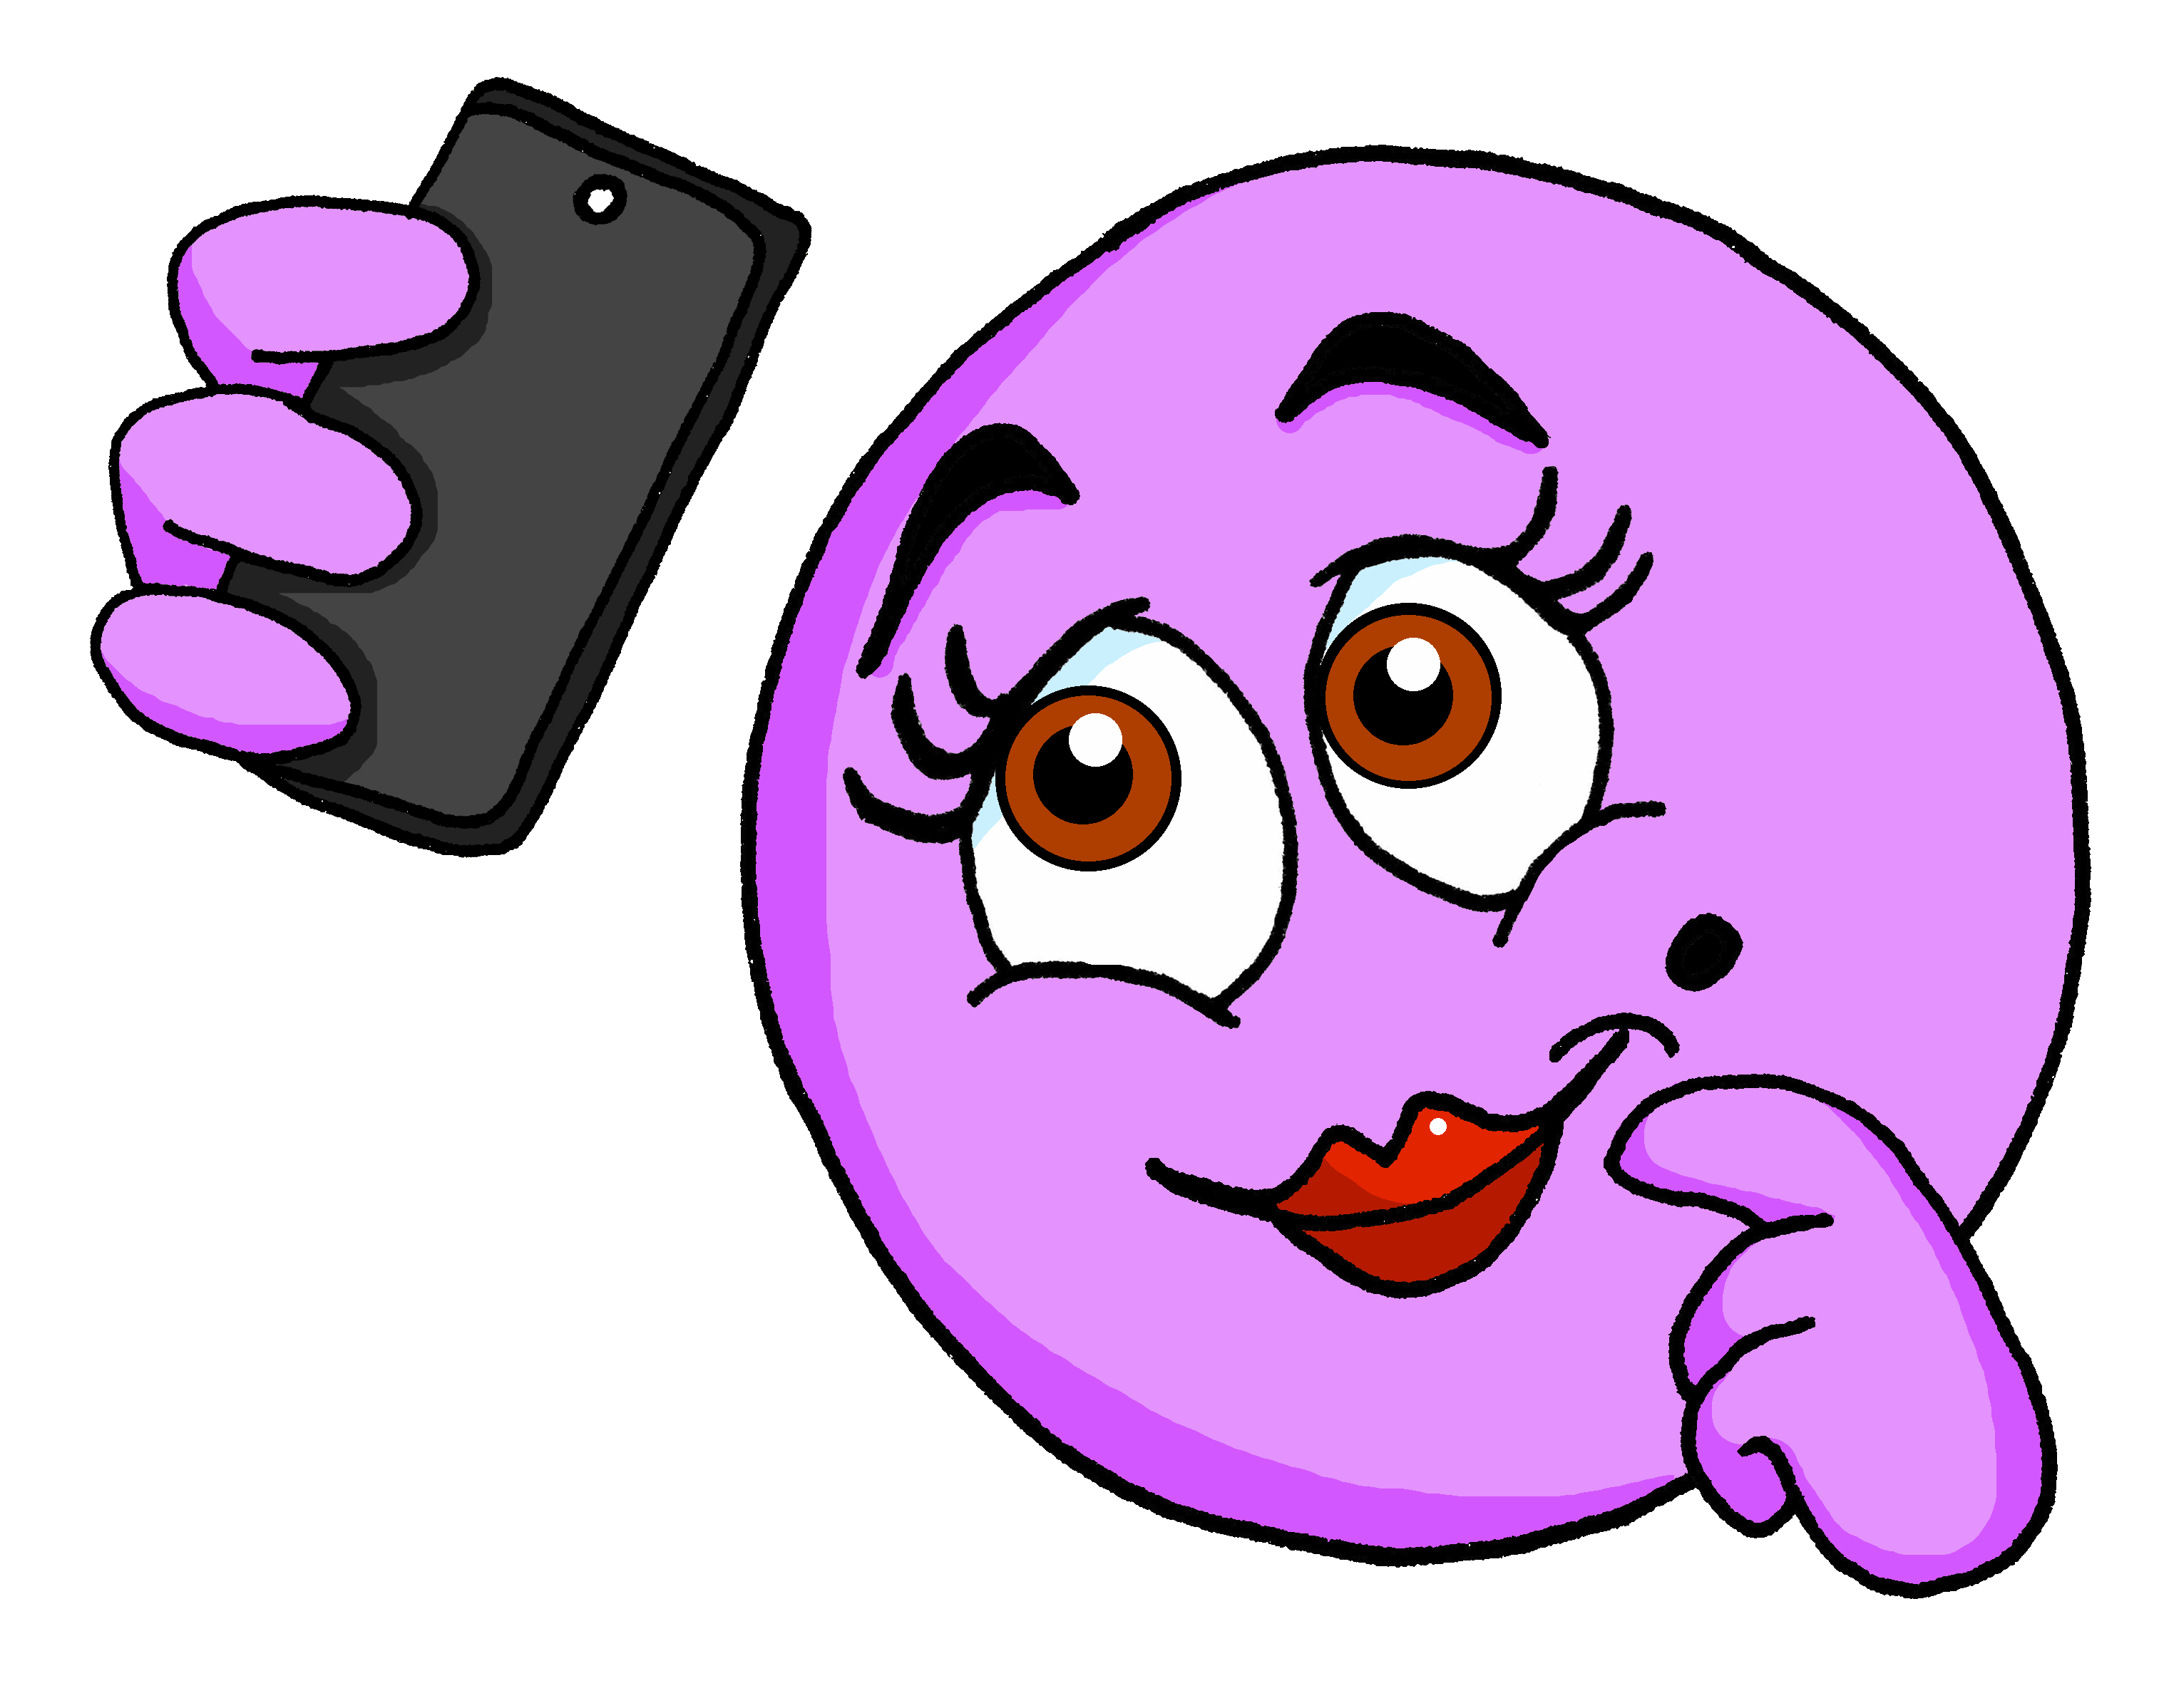
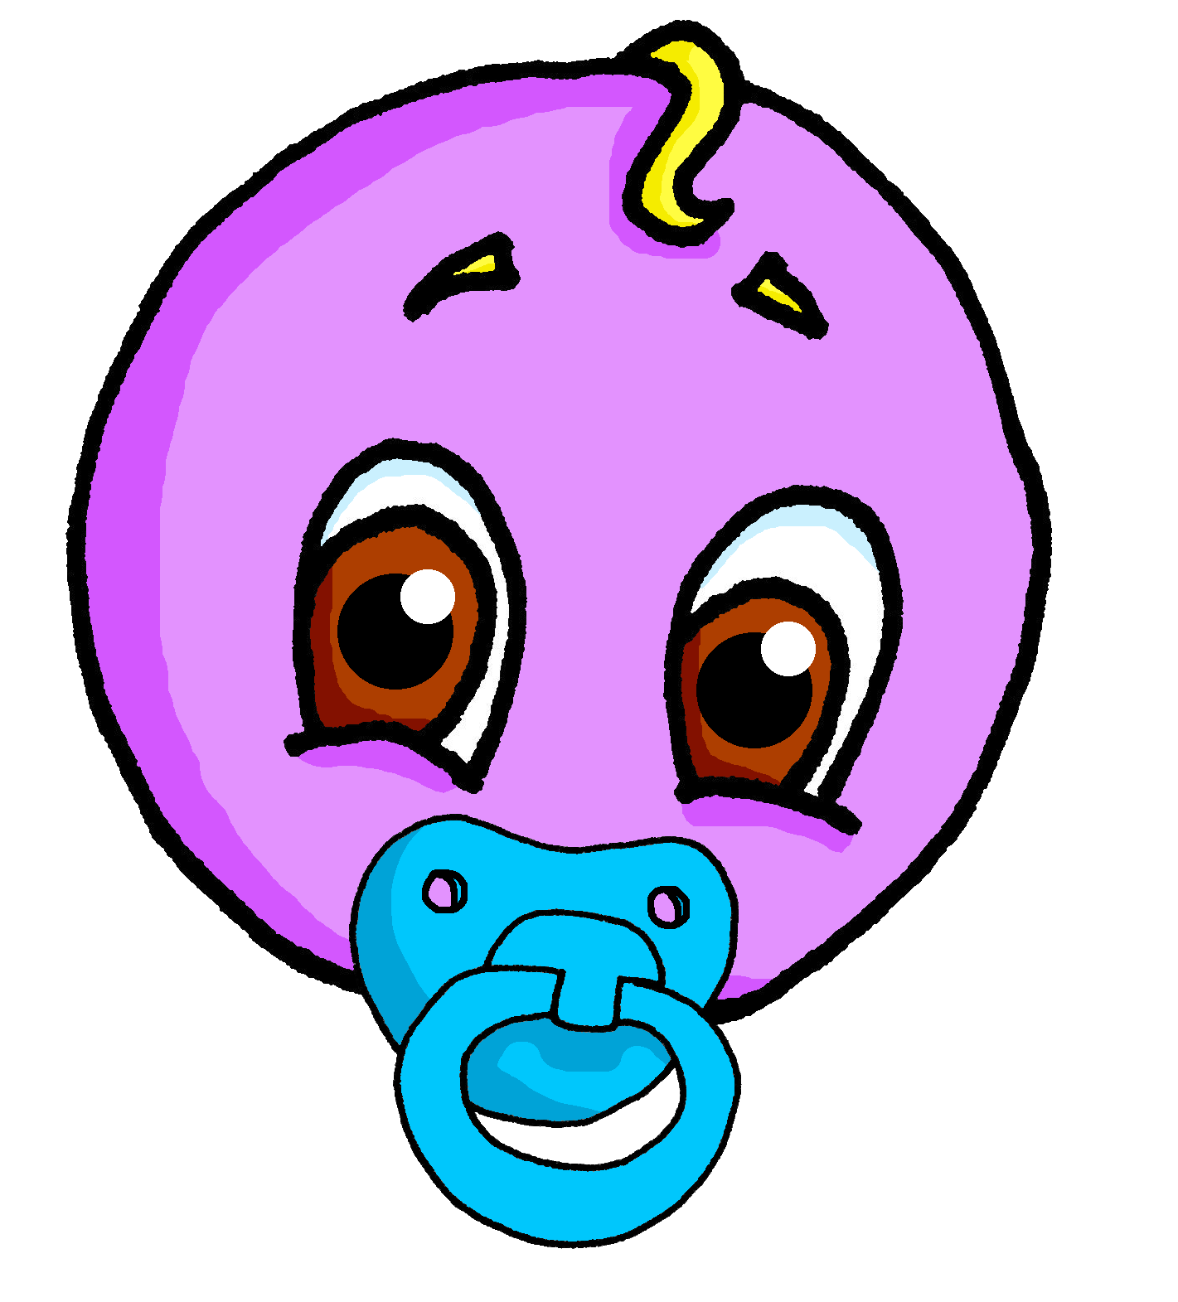
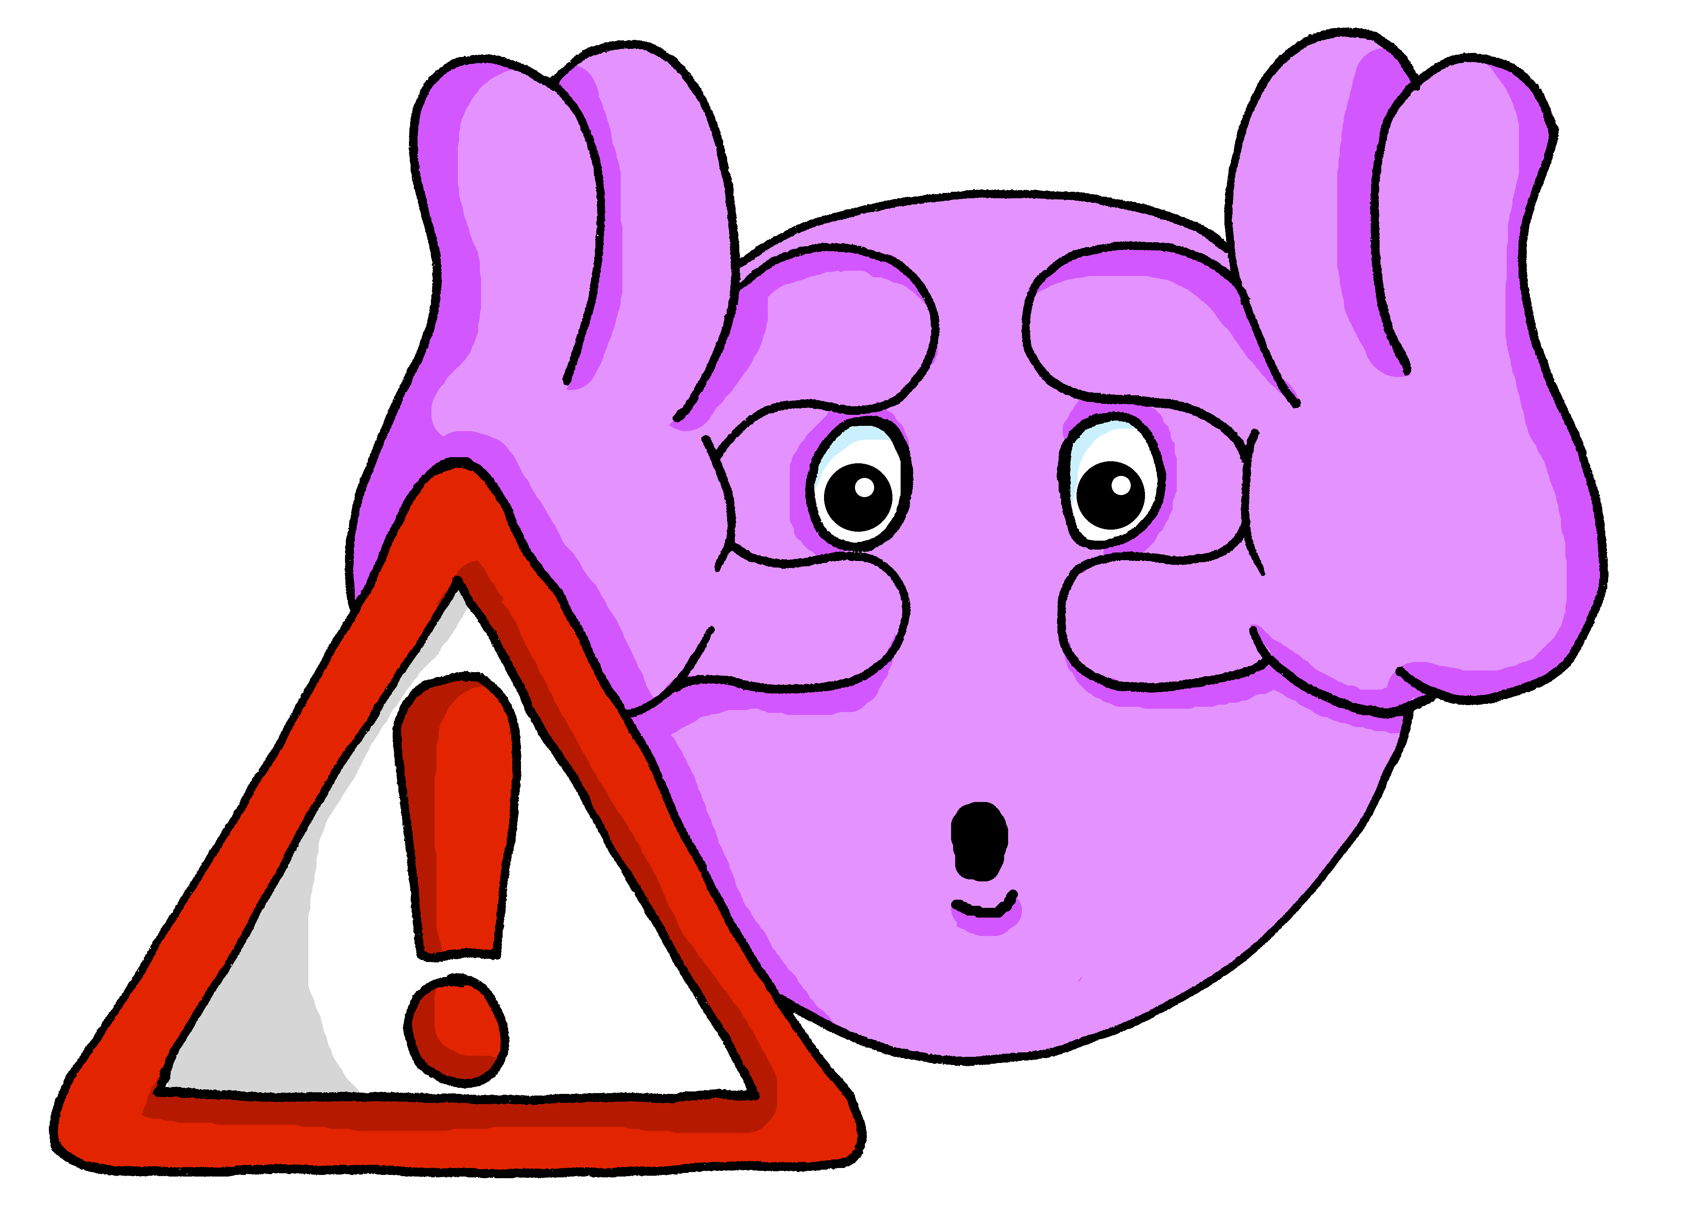
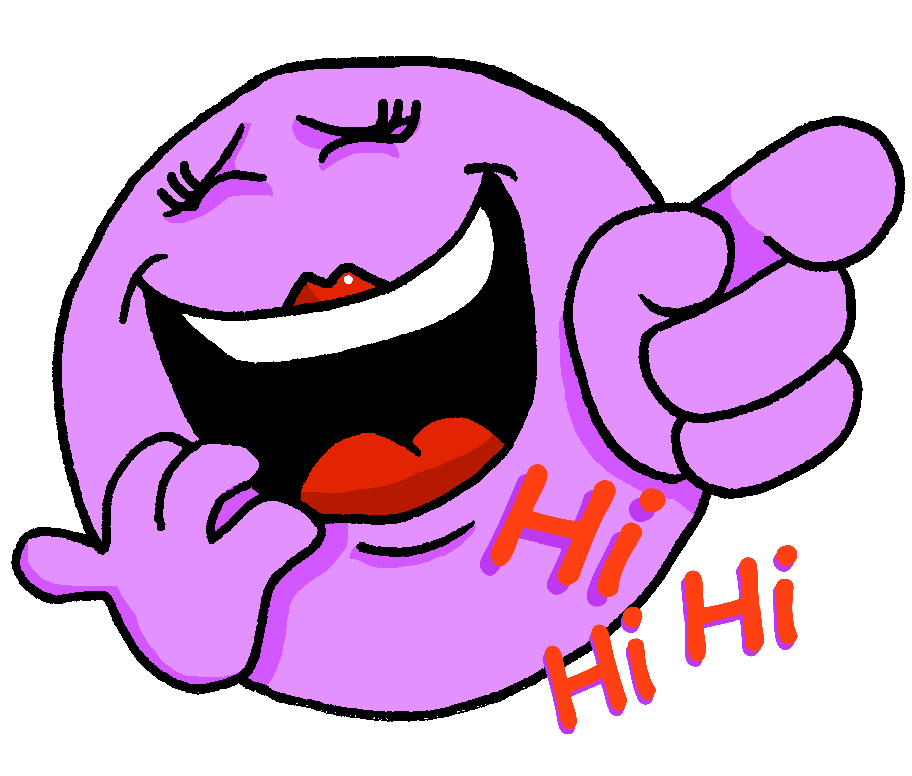
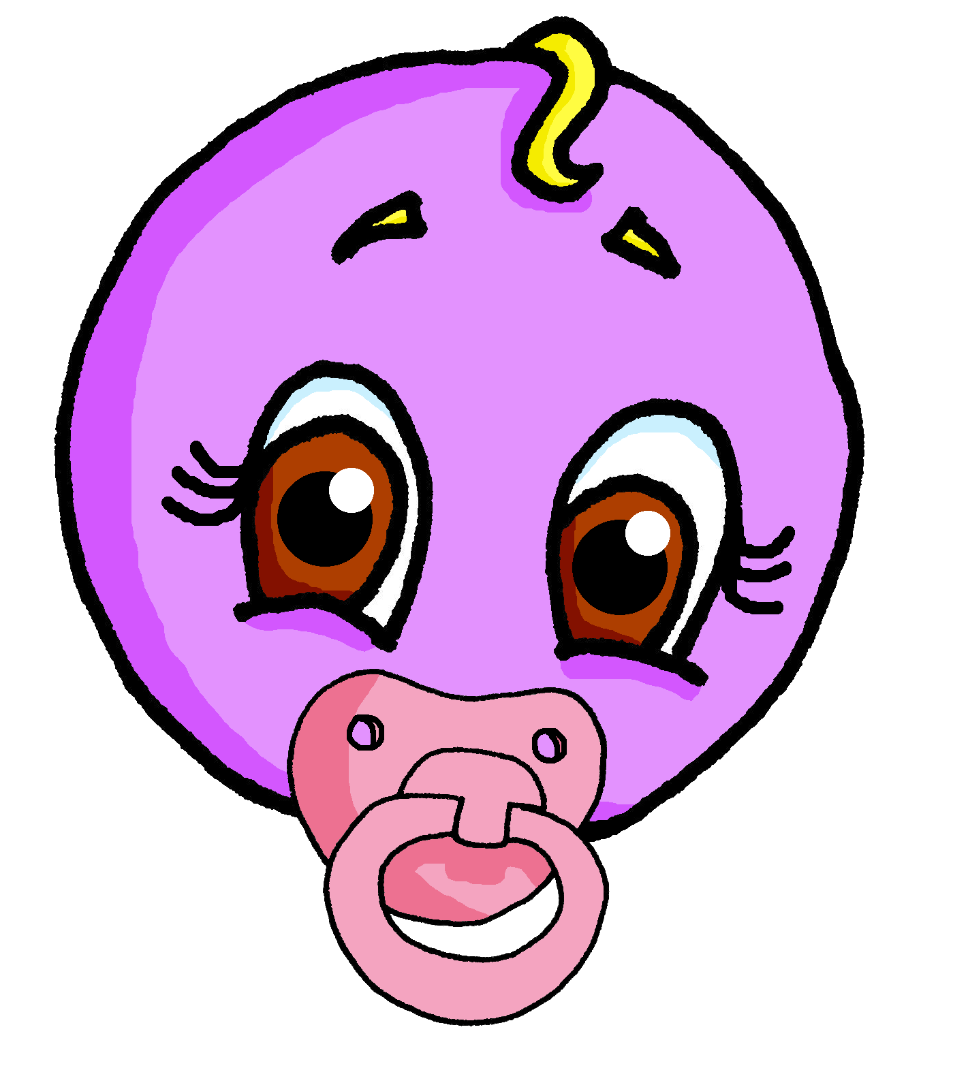
Follow up 3
C’est une question ou une phrase ?
parler
1
Elle est difficile
5
Elle est jolie
3
2
Il est jeune
6
Il est absent
S
3
Il est joli
7
Elle est prudente
4
Elle est drôle
8
Elle est jeune
0
DÉBUT
Notes:
Timing: 5 minutes
Aim: to practise oral production of statements and intonation questions (and again with a time limit).
Procedure:
Explain to the class that half will speak and half will listen, then they will swap.
Half of the class turns away from the board.
Click to bring up the punctuation for number 1. Pupils say the question.
The listening half responds, saying ‘question’. Alternatively, they could put up the right hand for questions, left hand for statements.
Continue with items 2-4.
Swap roles and complete items 5-8.
With the whole class facing the board, complete all items again, this time clicking Début to start a 3-second timer each time, to speed up production.

Slide 6
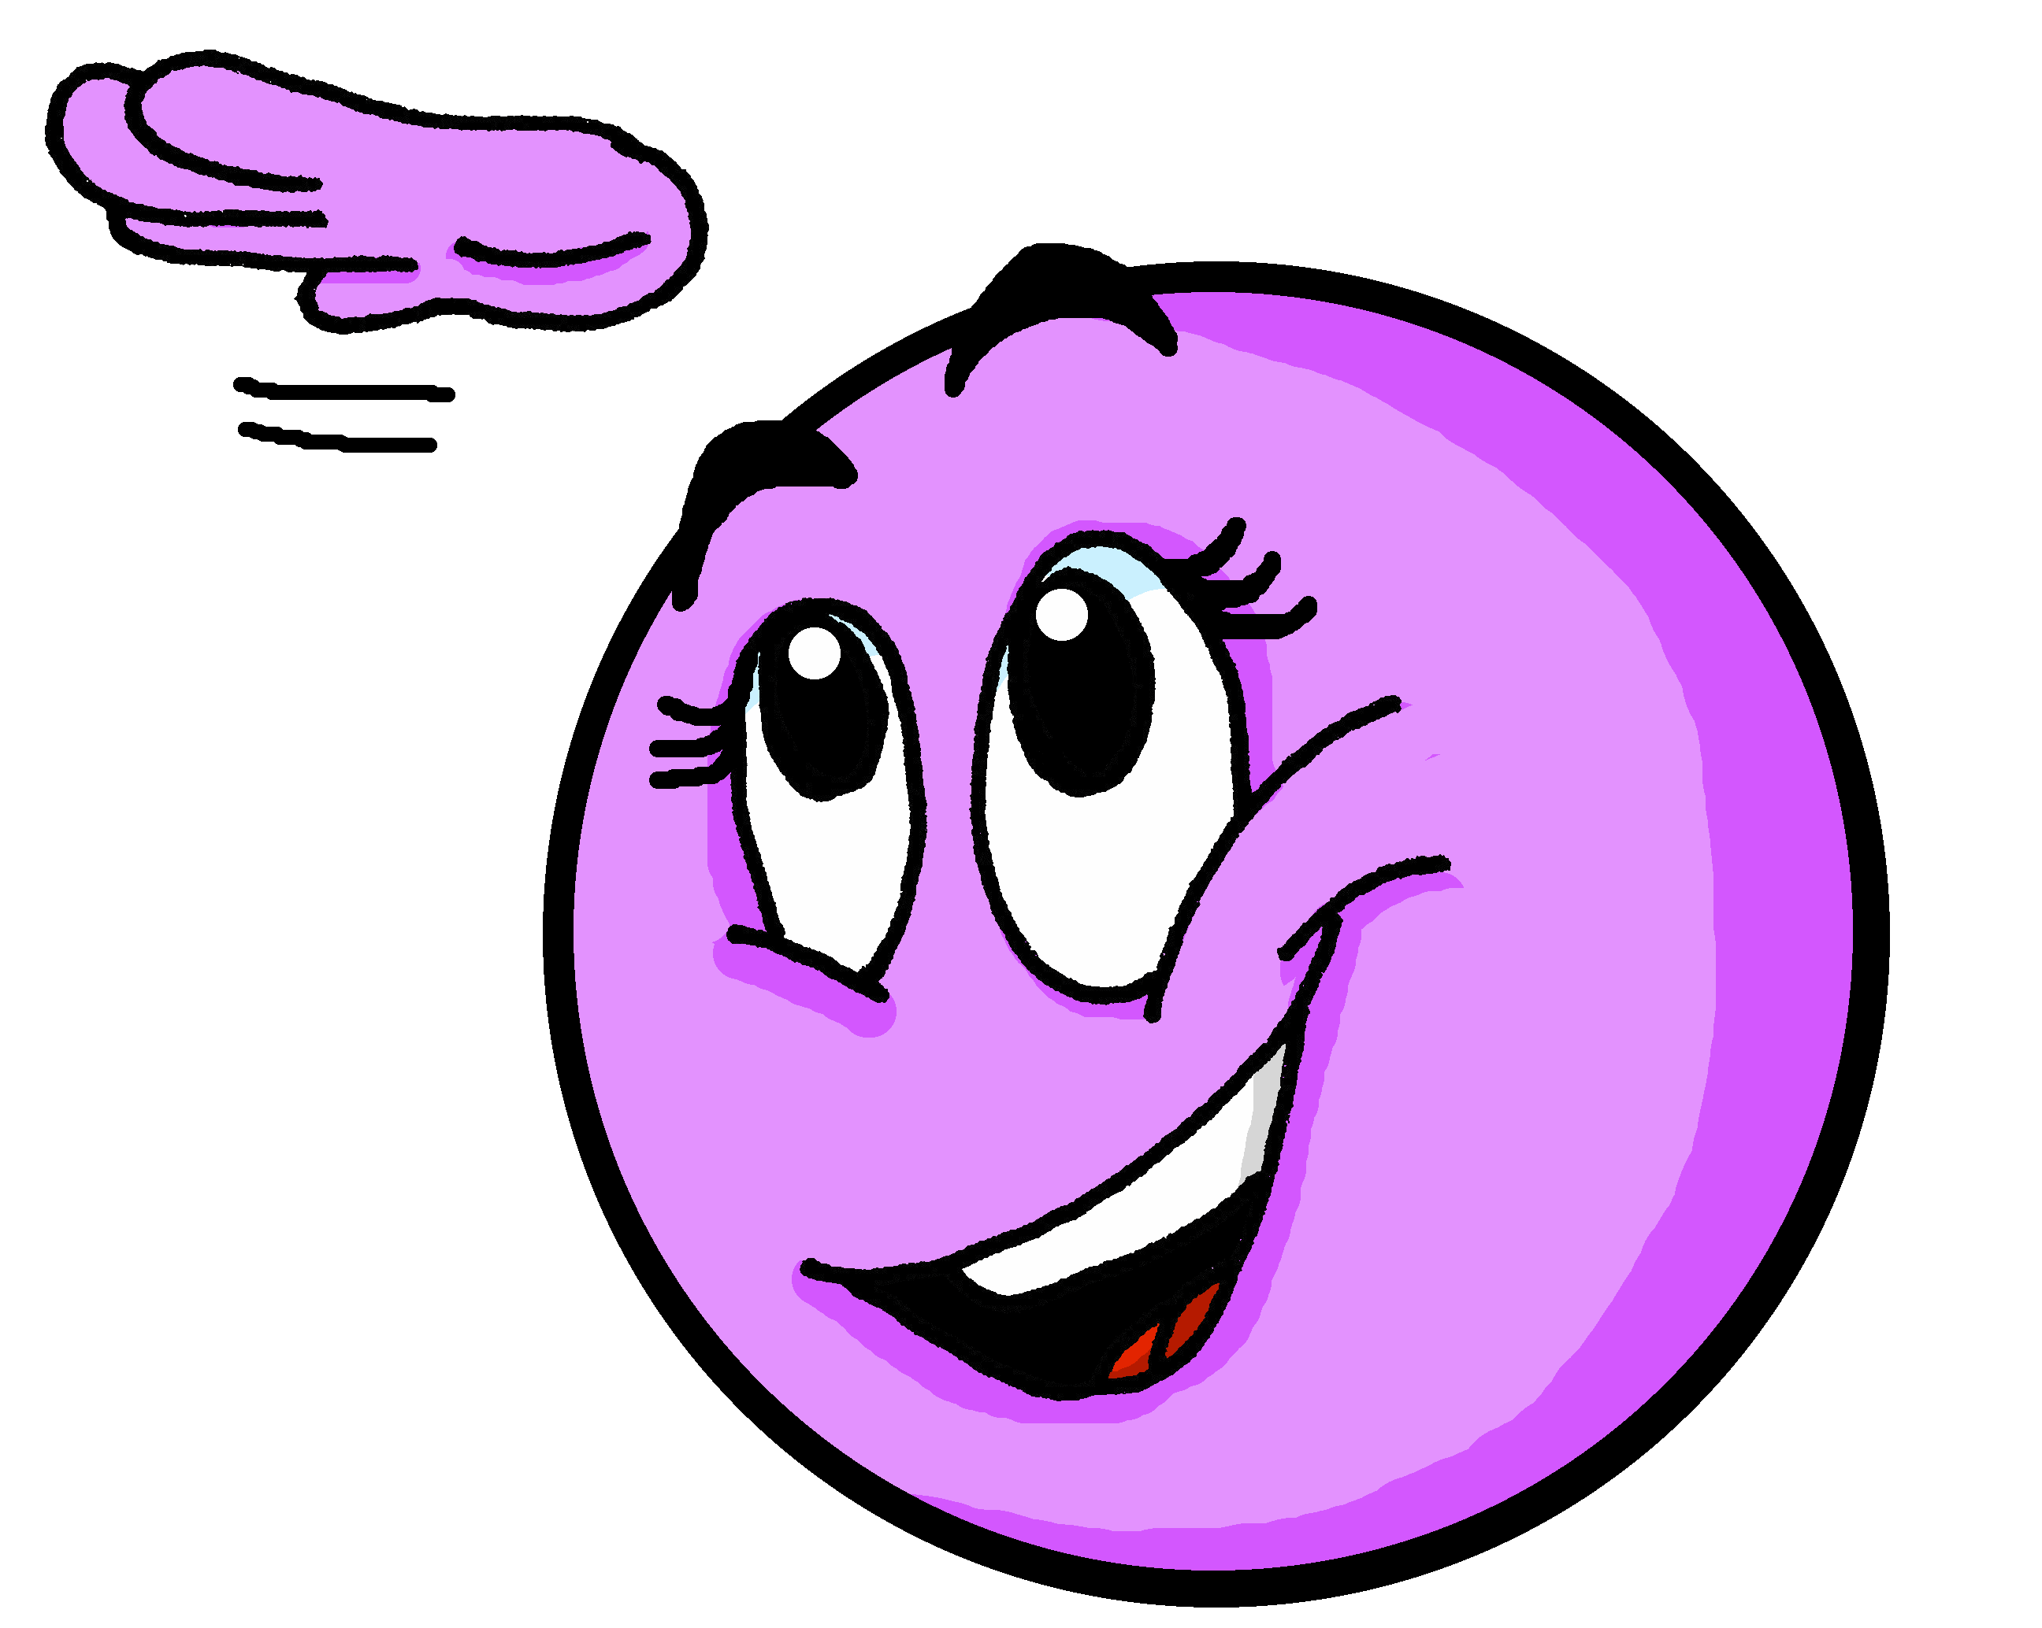
Follow up 4: Il est …? Elle est …?
Elle est difficile ?
Il est prudent ?
parler
1
5
60
2
6
S
3
7
Oui !
No !
4
8
0
DÉBUT
Notes:
Timing: 5 minutes
Aim: to use raised intonation and adjectival agreement in oral production to guess their partner’s characters as quickly as possible.
Procedure:
Partner A and B choose one of the eight emojis and writes down (in secret the phrase that describes that emoji (paying attention to the gender, too).
Partner B asks intonation questions to try to guess Partner A’s emoji. S/he has 60 seconds to guess it.
Pupils swap roles and repeat the process.

Slide 7
Follow up 5
.
Écris en français.
1 | I am important.
2 | You are funny.
3 | She is difficult.
4 | He is young.
écrire
Je suis prudent(e)
Je suis prudent(e) ?
Tu es drôle.
Tu es drôle ?
Elle est difficile.
Elle est difficile ?
Il est jeune.
Il est jeune ?
Can you make these sentences into a question?
Notes:
Timing: 10 minutes
Aim: to practise written production of full sentences using this week’s new vocabulary.
Pupils write the sentences (or the individual words) that they can write from memory.
Ask early finishers to turn the statements into questions, paying attention to the punctuation (i.e. the space between the final word and the question mark).
Click to elicit answers from pupils orally and bring up the answers.

