Slide 1
Describing me and others
Pierre
Yves
Jean-Michel
jaune
Follow ups 1-5
Notes:
Artwork by Steve Clarke. Pronoun pictures from NCELP (www.ncelp.org). All additional pictures selected from Pixabay and are
available under a Creative Commons license, no attribution required.
Frequency of new words:
Phonics: enfant [126] grand [59]
Vocabulary: indépendant [954] différent [350] important [215] prudent [1529] seul [102] tu [112] es [5]
Londsale, D., & Le Bras, Y. (2009). A Frequency Dictionary of French: Core vocabulary for learners London: Routledge.
The frequency rankings for words that occur in this PowerPoint which have been previously introduced in these resources are given
in the SOW and in the resources that first introduced and formally re-visited those words.
For any other words that occur incidentally in this PowerPoint, frequency rankings will be provided in the notes field wherever
possible.
Note that the first three lessons of the year teach language that can be continuously recycled as lesson routine every lesson in Y3/4.
The idea would be that the class teacher (whether or not s/he teaches the class French can re-use the language as part of the daily routine with the
class.

Slide 2
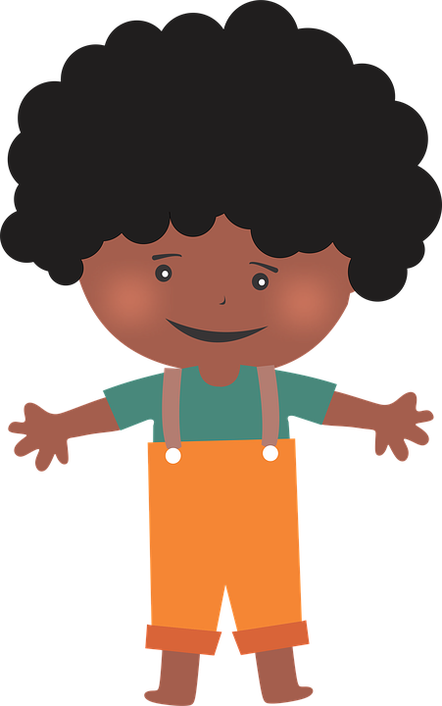
Follow up 1a
[an/en]
enfant
Lis : l’intrus, c’est quoi ?
Which name does or does not have the SSC [an/en]?
Ange
Anne
André
1
Jeanne
André
Marianne
2
3
Alexandre
Laurence
Denis
4
Stéphane
Antoine
Henri
Jean
Hannah
Nathan
5
Notes:
Timing: 5 minutes (two slides)
Aim: to practise spoken production of this week’s SSC [an/en] and differentiation from other similar sounds.
Procedure:
Click to bring up the prompt.
Pupils pronounce the names out loud and identify the odd one out – either the one that does or the one that doesn’t have the SSC [an/en].
Click for the answers.
If desired, click on each number to hear the three names pronounced.
Note: an less challenging alternative would be to complete the task as a listening. Blank the screen. Click on each number. Pupils note which one (1, 2, 3) does not have the sound [an/en].

Slide 3
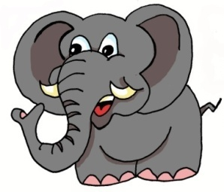
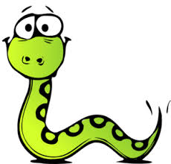
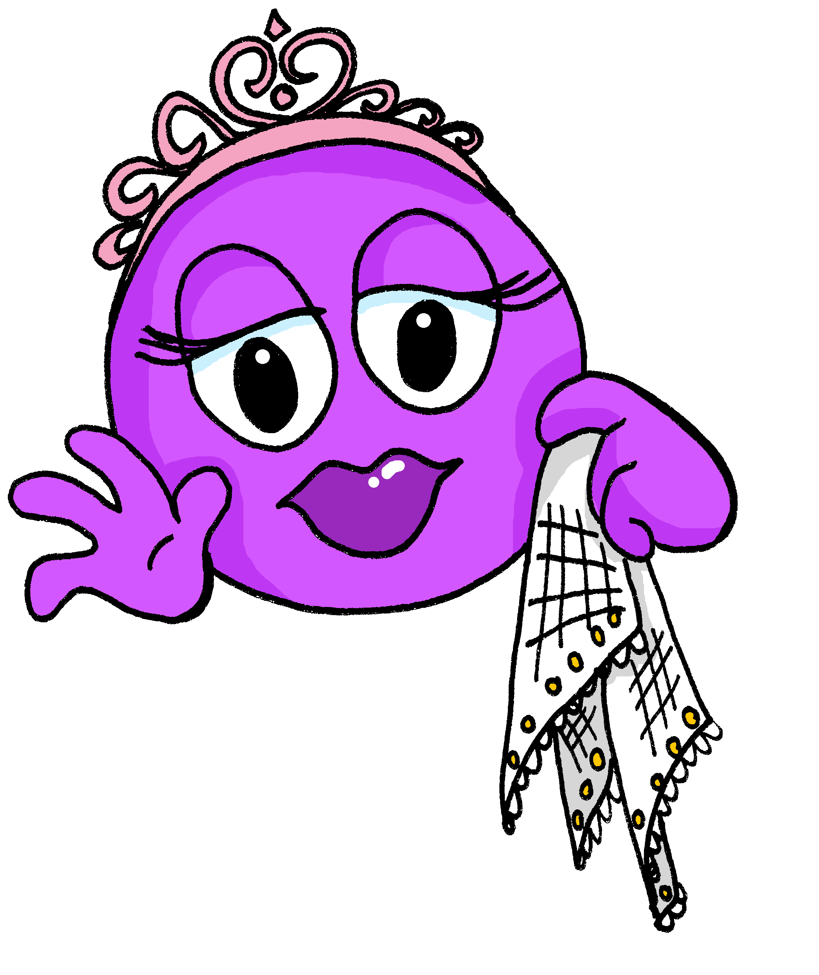
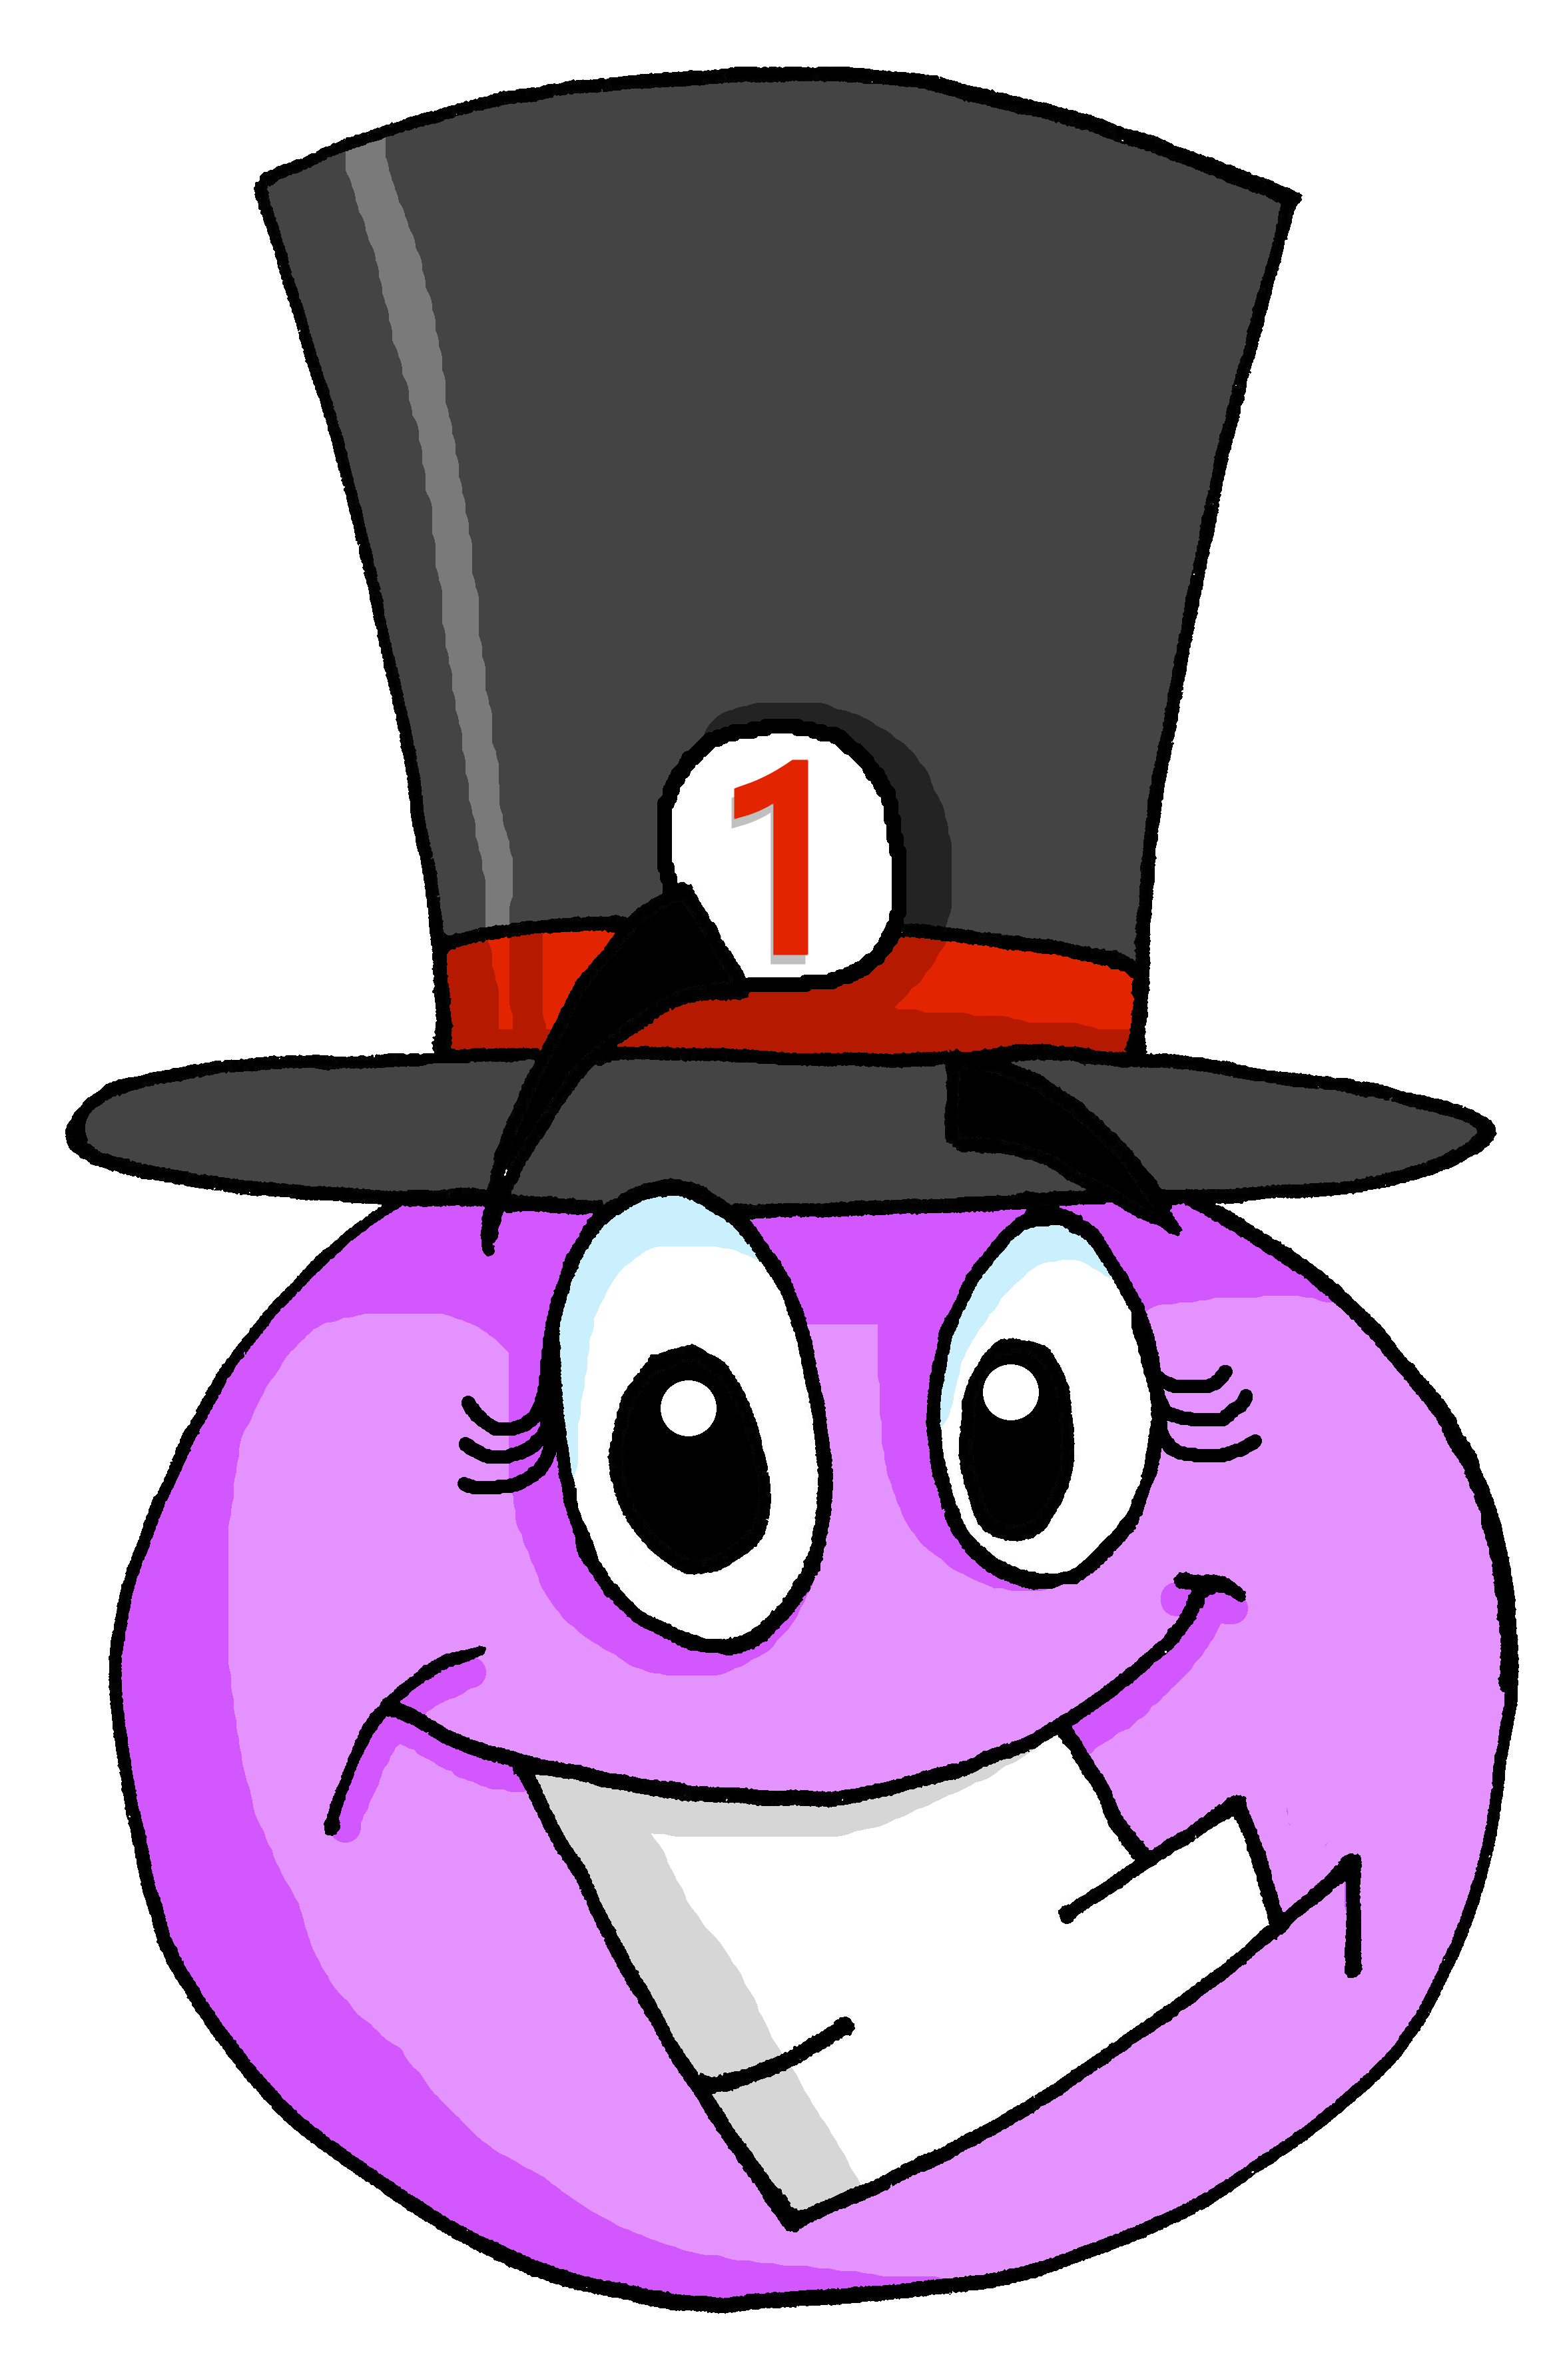
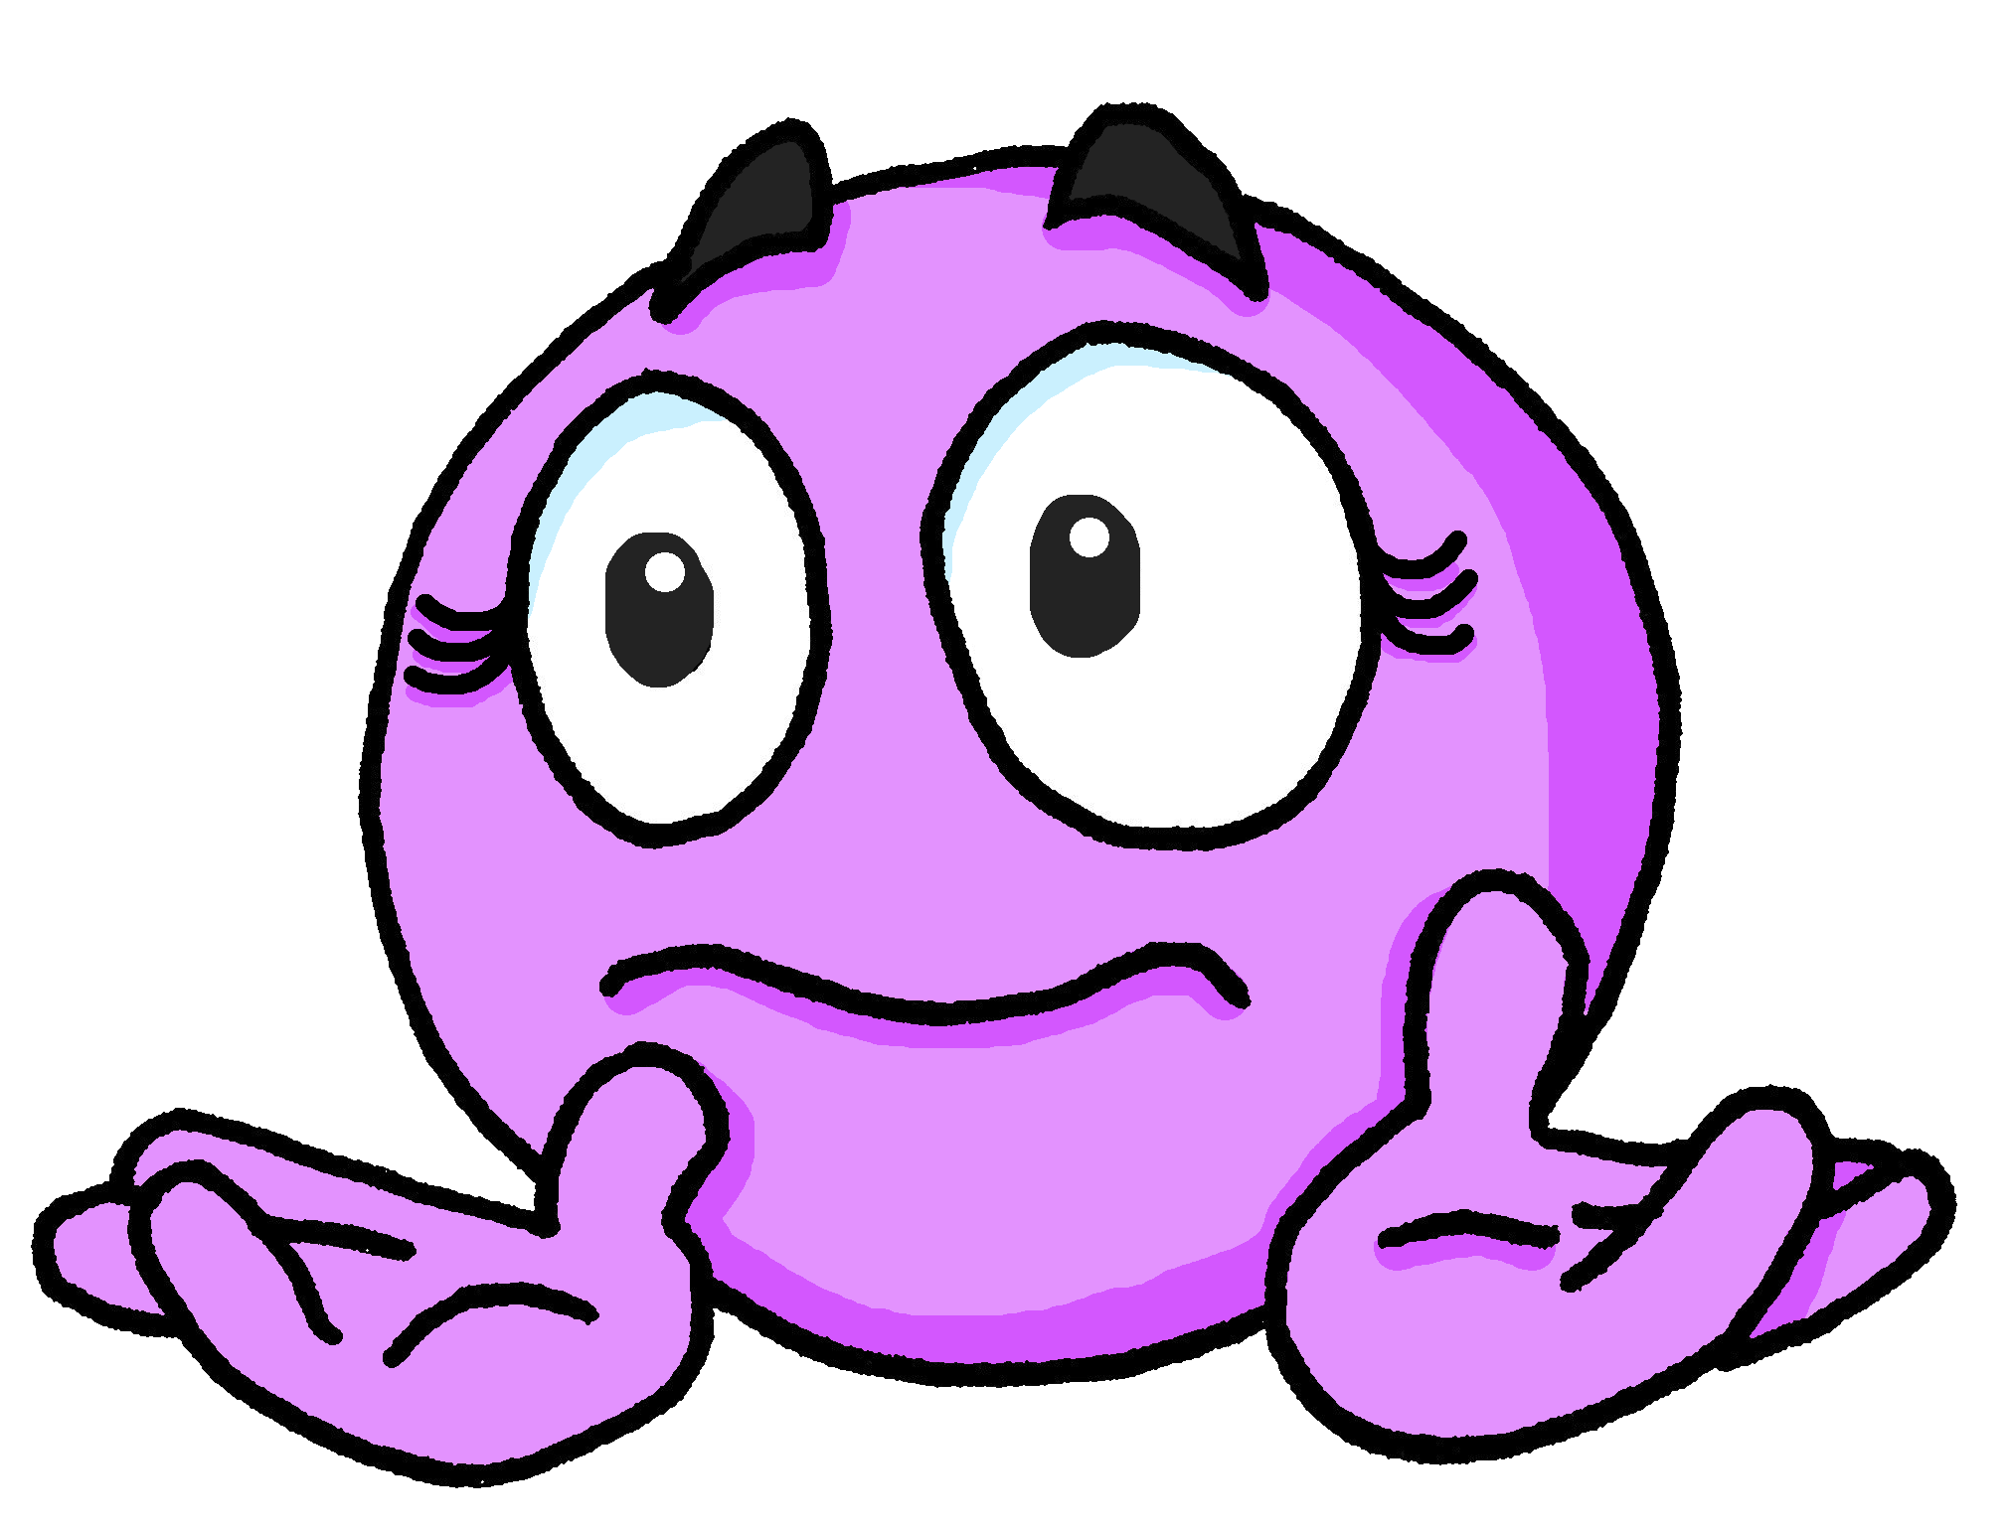
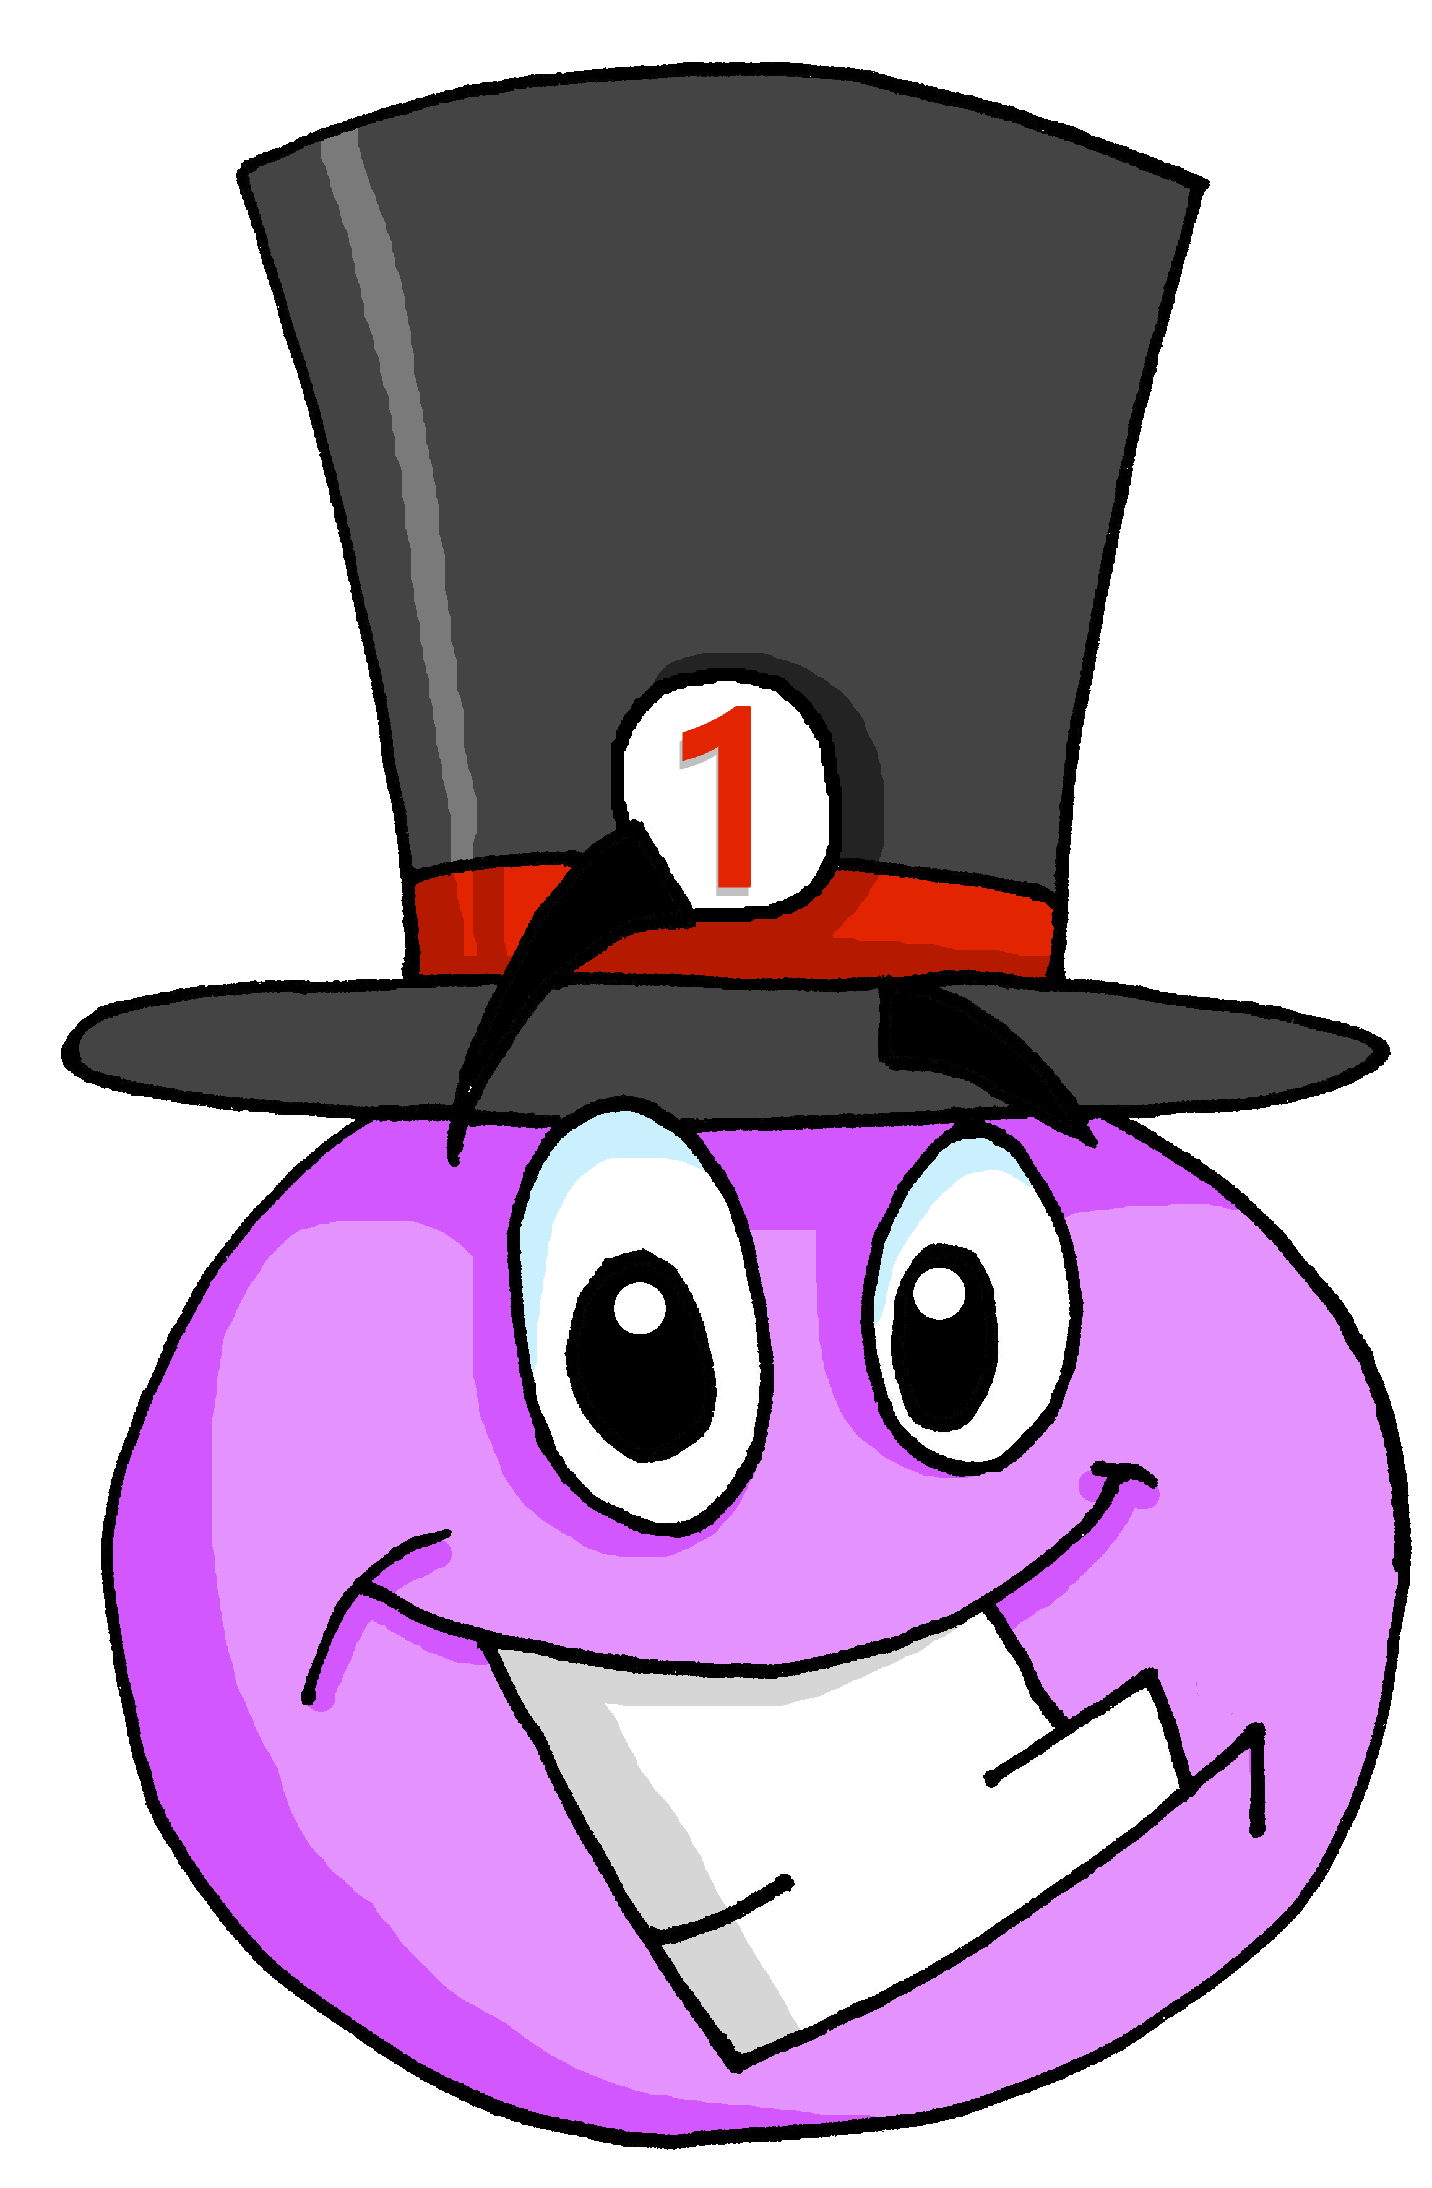
Follow up 1b
Prononce les mots.
prononcer
éléphant
serpent
enfant
content
30
différent
grand
élégante
prudent
S
importante
élégant
présente
différente
0
grande
contente
important
absent
DÉBUT
Notes:
Aim: to practise spoken production (read aloud) of words containing the SSC [an/en], and differentiating between silent final consonant and silent final ‘e’, when the consonant is sounded.
Procedure:
Pupils apply their phonics knowledge to read aloud these words, a mixture of known words and unknown cognates.
Each pupil has 30 seconds to pronounce as many of the words as possible.
The listening partner can send his/her partner back to the start if s/he hears the [an/en] pronounced with English pronunciation or the ‘t’ sounded when it should be silent, or not sounded, when it should be heard (in the feminine forms).
Teacher circulates to listen and support, as needed.
Pupils swap roles.

Slide 4
Follow up 2 :
Using adjectives
Remember to add ‘e’ to adjectives to make the feminine form:
The ‘d’ and ‘t’ are not pronounced.
Je suis grand.
I (a boy) am tall.
Masculine
An ‘e’ at the end, means you do pronounce the ‘d’ and ‘t’.
Il est petit.
He is short.
Je suis grande.
I (a girl) am tall.
Feminine
Elle est petite.
She is short.
Notes:
Timing: 5 minutes (two slides)
Aim: to revisit the previously taught pattern of adjective agreement (from Week 2).
Procedure:
Read the grammar explanation about adjective agreement.
Elicit English translation for the French examples provided.
Draw pupils’ attention to the SFC ‘t’ and to the change you hear when an ‘e’ is added.

Slide 5
Follow up 2 :
Monsieur Lemaire is asking the children some questions.
Look at the adjective. Decide if the pupil is a boy or a girl.
Écris 1-8 et le nom de la personne.
lire
la liste
Ex. | Adèle | Olivier | tu es prudente ?
1 | Anne | Milo | tu es seul ?
2 | Lucas | Callie | tu es petit ?
3 | Maxime | Hannah | tu es seule ?
4 | Patrice | Naomie | tu es grande ?
5 | Sophie | Oscar | tu es indépendant ?
6 | Pascal | Mia | tu es prudent ?
7 | Odile | Ali | tu es importante ?
8 | Charlotte | Amir | tu es indépendante ?
Notes:
Aim: to practise written understanding of masculine and feminine adjective forms and to connect them to meaning.
Procedure:
1. Explain the task. Ensure pupils know that the only way they will know if the teacher is asking a boy or a girl each question is by look at the form of the adjective he uses. 2. Pupils write 1-8 and the name of the pupil for each. 3. Click for answers and clarify any misunderstandings. 4. If time allows, revisit the meaning of the adjectives by asking questions. E.g. Who is asked these questions: 1. who is tall? 2. who is alone?

Slide 6
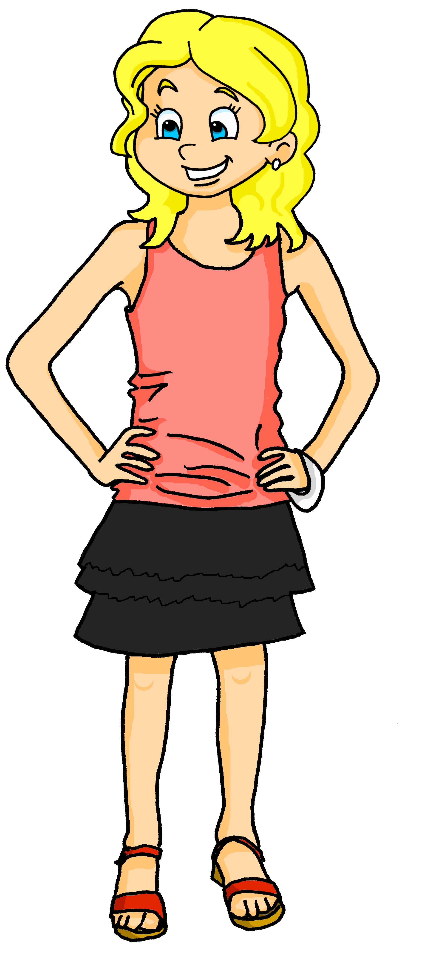
Follow up 3 [1/5]
Écoute.
Who is Adèle talking to? Her friend Léa or her brother Pierre?
écouter
Tu es prudente.
Pierre
Léa
Notes:
Timing: 5 minutes (five slides)
Aim: to practise aural recognition of masculine and feminine adjective forms and connect them to the correct gender.
Procedure:
Click on Adèle to hear her speak.
Pupils listen and select the correct person who is being addressed.
Click for answer and to see the written form of Adèle’s utterance.
Transcript: Tu es prudente.

Slide 7
Follow up 3 [2/5]
Écoute.
Who is Adèle talking to? Her friend Léa or her brother Pierre?
écouter
Tu es différent.
Pierre
Léa
Notes:
[2/6]
Transcript: Tu es différent.

Slide 8
Follow up 3 [3/5]
Écoute.
Who is Adèle talking to? Her friend Léa or her brother Pierre?
écouter
Tu es indépendant.
Pierre
Léa
Notes:
[3/5]
Transcript: Tu es indépendant.

Slide 9
Follow up 3 [4/5]
Écoute.
Who is Adèle talking to? Her friend Léa or her brother Pierre?
écouter
Tu es importante !
Pierre
Léa
Notes:
[4/5]
Transcript: Tu es importante !

Slide 10
Follow up 3 [5/5]
Écoute.
Who is Adèle talking to? Her friend Léa or her brother Pierre?
écouter
You can hardly hear the difference between seul and seule (–eule sounds a little longer than –eul) but you can see it in writing.
Tu es seule !
Pierre
Léa
Notes:
[5/5]
Transcript: Tu es seule !
Note: pupils are unlikely to hear a difference and may choose both (or they might just choose Pierre). The animated answers and callout explain that you can hardly hear the feminine –e ending on seule – there is just a slightly longer –eul sound in the feminine form - but in writing you can see the difference. After the callout, the box around Pierre is removed as he is no longer a possible answer.

Slide 11
Follow up 4 :
Tu es grand.| Il est prudent. | Elle est seule.
Say sentences to locate the hidden characters.
parler
important
independent
tall
different
careful
alone
You are
He is
She is
Notes:
Timing: 5 minutes (up to three rounds of the game)
Aim: to practise oral production of tu es, il est, elle est important(e), grand(e), different(e), indépendant(e), prudent(e) and seul(e), connecting these with the English meanings.
Procedure: 1. Explain that pupils are Adèle and trying to locate Pierre, Yves and Léa.
2. Model how they create a sentence to try to locate each person.
E.g. Teacher says Tu es important. Mouse over and click on the square to reveal what is underneath, in this case nothing. 3. Pupils volunteer sentences to locate the characters. Click on each square to make it fly out.
Note:
i) It is important to make clear that each character could be hiding behind any adjective, not just the ones that pupils think apply to him/her from the narrative so far! ii) However, each character is in the row his/her picture is in to support connection between words and meaning of the pronouns and verb forms. iii) There are two further versions of the game, with characters in different positions.
Answers: Pierre is under you are alone (tu es seul). Yves is under he is tall (il est grand). Léa is under she is different (elle est différente).

Slide 12
Follow up 4 :
Tu es grand.| Il est prudent. | Elle est seule.
Say sentences to locate the hidden characters.
parler
important
independent
tall
different
careful
alone
You are
He is
She is
Notes:
[2/3]
Answers: Pierre is under you are careful (tu es prudent). Yves is under he is tall (il est grand). Léa is under she is tall (elle est indépendante).

Slide 13
Follow up 4 :
Tu es grand.| Il est prudent. | Elle est seule.
Say sentences to locate the hidden characters.
parler
important
independent
tall
different
careful
alone
You are
He is
She is
Notes:
[3/3]
Answers: Pierre is under you are different (tu es différent). Yves is under he is important (il est important). Léa is under she is careful (elle est prudente).

Slide 14
Follow up 5 :
Écris.
Complete each English sentence with an adjective.

Write your sentence in French.
1 _____________________________
écrire
Tu es important | importante.
Decide if you are talking to a boy or a girl.
important
(You are _______________).

Je suis prudent | prudente.
2 _____________________________
Here you are talking about yourself.
careful
(I am ____________).

3 _____________________________
Elle est grande.
How do you write the adjective if you are talking about a girl?
tall
(She is ____________).
Notes:
Timing: 5 minutes
Aim: to practise scaffolded written production of this week’s new language.
Procedure: 1. Pupils first select an adjective (from this week) to complete the English version of the sentence. 2. Then they write the sentence translation in French. 3. Before pupils start, click for the call out to prompt them. The animations are set up to do each sentence and then check, give feedback.
Note: There are answers given to model the process but pupils can select any of the adjectives that they know for this task.

Slide 15
vocabulaire
Écris en anglais : Can you get at least 15 points?
mots
 | banane | moto | écouter
 | univers | cheval | midi
 | oui | bien | ça va ?
 | non | Au revoir ! | mal
 | important | seul | prudent
 | tu | différent | indépendant
 | grande | grand | es
banana
motorbike
to listen, listening
x3
universe
horse
midday
yes
good/well
is it going ok?
x2
no
Goodbye!
bad(ly)
important (m)
alone (m)
careful (m)
you
different (m)
independent (m)
x1
tall (f)
tall (m)
are
Notes:
EXTRA Note: this activity was in the 30-minute lesson for this week, but if time allows, pupils could do it again with different words this time to make their total of 15. Or they could try to do all of it. Or the teacher could use it as a quickfire meaning recall task. Timing: 5 minutes
Aim: to practise written comprehension of vocabulary from week 1, last week and this week.
Procedure: 1. Give pupils a blank grid. They fill in the English meanings of any of the words they know, trying to reach 15 points in total. 2. Remind pupils that adjectives can refer to male or female persons and they should note this in their translations. E.g. pleased (f), short (m).
Note: The most recently learnt and practised words are pink, words from the previous week are green and those from week 1 are blue, thus more points are awarded for them, to recognise that memories fade and more effort (heavy lifting!) is needed to retrieve them.
15

