Slide 1
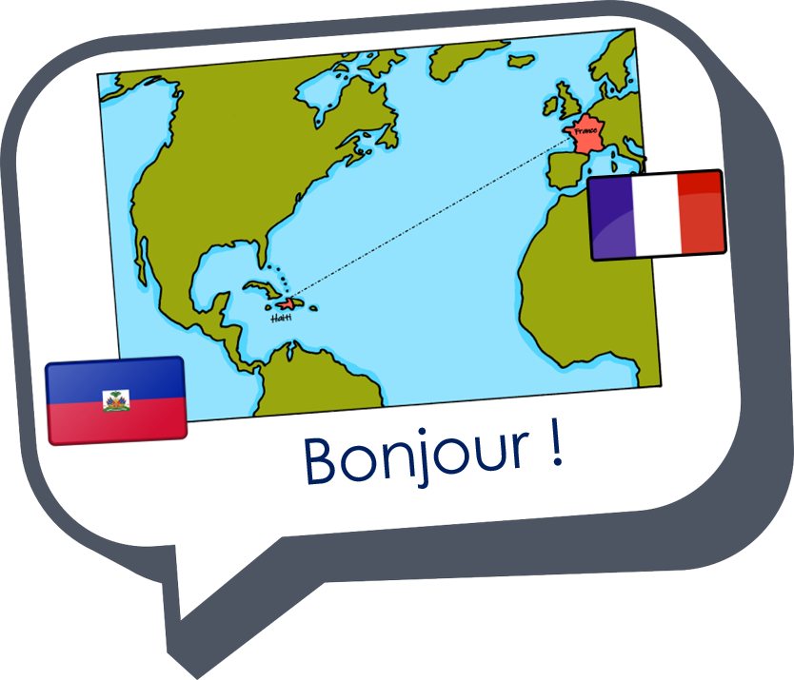
Describing me and others
jaune
Follow ups 1-5
Notes:
Artwork by Steve Clarke. Pronoun pictures from NCELP (www.ncelp.org). All additional pictures selected from Pixabay and are available under a Creative Commons license, no
attribution required.
Frequency of new words:
Phonics: mais [30]
Vocabulary: Ça va ? Ça va. [54/53] bien [47] mal [277] Oui [284] Non [75] Au revoir [4/1274]
Londsale, D., & Le Bras, Y. (2009). A Frequency Dictionary of French: Core vocabulary for learners London: Routledge.
The frequency rankings for words that occur in this PowerPoint which have been previously introduced in these resources are given in the SOW and in the resources that first
introduced and formally re-visited those words.
For any other words that occur incidentally in this PowerPoint, frequency rankings will be provided in the notes field wherever possible.
Note that the first three lessons of the year teach language that can be continuously recycled as lesson routine every lesson in Y3/4.
The idea would be that the class teacher (whether or not s/he teaches the class French can re-use the language as part of the daily routine with the class.

Slide 2
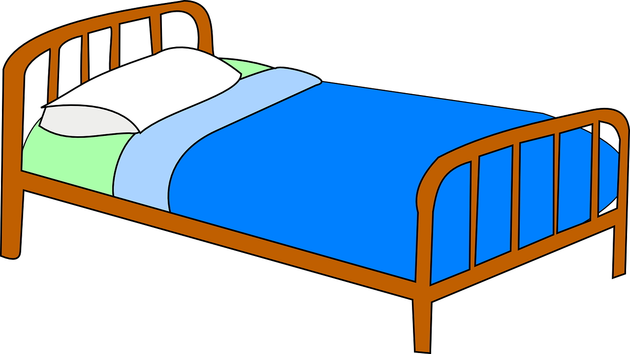
Follow up 1:
Écoute. Écris la bonne lettre.
s p o r t
B
t r o i s
m o t
écouter
1
I
A
C
2
E
word
3
A
D
p a r f a i t
E
m o i s
l i t
4
C
F
5
H
6
F
[month]
G
d e s
H
s o u s
f o r t
D
I
7
8
G
9
B
[some]
[under]
[strong]
Notes:
Timing: 5 minutes
Aim: to practise connecting sound and writing in words with silent final consonants –s and –t.
Procedure:
Click numbers 1-9 to listen to each word.
Pupils listen and write the correct letter.
Click to reveal answers.
If time allows, teacher to elicit choral read aloud from pupils by cueing with the English meanings.
Transcript: 1. fort 2. mois 3. sport 4. mot 5. sous 6. lit 7. parfait 8. des 9. trois
fort [107] mois [179] sport [2011] mot [220] sous [122] lit [1837] parfait [1600] des [2] trois [115]
Londsale, D., & Le Bras, Y. (2009). A Frequency Dictionary of French: Core vocabulary for learners London: Routledge.

Slide 3
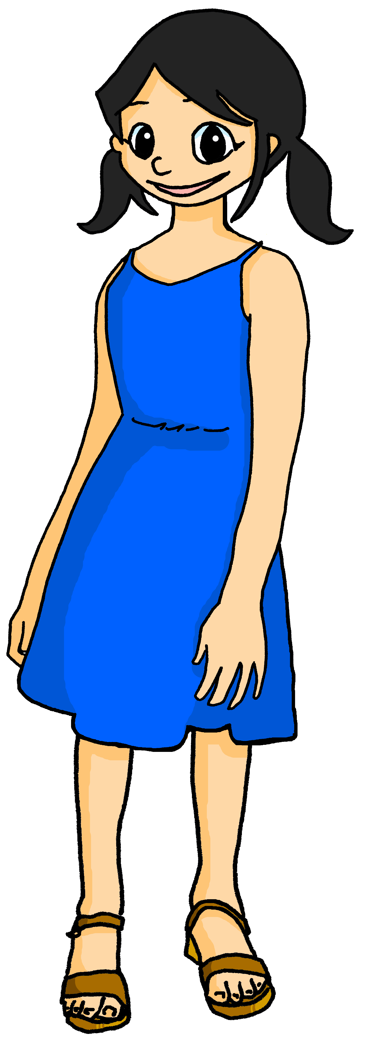
Follow up 2
Léa ‘s diary.
Léa is too busy to write much in her diary. How is her week of exams going?
lire
Lis les phrases. Draw an appropriate emoji to go with each diary entry.
1
Ça va bien.
2
Ça va.
3
Ça va bien.
4
Ça va mal.
5
Ça va.
Notes:
Timing: 5 minutes
Aim: to practise written comprehension of some of this week’s key vocabulary.
Procedure: 1. Read each phrase and draw the appropriate emoji. 2. Click to reveal answers. 3. Elicit phrases orally from students by prompting with English meanings.

Slide 4
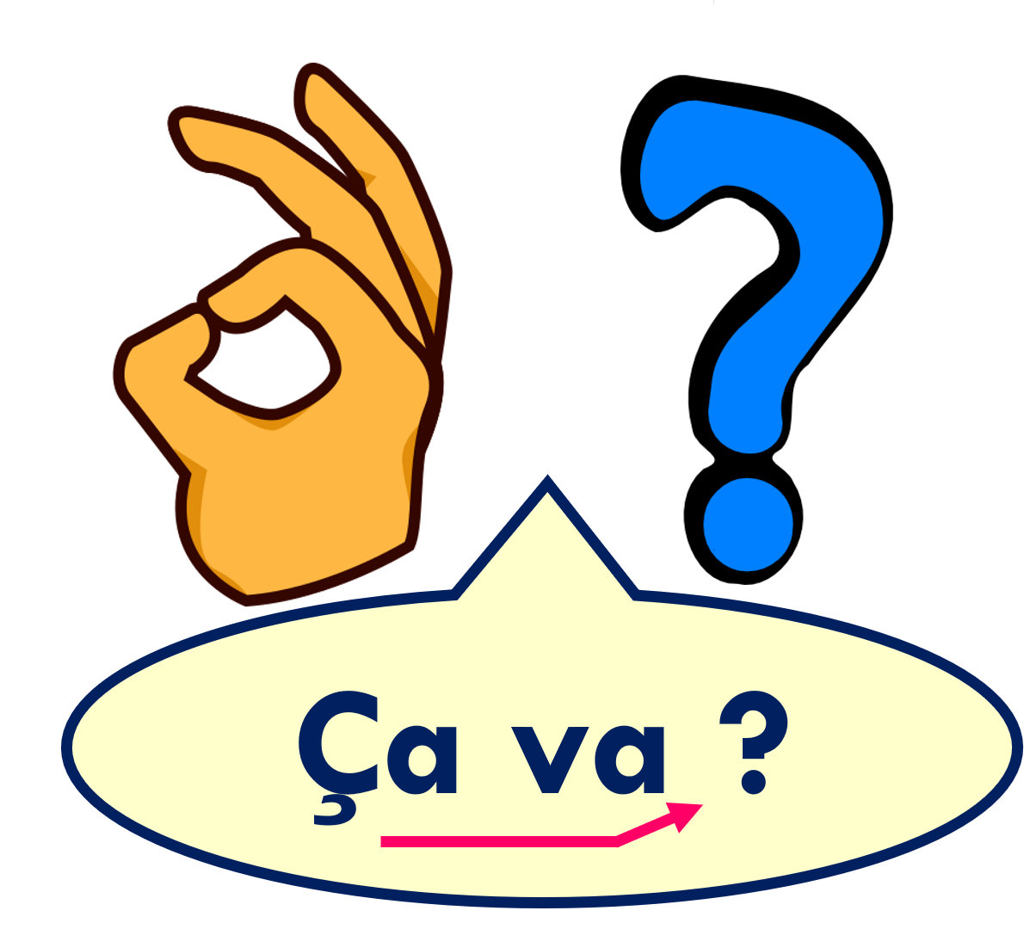
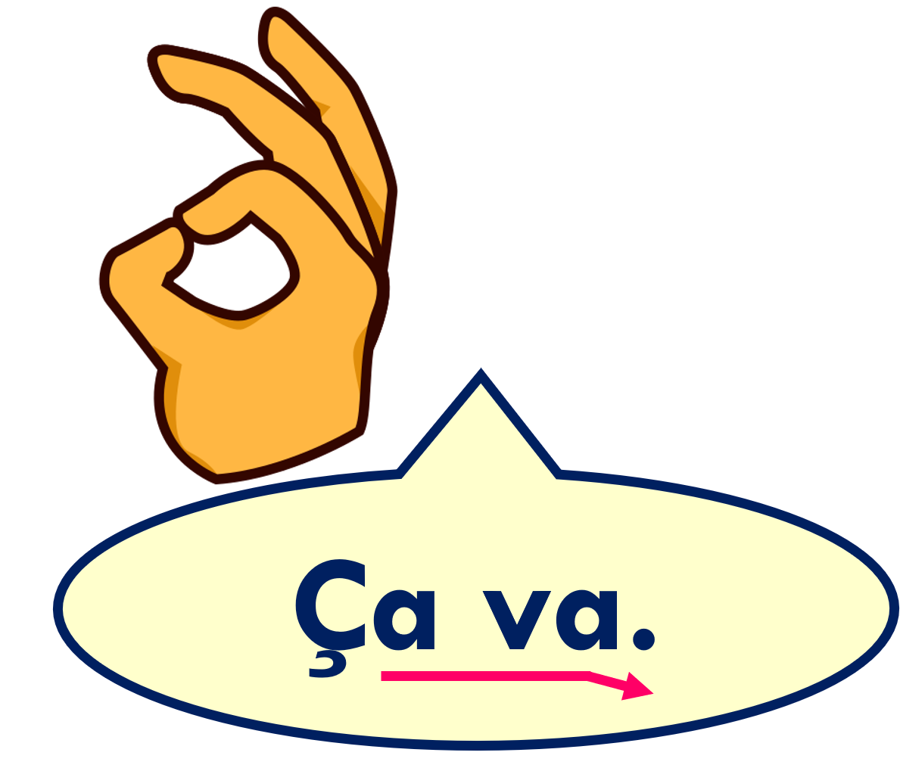
Creating questions [1/2]
To turn a statement into a question, just raise your voice at the end.
The ‘hook’ under the c changes a hard c into a soft c, pronounced s. It is called a cedilla.
This is a common way to ask ‘How are you?’ in French.
It’s going ok.
Is it going ok?
Notes:
Use this recap ahead of FOLLOW UP 3.
Timing: 1 minute (two slides)
Aim: to recap how to form intonation questions from statements.
Procedure:
Click to present information.
2. Elicit English translations for the French examples provided.
Note: Raised intonation questions will be practised formally again in Week 5.

Slide 5
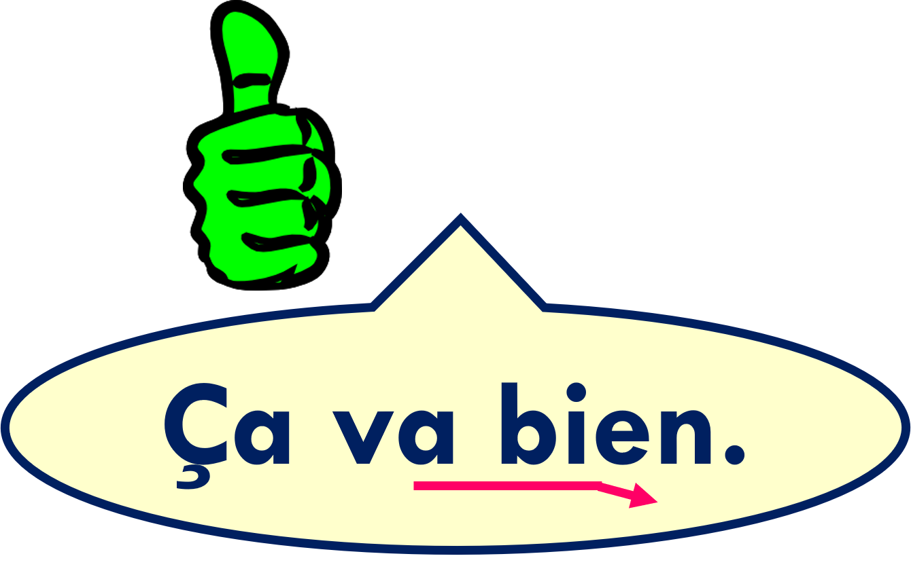
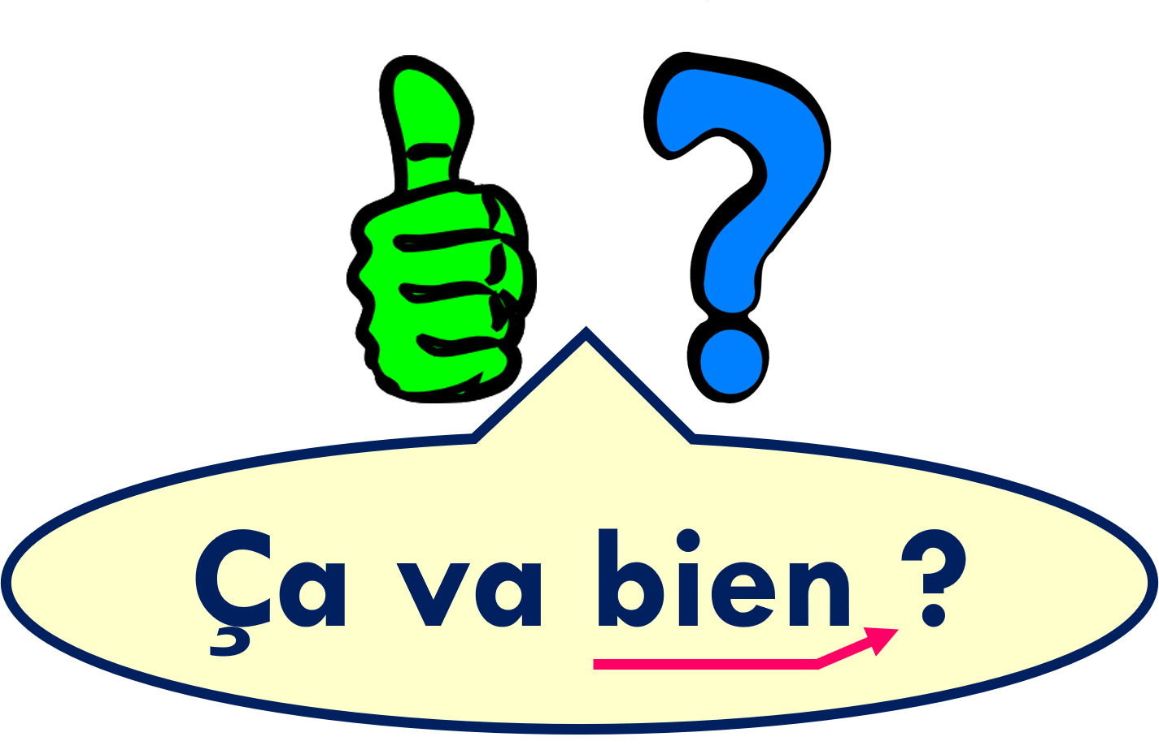
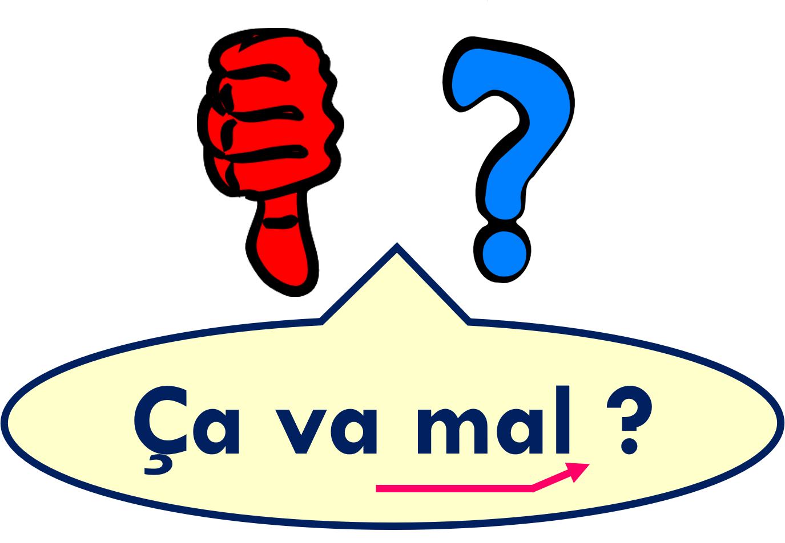
Creating questions [2/2]
It’s going well.
Is it going well?
It’s going badly.
Is it going badly?
Notes:
[2/2]

Slide 6
Follow up 3:
Écoute. Écris la bonne lettre.
Madame Dior likes asking rhyming questions.
Listen to the name. Which rhyming question (A, B, C) does she ask?
écouter
1
2
3
4
5
6
B
Adrien, ça va bien ?
Mme is a short way to write Madame.
A
Sara, ça va ?
A | Ça va ?
B | Ça va bien ?
C | Ça va mal ?
C
Mme Vidal, ça va mal ?
B
Jacquelin, ça va bien ?
A
Nicolas, ça va ?
C
Duval, ça va mal ?
Notes:
Timing: 5 minutes
Aim: to practise matching word final sounds heard in unfamiliar words with familiar written words that have the same sound.
Procedure:
Click to listen to each name.
Pupils decide which of the three questions rhymes with the name heard and write the correct letter.
Click to reveal answers.
Click again on each speech bubble to hear the full question.
Transcript: 1. Adrien, [ça va bien] ? 2. Sara, [ça va] ? 3. Madame Vidal, ça va [mal] ? 4. Jacquelin, [ça va bien] ? 5. Nicolas, [ça va] ? 6. Duval, [ça va mal] ?

Slide 7
Follow up 4
Pupil A says six names. Pupil B listens and responds with a question or statement that rhymes.
parler
60
Pupil A
1 | Madame Vidal
2 | Adrien
3 | Duval
4 | Nicolas
5 | Jacquelin
6 | Tara
Pupil B
1 | Jocelyn
2 | Chantal
3 | Noah
4 | Julien
5 | Abrial
6 | Lara
S
0
DÉBUT
Notes:
Time: 5 minutes
Aim: to practise aural production of the questions and statements from this week’s lesson.
Pupil B turns away from the board. S/he needs something to write on. S/he numbers 1 – 6 and puts a ? or a full stop by each number to prompt him/herself as to which type of utterance to use when s/he hears the name.
Click for Pupil A’s six names to appear. Pupil A reads name to his/her partner.
3. Pupil B listens and responds with an rhyming question (ça va, ça va bien, ça va mal).
4. Pupil A listens and writes in English what is said to him/her – paying attention to whether it is a question or statement.
5. Partner B turns back and pupils compare notes to check that they have the same punctuation written down.
6. Pupils then swap roles and repeat the task with the 2nd set of prompts.

Slide 8
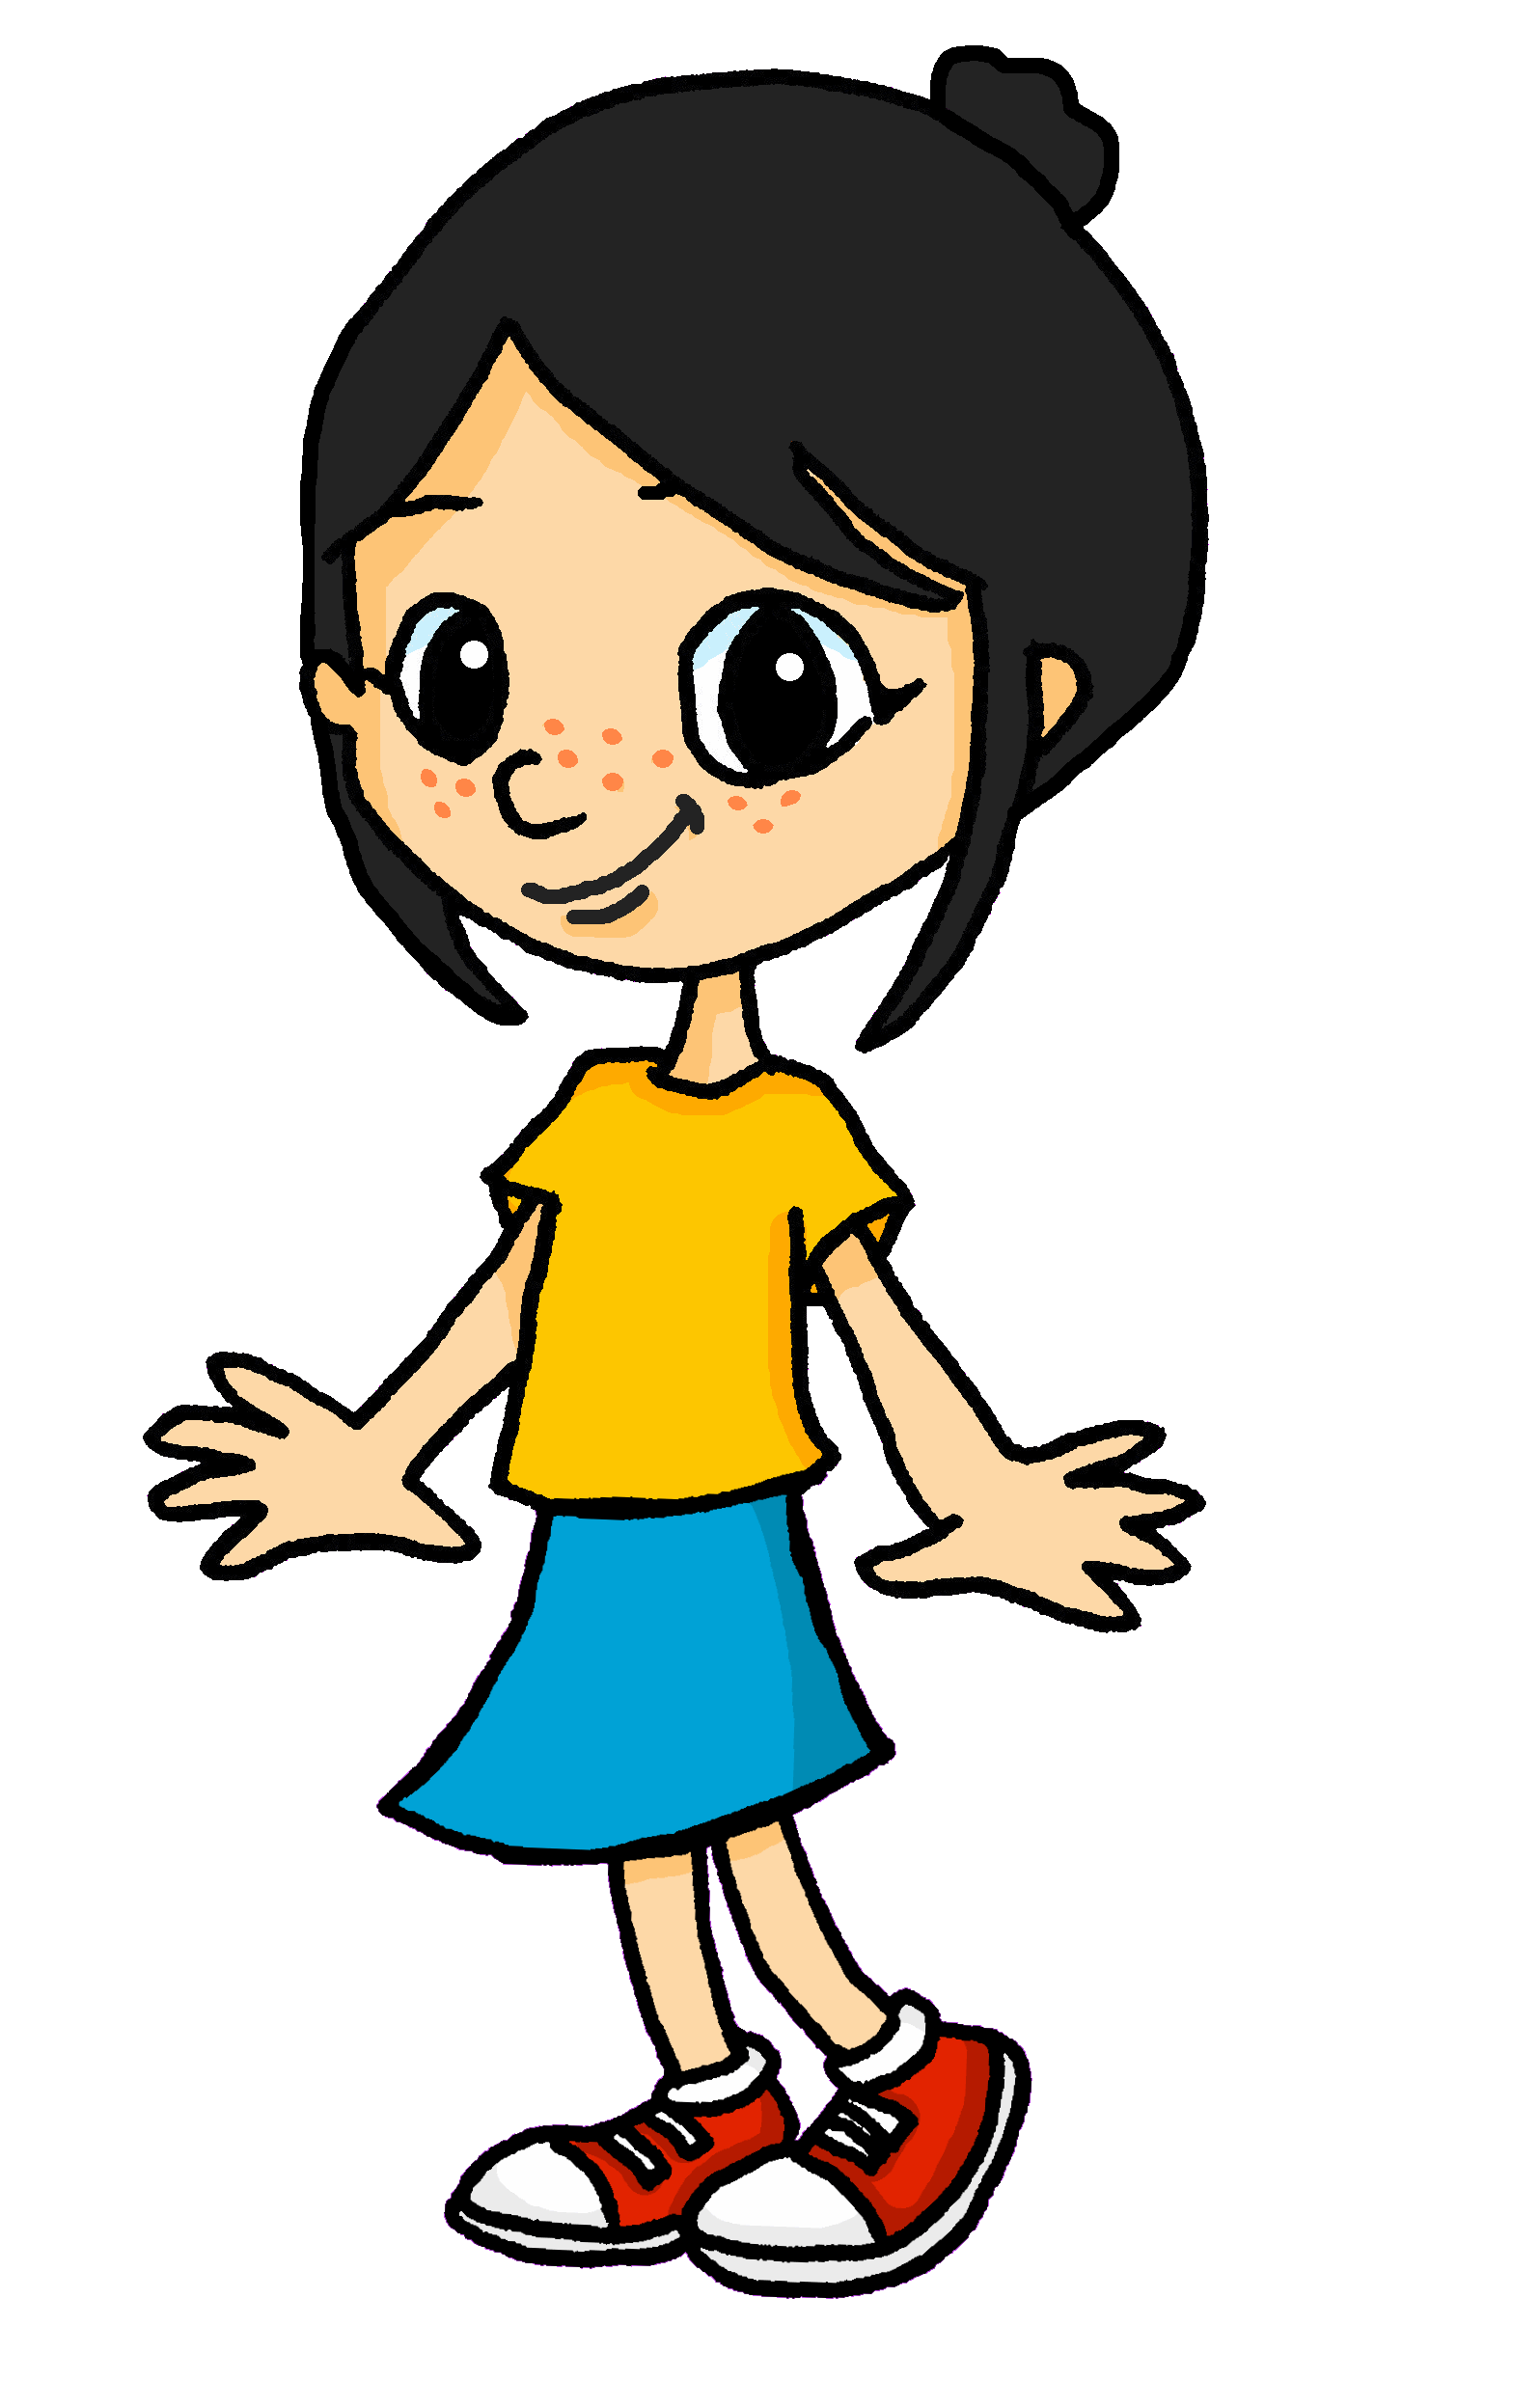
Follow up 5:
Écris. 
Léa’s little sister can’t yet write but she wants to have a diary, too. Write a French phrase to describe how each day goes for her.
écrire

1
2
3
4
5
Ça va bien.

Ça va.
1
2
3
4
5

Ça va bien.

Ça va mal.

Ça va bien.
Notes:
Timing: 5-10 minutes
Aim: to practise written production of some of this week’s key language.
Procedure:
Ensure pupils understand the task.
Given them time to write the five short phrases.
Click to check answers.

