Slide 1
Describing me and others
a – e – i o - u
jaune
Follow ups 1-5
Notes:
Artwork by Steve Clarke. Pronoun pictures from NCELP (www.ncelp.org). All additional pictures selected from Pixabay and are available under a Creative Commons license, no attribution required.
Frequency of new vocabulary and phonics:
Phonics: [a] [o] [e] [i] [u] source words: banane [>5000] cheval [2220] midi [2483] moto [>5000] univers [2112]
Vocabulary: écouter [429] parler [106] lire [278] écrire [382]
Londsale, D., & Le Bras, Y. (2009). A Frequency Dictionary of French: Core vocabulary for learners London: Routledge.
The frequency rankings for words that occur in this PowerPoint which have been previously introduced in these resources are given in the SOW and in the resources that first introduced and formally re-visited those words.
For any other words that occur incidentally in this PowerPoint, frequency rankings will be provided in the notes field wherever possible.

Slide 2
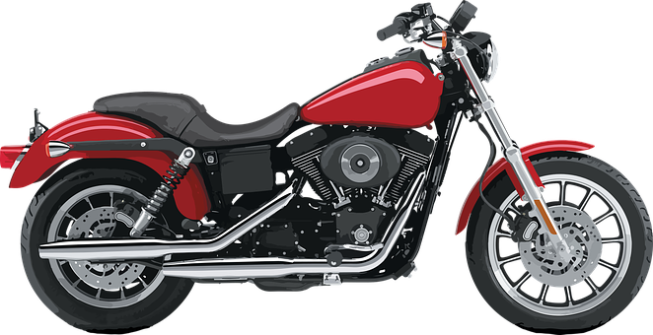
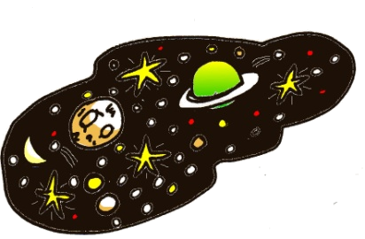
Follow up 1
Écoute. Which sound does each word have? Write the letter.
1
[i]
2
[o]
[a]
ici [here]
côte [coast]
[o]
[e]
[e]
3
ce [this, that]
[u]
[i]
[a]
[a]
[e]
[i]
4
5
[u]
adulte [adult]
samedi [Saturday]
Notes:
Timing: 5 minutes
Aim: to practise aural comprehension of the SSC [a] [o] [e] [i] and [u].
Procedure:
Explain the task. Pupils listen to unfamiliar words and match the sound to one (or more) of the five vowel sounds.
Click on each audio symbol to listen to the word.
Click to bring up the French word, English meaning and click again to bring up the matching vowel.
4. Additionally, try to elicit the source words for each SSC from pupils (midi, moto, cheval, banane, univers)
Transcript:
1. ici 2. côte 3. ce 4. adulte 5. samedi
2

Slide 3
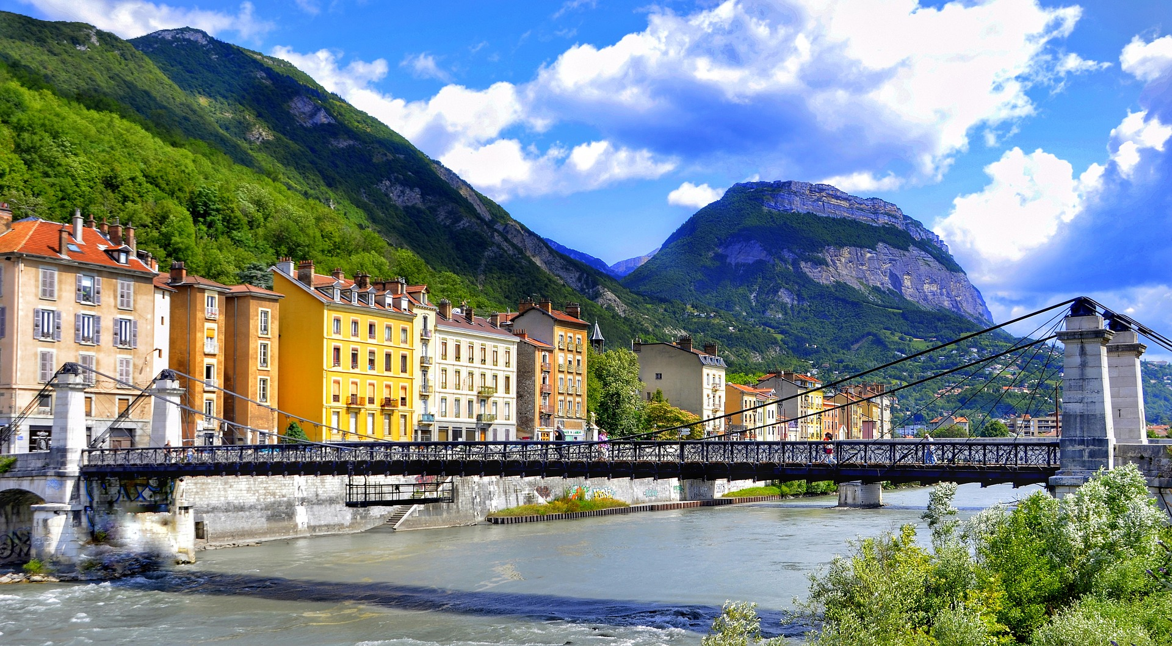
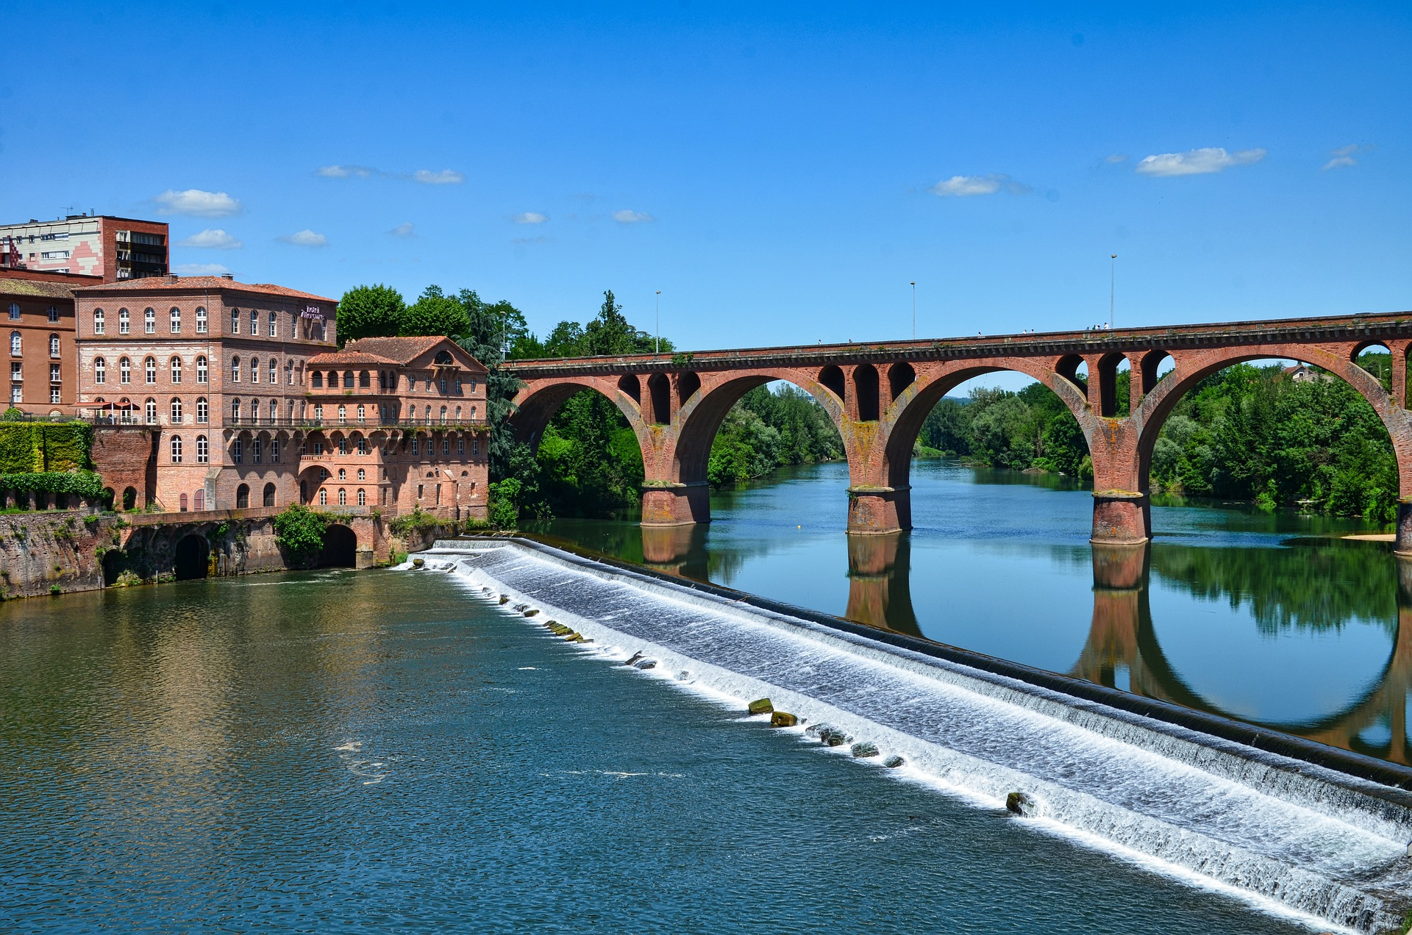
Follow up 2:
A Écoute. Écris la bonne lettre.
P a r i s
s a c
N i c o l a s
1
_
_
2
_
3
_
_
_
écouter
Écoute. Écris la bonne lettre.
m e l o n
G r e n o b l e
p a t t e
4
_
_
5
_
_
6
_
A l b i
L u c i e
S a l u t
7
_
_
8
_
_
9
_
_
Notes:
Timing: 5 minutes
Aim: to practise transcribing the missing vowels in unknown words; to connect sounds and writing.
Procedure:
Click to listen to each word.
Listen and write the missing letter(s).
Click to reveal answers.
Transcript: 1. Paris 2. sac 3. Nicolas 4. melon 5. Grenoble 6. patte 7. Albi 8. Lucie 9. Salut

Slide 4
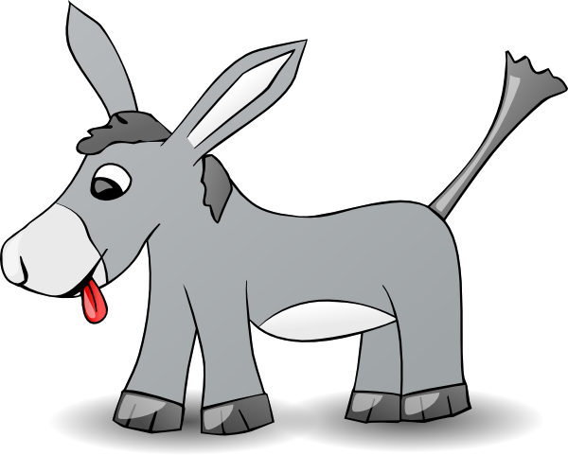
Follow up 3
Lis les phrases.
1. Voici Anne, l’âne à la cabane.
lire
[at]
[Here is]
2. Voici Alderic, le cheval à midi.
[at]
[Here is]
Notes:
Timing: 5 minutes (two slides)
Aim: to read aloud phrases containing the key vowel sounds from this week.
Procedure: 1. Pupils read aloud each phrase.
2. Click to hear the audio. 3. Click to bring up prompt pictures one by one and elicit the words again from pupils, chorally.

Slide 5
Follow up 3
Lis les phrases.
3. Voici Otto, la moto sur la photo.
lire
[on]
[Here is]
4. Voici Lulu, la tortue perdue dans l’univers.
[in]
[lost]
[Here is]

Slide 6
Follow up 4:
A Écoute. What is it in English?
écouter
[to listen]
[to speak]
[to read]
[to write]
écouter
parler
lire
écrire
1
2
3
4
5
6
[to read]
[to listen]
[to listen]
[to speak]
[to read]
[to write]
7
8
9
10
11
12
[to speak]
[to listen]
[to write]
[to read]
[to write]
[to speak]
Notes:
Timing: 5 minutes
Aim: to practise aural comprehension of four infinitive verbs.
Procedure:
1. Present the four verbs one by one and pupils repeat. 2. Click the audio buttons to listen 1-12. 3. Pupils respond (either with a gesture or saying the English meaning). 4. Click to reveal the answer each time.

Slide 7
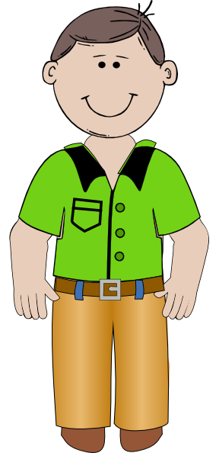
Follow up 5:

Écris.

1 _______________________
écrire
Ana va
parler.
(Ana is going to speak).

écouter.
2 ________________________
Papa va
(Dad/Daddy is going to listen).

3 ________________________
Ali va
lire.
(Ali va to read).
Notes:
Timing: 10 minutes
Aim: to practise writing individual words from memory.
Procedure: 1. Pupils practise writing the first word (lire) on their arms.
2. Click to reveal answer. 3. Continue with words 2-3. 4. Roll back the animations to start from the beginning.
5. This time, pupils write the words in pencil in their books. 6. Click to reveal the answers again.

Slide 8
Extra
parler
15
[to speak]
S
moto
_ _ _ _ _ _
_ _ _ _
parler
_ _ _ _ _ _
cheval
0
DÉBUT
Notes:
Additional optional/alternative activity Timing: 3 minutes (3 slides)
Aim: to practise oral production of phonics source words and the four infinitive verbs learnt this week.
Procedure:
1. Click to bring up images. 2. Start the timer. 3. Pupils try to say (or alternative write) all the words within the time given. Note: the timer can easily be adjusted. Click on Animations. Look top right to Duration. Change the number of seconds (you can choose any number between 1 – 59).

Slide 9
Extra
parler
15
[to read]
S
lire
_ _ _ _
_ _ _ _
banane
_ _ _ _ _ _
midi
0
DÉBUT

Slide 10
Extra
parler
15
[to listen]
[to write]
S
_ _ _ _ _ _
_ _ _ _ _ _ _
_ _ _ _ _ _
écouter
univers
écrire
0
DÉBUT

