Slide 1
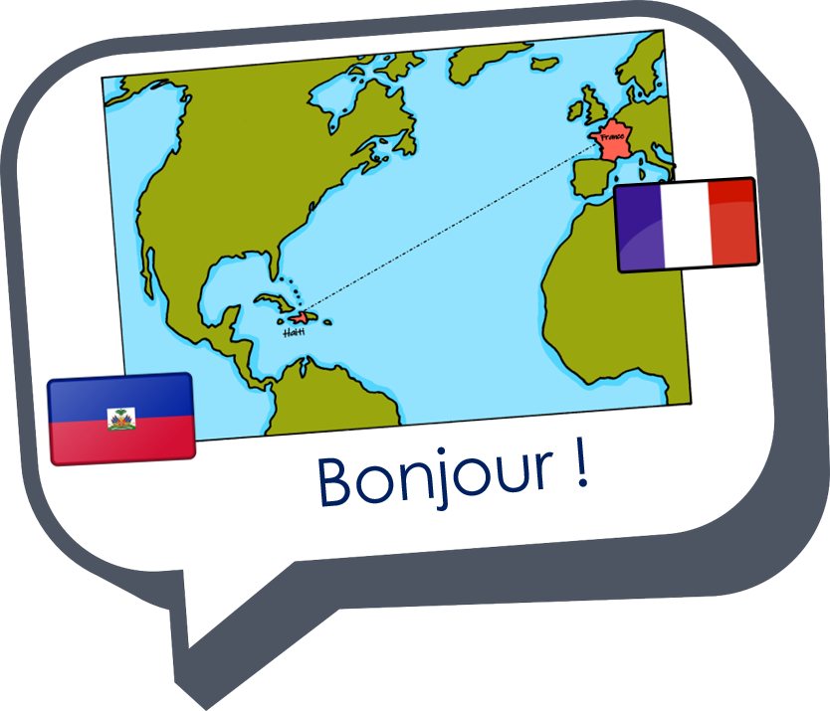
Saying what I and others have
jaune
Phonics quiz
Notes:
Artwork by Steve Clarke. Pronoun pictures from NCELP (www.ncelp.org). All additional pictures selected from Pixabay and are
available under a Creative Commons license, no attribution required.
This lesson contains a phonics assessment to check progress in SSC practised in the first 12 weeks of this year’s course.
The frequency rankings for words that occur in this PowerPoint which have been previously introduced in these resources are given in the SOW and in the resources that first introduced and formally re-visited those words. For any other words that occur incidentally in this PowerPoint, frequency rankings will be provided in the notes field wherever possible.
Londsale, D., & Le Bras, Y. (2009). A Frequency Dictionary of French: Core vocabulary for learners London: Routledge.
1

Slide 2
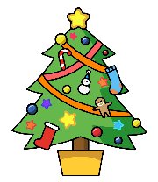
prononcer
Joyeux Noël !
Read aloud the Christmas present and the French name. They have the same final sound.
You have not learnt these words so use what you know about how to pronounce French.
tapis
Remember Silent Final Consonants!
Bibi
Notes:
Phonics assessment Week 14 Prior preparation: print out one set of phonics slides and cut in half; print out sufficient pupil feedback sheets to have one per pupil.
Timing: 1 minute
Aim: to introduce the phonics quiz to pupils and model an example
Procedure: 1. Click to bring up the SSC, the name and the present item.
2. Elicit the item and the name.
3. Click the words to hear them pronounced.
Note:
there are no follow up lessons this week, so it would be possible to continue the speaking assessments in the follow up time during this week, as needed.
if preferred, and the resources are available, pupils could record their answers (e.g. on computer or ipad) though this would involve the teacher listening back to assess them.
Frequency of unknown words: drapeau [2582]
Londsale, D., & Le Bras, Y. (2009). A Frequency Dictionary of French: Core vocabulary for learners London: Routledge.
2

Slide 3
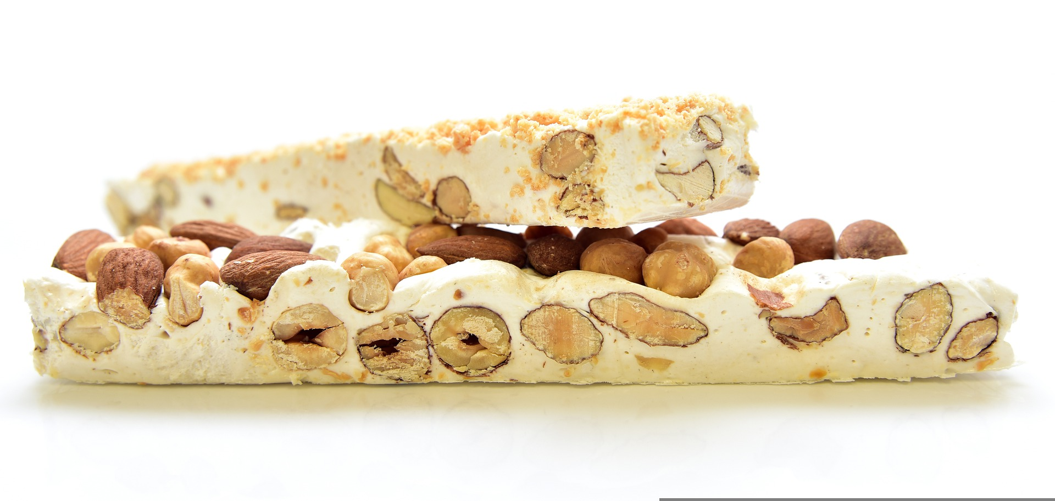
prononcer
[SFC]
[(e)au]
prononcer
nougat
drapeau
Nicolas
Beau
Notes:
Phonics assessment Week 14 Prior preparation: print out one set of phonics slides and cut in half; print out sufficient pupil feedback sheets to have one per pupil.
Timing: 1 minute per pupil
Aim: to assess pupils’ ability to read aloud the SSC taught this term. Procedure: 1. Give out the independent task that pupils will work on during the lesson. 2. Listen to individual pupils reading the words aloud. Mark in real time.
3. If desired, teachers can listen to the audio versions in preparation.
Note:
there are no follow up lessons this week, so it would be possible to continue the speaking assessments in the follow up time during this week, as needed.
if preferred, and the resources are available, pupils could record their answers (e.g. on computer or ipad) though this would involve the teacher listening back to assess them.
Frequency of unknown words: drapeau [2582] nougat [>5000]
Londsale, D., & Le Bras, Y. (2009). A Frequency Dictionary of French: Core vocabulary for learners London: Routledge.
3

Slide 4
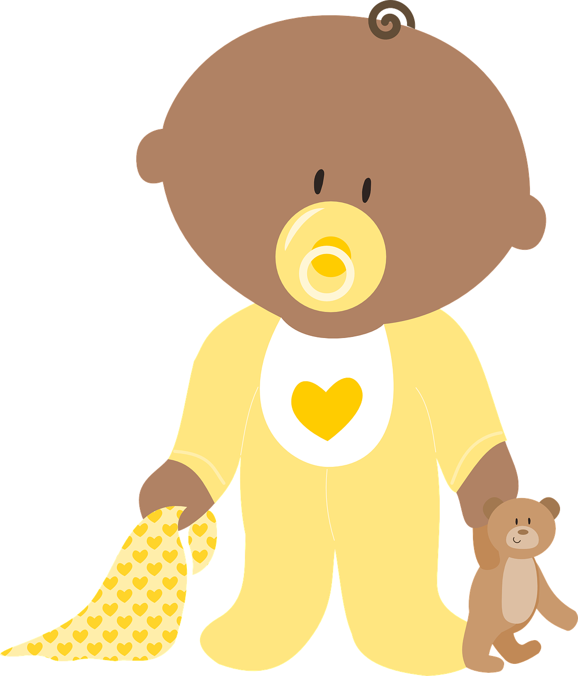
prononcer
[u]
[ch]
prononcer
tenue (de foot)
broche
Sabinu
Gavroche
Notes:
Frequency of unknown words: broche [>5000] tenue [1899]
Londsale, D., & Le Bras, Y. (2009). A Frequency Dictionary of French: Core vocabulary for learners London: Routledge.
4

Slide 5
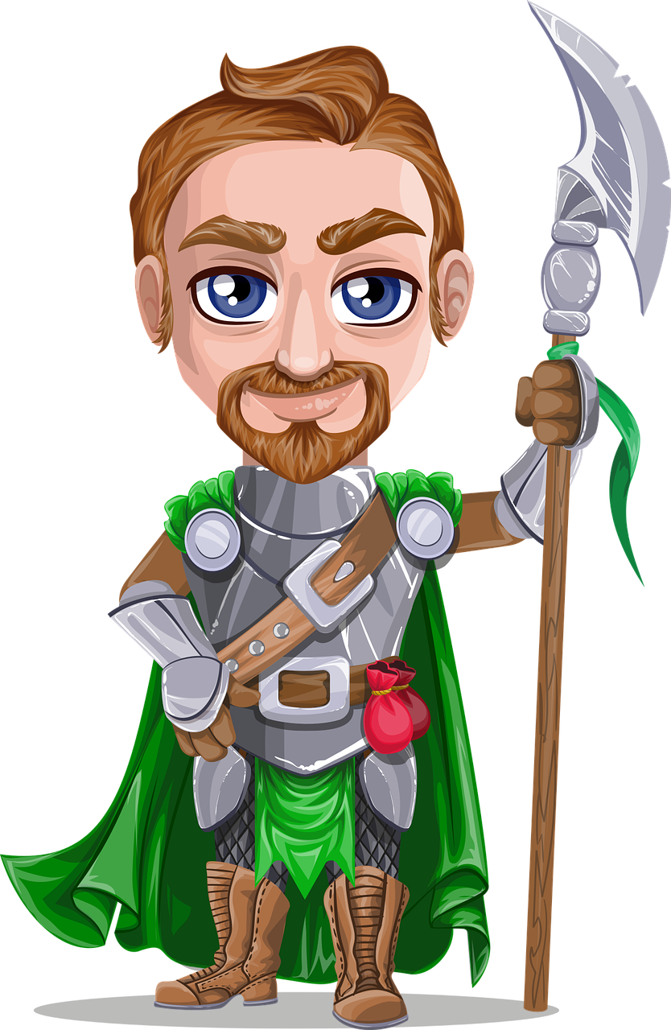
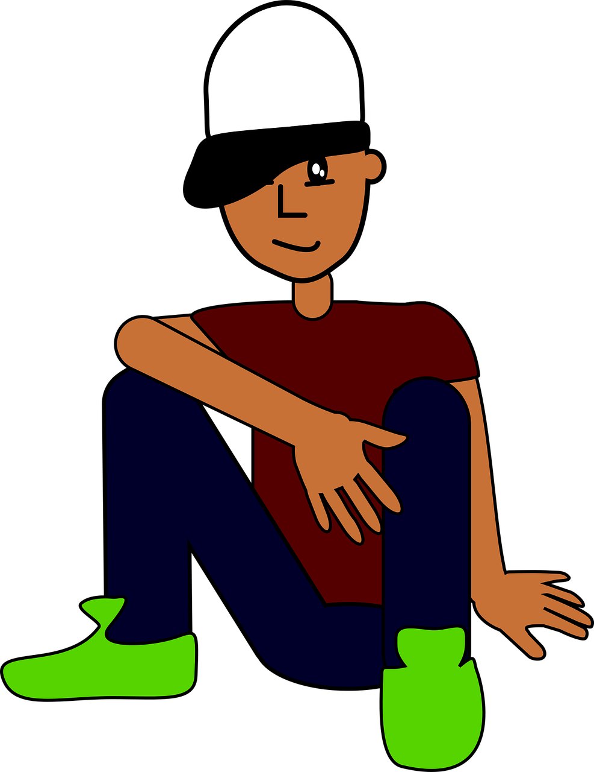
prononcer
[on]
[eu]
prononcer
avion
preux
Manon
Bartholmieu
Notes:
Frequency of unknown words: avion [1409] émeu [>5000]
Londsale, D., & Le Bras, Y. (2009). A Frequency Dictionary of French: Core vocabulary for learners London: Routledge.
5

Slide 6
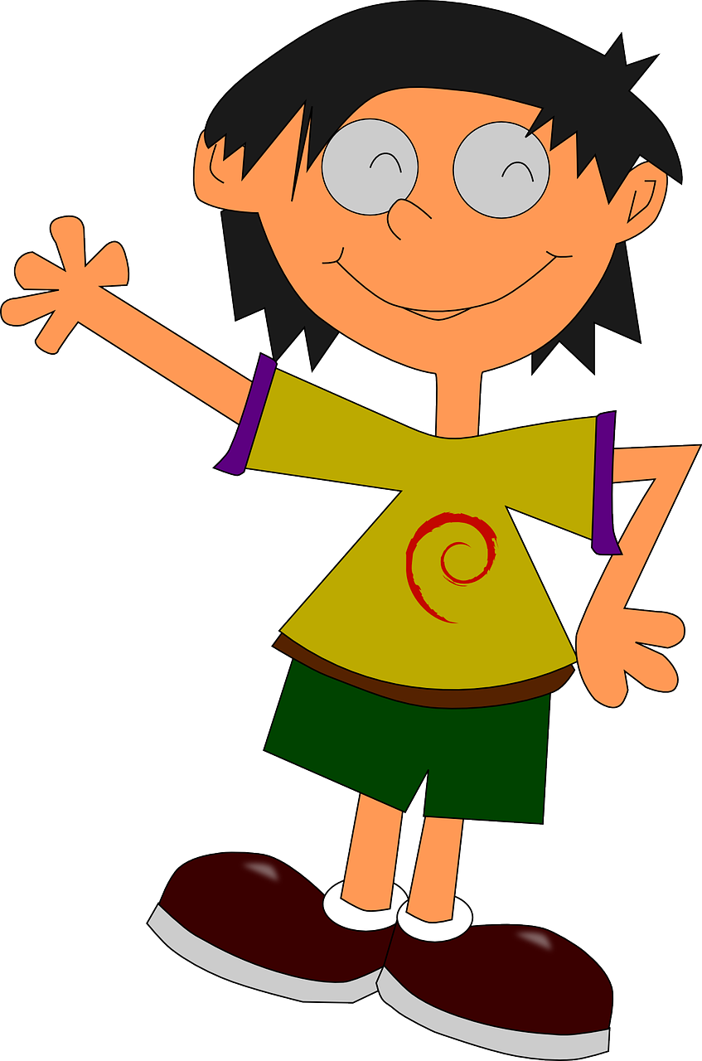
prononcer
[an/en]
[eu]
prononcer
pervenche
bijou
Blanche
Amou
Notes:
Frequency of unknown words: bijou [401] pervenche [>5000]
Londsale, D., & Le Bras, Y. (2009). A Frequency Dictionary of French: Core vocabulary for learners London: Routledge.
6

Slide 7
Au revoir !
jaune
Notes:
7

Slide 8
Teacher audio version
 | Present | Name | SSC [sound-symbol correspondence] | p/ x
1 | nougat | Nicolas | SFC
2 | drapeau | Beau | [au/eau/o]
3 | tenue (de foot) | Sabinu | [u]
4 | broche | Gavroche | [ch]
5 | avion | Manon | [on]
6 | preux | Bartholmieu | [eu]
7 | pervenche | Blanche | [an/en]
8 | bijou | Amou | [ou]
Notes: 1] Words have been deliberately chosen to assess the same SSC spelt in different ways – as/at – en/an This is a challenging but important aspect of French SSC knowledge. 2] Each item offers two opportunities to assess the same SSC, but only one SSC is assessed per item (e.g. Blanche only assesses [en] not [ch]. 3] Teachers award one point for the SSC in each word (name and present) (max. 2 points per item). 4] Teachers may want to note additional SSC that are pronounced correctly/incorrectly to inform their planning of further practice.
5] Note that we are teaching phonics to achieve clear, comprehensible speech rather than native-like pronunciation. We therefore listen out for signs that the children are applying their phonemic knowledge to these new words, knowing that the SSC are not pronounced as in English.
Notes:
Teacher audio version for preparation

Slide 9
Phonics quiz
Phonics quiz
Pupil name: ____________________________
Total score: _____ / 16
Pupil name: ____________________________
Total score: _____ / 16
 | Present | Name | SSC [sound-symbol correspondence] | p/ x
1 | nougat | Nicolas | SFC
2 | drapeau | Beau | [au/eau/o]
3 | tenue (de foot) | Sabinu | [u]
4 | broche | Gavroche | [ch]
5 | avion | Manon | [on]
6 | preux | Bartholmieu | [eu]
7 | pervenche | Blanche | [an/en]
8 | bijou | Amou | [ou]
 | Present | Name | SSC [sound-symbol correspondence] | p/ x
1 | nougat | Nicolas | SFC
2 | drapeau | Beau | [au/eau/o]
3 | tenue (de foot) | Sabinu | [u]
4 | broche | Gavroche | [ch]
5 | avion | Manon | [on]
6 | preux | Bartholmieu | [eu]
7 | pervenche | Blanche | [an/en]
8 | bijou | Amou | [ou]
Notes:
Pupil feedback and assessment sheet
9

