Slide 1
Saying what I and others have
jaune
What do I know now?
Notes:
Artwork by Steve Clarke. Pronoun pictures from NCELP (www.ncelp.org). All additional pictures selected from Pixabay and are
available under a Creative Commons license, no attribution required.
This lesson (and week 14’s lesson) contains assessments to check progress in language learnt in the first 12 weeks of this year.
The frequency rankings for words that occur in this PowerPoint which have been previously introduced in these resources are given in the SOW and in the resources that first introduced and formally re-visited those words. For any other words that occur incidentally in this PowerPoint, frequency rankings will be provided in the notes field wherever possible.
1

Slide 2
écouter
Torion is from another planet. They like earth and speaking French but often forget word meanings, spellings and things like gender and verb forms. Help Torion by answering the questions in this quiz.
A For each question, put a cross (x) under the English meaning that matches what you hear.
You will hear each French word twice. Choose one correct answer only.
 | A | B | C | D
1. | Mr, Sir | goodbye | hello | Mrs, Ms.
 | ☐ | ☐ | ☐ | ☐
2. | to be | to read | to have | to write
 | ☐ | ☐ | ☐ | ☐
3. | poster | bedroom | drawing | Sunday
 | ☐ | ☐ | ☐ | ☐
4. | he | you | I | she
 | ☐ | ☐ | ☐ | ☐
1
2
3
4
Notes:
Timing: 20-25 minutes (all assessment slides)
Aim: to practise aural comprehension of vocabulary taught in weeks 1-12 of this year.
Procedure:
1. Click the audio buttons to play each item. (The words are recorded twice with a pause to allow pupils to process the information).
2. Pupils can either write 1C, etc.. or if they have the assessment on a print out they can put a X in the correct box.
3. Note that the first item can be completed, with support from the teacher, as an example. It is NOT included in the overall total marks.
3. After items 1-4, continue to the next slide to complete the remainder of the task.
Transcript:
au revoir
avoir
affiche
elle
2

Slide 3
écouter
 | A | B | C | D
5. | in | under | every | on
 | ☐ | ☐ | ☐ | ☐
6. | day | today | midday | Tuesday
 | ☐ | ☐ | ☐ | ☐
7. | brave | pencil | curious | cat
 | ☐ | ☐ | ☐ | ☐
5
6
7
Notes:
[2/2]
Transcript:
5. dans
6. midi
7. courageux
3

Slide 4
écouter
B For each question, put a cross (x) under the type of word you hear. You will hear each French word twice. Choose one correct answer only.
This word is a good example of …
 | A | B | C | D
1. | a day of the week ☐ | personality ☐ | an activity ☐ | an object ☐
2. | an object ☐ | a mood ☐ | a question word ☐ | a day of the week ☐
3. | an animal ☐ | a question word ☐ | a day of the week ☐ | an object ☐
4. | a food ☐ | an object ☐ | personality ☐ | an activity ☐
5. | an object ☐ | an animal ☐ | a person ☐ | an activity ☐
1
2
3
4
5
Notes:
Procedure:
1. Click the audio buttons to play each item. (The words are recorded twice with a pause to allow pupils to process the information).
2. Pupils can either write 1C, etc.. or if they have the assessment on a print out they can put a X in the correct box.
3. Note that the first item can be completed, with support from the teacher, as an example. It is NOT included in the overall total marks.
4. When complete, continue to the reading.
Transcript:
drôle
chaise
où
heureux
écouter
4

Slide 5
lire
C Help Torion to translate the underlined French word to complete each English sentence.
1. J’ai une carte. I have a _____________ .
2. Ça va mal. It’s going _____________ .
3. Tu as un lit. You have a _____________ .
4. Tu es indépendant ? ______ you independent?
5. C’est pour toi ? Is it for _____________ ?
6. Elle est prudente. She is _____________ .
7. C’est difficile ? Is it _____________?.
8. Il a un bureau. He has a _____________ .
9. Le cheval est jeune. The horse is ________________.
10. Madame Pau a une idée. ______ Pau has an idea.
Notes:
Aim: to practise written recall of previously taught vocabulary.
Procedure:
Ensure that the task is clear.
Pupils could write 1 – 10 and the individual English word meanings (or they could fill in if they have printed assessment sheets).
5

Slide 6
écrire
D Translate the underlined English words to complete the French sentence.
1. It’s a drawing. C’est _____ __________. (write two words)
2. Pierre is curious. Pierre est _____________. (write one word)
3. It’s going well. _____ _____ bien. (write two words)
4. Is it important for me? C’est _____________ _______ moi ? (write two words)
5. He has an answer. Il a ______ _______________. (write two words)
6. A cat is ideal. Un ___________ est __________. (write two words)
7. Every day it’s great. ___________ _______ c’est super. (write two words)
8. She is happy. Elle est ___________________. (write one word)
9. Today it’s Thursday. __________________, c’est jeudi. (write one word)
10. No, Mr Pau is serious! ___, ________Pau est ____________ ! (write three words)
Notes:
Aim: to practise written production of previously taught vocabulary.
Procedure:
Ensure that the task is clear.
Pupils could write 1 – 10 and the individual English word meanings (or they could fill in if they have printed assessment sheets).
6

Slide 7
lire
Grammar
A Put a (X) next to the person the sentence is about.
1 | ☐ I ☐ you _{[singular]} ☐ she/he | …est absente. |  | 4 | ☐ I ☐ you _{[singular]} ☐ she/he | …a une question.
2 | ☐ I ☐ you _{[singular]} ☐ she/he | …as une moto. |  | 5 | ☐ I ☐ you _{[singular]} ☐ she/he | …suis là.
3 | ☐ I ☐ you _{[singular]} ☐ she/he | …es calme. |  | 6 | ☐ I ☐ you _{[singular]} ☐ she/he | …ai un message.
Notes:
Aim: to practise written understanding of previously taught grammar features.
Procedure:
Ensure that the task is clear.
Pupils could write 1 – 6 and the correct English pronoun (or they could fill in if they have printed assessment sheets).
7

Slide 8
lire
Grammar
B Put a (X) next to two words that could finish this sentence about Arnaud (a boy).
 | Tick two boxes.
1. Arnaud est _______. | a) jolie | ☐
 | b) drôle | ☐
 | c) anglaise | ☐
 | d) jeune | ☐
 | e) heureuse | ☐
Put a (X) next to two words that could finish this sentence about Émilie (a girl).
 | Tick two boxes.
2. Émilie est _______. | a) curieux | ☐
 | b) différente | ☐
 | c) seul | ☐
 | d) important | ☐
 | e) difficile | ☐
Notes:
Aim: to practise written understanding of previously taught grammar features.
Procedure:
Ensure that the task is clear.
Pupils could write the answers only (or they could fill in if they have printed assessment sheets).
8

Slide 9
écrire
Grammar
C Write the French word for ‘a’. 1. _______ crayon (m) 2. _______ semaine (f)
D Write the French for the English given in brackets.
1. Tu ________ quoi ? (have) 2. Elle ________ jeune. (is) 3. Tu ________ content. (are) 4. Je ________ présent. (am)
Notes:
Aim: to practise written production of previously taught grammar features.
Procedure:
Ensure that the task is clear.
Pupils could write the answers only (or they could fill in if they have printed assessment sheets).
9

Slide 10
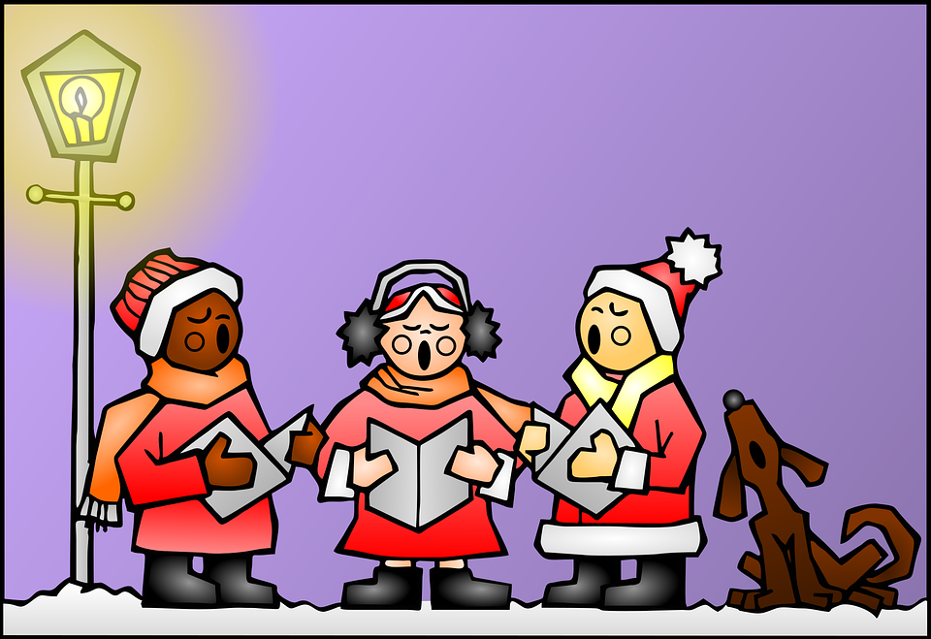
écouter
Une chanson : Noёl Jazz
le Noёl - Christmas
A Écoute et complète.
B Puis, lis et chante.
Noël, c’est comme un rythme de jazz,
ça commence tout doucement
on n’entend que la contrebasse
comme le cœur d’un petit enfant.
Et sur ce rythme là : Noël
Chantez tous avec moi, Noël,
Chantez, chantez tout bas,
Noël, Noël.
_ _
_ _
_ _
_ _
_ _
_ _
_ _
_ _
_ _
_ _
comme – like | commencer – to start
doucement – quietly |on n’entend que – you only hear la contrebasse – double bass |le cœur – heart
chanter – to sing tous – everyone, all avec – with | tout bas – very low
Notes:
Timing: flexible
Note: the majority of this lesson will be taken up with the vocabulary and grammar parts of the assessment. However, this Christmas carol can fit in either at the end of this week’s lesson or in the follow up time this week. There are no other follow up materials this week, as we anticipate schools will be busy at this time of term. The song would make a good addition to a Christmas assembly.
Aim: to enjoy a French Christmas song; to listen out for key SSC and transcribe them; to join in with the song whilst listening and reading.
Song with text: https://www.youtube.com/watch?v=5VpDBtEJeKI
Procedure: 1. Pupils listen and fill in the missing letters. These are SSC that pupils have practised this term (handout is available at the end of this presentation). 2. Click to reveal answers.
3. Click to reveal the gloss boxes with key vocabulary and arrive at a working translation of the meaning, so that pupils understand the message of the song (see below). 4. Play video so pupils can join in with the song. Translation of the song: Christmas is like a jazz rhythm,
it starts slowly
we only hear the double bass
like the heart of a small child.
And to this rhythm: Christmas
All sing with me, Christmas, Sing, sing low, Christmas, Christmas.
10

Slide 11
Au revoir !
jaune
Notes:
11

Slide 12
écouter
Torion is from another planet. They like earth and speaking French but often forget word meanings, spellings and things like gender and verb forms. Help Torion by answering the questions in this quiz.
A For each question, put a cross (x) under the English meaning that matches what you hear.
You will hear each French word twice. Choose one correct answer only.
 | A | B | C | D
1. | Mr, Sir | goodbye | hello | Mrs, Ms.
 | ☐ | ☐ | ☐ | ☐
2. | to be | to read | to have | to write
 | ☐ | ☐ | ☐ | ☐
3. | poster | bedroom | drawing | Sunday
 | ☐ | ☐ | ☐ | ☐
4. | he | you | I | she
 | ☐ | ☐ | ☐ | ☐
1
2
3
4
Notes:
ANSWERS
Transcript:
au revoir
avoir
affiche
elle
12

Slide 13
écouter
 | A | B | C | D
5. | in | under | every | on
 | ☐ | ☐ | ☐ | ☐
6. | day | today | midday | Tuesday
 | ☐ | ☐ | ☐ | ☐
7. | brave | pencil | curious | cat
 | ☐ | ☐ | ☐ | ☐
5
6
7
Notes:
[2/2]
Transcript:
5. dans
6. midi
7. courageux
13

Slide 14
écouter
B For each question, put a cross (x) under the type of word you hear. You will hear each French word twice. Choose one correct answer only.
This word is a good example of …
 | A | B | C | D
1. | a day of the week ☐ | personality ☐ | an activity ☐ | an object ☐
2. | an object ☐ | a mood ☐ | a question word ☐ | a day of the week ☐
3. | an animal ☐ | a question word ☐ | a day of the week ☐ | an object ☐
4. | a food ☐ | an object ☐ | personality ☐ | an activity ☐
5. | an object ☐ | an animal ☐ | a person ☐ | an activity ☐
1
2
3
4
5
Notes:
ANSWERS
Transcript:
drôle
chaise
où
heureux
écouter
14

Slide 15
lire
C Help Torion to translate the underlined French word to complete each English sentence.
1. J’ai une carte. I have a _____________ .
2. Ça va mal. It’s going _____________ .
3. Tu as un lit. You have a _____________ .
4. Tu es indépendant ? ______ you independent?
5. C’est pour toi ? Is it for _____________ ?
6. Elle est prudente. She is _____________ .
7. C’est difficile ? Is it _____________?.
8. Il a un bureau. He has a _____________ .
9. Le cheval est jeune. The horse is ________________.
10. Madame Pau a une idée. ______ Pau has an idea.
letter
badly
bed
Are
you
careful
difficult
desk
young
Mrs
Notes:
ANSWERS
15

Slide 16
écrire
D Translate the underlined English words to complete the French sentence.
1. It’s a drawing. C’est _____ __________. (write two words)
2. Pierre is curious. Pierre est _____________. (write one word)
3. It’s going well. _____ _____ bien. (write two words)
4. Is it important for me? C’est _____________ _______ moi ? (write two words)
5. He has an answer. Il a ______ _______________. (write two words)
6. A cat is ideal. Un ___________ est __________. (write two words)
7. Every day it’s great. ___________ _______, c’est super. (write two words)
8. She is happy. Elle est ___________________. (write one word)
9. Today it’s Thursday. __________________, c’est jeudi. (write two words)
10. No, Mr Pau is serious! ____, ____________Pau est__________ ! (write three words)
un dessin
curieux
Ça va
important pour
une réponse
chat
idéal
Chaque jour
heureuse
Aujourd’hui
Non, Monsieur
sérieux
Notes:
ANSWERS
16

Slide 17
lire
Grammar
A Put a (X) next to the person the sentence is about.
1 | ☐ I ☐ you _{[singular]} ☐ she/he | …est absente. |  | 4 | ☐ I ☐ you _{[singular]} ☐ she/he | …a une question.
2 | ☐ I ☐ you _{[singular]} ☐ she/he | …as une moto. |  | 5 | ☐ I ☐ you _{[singular]} ☐ she/he | …suis là.
3 | ☐ I ☐ you _{[singular]} ☐ she/he | …es calme. |  | 6 | ☐ I ☐ you _{[singular]} ☐ she/he | …ai un message.
Notes:
ANSWERS
17

Slide 18
lire
Grammar
B Put a (X) next to two words that could finish this sentence about Arnaud (a boy).
 | Tick two boxes.
1. Arnaud est _______. | a) jolie | ☐
 | b) drôle | ☐
 | c) anglaise | ☐
 | d) jeune | ☐
 | e) heureuse | ☐
Put a (X) next to two words that could finish this sentence about Émilie (a girl).
 | Tick two boxes.
2. Émilie est _______. | a) curieux | ☐
 | b) différente | ☐
 | c) seul | ☐
 | d) important | ☐
 | e) difficile | ☐
Notes:
ANSWERS
18

Slide 19
écrire
Grammar
C Write the French word for ‘a’. 1. _______ crayon (m) 2. _______ semaine (f)
D Write the French for the English given in brackets.
1. Tu ________ quoi ? (have) 2. Elle ________ jeune. (is) 3. Tu ________ content. (are) 4. Je ________ présent. (am)
un
une
as
est
es
suis
Notes:
ANSWERS
19

Slide 20
une chanson handout
Une chanson : Noёl Jazz
le Noёl - Christmas
Une chanson : Noёl Jazz
le Noёl - Christmas
A Écoute et complète.
A Écoute et complète.
B Puis, lis et chante.
B Puis, lis et chante.
Noël, c’est comme un rythme de jazz,
ça comm_ _ce t_ _t d_ _cement
on n’ent_ _d que la c_ _trebasse
comme le cœur d’un petit _ _fant.
Noël, c’est comme un rythme de jazz,
ça comm_ _ce t_ _t d_ _cement
on n’ent_ _d que la c_ _trebasse
comme le cœur d’un petit _ _fant.
Et sur ce rythme là : Noël
Ch_ _tez t_ _s avec moi, Noël,
Ch_ _tez, ch_ _tez tout bas,
Noël, Noël.
Et sur ce rythme là : Noël
Ch_ _tez t_ _s avec moi, Noël,
Ch_ _tez, ch_ _tez tout bas,
Noël, Noël.
Notes:
HANDOUT
20

