Slide 1
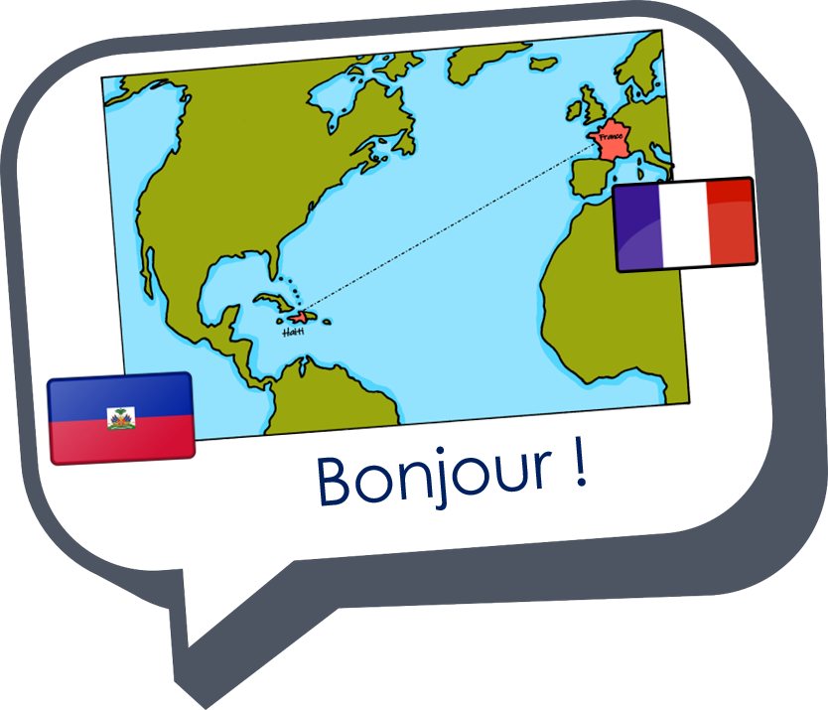
Saying what I and others have
Jean-Michel écrit une histoire
jaune
« Avoir » : j’ai, il/elle a
c’est quoi ? intonation + wh-word questions
SSC [u] [ou]
Term 1 Week 12
Notes:
Artwork by Steve Clarke. Pronoun pictures from NCELP (www.ncelp.org). All additional pictures selected from Pixabay and are
available under a Creative Commons license, no attribution required.
Phonics: [u] [ou] tu [112] salut ! [2205] amusant [4695] utiliser [345] nous [31] bonjour ! [1972] douze [1664] jouer [219] jour [78]
Vocabulary: chaque [151] jour [78] revisit days of the week
Revisit 1: avoir [8] j’ai, il a, elle a, quoi [297] chat [3138] crayon [>5000] dessin [2624] message [792]
Revisit 2: bien [47] mal [277] Oui [284] Non [75] Au revoir [n/a] Ça va ? [54/53]
Londsale, D., & Le Bras, Y. (2009). A Frequency Dictionary of French: Core vocabulary for learners London: Routledge.
The frequency rankings for words that occur in this PowerPoint which have been previously introduced in these resources are given
in the SOW and in the resources that first introduced and formally re-visited those words.
For any other words that occur incidentally in this PowerPoint, frequency rankings will be provided in the notes field wherever
possible.
1

Slide 2
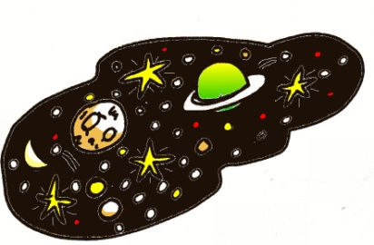
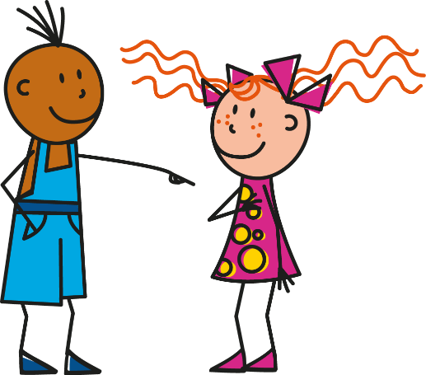
prononcer
[u]
tu
univers
Salut !
amusant
utiliser
Notes:
Timing: 3 minutes (three slides)
Aim: to recap SSC [u] and present [ou]
Note: [u] was previously introduced with other vowel sounds. It is recapped here to provide a contrast with SSC [ou] which is introduced for the first time.
Procedure:
Introduce and elicit the pronunciation of the individual SSC [u] then the source words ‘tu’.
Click to bring on the picture and get pupils to repeat (with gesture, if using).
Present and practise the cluster words. Note that pupils now already know all of these except ‘utiliser’.
Gesture: gesture for tu – pointing away to an imaginary person in front of you.
2

Slide 3
prononcer
[ou]
nous
Bonjour !
douze
Mon
jour
jouer
Notes:
Procedure:
Introduce and elicit the pronunciation of the individual SSC [ou] and then the source word ‘nous’(with gesture, if using).
Click to bring on the picture and get pupils to repeat (with gesture, if using).
Present and elicit the pronunciation of the four cluster words. Note that pupils already know Bonjour !, jour is a new word for this week. Douze and jouer will be learnt as vocabulary next term.
Gesture: gesture for nous – spreading arms out in front palms down, do a sweeping motion (similar to a breaststroke in swimming), motioning inclusivity ‘we’.
3

Slide 4
prononcer
[u]
[ou]
tu
nous
Notes:
Aim: to recap SSC [u] and [ou]
Procedure:
Remind pupils of these two source words.
Practise the difference in sound and mouth shape between the two.
Note: i) gesture for tu – pointing away to an imaginary person in front of you.
ii) gesture for nous – spreading arms out in front palms down, do a sweeping motion (similar to a breastroke in swimming), motioning inclusivity ‘we’.
4

Slide 5
prononcer
Une route compliquée [1/2]
Prononce les mots.
.
couple
brochure
journal
fortune
blouse
cousin
kangourou
routine
culture
capture
mural
minute
bambou
cure
moustache
curry
courgette
figure
dune
nougat
Notes:
Timing: 5 minutes
Aim: To practise the pronunciation of French and English cognate words with the SSC [u] and [ou].
Procedure:
Pupils work in pairs to practise pronunciation.
Click to circle the start and finish points.
Pupil A says the word in English, Pupil B repeats it in French.
Click to bring up arrow to next word.
Repeat steps 3-4 for 10 words.
Click on the words to hear their French pronunciation by a native speaker.
Repeat on next slide with pupils taking opposite roles.
5

Slide 6
prononcer
Une route compliquée [2/2]
couple
brochure
journal
fortune
blouse
cousin
kangourou
routine
culture
capture
mural
minute
bambou
cure
moustache
curry
courgette
figure
dune
nougat
Notes:
[2/2]
Aim: To practise the pronunciation of French and English cognate words with the SSC [u] and [ou].
Procedure:
Pupils work in pairs to practise pronunciation.
Click to circle the start and finish points.
Pupil A says the word in English, Pupil B repeats it in French.
Click to bring up arrow to next word.
Repeat steps 3-4 for 10 words.
Click on the words to hear their French pronunciation by a native speaker.
Repeat on next slide with pupils taking opposite roles.
6

Slide 7
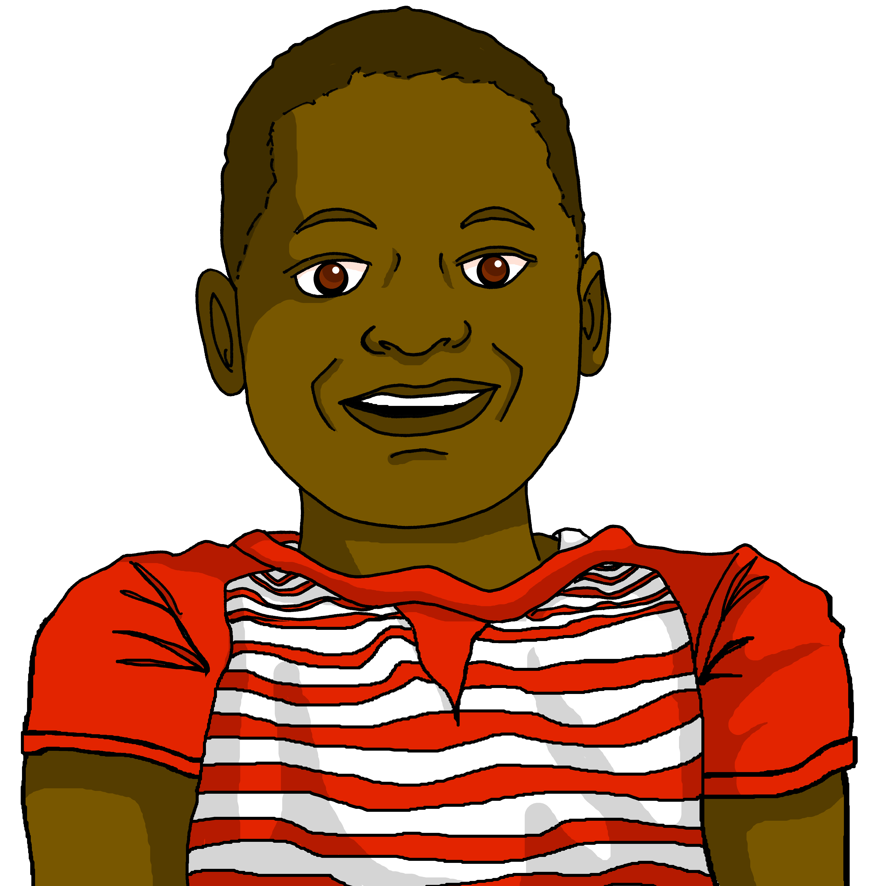
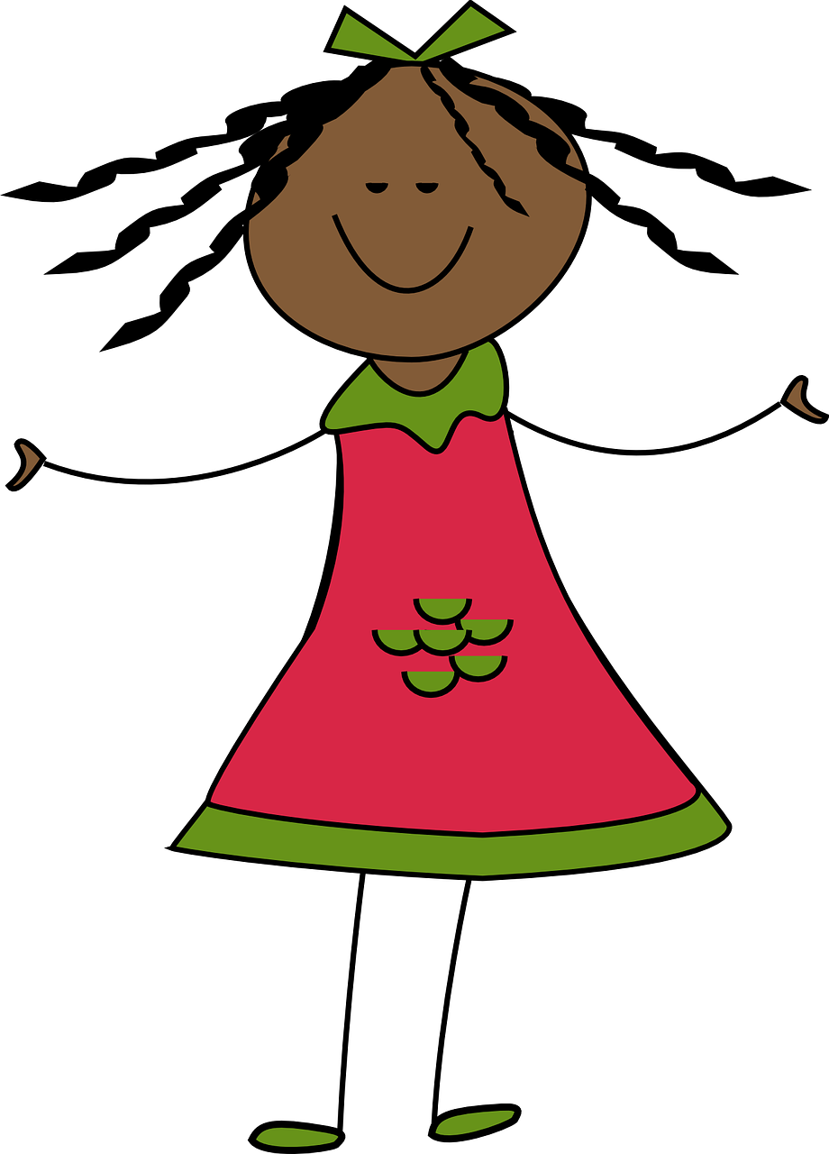
lire
Jean-Michel écrit une histoire pour sa cousine.
His dream is the inspiration for the story.
Lis le texte. Puis, écoute et vérifie.
. Éoute les noms des animaux. C’est [ien] ou [(a)in]?
Chaque jour, Maurice a une carte pour un ami ou une amie.
Aujourd’hui, c’est lundi.
Il a un ballon pour Manon.
Notes:
Timing: 7 minutes
Aim: to revisit days of the week and practise the SSC [u], [ou], [au], [ch], [ien] and SFC in a story.
Procedure:
Ensure that the context is clear. Jean-Michel has decided to write a story for Marie (his cousin) using his dream as inspiration.
Pupils read the story aloud, line by line, as per the animations.
Click on each text box to hear each line pronounced by a native speaker.
7

Slide 8
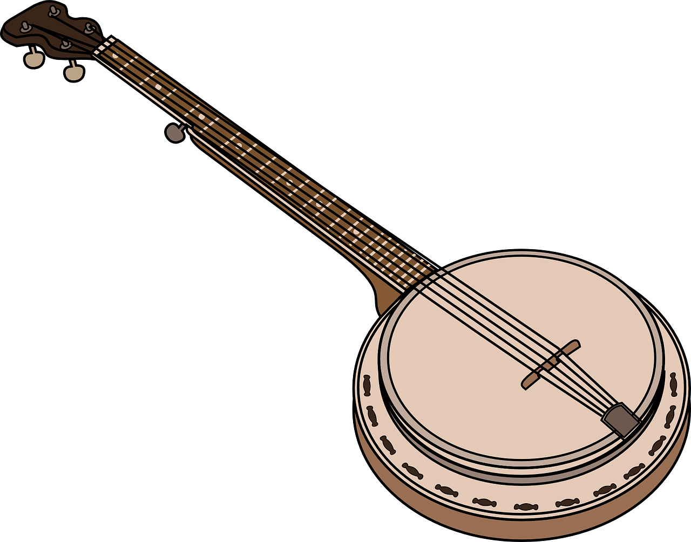
lire
Aujourd’hui c’est mardi.
Aujourd’hui, c’est mercredi.
Il a une tortue pour Lulu.
Il a un banjo pour Léo.
Notes:
[2/4]
8

Slide 9
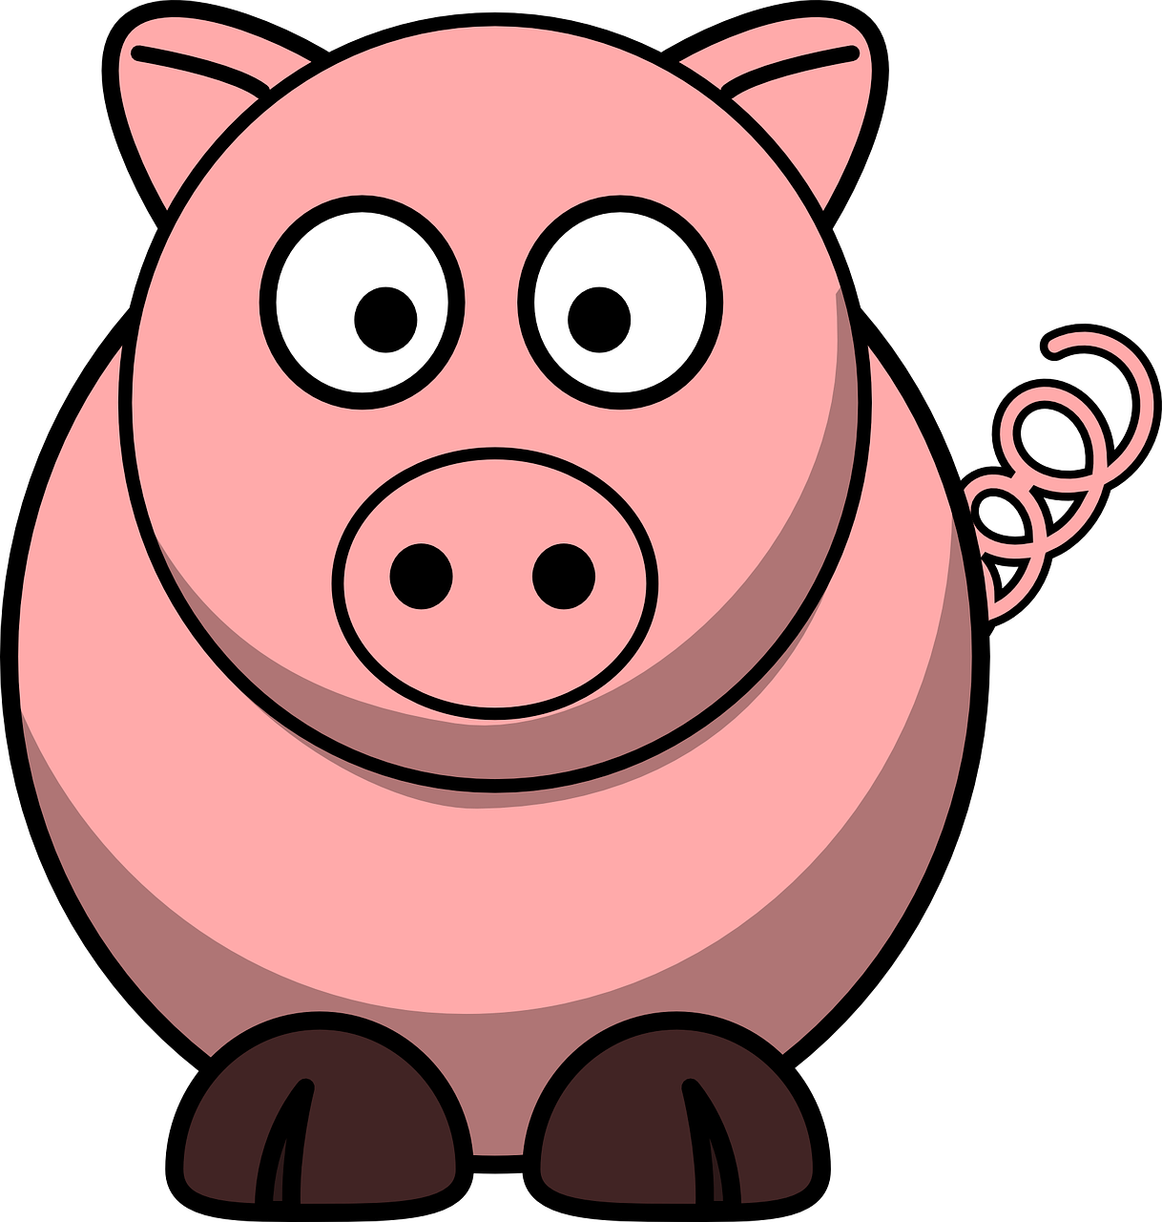
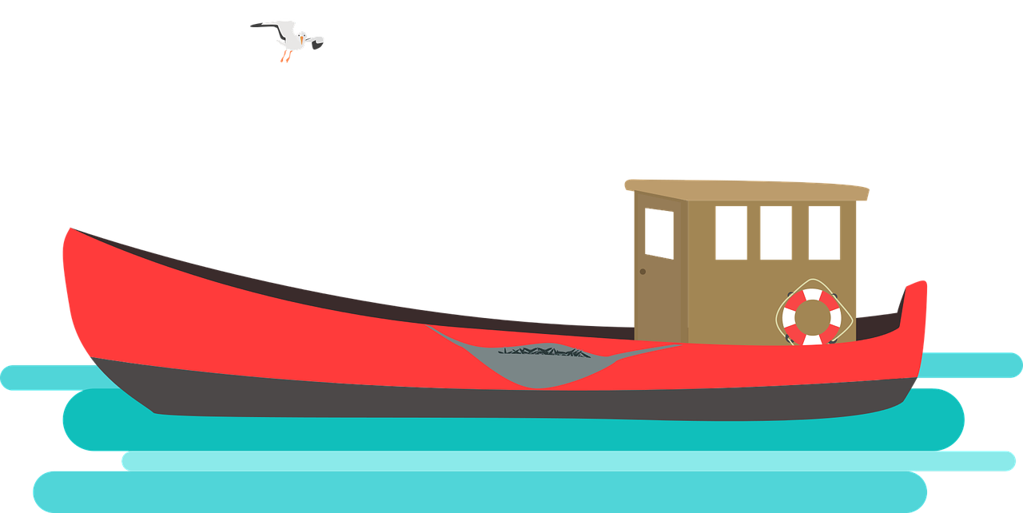
lire
Aujourd’hui c’est jeudi.
Aujourd’hui, c’est vendredi.
Il a un cochon pour Charlotte.
Il a un bateau pour Philo.
Notes:
[3/4]
9

Slide 10
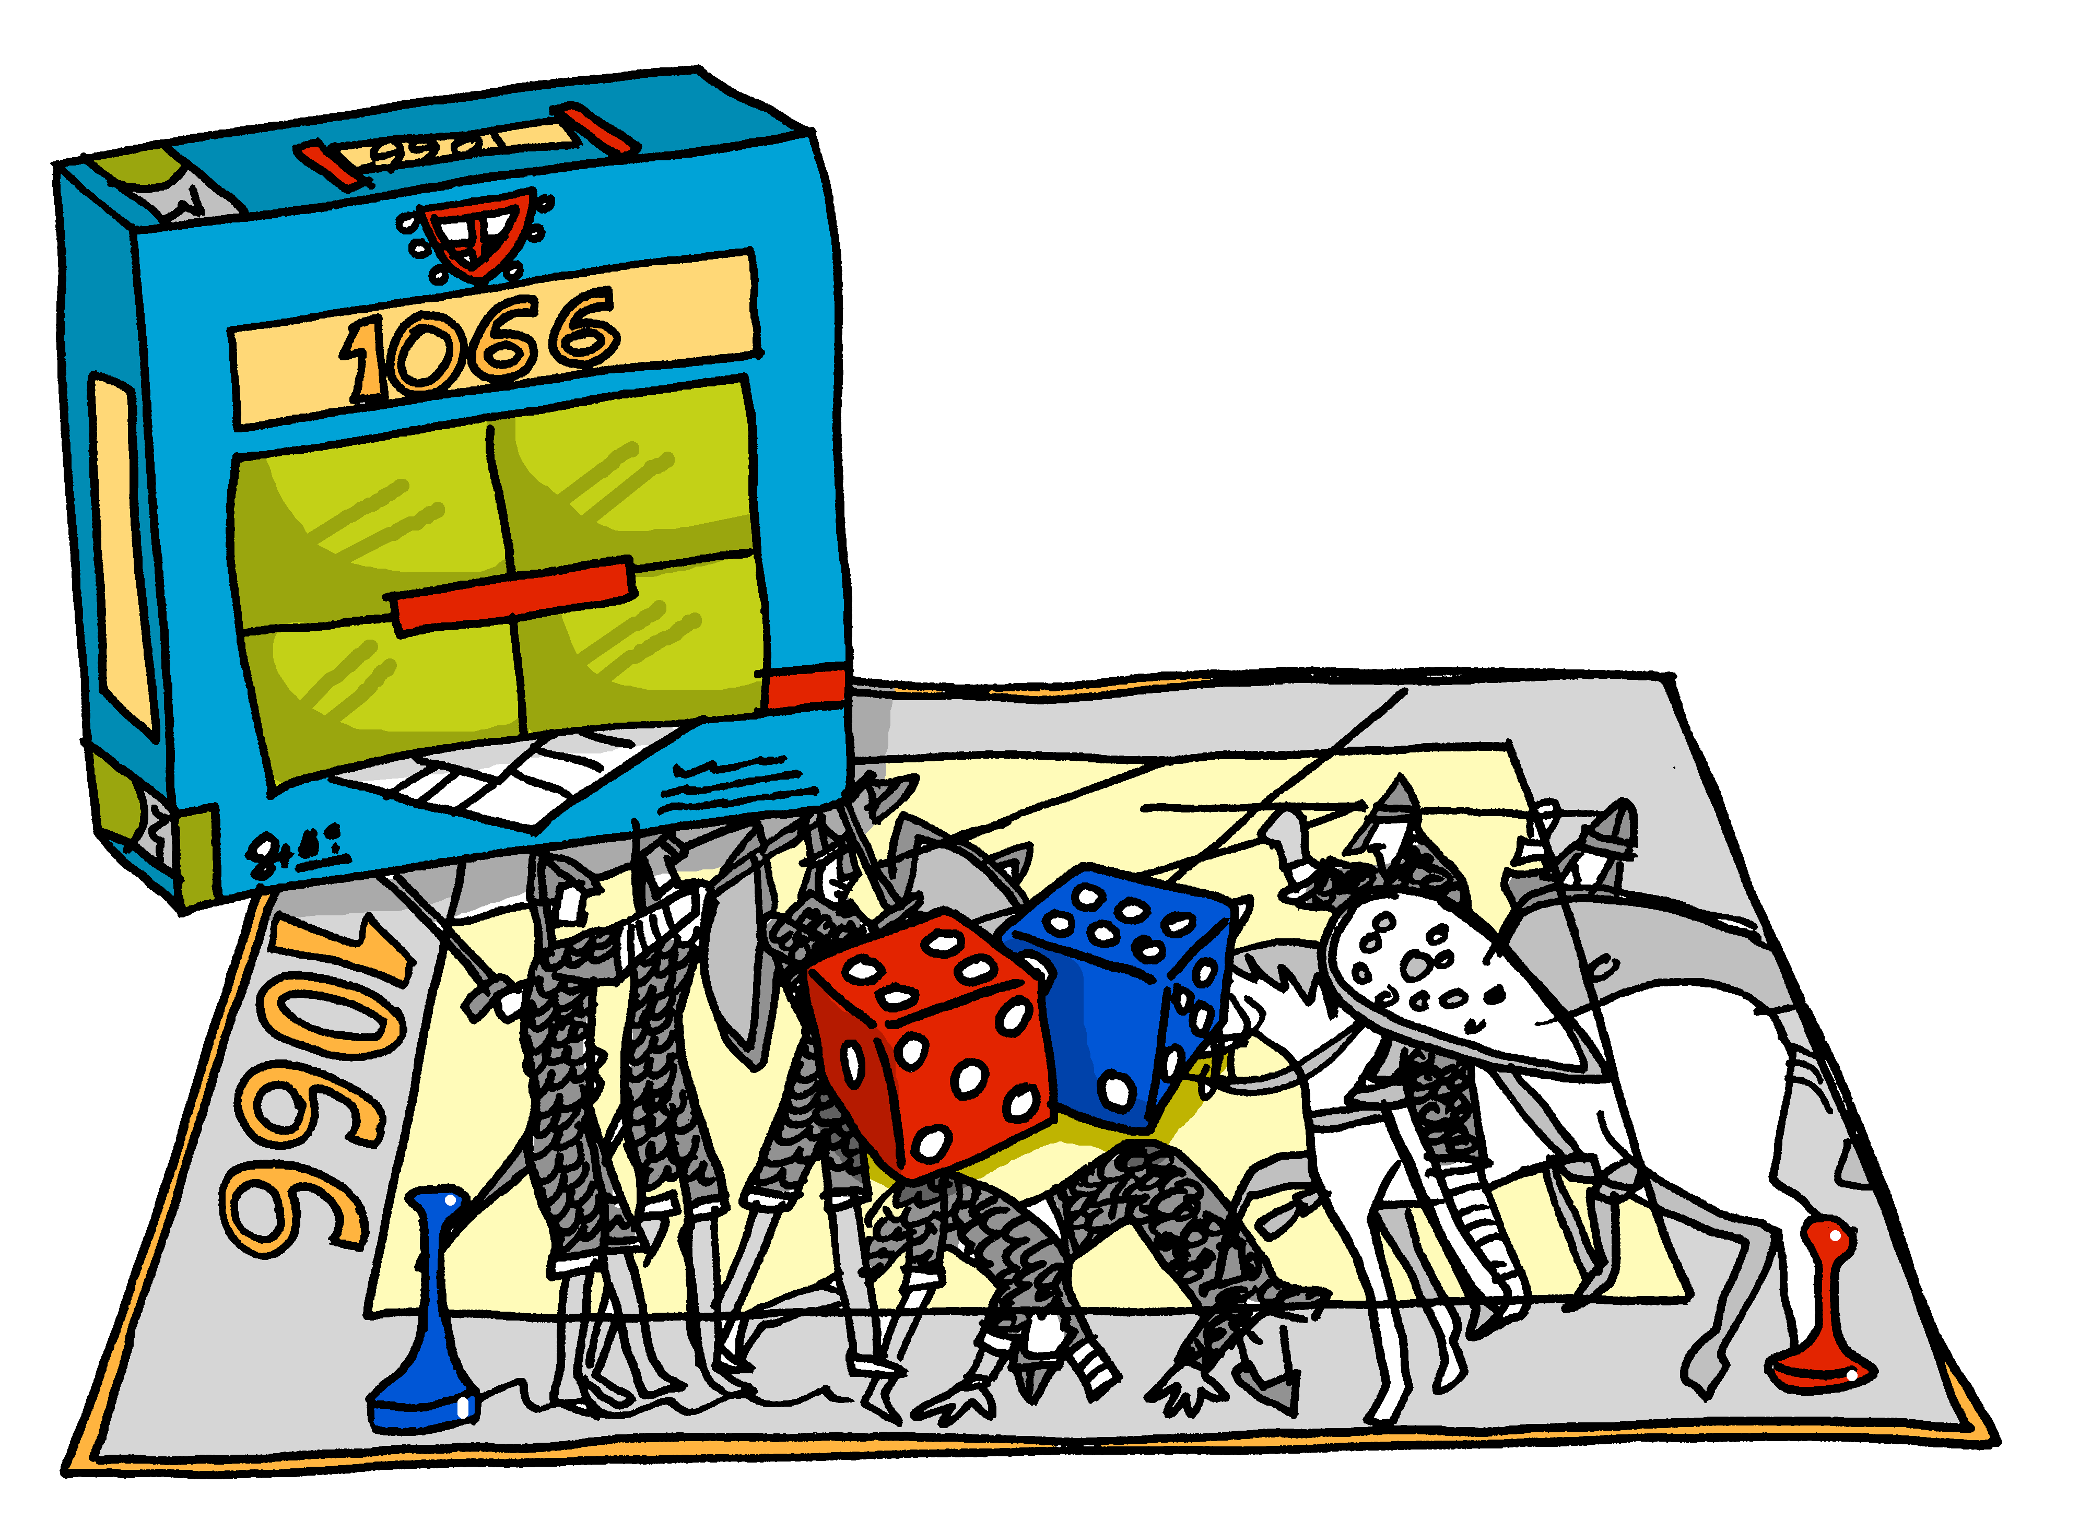
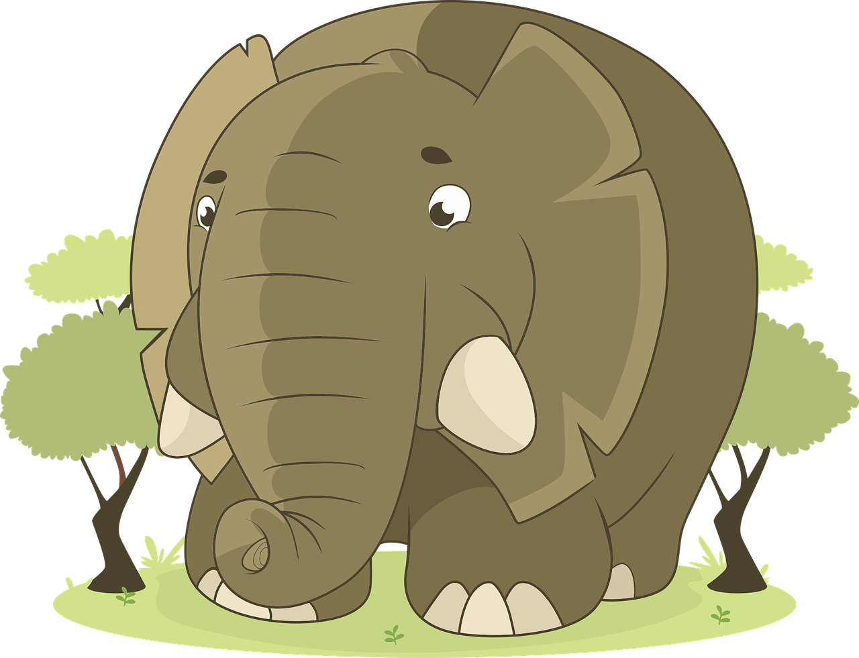
lire
Aujourd’hui c’est samedi.
Aujourd’hui, c’est dimanche.
Il a un éléphant pour Laurent.
Il a un jeu pour Mathieu.
Notes:
[4/4]
10

Slide 11
parler
C’est quel jour ?
.
Aujourd’hui, c’est lundi !
Today it’s Monday!
Mon
Notes:
Timing: 5 minutes (7 slides)
Aim: to practise spoken production of aujourd’hui, c’est and the days of the week from memory.
Procedure:
1. Click to bring up the card.
2. Click again for the day, then the English prompt.
3. Elicit the French from all pupils, chorally.
4. Repeat steps 1-3 for the next six slides.
Note: the days are not in week order to remove the sequential support of recalling the words in order.
11

Slide 12
parler
C’est quel jour ?
.
Today it’s Thursday!
Aujourd’hui, c’est jeudi !
Thu
Notes:
2/7
12

Slide 13
parler
C’est quel jour ?
.
Today it’s Saturday!
Aujourd’hui, c’est
samedi !
Sat
Notes:
3/7
13

Slide 14
parler
C’est quel jour ?
.
Today it’s Tuesday!
Aujourd’hui, c’est
mardi !
Tue
Notes:
4/7
14

Slide 15
parler
C’est quel jour ?
.
Aujourd’hui, c’est
vendredi !
Today it’s Friday!
Fri
Notes:
5/7
15

Slide 16
parler
C’est quel jour ?
.
Aujourd’hui, c’est
dimanche !
Today it’s Sunday!
Sun
Notes:
6/7
16

Slide 17
parler
C’est quel jour ?
.
Aujourd’hui, c’est
mercredi !
Today it’s Wednesday!
Wed
Notes:
7/7
17

Slide 18
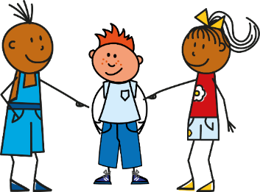
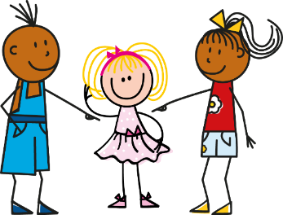
Questions with quoi
To ask a ‘yes/no’ question, make your voice go up at the end of a statement:
C’est lundi ?
Is it Monday?
To ask a ‘what’ question, use ‘quoi’ at the end:
C’est quoi ?
What is it?
(literally, it is what?)
To ask a ‘what’ s/he has:
Il a quoi ?
What does he have?
(literally, he has what?)
Elle a quoi ?
What does she have?
(literally, she has what?)
Notes:
Timing: 2 minutes
Aim: To recap the meaning of quoi and how to use it in an intonation question.
Procedure:
Click to present the information.
Elicit the English meanings of the examples.
18

Slide 19
écrire
Jean-Michel pose des questions à sa cousine.
. Éoute les noms des animaux. C’est [ien] ou [(a)in]?
Complète les mots de la conversation.
- Charlotte, elle a quoi ? - Elle a un cochon.
___
_
___
__
_
- Manon, elle a quoi ? - Elle a un ballon.
_
___
___
_
- Philo, elle a quoi ? - Elle a un bateau.
__
_
___
__
_
- Lulu, elle a quoi ? - Elle a une tortue.
___
_
___
___
_
- Laurent, il a quoi ? - Il a un éléphant.
_
_
___
_
_
- Léo, il a quoi ? - Il a un banjo.
_
_
___
_
- Mathieu, il a quoi ? - Il a un jeu.
_
_
_
___
_
_
Notes:
Timing: 8 minutes
Aim: to practise written production of il, elle, a, quoi.
Procedure:
Pupils write the dialogue out, filling in the missing words from memory.
Click to reveal the written answers.
Click on each speech bubble to hear the pairs of lines.
19

Slide 20
Au revoir !
jaune
Notes:
20

