Slide 1
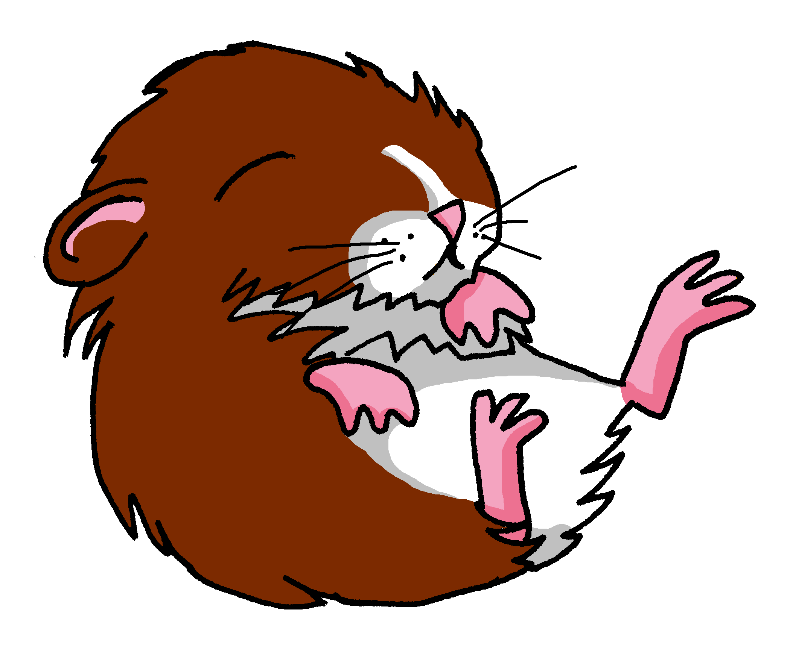
Saying what I and others have
jaune
Follow ups 1-5
Notes:
Artwork by Steve Clarke. Pronoun pictures from NCELP (www.ncelp.org). All additional pictures selected from Pixabay and are
available under a Creative Commons license, no attribution required.
Phonics: [au/eau/o] gauche[607] faux [555] eau[475] photo [1412] aussi [44]
Vocabulary: moi [132] toi [510] [38] carte [955] 2298] idéal [1429] de [6] pour [10]
Revisit 1: affiche [2886] bureau [273] chaise [3419] chambre [633] idée [239] lit [1837] un [3] une [3] (revisit moto, cheval)
Revisit 2: je [22] il [13] elle [38] être [5] suis, est monsieur [79] madame [294] présent [216] absent [2016] ici [167] là [109] Bonjour ! [1972] Salut ! [2205]
Londsale, D., & Le Bras, Y. (2009). A Frequency Dictionary of French: Core vocabulary for learners London: Routledge.
The frequency rankings for words that occur in this PowerPoint which have been previously introduced in these resources are given
in the SOW and in the resources that first introduced and formally re-visited those words.
For any other words that occur incidentally in this PowerPoint, frequency rankings will be provided in the notes field wherever
possible.

Slide 2
[au]
[au / eau / o]
prononcer
gauche
Notes:
Timing: 2 minutes
Aim: to present SSC [au].
Procedure:
Click to bring up the SSC [au]. Repeat the SSC [au] and the source word gauche with the class. Introduce the gesture, if using.
Click to bring up the picture.
Pupils to practise saying the SSC and source word several times.
Suggested gesture: https://www.signbsl.com/sign/left Tap the left forearm with the right hand.

Slide 3
[au]
[au / eau / o]
gauche
prononcer
faux
eau
photo
aussi
[also]
Notes:
Timing: 2 minutes
Aim: To introduce SSC [au]
Procedure:
1. Introduce and elicit the pronunciation of the individual SSC [au] and then the source word again ‘gauche’ (with gesture, if using). 2. Then present and elicit the pronunciation of the five cluster words.
Frequency:
gauche [607] faux [555] eau [475] photo [1412] aussi [44]
Londsale, D., & Le Bras, Y. (2009). A Frequency Dictionary of French: Core vocabulary for learners London: Routledge.

Slide 4
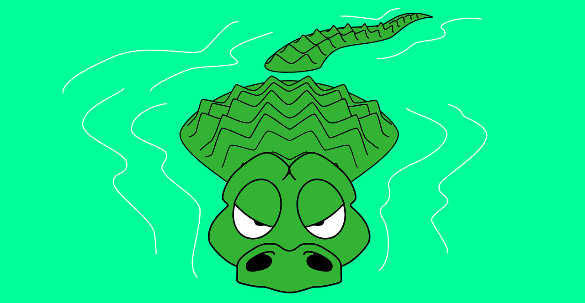
Follow up 1:
. Écoute les noms des animaux. C’est [ien] ou [(a)in]?
Lis les mots avec le son [(e)au/o].
. Écoute les noms des animaux. C’est [ien] ou [(a)in]?
Attention ! Il y a des crocodiles dans l’eau !
jeu – game | fou - mad
astronaut
jeune
faux
poste
piano
jaune
fou*
eau
photo
12
jeu*
banjo
S
personne
0
DÉBUT
Notes:
Timing: 3 minutes
Aim: to consolidate SSC [(e)au/o].
Procedure:
Start the timer. Pupil A tries to say all 7 words (piano, eau, jaune, photo, banjo, astronaut, faux) which have the SSC [(e)au/o] with correction pronunciation (avoiding the five distractors jeune, jeu, personne, poste, fou) within 12 seconds.
Pupil B listens and if pupil A says one of the five distractor words s/he can stop her/his partner as they will have fallen into crocodile-infested waters and their turn is over!
They swap roles and repeat.
If either pupil hasn’t completed the task in the time, the teacher can offer additional rounds of practice against the timer.
Click on each word to listen and check (in audio version, or teacher says each word). Click to show the arrow to the next correct word and to disappear all the words that don’t have the SSC [(e)au/o].
Frequency of unknown words and cognates: astronaut [>5000] banjo [>5000] faux [555] fou [1357] jaune [2585] jeu [291] personne [84] piano [>5000] poste [489]
Londsale, D., & Le Bras, Y. (2009). A Frequency Dictionary of French: Core vocabulary for learners London: Routledge.

Slide 5
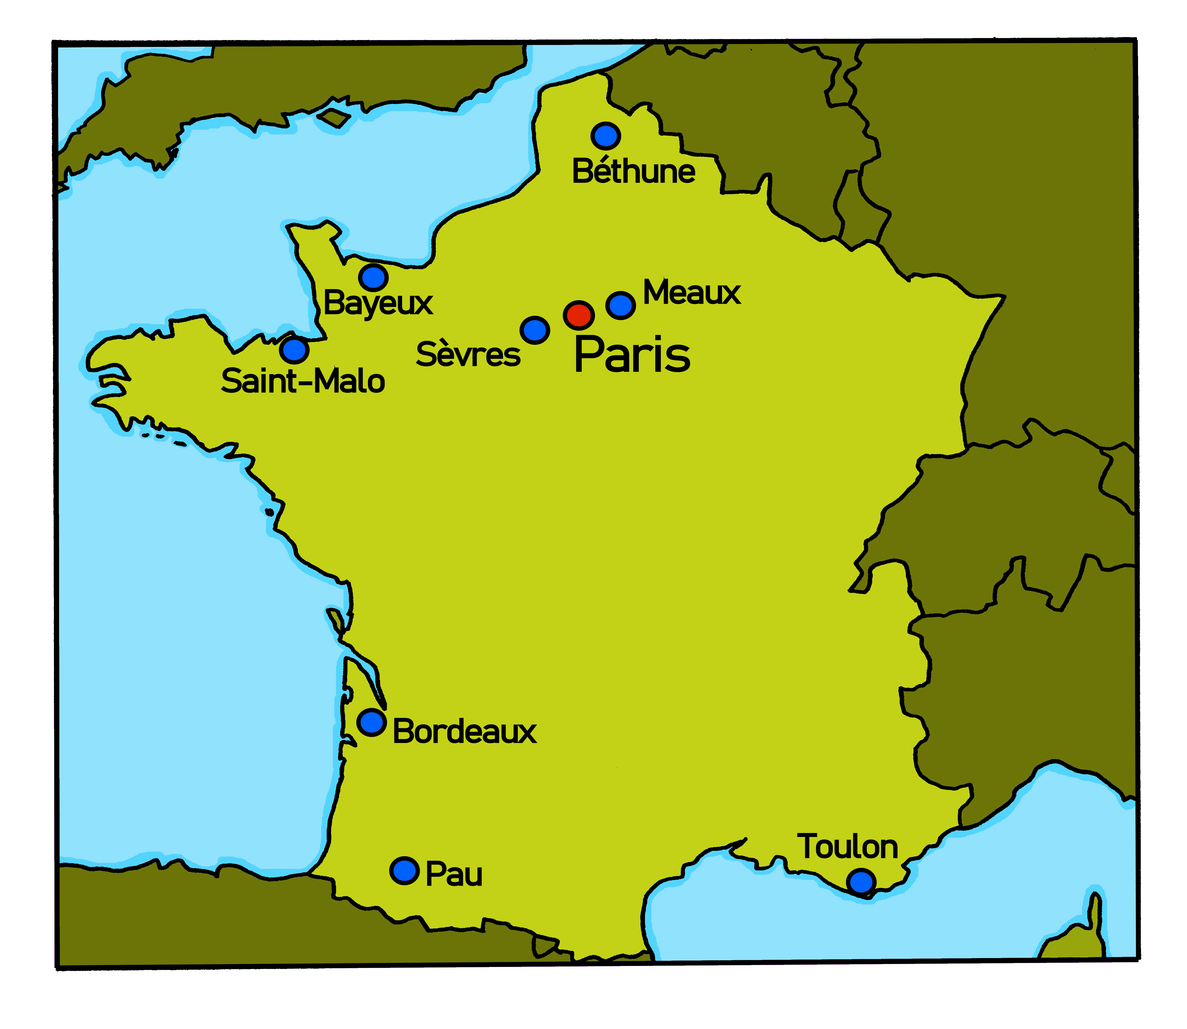
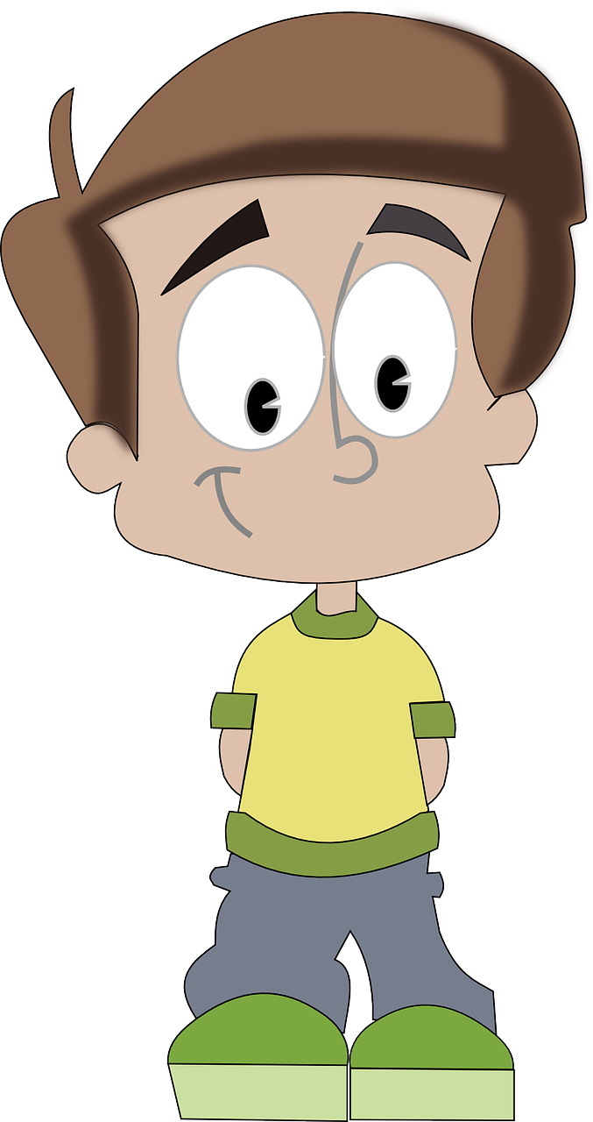
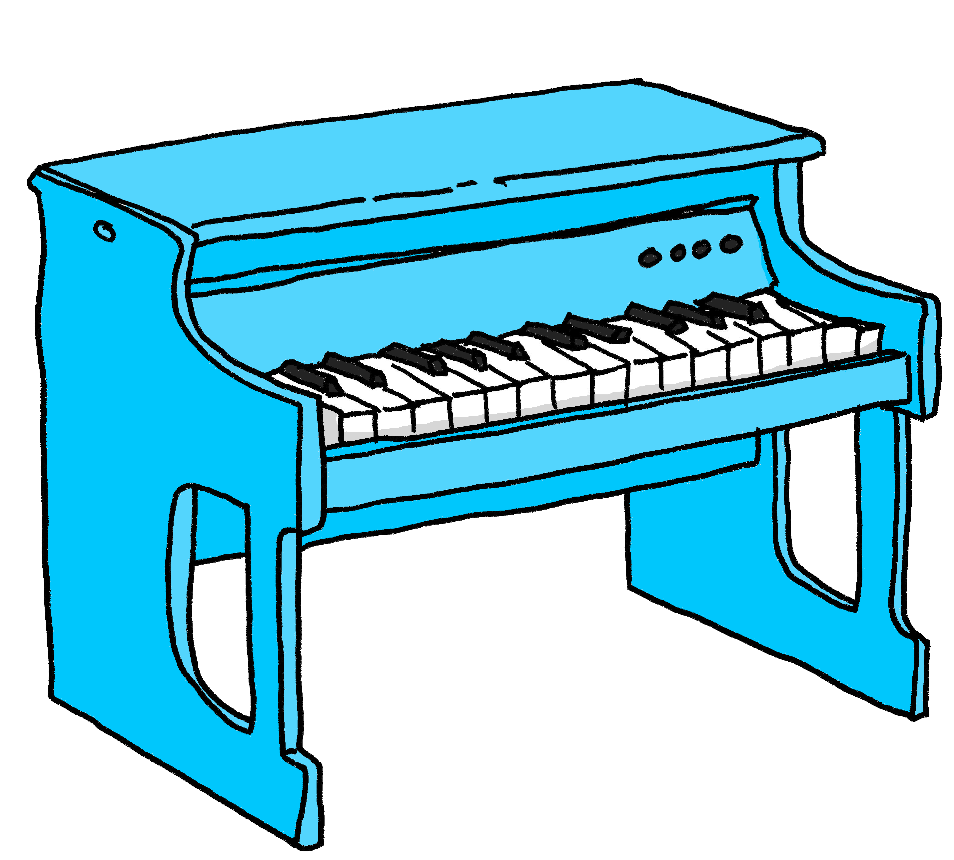
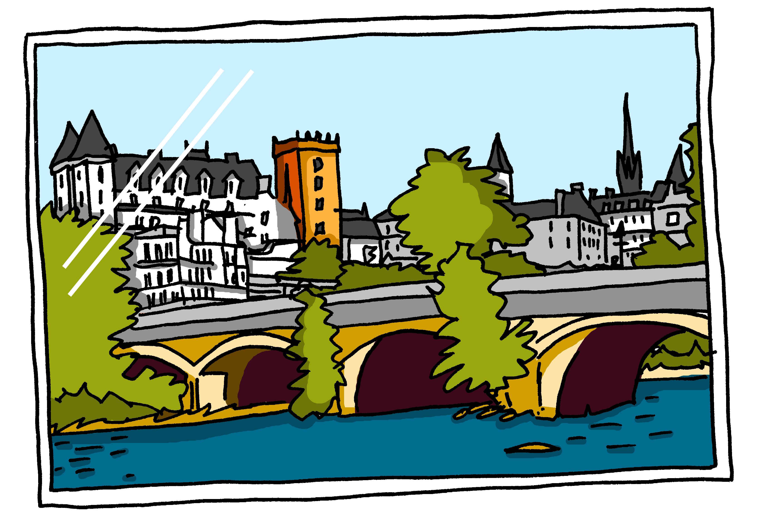
Follow up 2:
. Écoute les noms des animaux. C’est [ien] ou [(a)in]?
Parle. C’est quoi ? Puis, écoute et vérifie.
1. C’est Mathieu de Bayeux.
une lune – a moon
8
parler
2. C’est un cheval de Laval.
1
3. C’est un piano de Saint-Malo.
Mathieu
7
écouter
Laval
4. C’est un bureau de Bordeaux.
2
Note: de = from
3
5. C’est une photo de Pau.
6. C’est un crayon de Toulon.
4
7. C’est une moto de Meaux.
5
8. C’est une lune de Béthune.
6
Notes:
Timing: 5 minutes
Aim: to practise spoken production of some previously taught nouns and new French place names and nouns with SSC [au], [eu], [on], [a], SFC and [u].
Procedure: 1. Explain to pupils that they are to name the item and where it is from, in French and that the item and the place share a common sound.
2. Model this with item 1. e.g., C’est Mathieu …. de… and elicit the full sentence. Click to reveal the written sentence and click on number 1 to hear the sentence said. 3. Given pupils 30 seconds to think and talk with a partner about number 2. Elicit the sentence (either chorally or from volunteers). Click for the written and audio versions. 4. Repeat with items 3 – 8.

Slide 6
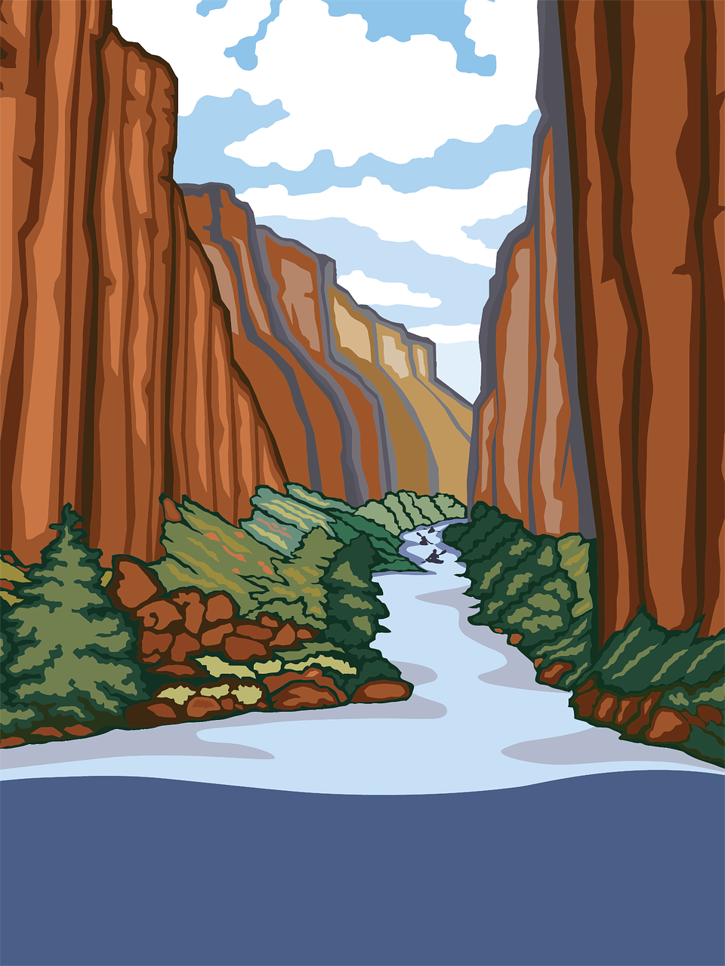
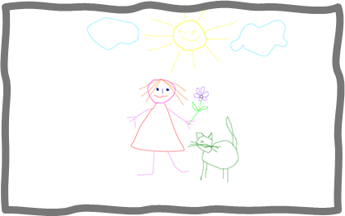
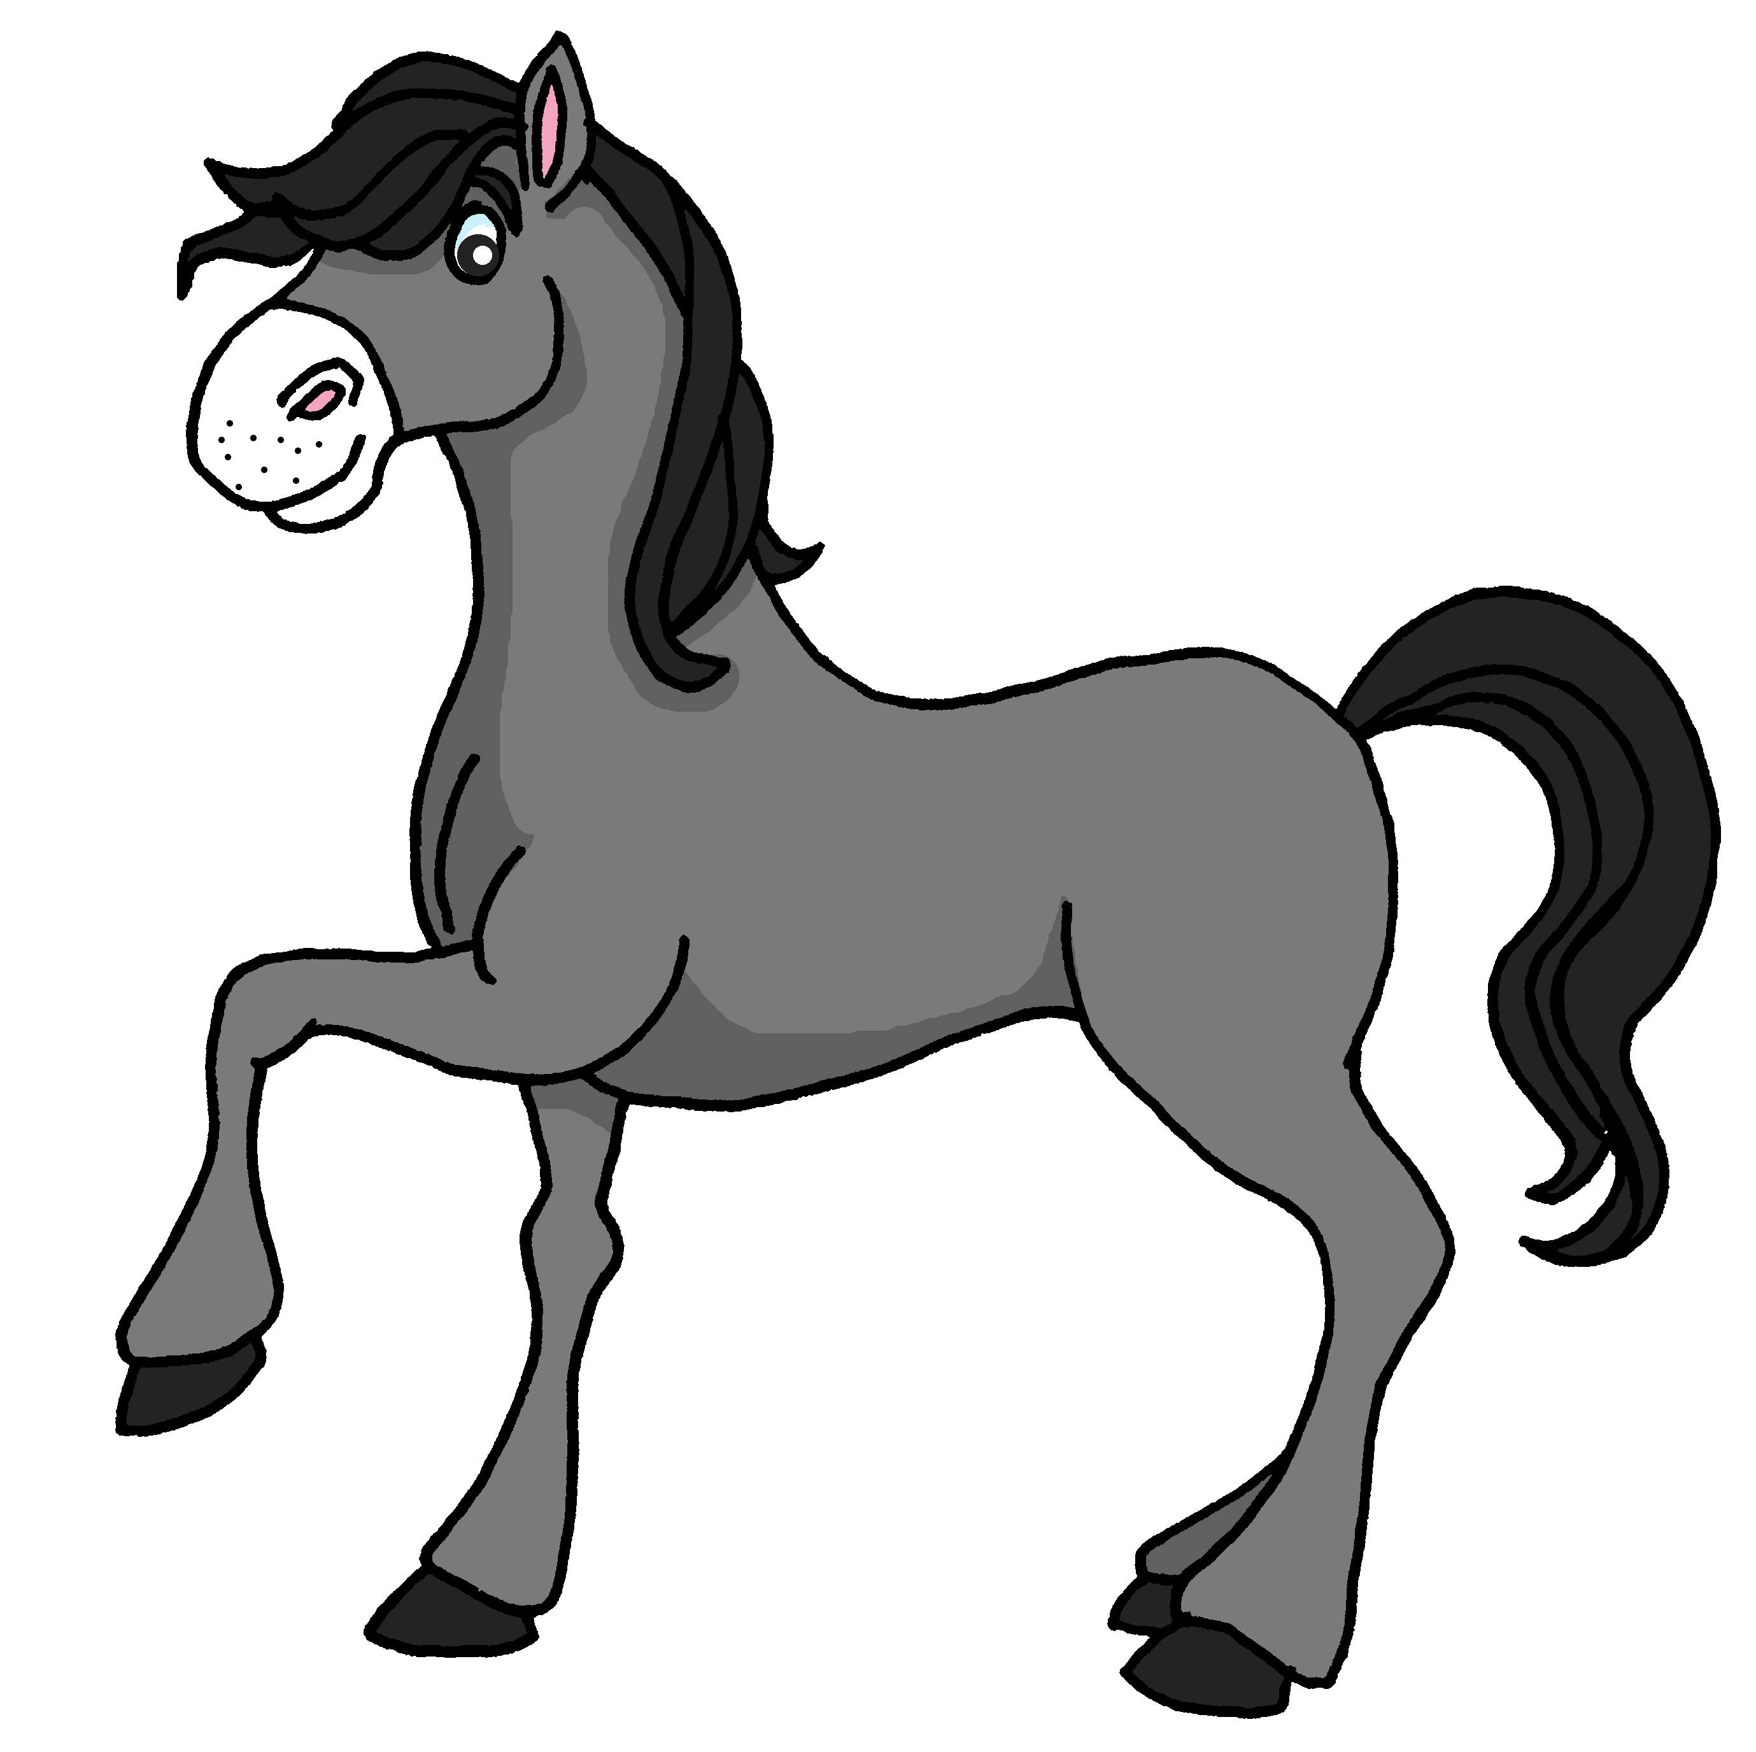
Follow up 3
. Écoute les noms des animaux. C’est [ien] ou [(a)in]?
Écoute. Écris l’objet en français et en anglais.
écouter
un bureau
un crayon
un lit
un chat
un cheval
un dessin
une affiche
Notes:
Timing: 5 minutes
Aim: to practise transcription and aural comprehension of previously taught nouns in a longer spoken context.
Procedure: 1. Click to re-listen to the story from this week’s lesson.
2. Pupils write the presents in French and English (left to right 1-7).
3. Click to reveal a picture of each object and its French word, for pupils to check their spelling and their understanding.

Slide 7
Il a quoi ? Elle a quoi ?
Remember that quoi means what.
You also know how to add quoi to make a question:
C’est quoi ?
What is it?
C’est un cadeau.
It is a present.
You can add quoi to make other questions, too:
Il a quoi ?
Elle a quoi ?
What does he have?
What does she have?
In English, we add ‘does’, in French we just make our voice go up.
Notes:
Timing: 2 minutes
Aim: to extend the use of ‘quoi’ to questions with avoir.
Procedure:
Click to present the short explanation.
Elicit English meanings for the French examples.
7

Slide 8
Follow up 4:
Il a quoi ?
Elle a quoi ?
Choose to ask: What does he have? OR what does she have?
Your partner will answer according to the picture.
parler
Il a quoi ?
Il a un crayon.
‘What does he have…..?’
Gaston (m)
Lucie (f)
Notes:
Timing: 5 minutes
Aim: to practise oral production of il a and elle a + quoi in raised intonation questions, and this week’s vocabulary items.
Procedure: 1. Pupil A chooses to ask ‘does she have’ or ‘does he have’ 2. Pupil B answers by selecting the correct response. There are pairs of male / female characters presented here (signified by the (m) or (f) in brackets and additionally colour-coded.
3. After slide 1 (four question and answers), move on to slide 2, swap roles and repeat the task.
Note: answers depend on the question asked so audio not provided.

Slide 9
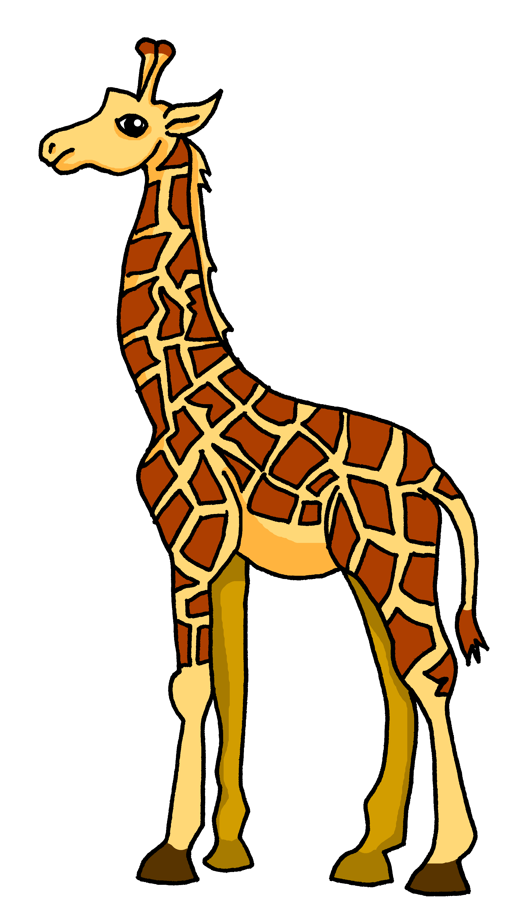
Follow up 4A
Il a quoi ?
Elle a quoi ?
1a
1b
2a
2b
Lucie (f)
Hugo (m)
Philo (f)
parler
Pascal (m)
3a
3b
4a
4b
Maurice (m)
Margot (f)
Philo (f)
Nicolas (m)
Notes:
Partner A asks questions

Slide 10
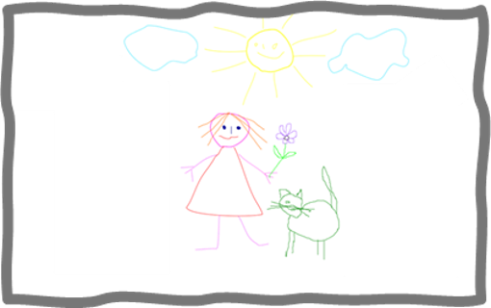
Follow up 4B
Il a quoi ?
Elle a quoi ?
1a
1b
2a
2b
Philo (f)
Margot (f)
Hugo (m)
parler
Gaston (m)
3a
3b
4a
4b
Martin (m)
Margot (f)
Lucie (f)
Pascal (m)
Notes:
Partner B asks questions

Slide 11
vocabulaire

Follow up 5
Écris en français. Can you get at least 15 points?
mots
 | Hi! | Mrs, (Miss) teacher | Hello!
 | I am | he is | Mr, Sir (teacher)
 | a bedroom | a chair | a desk
 | a (m) | a (f) | an idea
 | ideal (f) | you have (singular) | she has
 | for | for me | for you
 | a card | ideal (m) | from
Salut !
Madame
Bonjour !
x3
je suis
il est
Monsieur
une chambre
une chaise
un bureau
x2
un
une
une idée
idéale
tu as
elle a
pour
pour moi
pour toi
x1
une carte
idéal
de
Notes:
Timing: 5-10 minutes
Aim: to practise written comprehension of vocabulary from this week and previous weeks.
Procedure: Give pupils a blank grid. They fill in the French meanings of any of the words they know, trying to reach 15 points in total.
Note: The most recently learnt and practised words are pink, words from the previous week are green and those from week 1 are blue, thus more points are awarded for them, to recognise that memories fade and more effort (heavy lifting!) is needed to retrieve them.
11

Slide 12
vocabulaire
Écris en français : Can you get at least 15 points?
mots
 | Hi! | Mrs, (Miss) teacher | Hello!
 | I am | he is | Mr, Sir (teacher)
 | a bedroom | a chair | a desk
 | a (m) | a (f) | an idea
 | ideal (f) | you have (singular) | she has
 | for | for me | for you
 | a card | ideal (m) | from
x3
x2
x1
Notes:
HANDOUT
12

