Slide 1
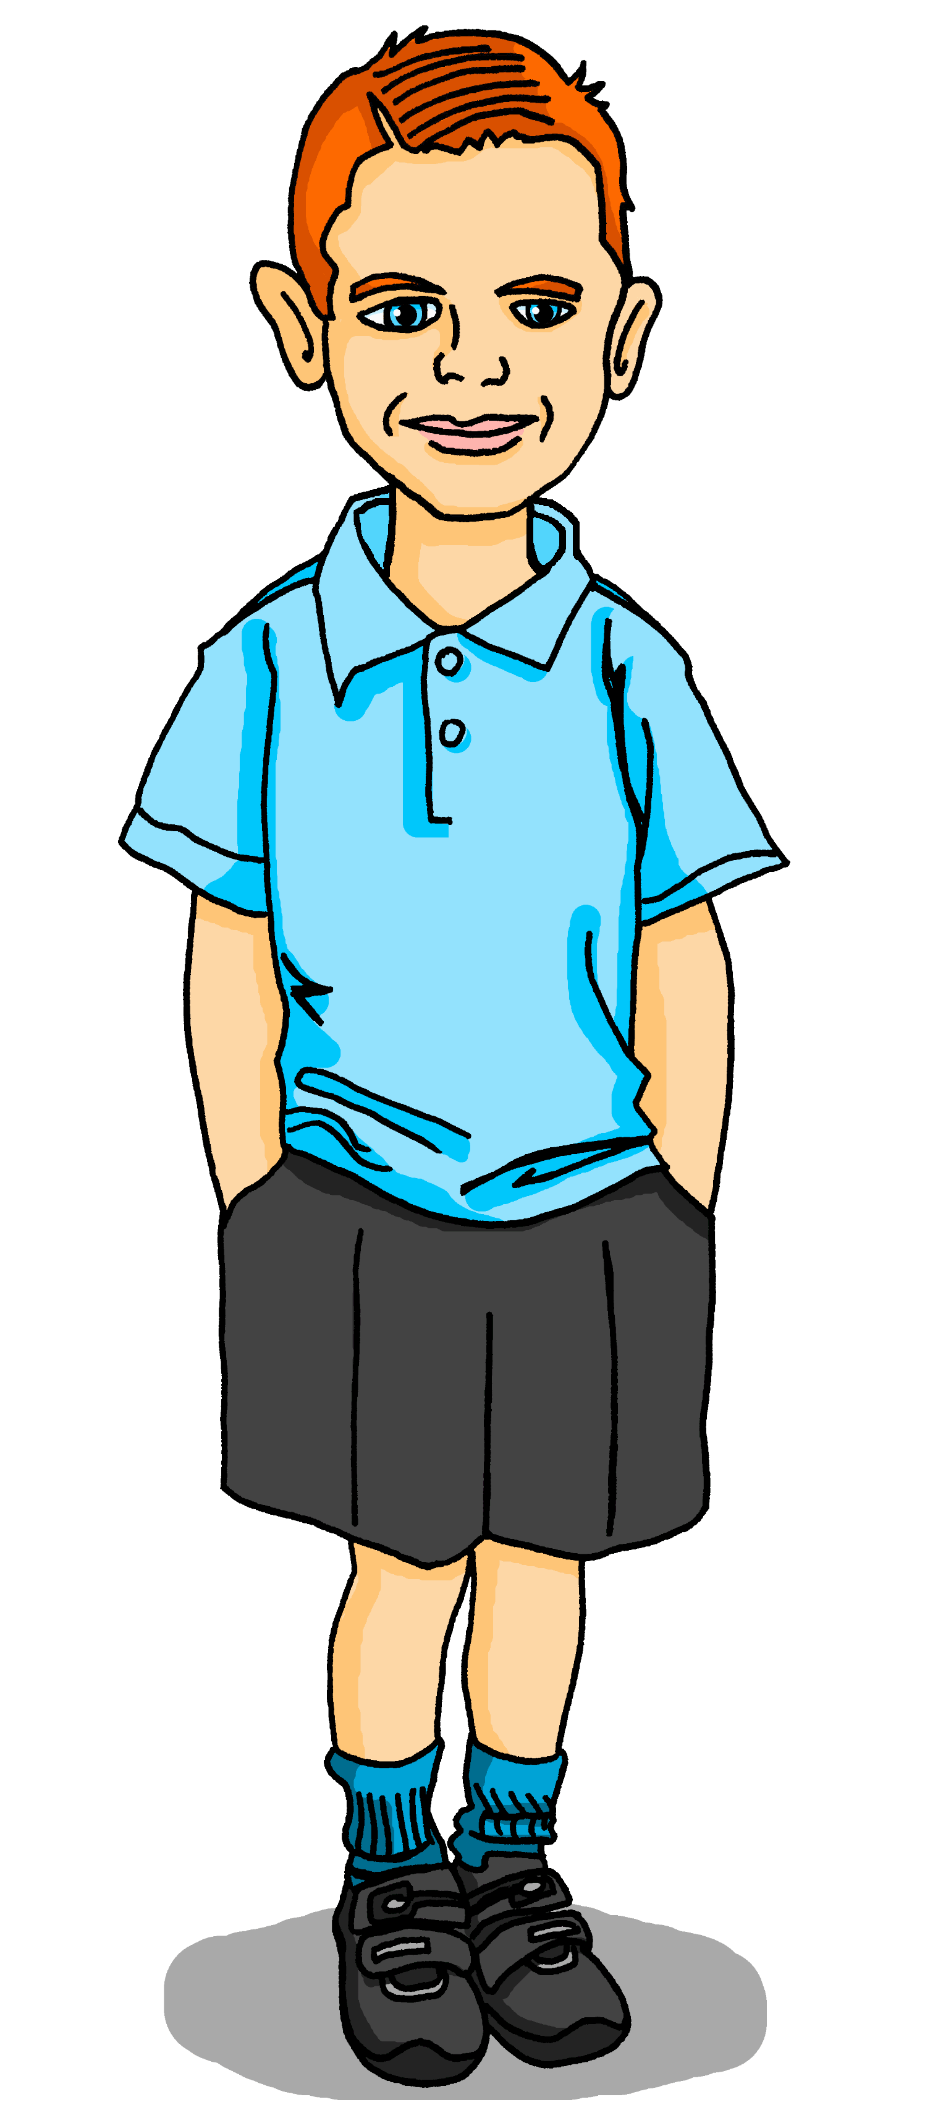
Saying what I and others have
jaune
Follow ups 1-5
Notes:
Artwork by Steve Clarke. Pronoun pictures from NCELP (www.ncelp.org). All additional pictures selected from Pixabay and are available under a Creative Commons license, no attribution required.
Frequency of new vocabulary and phonics:
Frequency of new vocabulary and phonics:
Phonics: [on] non ! [72] crayon [>5000] onze [2447] monde [77] pont [1889]
Vocabulary: tu as [8] question [144] réponse [456] où [48] dans [11] sur [16] sous [122]
Revisit 1: Revisit days of the week, courageux [2198] curieux [2424] heureux [764] sérieux [412]
Revisit 2: écouter [429] écrire [382] lire [278] parler [106] banane [>5000] cheval [2220] midi [2483] moto [>5000] univers [2112]
Londsale, D., & Le Bras, Y. (2009). A Frequency Dictionary of French: Core vocabulary for learners London: Routledge.
The frequency rankings for words that occur in this PowerPoint which have been previously introduced in these resources are given in the SOW and in the resources that first introduced and formally re-visited those words.
For any other words that occur incidentally in this PowerPoint, frequency rankings will be provided in the notes field wherever possible.

Slide 2
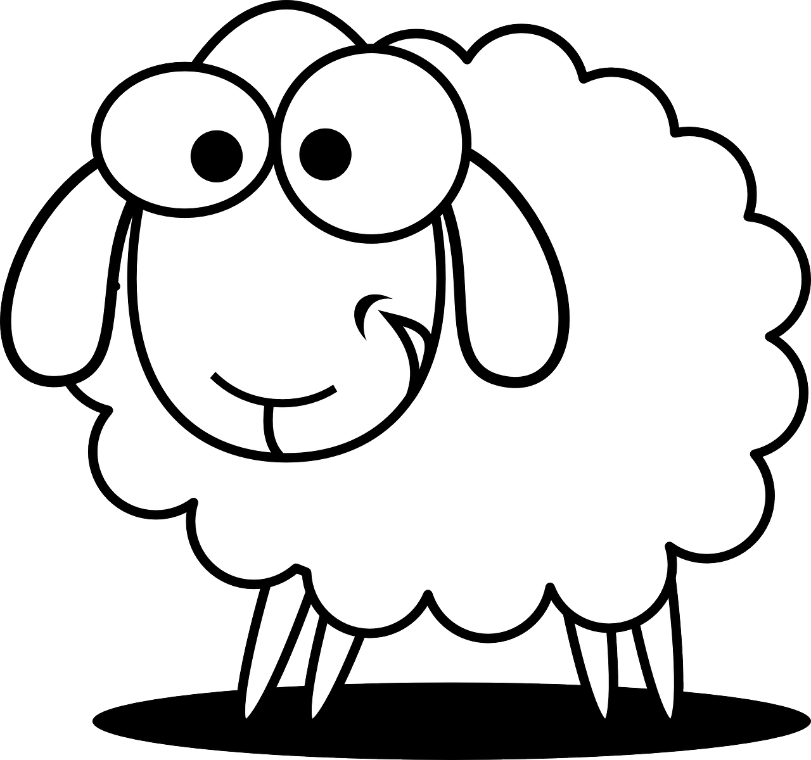
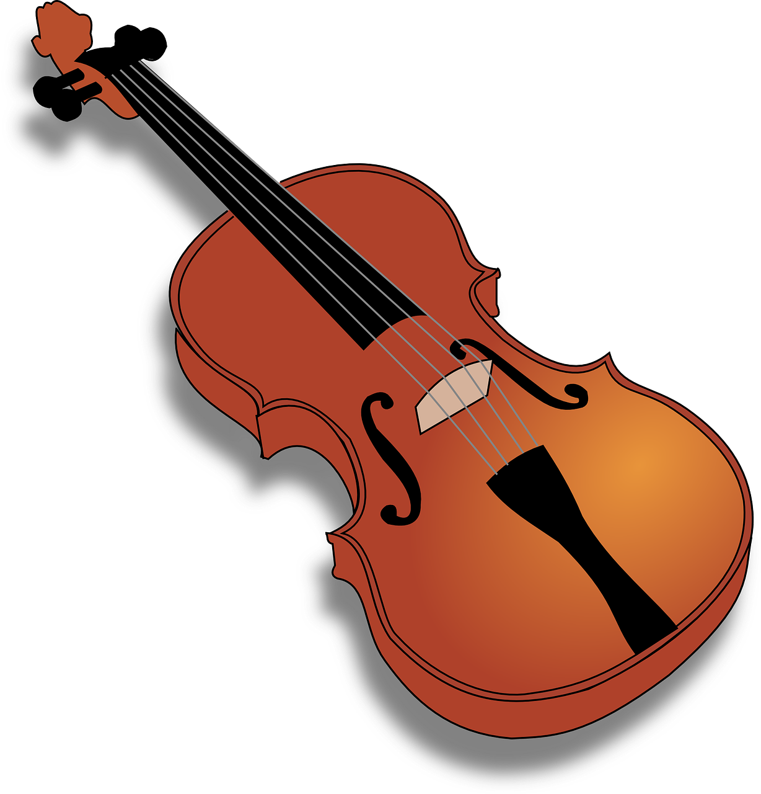
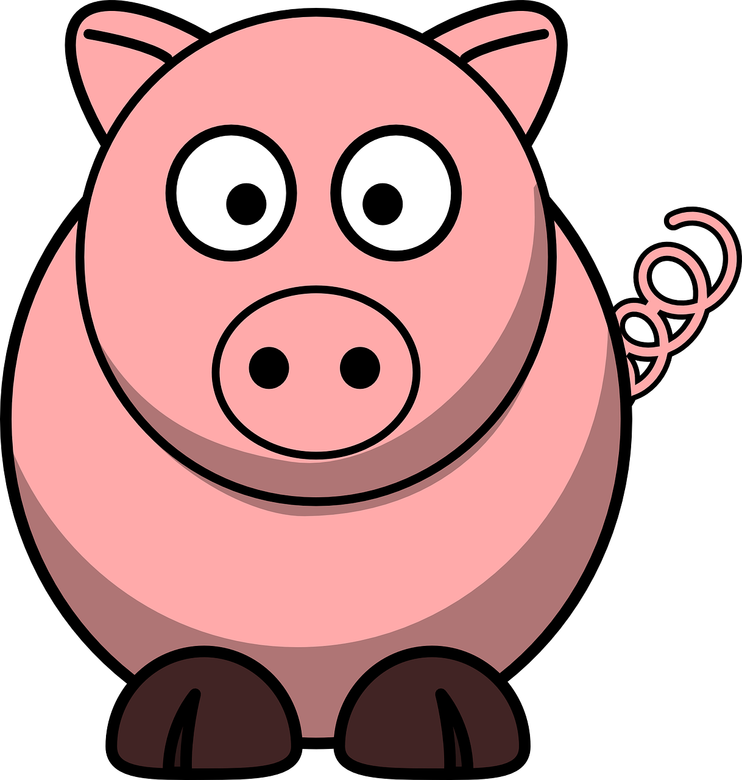
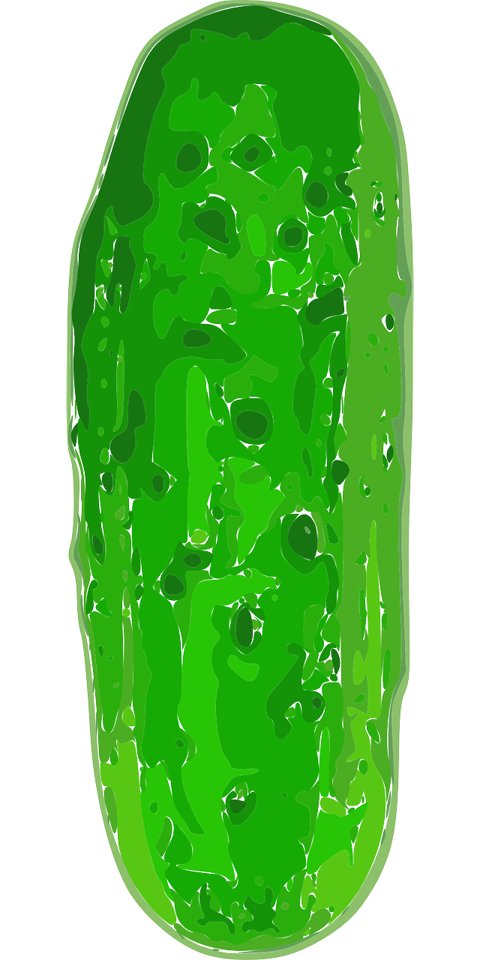
Follow up 1
.
Parle avec ton/ta partenaire.
Build up your sentences, one item at a time.
.
parler
Mon oncle Basson a un violon dans le salon.
B
A
un mouton
.
1
un violon
2
3
un melon
Mon oncle Basson a un violon et un mouton dans le salon.
.
Mon oncle Basson a un violon , un mouton et un melon dans le salon.
4
un poisson
5
un cochon
6
une tarte au citron
7
un jambon
8
un caméléon
9
un cornichon
Notes:
Timing: 5 minutes
Aim: to practise spoken production of unknown words with the SSC [on].
Procedure: 1. Pupils take it in turns to speak, adding one item each time. 2. Teachers can click each number to hear each of the sentences, as and when required.
Transcript:
Mon oncle Basson a un violon dans le salon.
Mon oncle Basson a un violon et un mouton dans le salon. Mon oncle Basson a un violon , un mouton et un melon dans le salon.
Mon oncle Basson a un violon , un mouton, un melon et un poisson dans le salon.
Mon oncle Basson a un violon , un mouton, un melon, un poisson et un cochon dans le salon.
Mon oncle Basson a un violon , un mouton, un melon, un poisson, un cochon et une tarte au citron dans le salon.
Mon oncle Basson a un violon , un mouton, un melon, un poisson, un cochon, une tarte au citron et un jambon dans le salon.
Mon oncle Basson a un violon , un mouton, un melon, un poisson, un cochon, une tarte au citron, un jambon et un caméléon dans le salon.
Mon oncle Basson a un violon , un mouton, un melon, un poisson, un cochon, une tarte au citron, un jambon, un caméléon et un cornichon dans le salon.

Slide 3
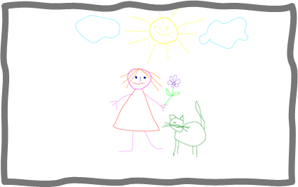
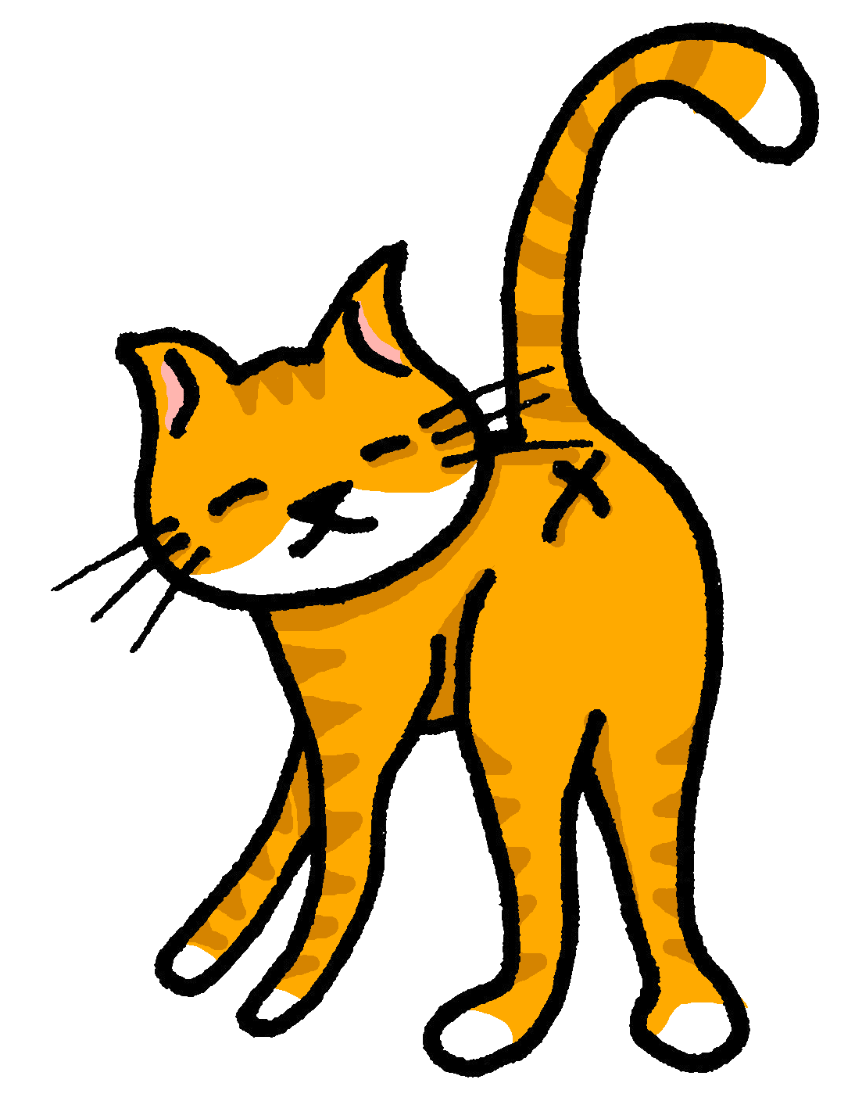
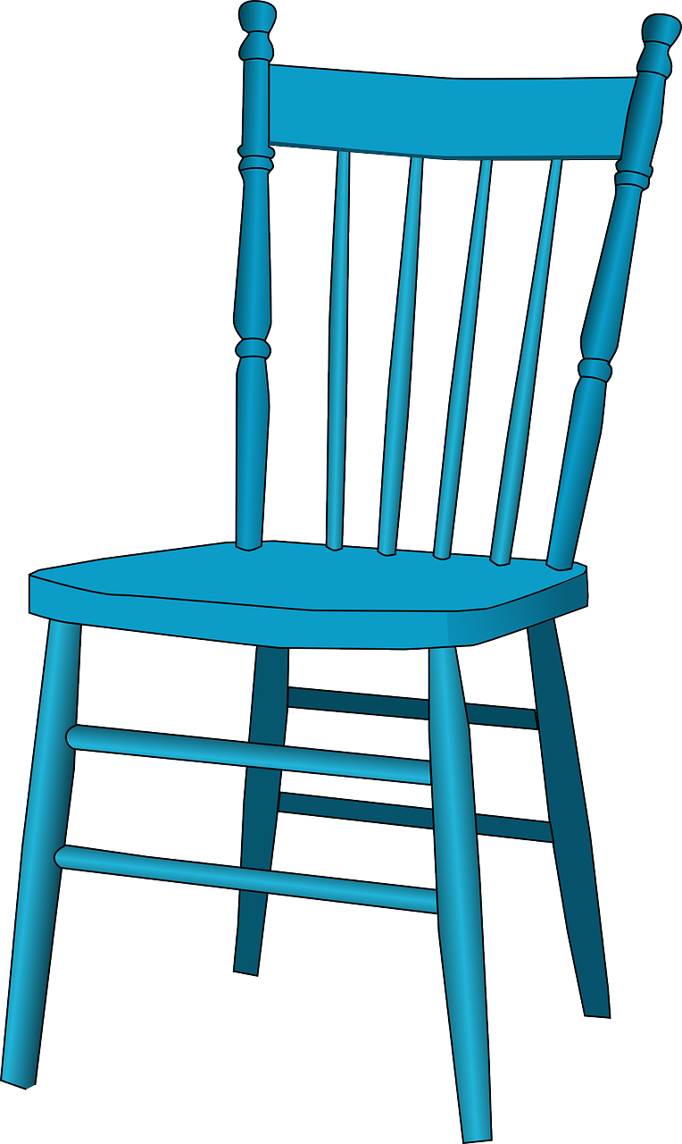
Follow up 2
Lis. Qui a quoi ? C’est où ?
Note what the two friends have? Write ‘I’ (Pierre) or ‘he’ (Max) (or X if neither has it). Where do they have things? Write the details in English.
lire
1. J’ai un chat sous un lit.
I
on a desk
2. Il a une chaise sous un bureau.
----
3. Il a un message sur une chaise.
under a bed | on a poster
I + he
4. J’ai un dessin sur un bureau.
on a desk | on a chair
5. J’ai une moto sur un lit.
I + he
6. Il a une banane sur une chaise.
he
under a desk
7. J’ai un message sur un bureau.
8. Il a un chat sur une affiche.
Notes:
Timing: 5 minutes
Aim: to practise written comprehension of a this week’s verbs and other vocabulary.
Procedure: 1. Pupils read each sentence and look at the list of five items. 2. They decide who has it (or note if no-one does).
3. Elicit the answers orally and click to reveal the answers.
4. Pupils note where each item is.
5. Elicit the answers orally and reveal the written answers.
6. Finally ask pupils to identify anything the boys have mentioned which are not on the list.
7. Elicit the English meanings of these three items, orally.

Slide 4
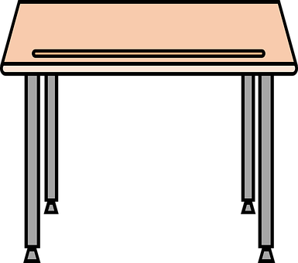
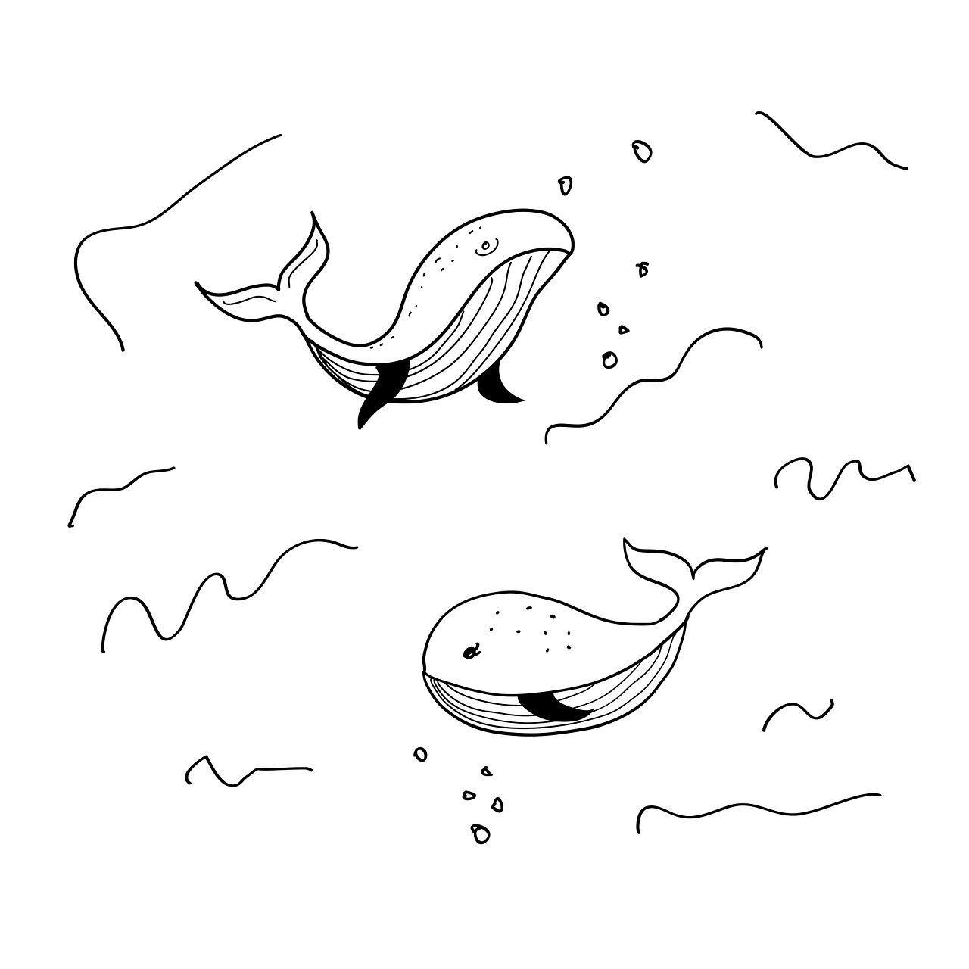
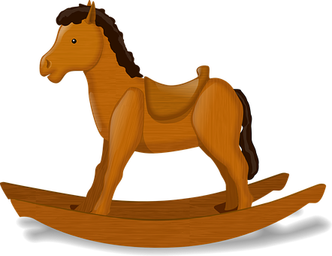
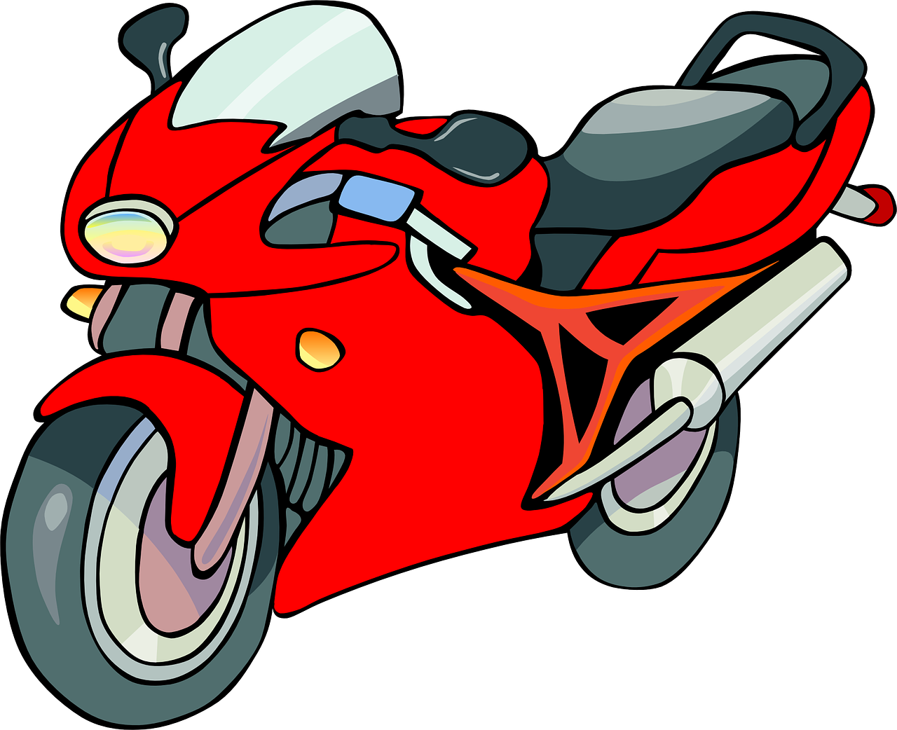
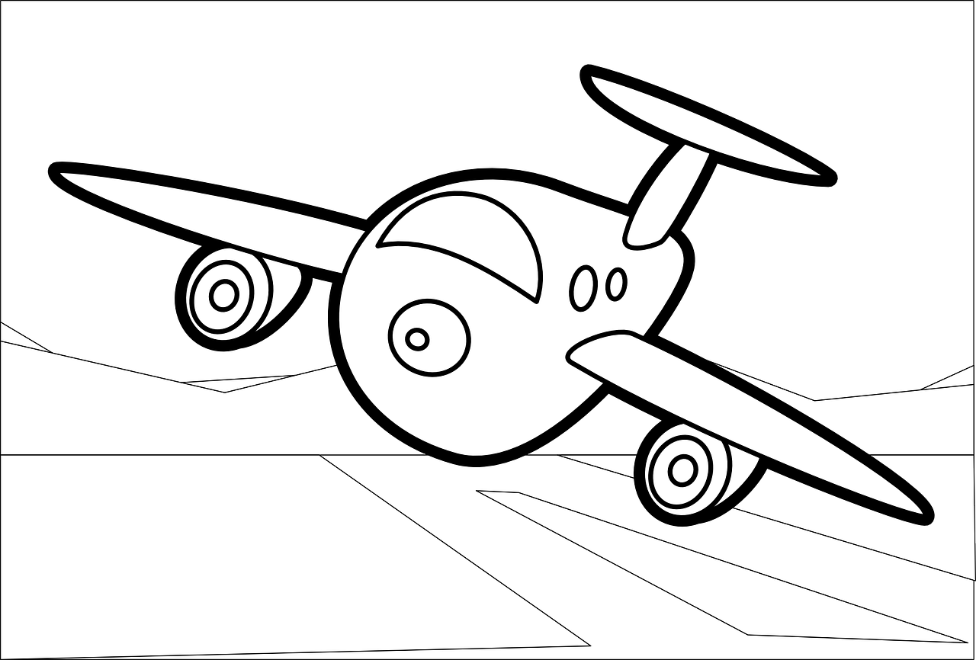
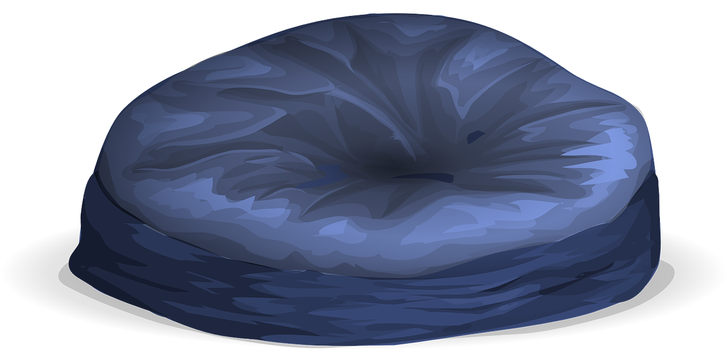
Follow up 3
.
Écoute. Pierre parle. Qui a quoi ? C’est où ?
I | He
what?
where?
écouter
1
I have
drawing
on a cat
2
He has
a horse
on a poster
3
He has
a banana
on a desk
Pierre
He has
a drawing
under a cat
4
5
I have
a universe
on a poster
I have
a motorbike
under a desk
6
Max
Notes:
Timing: 5 minutes
Aim: to practise aural comprehension of j’ai and il a and correctly connect indefinite articles with nouns of the correct gender.
Procedure: 1. Click to listen. 2. Pupils write I or he, the item and where it is. Note: they do this without seeing the photos of the rooms.
3. They may need three or four playings of each item.
4. Click to bring up photos of two rooms. Pupils decide, based on their answers, which room belongs to which person.
5. Click to reveal all of the written answers.
Transcript:
J’ai un dessin sur un chat.
Il a un cheval sur une affiche.
Il a une banane sur un bureau.
Il a un dessin sous un chat.
J’ai un univers sur une affiche.
J’ai une moto sous un bureau.

Slide 5
Follow up 4
Personne A écrit un numéro 1-4 en secret.
Personne B devine :
‘Do you have…..?’
1
2
un | chat
 | cheval
 | bureau
 | dessin
 | crayon
 | univers
parler
3
4
une | chaise
 | affiche
 | moto
 | banane
sur | sous
devine = s/he guesses
Notes:
Timing: 5 minutes
Aim: to practise oral production of ‘tu as’, oui, non, sur, sous, and some previously taught nouns.
Procedure: 1. Pupil A chooses (in secret) a room. 2. Pupil B asks questions to guess which room A has chosen. 3. When B correctly guesses, pupils swap and repeat the task. Note: for some pupils, teachers could increase the challenge by removing or partially obscuring the vocabulary support, either before the first round, or for subsequent rounds.

Slide 6
vocabulaire
Follow up 5 - Écris en anglais : Can you get at least 15 points?
mots
 | midi | parler | écouter
 | un univers | lire | écrire
 | courageuse | sérieux | curieux
 | mercredi | mardi | heureuse
 | sur | une question | une réponse
 | dans | sous | où ?
 | avoir | j’ai | tu as
midday
to speak, speaking
to listen, listening
x3
a universe
to read, reading
to write, writing
brave (f)
serious (m)
curious (m)
x2
Wednesday
Tuesday
happy (f)
on (top of)
a question
an answer
in
under(neath)
where?
x1
to have, having
I have
you have
Notes:
Timing: 5-10 minutes
Aim: to practise written comprehension of vocabulary from this week and previous weeks.
Procedure: 1. Give pupils a blank grid. They fill in the French meanings of any of the words they know, trying to reach 15 points in total. 2. Remind pupils that adjectives can refer to male or female persons and they should note this in their translations. E.g. pleased (f) → contente, short (m) → petit.
Note: The most recently learnt and practised words are pink, words from the previous week are green and those from week 1 are blue, thus more points are awarded for them, to recognise that memories fade and more effort (heavy lifting!) is needed to retrieve them.
6

Slide 7
vocabulaire
Follow up 5 - Écris en français : Can you get at least 15 points?
mots
 | to speak | midday | a universe
 | to listen | to write | to read
 | serious (f) | Friday | Wednesday
 | brave (m) | curious (f) | happy (m)
 | on (top of) | to have, having | under(neath)
 | an answer | where? | in
 | I have | you have | a question
parler
midi
un univers
x3
écouter
écrire
lire
sérieuse
vendredi
mercredi
x2
courageux
curieuse
heureux
sur
avoir
sous
une réponse
où ?
dans
x1
j’ai
tu as
une question
Notes:
Timing: 5-10 minutes
Aim: to practise written comprehension of vocabulary from this week and previous weeks.
Procedure: 1. Give pupils a blank grid. They fill in the French meanings of any of the words they know, trying to reach 15 points in total. 2. Remind pupils that adjectives can refer to male or female persons and they should note this in their translations. E.g. pleased (f) → contente, short (m) → petit.
Note: The most recently learnt and practised words are pink, words from the previous week are green and those from week 1 are blue, thus more points are awarded for them, to recognise that memories fade and more effort (heavy lifting!) is needed to retrieve them.
7

Slide 8
vocabulaire
Follow up 5 - Écris en anglais : Can you get at least 15 points?
mots
 | midi | parler | écouter
 | un univers | lire | écrire
 | courageuse | sérieux | curieux
 | mercredi | mardi | heureuse
 | sur | une question | une réponse
 | dans | sous | où ?
 | avoir | j’ai | tu as
x3
x2
x1
Notes:
HANDOUT 1
8

Slide 9
vocabulaire
Follow up 5 - Écris en français : Can you get at least 15 points?
mots
 | to speak | midday | a universe
 | to listen | to write | to read
 | serious (f) | Friday | Wednesday
 | brave (m) | curious (f) | happy (m)
 | on (top of) | to have, having | under(neath)
 | an answer | where? | in
 | I have | you have | a question
x3
x2
x1
Notes:
Handout 2
9

