Slide 1



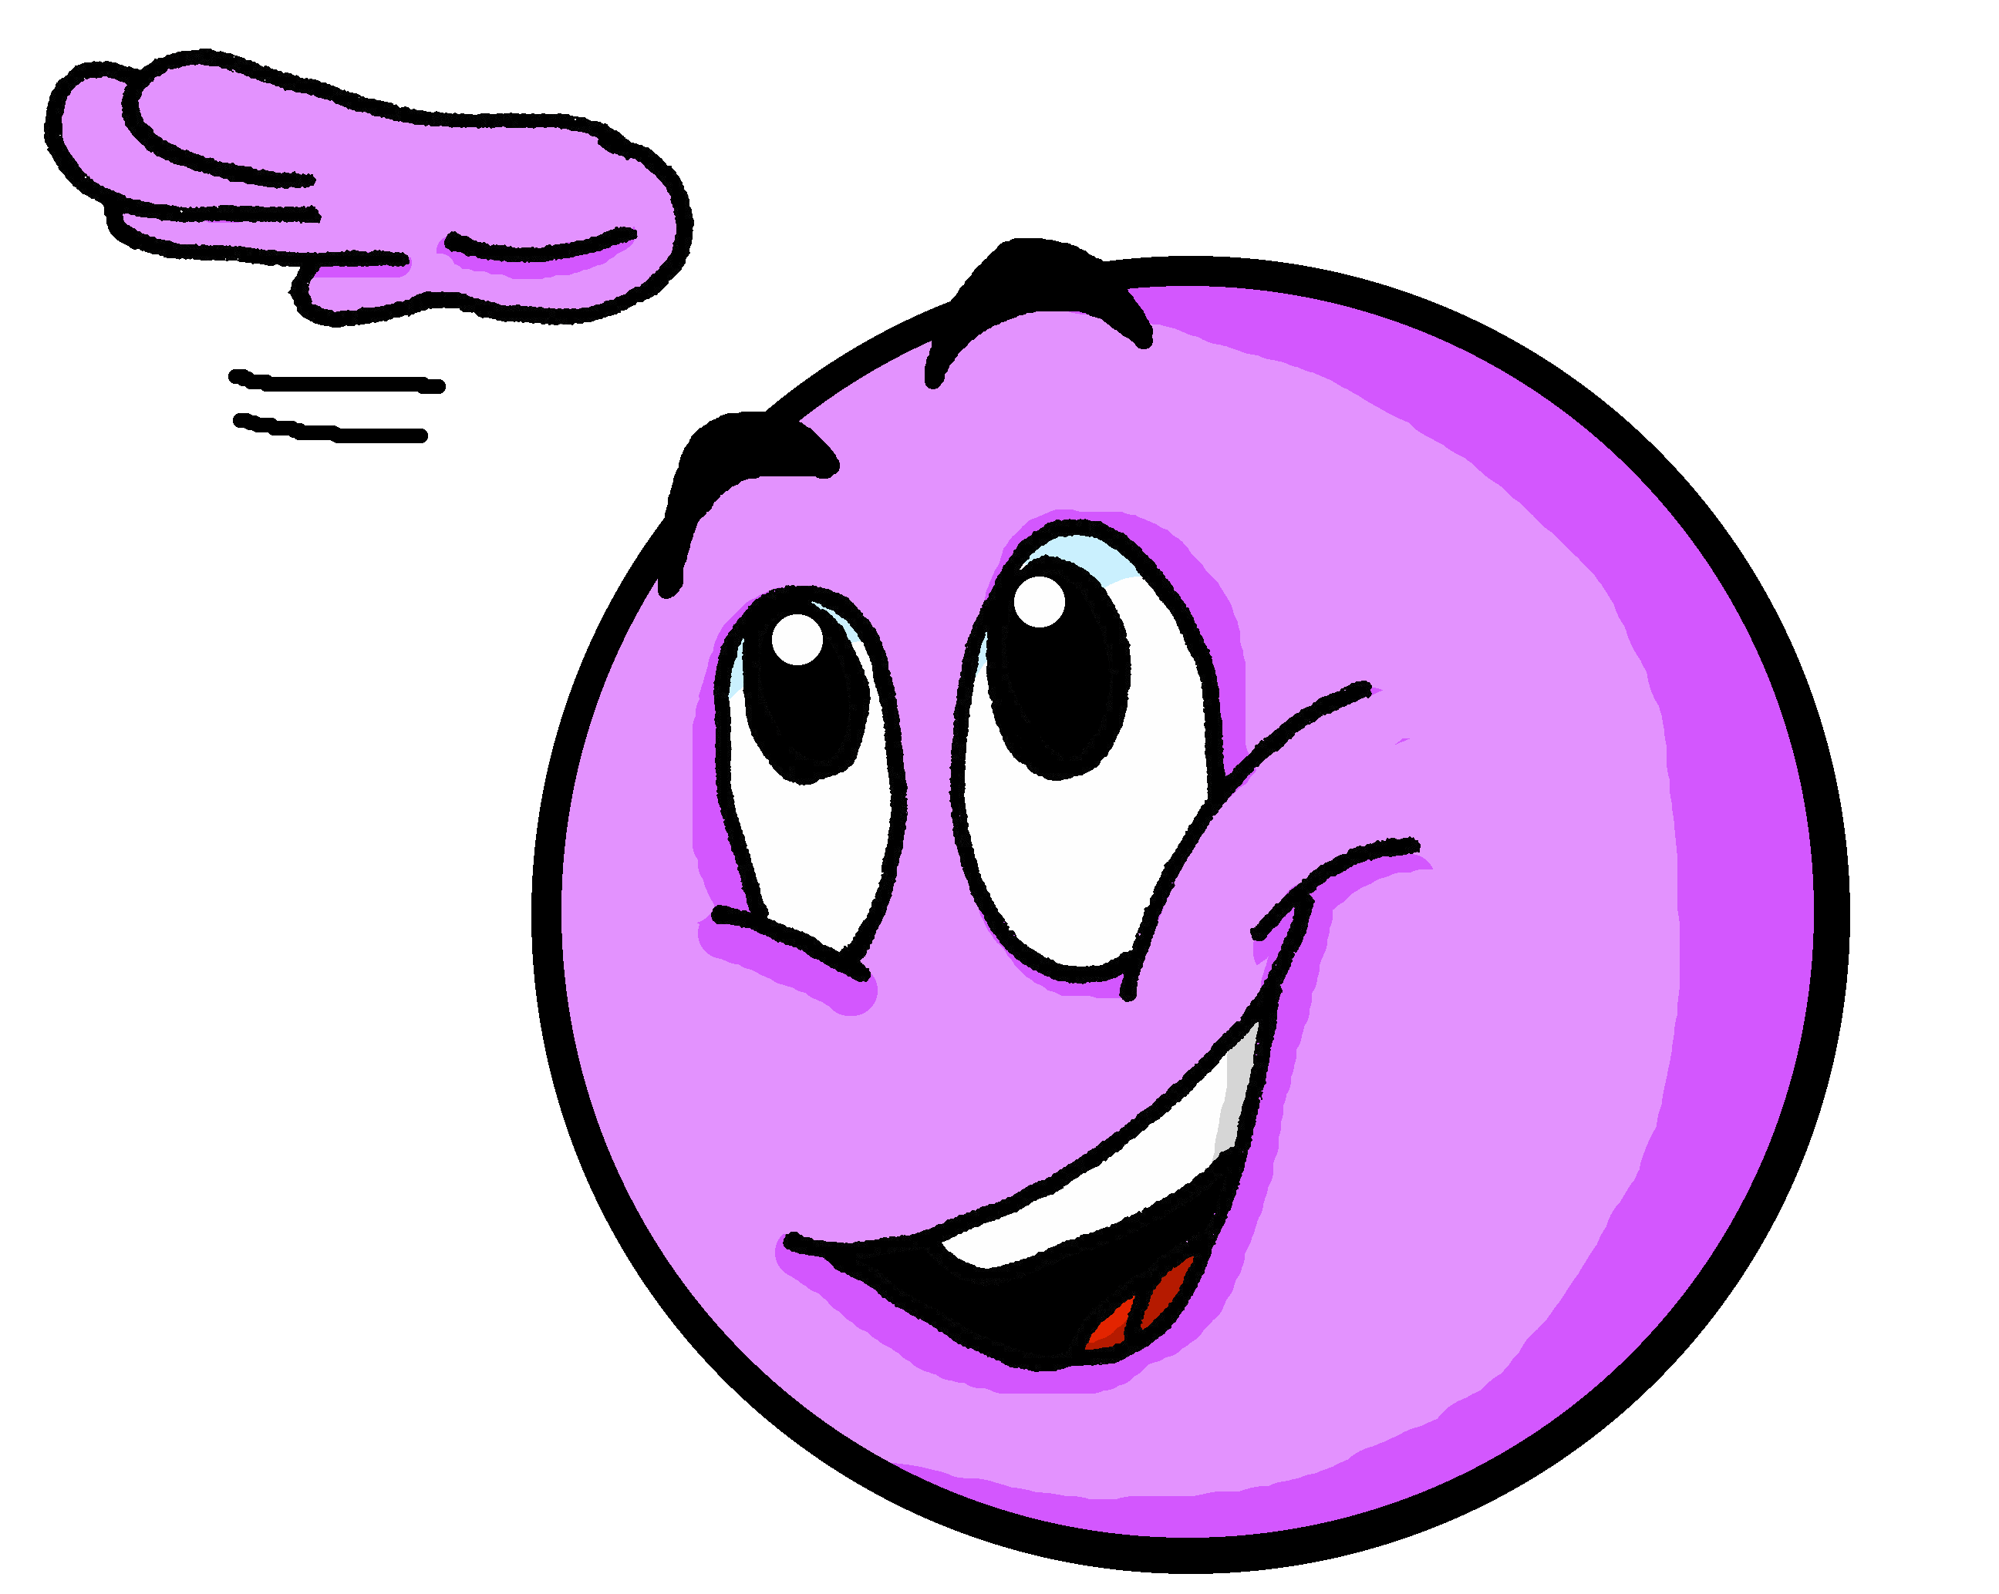

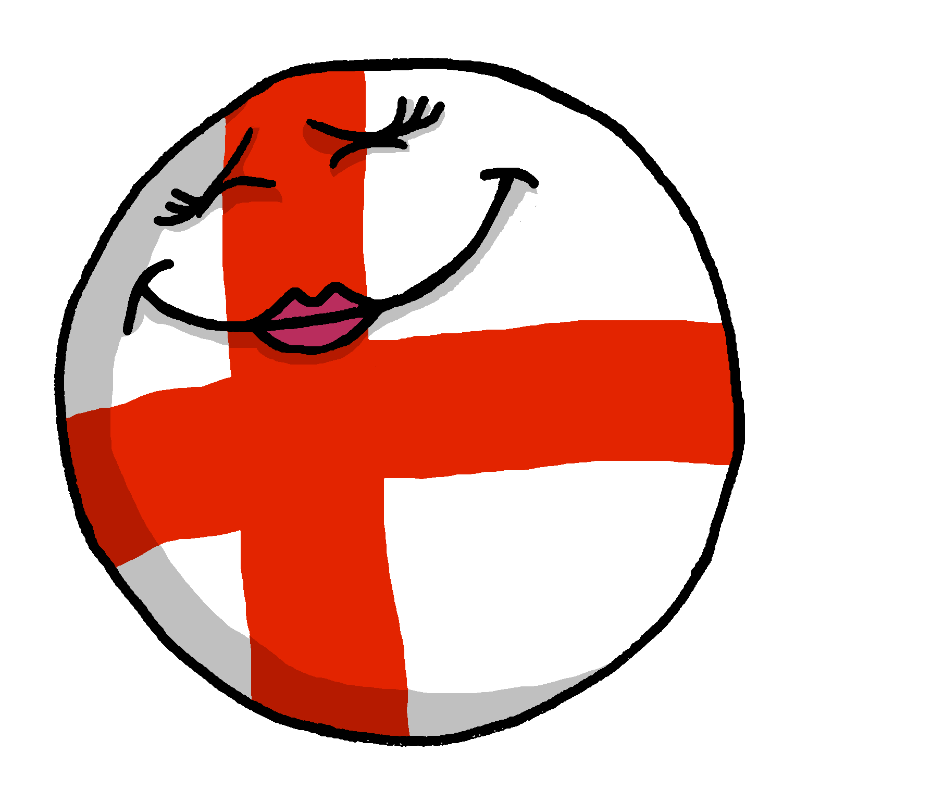
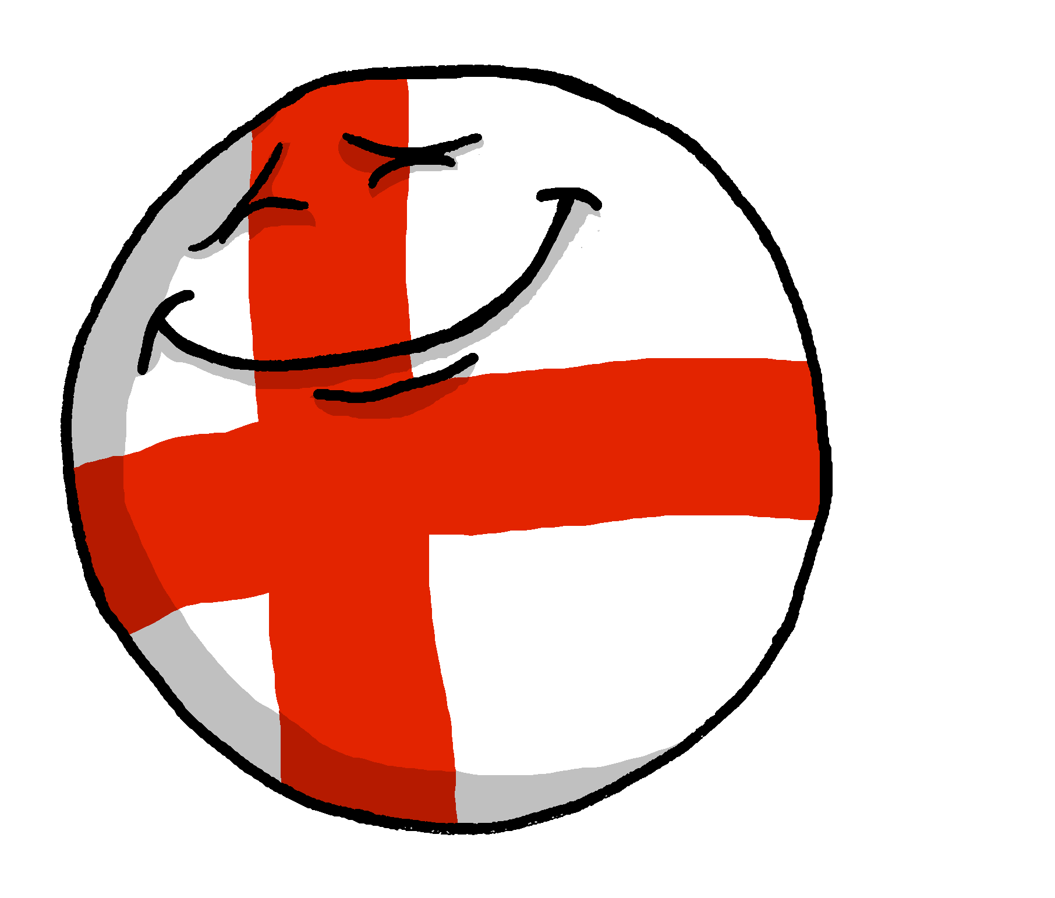

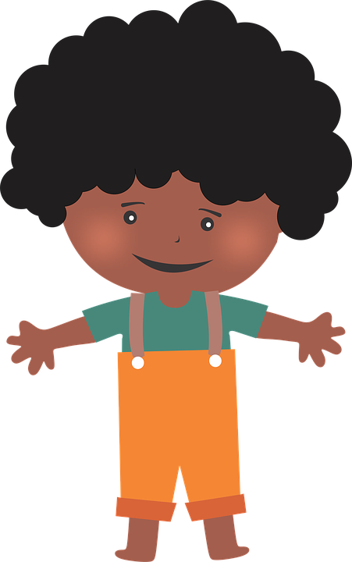
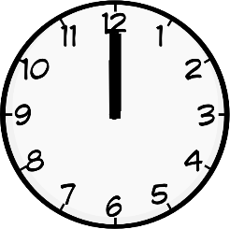
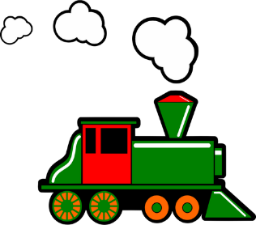
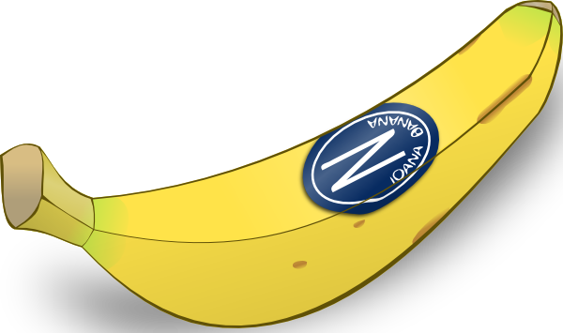
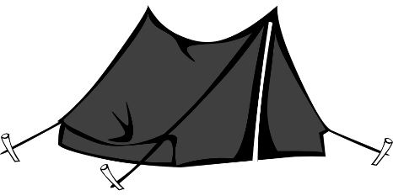
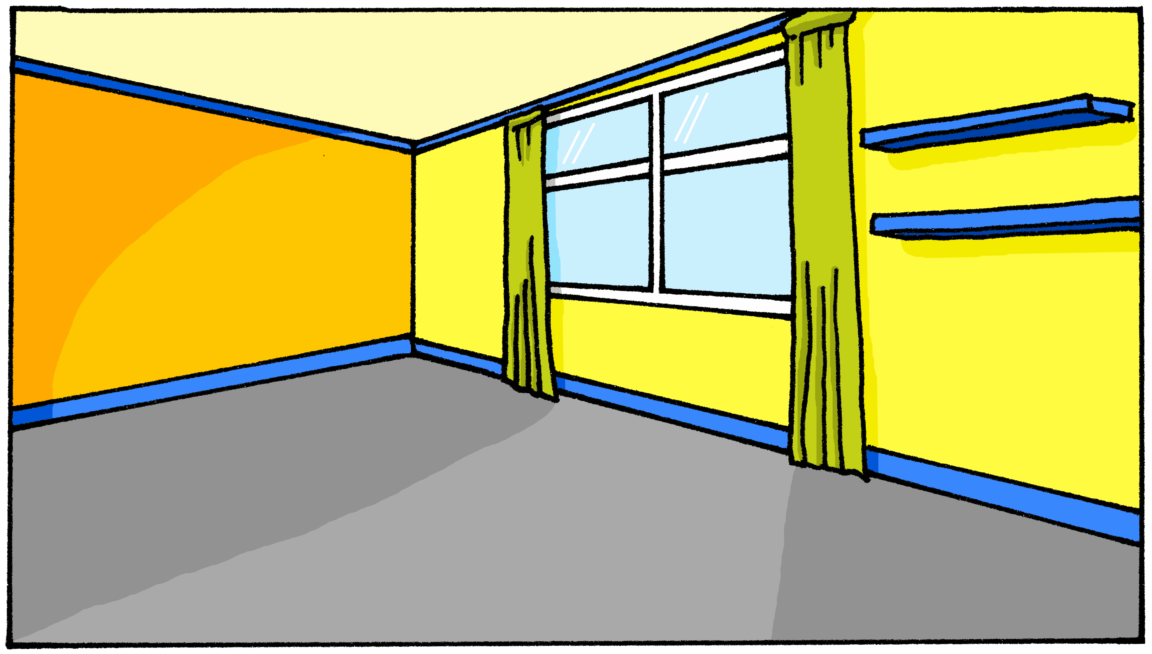
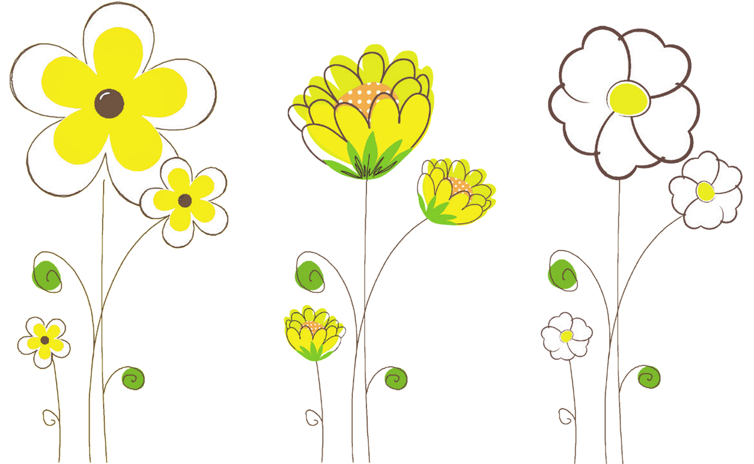


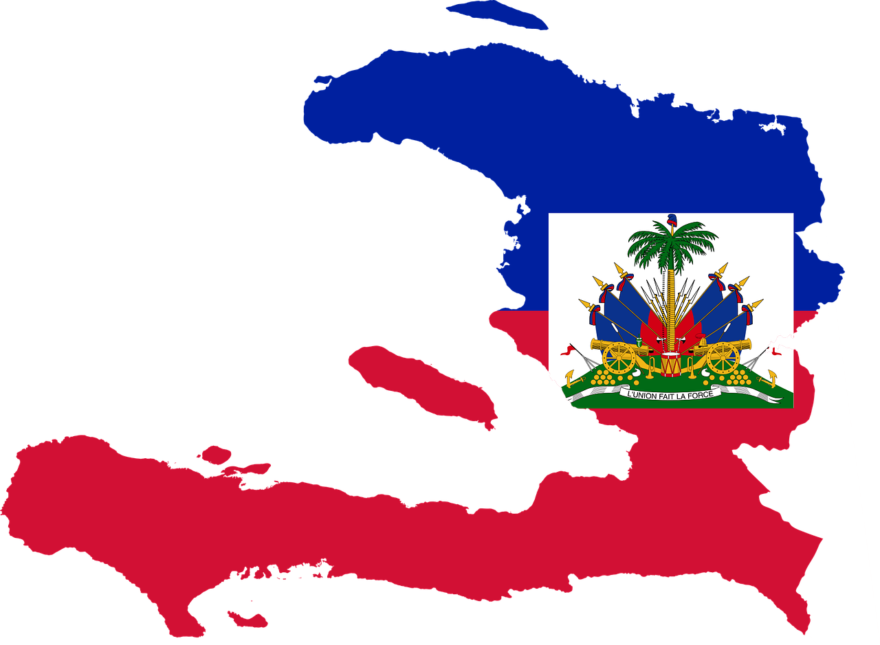
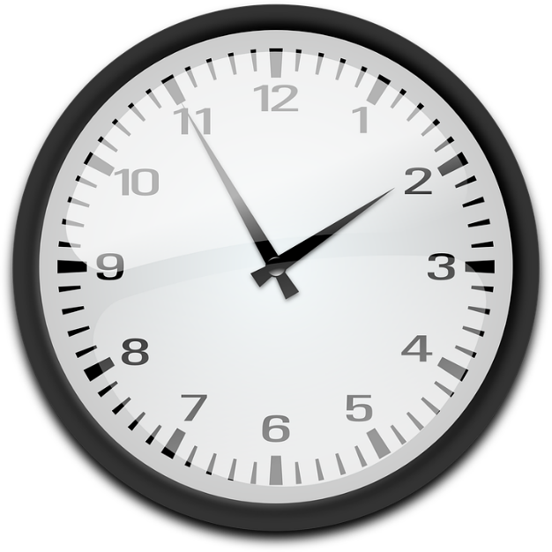
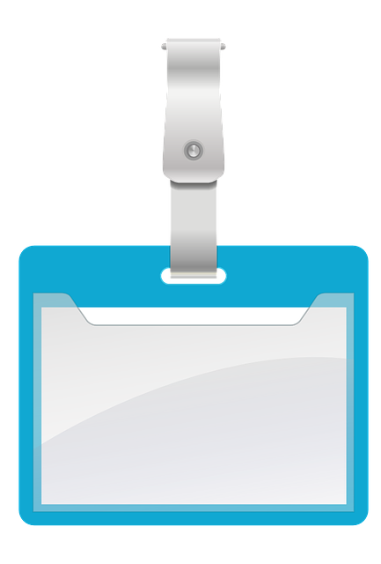


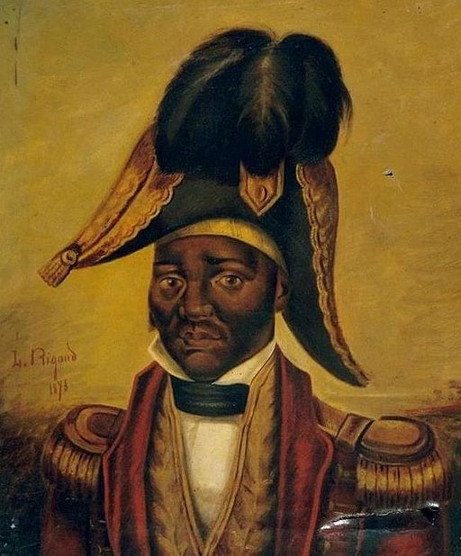
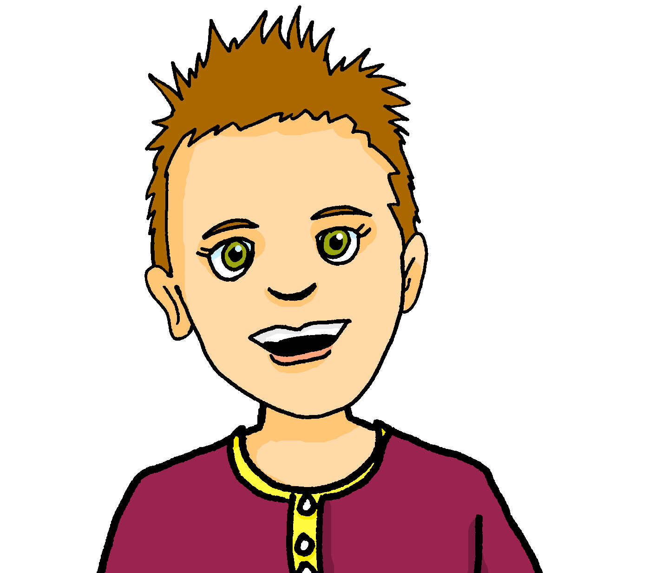
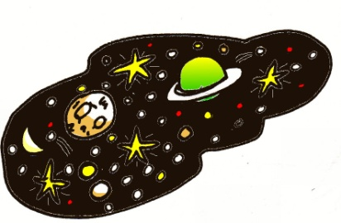
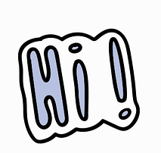
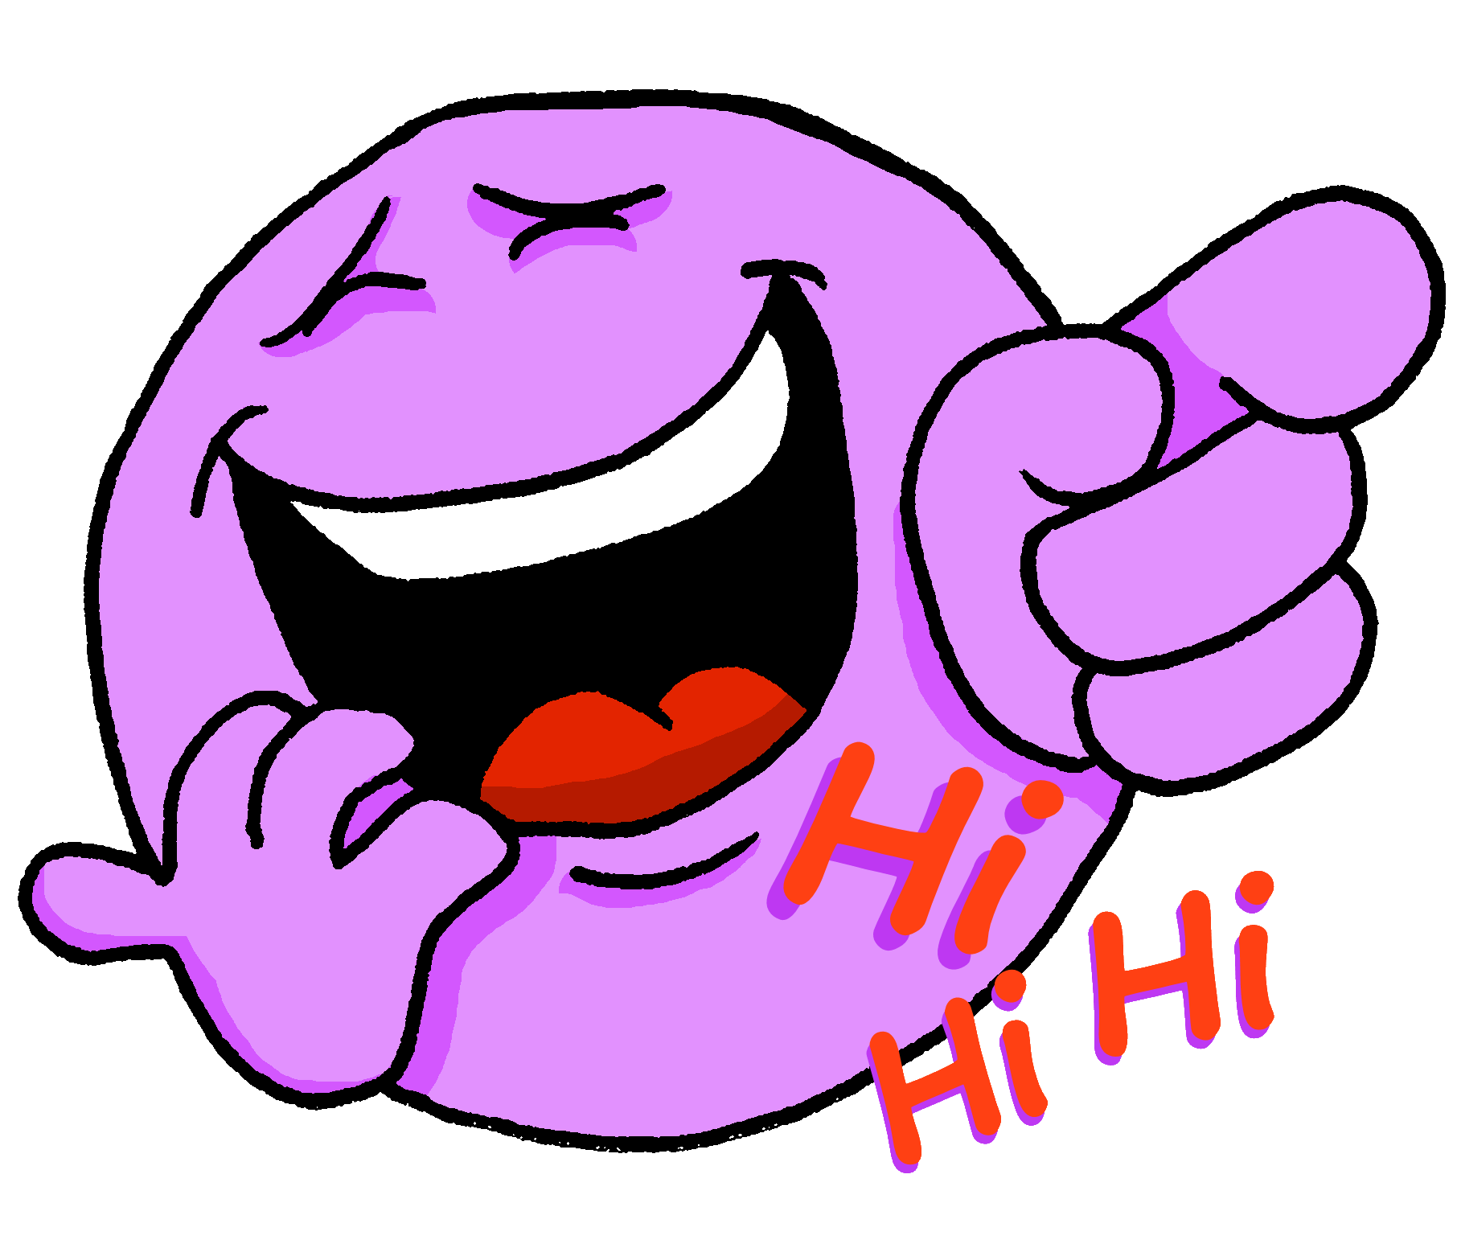

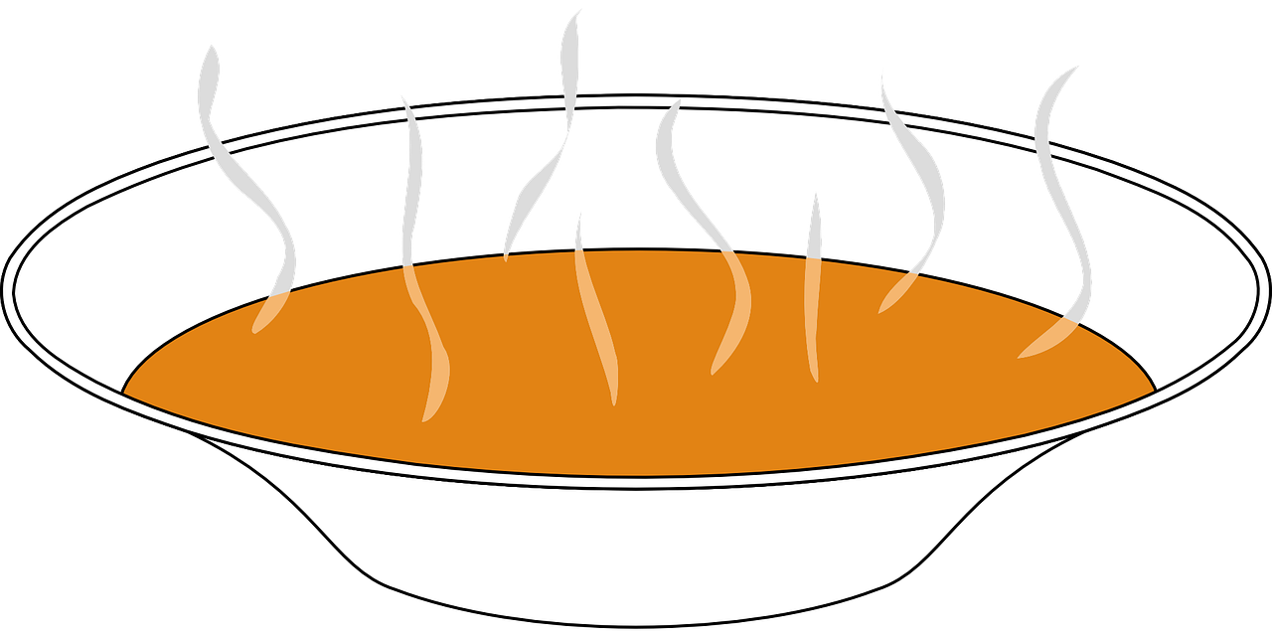


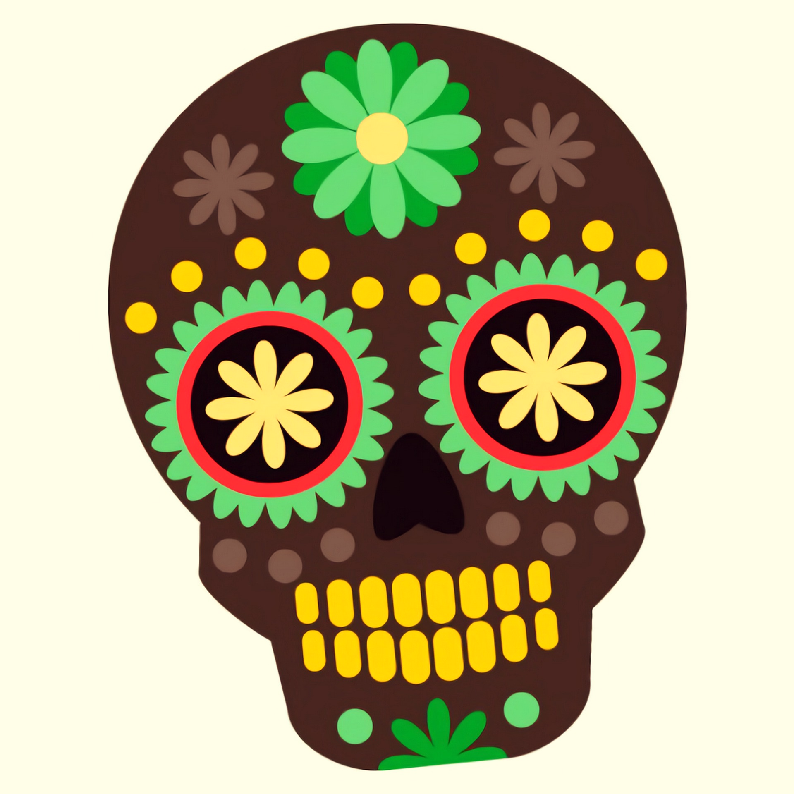
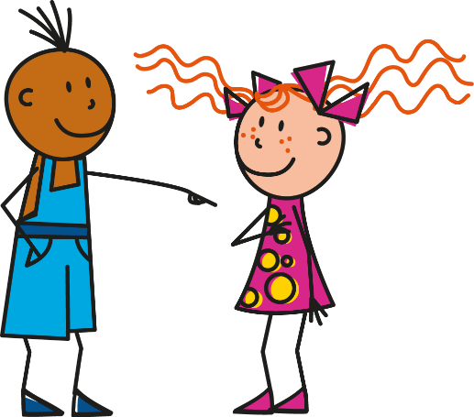
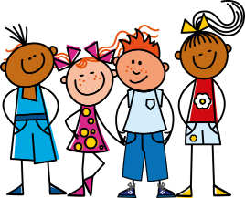

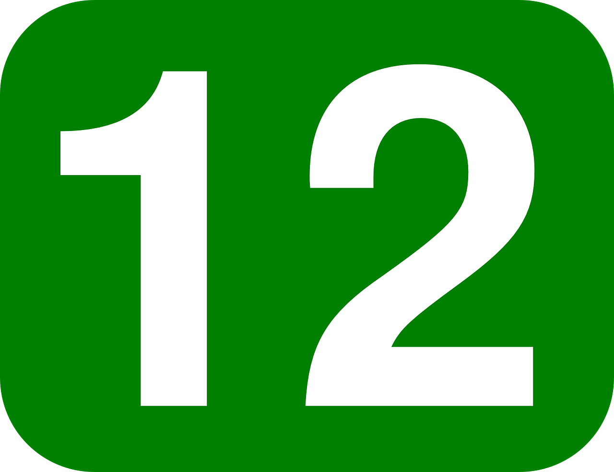
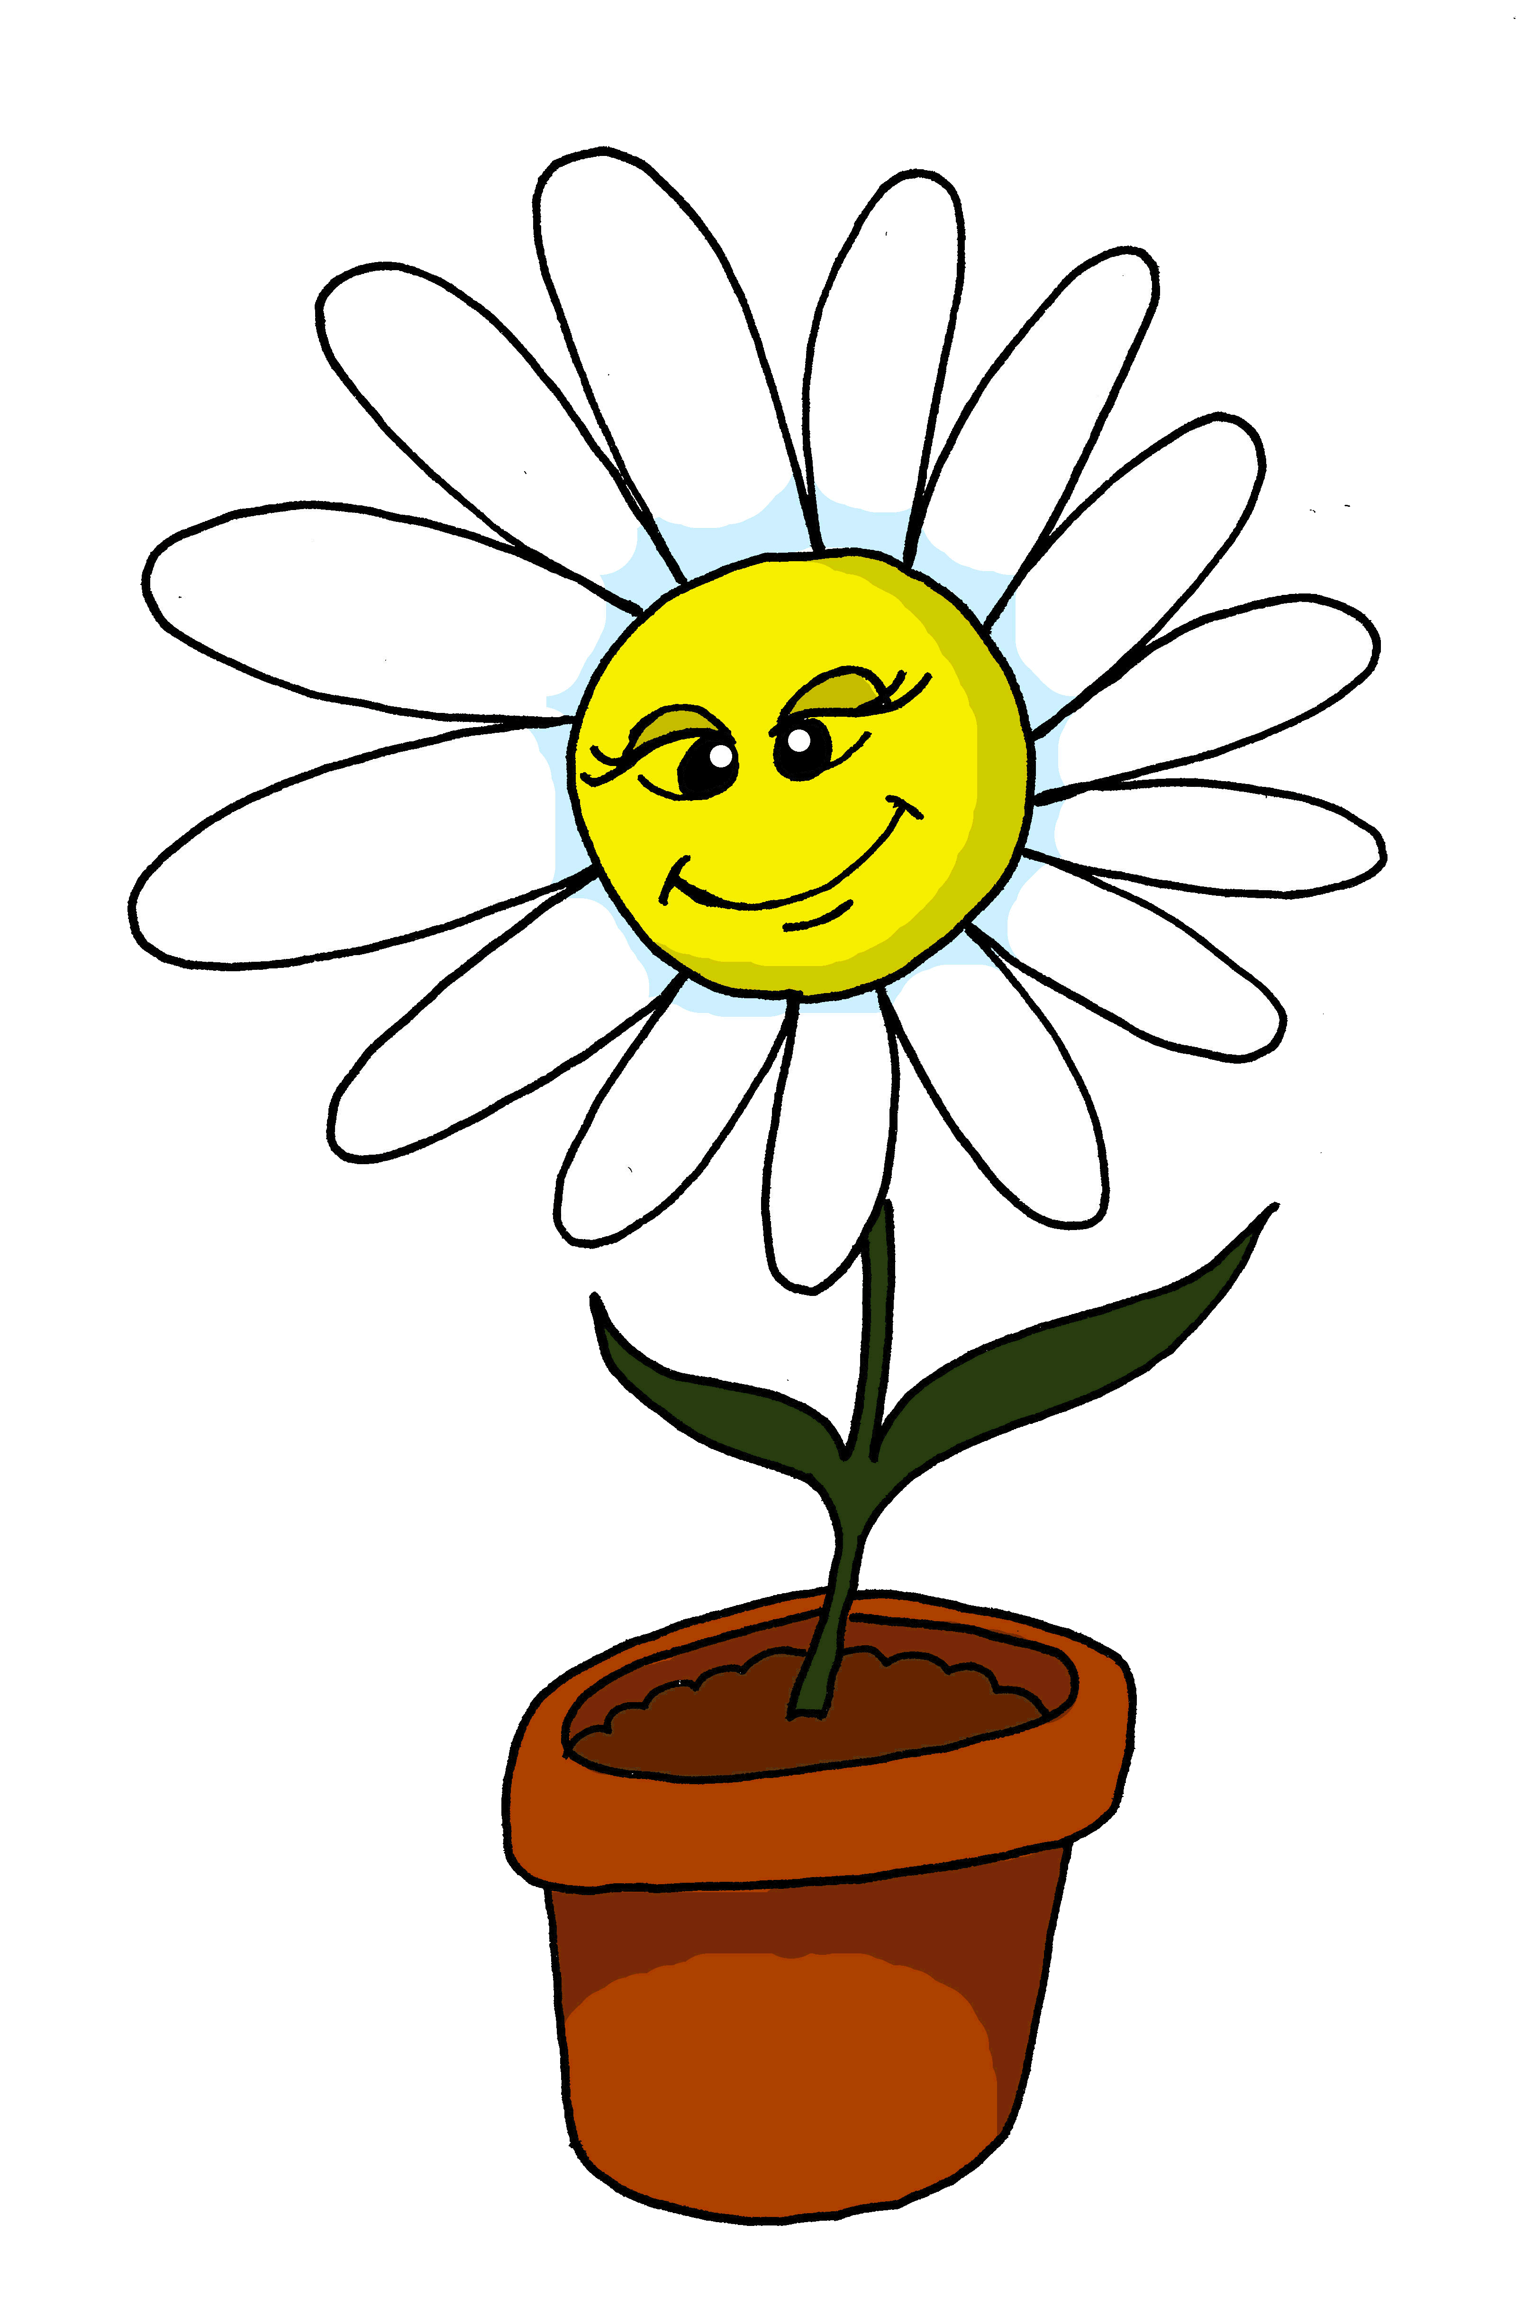
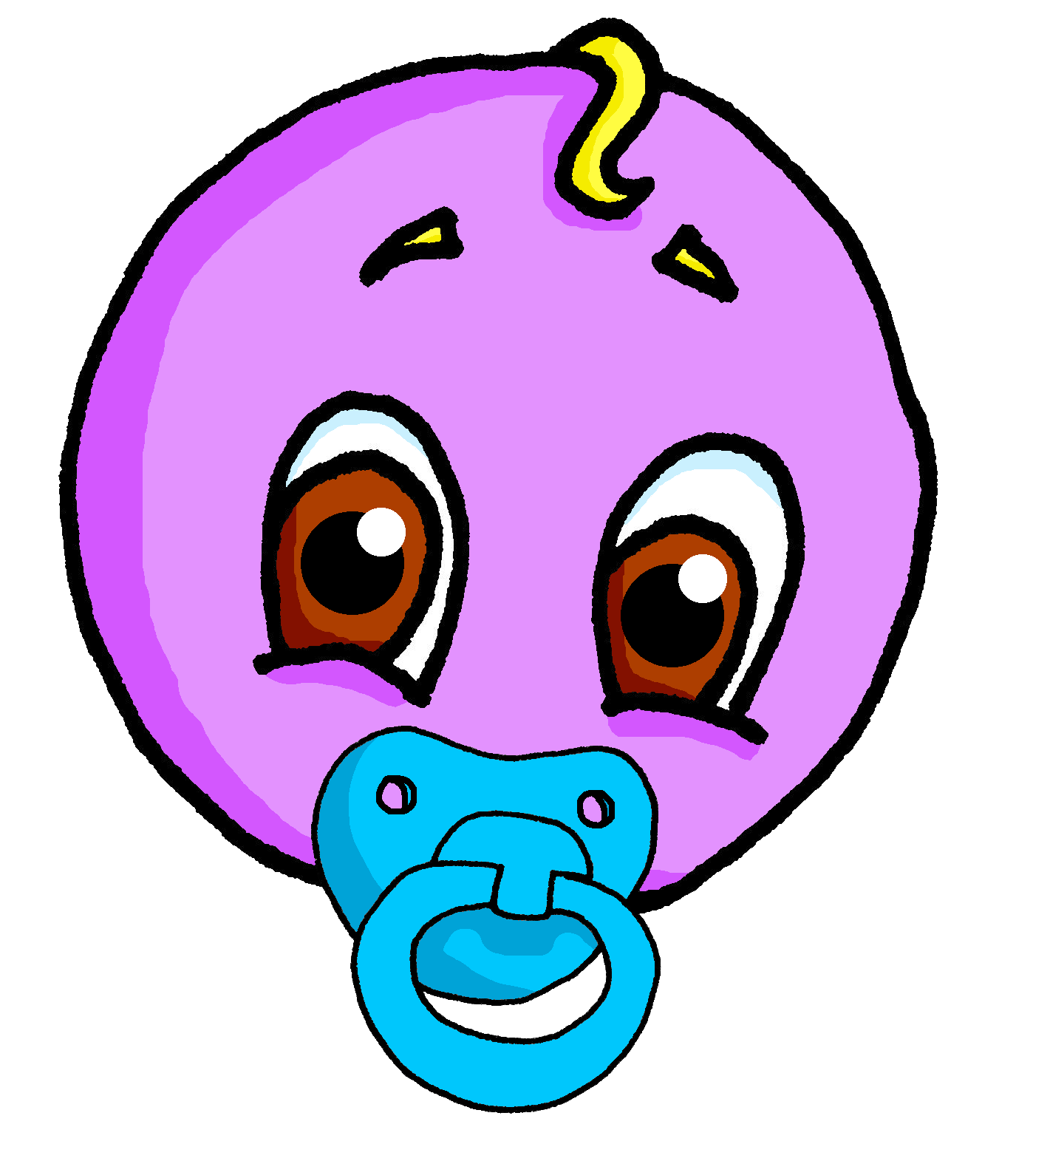
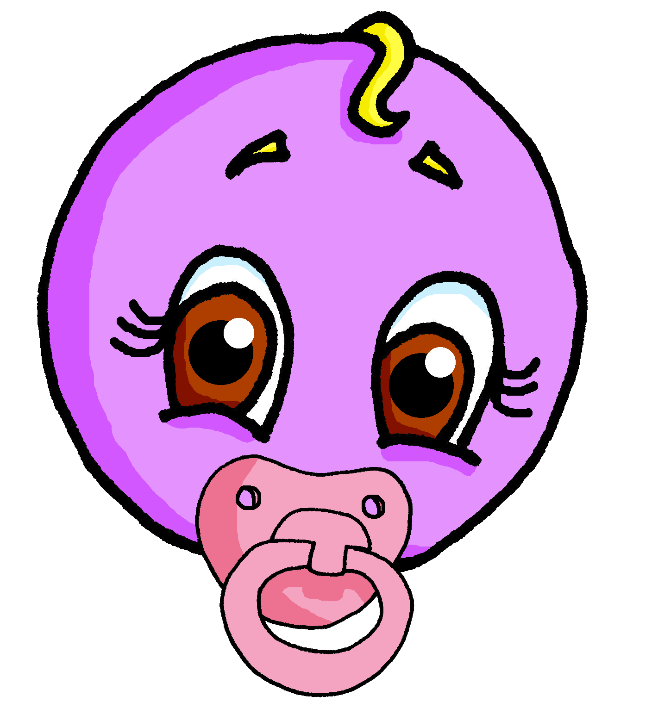

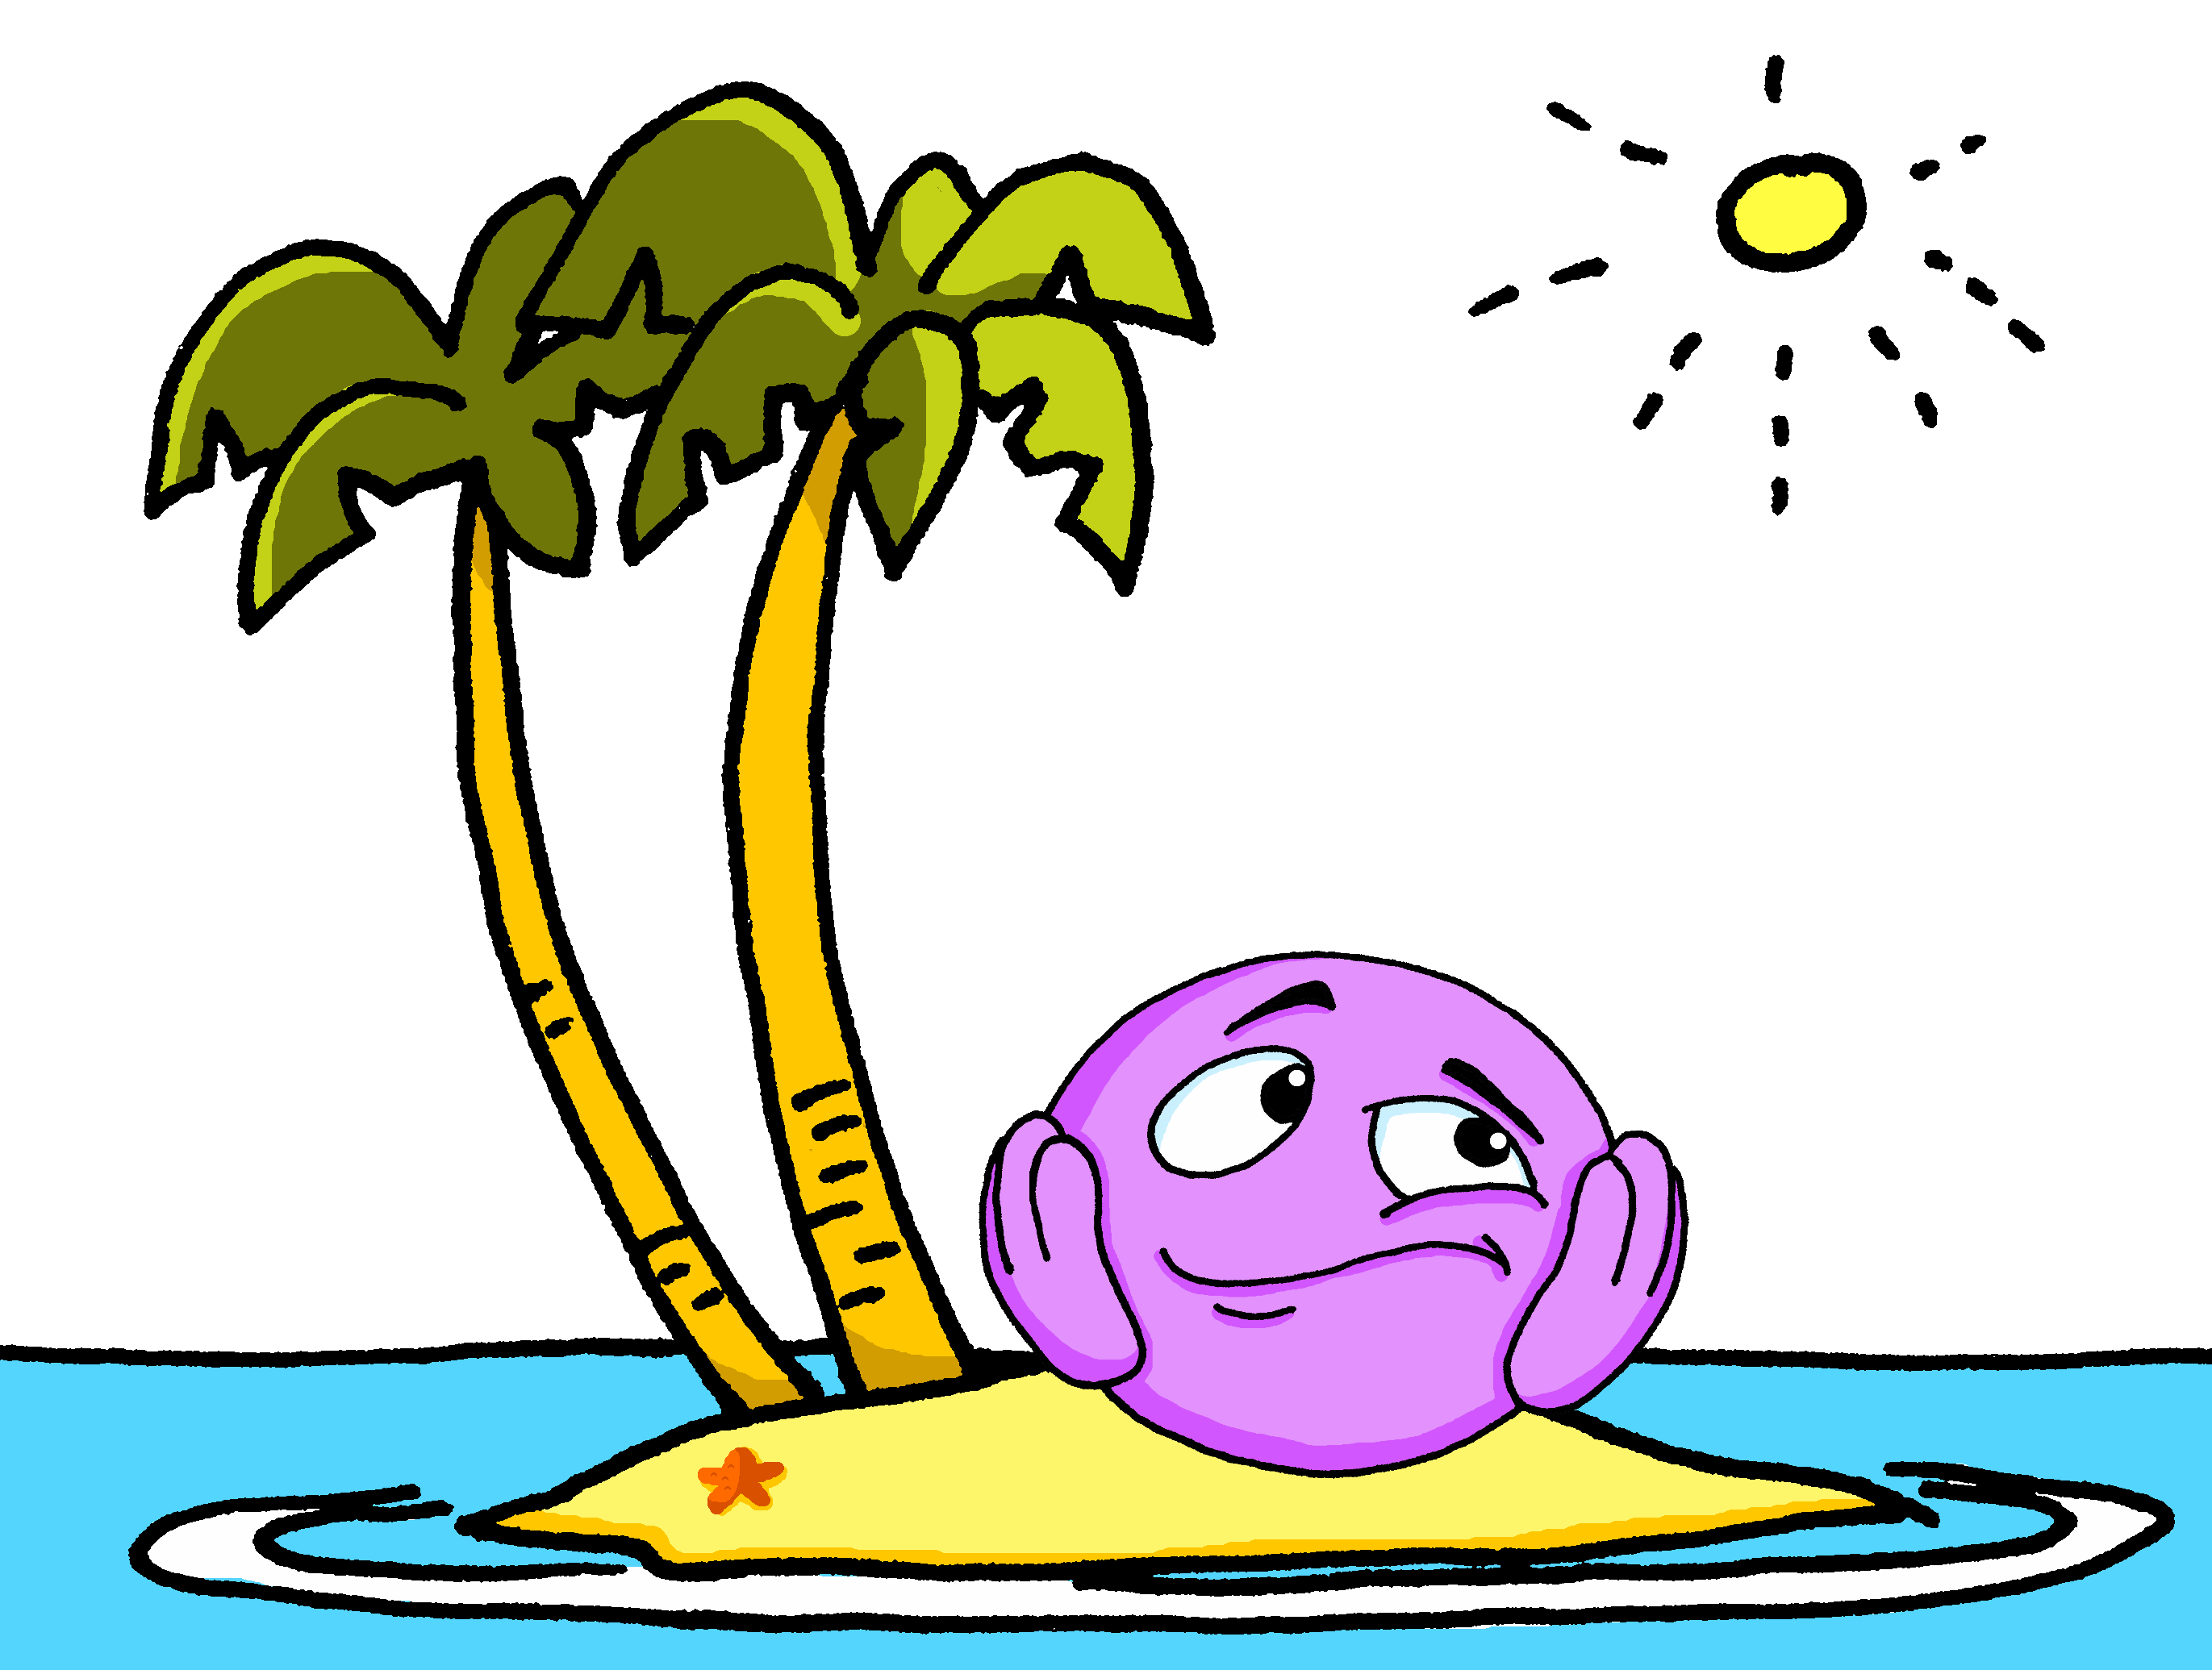
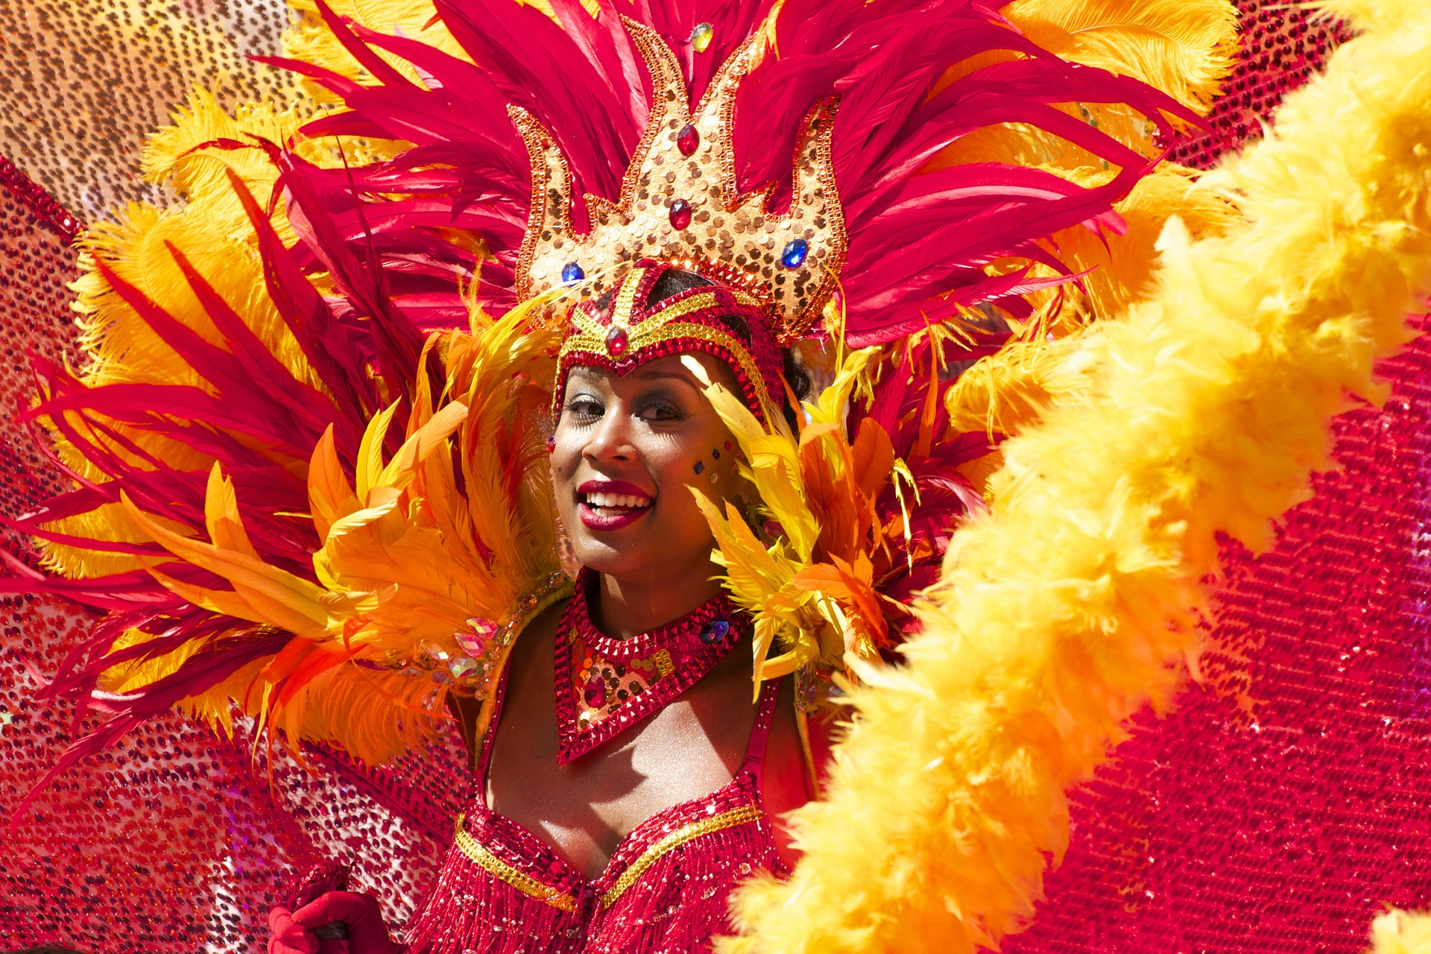
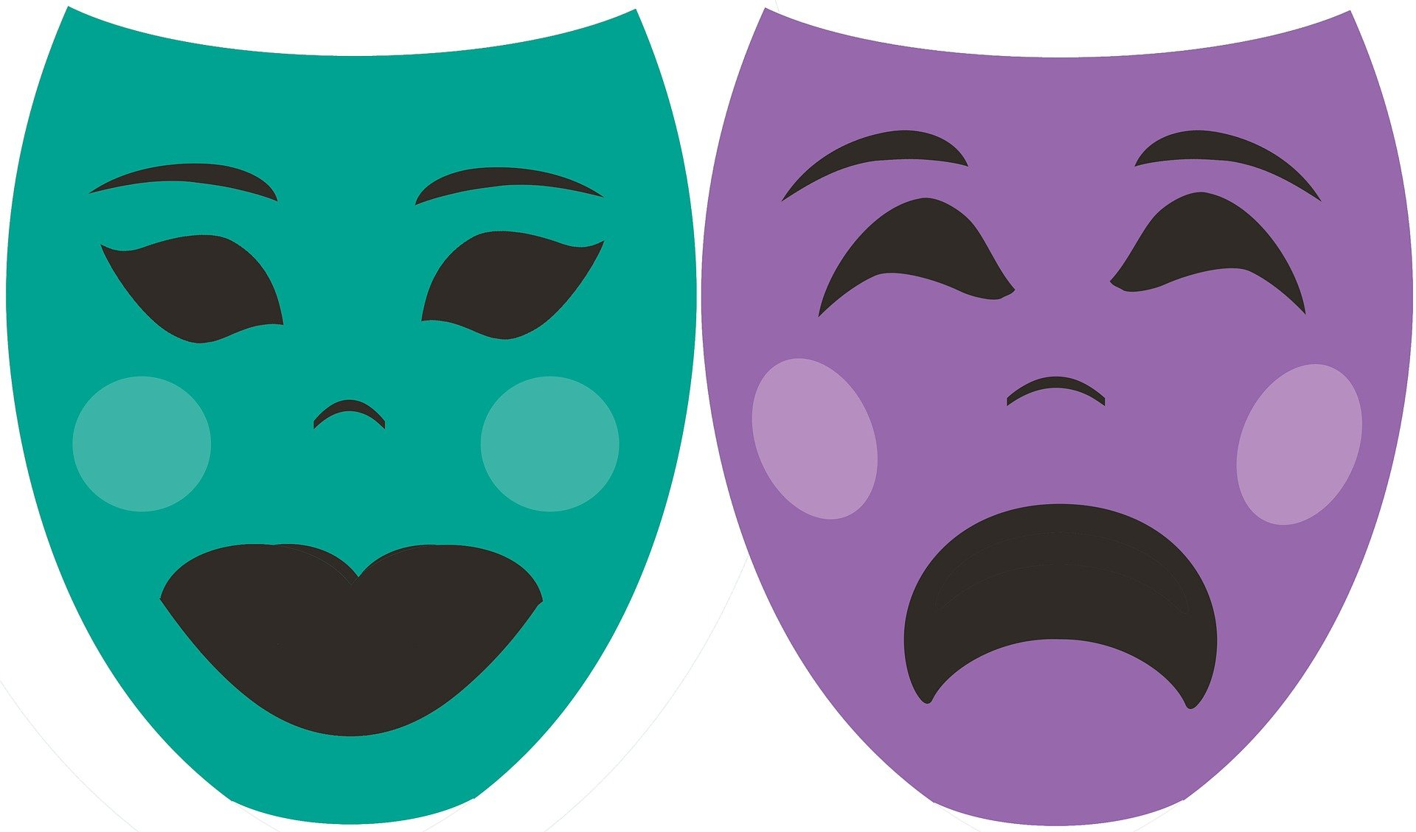


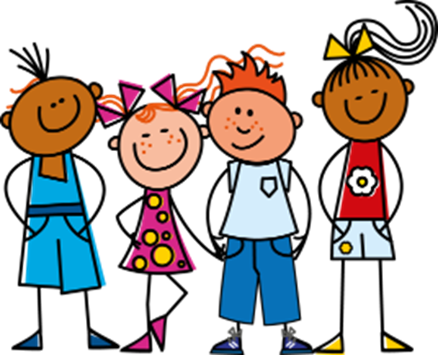
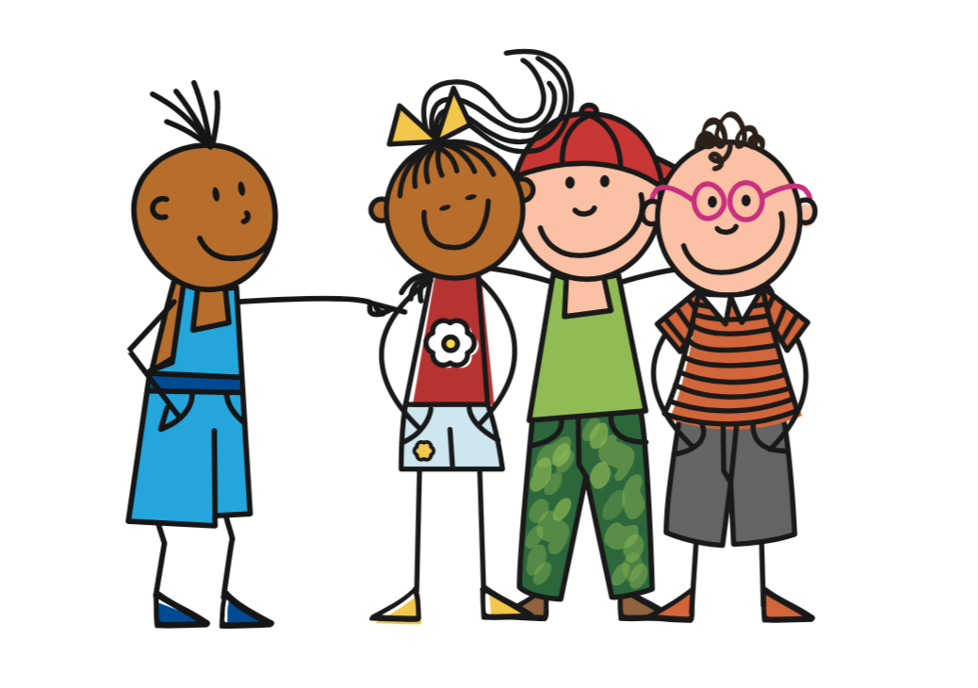


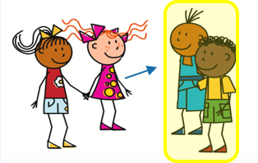
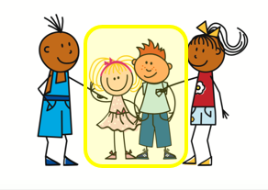

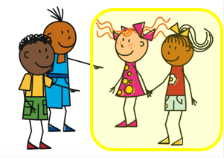
Vert Knowledge Organiser - Autumn Term A
Échange en ligne
être – to be|being
nous sommes – we are
vous êtes – you (pl) are
ils sont – they (m, m/f) are
elles sont – they (f) are
Les nombres - numbers
treize – 13
quatorze – 14
quinze – 15
seize – 16
dix-sept – 17
dix-huit – 18
dix-neuf – 19
vingt – 20, vingt-et-un – 21
trente – 30
qui ? – who?
quel, quelle ? – which?
La description
allemand(e) – German (m(f))
espagnol(e) – Spanish (m(f))
créatif|créative – creative (m|f)
positif | positive – positive (m|f)
négatif | négative – negative (m|f)
dangereux | dangereuse (m|f)
ennuyeux | ennuyeuse – boring
travailleur - hard working (m)
travailleuse – hard working (f)
la date – date
le concert - concert
la règle – ruler¹, rule²
la saison – season
le spectacle – show
tôt – early
ensemble – together
Phonics
[SFC] Silent Final Consonant | - t petit | - s mais | - d grand | - x deux
[but]
Liaison is common here because it makes the language flow better.
Liaison | optional –s and –t liaison | je suis anglaise. | Il est anglais.
➜
oral vs nasal [a] | [en/an] [i] | [(a)in] | [a] banane | [en/an] enfant | [i] midi | [(a)in] train
same sounds [en/an] & [em/am] | camp | ensemble | chambre | printemps
enfant
temps
same sounds [on] & [om] | combat | tomber
Remember! [en/an] sounds the same as [em/am] and [on] the same as [om].
Non !
nom
Pierre
univers
Salut !
amusant
utiliser
different sounds [u] versus [ou]
tu
nous
Bonjour !
jour
Mon
douze
jouer
closed[eu] versus open [eu] | fleur | jeune | neuf | acteur | seul
peu
peur
Subject pronouns | Describing people with the verb être | Describing more than one
More plural adjectives | Asking WH-questions | Saying my
nous ➜ we
Use plural forms of adjectives to describe more than one noun:
Masculine adjectives ending in –eux stay the same in plural:
Add quand to ask when:
There are three words for my: mon, ma, mes.
tu es
il est
Ton anniversaire, c’est quand ?
They agree with the gender of the possession:
vous ➜ you (pl)
you are
elle est
Il sont créatifs.
s/he is
They (m, m/f) are creative.
Ils sont dangereux.
When is your birthday?
ils ➜ they
je suis
nous sommes
They (m, m/f) are dangerous.
Add quel, quelle to ask which:
mon problème
my problem
être
ma solution
my solution
I am
we are
Elles sont créatives.
Feminine adjective forms ending in –euse add –s:
Nous sommes quel jour ?
ils, elles
sont
my problems
elles ➜ they
vous
êtes
They (f) are creative.
➜
Which (what) day is it?
mes problèmes
Use ‘ils’ (they) for all masculine nouns. Use ‘elles’ for all feminine nouns.
mes solutions
my solutions
they are
you (pl)
are
Add -s to the singular masculine & feminine forms.
Elles sont dangereuses.
Nous sommes quelle date ?
Use mes for m. and f. plural nouns
They (f) are dangerous.
Which (what) date is it?

Slide 2

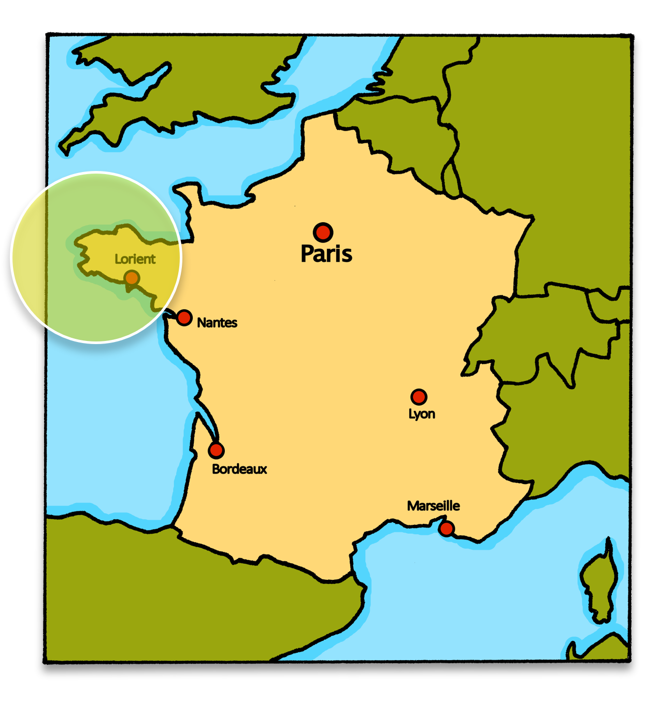




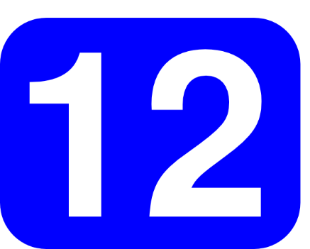

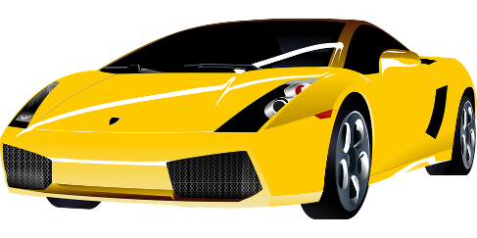




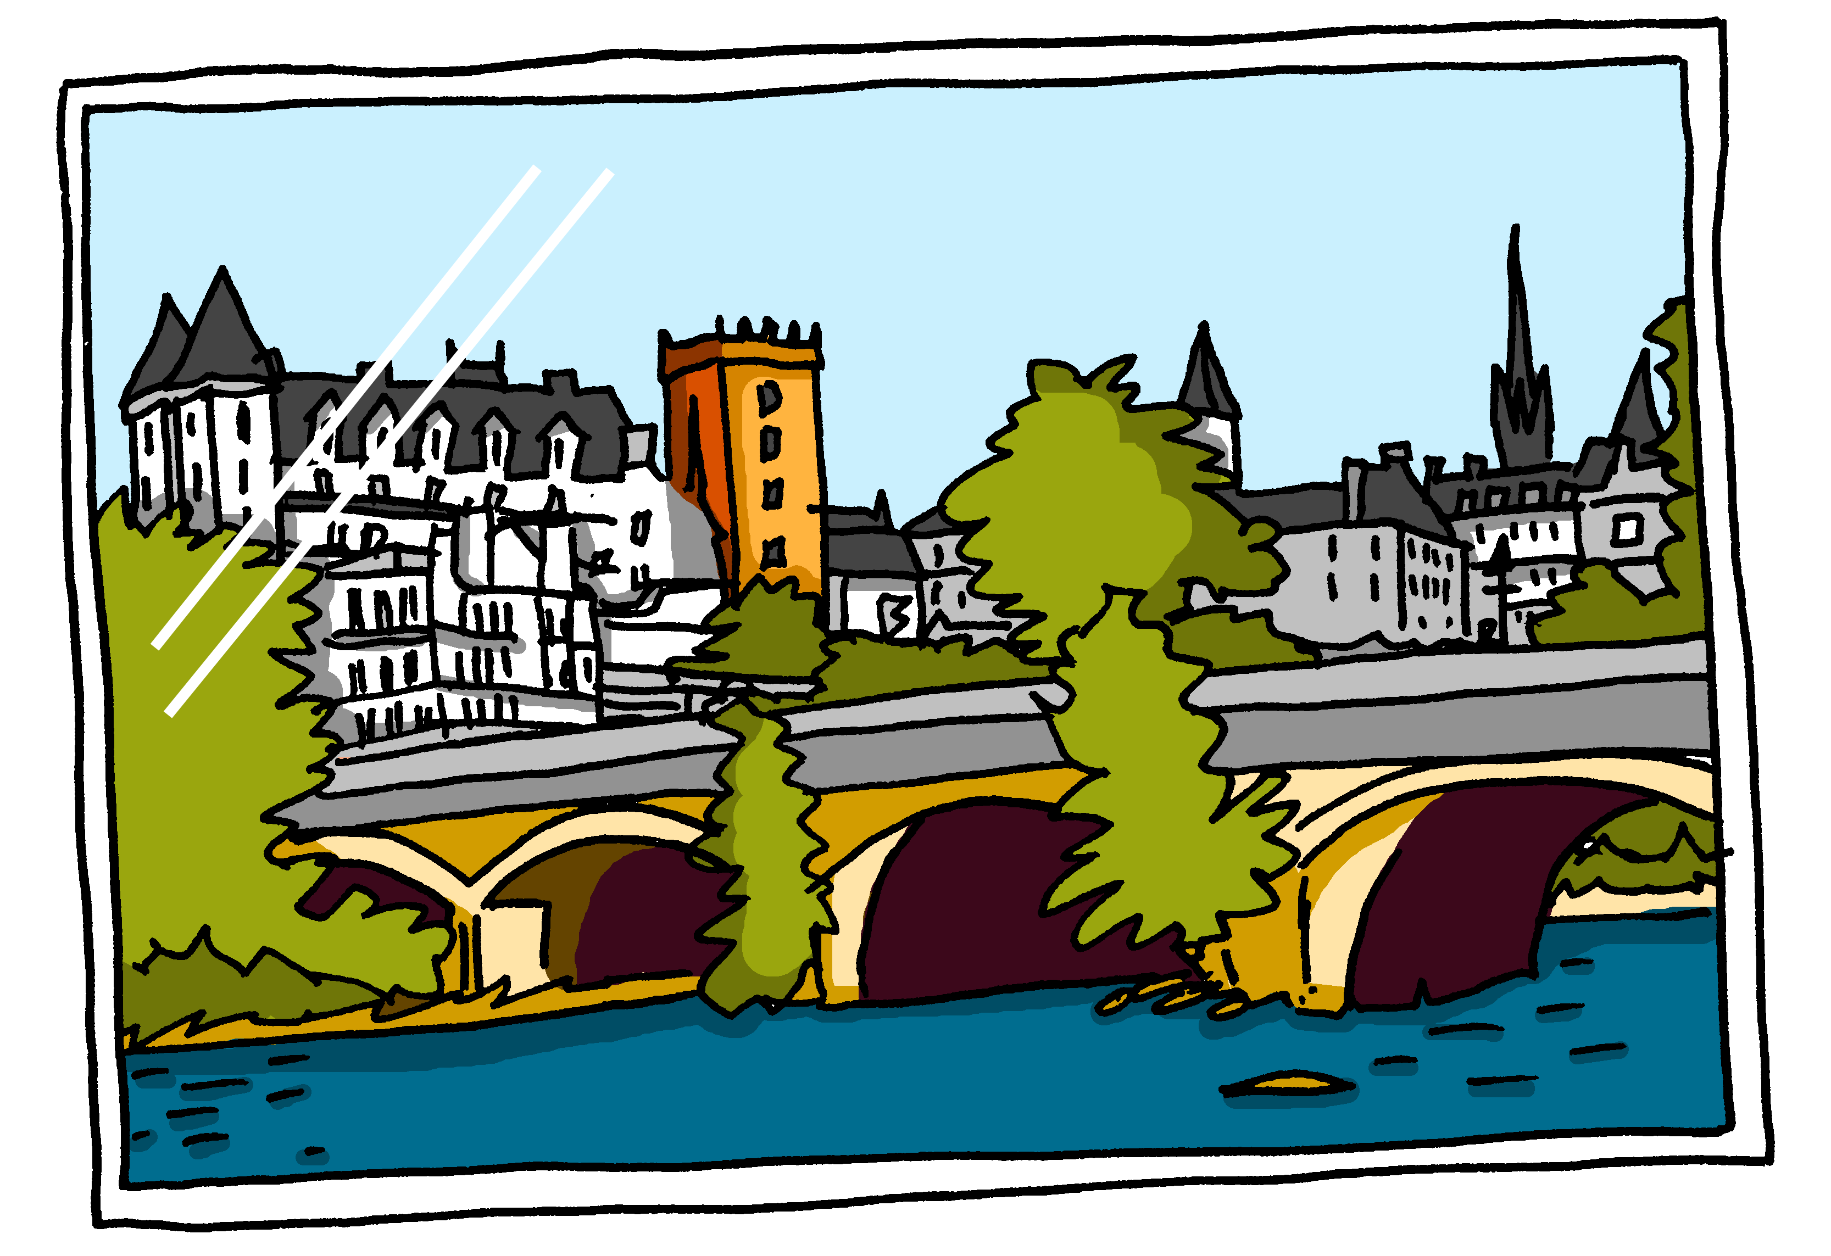
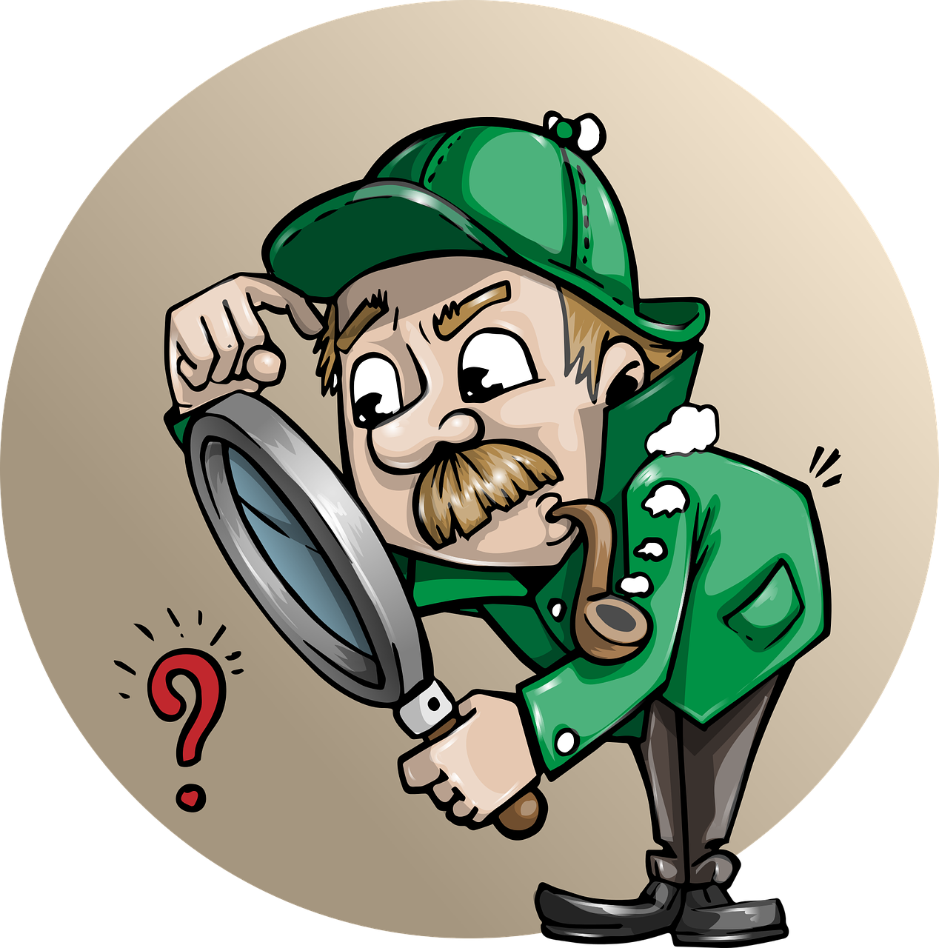
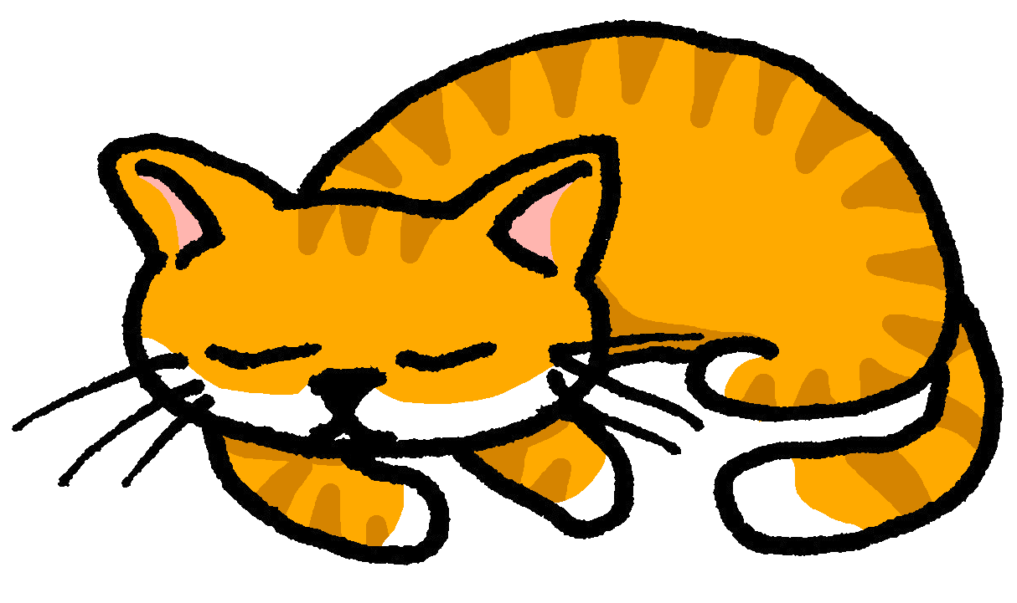
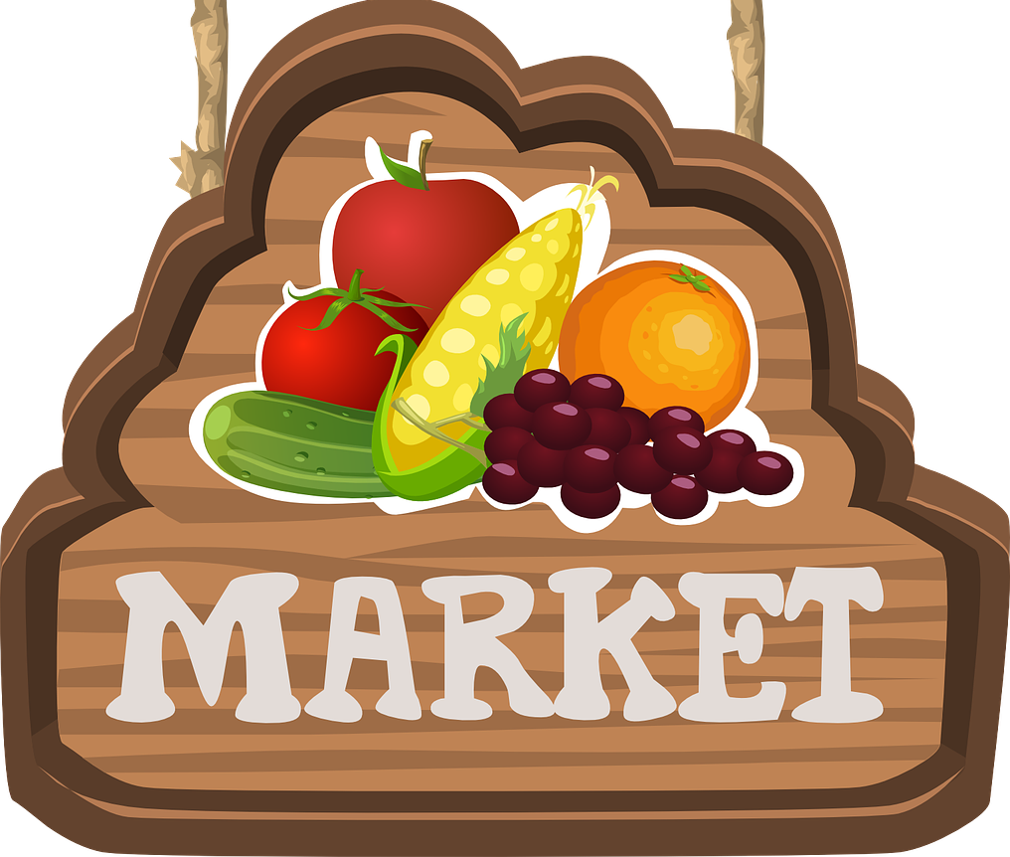

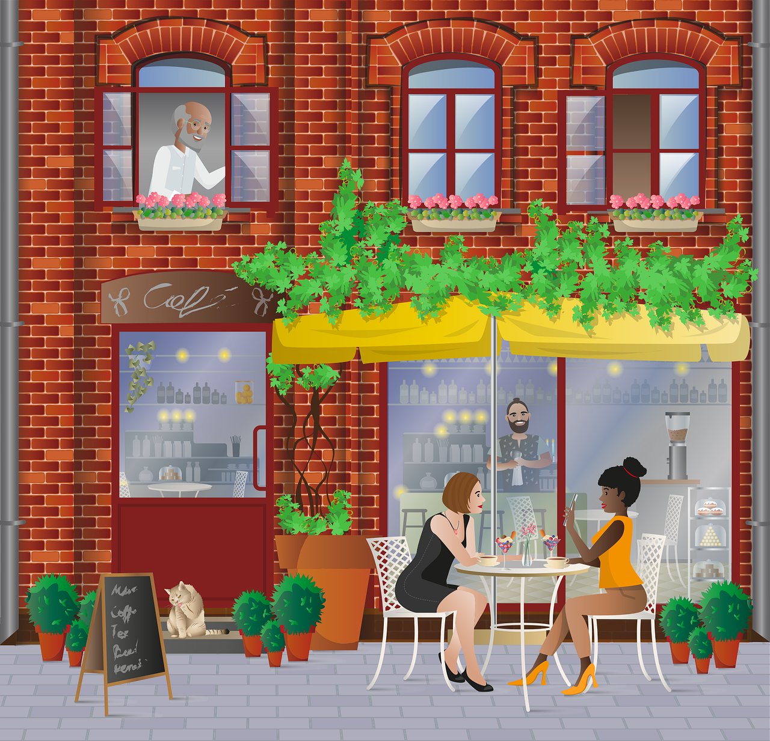
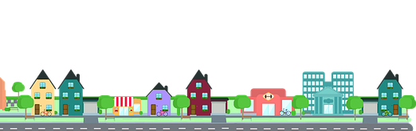


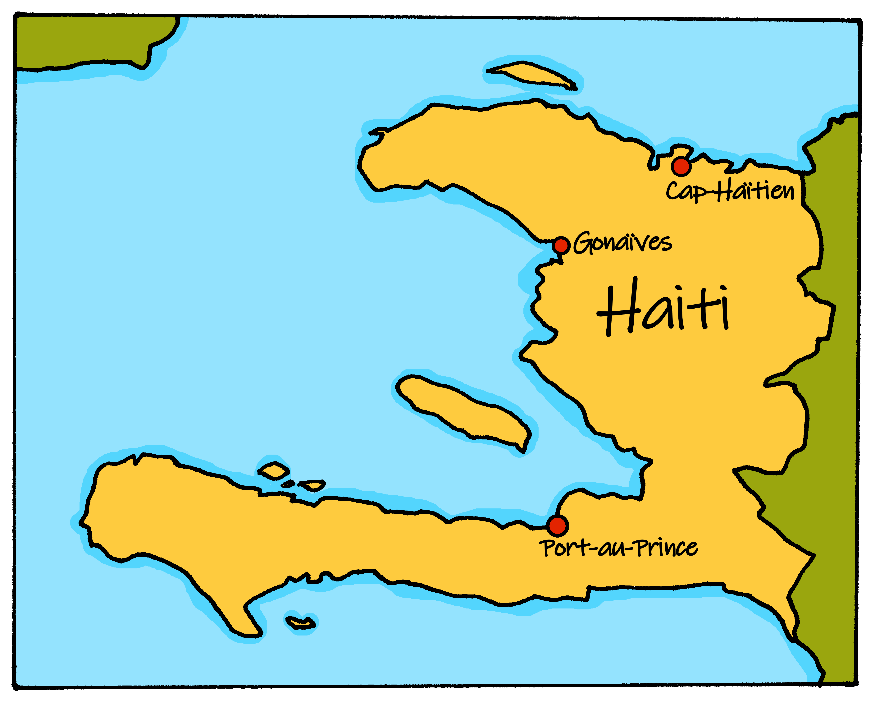
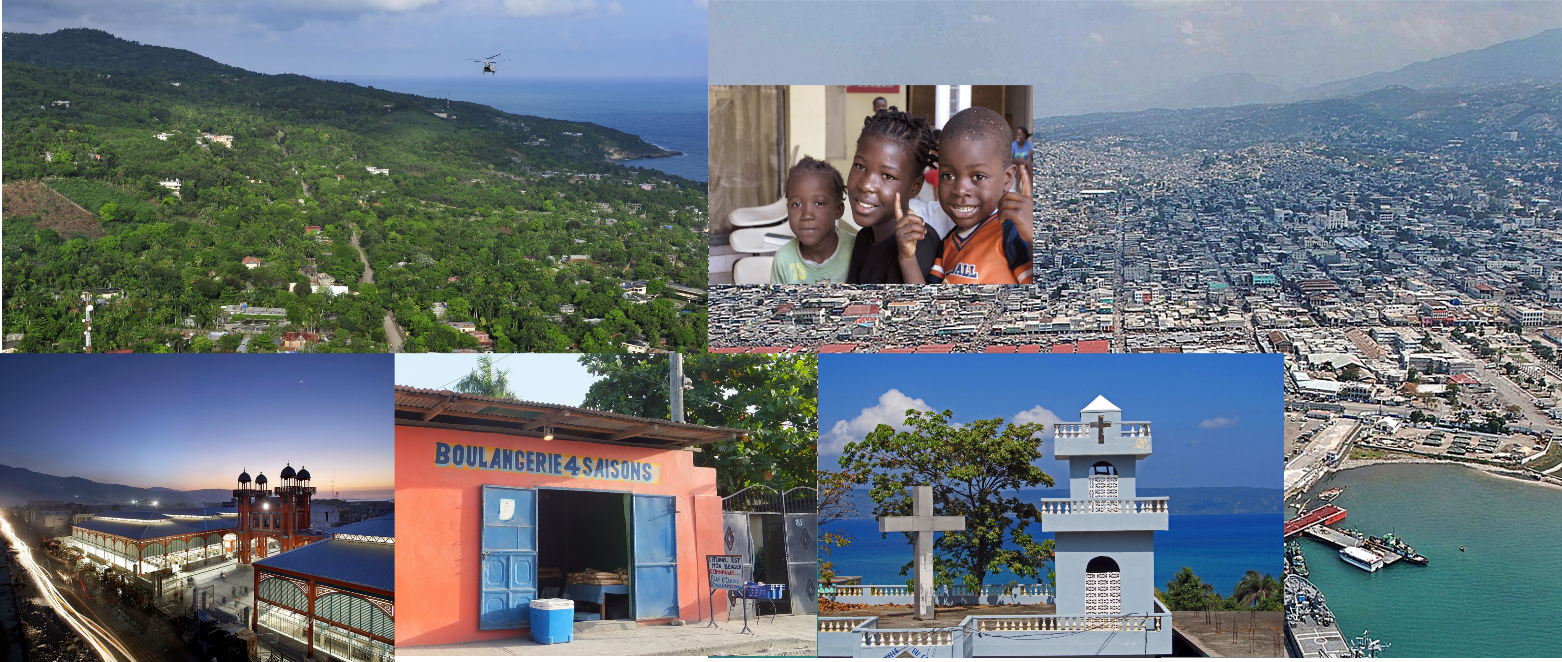
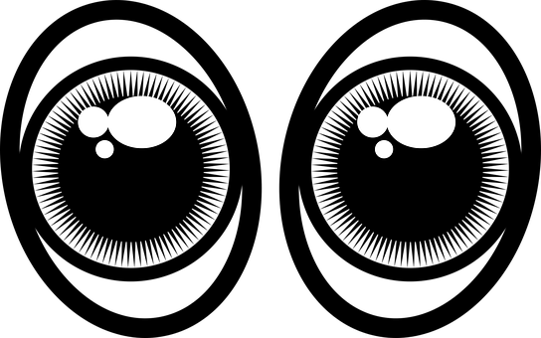
Vert Knowledge Organiser - Autumn Term B
En ville
avoir – to have|having
nous avons – we have
vous avez – you (pl) have
ils ont – they (m, m/f) have
elles ont – they (f) have
le bâtiment – building
le café – café
le centre commercial – shopping centre
le cinéma – cinema
l’hôtel – hotel
le magasin – shop
le marché – market
le pont – bridge
l’église – church
la poste – post office
la rue – street
derrière – behind
devant – in front of
entre – between
des – some
La description
blond – blond
court – short
crépu - frizzy
excellent – excellent
long, (longue) – long
ovale – oval
rond - round
roux, (rousse) – ginger, red
utile – useful
l’acteur – actor | l’actrice – actress
le cheveu – (single) hair
les cheveux – hair (s)
le visage - face
Adjectives that go before the noun
beau – beautiful (m)
belle – beautiful (f)
bon – good (m)
bonne – good (f)
mauvais, mauvaise – bad (m), (f)
nouveau – new (m)
nouvelle – new (f)
vieux – old (m)
vieille – old (f)
Phonics
[SFe] Silent Final e
timide
shy
monde
moderne
centre
douze
[au/eau/o]
gauche
faux
eau
aussi
photo
chercher
dimanche
chat
marché
bouche
[ch]
Sun
Liaison is needed between pronoun and verb.
➜
 | nous avons | vous avez | ils ont | elles ont
Saying what people have with the verb avoir | Plural indefinite article des (some)
Adjectives before the noun | Definite article with physical description
il a
Remember! To say ‘a’ with masculine nouns, use ‘un’. Use ‘une’ with feminine nouns.
tu as
elle a
you have
s/he has
To say ‘some’ (plural) use ‘des’.
j’ai
avoir
nous avons
Il y a des cafés.
There are some cafés.
I have
we have
ils, elles
ont
vous
avez
Il y a des rues.
There are (some) streets.
you (pl)
have
⚠ English can leave out ‘some’ but in French we always need ‘des’.
they have
Some adjectives go before the noun:
These adjectives refer to beauty, age, good/bad or size:
In French we can use the definite article ‘the’ for physical description. In English, we leave the article out or use ‘a’, e.g., has a round face.
un beau parc a beautiful park
une belle église a beautiful church
B
La capitale d’Haïti est Port-au-Prince.
Elle a une population d’environ 1.000.000 personnes.
A
un vieux musée an old museum
une jeune fille a young girl
Il a le visage rond.
He has a round face.
G
une bonne école a good school
une mauvaise université a bad uni
Il a les yeux ronds.
S
un grand magasin a big shop
une petite poste a small post office
He has round eyes.
Notes:
Note- the image is used to identify the Cannes Film Festival in line with the fair use policy found here: https://en.wikipedia.org/wiki/File:Festival_de_Cannes_logo.svg

