Slide 1
Français
Rouge Term 2
Nom : ……………………………………………….
Professeur(e) : ……………………………………..
Classe : ……………………………………………..

Slide 2
Contents
Contents | page
Introduction: La famille Kergosien | 1
Les phoniques | 2
Term 2 Learning Overview | 3
1. Talking about activities in class | 4-7
2. More activities in class | 8-10
3. Talking about family activities at home | 11-14
4. Describing people’s things | 15-17
5. Talking about belongings and activities | 18-21
6. Talking about belongings and activities [2] | 22-25
7. Talking about liking and preferring | 26-28
8. Saying how many things there are | 29-31
9. Talking about ‘some’ and everyday activities | 32-35
10 & 11. Révision and Easter | 36

Slide 3
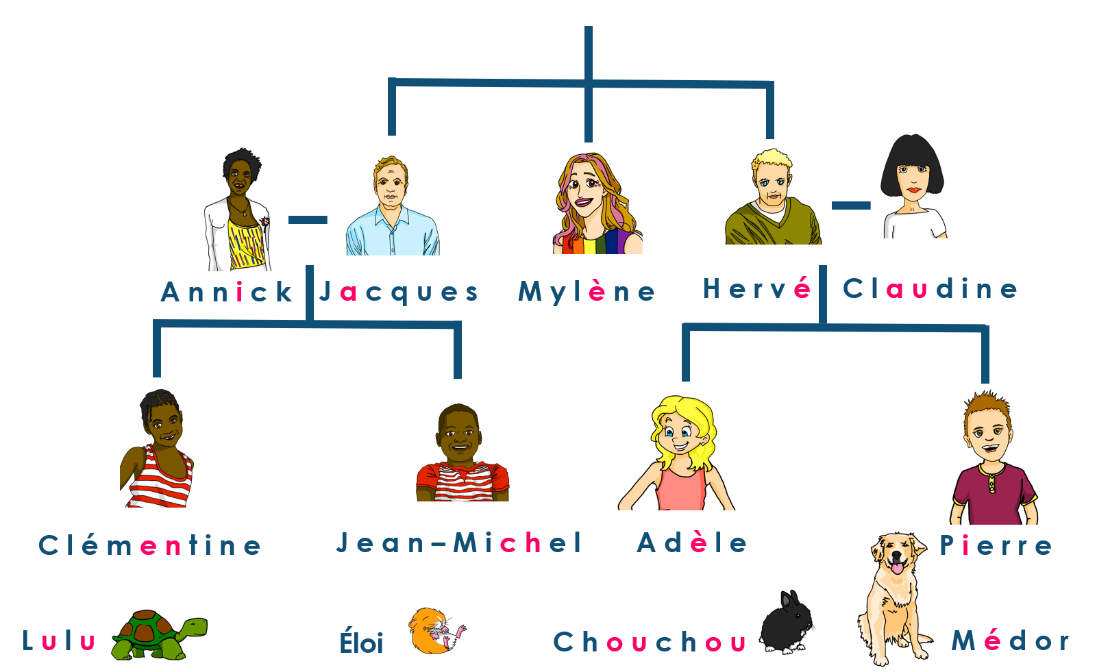
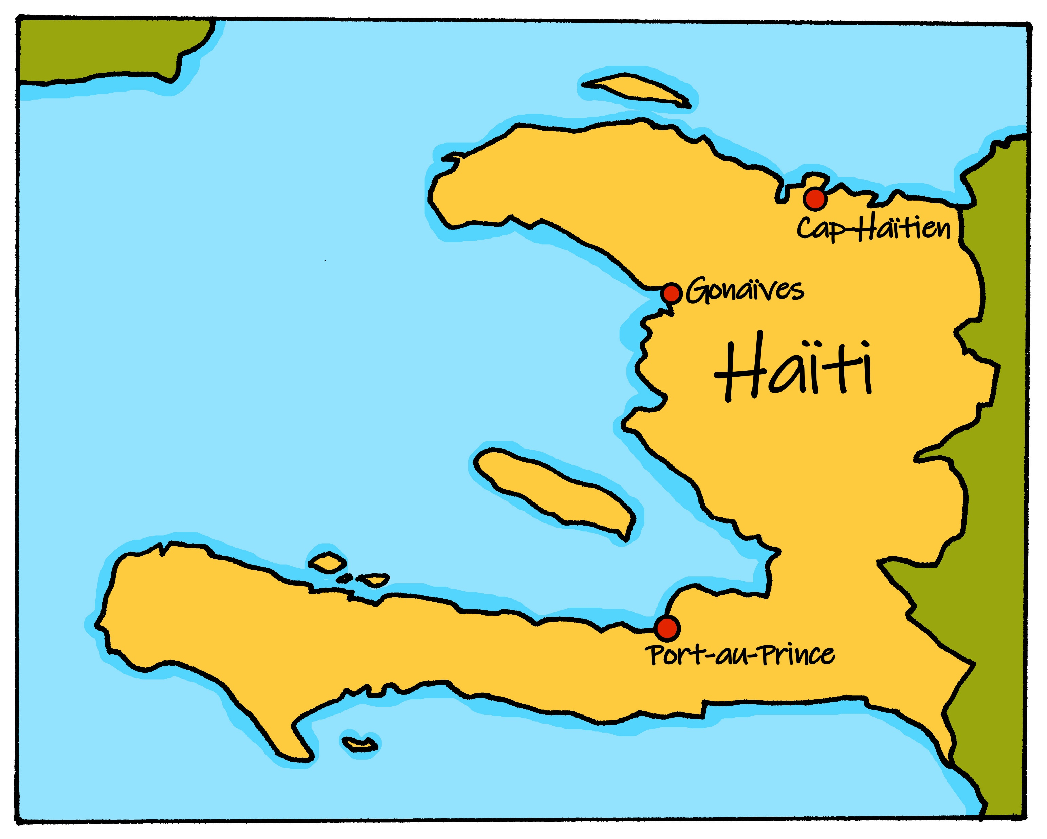
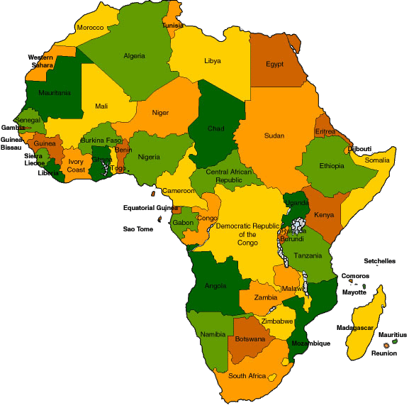
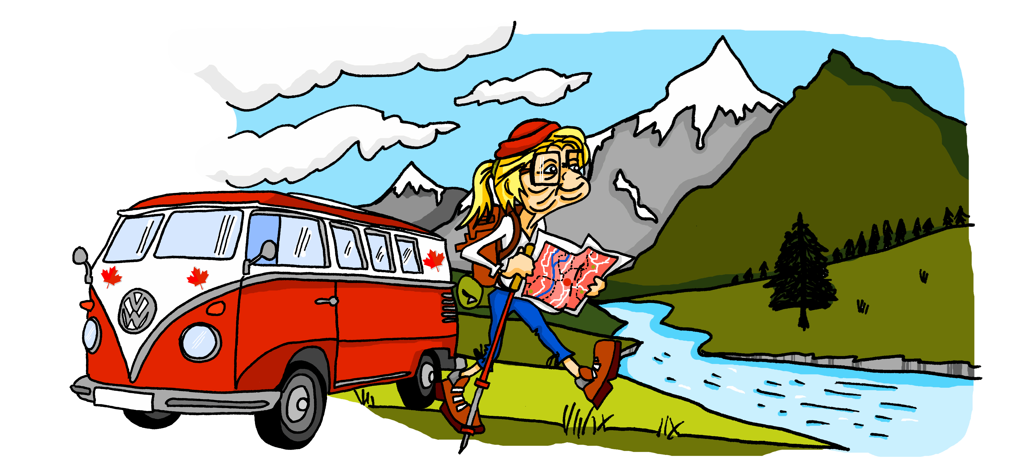
Characters
La famille Kergosien
Renée
We say ‘la Francophonie’ to mean French-speaking peoples and countries.
There are 29 countries with French as
an official language. 21 of these countries are in Africa. Five are in Europe. The other three are: Canada, Haiti and Vanuatu.

Slide 4
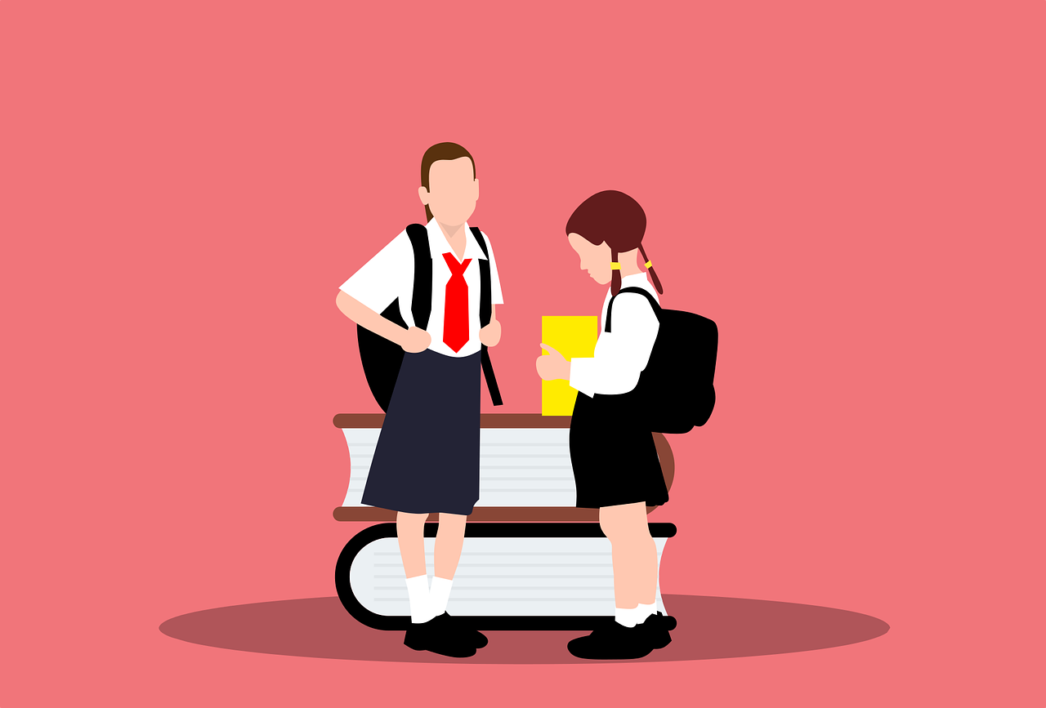
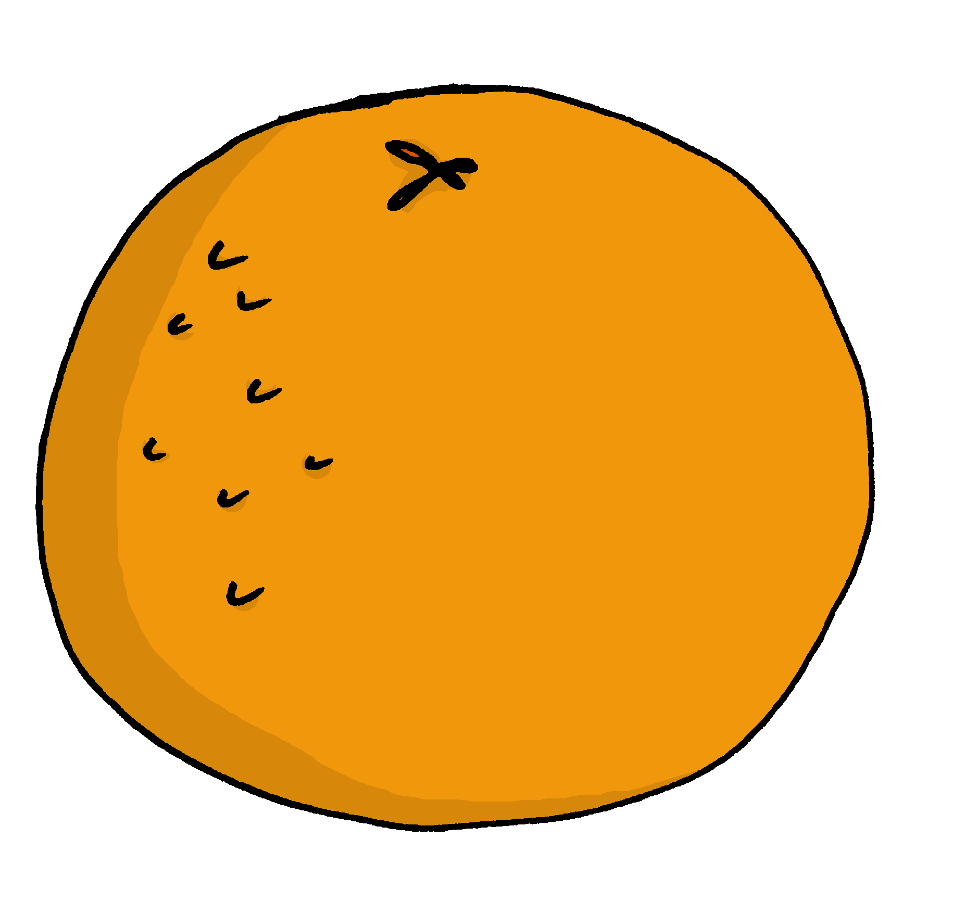
Phonics
Phonics
[é|er]
[-ez]
[eu]
et (and)
nez
(fear)
répéter
peur
[è|ê]
[è|ê]
[ai]
(party, celebration)
fête
(brother)
frère
vrai
[oi]
[liaison-x]
[liaison-s]
[(a)in]
(to see, seeing)
voir
deux uniformes
trois oranges
train

Slide 5
Term overview
Term 2 learning
UNIT | Context CommunicationCulture | Key ideas (GRAMMAR) | PHONICS | VOCABULARY
Unit 4 (W1-5) | Saying what I and others do in class at home Menton carnival | Talking about doing Infinitive – regular ER verbs (singular) Definite articles – le, la, l’ Talking about possession Possessive adjectives – mon, ma, ton, ta ‘de’ for possession | SSC [é] [er] SSC [ez] & et (and) SSC open [eu] SSC [è] [ê] | Range of regular –ER verbs Family members Range of nouns, adjectives and adverbs
Unit 5 (W6-7) | Saying what I and others like family & friends at home | Talking about liking, preferring Essential verb: to like – AIMER, to prefer – PRÉFÉRER Joining ideas together Conjunctions et, mais, aussi | SSC [ai] SSC [oi] | Range of regular –ER verbs Range of singular masculine and feminine nouns
Unit 6 (W8-9) | Saying how many and describing things | Talking about more than one Essential verb: there is/are – il y a Plural indefinite article – des Regular plural marking on nouns [-s] | Liaison (s), (x) SSC [(a)in] | Numbers 1-12 Parts of the body (Jaune only)
Unit 7 (W10-11) | Revision Easter | Revisit key ideas | Revisit SSC | Revisit vocabulary

Slide 6
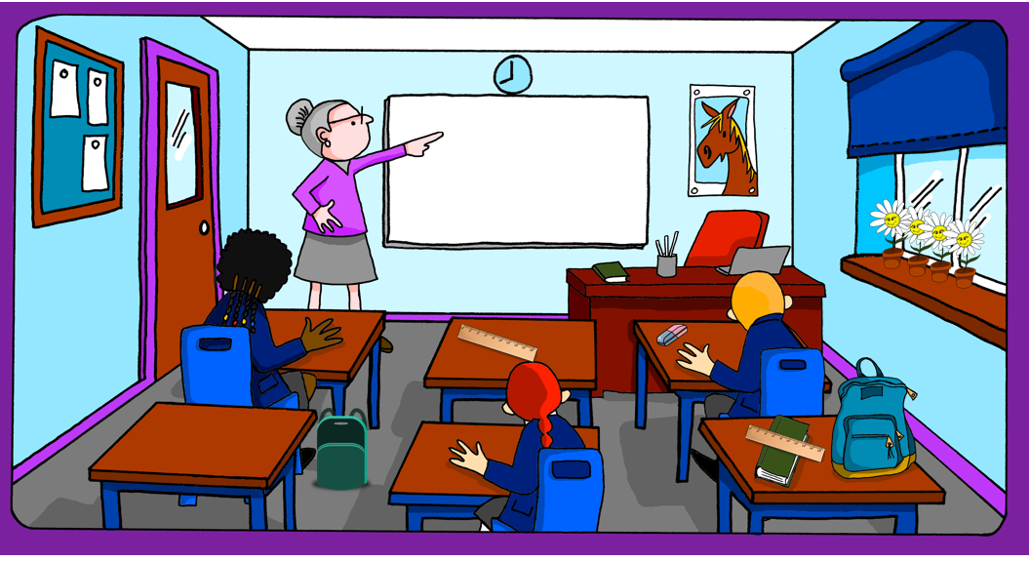
Term 1 week 1
Saying what I and others do
1
Rouge term 2
🎯
Using –ER infinitive verbs to talk about classroom activities
SSC [é|er]
[é|er]
répéter
lire
Write down the key language for this week.
répéter |  | important
chanter |  | normal
utiliser |  | avec
une phrase |  | tous les jours
facile
-ER verbs
[infinitives]
grammaire
In English, the infinitive is often written ‘to + verb’:
It’s fun to sing in French.
Add ‘de’ to link adjective and verb.
In French, many infinitives end in –er:
C’est amusant de chanter en français.
In English we use the –ing form of the verb, here.
You can also begin a French sentence with the infinitive:
Chanter en français, c’est amusant !
Singing in French is fun!
lire
Which new words for this week are infinitives? Write them here.
French | English
4

Slide 7
Term 1 week 1
Saying what I and others do
1
Rouge term 2
lire
Adèle écrit. After a term Adèle writes what she’s learned. Complète les phrases en anglais.
1
C’est important de parler avec Madame Dior.
2
Lire un texte avec Léa, c’est amusant !
[1] It is important ____ _______ to Mrs Dior.
[2] _____________ a text with Léa is fun.
[3] It is important ____ __________ a ruler in class.
[4] _____________ an animal in class is difficult!
[5] It is _________ ___ ___________ a phrase.
[6] It’s important ____ ________ with Léa in class.
[7] _____________ in French is good!
3
C’est important d’utiliser une règle en classe.
4
Avoir un animal en classe, c’est difficile !
5
C’est facile de répéter une phrase.
6
C’est important de parler avec Léa en classe.
7
Chanter en français, c’est bien ça !
écouter
Madame Dior parle. L’infinitif, c’est où ? Écoute et écris.
 | beginning | in the middle
1
2
3
4
5
6
l’infinitif | en anglais
écouter | It’s easy ___ ______ to Madame Dior.
 | ________ an exercise book in class is normal!
 | It’s fun to sing in class.
 | Writing a paragraph is easy!
 | It’s important to repeat a phrase in French.
 | Reading in French is fun!
5

Slide 8
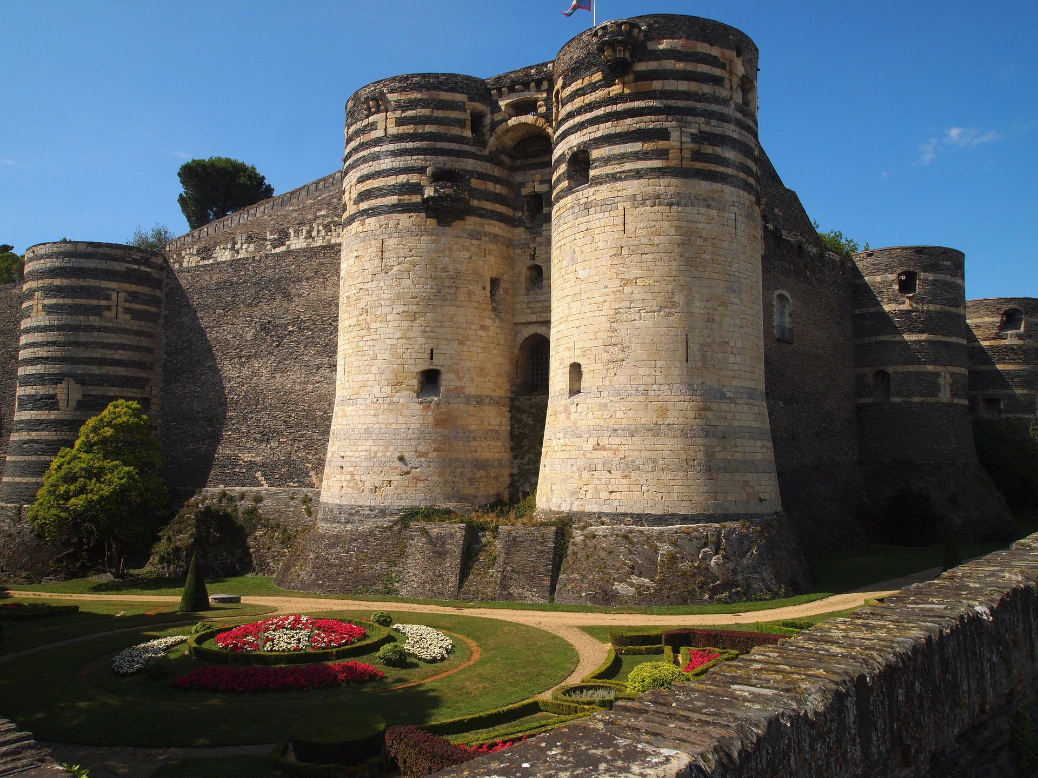
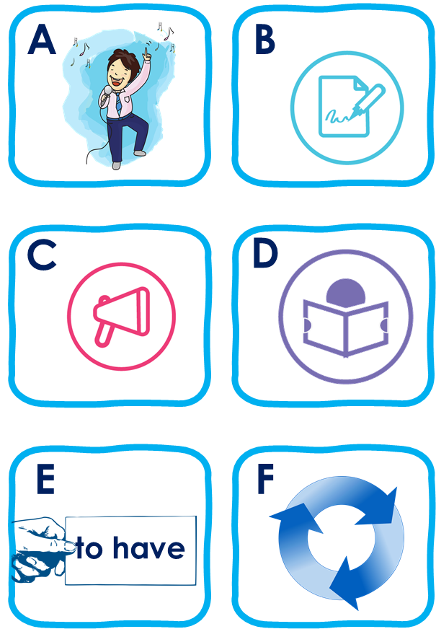
Term 1 week 2
Saying what I and others do
1
Rouge term 2
Écoute. C’est [e] ou [é|er] ?
1 | G r ___ n o b l e
2 | A n g ___ s
3 | B ___ z o n s
4 | M ___ l u n
5 | O r l ___ a n s
6 | C h a m b ___ r y
lire
Write down the English meanings 1-12.
1 |  | 7
2 |  | 8
3 |  | 9
4 |  | 10
5 |  | 11
6 |  | 12
vocabulaire
Écoute. Le verbe, c’est quoi ? Écris la lettre et l’adjectif en anglais.
 | image | adjectif | information extra
1 | D | easy | to write (in English)
2
3
4
5
6
6

Slide 9
Term 1 week 2
Saying what I and others do
1
Rouge term 2
lire
Le verbe correct, c’est où ?
 | Phrase en français
1 | C’est super de chanter le dimanche.
2 | Avoir un dictionnaire, c’est normal !
3 | C’est important de parler avec Mme Dior.
4 | Lire une gomme, c’est impossible !
5 | Parler avec un partenaire, c’est facile !
6 | C’est amusant de parler en français.
verbe en anglais
to sing | singing | to talk | talking
to use | using | having | to have
speaking | to speak | to repeat | repeating
reading | to read | writing | to write
to talk | talking | to listen | listening
singing | speaking | to sing | to speak
lire
Écris les phrases en anglais.
1 | It’s great to sing on Sunday.
2
3
4
5
6
écrire
Écris en français. Can you get at least 15 points?
 | today | this, that | to read, reading
 | Friday | Saturday | Sunday
 | Tuesday | Wednesday | Thursday
 | a day | each, every | Monday
 | normal | with | everyday
 | a phrase | easy | important
 | to sing, singing | to repeat, repeating | to use, using
x3
x2
x1
7

Slide 10
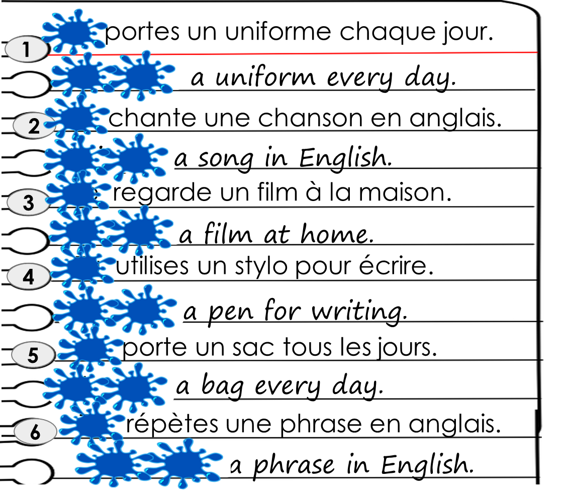
Term 1 week 2
Saying what I and others do
2
Rouge term 2
🎯
prononcer
Saying what I and you do
[-ez]
[-ez] and et sound the same as [é|er]
Saying what he and she does
nez
et (and)
lire
Write down the key language for this week.
porter |  | un uniforme
regarder |  | une chanson
un chapeau |  | et
un film |  | mais
un instrument |  | à
Knowing who does what
grammaire
To mean ‘I’ with a verb, change the ending to match the pronoun:
Je parle français.
I speak French.
Note that parle and parles sound the same because of the Silent Final Consonant.
To mean ‘you’ with a verb:
Tu parles français.
You speak French.
lire
Un accident ! 💧
C’est ‘I’ ou ‘you’ ? Et en anglais ?
 | I | you
1
2
3
4
5
6
Verbe
you wear
8

Slide 11
Term 1 week 3
Saying what I and others do
2
Rouge term 2
Knowing who does what
grammaire
To mean ‘’he’ and ‘she’ with a verb, use ‘il’ and ‘elle’ and the ending –e:
Il porte un chapeau à la maison.
He wears a hat at home/at the house.
Elle porte un sac à l’école.
She carries a bag at school.
Note that porter means ‘wear’ and ‘carry’.
lire
Is Adèle asking about Pierre (tu) or Max (il)?
 |  | (tu) | (il) |  |  | (tu) | (il)
1 | … porte un sac à l’école tous les jours ? |  |  | 5 | … portes un uniforme chaque jour ?
2 | … parles en ligne* avec Yves, aujourd’hui ? |  |  | 6 | … utilises un cahier pour le vocabulaire français à l’école* ?
3 | … regardes un film avec Maman le samedi ? |  |  | 7 | … regarde un match de football le weekend ?
4 | Le weekend, … porte un chapeau à la maison ? |  |  | 8 | … utilise un instrument à l’école ? Un saxophone ?
1
5
2
6
3
7
4
8
parler
Wish five people in your class a Happy New Year in French.
Bonne Année ! Literally ‘Good year!’ it means ‘Happy New Year!’. You can say Bonne année ! or Bonne année et bonne santé ! (Happy New Year and good health!)
écrire
Écris 5 phrases en français.
un chapeau
un uniforme
un instrument
un t-shirt
une règle un sac un cahier
une phrase un film
une chanson
en anglais
en français à la maison à l’école
[I sing] [You sing] [I listen to] [S/he listens to] [I use] [You use] [I speak] S/he speaks]
[I watch] [You watch] [I wear, carry] [S/he wears, carries]
1
2
3
4
5
9

Slide 12
Term 1 week 3
Saying what I and others do
2
Rouge term 2
lire
Lis les messages.
C’est Adèle ou Pierre ? Écris en anglais.
Le samedi, elle porte un t-shirt à la maison.
Who? | What? | extra details
Aujourd’hui elle parle en ligne* avec Léa.
Adèle
wears a t-shirt
at home
Normalement, il porte un jean* à la maison.
Chaque jour il porte un uniforme.
Elle porte un sac à l’école*.
Il utilise un cahier pour le vocabulaire français.
Il regarde un film avec Maman.
écrire
Écris en français. Can you get at least 15 points?
 | brave (m) | curious (f) | serious (m)
 | Sunday | a week | happy (f)
 | Thursday | Friday | Saturday
 | Monday | Tuesday | Wednesday
 | a uniform | but | at
 | a hat | a film | a house
 | to wear, carry | to look, watch | a song
x3
x2
x1
10

Slide 13
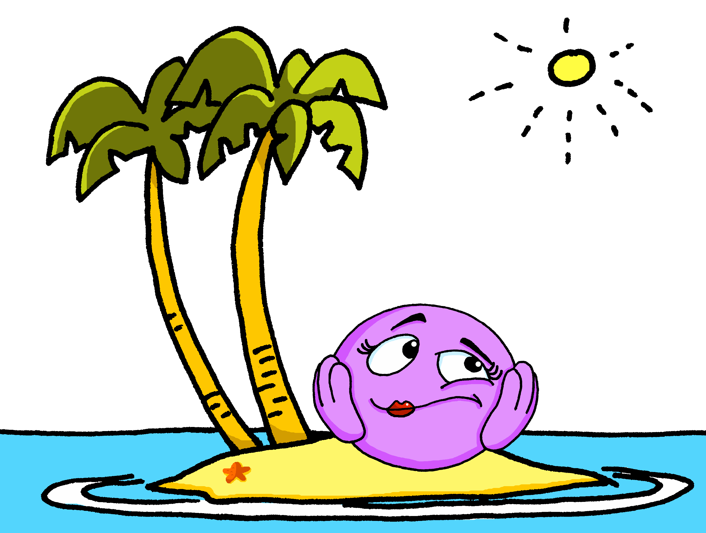
Term 1 week 3
Saying what I and others do
3
Rouge term 2
It sounds like the ‘ur’ in ‘hurt’.
🎯
prononcer
Talking about family activities at home
closed[eu]
This is a closed vowel. When you say this sound, your tongue is near the top of your mouth.
open[eu]
This is an open vowel. When you say this sound, your tongue is near the bottom of your mouth.
Remember!
( bit, a little)
(fear)
[eu] is open when followed by r, f, l, but closed before x, s.
un peu
peur
prononcer
lire
Closed or open [eu]?
 |  | open [eu] | closed [eu]
1 | bleu
2 | deux
3 | ordinateur
4 | seule
 |  | open [eu] | closed [eu]
5 | sérieuse
6 | fleur
7 | bœuf
8 | curieux
lire
Write down the new key language for this week.
donner |  | la mère
preparer |  | la sœur
trouver |  | le
la famille |  | la
le frère |  | à
le père
The definite article (words for ‘the’)
grammaire
We know that all French nouns have gender, and are masculine or feminine.
We use ‘un’ to mean ‘a’ (masculine) and ‘une’ (feminine).
To mean the in French before a noun, use le (masculine) or la (feminine) or l’ if the noun starts with a vowel.
le chien (the dog)
la phrase (the sentence)
l’uniforme (the uniform)
11

Slide 14
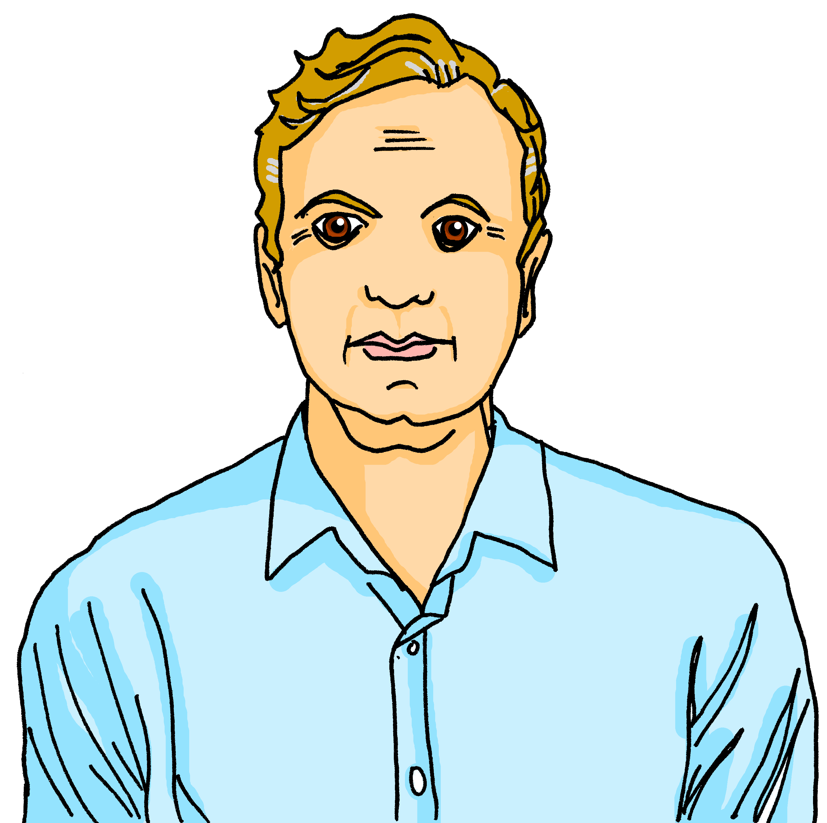
Term 1 week 3
Saying what I and others do
3
Rouge term 2
lire
C’est qui ? C’est quelle activité ?
1 | Le | mère | père | prépare le | chanson. | gâteau.
The father prepares the cake.
2 | La | sœur | frère | trouve le | cadeau. | gomme.
_______________________________________________________________________.
3 | La | chien | famille | regarde l’ | chat. | animal.
______________________________________________________________________.
4 | L’ | peluche| animal | est orange.
_______________________________________________________.
5 | La | mère | père | donne le | peluche | cadeau | à Jean-Michel.
______________________________________________________________________________________.
6 | La | sœur | frère | aime la | cadeau. | réponse.
_______________________________________________________________________________.
écouter
C’est qui ? C’est quelle activité ?
 | C’est qui ? |  | Extra details
1 | le | la | famille | frère | sings the song.
2 | le | la | chien | sœur | finds the rubber.
3 | le | la | mère| frère | wears the hat.
4 | le | la | sœur | père | gives the present to J-M.
5 | le | la | chien | peluche | repeats the phrase.
6 | le | la | chat | famille | watches the film.
Follow up 4
parler
Person A. (Person B – turn to the next page.)
Say each sentence but say ‘beep’ for the word in brackets.
Now your turn to listen to your partner. Write down each word, and choose and write the correct missing word.
1. Le [frère] a un cadeau. 2. La [peluche] chante une chanson. 3. La [famille] prépare la maison. 4. La [mère] utilise le stylo. 5. Le [père] porte un uniforme.
Le
père
prépare
le
gâteau.
12

Slide 15
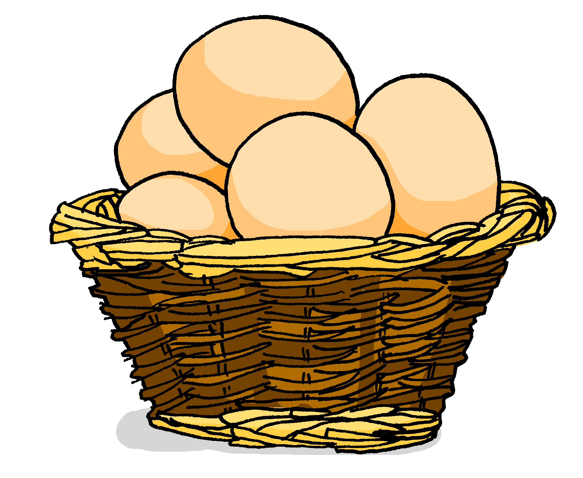
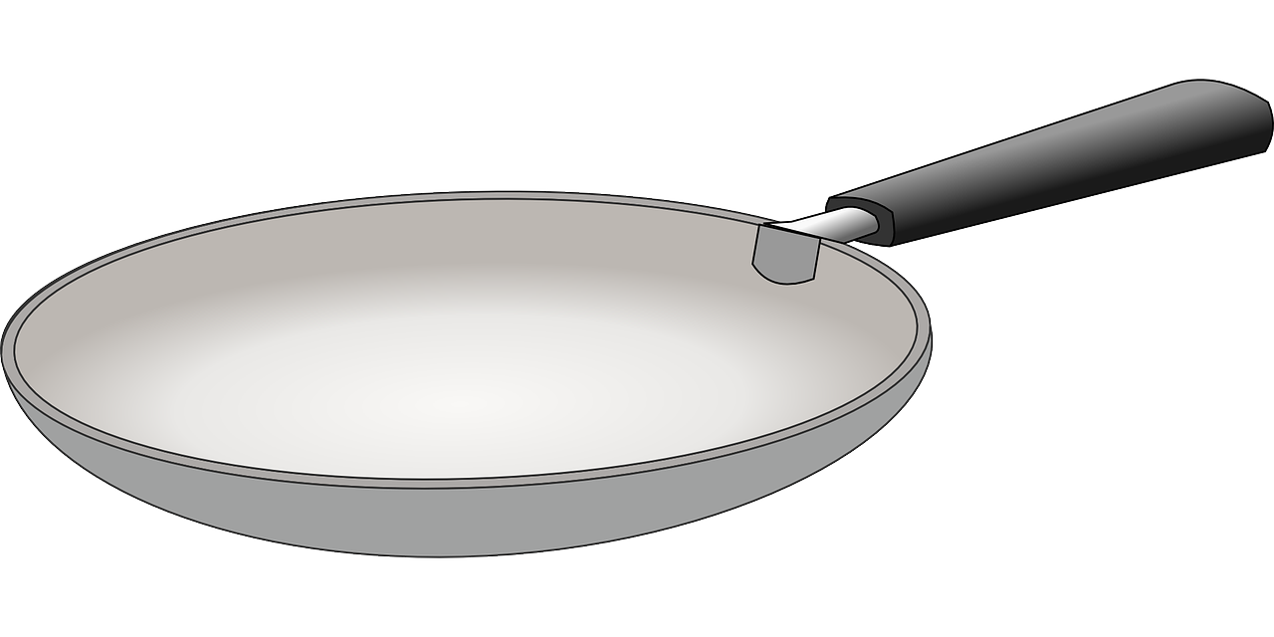
Term 1 week 3
Saying what I and others do
3
Rouge term 2
Follow up 4
parler
Person B. (Person A – turn to the previous page.)
Listen to your partner. Write down each word, and choose and write the correct missing word.
Now your turn to say each sentence but say ‘beep’ for the word in brackets.
1. Le [père] prépare le gâteau. 2. Le [chien] regarde un film. 3. La [sœur] a le jeu. 4. La [famille] trouve le cadeau. 5. Le [frère] répète la phrase.
a
Le
frère
un
cadeau.
écouter
La chandeleur
 | open [eu] | closed [eu]
1
2
3
 | open [eu] | closed [eu]
4
5
6
lire
Écris en anglais. Can you get at least 15 points?
 | le sac | la peluche | le stylo
 | le jeu | le cahier | l’orange
 | une | le ballon | la bouteille
 | le | la | un
 | le frère | la sœur | à
 | la famille | la mère | le père
 | donner | préparer | trouver
vocabulaire
x3
x2
x1
13

Slide 16
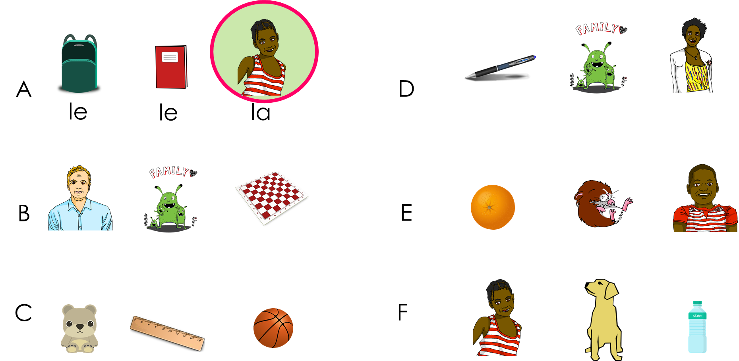
Term 1 week 3
Saying what I and others do
3
Rouge term 2
lire
parler
Trouve l’intrus. (Find the odd one out).
écrire
Écris en français. Can you get at least 15 points?
vocabulaire
 | (the) bag | (the) cuddly toy | (the) pen
 | (the) game | (the) exercise book | (the) orange
 | a (f) | (the) ball | (the) bottle
 | the (m) | the (f) | a (m)
 | (the) brother | (the) sister | to, at
 | (the) family | (the) mother | (the) father
 | to give, giving | to prepare, preparing | to find, finding
x3
x2
x1
14

Slide 17
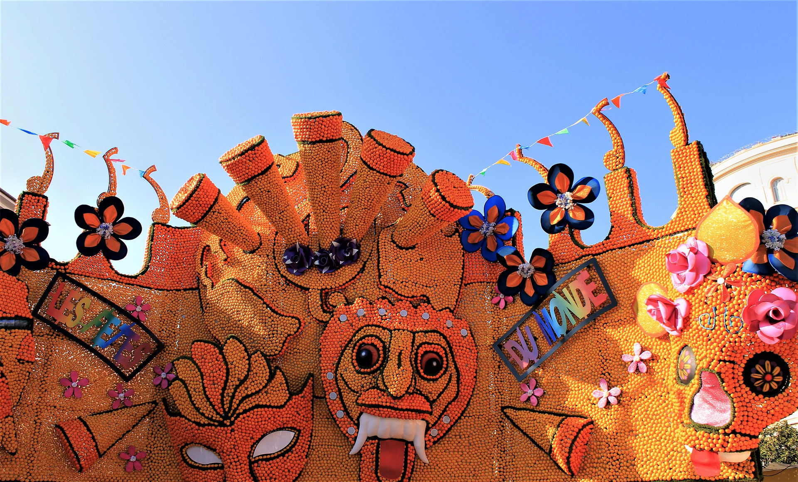
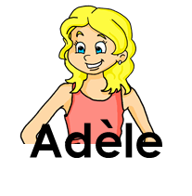
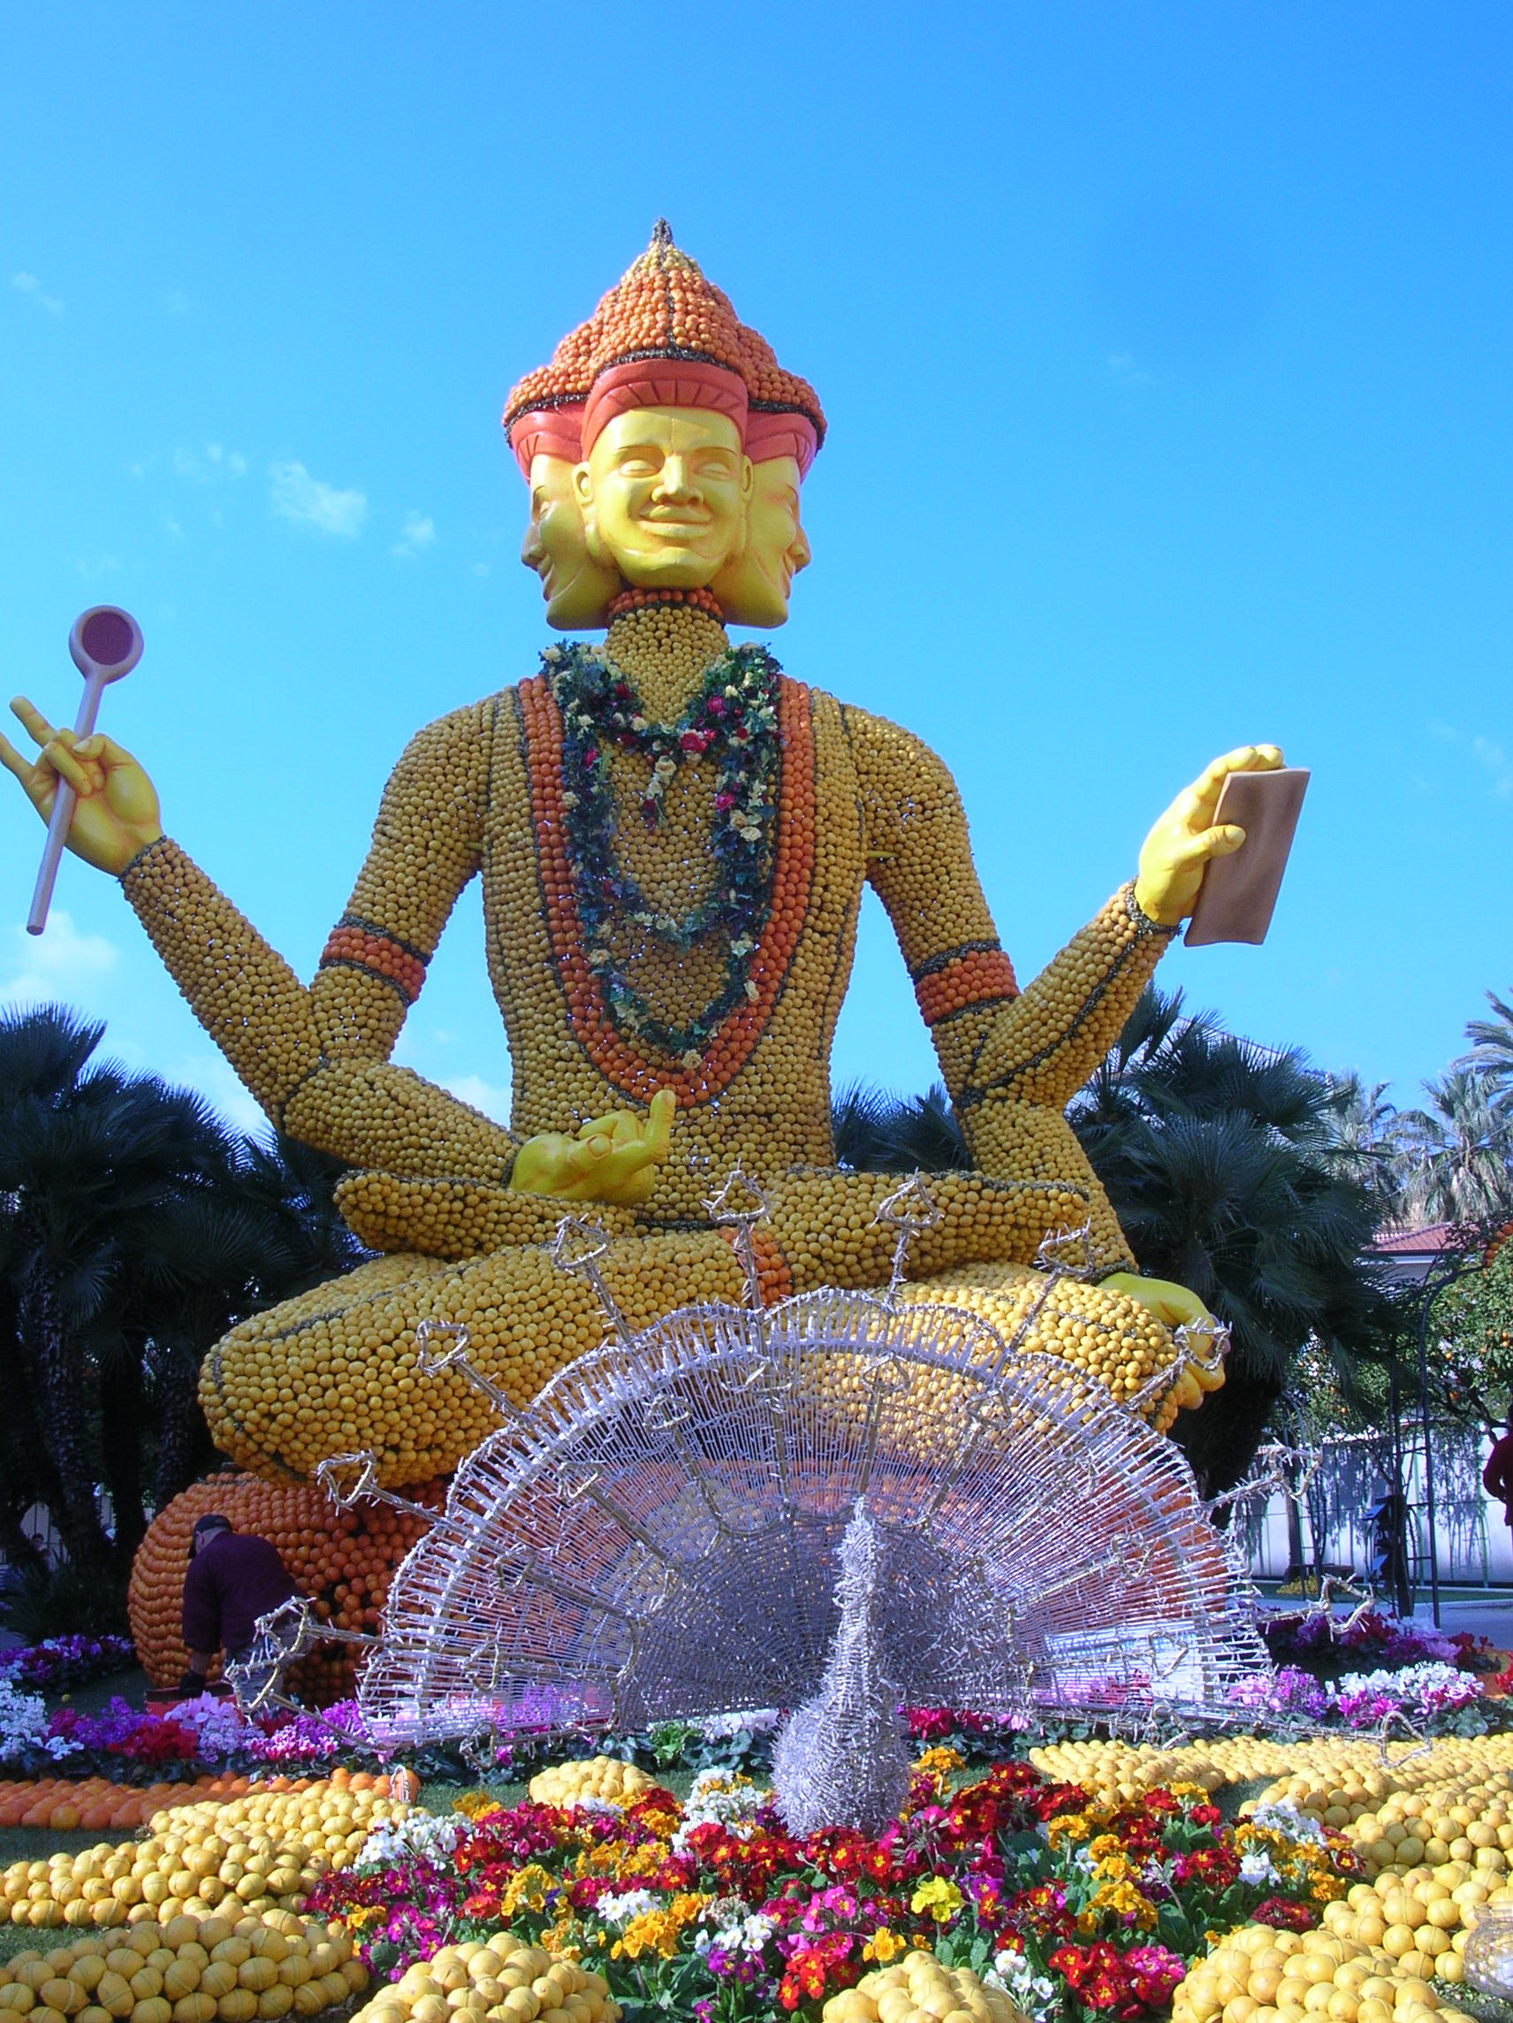
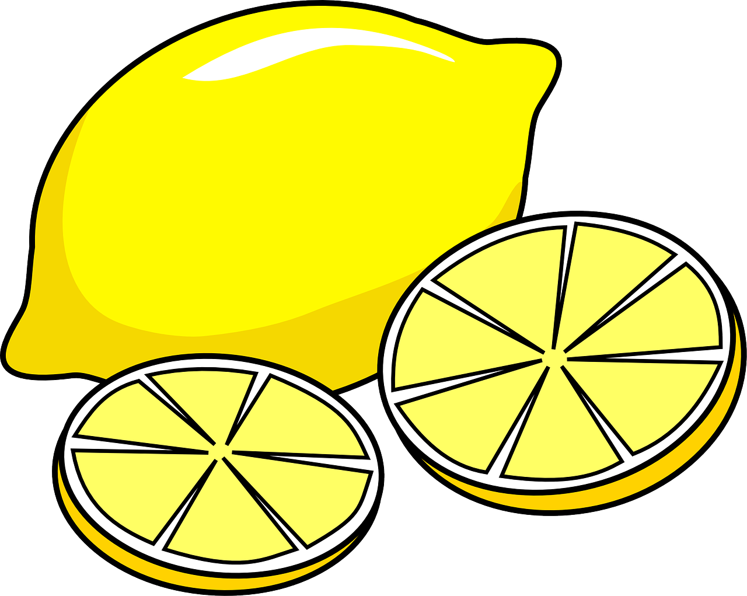
Term 1 week 4
Saying what I and others do
4
Rouge term 2
🎯
prononcer
Using ‘de’ for possession
[è|ê]
Describing people’s things
(party, celebration)
fête
Le Carnaval de Menton
lire
Write down the key language for this week.
la fête |  | petit
la fille |  | grand
le fruit |  | de
le garçon
lire
Écris en anglais.
le frère de Mylène | Mylène’s brother
la sœur de Pierre
le père de Jean-Michel
le chapeau de Mylène
la fête de Menton
la sculpture de Datta
Using adjectives
grammaire
Remember that adjectives change spelling to match the gender of the noun:
Le fruit est petit.
➜
The fruit is small.
La fête est grande.
➜
The party is big.
Note that grand means big as well as tall, and petit means small and short.
écouter
C’est l’image A ou B ? C’est quoi en anglais ?
1 | A | The banana is big. | 4
2 |  | 5
3 |  | 6
15

Slide 18
Term 1 week 4
Saying what I and others do
4
Rouge term 2
lire
Le mot correct, c’est quoi ? Écris l’adjectif en anglais.
1 | La sœur | Le frère est petite. | short
2 | Le fruit | L’orange est petite.
3 | Le garçon | La fille est grand.
4 | La fête | Le carnaval de Menton est grande.
5 | La maison | Le chapeau de Mylène est petit.
6 | Le père | La mère d’Adèle est grand.
écouter
 | [e] | [è|ê]
1 |  |  | le frère
2
3
4
5
 | [e] | [è|ê]
6
7
8
9
10
lire
Écris en anglais. Can you get at least 15 points?
 | la photo | la table | ou
 | l’animal | le chien | le chat
 | il a | elle a | quoi
 | avec | tous les jours | j’ai
 | chanter | utiliser | facile
 | le garçon | de | répéter
 | la fête | la fille | le fruit
vocabulaire
x3
x2
x1
16

Slide 19
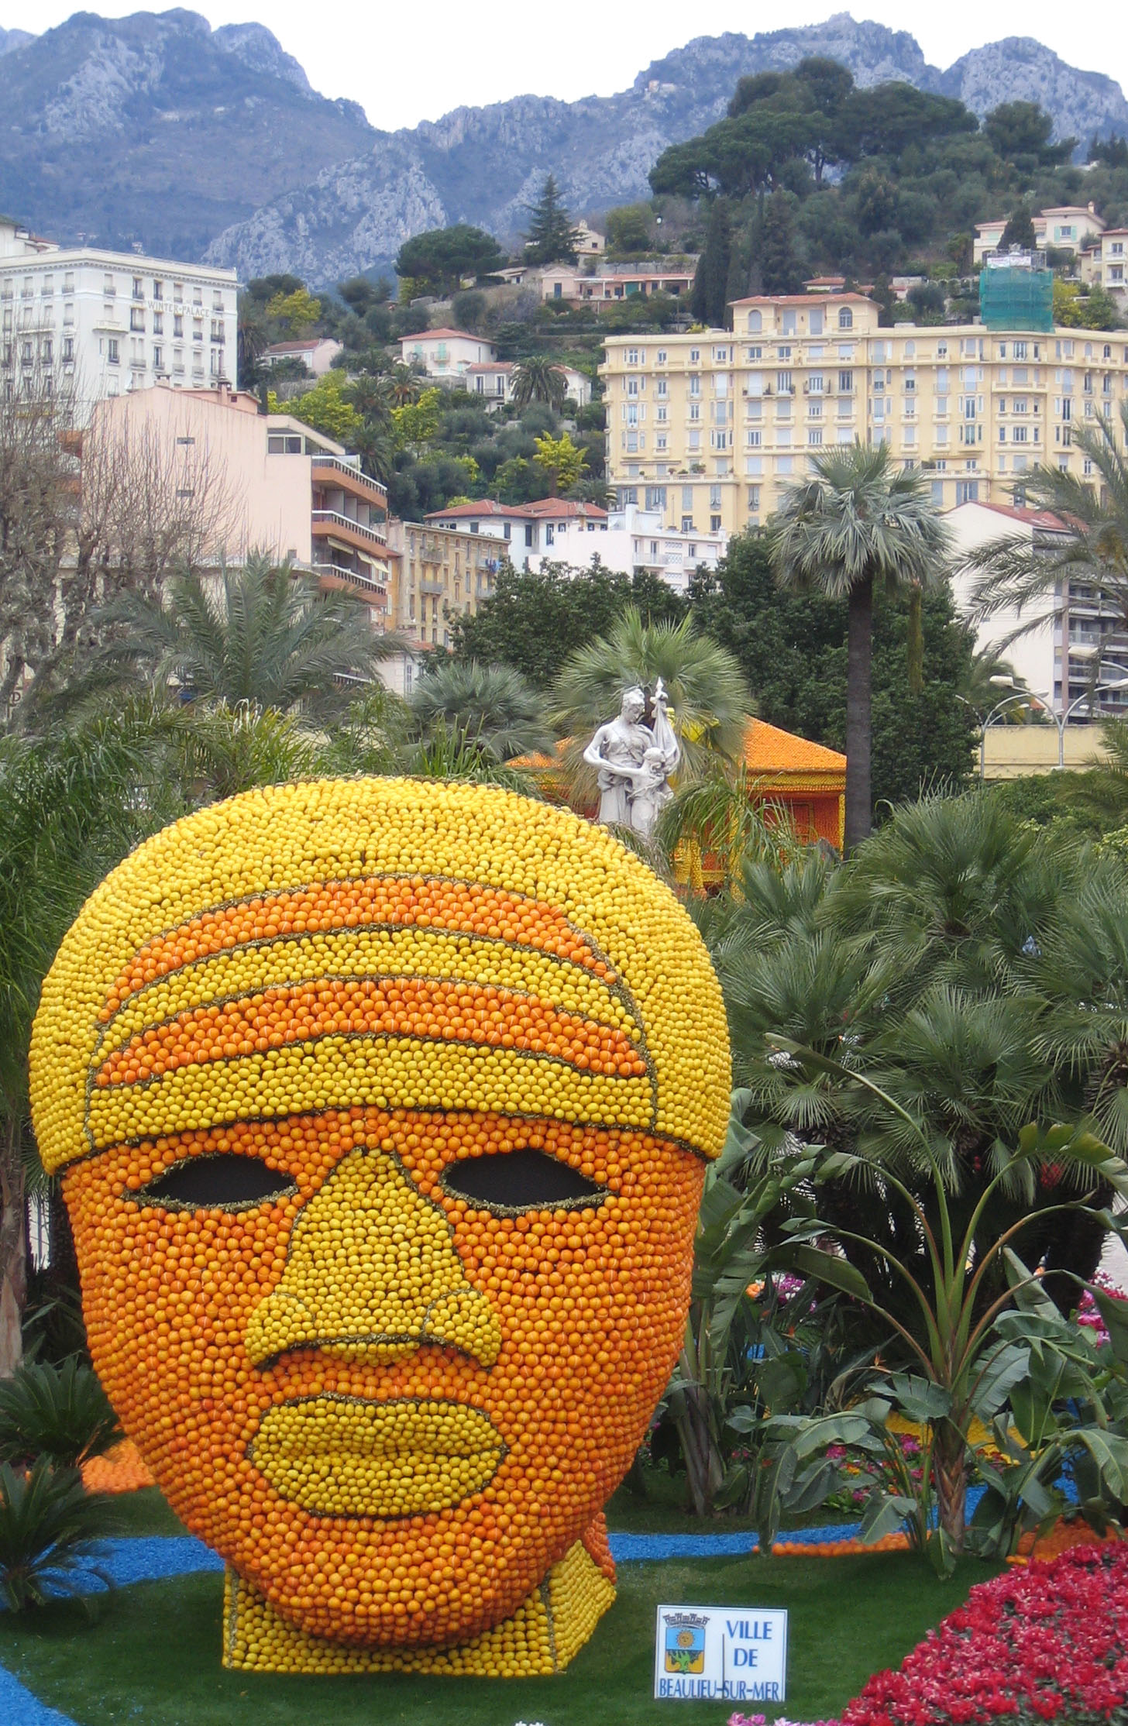
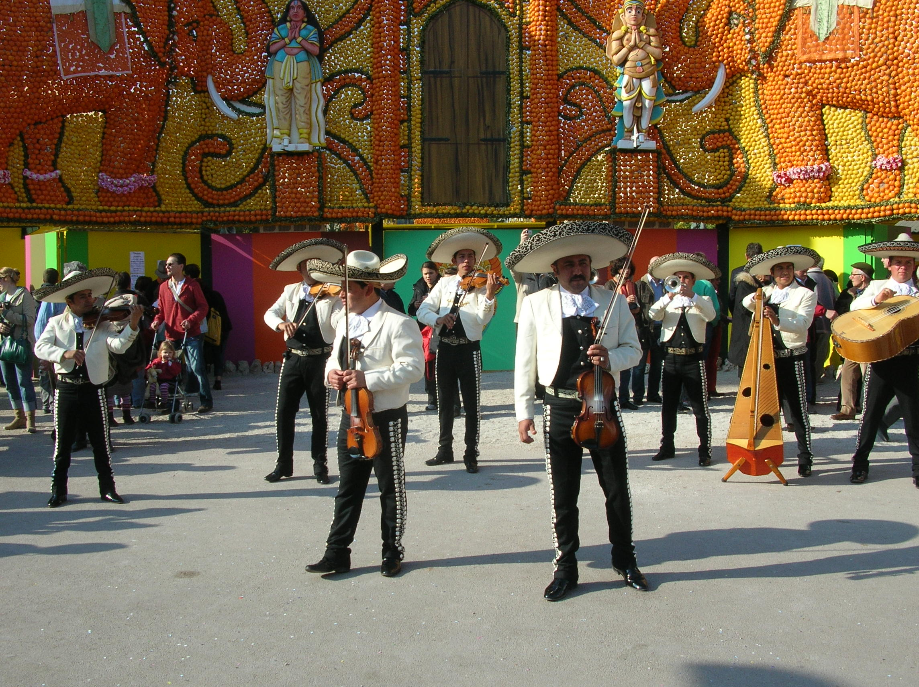
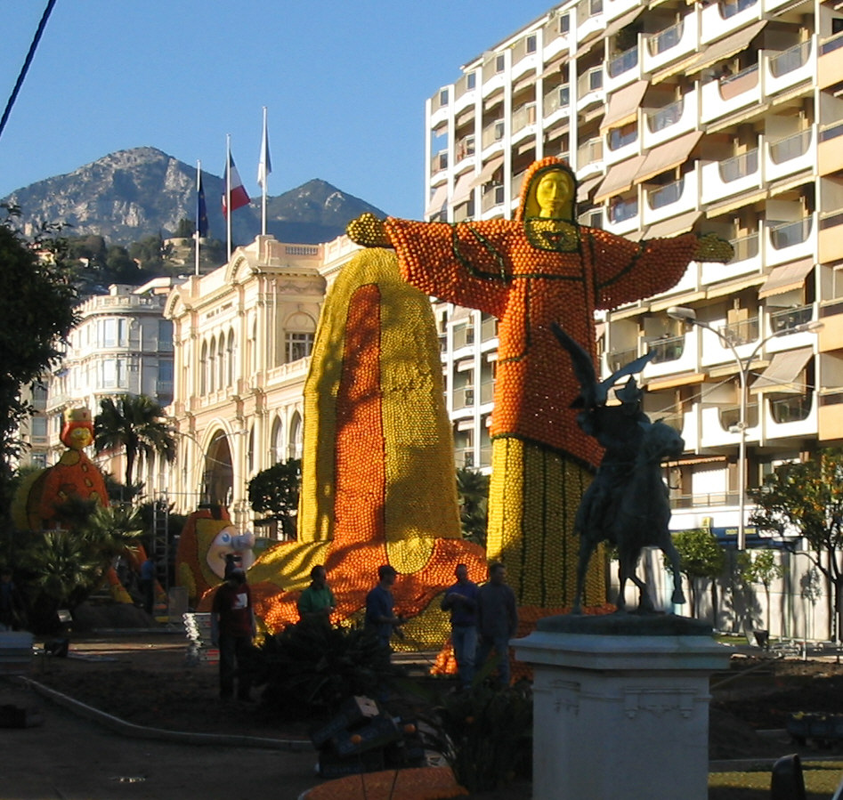
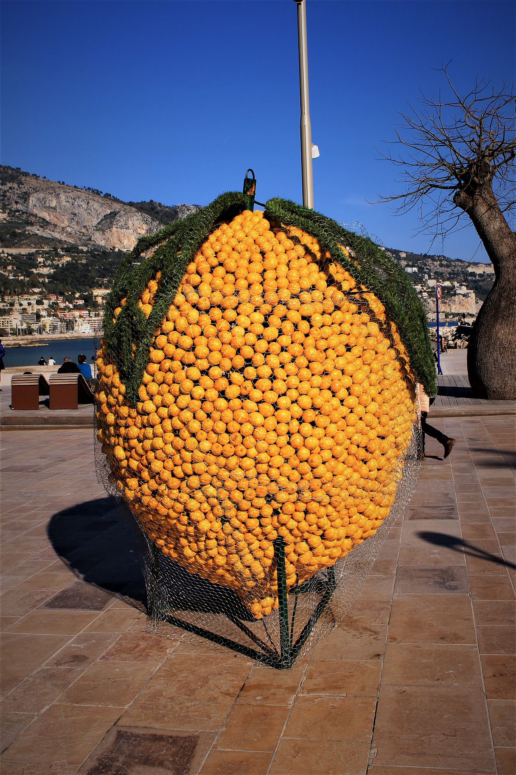
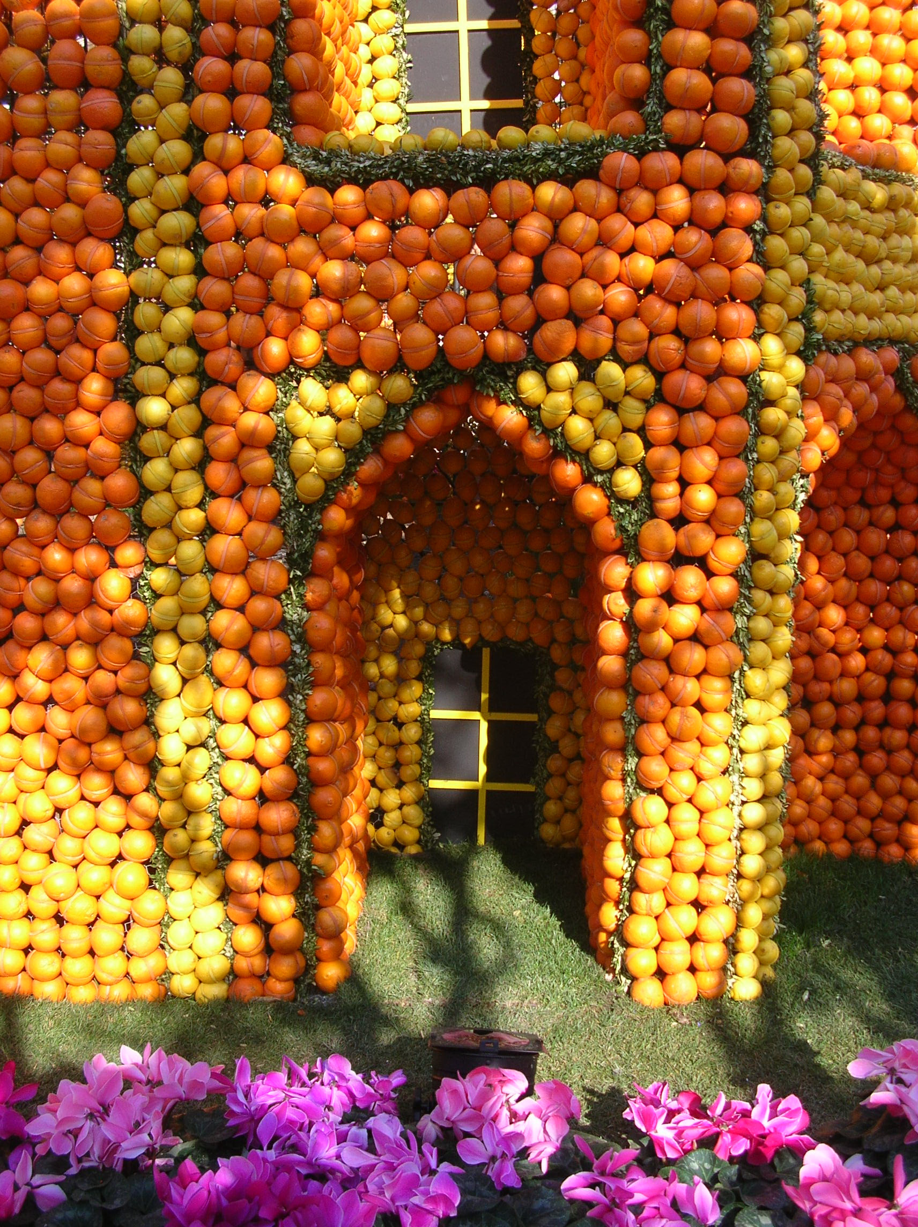
Term 1 week 4
Saying what I and others do
4
Rouge term 2
écrire
Écris des phrases.
1
The head is big.
4
The boy is short.
La tête est grande.
________________________.
2
The person is tall.
5
The fruit is small.
_______________________.
________________________.
3
The house is small.
6
The celebration is big.
_______________________.
________________________.
écrire
Écris en français. Can you get at least 15 points?
vocabulaire
 | (the) photo | (the) table | or
 | (the) pet, animal | (the) dog | (the) cat
 | he has | she has | what
 | with | every day | I have
 | to sing, singing | to use, using | easy
 | (the) boy | of | to repeat, repeating
 | (the) party, celebration | (the) girl | (the) fruit
x3
x2
x1
17

Slide 20
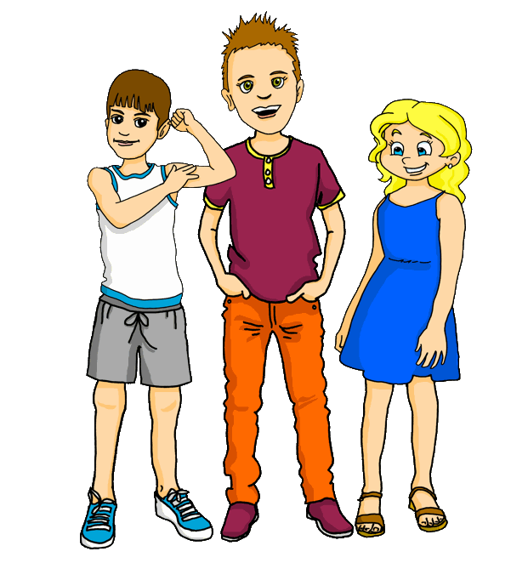
Term 1 week 5
Saying what I and others do
5
Rouge term 2
🎯
prononcer
Using possessives ‘my’ and ‘your’ to talk belongings
Talking about activities in the present
[è]
[é|er]
[e]
frère
répéter
cheval
écouter
Écoute et complète les noms.
C’est [é], [è], ou [e] ?
1 | O c __ a n e
2 | R __ n __
3 | F r __ d __ r i c
4 | M y l __ n e
5 | S t __ p h a n e
6 | F i d __ l e
lire
Write down the key language for this week.
passer |  | le déjeuner |  | l’amie
manger |  | le weekend |  | mon, ma
voici |  | l’ami |  | ton, ta
Saying ‘my’ and ‘your’
grammaire
We know that all French nouns have gender (masculine and feminine) and different words for ‘a’ and ‘the’. There are also different words for ‘my’ and ‘your’:
mon frère
➜
my brother
ma sœur
➜
my sister
ton chien
➜
your dog
ta famille
➜
your family
écouter
C’est quoi ?
masculine
feminine
1 | Voici ton… | chat | peluche
2 |  | film | chanson
3 |  | crayon | règle
4 |  | livre | gomme
5 |  | chapeau | famille
6 |  | uniforme | bouteille
18

Slide 21
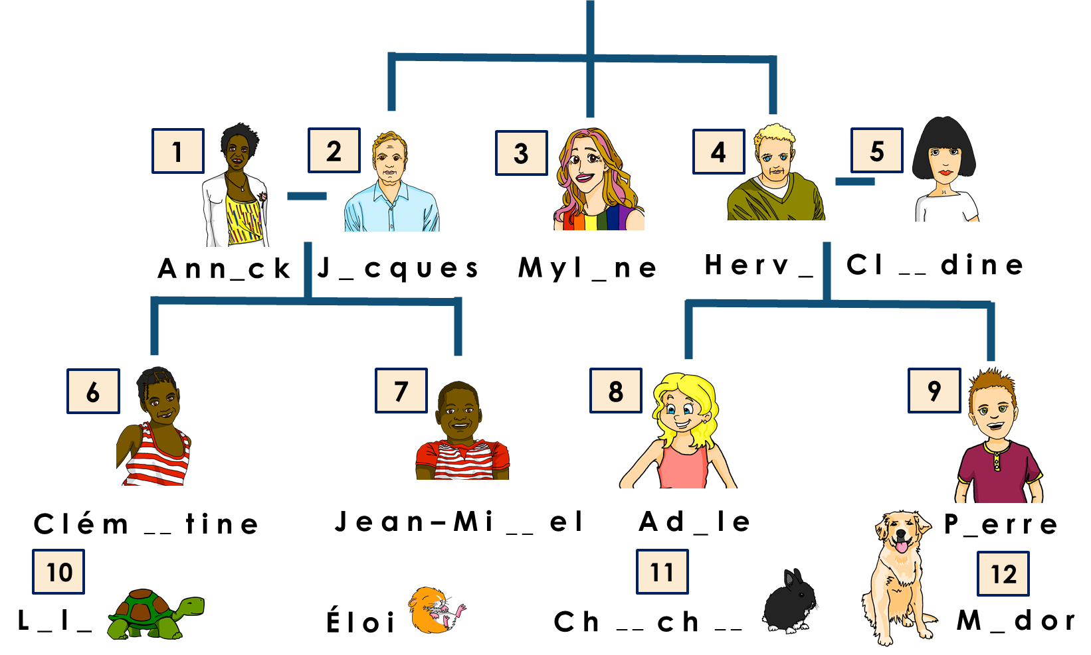
Term 1 week 5
Saying what I and others do
5
Rouge term 2
qui ? = who?
lire
C’est qui ? Who is it?
1
2
 | mère | frère
1
2
3
4
3
4
 | père | sœur
5
6
7
8
5
6
7
8
écouter
Complète la famille Kergosien.
Translating the French present tense into English
grammaire
➜
In French there is one way to talk about things in the present. In English there are two ways:
Ma mère regarde un film chaque weekend.
We use the simple present for regular, repeated actions.
My mum watches a film every weekend.
Ma mère regarde un film maintenant.
We use the continuous present for ongoing actions.
My mum is watching a film now.
19

Slide 22
Term 1 week 5
Saying what I and others do
5
Rouge term 2
lire
What is Pierre saying to his sister about what is happening at the moment?
1
Tu regardes les parades à la fête de Menton.
You are watching the parades at the Menton festival.
2
Papa prépare le déjeuner à la maison.
_____________________________________________________
3
Tu manges un fruit à la fête ?
_______________________________________________
4
Elle porte a chapeau à la fête ?
_______________________________________________
Je suis le cousin de Pierre !
5
Tu donnes un cadeau à ton frère ?
_______________________________________________
écouter
Écris en anglais.
 | en anglais
1 | I’m ______________ a film on _________________
2 | Mylène is __________________ the weekend with _________ __________.
3 | Médor is eating __________ ________________!
4 | Dad is ________________ lunch at the _____________.
5 | I’m listening to a _______________ ________________on the radio.
lire
Écris en anglais. Can you get at least 15 points?
 | le chat | la table | quoi ?
 | répéter | chanter | ou
 | avec | tous les jours | facile
 | ton | ta | utiliser
 | l’amie | mon | ma
 | le déjeuner | le weekend | l’ami
 | passer | manger | voici
vocabulaire
x3
x2
x1
20

Slide 23
Term 1 week 5
Saying what I and others do
5
Rouge term 2
lire
Écris en anglais.
to eat, eating
écrire
Écris en français.
1
____ _________ le samedi avec _______ famille.
She is spending Saturday with my family.
2
___ __________ un fruit _______ ______ _________.
He eats a fruit every day.
3
Tu donnes _____ déjeuner à _____ chien.
You give your lunch to my dog.
4
___ ____________ un film avec ______ amie.
I am watching a film with my friend (f).
5
_____ ____________ le weekend _____ la maison.
You are spending the weekend at the house.
écrire
Écris en français. Can you get at least 15 points?
 | (the) cat | (the) table | what?
 | to sing, singing | to repeat, repeating | or
 | with | every day | easy
 | your (m) | your (f) | to use, using
 | (the) friend (f) | my (m) | my (f)
 | (the) lunch | (the) weekend | (the) friend (m)
 | to eat, eating | to pass, spend (time) | here is, this is
vocabulaire
x3
x2
x1
21

Slide 24
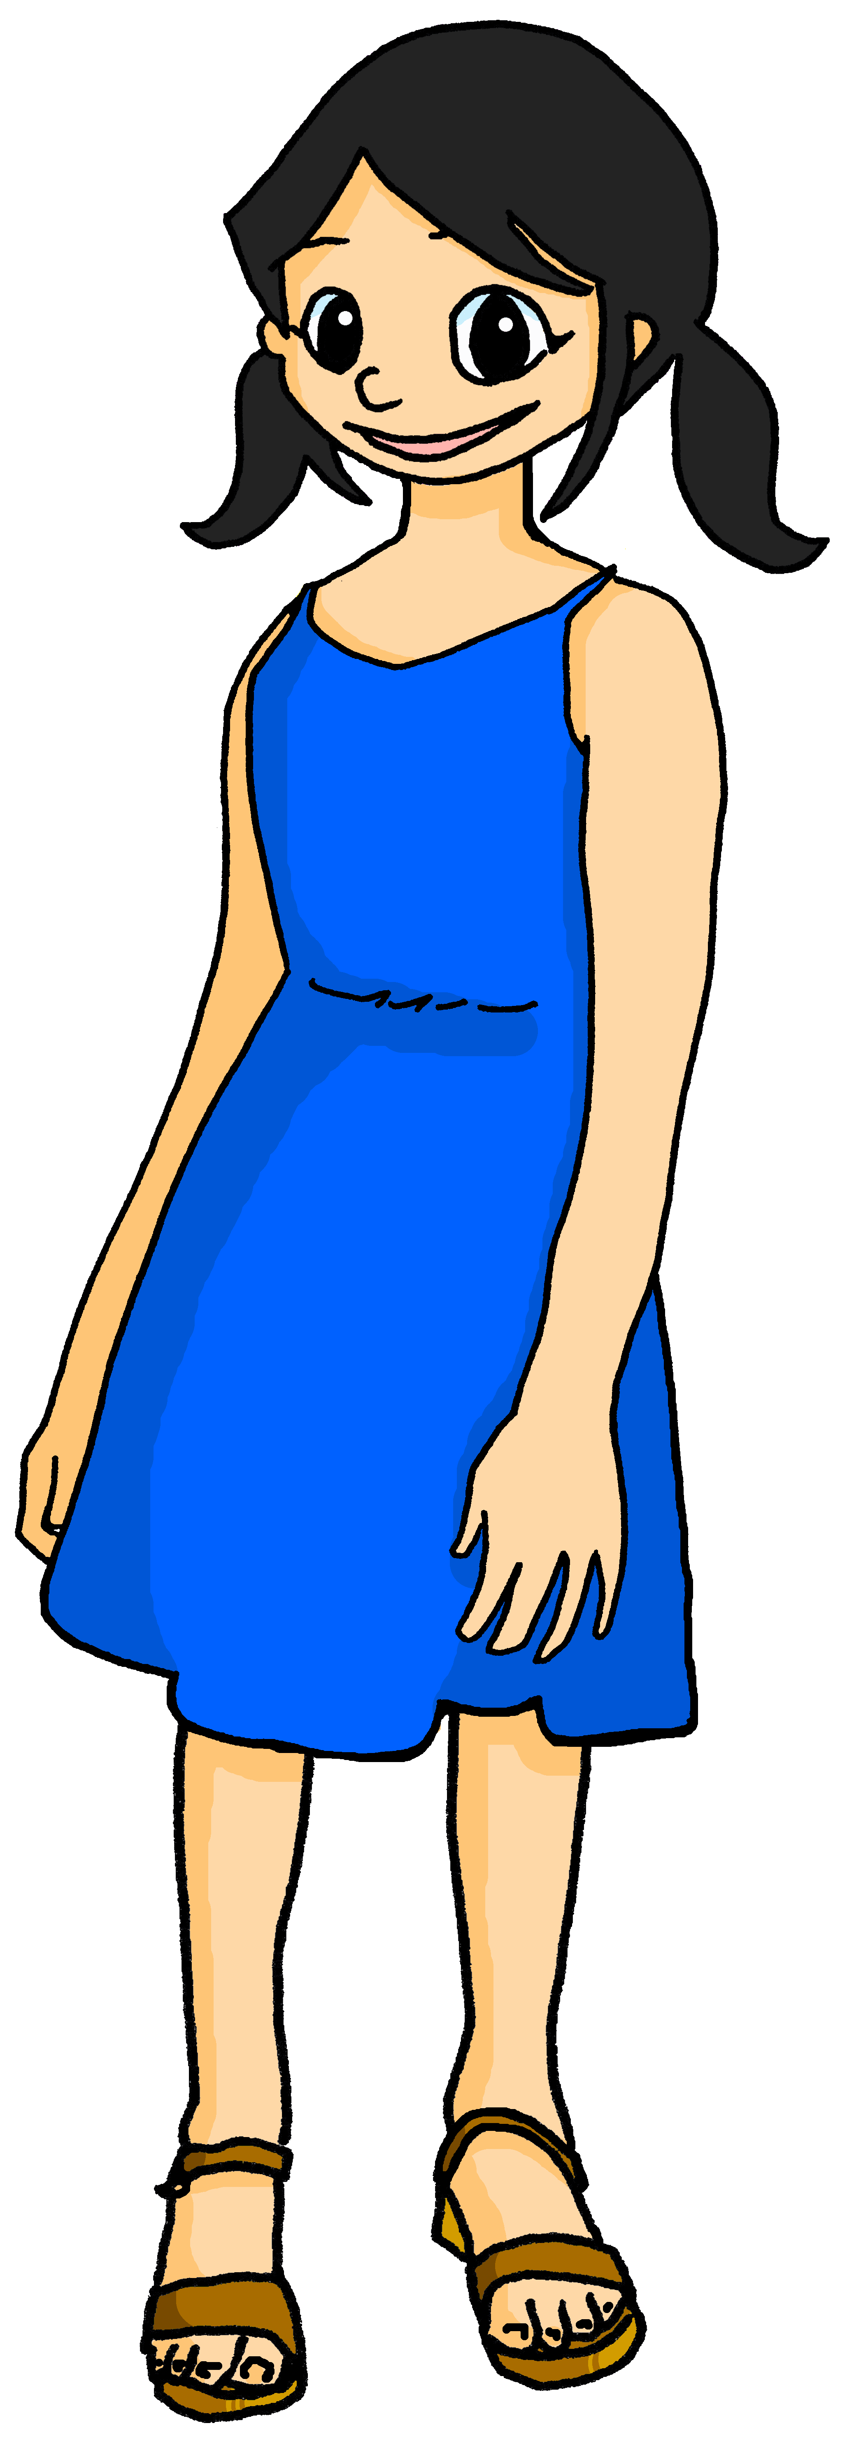
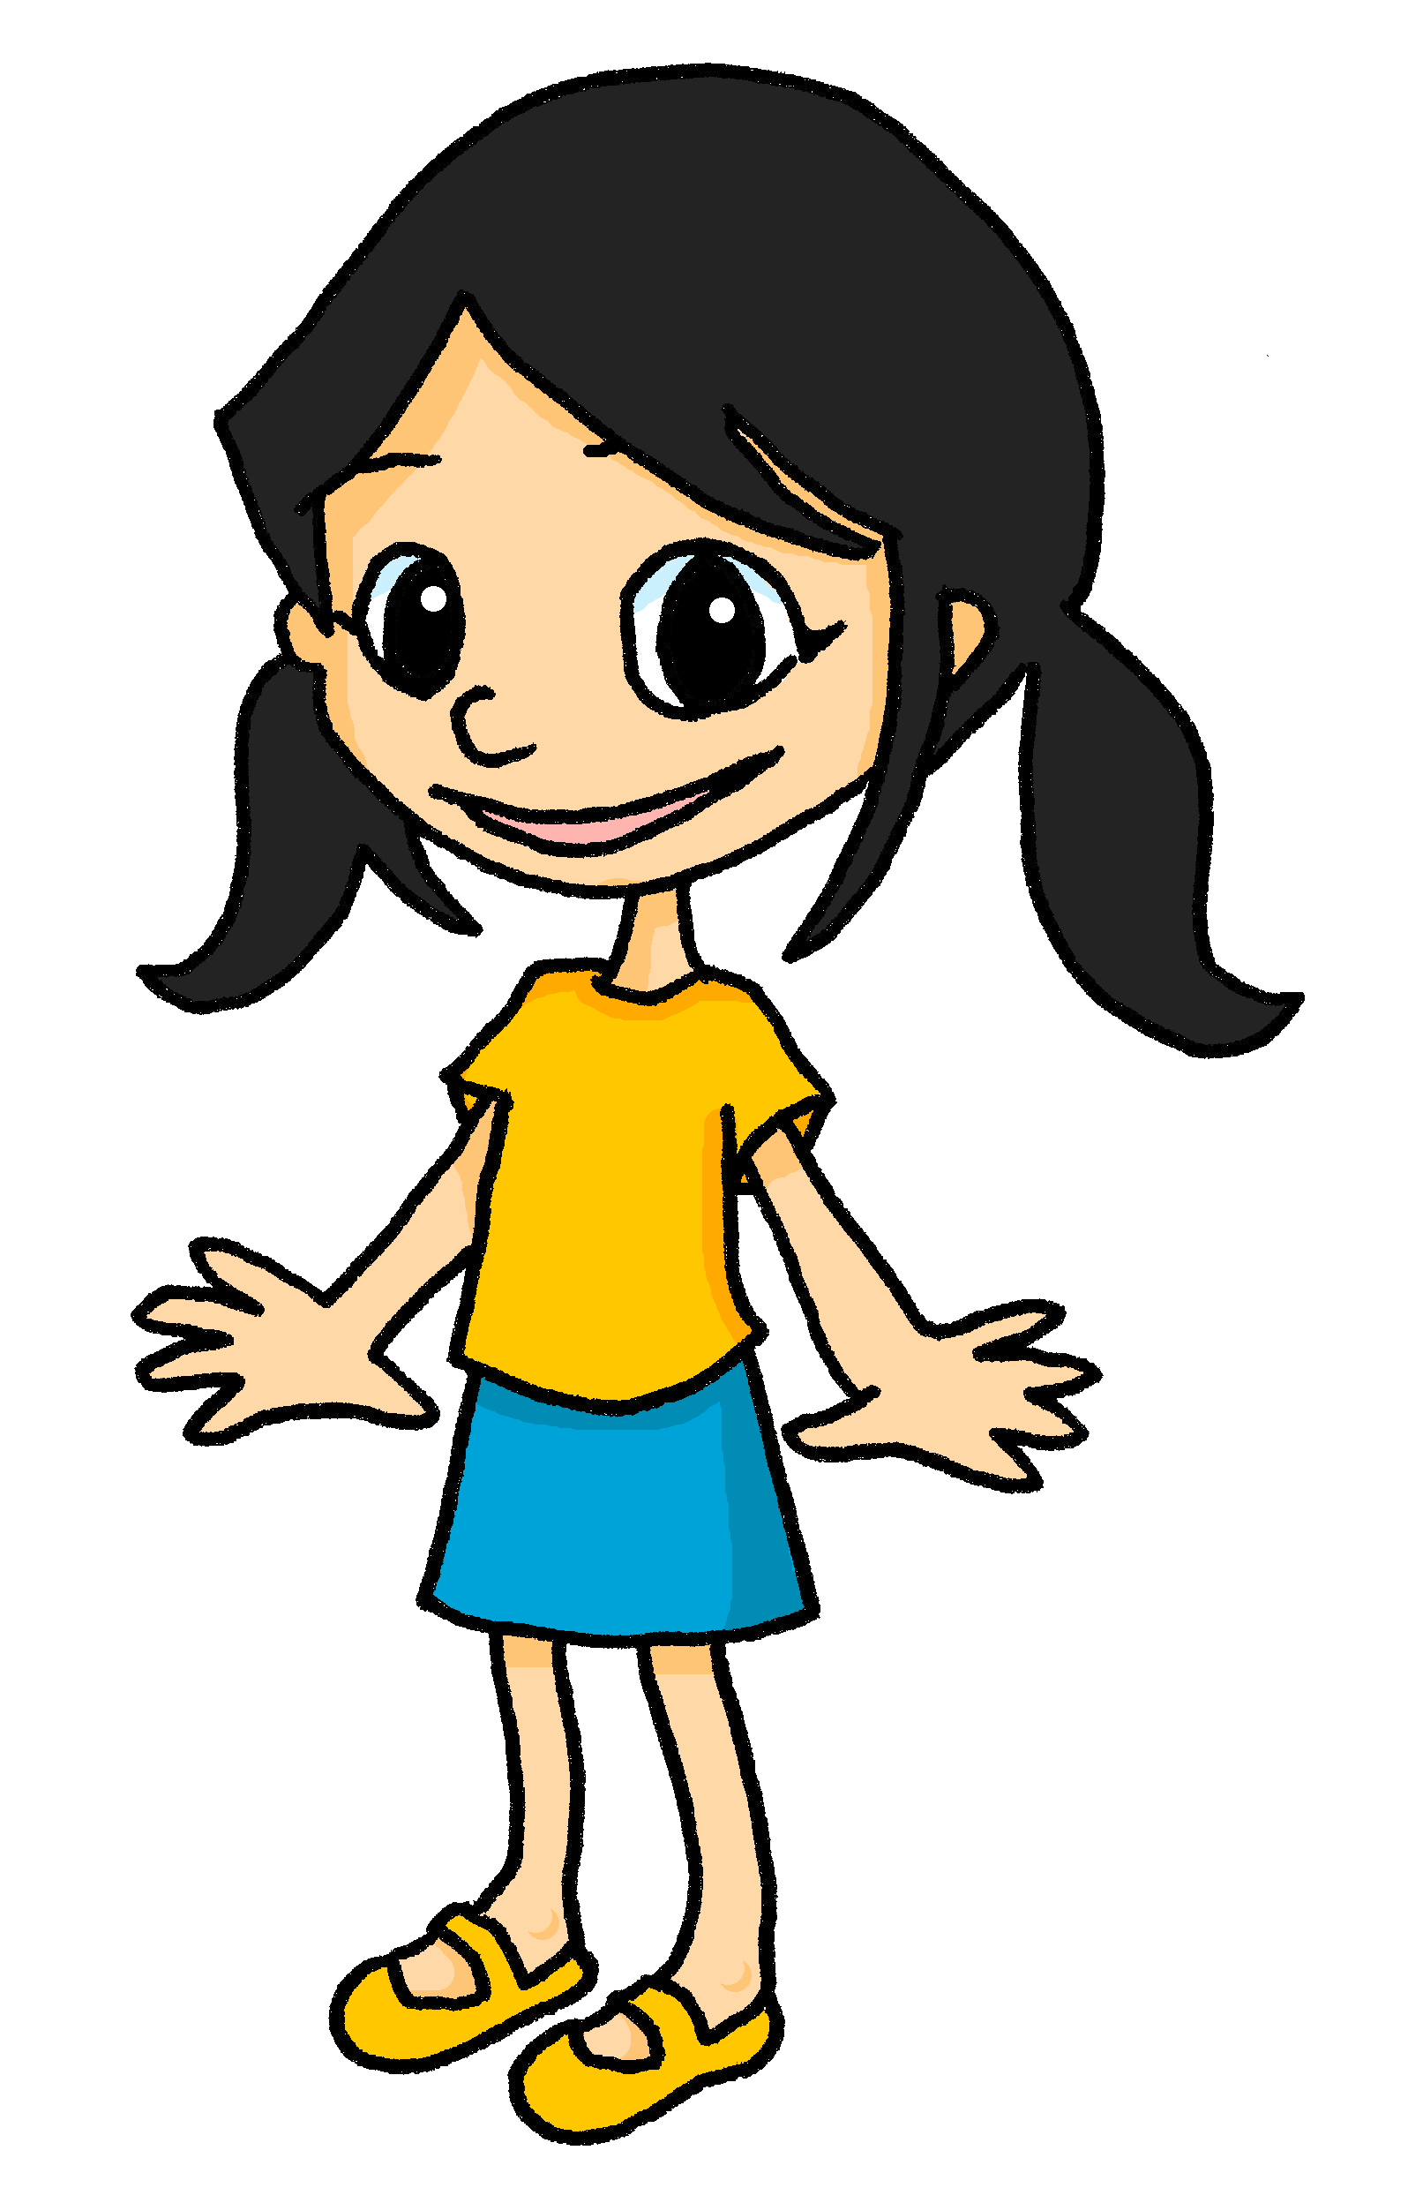
Term 1 week 6
Saying what I and others like
6
Rouge term 2
🎯
prononcer
Eugénie et Léa
Using ‘mon, ma’ and ‘ton, ta’
Using ‘à’ to mean ‘to’, ‘at’ ‘in’
[ai]
vrai
lire
Write down the key language for this week.
aimer |  | l’école
aider |  | à
habiter |  | aussi
Saying ‘my’ and ‘your’
grammaire
We know to use mon, ton for masculine and ma, ta for feminine nouns. However, when any noun starts with a vowel, remember to use mon and ton:
masculine
feminine
mon ami
➜
my male friend
mon amie
➜
my female friend
ton hôtel
➜
your hotel
ton école
➜
your school
lire
C’est ‘le/l’’ ou ‘la/l’ ?
fille
photo
école
le, l’
ballon
garçon
la, l’
cahier
bouteille
table
chat
stylo
peluche
animal
sac
jeu
chanson
livre
cadeau
règle
gomme
maison
22

Slide 25
Term 1 week 6
Saying what I and others like
6
Rouge term 2
écouter
Eugénie aime quoi exactement ?
 | A ou B | A ou B
1 | sac | bouteille | peluche | chat
2 | jeu | chanson | photo | livre
3 | table | cadeau | ballon | règle
4 | stylo | banane | gomme | cahier
5 | école | maison | garçon | fille
1. bag, cat
2.
3.
4.
5.
Meanings of ‘à’
grammaire
à can mean ‘to’, ‘at’ and ‘in’ with town and city names:
Je donne un cadeau à Léa.
➜
I give a present to Léa.
J’aide mon père à la maison.
➜
I help my dad at the house/home.
J’habite à Lorient.
➜
I live in Lorient.
lire
Adèle décrit Léa ou Yves ?
Léa | Yves
1.
2.
3.
4.
5.
6.
7.
8.
1
Voici mon ami.
à
2
Il habite à Lorient.
[at]
Il aide la professeure à l’école.
3
à
[__]
4
Elle est intelligente et amusante.
à
5
Elle aide à la maison chaque jour.
[__]
à
6
Le weekend, il est à Paris.
[__]
Elle passe le weekend à Lorient avec moi.
7
à
[__]
8
Je parle à mon amie tous les jours.
à
[__]
Write your favourite words in French, here.
Write your favourite words in French, here.
vocabulaire
23

Slide 26
Term 1 week 6
Saying what I and others like
6
Rouge term 2
écouter
Le verbe correct, c’est quoi ? Écris en français et en anglais.
1
Elle __________ ton sac.
‘ai’ ((i) have), ‘aime’ (like) and ‘aide’ (help) sound similar. What is Léa saying?
She likes your bag.
2
J’__________ ma professeure.
_________________________________________________.
3
J’_______ un stylo et j’ _________ aussi une gomme.
_________________________________________________.
4
Tu ____________ ton père à la maison.
_________________________________________________.
5
Tu _______________ ton école.
_________________________________________________.
6
Il _______________ aussi à la maison.
_________________________________________________.
lire
Écris en anglais. Can you get at least 15 points?
 | moi | toi | parfait
 | le cadeau | le gâteau | pour
 | la sœur | le père | la mère
 | préparer | la famille | le frère
 | donner | trouver | parler
 | l’école (f) | à | aussi
 | habiter | aimer | aider
vocabulaire
x3
x2
x1
24

Slide 27
Term 1 week 6
Saying what I and others like
6
Rouge term 2
Position of aussi (also, too)
grammaire
In English we use ‘also’ between the subject and verb; in French, use aussi after the verb:
He also helps at home.
➜
Il aide aussi à la maison.
If aussi is at the end of a sentence, we translate it as ‘too’ in English:
He helps at home, too.
➜
Il aide à la maison, aussi.
écrire
1
J’aime le livre ____________________________________.
I like the book and I also like the film.
2
J’habite à Lorient ______________________________________.
I live in Lorient and she also lives here.
3
Il a une sœur _______________________________.
He has a sister and he also has a dog.
4
J’utilise un stylo ________________________________.
I use a pen and you also use a pen.
5
Tu portes un uniforme ___________________________________.
You wear a uniform and she also wears a uniform.
écrire
Écris en français. Can you get at least 15 points?
 | me (e.g. for me) | you (e.g. for you) | perfect (m)
 | (the) present | (the) cake | for
 | (the) sister | (the) father | (the) mother
 | to prepare, preparing | (the) family | (the) brother
 | to give, giving | to find, finding | to speak, speaking
 | (the) school | in, at, to | also, too
 | to live, living | to like, liking | to help, helping
vocabulaire
x3
x2
x1
25

Slide 28
Term 1 week 7
Saying what I and others like
7
Rouge term 2
🎯
prononcer
Talking about liking and preferring
[oi]
(to see, seeing)
voir
lire
Write down the key language for this week.
préférer |  | dans
la ville |  | en ce moment
le village
Translating the French present tense into English
grammaire
Remember, English has two present tense forms but French has one:
Tu écoutes une chanson tous les jours.
This form is for regular, repeated actions.
You listen to a song every day.
Tu écoutes une chanson en ce moment.
This form is for something happening now.
You are listening to a song at the moment.
lire
Help Pierre with his English homework by choosing the correct adverb.
1. I sing…
2. Max is playing football…
3. You speak English…
4. She is listening to a song…
5. I am helping…
at the moment. | every week.
at the moment. | every week.
at the moment. | every week.
at the moment. | every week.
at the moment. | every week.
26

Slide 29
Term 1 week 7
Saying what I and others like
7
Rouge term 2
Pierre needs more help!
Term 1 week 7
écouter
Le verbe correct en anglais, c’est quoi ?
1
You help|are helping your sister.
2
I prepare|am preparing my bag.
If you hear tous les jours (every day) use the simple present.
3
I use|am using a pen.
4
He eats|is eating a sandwich.
5
She watches|is watching a film.
If you hear en ce moment use the continuous (-ing) present.
6
You repeat|are repeating a phrase.
7
She lives|is living in a town.
Verbs of opinion
grammaire
Opinion verbs usually translate into the simple present in English:
J’aime la ville mais je préfère le village.
Note that aussi goes after the verb.
I like the town but I prefer the village.
Il aime la semaine et il aime aussi le weekend.
écouter
Le mot avec le son [oi], c’est A ou B ?
1 | A
2
3
4
5
6
lire
Écris en anglais. Can you get at least 15 points?
 | dimanche | jeudi | mardi
 | lundi | mercredi | vendredi
 | de | le jour | chaque
 | le garçon | la fête | le fruit
 | dans | en ce moment | la fille
 | préférer | la ville | le village
vocabulaire
x3
x2
x1
27

Slide 30
Term 1 week 7
Saying what I and others like
7
Rouge term 2
écouter
A. Choose the correct article and word. B. Write the correct word.
E
1
2
3
4
5
my | your | a | the
bottle | book
the | my
___ ________ | ma mère
le village | ___ ________
___ ________ | mon déjeuner
___ ________ | ma famille
le weekend | ___ ________
la ville | ___ ________
my | your | a | the
banana | fruit
my | your | a | the
boy | sister
my | your | a | the
day | party
my | your | a | the
brother | house
my | your | a | the
mum | dad
écrire
Écris en français.
1
J’aide ma mère ____________________________________.
I help my mum but he helps the teacher.
2
Je chante à l’école ______________________________________.
I sing at school and I also sing at the house/at home.
3
Il habite à Londres _______________________________.
He lives in London but he prefers Paris.
4
Tu aimes l’école ________________________________.
You like school but I prefer the weekend.
5
Elle prépare la fête ___________________________________.
She is preparing the party and she is also talking to mum.
écrire
Écris en français. Can you get at least 15 points?
 | Sunday | Thursday | Tuesday
 | Monday | Wednesday | Friday
 | from, of | (the) day | each, every
 | (the) boy | (the) party, celebration | (the) fruit
 | in | at the moment | (the) girl
 | to prefer, preferring | (the) town | (the) village
vocabulaire
x3
x2
x1
28

Slide 31
Term 1 week 8
Saying how many and describing things
8
Rouge term 2
🎯
prononcer
When an ‘x’ or ‘s’ is followed by a vowel you often pronounce it.
This is called liaison.
Using ‘il y a’ to say how many there are
[liaison-x]
[liaison-s]
deux uniformes
trois oranges
lire
Write down the key language for this week.
un |  | six |  | il y a
deux |  | sept
trois |  | huit
quatre |  | neuf
cinq |  | dix
Il y a (there is/there are)
grammaire
Il y a un village.
➜
There is a/one village.
Il y a deux villages.
➜
There are two villages.
⚠ il a = he has il y a = there is, there are
écouter
Does Adèle say what Pierre (he) has or what there is?
 | [he has] | [there is/there are] | [nombre ?]
1 |  |  | 1
2
3
4
5
6
29

Slide 32
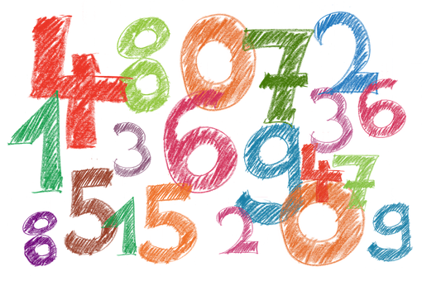
Term 1 week 8
Saying how many and describing things
8
Rouge term 2
lire
Lis les phrases et decide. Identifie le mot correct.
Il a un ballons.| ballon.
Il y a sept fruits. | fruit.
Il y a un uniforme. | uniformes.
Il a trois photo. | photos.
Il y a deux crayon. | crayons.
Il a cinq livres.| livre.
How many items does Pierre have in total?
Does Pierre himself have anything to eat?
b. What can Pierre do?
c. Would you prefer to have what Pierre has or what is lying round the house?
écouter
Bingo ! Écris six nombres.
lire
Écris en anglais. Can you get at least 15 points?
 | le chat | la table | quoi ?
 | répéter | chanter | ou
 | avec | tous les jours | facile
 | ton | ta | utiliser
 | l’amie | mon | ma
 | le déjeuner | le weekend | l’ami
 | passer | manger | voici
vocabulaire
x3
x2
x1
30

Slide 33
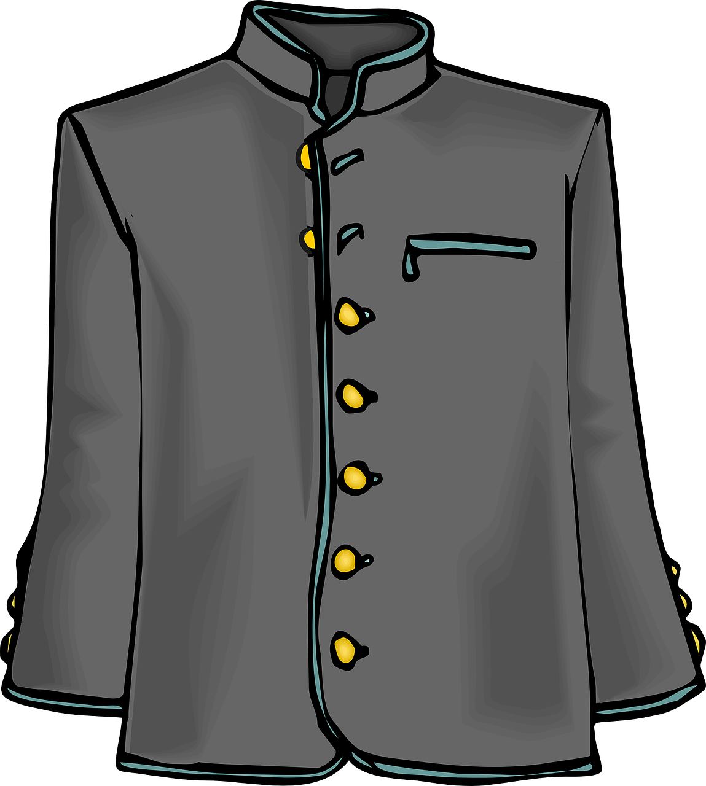
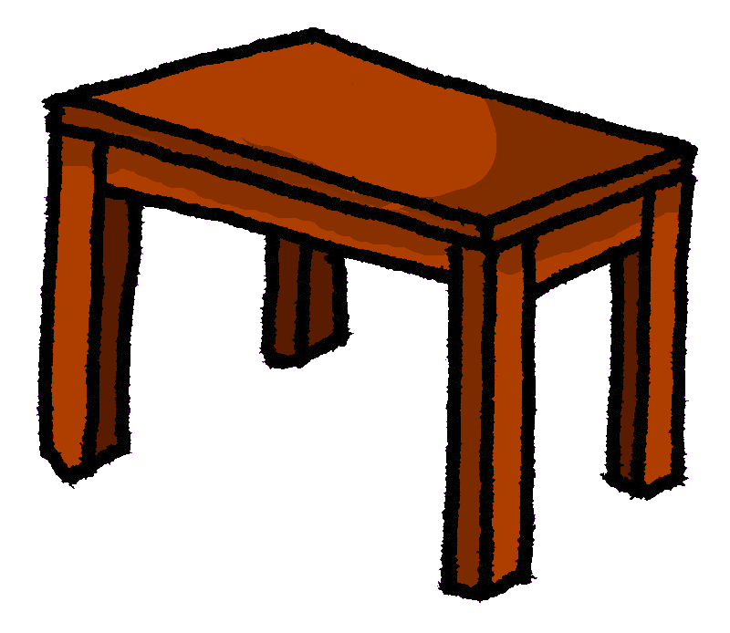
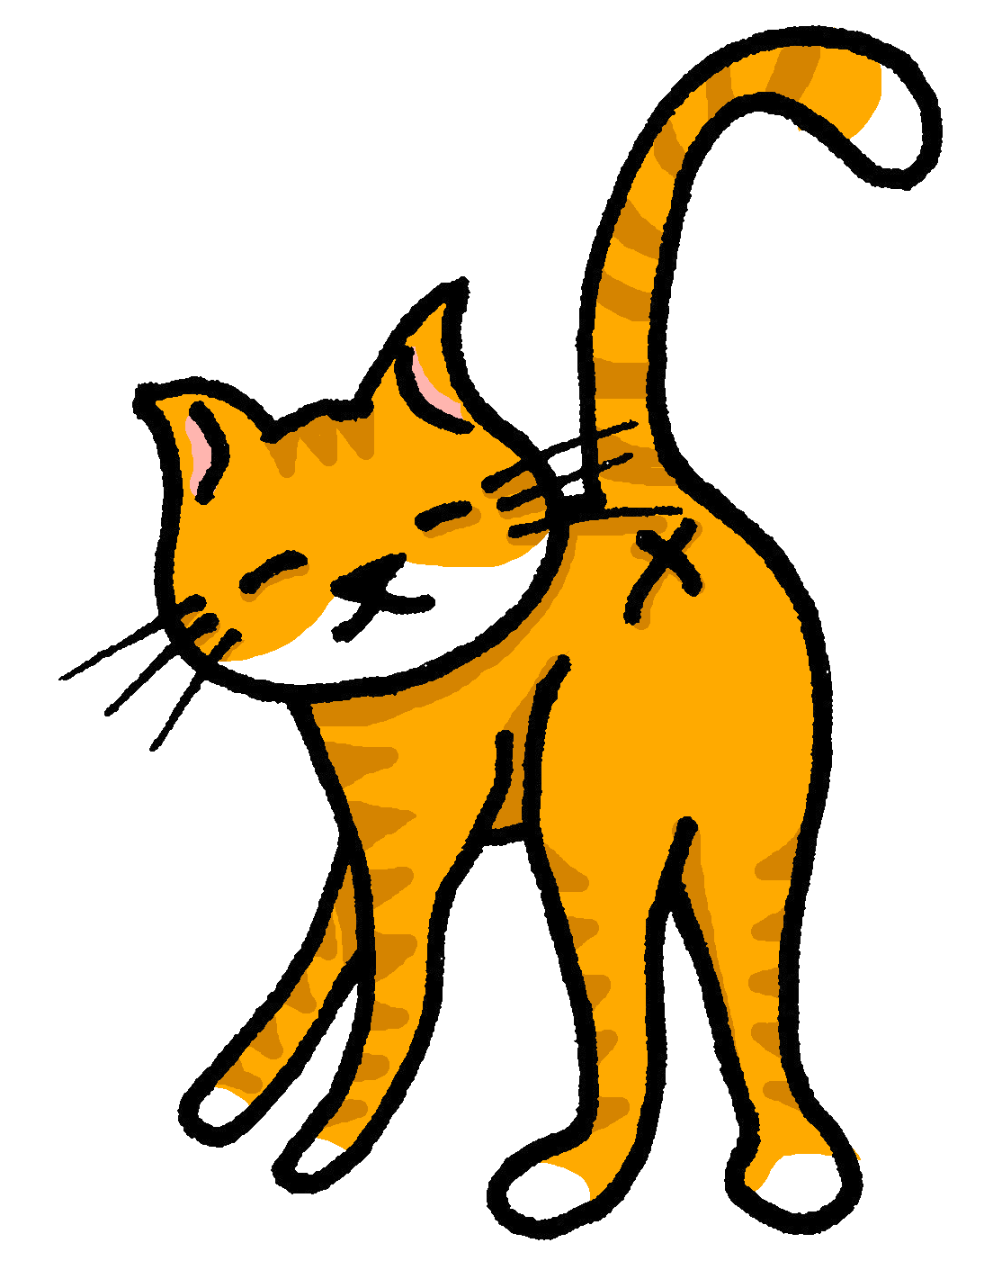
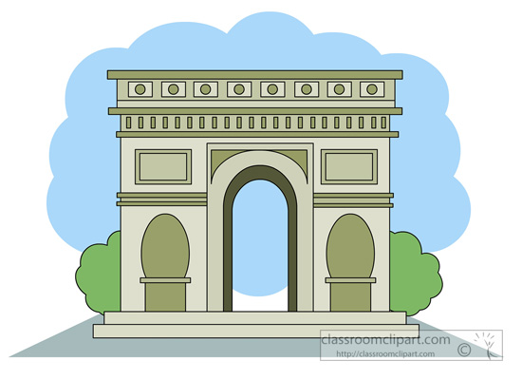
Term 1 week 8
Saying how many and describing things
8
Rouge term 2
écouter
A. La phrase correcte, c’est quoi ?
B. Trouve l’image correcte et écris le nombre.
 | A | B
1 | He has… | There are…
2 | You have… | She has…
3 | There are… | He has…
4 | I have… | You have…
5 | There are… | He has…
6 | There are… | There is…
A | B
C | D
E | F
3
écrire
Écris en français.
t r o i s | _ _ _ _ | _ _ _ | _ _ _ _ | _ _ _
_ _ _ | _ _ _ _ _ _ | _ _ _ _ | _ _ _ _ | _ _ _ _
écouter
Écris en anglais.
1 | There is a/one table.
2
3
4
5
6
7
8
écrire
Écris en français. Can you get at least 15 points?
 | your (m) | your (f) | here is, this is
 | my (f) | my (m) | (the) lunch
 | (the) friend (f) | to pass, spend (time) | to eat, eating
 | three | a/an, one (m), (f) | two
 | twelve | five | eleven
 | seven | nine | four
 | there is, there are | ten | eight
vocabulaire
x3
x2
x1
31

Slide 34
Term 1 week 9
Saying how many and describing things
9
Rouge term 2
🎯
prononcer
écouter
Identifie les mots.
Using ‘des’ to mean ‘some’
[(a)in]
A | 10
B
C
D
E
F
train
lire
Write down the key language for this week.
la chose |  | combien ?
des
vocabulaire
des (some)
grammaire
To mean ‘a/an’, use either un or une:
Il y a un cahier.
Il y a une bouteille.
➜
There is an exercise book.
➜
There is a bottle.
To mean ‘some’, use des with all nouns:
Il y a des bouteilles.
Il y a des cahiers.
➜
There are some exercise books.
➜
There are some bottles.
écouter
Identifie le sac correct. Answer = ______________
A
B
C
Combien de… ? (how many…?)
grammaire
To ask ‘how many’ with a noun, use combien de:
Il y a combien de livres ?
➜
How many books are there?
Il y a trois livres.
➜
There are three books.
32

Slide 35
Term 1 week 9
Saying how many and describing things
9
Rouge term 2
⚠Attention !
There is no punctuation!
lire
C’est une question ou c’est une phrase ?
1 | Il y a ____________ chiens
2 | Il y a ____________ de chats
3 | Il y a ____________ de crayons
4 | Il y a ____________ bouteilles
5 | Il y a ____________ règles
6 | Il y a ____________ de cahiers
écouter
C’est [(a)in] ou [a] ?
[(a)in]
[a]
[(a)in]
[a]
[(a)in]
[a]
1
2
3
4
5
6
7
8
9
écouter
C’est A ou B ? Écris en anglais.
A
B
en anglais
1
some parties/celebrations
2
3
4
5
6
parler
Person A. (Person B – turn to the next page.)
Round 1
Round 2 Write here what your partner says there is/are.
Say there are these things. Il y a…
1. some girls
2. a party/celebration
3. ten dogs
4. some fruit(s)
5. a school
1.
2.
3.
4.
5.
33

Slide 36
Term 1 week 9
Saying how many and describing things
9
Rouge term 2
parler
Person B. (Person A – turn to the previous page.)
Round 1 Write here what your partner says there is/are.
Round 2
Say there are these things. Il y a…
1.
2.
3.
4.
5.
1. five cuddly toys
2. two exercise books
3. some bottles
4. twelve things
5. a boy
écouter
A. Écris ‘one’ ou ‘some’. B. C’est ‘he has’ ou ‘there is/are’ ?
‘a/one’ ou ‘some + ?
1
He has… | There is/are…
He has… | There is/are…
He has… | There is/are…
He has… | There is/are…
He has… | There is/are…
He has… | There is/are…
a sister
2
3
4
5
6
lire
Écris en anglais. Can you get at least 15 points?
 | l’école | aussi | à
 | aider | aimer | habiter
 | cinq | deux | trois
 | sept | douze | neuf
 | quatre | onze | huit
 | Il y a | un | une
 | des | la chose | combien (de)
x3
vocabulaire
x2
x1
34

Slide 37
Term 1 week 9
Saying how many and describing things
9
Rouge term 2
lire
C’est qui ? Adèle (je) ou Pierre (tu) ? Write ‘je’ or ‘tu’ in each gap.
1
___ prépares le déjeuner et ___ trouve le pain pour toi.
4
___ regarde un film
à la maison et ___ regardes des vidéos sur YouTube.
2
___ mange un
sándwich et deux oranges mais ___ manges dix sandwichs !
5
Puis ___ aides
Maman dans le jardin et ___ parle à mon amie sur Whatsapp.
3
___ chantes mal
et ___ répètes toujours des phrases !
6
C’est un weekend normal chez nous!
Pierre
Who is preparing lunch? _____________________________________________________
Who eats two oranges? _____________________________________________________
Who always repeats phrases when they sing? _________________________________
Who is watching a film? _____________________________________________________
Who is talking to a friend? ____________________________________________________
Who is helping in the garden? ________________________________________________
What does Adèle’s last message say? _________________________________________
écrire
Écris en français. Can you get at least 15 points?
 | (the) school | also | to, at, in
 | to help, helping | to like, liking | to live, living
 | five | two | three
 | seven | twelve | nine
 | four | eleven | eight
 | there is/are | a/an, one (m) | a/an, one (f)
 | some | (the) thing | how many
vocabulaire
x3
x2
x1
35

Slide 38
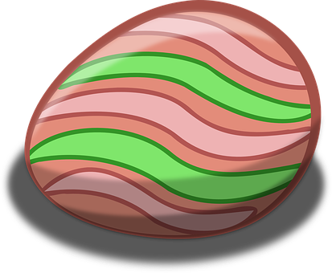
Term 1 week 13
Révision
Rouge term 2
10
11
les œufs 🥚
écrire
Activité 1. Cherche 🔎.
les lapins 🐰
les fleurs 🌷
1 Écris. ✍
Il y a combien d’œufs?
Il y a _____ ___________.
Il y a combien de lapins?
Il y a _____ ___________.
Il y a combine de fleurs ?
Il y a _____ ___________.
lire
Activité 2. Un message
2 Use the eggs to decipher the message:
J
3 Unscramble the English letters to translate the message into English.
pahpy sEtare ➡ _ _ _ _ _ _ _ _ _ _
36

