Slide 1
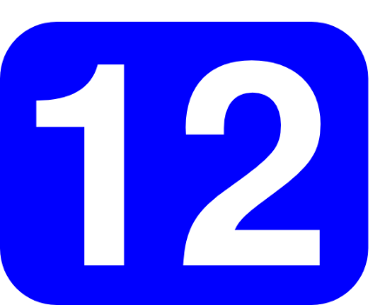
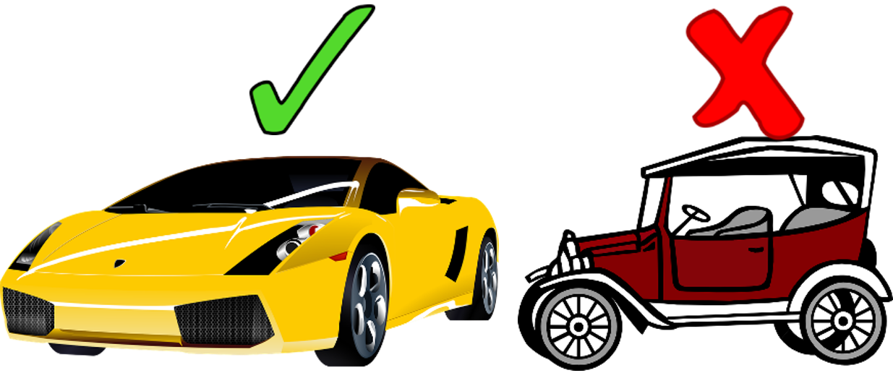
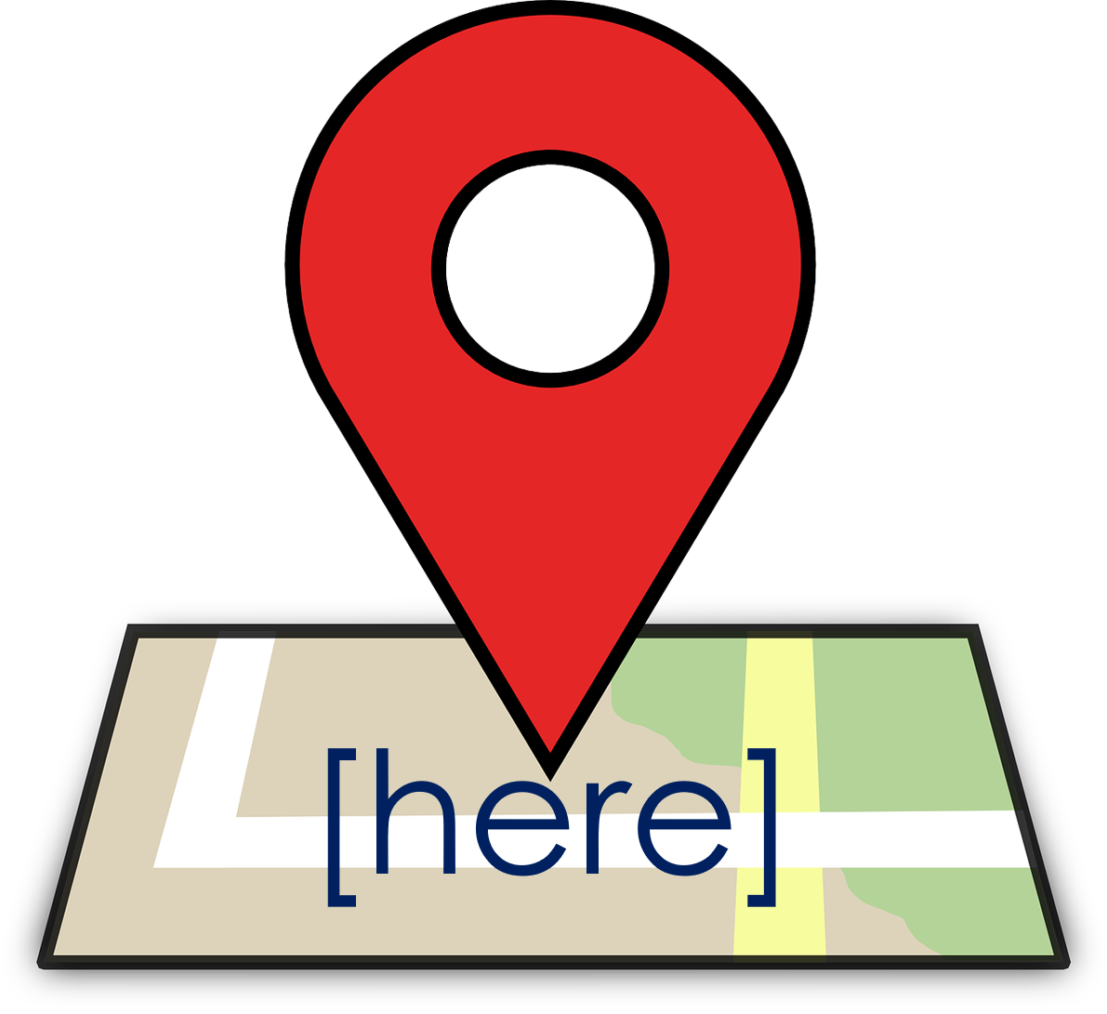
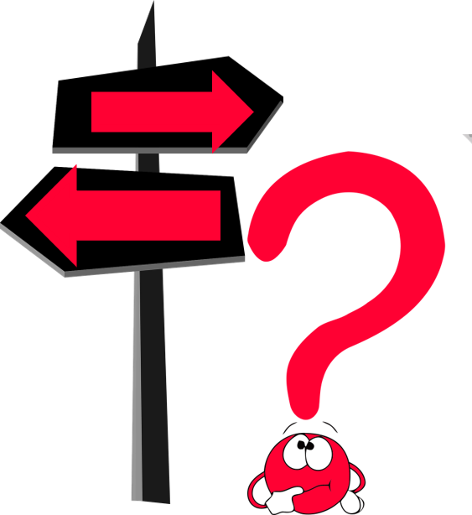
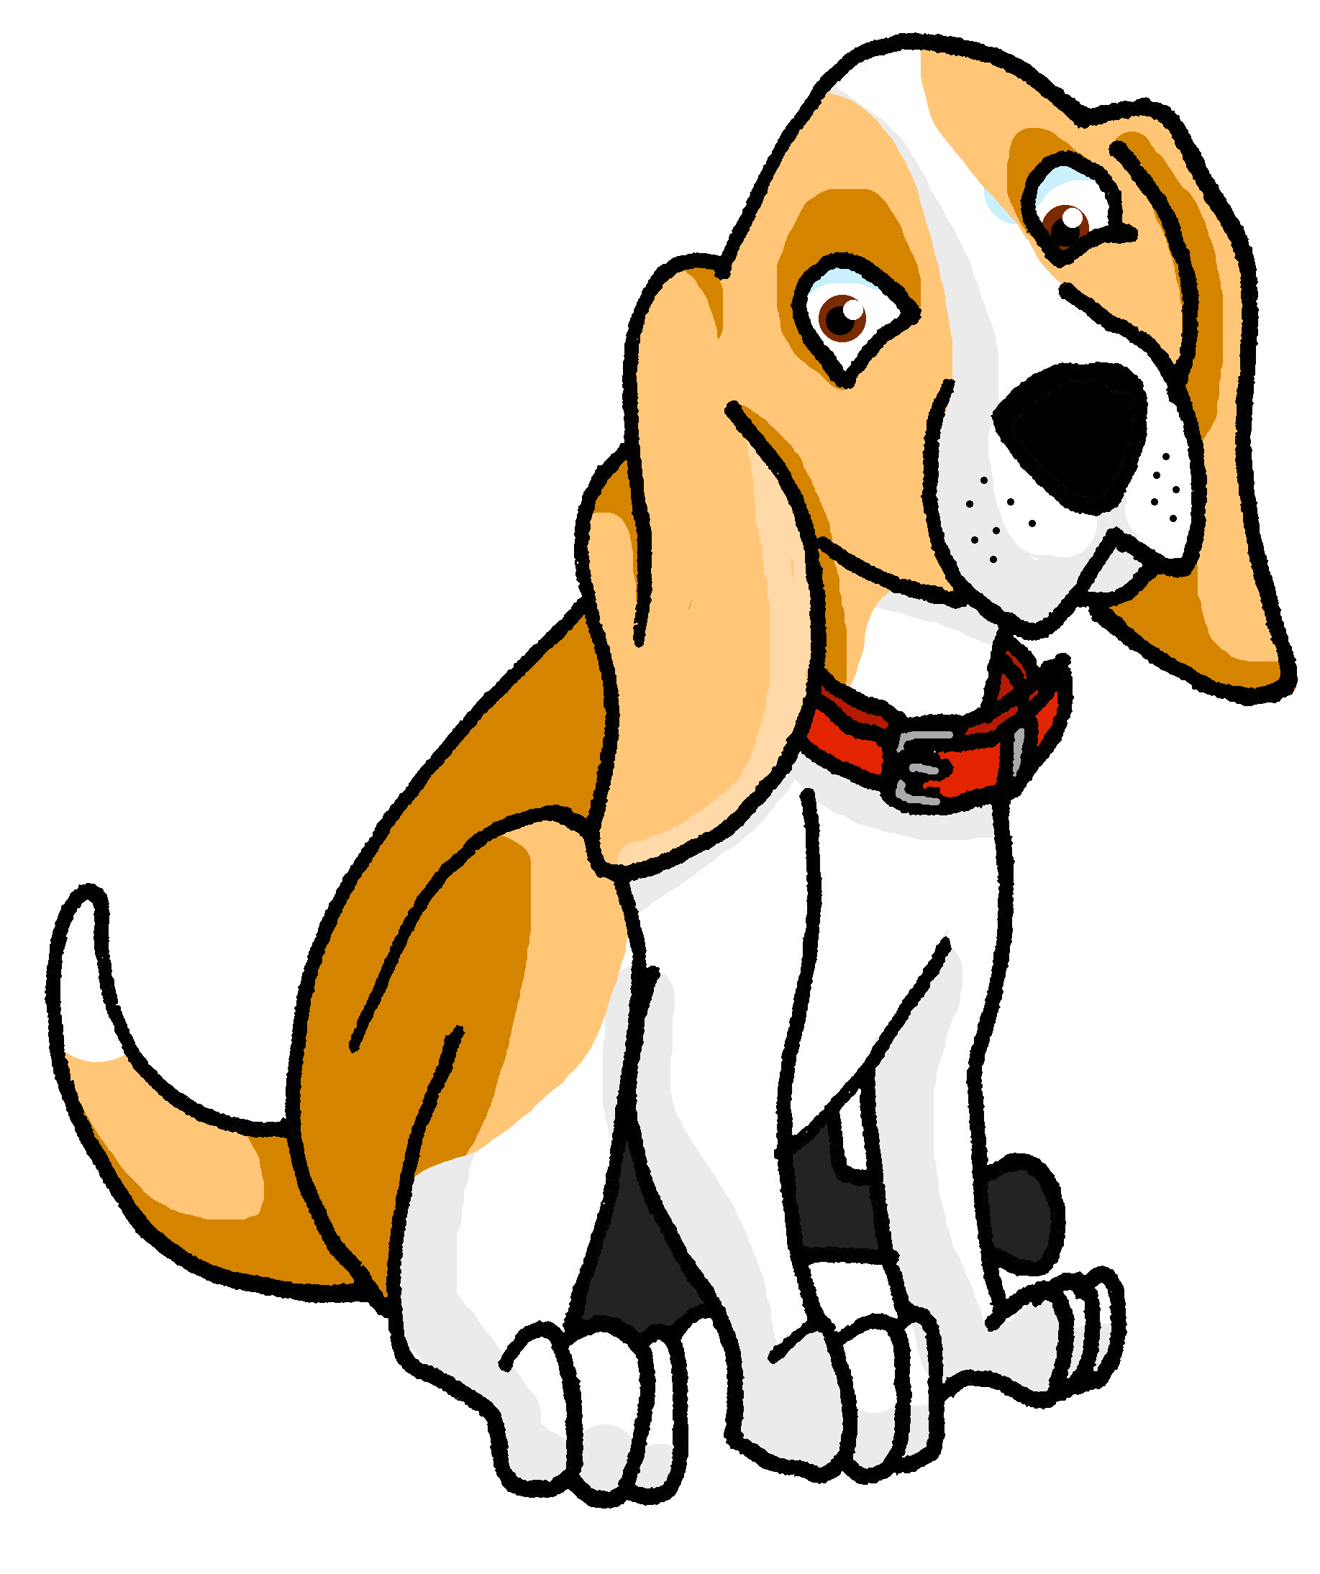
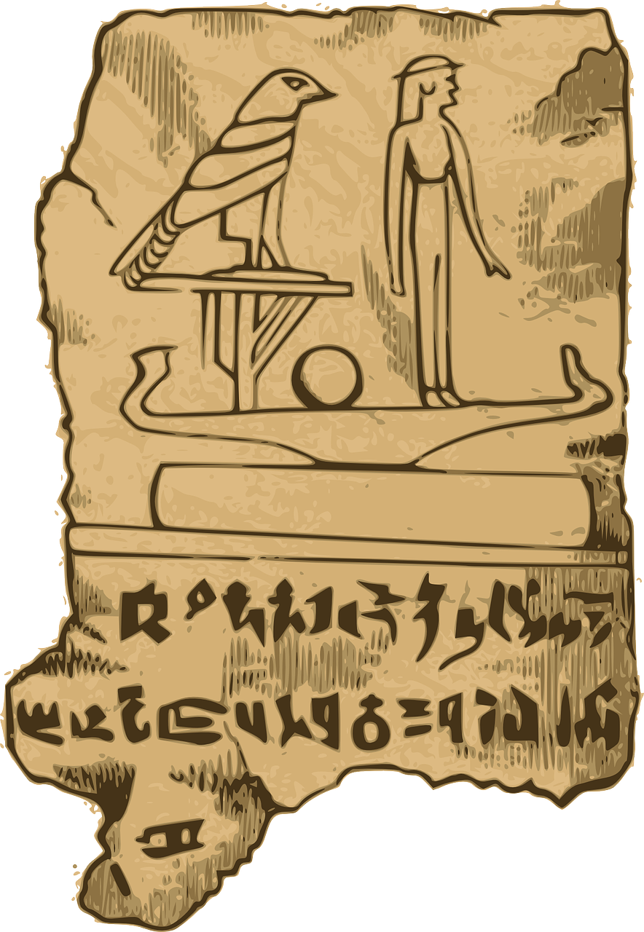
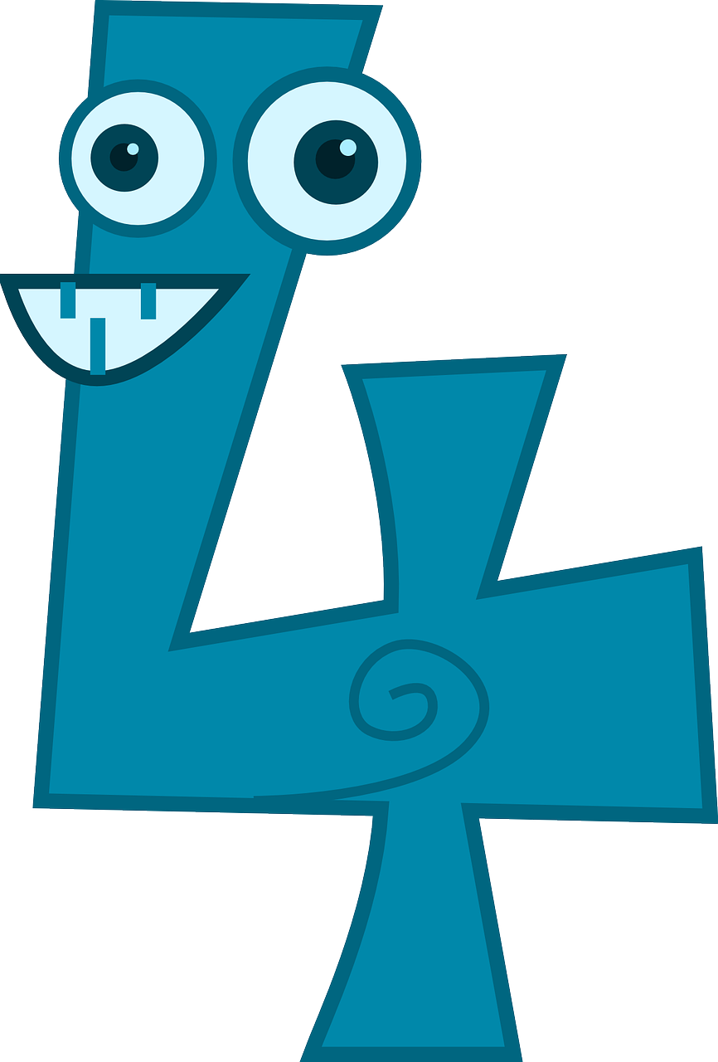
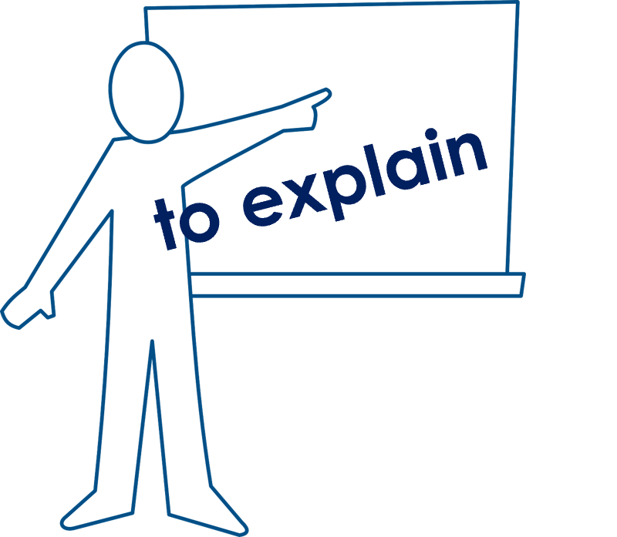
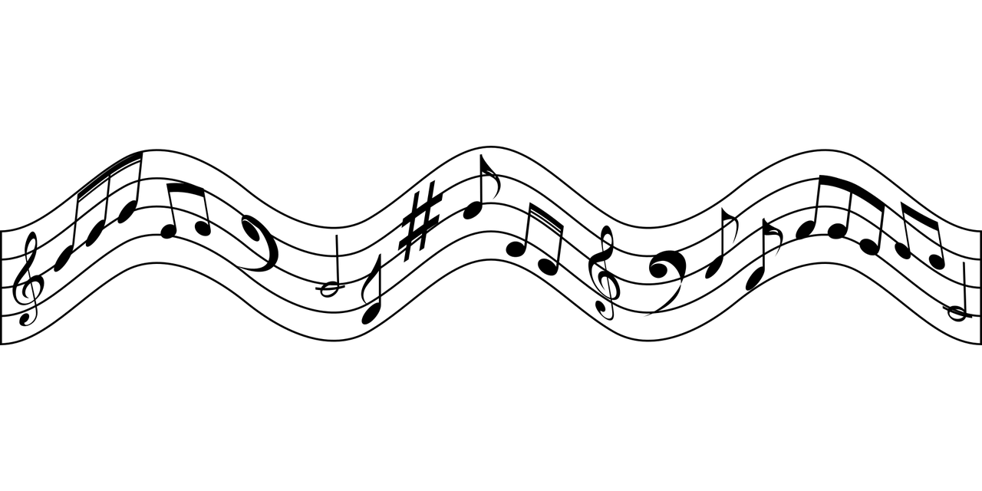
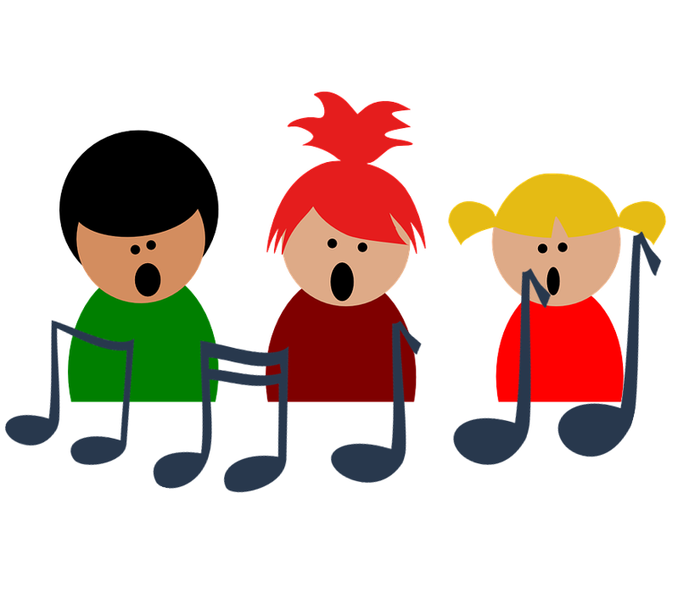
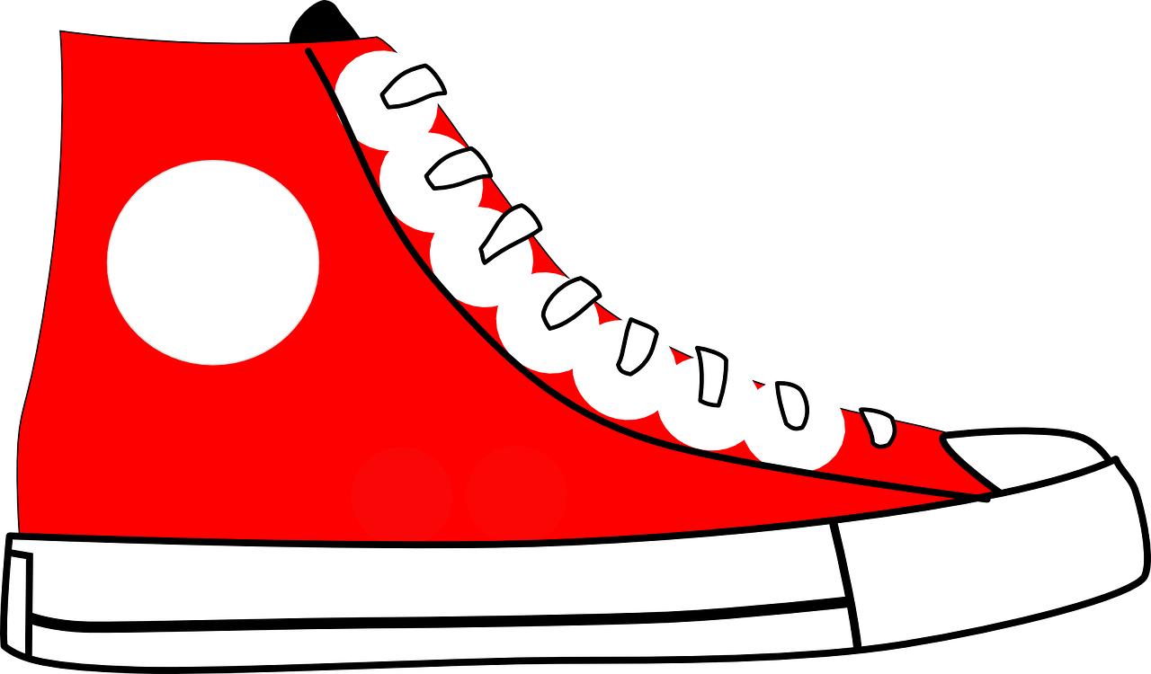
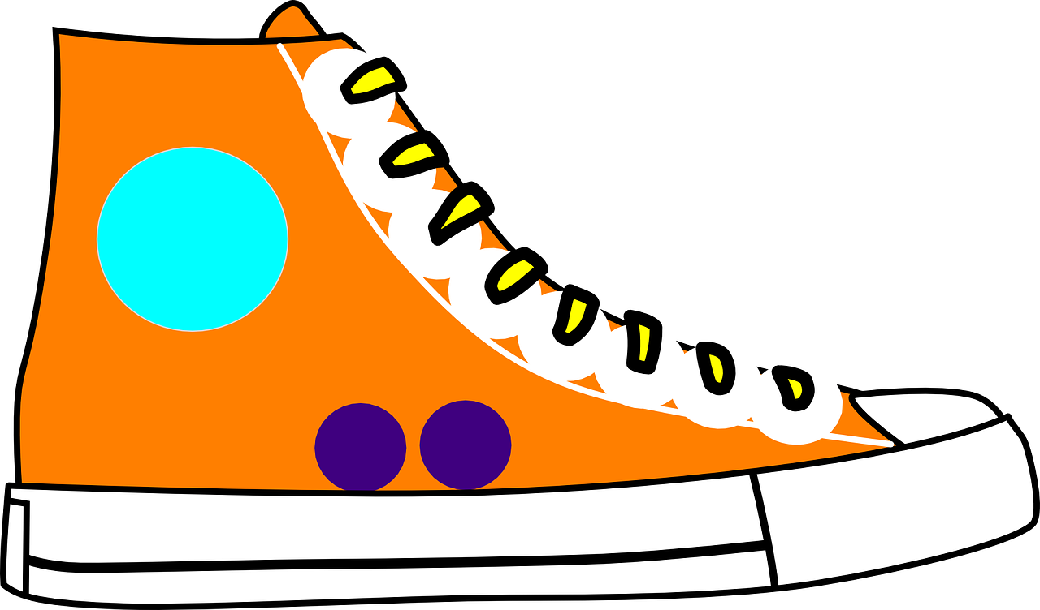
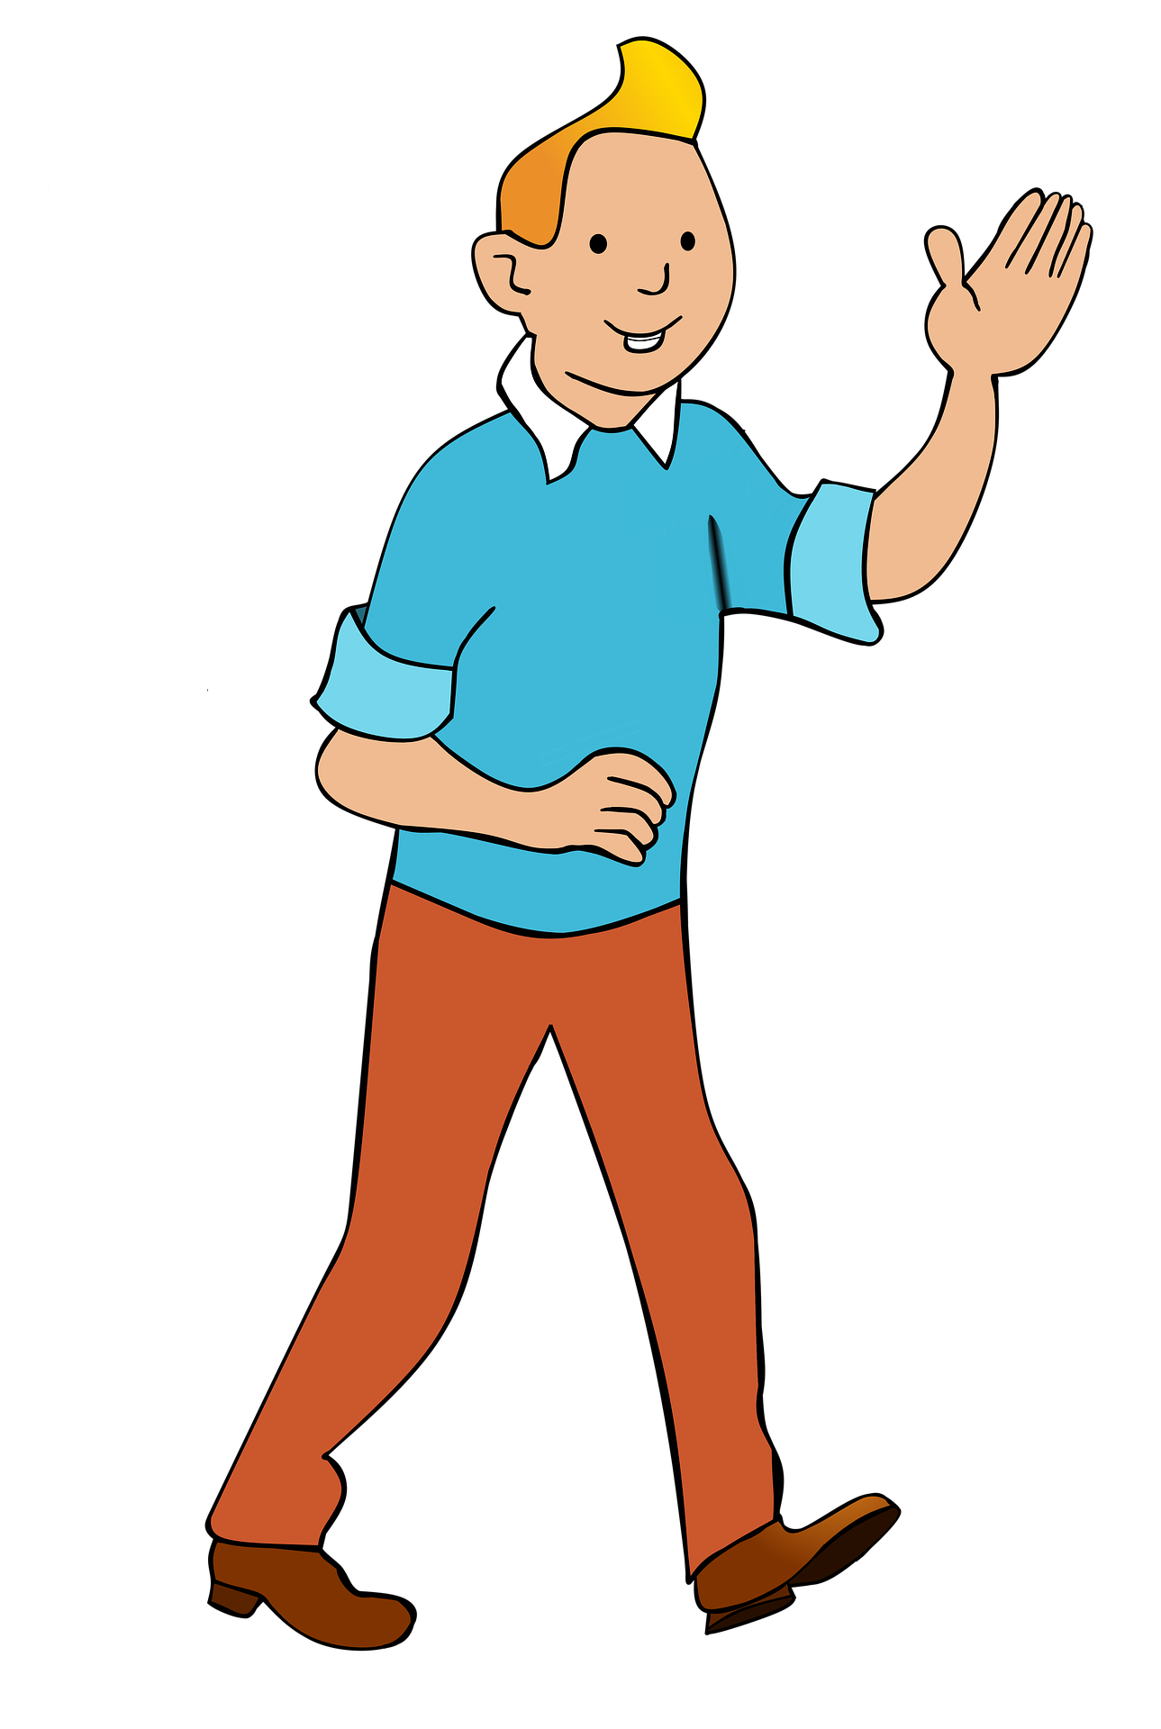
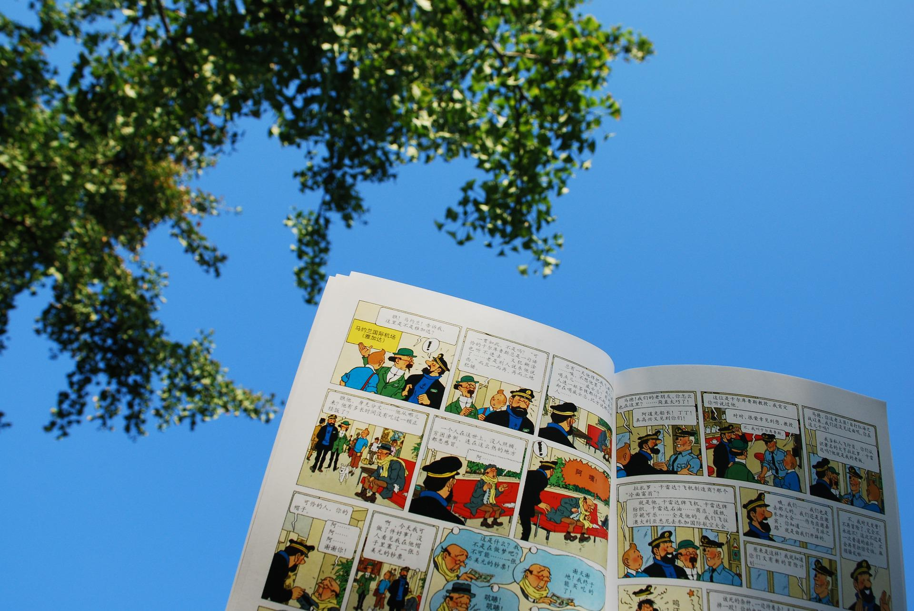
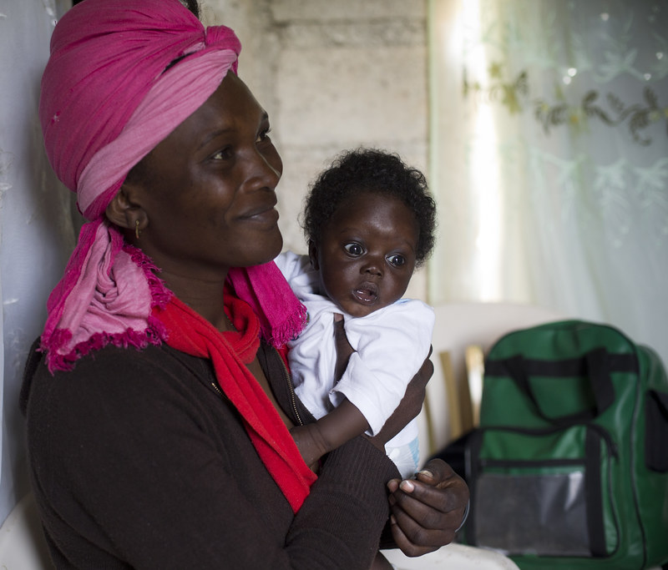
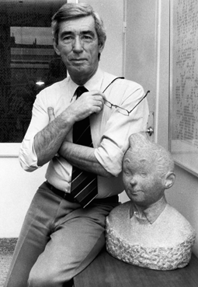
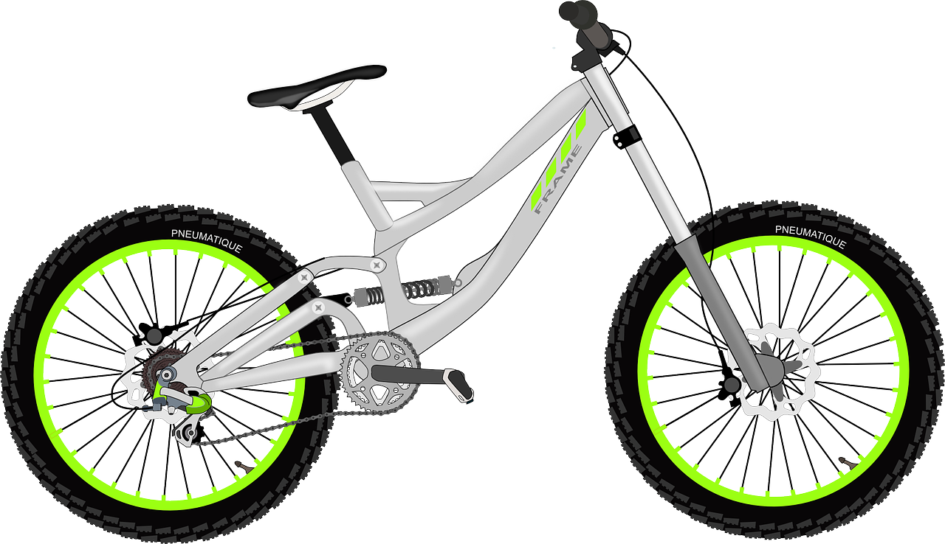
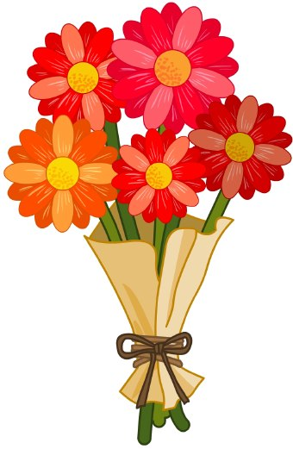
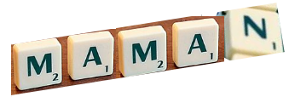
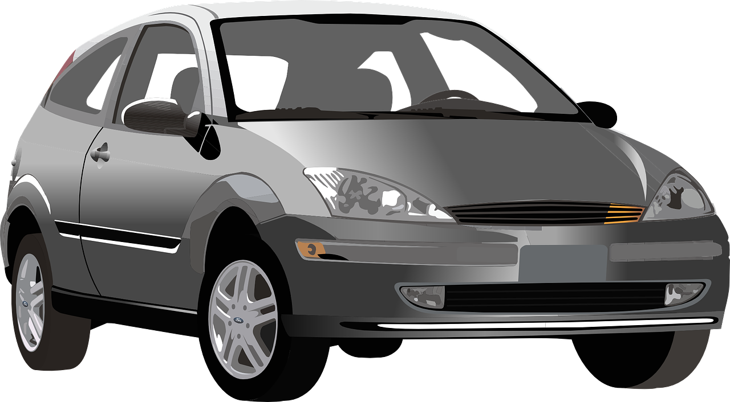
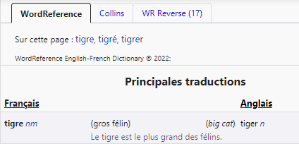
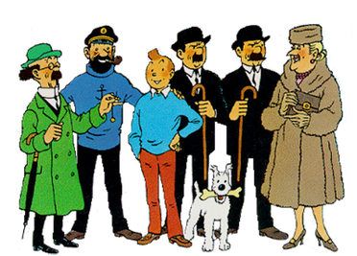
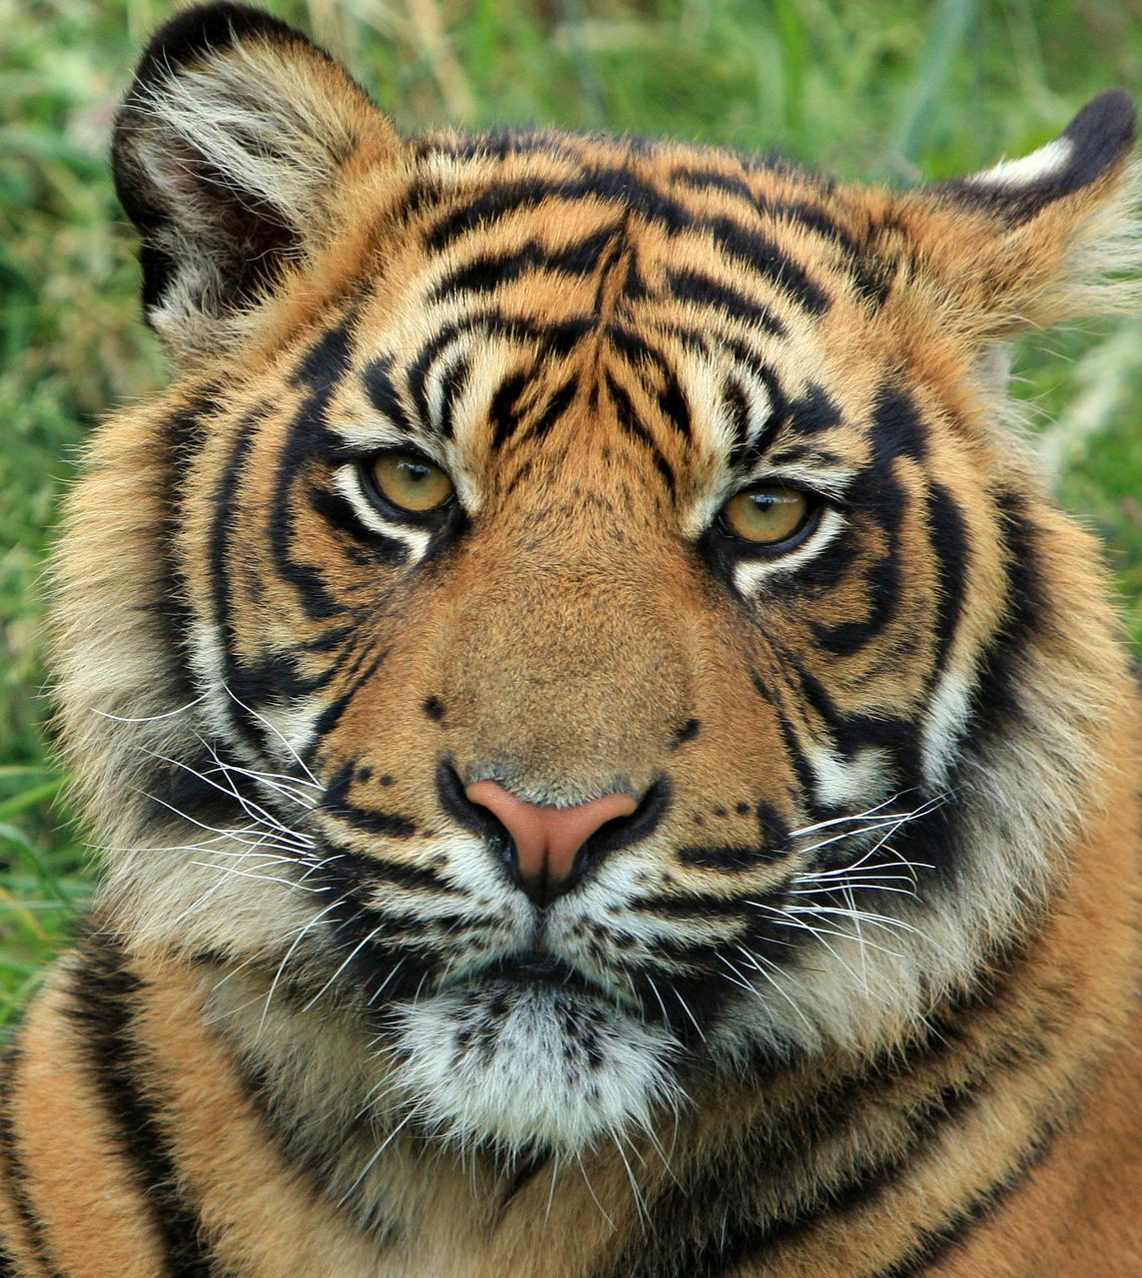
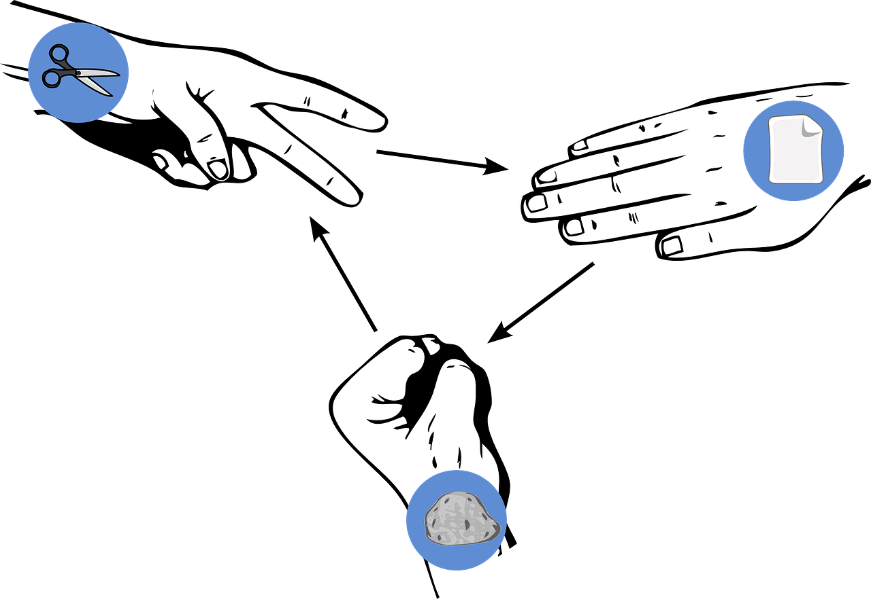
Rouge Knowledge Organiser - Summer Term A
La description
bleu, bleue – blue
cher, chère – expensive
different, différente – different
difficile – difficult
gris, grise – grey
jaune – yellow
lent, lente – slow
rapide – fast
rouge - red
sympa(thique) – nice
vert, verte – green
Les choses
le vélo – bicycle
la voiture – car
Les personnes
elle – she, it (f)
il – he, it (m)
le cousin – male cousin
la cousine – female cousin
la femme – woman
l’homme (m) – man
le professeur – male teacher
la professeure – female teacher
Phonics
Comment ? - How?
Silent Final ‘e’ [SFe] | timide | monde | douze | centre | moderne
[ç/c] soft ‘c’ | ici | cinéma | decider | français | garçon
[ien] | bien | chien | ancien | bientôt | combien
[old/ancient]
[how much]
[qu] | question | quatre | expliquer | musique | unique
Adjectives after nouns In English adjectives come before the noun. In French adjectives normally come after the noun: a grey bike un vélo gris une voiture rapide | Saying ‘it’ in French Remember il is ‘he’ and elle is ‘she’. Use il to mean ‘it’ for masculine nouns, too: Le cadeau est petit.➜ Il est petit. (It is small.) Also use elle to mean ‘it’ for feminine nouns: La peluche est grande.➜ Elle est grande. (It is big.)
Male and female person nouns The words for man (l’homme) and woman (la femme) are different. Some person nouns just add ‘e’ for female forms: le cousin ➜ la cousine. le professeur ➜ la professeure. | Ask ‘What is it like?’ Comment ? means How? but:
Les aventures de Tintin
sont une série de bandes dessinées.
très – very et – and mais – but aussi – also, too
Salut ! Je suis Tintin.
En France et à Haïti la Fête des Mères est le dernier* dimanche de mai. Au Canada, c’est le deuxième* dimanche de mai.
C’est la création
de Hergé, un auteur belge.
Tintin est un jeune reporter. Il a un fox-terrier Milou et deux amis importants : le capitaine Haddock et le Professeur Tournesol.
Using reference materials
www.wordreference.com
All dictionaries have symbols with useful
n = noun
m = masculine
f = feminine
le tigre (the tiger) un tigre (a) tiger
information about the type of word, (e.g., noun,
Il est comment ?
What is it (m) like?
The game pierre-papier-ciseaux is as popular in France as it is in England.
➜
adjective) and noun gender (masculine or feminine).
masculine
Elle est comment ?
➜
What is it (f) like?
What game
is it?.

Slide 2
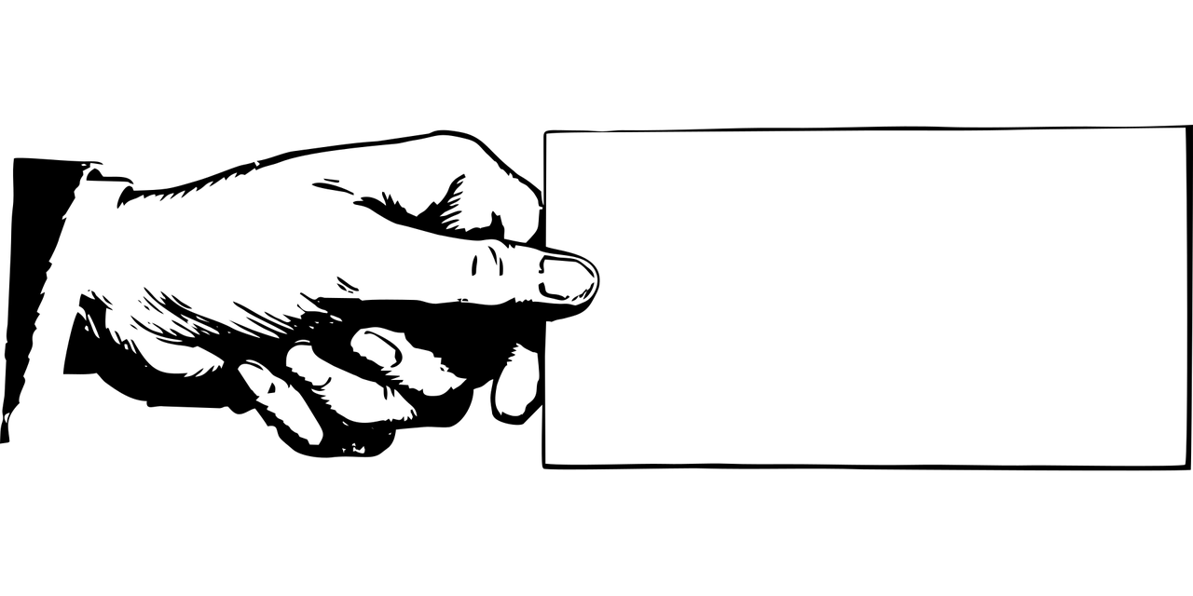
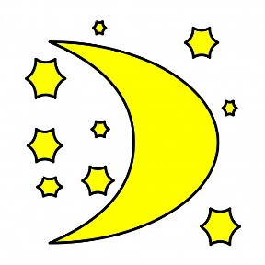
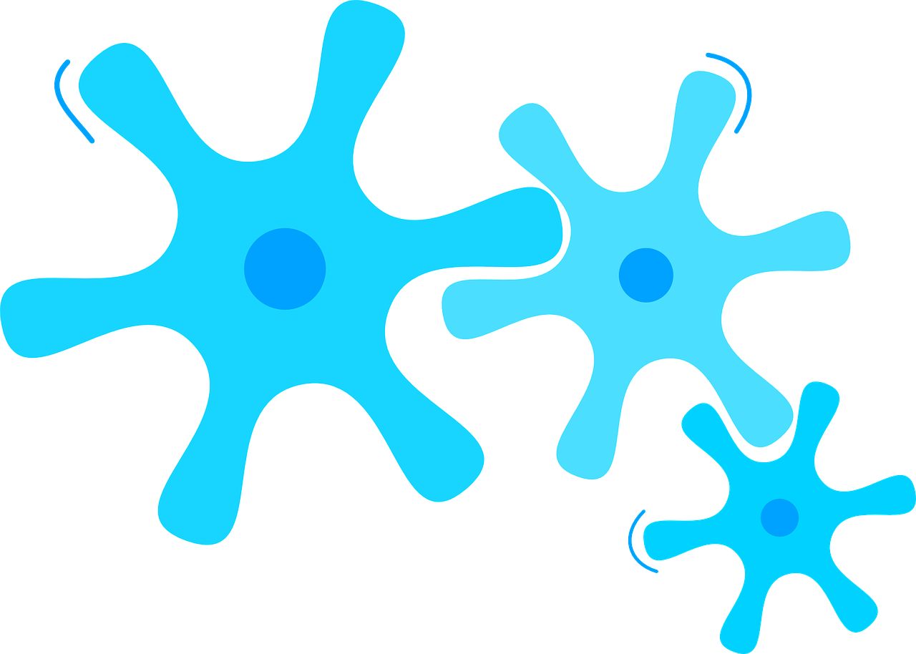
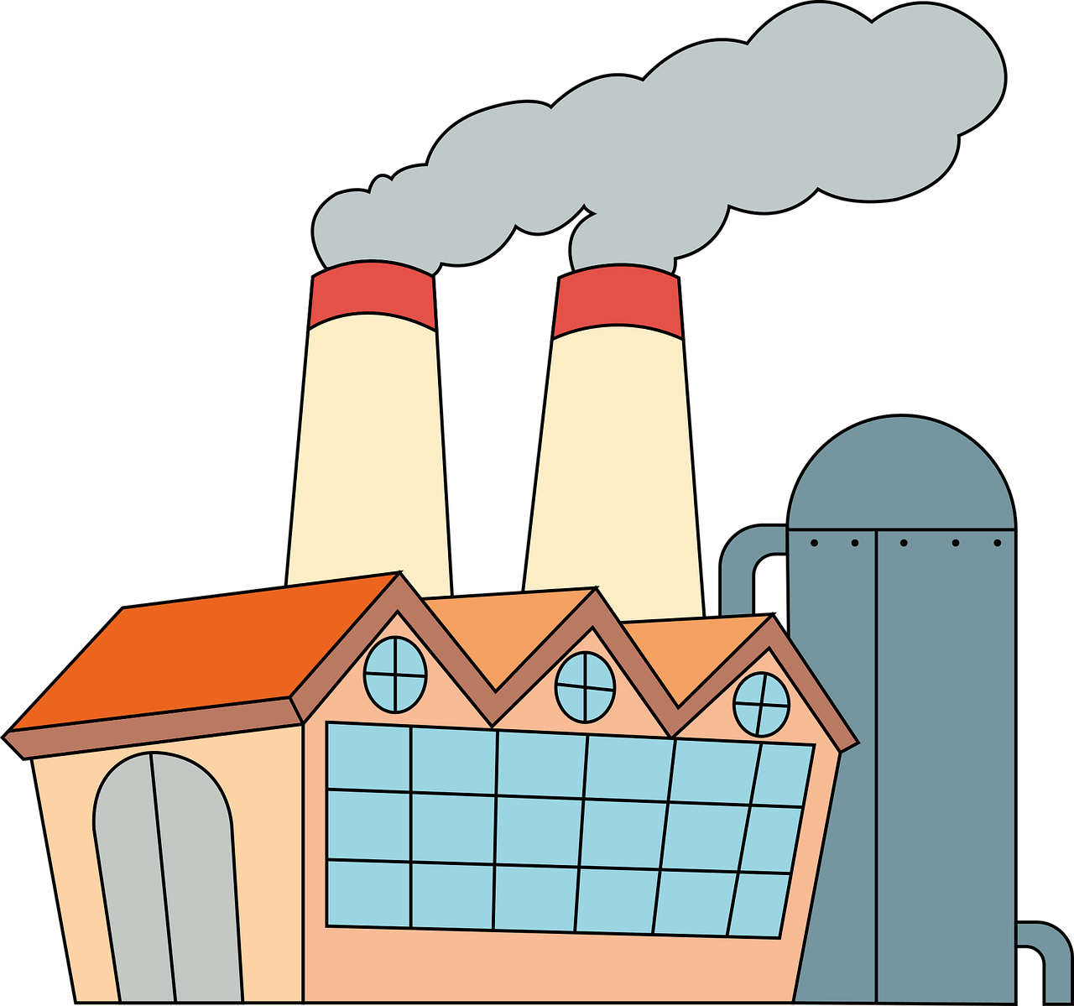
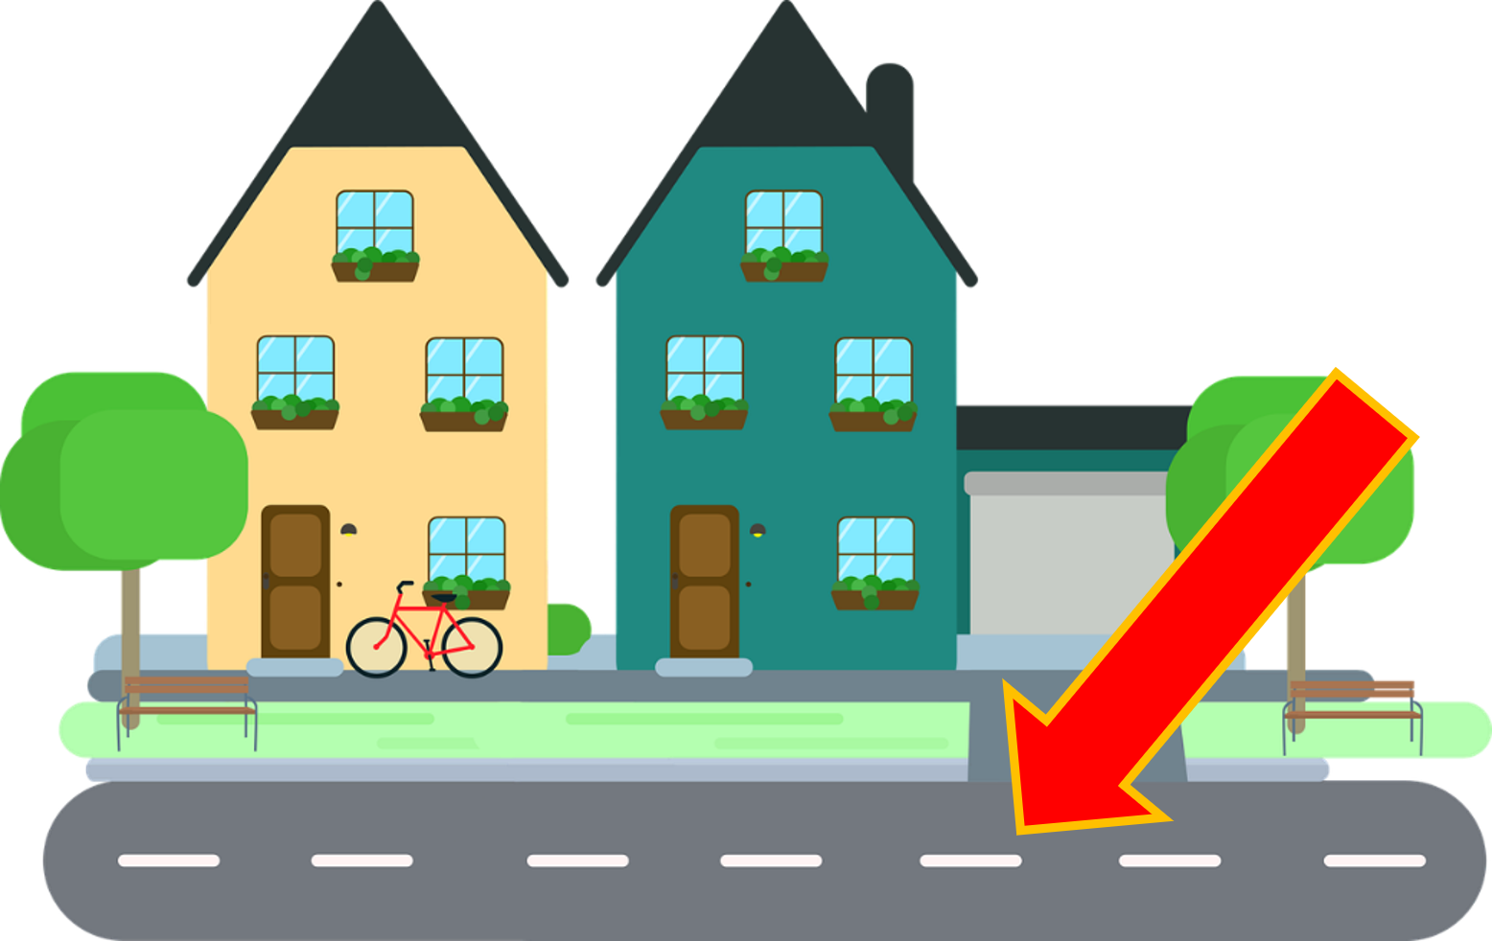
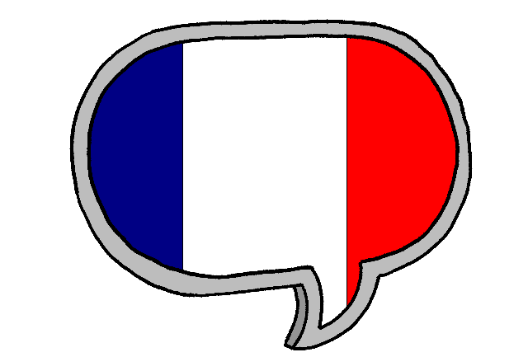
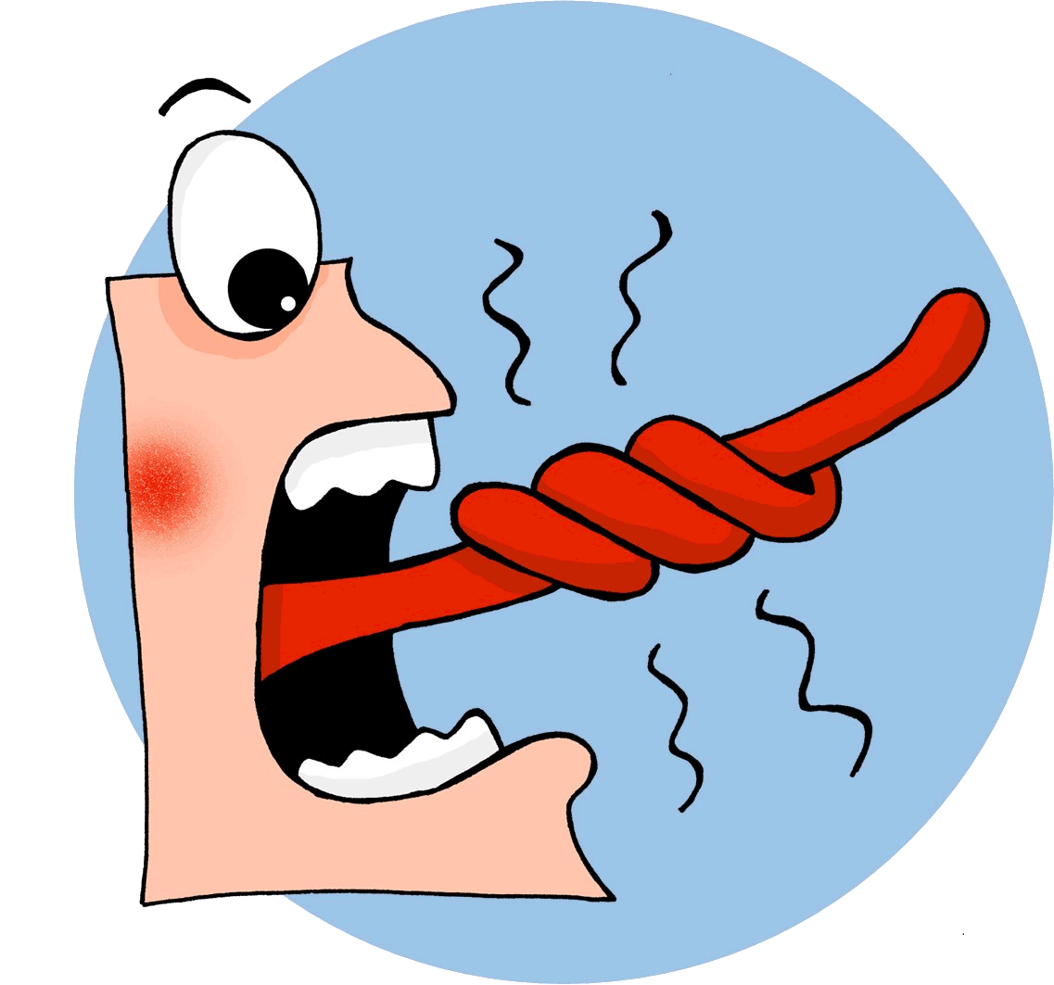
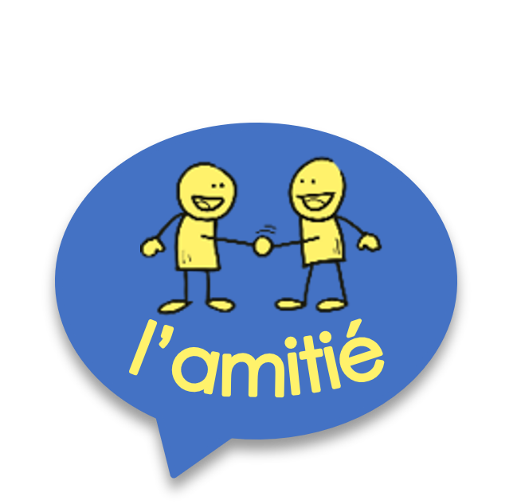
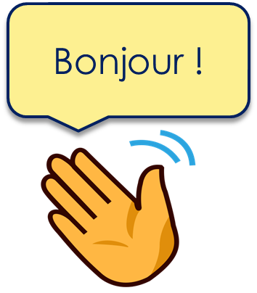
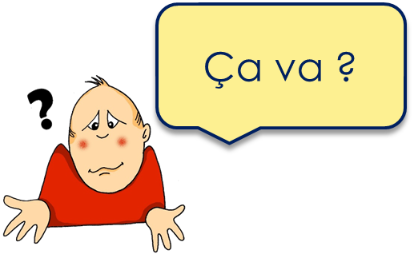
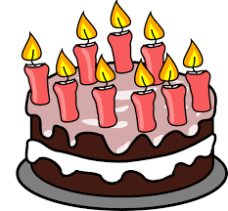
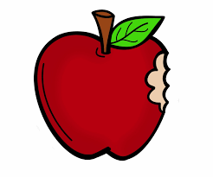
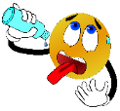
Rouge Knowledge Organiser - Summer Term B
Ça va comment ?
avoir – to have|having
j’ai – I have
tu as – you have
il a – he has
elle a – she has
l’an (m) – year
la faim – hunger
la pomme – apple
la raison – reason, right
le soif – thirst
le tort – wrong
Opinions et activités
aimer – to like, liking
détester – to hate, hating
jouer – to play, playing
travailler – to work, working
le silence - silence
en retard - late
les – the (plural
merci – thank you
s’il te plait – please (informal)
si vous plait – please (formal)
Phonics
gymnastique
[j/soft g]
jour
j’ai
génial
déjà
I have
motion
pollution
population
[-tion]
Attention !
solution
Watch out!
⚠ There is no sound like this in English!
triste
moderne
être
parler
[r]
rue
French [r] is a raspy sound pronounced in the back of the throat.
Trois grands gros rats dans trois grands gros trous !
Knowing who does what | Infinitive verbs
 | Ask ‘What is it like?’ Comment ? means How? but:
Learning languages is about making friends.
You show kindness when you learn even a few words in another language.
Let’s remember some of the friendship sentences we have learnt already!
We know the infinitive verb tells us the general meaning.
Remember that there are two ways to translate French infinitives into English:
Add‘de’ to link adjective and verb.
What other kind things can you say?
parler ➜ to speak, speaking
C’est facile de parler français.
➜ It’s easy to speak French.
To mean ‘i’, you’, ‘s/he’, change the verb ending to match the pronoun:
School assemblies are not very common in France but pupils like preparing a show (un spectacle) for the end of the year. They rehearse in the big hall or gym. Sometimes
they wear a costume (un déguisement), too.
Parler français, c’est facile.
➜ Speaking French is easy.
je parle ➜ I speak
tu parles ➜ you speak il parle ➜ he speaks elle parle ➜ she speaks
Two verb structures
Avoir not être You know that avoir means ‘to have, having’: We also sometimes use avoir to mean ‘to be, being’:
When a French sentence has two verbs, the 2nd verb is in infinitive form.
J’ai un chien. ➜
I have a dog.
Les – the (plural)
We know the word ‘des’ means some for both masculine and feminine nouns:
J’aime parler français. ➜
I like speaking French.
In English we usually say –ing in two-verb structures.
J’ai faim. ➜
I am hungry.
⚠ These literally mean: I have hunger. You have thirst. He has reason/right. She has wrong.
J’ai soif. ➜
I am thirsty.
Voici des pommes. ➜ Here are some apples.
J’ai raison.➜
I am right.
The plural word for ‘the’ is ‘les’. It is the same for both m and f nouns.
J’aime le français. ➜
I like French.
Note that when a noun follows aimer or détester, we always need an article in French:
J’ai tort. ➜
I am wrong.
Voici les pommes. ➜ Here are the apples.

