Slide 1
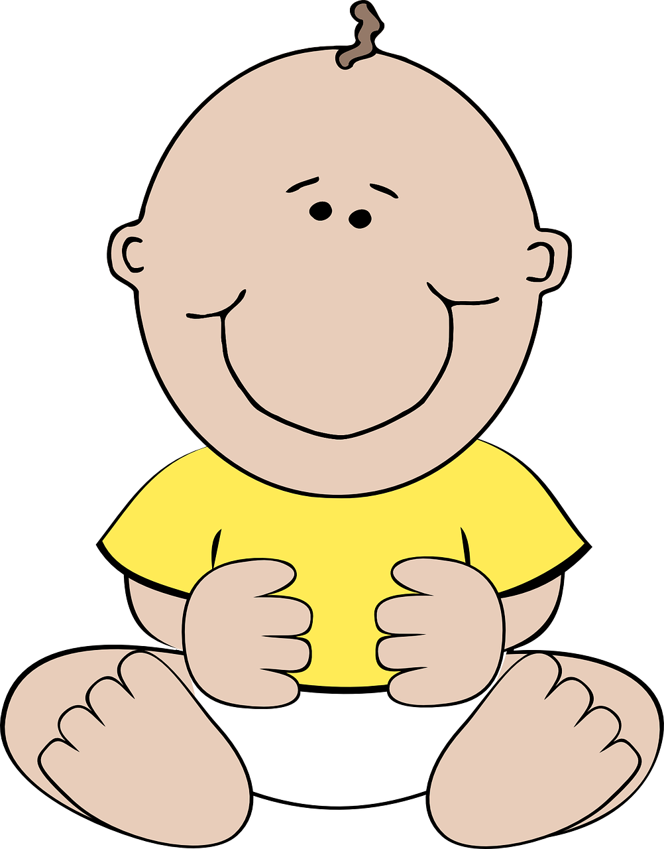
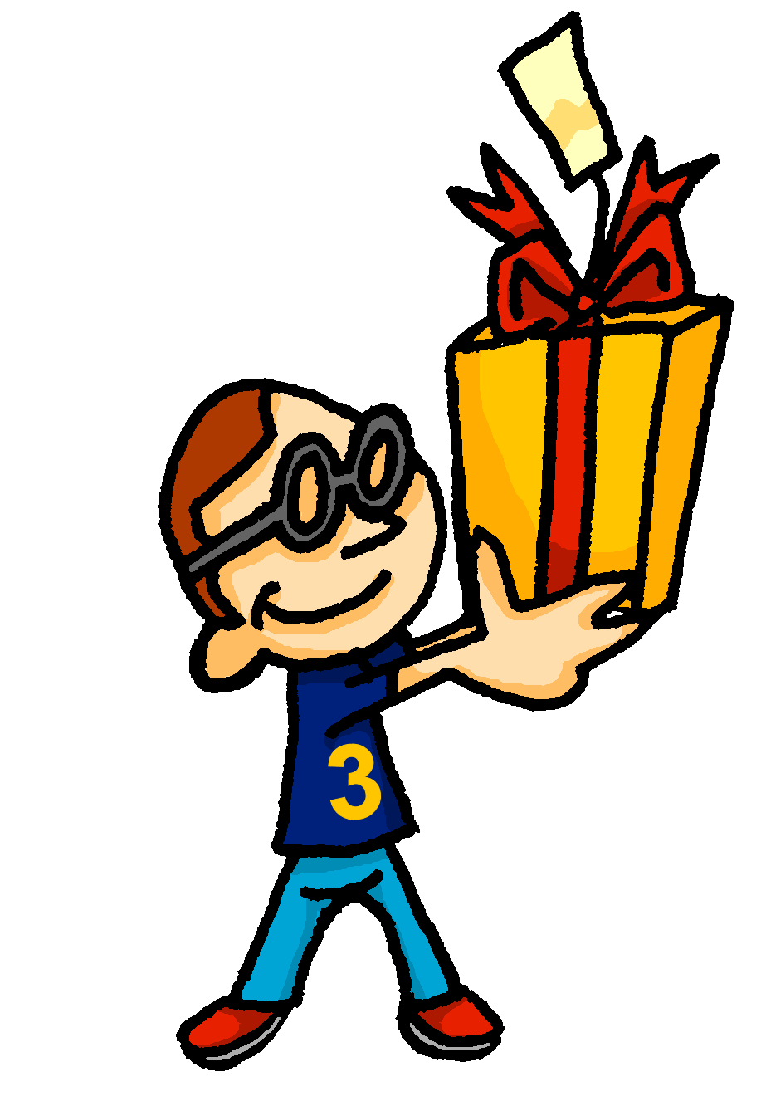
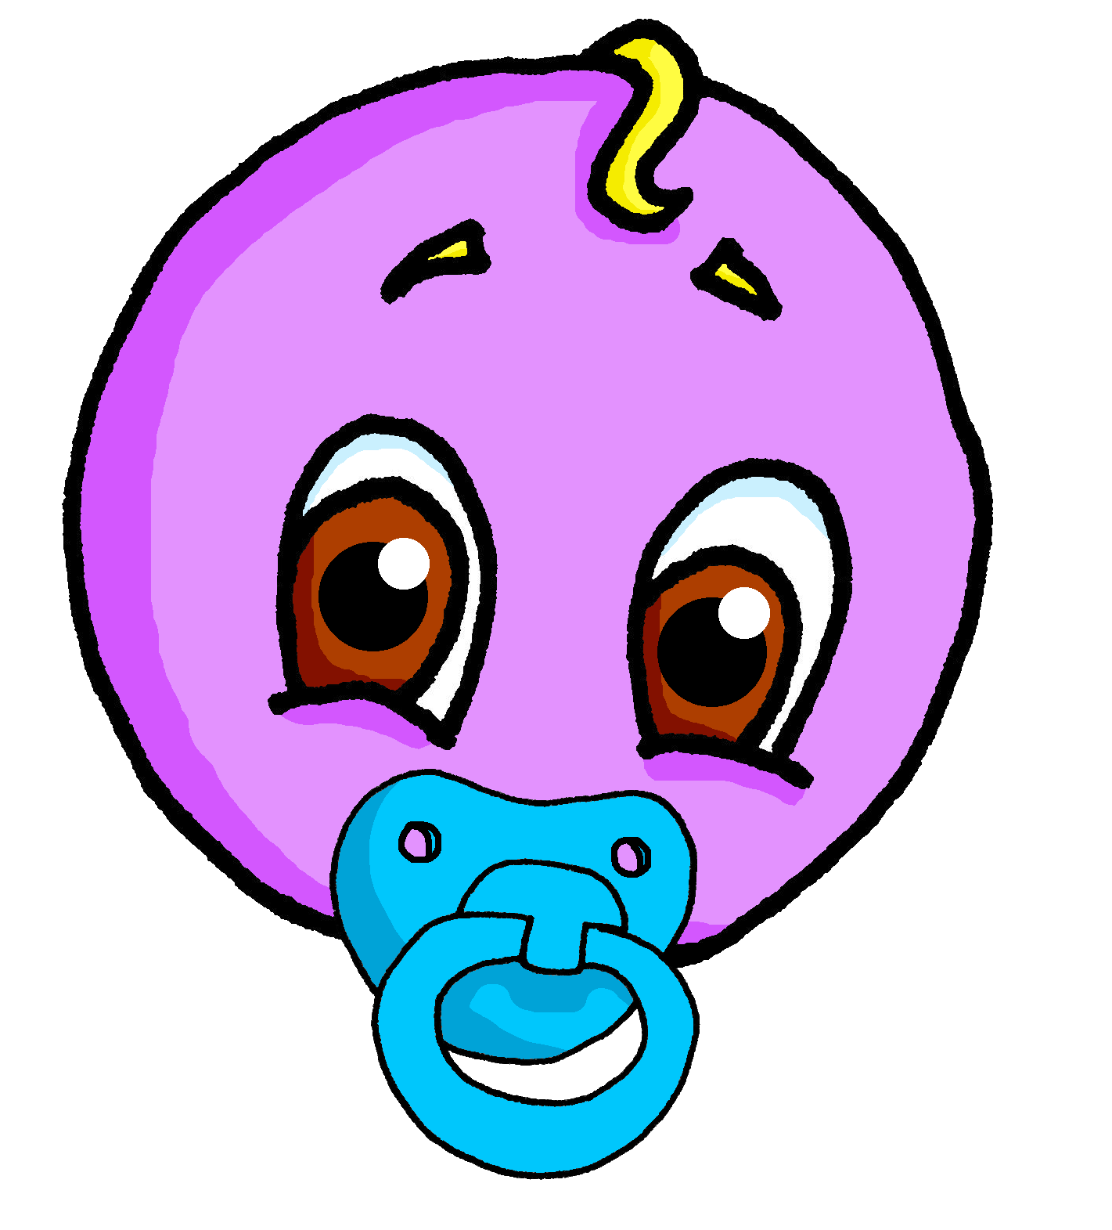
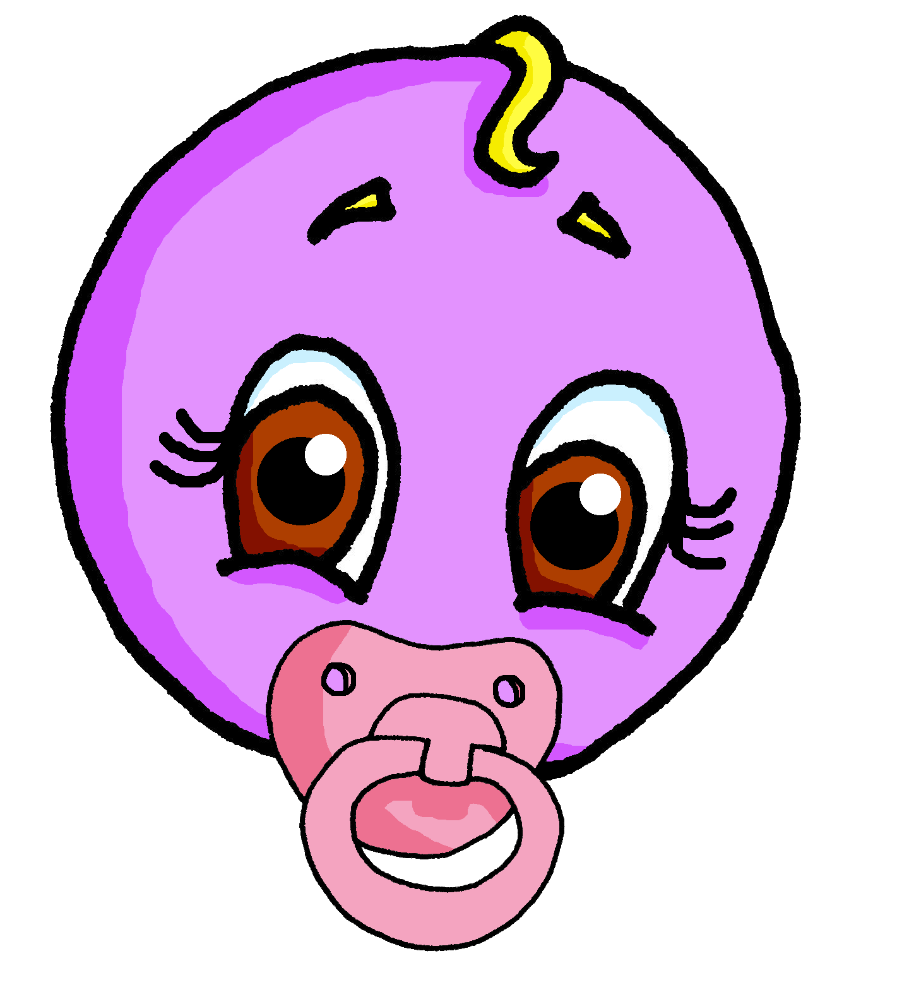
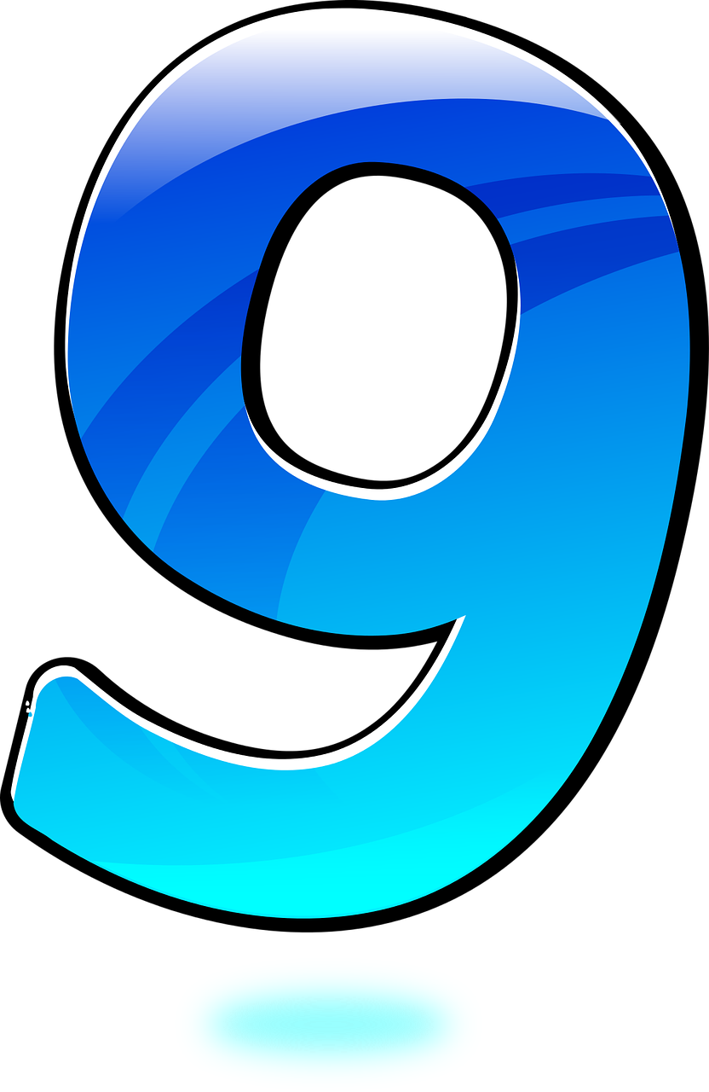
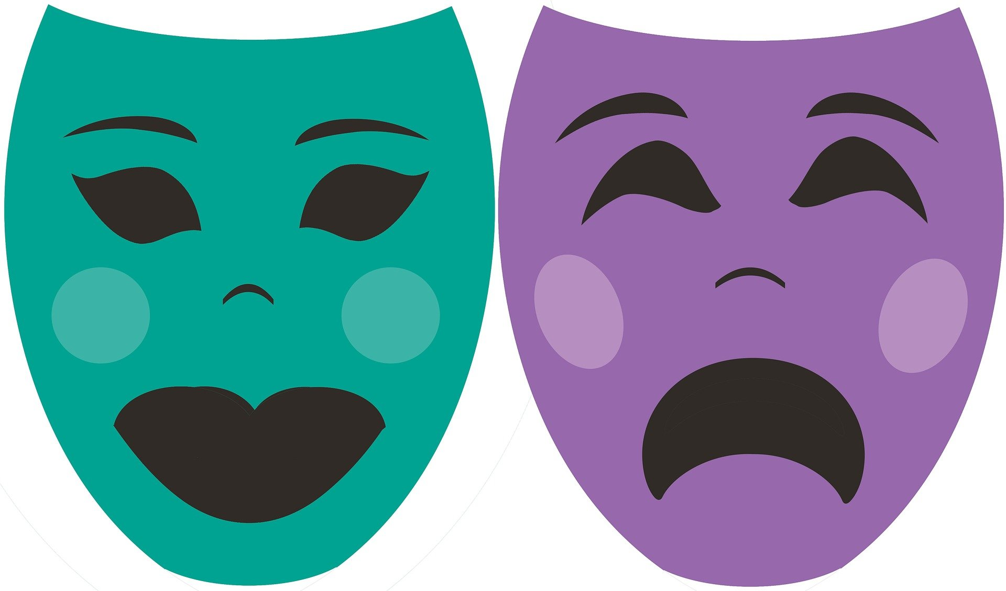
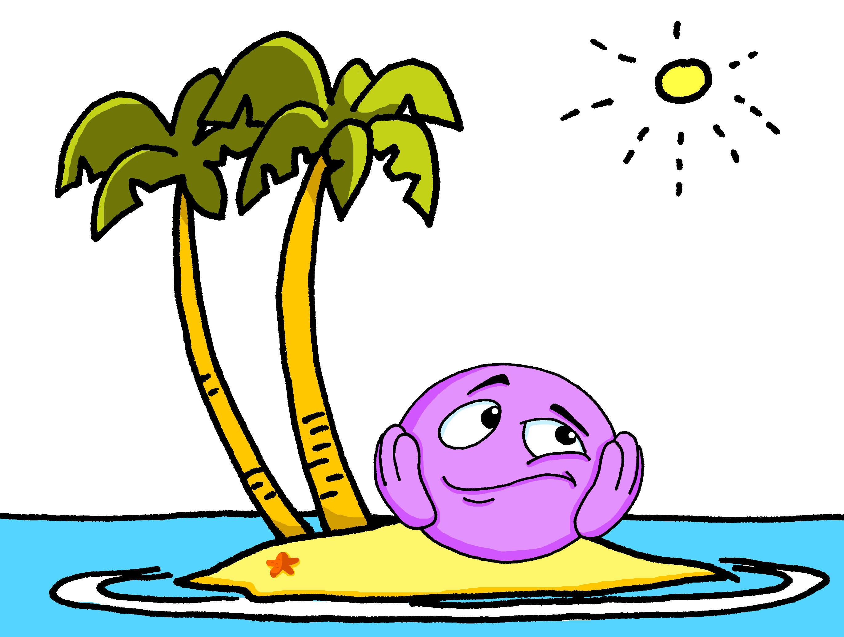
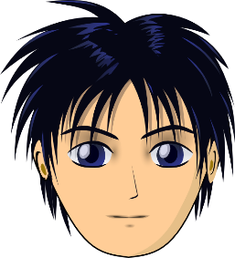
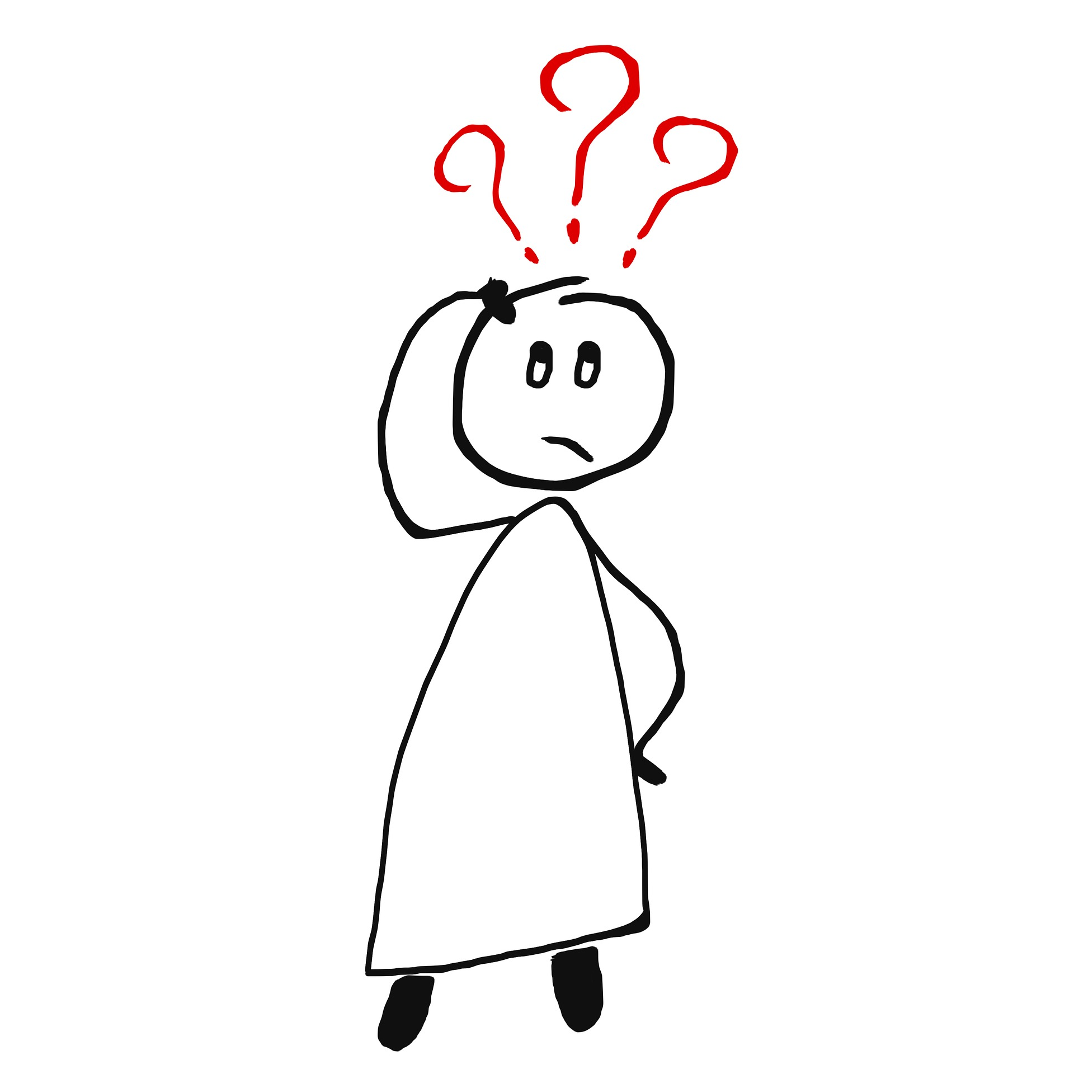
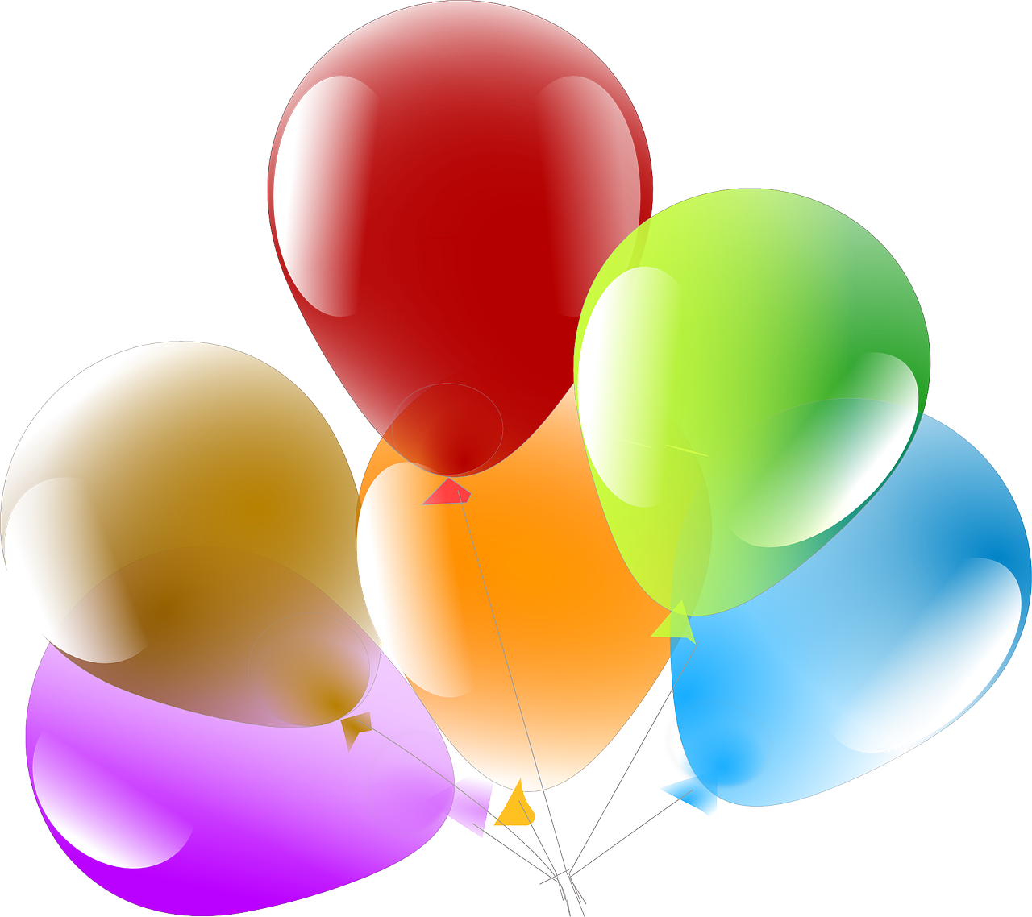
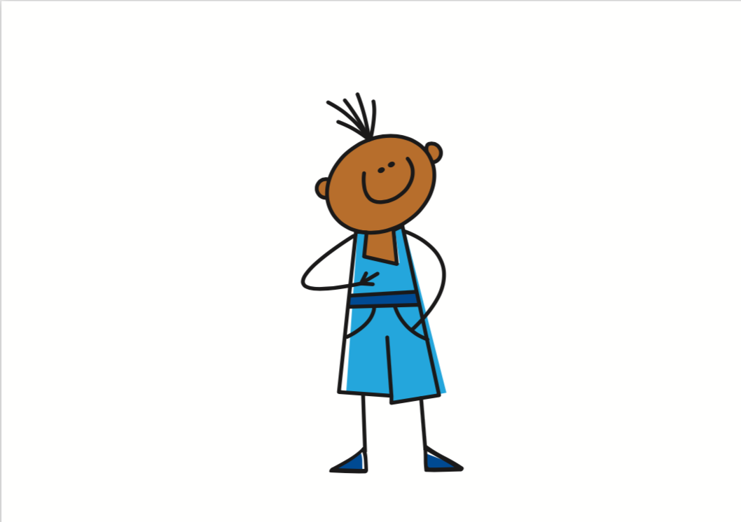
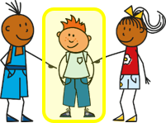
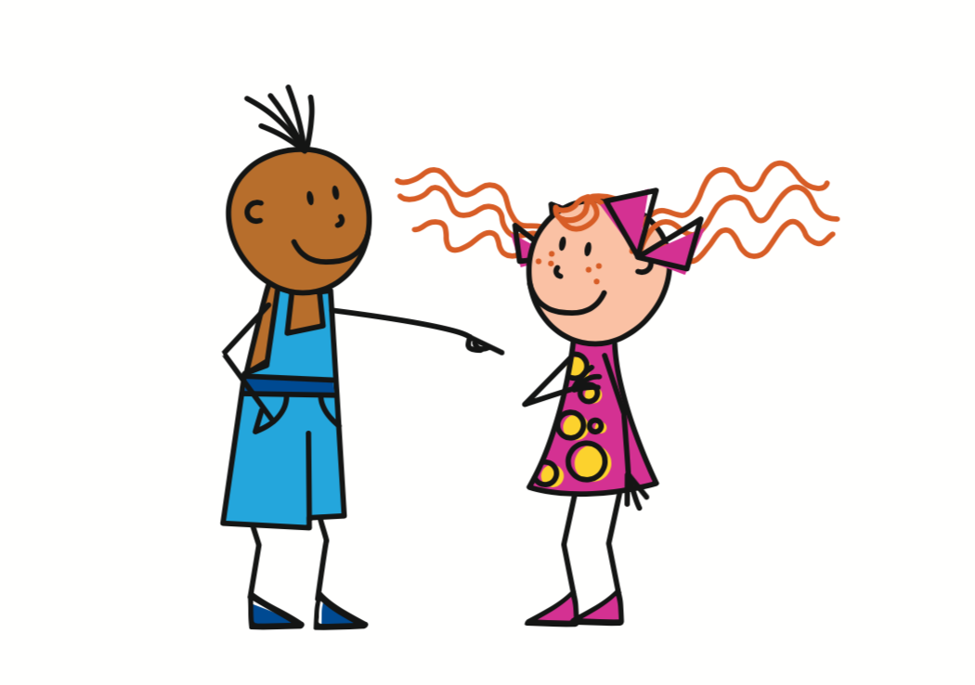
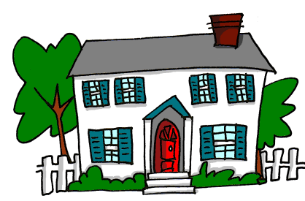
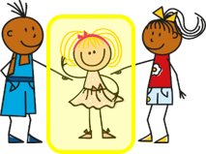
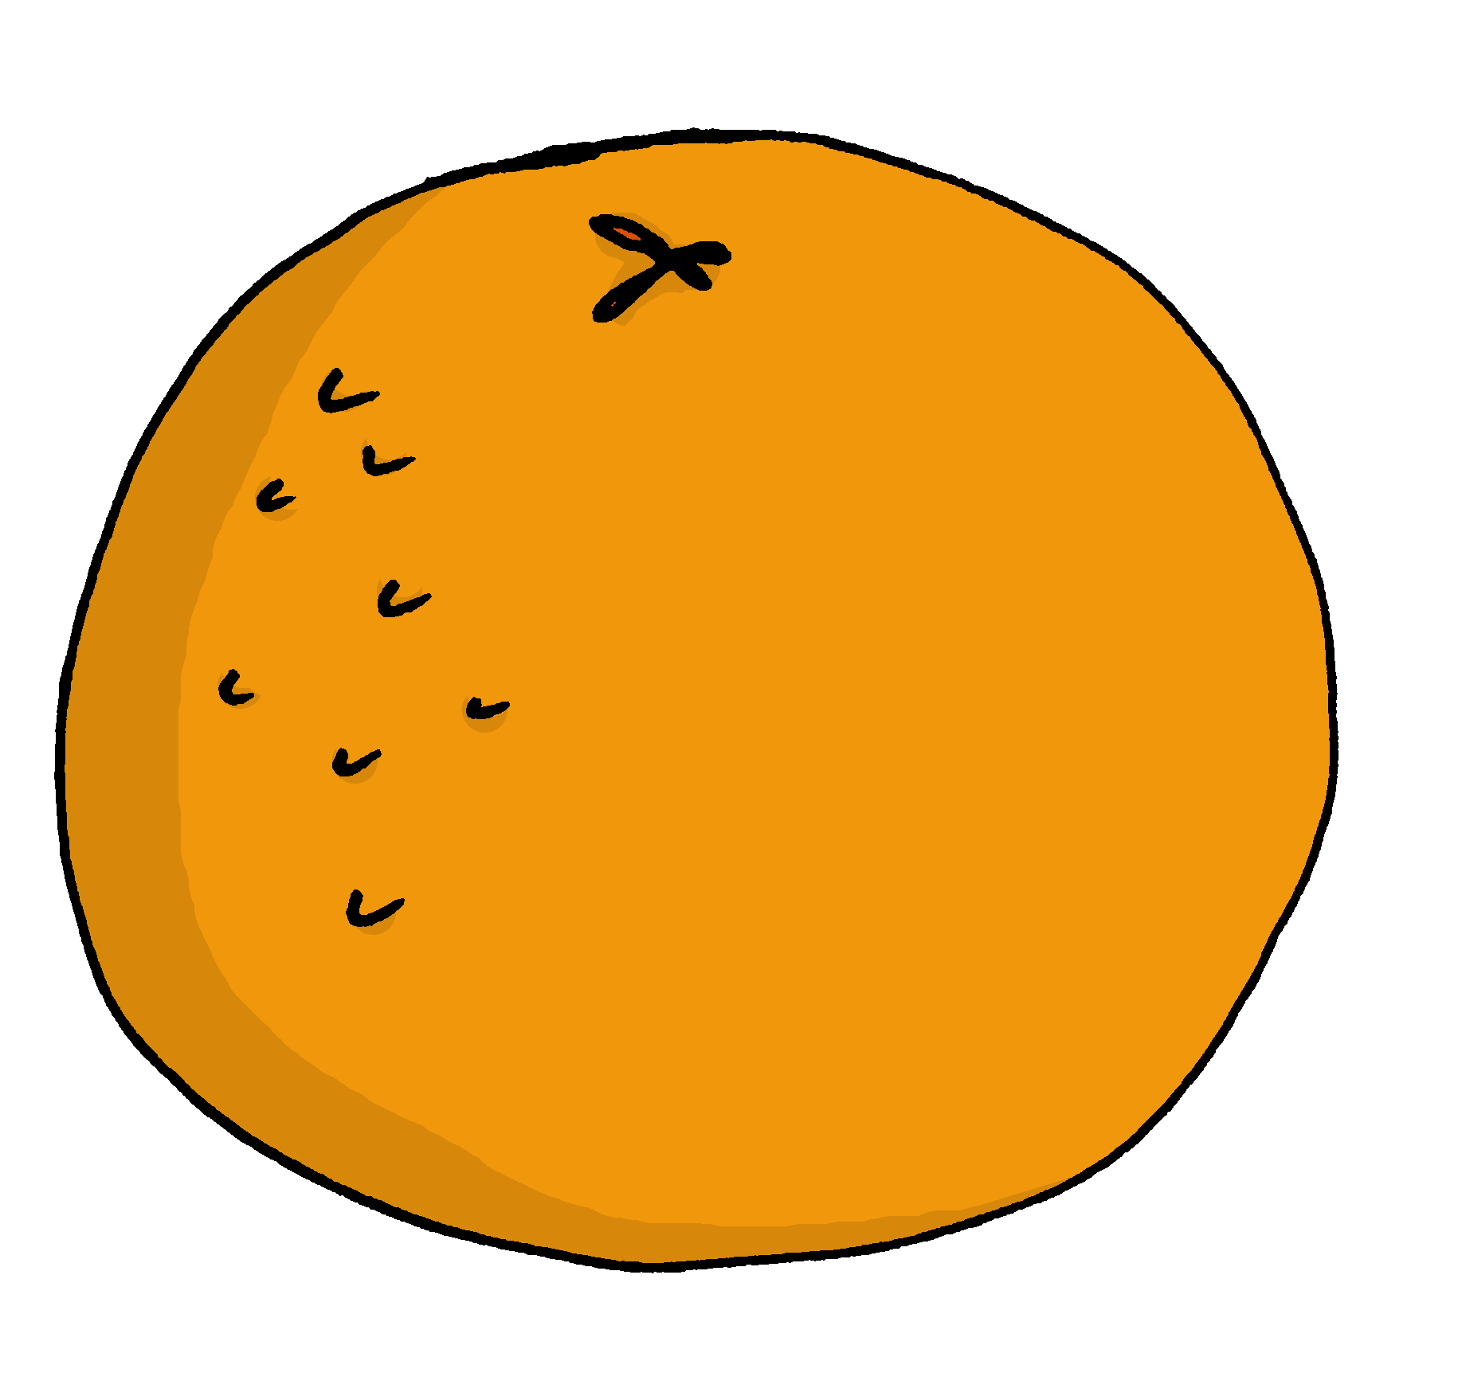
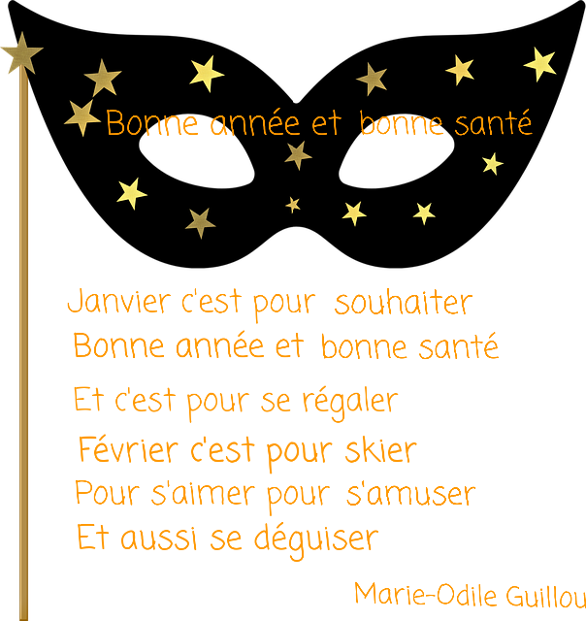
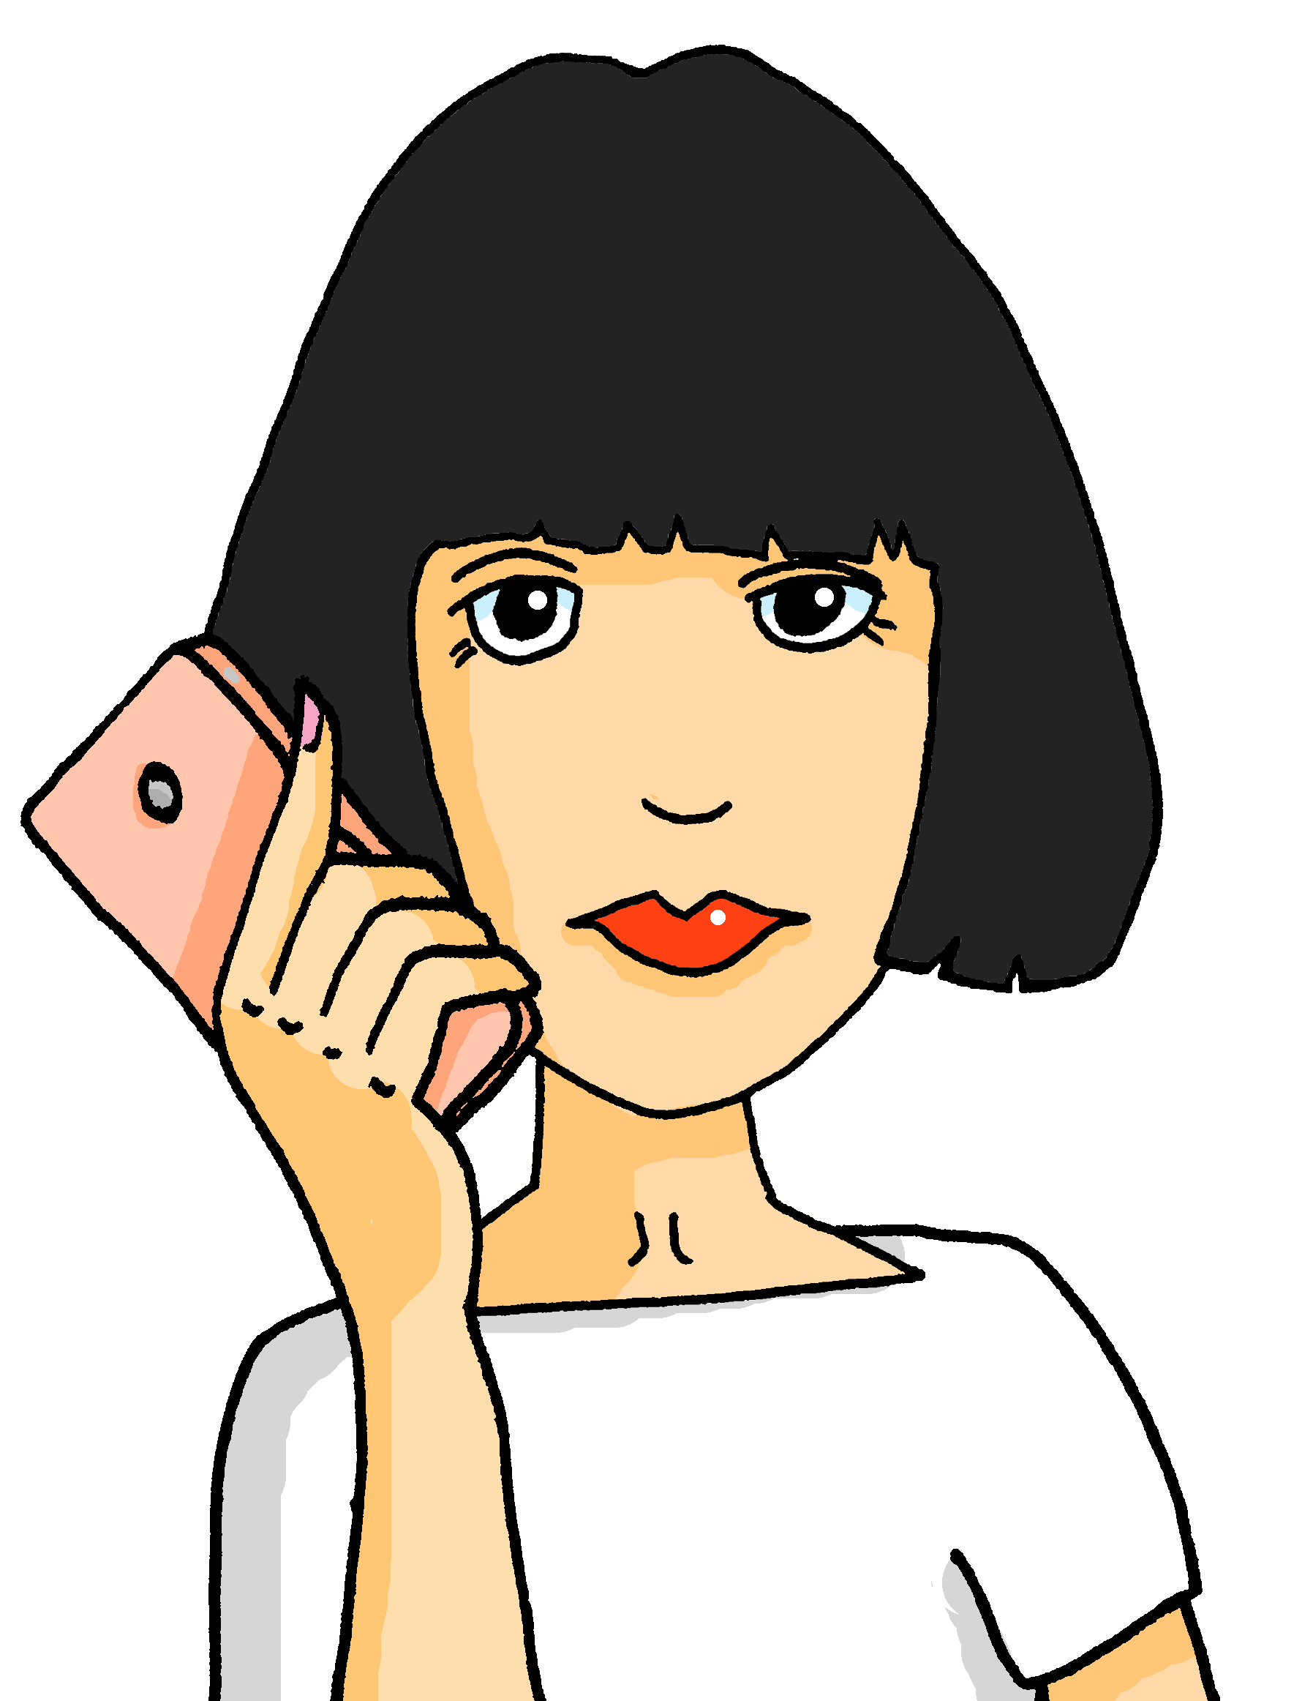
Rouge Knowledge Organiser - Spring Term A
Les activités
aider – to help|helping
aimer – to like|liking
chanter – to sing|singing
donner – to give|giving
habiter – to live|living
manger – to eat|eating
passer – to pass, spend|passing, spending
porter – to wear, carry|wearing, carrying
préférer – to prefer, preferring
préparer – to prepare|preparing
regarder – to look, watch|looking, watching
répéter – to repeat|repeating
trouver – to find|finding
utiliser – to use|using
La description
facile – easy
grand, grande – tall, big
important, importante – important
normal, normale – normal
petit, petite – short, small, little
le, la – the (m), the (f)
mon, ma – my (m), my (f)
ton, ta – your (m), your (f)
avec – with
Les choses
la chanson – song
le chapeau – hat
la chose – thing
le déjeuner – lunch
l’école (f) – school
la fête – party, celebration, festival
le fruit – (piece of) fruit
le film – film
la maison – house
la phrase – phrase, sentence
l’uniforme (m) – uniform
le village – village
la ville – town
le weekend - weekend
Les personnes
l’ami (m) – (male) friend
l’amie (f) – (female) friend
la famille – family
la fille – girl
le frère – brother
le garçon – boy
la mère – mother, mum
le père – father, dad
la sœur – sister
Phonics
[é] [er] | répéter | écrire | bébé
[et] [ez] | parler | donner | et | nez
[nose]
open [eu] | peur | jeune | neuf | acteur | seul
[fear]
[young]
[alone]
[è] [ê] | fête | tête | frère | être | problème
[head]
[to be, being]
Infinitive verbs Use two meanings in English for infinitive verbs in French: C’est important d’écouter le prof. ➜ It’s important to listen to the teacher. Écouter le prof, c’est important. ➜ Listening to the teacher is important. | Present tense –ER verbs chanter – to sing|singing je chante ➜ I sing tu chantes ➜ you sing il chante ➜ he sings elle chante ➜ she sings | Definite articles – ‘the’ To say the in French use le before a masculine noun and la before a feminine noun. le crayon la maison Use l’ for any noun that starts with a vowel or h-. l’animal (m), l’orange (f).
Possessive adjectives The adjectives ‘my’ and ‘your’ have different forms to match the gender of the noun they describe: mon frère, ton chien ma sœur, ta famille | Use of ‘de’ for possession La mère de Pierre ➜ The mother of Pierre OR Pierre’s mother/mum. There is no apostrophe for possession in French.
et – and mais – but aussi – also, too

Slide 2
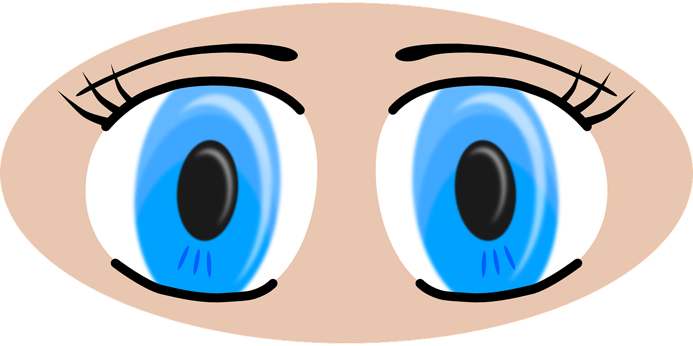
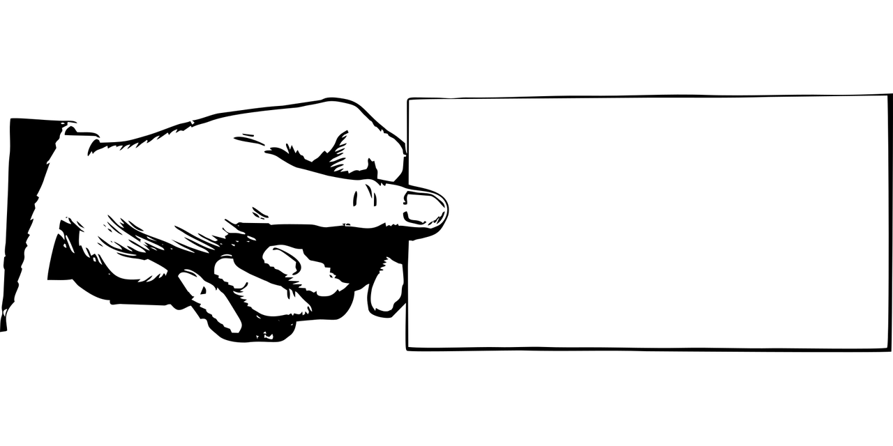
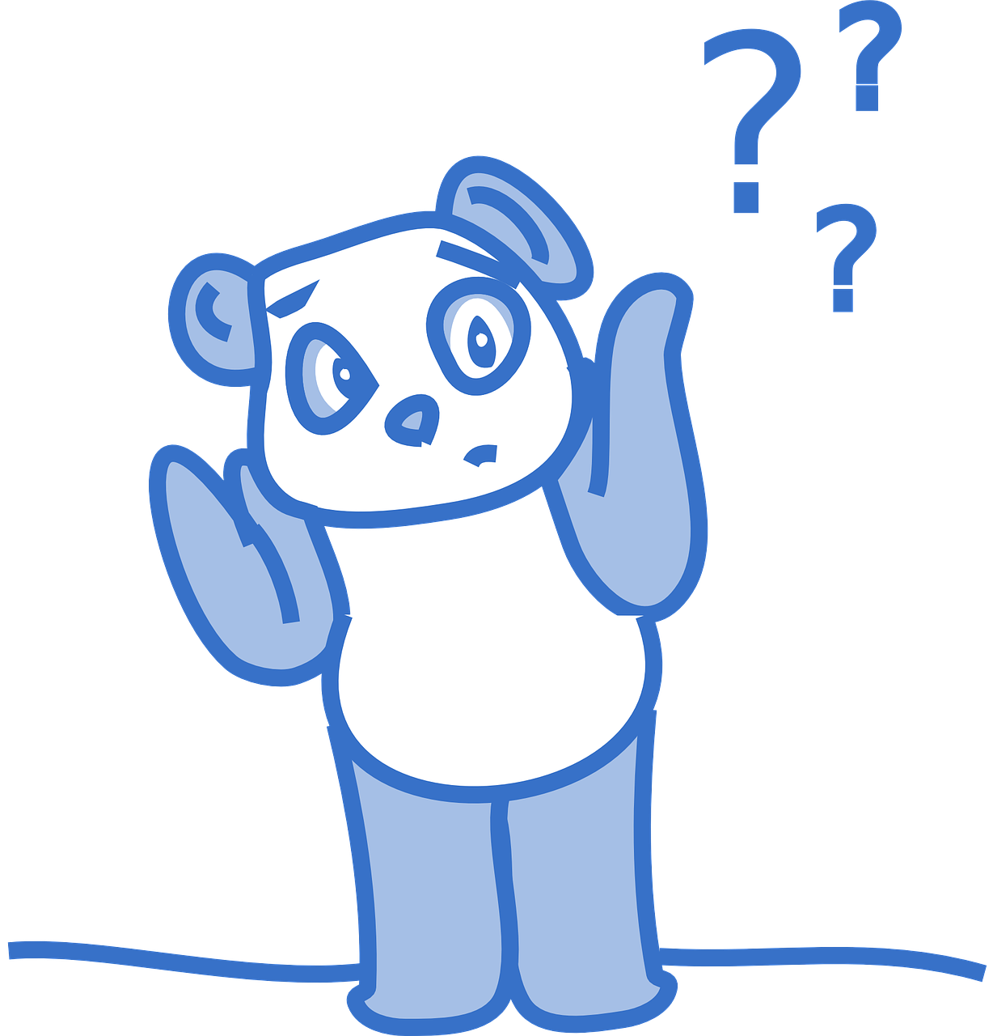
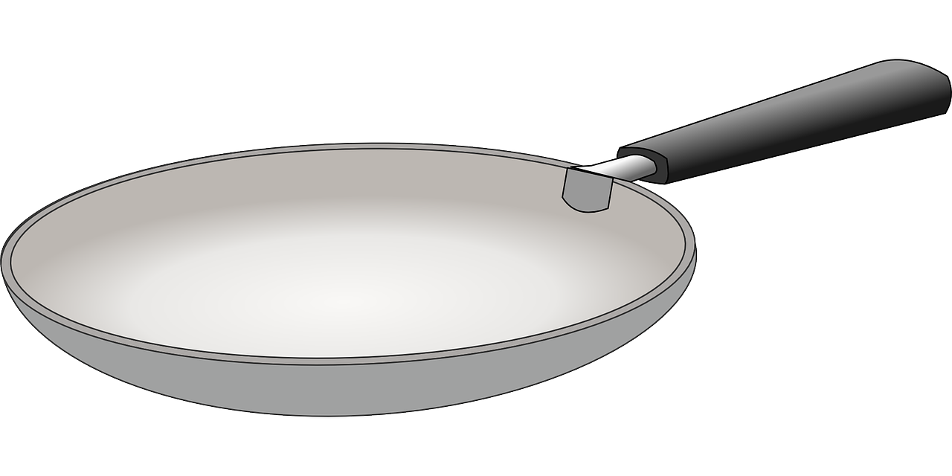
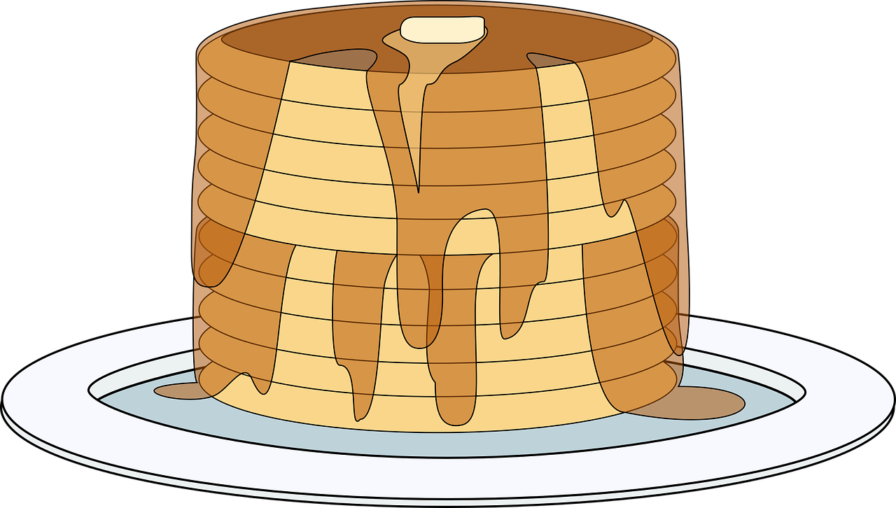
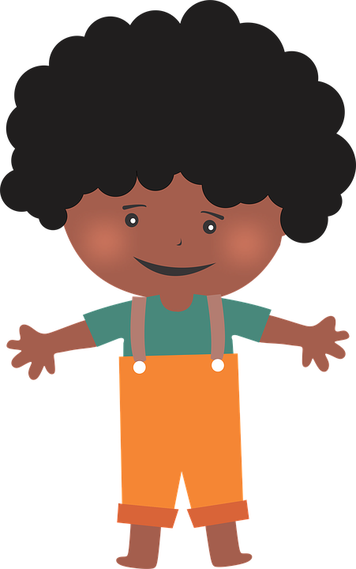
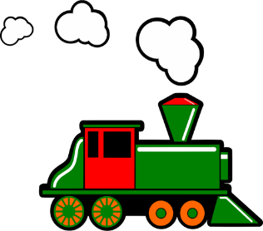
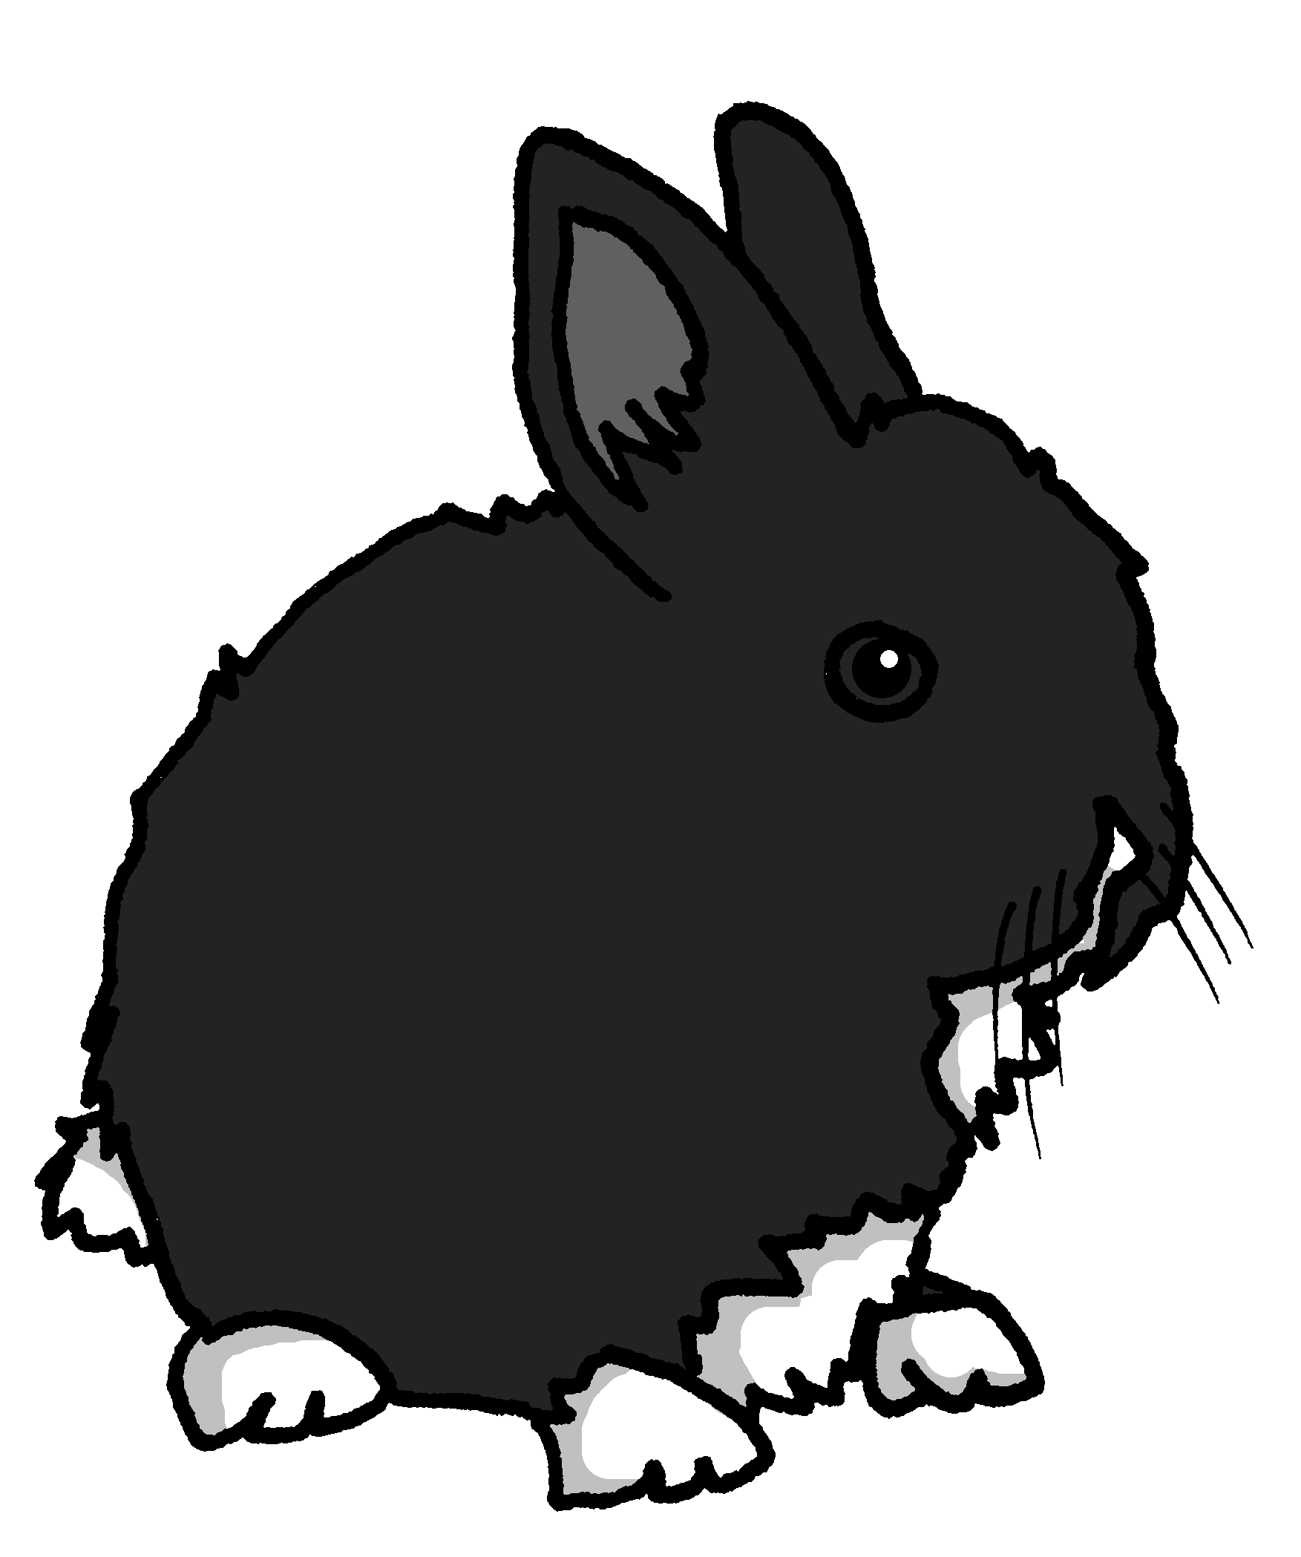
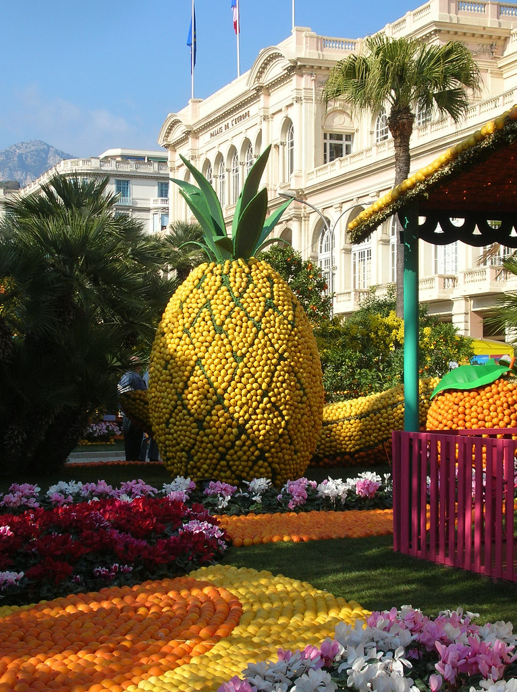
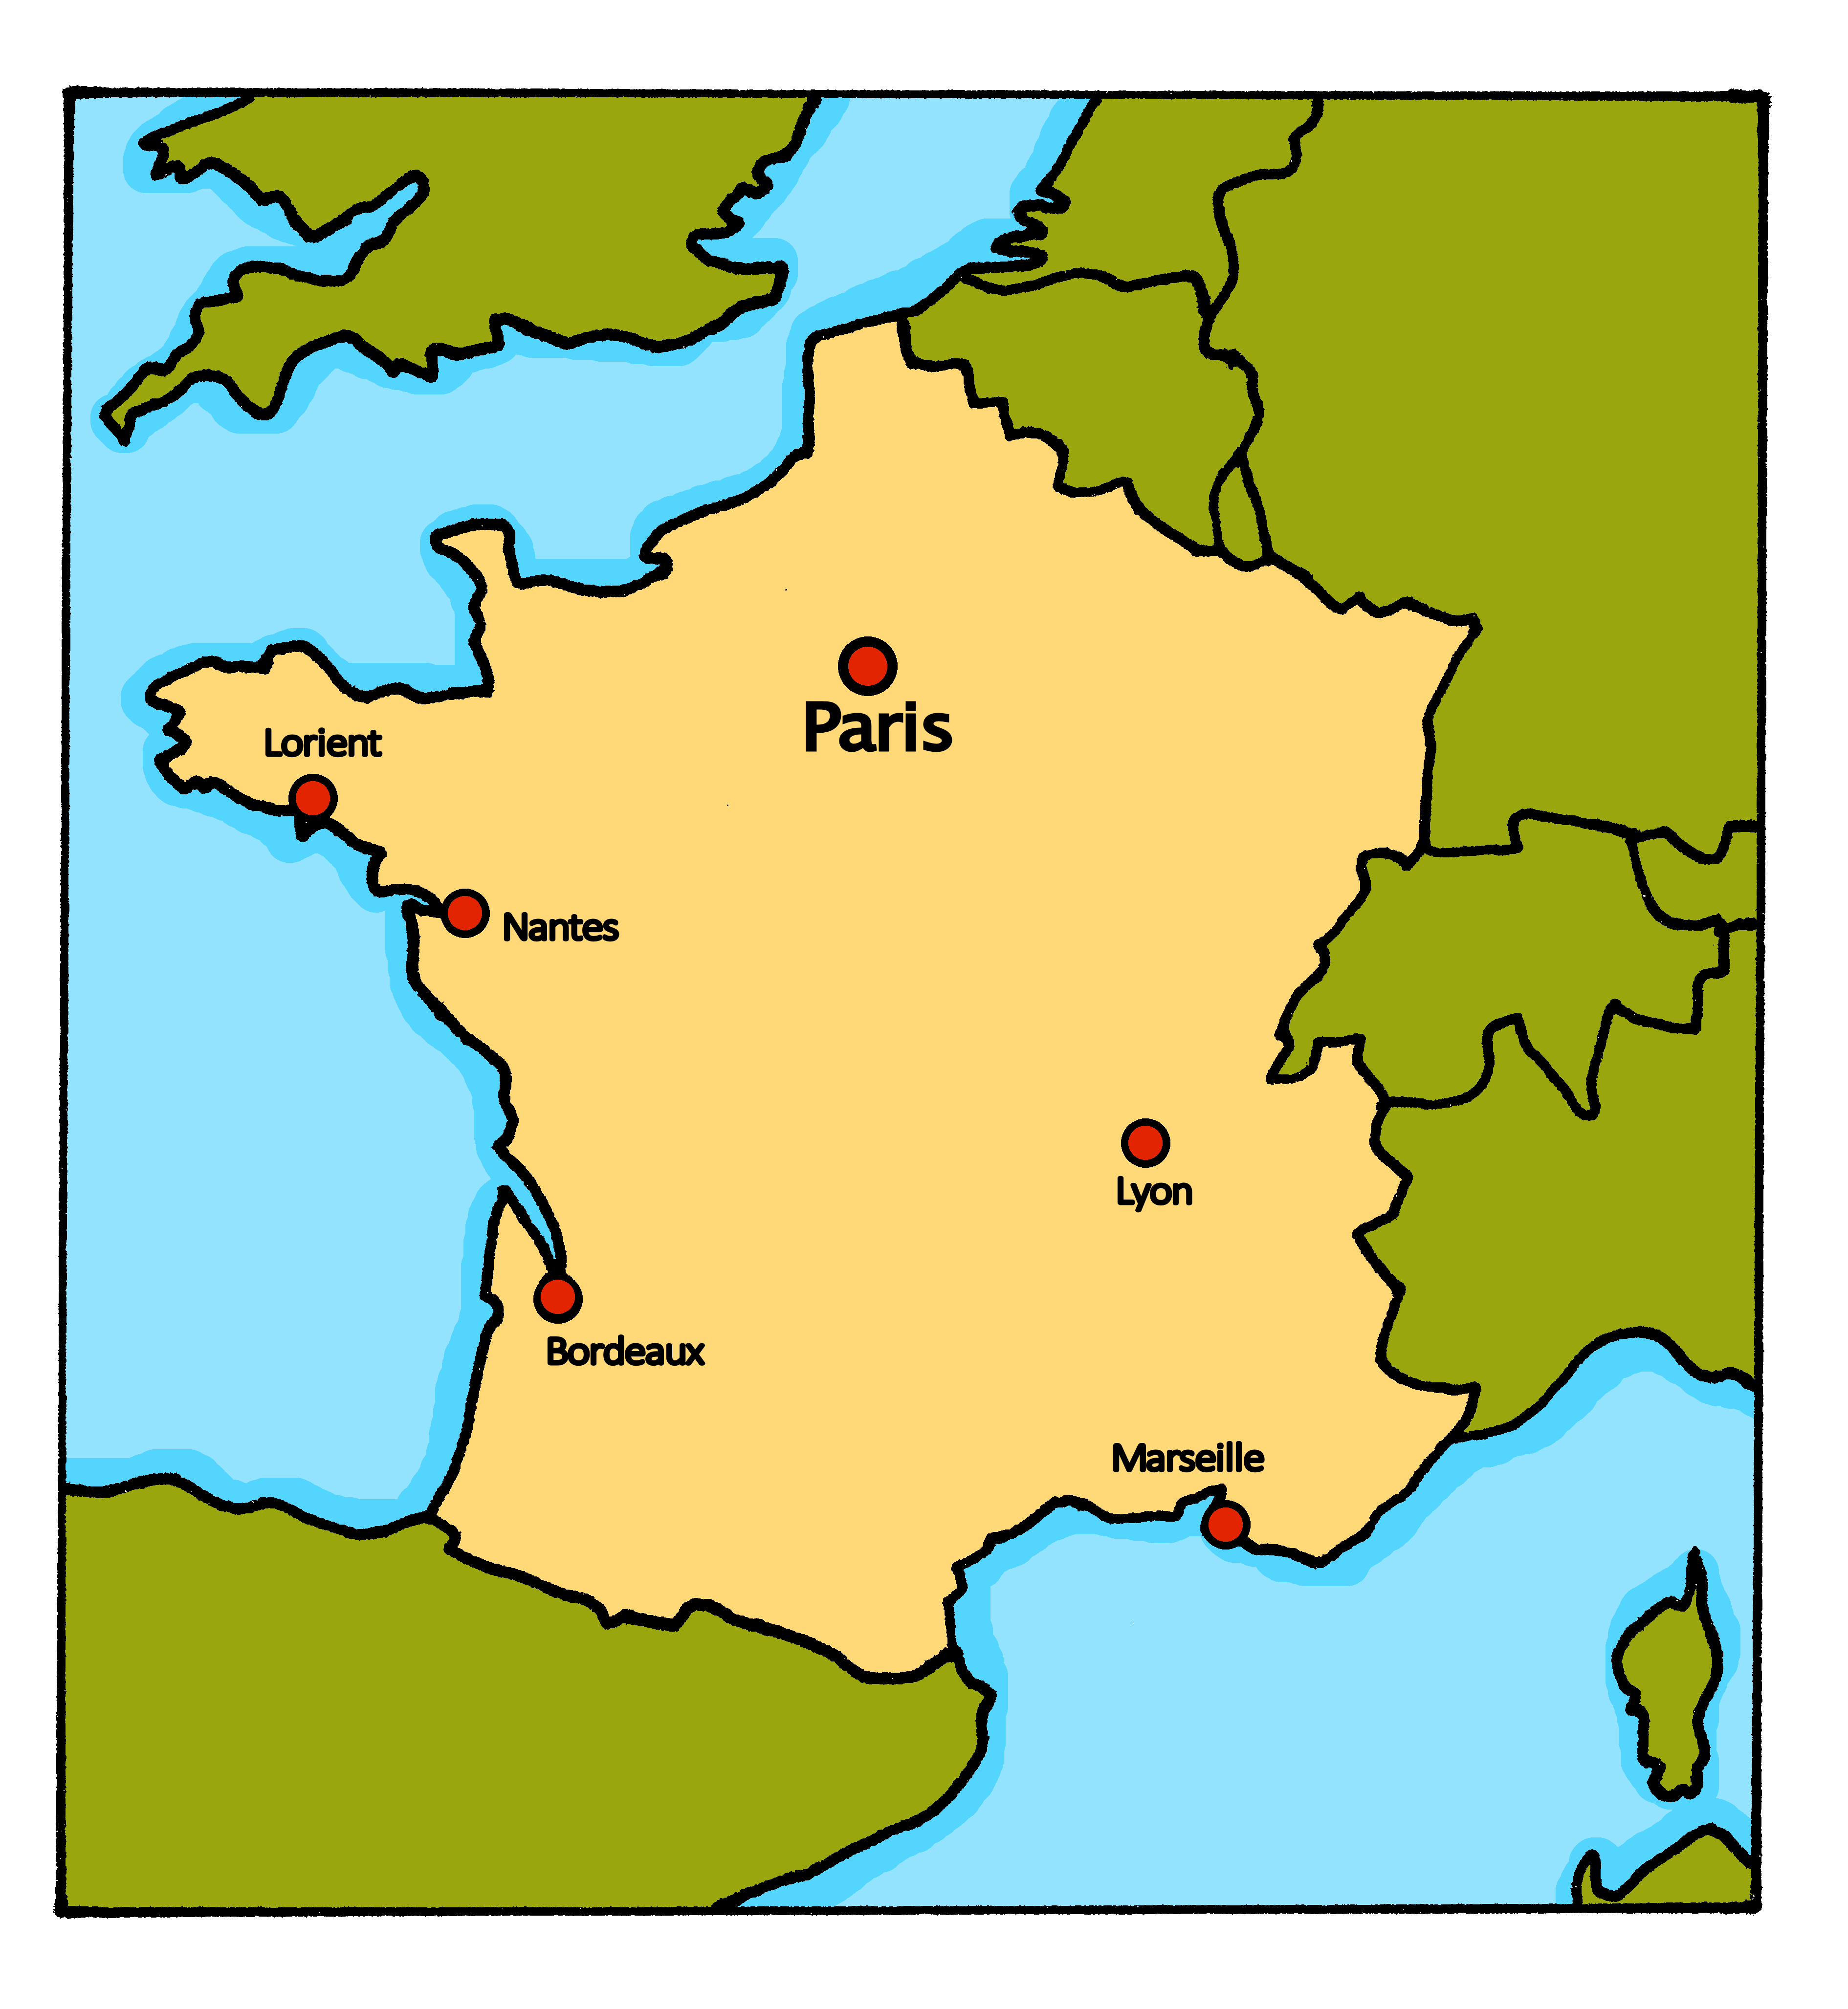
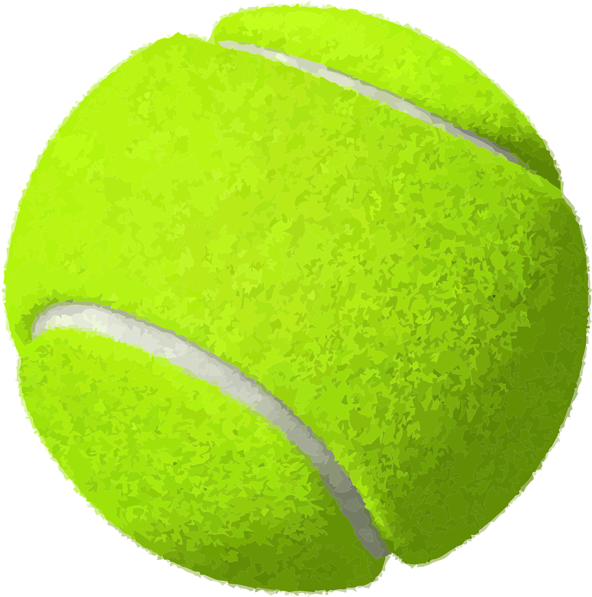
Rouge Knowledge Organiser - Spring Term B
Les nombres de 1 à 12
un – a/an (m), one (m)
une – a/an (f), one (f)
deux – two
trois – three
quatre – four
cinq – five
six – six
sept – seven
huit – eight
neuf – nine
dix – ten
onze – eleven
douze – twelve
combien – how many
des – some
il y a – there is, there are
tous les jours – every day
en ce moment – at the moment
Phonics
semaine
La Chandeleur
Le deux février en France, c’est la Chandeleur.
C’est une fête délicieuse. On mange des crêpes !
[ai]
vrai
maison
aider
aimer
to help, helping
to like, liking
week
[oi]
voir
avoir
to have, having
Au revoir !
pourquoi ?
trois
to see, seeing
why?
Liaison | s- and x-liaison before a noun starting with a vowel or h-. | deux enfants | trois oranges
[(a)in]
train
vingt
main
fin
lapin
end
Le Carnaval de Menton est une fête des fruits.
Translating the French present tense into English English has two present tense forms but French has one:
Indefinite article – ‘some’ Remember! To say a (or an) in French use un before a masculine noun and une before a feminine noun. To say some use des for all nouns: Il y a des ballons. Il y a des bouteilles. Making nouns plural As in English, we can add an –s to the end of most French words to make them plural. However, the –s is silent in French! (SFC) You cannot tell by listening to a French noun whether it is singular or plural so always check its determiner.
Tu écoutes une chanson.
You listen to a song.
This is for a regular, repeated action in the present, like a routine.
Menton
You are listening to a song.
Adverbs of time tell us which English meaning to use:
Tu écoutes une chanson tous les jours.
You listen to a song every day.
Tu écoutes une chanson en ce moment.
This is for an ongoing action, now.
You are listening to a song at the moment.
Bonne Année ! Literally ‘Good year!’ it means ‘Happy New Year!’. It is the first thing you say to everyone you talk to for the first time in January. In France, you have the whole month of January to souhaiter la bonne année.
You can say Bonne année ! or Bonne année et bonne santé ! (Happy New Year and good health!)

